Slide 1
N-gram Based text compression
Supervised By
Presented By
Dr. K. M. Azharul Hasan
Professor
Sabnaj Akter
Roll:1907042
Course No: CSE 4000
Computer Science and Engineering
Khulna University of Engineering & Technology

Slide 2
Outline
Motivation
Introduction
Related Works
Problem Statement
Objectives
Proposed Methodology
Experimental Result
Conclusion
References

Slide 3
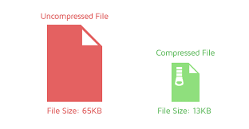
Motivation
Tokenization, Dictionary Generation, Compression, Decompression.
Integration into Unified Model.
Addressing Text File Size.
Figure 1: Input and output file size

Slide 4
Introduction
Data compression is the process of reducing size of the data.
Without losing meaning of the data.
Reduce redundancy.
Replace data with a short code.

Slide 5
Related works
D. A. Huffman [5], proposed Huffman coding and arithmetic coding to compress data.
Their solution has compression ratio 63%.
However, the approach is complex in practical application.

Slide 6
Related works
H. Al-Bahadili [1], proposed binary Encoding for Character-Based Compression.
Involves encoding characters as binary codes.
Challenging when dealing with varying character.
optimized for 8-bit character word lengths.

Slide 7
Related works (Cont’d)
J. Platos and J. Dvorskþ[2], Word-based compression using LZ77.
Implementing various sliding windows.
Struggle with memory limitations.
Best in comparison to other word-based method.

Slide 8
Related works (Cont’d)
Approach | Pros | Cons | Potential Improvements
N-gram with Huffman Encoding | ✓ Combines context preservation with efficient encoding ✓ Reduces dictionary size | ✗ High preprocessing time ✗ Complex for real-time applications | Develop faster preprocessing methods for real-time usage.
N-gram with LZW Compression | ✓ Efficient storage for repetitive patterns ✓ Captures patterns at multiple levels | ✗ Struggles with diverse, irregular text ✗ Poor with non-repetitive text | Combine with adaptive methods to handle diverse text structures effectively.
N-gram Based Compression with Morphology | ✓ Suitable for morphologically rich languages ✓ Better compression for structured text | ✗ Language-dependent ✗ Complex dictionary creation for multiple languages | Explore hybrid approaches combining morphology and N-gram models..
N-gram Compression Using Dictionary Method | ✓ Efficient for frequent patterns ✓ Reduces redundancy with dictionary lookups | ✗ Dictionary size grows with larger N-grams ✗ High memory overhead | Optimize dictionary management with adaptive models to reduce memory usage.

Slide 9
Problem statement
As evident from the literature review, there are several issues regarding text compression. They are –
Traditional methods unable to handle unknown word.
Their compression ratio is not good enough.
There is no model for Bengali text compression.

Slide 10
Objectives
Analyze traditional text compression methods.
Create a diverse text dataset of Bengali language.
To develop an optimal n-gram based method. That can:
Compress text data.
Decompress text data.
Evaluate compression ratio.

Slide 11
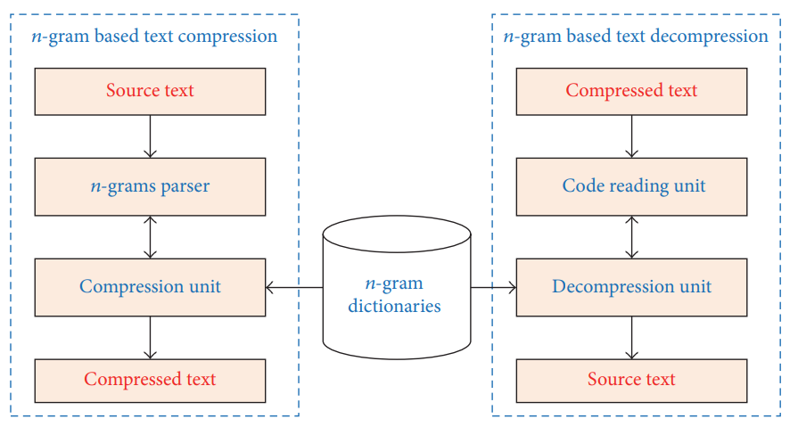
Proposed methodology
Attention Mechanism
Figure 2: Proposed Methodology of the model

Slide 12
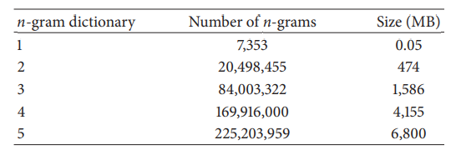
Proposed methodology (Cont’d)
Dataset: I will use five gram. Dataset for five gram:
Table 1: Dataset for each gram

Slide 13
Proposed methodology (Cont’d)
Steps of Proposed Method:
Remove whitespace and other unnecessary punctuation from text dataset.
Tokenization of process data.
Create dictionary of unigram, bigram, trigram, four gram and five gram.
Compress data using dictionary.
Decompress the compress data using reverse dictionary.

Slide 14
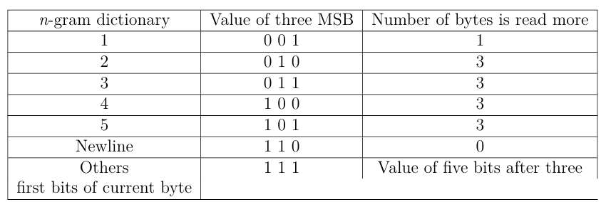
Proposed methodology (Cont’d)
Compression Process: Every matched n-gram data will be replaced by binary bit. Here 3 MSB bit for the dictionary value and rest of the bit for matched data.
Table 2: Used bit for each gram

Slide 15
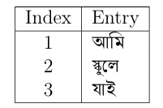



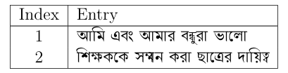
Proposed methodology (Cont’d)
Example of Compression:
Table 3: Unigram dictionary
Table 4: Bigram dictionary
Table 5: Trigram dictionary
Attention Mechanism
Table 6: Four-gram dictionary
Table 7: Five-gram dictionary

Slide 16
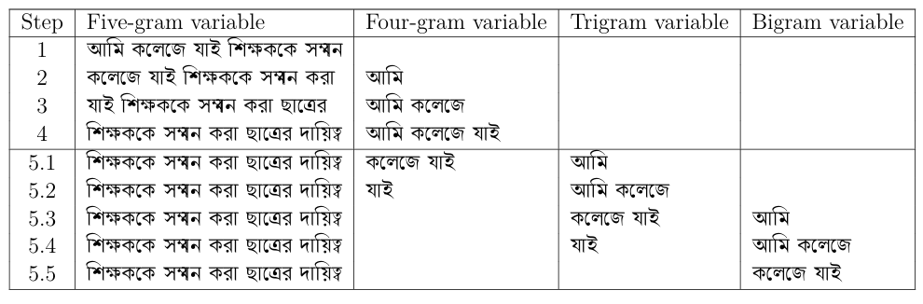
Proposed methodology (Cont’d)
Let us encode the following sequence using the n-gram approach:
Table 8: All steps of n-gram parser
Attention Mechanism

Slide 17
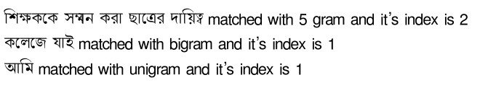
Proposed methodology (Cont’d)
Attention Mechanism
Encoded ouput: 0010000000000001|01000000000000000000000000000001| 10100000000000000000000000000010

Slide 18
Proposed methodology (Cont’d)
Decompression Process:
Identifying the dictionary using 3 MSB bit.
Calculate the index value using rest of bit.
Find the input value of corresponding index value from reverse dictionary.
Replace string with input text data.

Slide 19
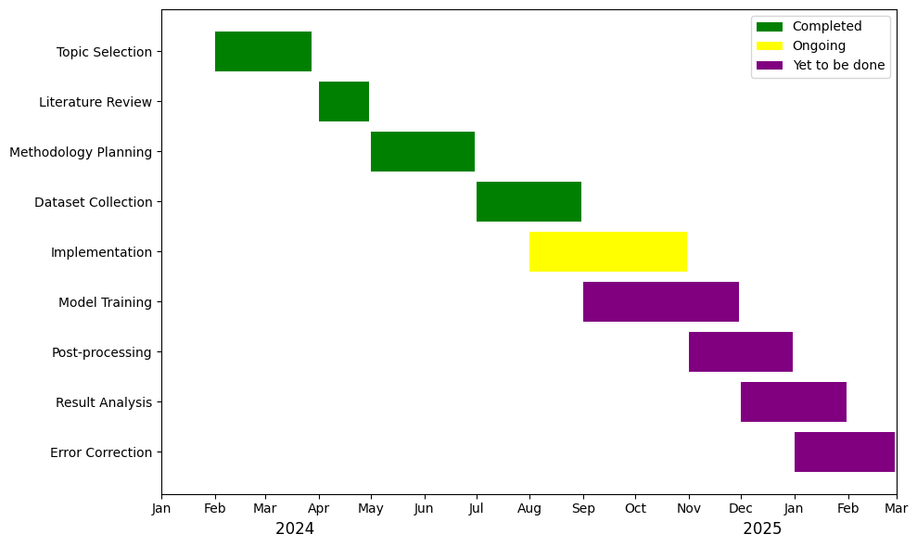
Total Progress using Gantt Chart
Figure 3: Gantt chart

Slide 20
Total Progress (Cont’d)
Dataset Collection: Gathered diverse dataset for compression model.
Technique Exploration: Employed tokenization, generating dictionary .
Efficacy Assessment: Tested techniques for English data.
Quality Evaluation: Evaluated the quality of output.
Compression Ratio Calculation: Analyzed compression ratio.

Slide 21
Remaining Work
Develop N-gram based data compression model.
Merge tokenization, n-gram dictionary, compression and decompression unit.
Train holistic model for quality.
Compare performance with other methods.

Slide 22
Remaining Work (Cont’d)
Evaluate on Bangla datasets.
Refine model iteratively.
Test in real-world applications.
Address ethical considerations.
Document process and findings.

Slide 23
Conclusion
Advancing data compression.
Aiming for significant compression ratio.
Guided by Comprehensive Literature Review.
Important for reducing file size.
Important for data transfer.

Slide 24
references
H. Al-Bahadili and S. M. Hussain, “An adaptive character word length algorithm for data compression,” Computers and Mathematics with Applications, vol. 55,no. 6, pp. 1250–1256, 2008..
J. Platos and J. Dvorskþ, “Word-based text compression,” CoRR abs/0804.3680, 2008..
D. A. Huffman, “A method for the construction of minimum redundancy codes,” Proceedings of the IRE,vol.40,no.9,pp. 1098–1101, 1952.
J. Plato s, V. Sna sel, and E. El-Qawasmeh, “Compressionof small text files,” Advanced Engineering Informatics,vol.22,no.3,pp. 410–417, 2008.
K.Kalajdzic, S. H.Ali, andA.Patel, “Rapidlossless compression of shorttext messages,”ComputerStandards&Interfaces,vol.37, pp.53–59,2015.
[1] Vu H. Nguyen, Hien T. Nguyen ”n-Gram-Based Text Compression” IEEE Trans actions on Information Theory,14 November 2016.

Slide 25
THANK YOU

Slide 26
?
Any
QUESTION

