Slide 1


Title: Image Caption Generation
Course Code: CSE 4120
Course Title: Technical Writing & Seminar
Supervised By:
Dr. K.M Azharul Hasan
Professor of Department of Computer Science and Engineering
&
Sunanda Das
Assistant Professor of Department of Computer Science and Engineering
Presented by: Sabnaj Akter
Roll: 1907042
Year: 4th
Semester: 1st
Department of Computer Science
and Engineering
Khulna University of Engineering & Technology

Slide 2
OUTLINE
2
Papers
Introduction
Literature Review
Methodology
Result Analysis and Relative Comparisons
Findings
Recommendation
Conclusion
References
6/2/2024

Slide 3
PAPERS:
4
Table-1: List of papers used in this study
SL NO | TITLE | AUTHORS | CONFERENCE/JOURNAL NAME | PUBLISHER & PUBLISHED YEAR
1. | Generating Image Captions using Deep Learning and Natural Language Processing | Subhash Chand Gupta Akshita Tyagi Tulsi Sharma Rana Majumdar | 2021 9th International Conference on Reliability, Infocom Technologies and Optimization (Trends and Future Directions) (ICRITO) Amity University, Noida, India. Sep 3-4, 2021) | IEEE-2021
2. | Image Caption Generation using Deep Learning Technique | Chetan Amritkar Vaishali Jabade | 2018 Fourth International Conference on Computing Communication Control and Automation (ICCUBEA) | IEEE-2018
3. | Image caption generation using Attention Mechanism | Vaishnavi Agrawal Neha Tuniya Vibha Vyas Shariva Dhekane | 12th ICCCNT 2021 July 6-8, 2021 - IIT - Kharagpur Kharagpur, India | IEEE-2021
6/2/2024

Slide 4
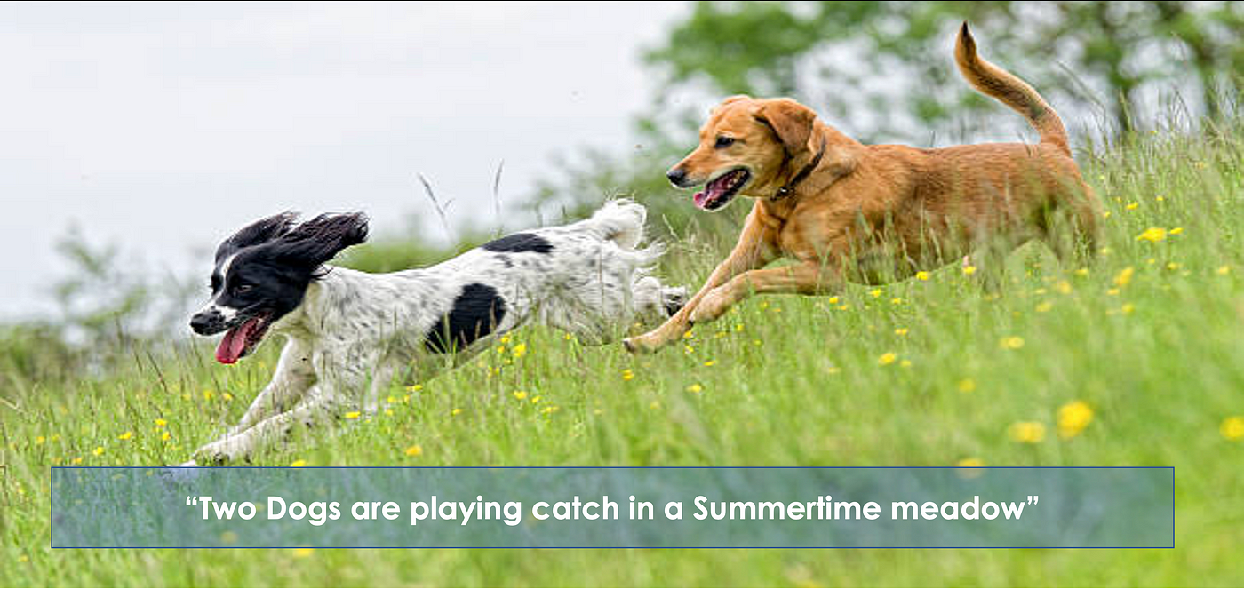
INTRODUCTION:
3
What is image caption generation ?
Image captioning is used to generate sentences describing the scene captured in the form of images. It identifies objects in the image
Why image caption generator is so important?
Enhanced Accessibility
Content Organization and Retrieval
Improved User Experience
Automation in Content Creation
Aid in Data Annotation
Fig-1: Caption generation
6/2/2024

Slide 5
LITERATURE REVIEW:
5
Table-2: Literature Review
SL NO | NAME | DESCRIPTION
1. | CNN(Convolutional neural network) | CNN extract features from image. These features are then used by a language model to generate captions
2. | RNN(recurrent neural network) | RNNs are designed to process sequences of data, making them ideal for tasks that involve generating or understanding sequences
3. | LSTM(long short-term memory networks) | LSTM networks are a type of Recurrent Neural Network (RNN) particularly well-suited for tasks involving sequence prediction and generation,
4. | Attention Machine | the attention mechanism enhances the model's ability to generate accurate and contextually relevant captions by allowing it to focus on specific parts of the image
6/2/2024

Slide 6
METHODLOGY (Paper-1) :
6
Name: Generating Image Captions using Deep Learning and Natural Language Processing Model Description:
CNN , Specifically the Inception V3 model is used for feature extraction from images.
RNN (Recurrent Neural Network): Particularly, GRU (Gated Recurrent Unit) and LSTM (Long Short-Term Memory) are used for generating the captions from the extracted features.
Attention Mechanism: Bahdanau attention is employed to enhance the performance of the model by focusing on relevant parts of the image during caption generation.
Dataset Description:
Flickr8k Dataset: This dataset consists of 8000 images, each paired with appropriate captions.
6/2/2024

Slide 7
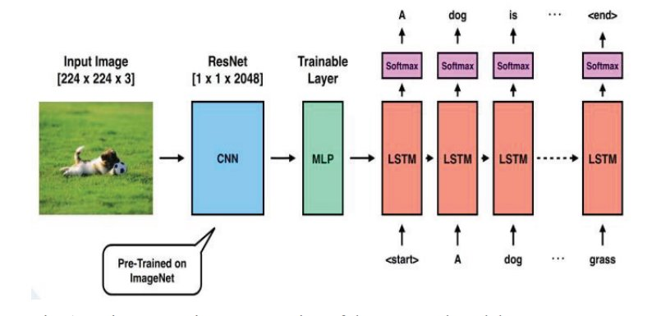
METHODLOGY (Paper-1) (Cont’d):
7
Fig 2:Diagramatic representation of proposed model
6/2/2024

Slide 8
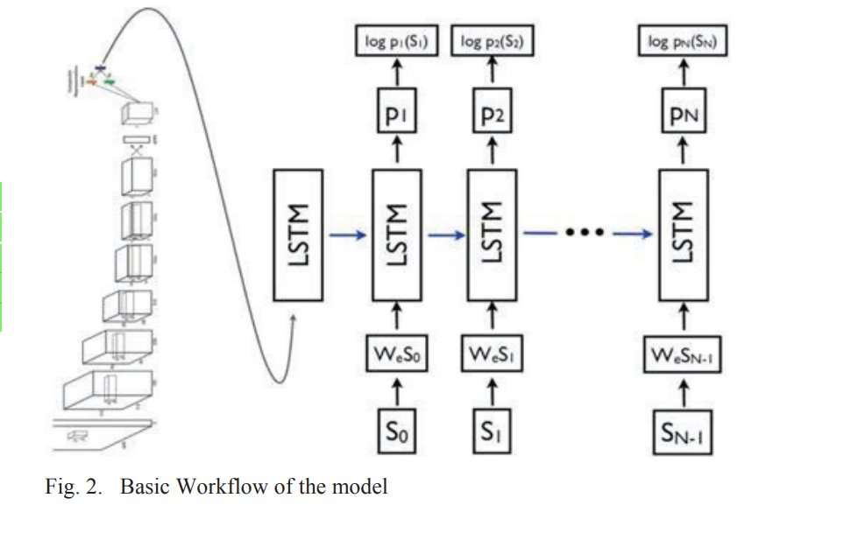
METHODLOGY (Paper-1) (Cont’d):
8
3
3
6/2/2024

Slide 9
METHODLOGY (Paper-2) (Cont’d):
9
Paper Name: Image Caption Generation using Deep Learning Technique
Model Description:
Employs a hybrid model utilizing both Convolutional Neural Networks (CNN) and Recurrent Neural Networks (RNN).
The model uses a pre-trained CNN for feature extraction from images .
An RNN, particularly Long Short-Term Memory (LSTM), for generating descriptive captions.
Dataset Description:
Flickr8k dataset, which consists of 8,000 images.
Each accompanied by five different descriptive captions
6/2/2024

Slide 10
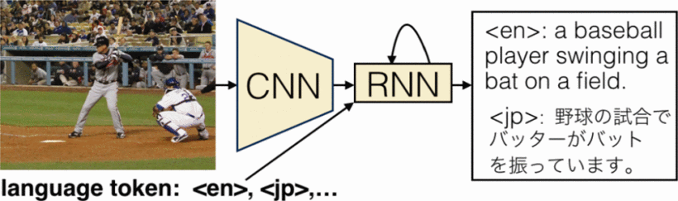
METHODLOGY (Paper-2) (Cont’d):
10
Fig-4:Model based on Neural Network
6/2/2024

Slide 11
METHODLOGY (Paper-3) (Cont’d):
11
Paper Name: Image caption generation using Attention Mechanism
Model Description:
Used the Inception V3 model for feature extraction
The attention mechanism is incorporated to enhance the performance of the caption generation model
An LSTM (Long Short-Term Memory) network is used as the RNN for generating the sequences of words that form the captions
Dataset Description:
MSCOCO dataset is used for training the model
It contains over 120,000 images with multiple annotated captions for each image.
6/2/2024

Slide 12
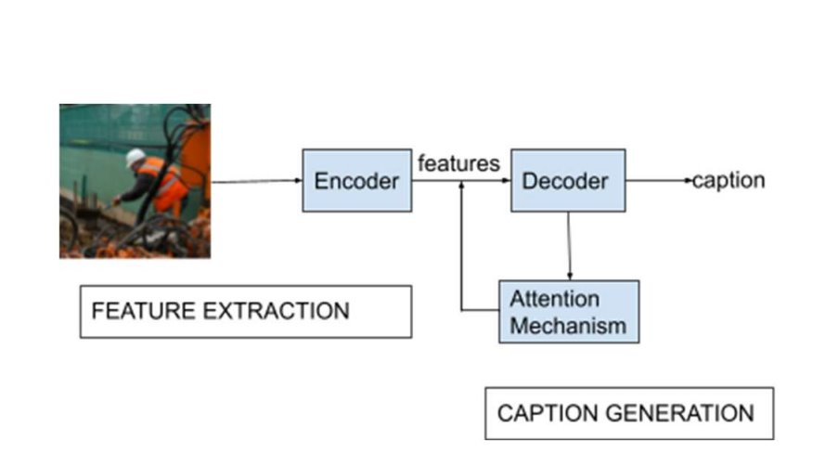
METHODLOGY (Paper-3) (Cont’d):
12
Fig-5: Image caption generator with attention mechanism
6/2/2024

Slide 13
RESULT ANALYSIS & RELATIVE COMPARISONS :
13
Table-4: Relative Comparisons
Field | Generating Image Captions using Deep Learning and Natural Language Processing | Image Caption Generation using Deep Learning Technique | Image caption generation using Attention Mechanism
Result Analysis | No specific metrics mentioned, likely uses standard metrics like BLEU. | BLEU scores: Flickr8k = 0.53356, Flickr30k = 0.61433, MSCOCO = 0.67257 | Attention mechanism aims for better accuracy; specific metrics not provided.
6/2/2024

Slide 14
RESULT ANALYSIS & RELATIVE COMPARISONS (Cont’d) :
14
Table-5: Relative Comparisons
Field | Generating Image Captions using Deep Learning and Natural Language Processing | Image Caption Generation using Deep Learning Technique | Image caption generation using Attention Mechanism
Dataset Analysis | Flickr8k dataset, which contains 8,000 images with captions. | Three datasets: Flickr8k, Flickr30k, and MSCOCO | MSCOCO dataset with 82,000 images, each having five annotated captions.
Dataset Limitation | Captions are single-line, which may not capture complex image details. | Datasets vary significantly in size, which might affect model performance consistent. | Despite the large dataset, the focus is primarily on MSCOCO, limiting diversity
6/2/2024

Slide 15
RESULT ANALYSIS & RELATIVE COMPARISONS (Cont’d) :
15
Table-6: Relative Comparisons
Field | Generating Image Captions using Deep Learning and Natural Language Processing | Image Caption Generation using Deep Learning Technique | Image caption generation using Attention Mechanism
Error Analysis | Errors in generated captions due to misidentification of objects and scenes | Errors include descriptions with minor inaccuracies | Errors occur when the attention mechanism misidentifies important image regions
Limitation | Limited dataset size restricts the model's ability to generalize well. | Model performance varies with dataset size Larger datasets needed to achieve better accuracy and reduce loss. | Complexity in finding the optimal encoder-decoder combination The model's effectiveness is heavily dependent on the attention mechanism.
6/2/2024

Slide 16
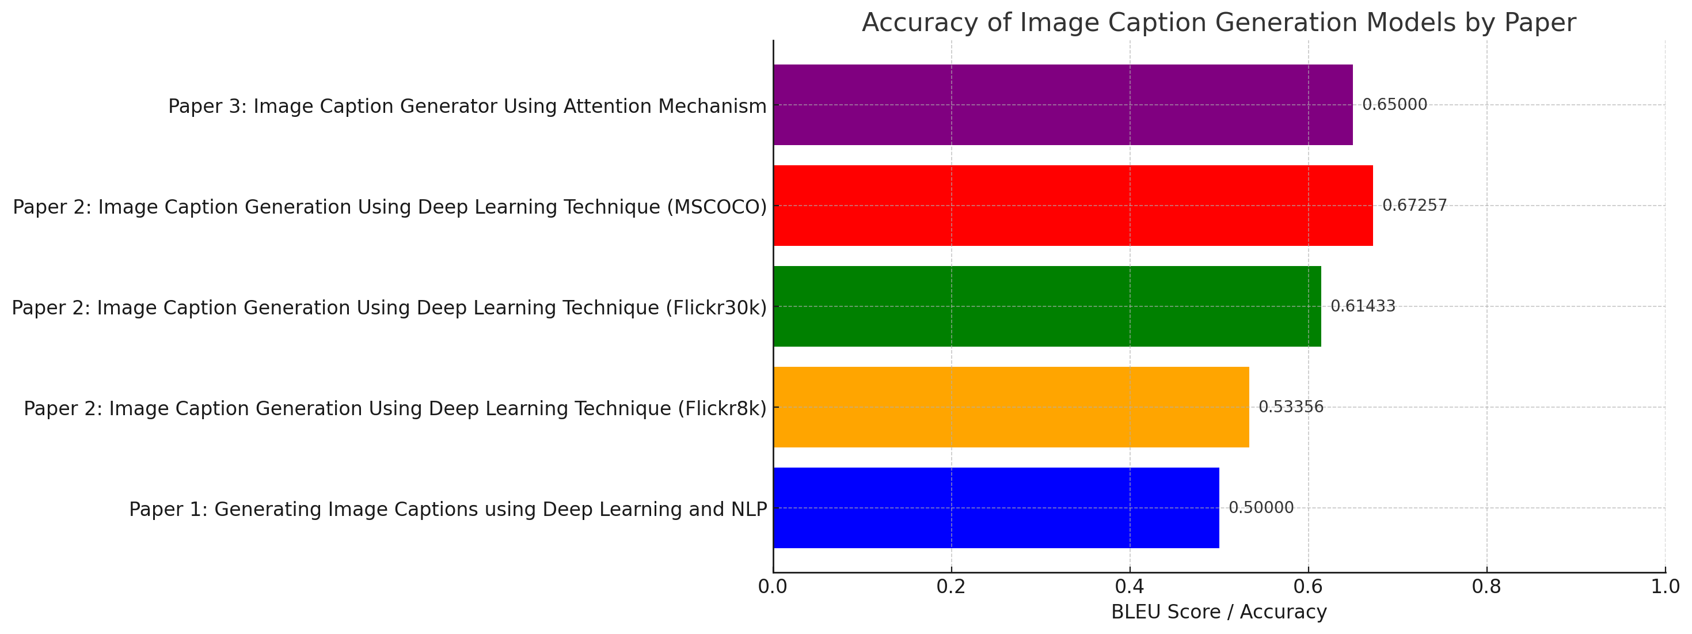
FINDINGS:
16
6/2/2024

Slide 17
FINDINGS (Cont’d):
17
Paper 1: Generating Image Captions using Deep Learning and NLP: Assigned a hypothetical BLEU score of 0.5 due to lack of specific data. Limited dataset size restricts the model's ability to generalize well
Paper 2: Image Caption Generation Using Deep Learning Technique:
Flickr8k: BLEU score of 0.53356
Flickr30k: BLEU score of 0.61433
MSCOCO: BLEU score of 0.67257
Larger dataset helps to preserve diversity.
Paper 3: Image Caption Generator Using Attention Mechanism: Assigned a hypothetical BLEU score of 0.65 due to lack of specific data. Complexity in finding the optimal encoder-decoder combination.
6/2/2024

Slide 18
RECOMMENDATION:
18
Overall comparing all the aspects, Deep Learning and Natural Language Processing approach is the most promising approach for the following reasons:
Robust Performance: Applies standard deep learning techniques across multiple datasets, showing flexibility and robustness.
Dataset Size and Diversity: Used three datasets- Flickr8k, Flickr30k, and MSCOCO, providing a range of sizes and diversities.
Good Accuracy: Provides detailed BLEU scores: It has almost 68% accuracy.
6/2/2024

Slide 19
CONCLUSION:
19
The approach for generating image caption was studied.
A thorough description of their methodology was given.
Via result and error analysis the best approach was found.
The best working dataset is also acknowledged.
6/2/2024

Slide 20
REFERENCES:
20
[1] Hossain, M. Z., Sohel, F., Shiratuddin, M. F., &amp; Laga, H. (2019),“A comprehensive survey of deep learning for image captioning”, ACM Computing Surveys (CSUR), 51(6), 1-36.
[2] Vinyals, O., Toshev, A., Bengio, S., &amp; Erhan, D. (2016). “Show and tell: Lessons learned from the 2015 mscoco image captioning challenge”, IEEE transactions on pattern analysis and machine intelligence, 39(4), 652-663.. [3] Yao, Benjamin Z., et al. ”I2t: Image parsing to text description.” Proceedings of the IEEE 98.8 (2010): 1485-1508.
[4] Farhadi, Ali, et al. ”Every picture tells a story: Generating sentences from images.” Euro-pean conference on computer vision. Springer, Berlin, Heidelberg, 2010.
[5] O. Vinyals, A. Toshev, S. Bengio et al., "Show and tell: Lessons learned from the 2015 MSCOCO image captioning challenge", IEEE Transactions on Pattern Analysis and Machine Intelligence, vol. 39, no. 4, 2017.
[6] Asifullah Khan, Anabia Sohail, Umme Zahoora, Aqsa Saeed Qureshi, “A survey of the recent architectures of deep convolutional neural networks”, Artificial Intelligence Review, DOI, 2020.
6/2/2024

Slide 21
21
THANK YOU
6/2/2024

