Slide 1

Configuring Spiking Neural Network Training Algorithms
Mst. Mausumi Sabnam Mustari
Supervisor
Professor. Dr. Antonina Kolokolova
Memorial University of Newfoundland, Newfoundland, Canada
Date : 25/07/2017

Slide 2

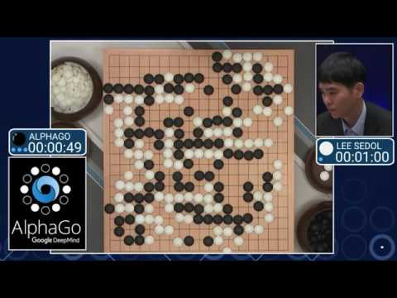


The renaissance of Artificial Intelligence

Slide 3
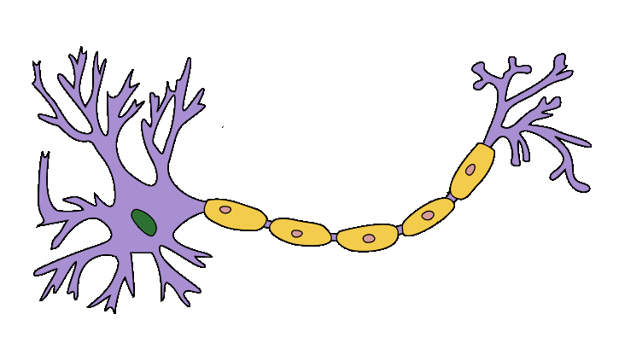
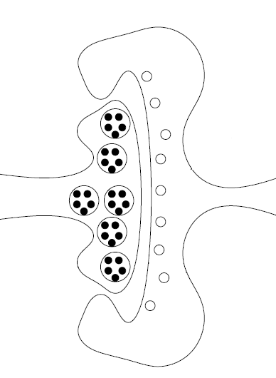

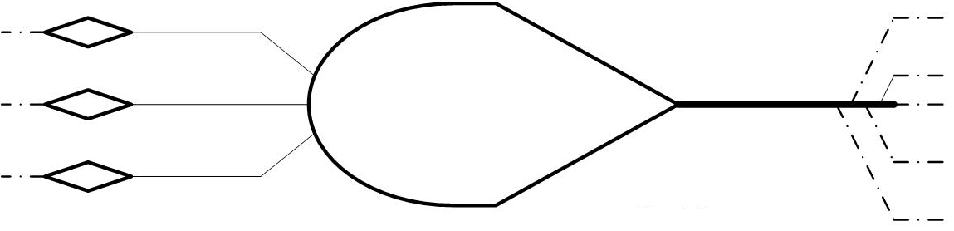
Biological Neuron:
Synapse
Axon
Axon Terminal
Dendrite
Soma

Slide 4
First Generation Artificial Neuron:
The first artificial neuron was proposed by W. McCulloch & W. Pitts in 1943
used to classify linearly separable class
often binary classification

Slide 5
Second Generation Artificial Neuron:
The artificial sigmoid neuron models the rate at which spikes are generated
Number of spikes
Time frame
y is firing rate , Spike timing is not considered
Gives real valued output bounded by (0,1)

Slide 6
Third Generation Artificial Neuron:
Spiking neuron model was introduced by J. Hopfield in 1995
Spiking neural networks are
- biologically more plausible,
- computationally more powerful,
- considerably faster
than networks of the second generation

Slide 7
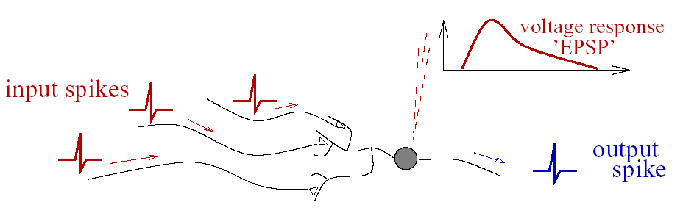
Artificial Spiking Neuron:
Computing with precisely timed spikes is more powerful than with “rates”.

Slide 8
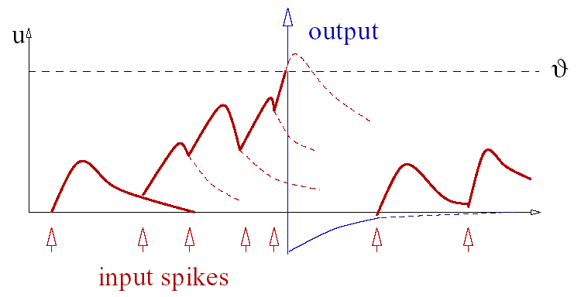
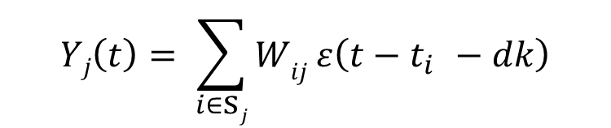
Spiking Neuron
Membrane potential is a weighted sum of impinging spikes, a spike generated when potential crosses threshold, reset potential.
$$Yj\left(t\right)= \sum_{i∈\text{s}j}{Wij ε\left({t−t}_{i }−dk\right)}$$

Slide 9


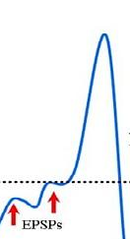
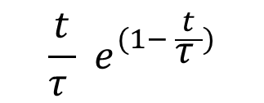
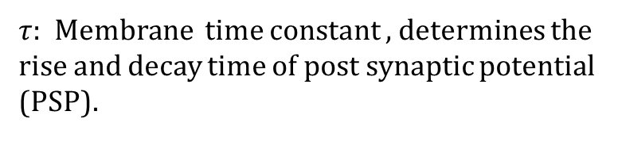
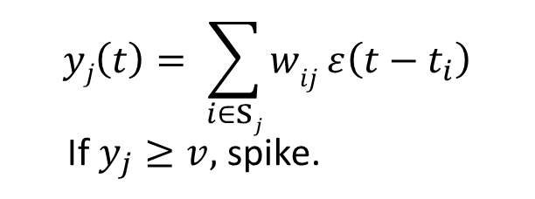


Processing At Each Neuron
Spiking Neuron: ε(t) is the kernel describing how a single spike changes the potential.
Sigmoidal Neuron: continuous range of values between 0 and 1, so output changes very slowly with input
$$yj\left(t\right)= \sum_{i∈\text{s}j}{wij ε\left({t−t}_{i}\right)}$$
If $y_{j}≥v,$ spike.
$$\frac{t}{\text{τ} }{ e}^{(1− \frac{t}{\text{τ} })}$$
$ε\left(t\right)$ $=$
$f\left(x\right)= \frac{1}{\text{1}{ + e}^{−x}}$
$\text{τ}$: Membrane time constant , determines the rise and decay time of post synaptic potential (PSP).

Slide 10
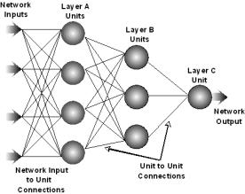
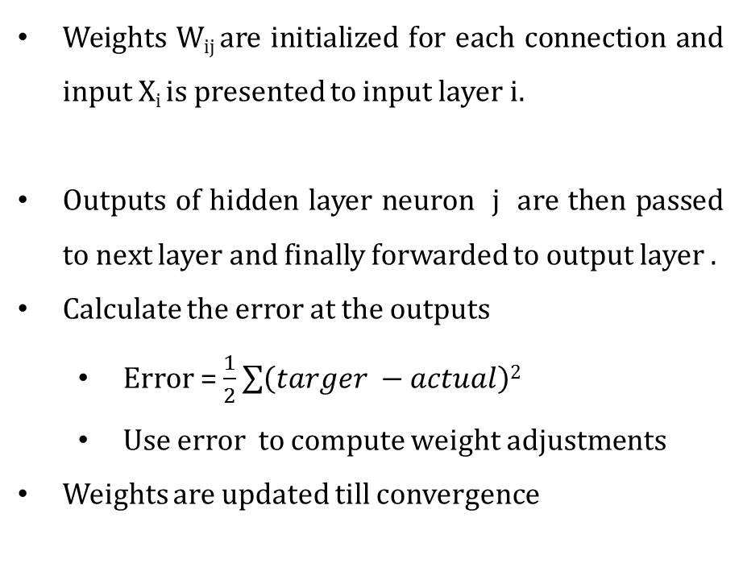
Feed Forward Artificial Neural Network
Weights W_{ij} are initialized for each connection and input X_{i} is presented to input layer i.
Outputs of hidden layer neuron j are then passed to next layer and finally forwarded to output layer .
Calculate the error at the outputs
Error = $\frac{1}{2}\sum{\left(targer −actual\right)2}$
Use error to compute weight adjustments
Weights are updated till convergence
Fig. 1. Feed Forward Network

Slide 11
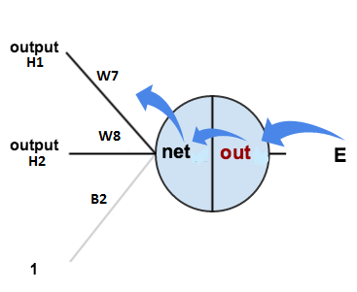
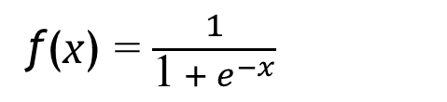

Back Propagation Algorithm
Error E = $\frac{1}{2}Σ_{i∈outputs} \left(t_{d} −t_{a}\right)2$
Here,$t_{d}$ is desire output and $t_{a} is$actual output
Let $η$be the learning rate.
After evaluating a sample, update the weights by:
∆ w$ij =$ $−$ η $\frac{∂E}{∂w_{ij}}$
For example, if $j$is an output neuron,
w$ij=w_{ij}−η\left(target_{j}−actual_{j}\right)∗actual_{j}∗\left(1−actual_{j}\right)∗actual_{i}$
$δ_{j}$
ƒ(x) = $\frac{1}{\text{1}{ + e}^{−x}}$

Slide 12
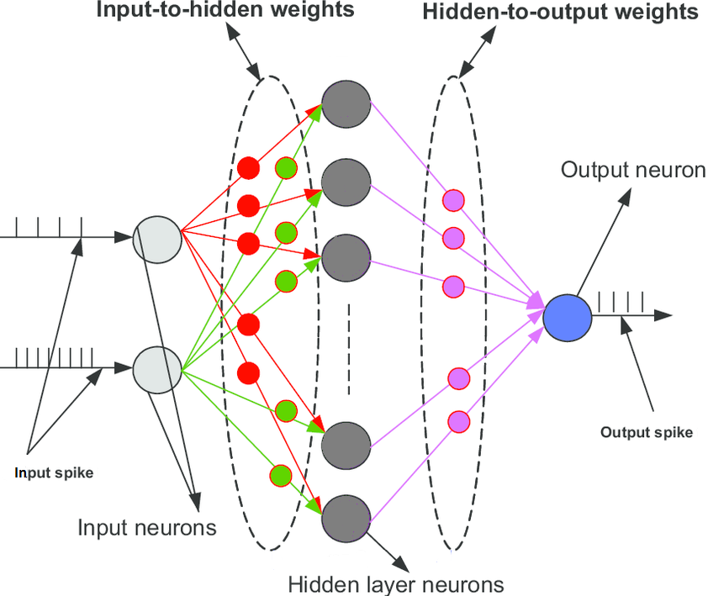
Spiking Neural Network (SNN)

Slide 13
SNN Training Methods:
NSEBP [Xie, Qu, Liu, Zhang, Kurths 2016]
Multiple spikes per neuron.
Presynaptic spike jitter instead of gradient descent.
Need random noise.
For benchmarks, only trained one layer.
Spike-Prop [Bohte, Kok, Poutre 2002 ]
Single spike per neurons
Multiple synapses with delays
Variant of back-prop.
No random noise
ReSuMe [Ponulak, Filip, 2005]
Single spikes per neuron.
learning proceeds by correlation of spike times instead of gradient descent.
learning depend on network size and learning window

Slide 14
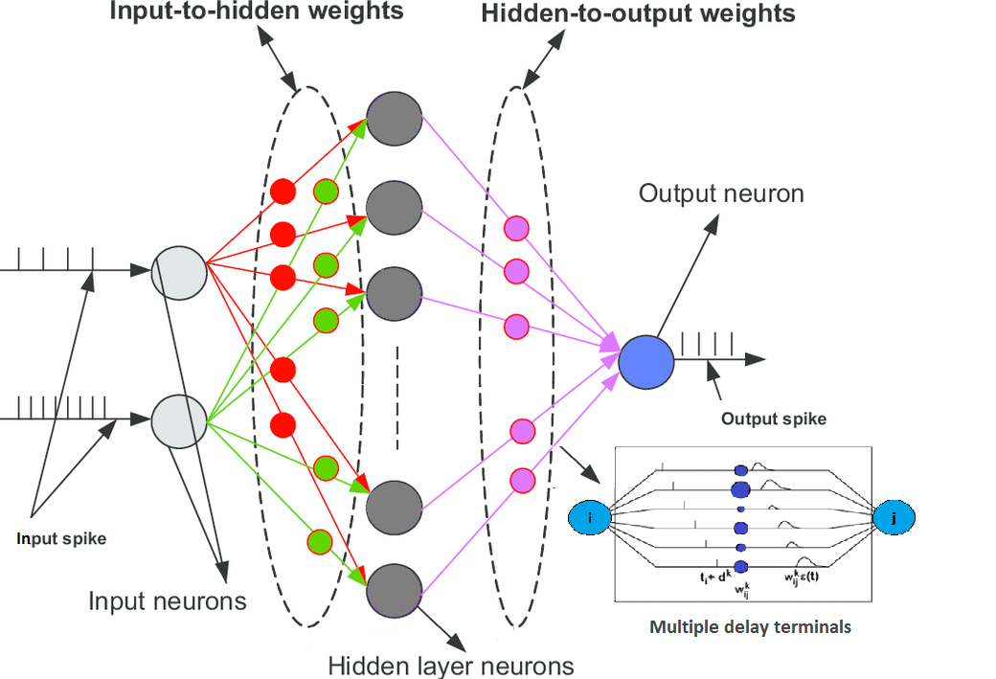
Spiking Neural Network (SNN)

Slide 15
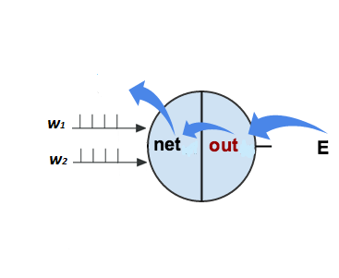





Spike-Prop Algorithm [Bohte, Kok, Poutre 2002 ]
Error E = $\frac{1}{2}Σ_{i∈outputs} \left(t_{di} −t_{ai}\right)2$
Here, $t_{di}$ is desire and $t_{ai}$ is actual output spike time
Let $η$be the learning rate
After evaluating a sample, update the weights by:
∆ w$ijk =$ $−$ η $\frac{∂E}{∂w_{ijk}}$
For example, if $j$is an output neuron,
Adjust weight by
$w_{ijk}=w_{ijk}−η y_{i}\left(t_{j}\right)δ_{j}$
$$yj\left(t\right)=\sum_{i∈\text{s}j}{ wijk ε\left({t−t}_{i}−d_{k}\right)}$$
If $y_{j}≥v,$ spike.
$Here, k∈synapses$
$$\frac{t}{\text{τ} }{ e}^{(1− \frac{t}{\text{τ} })}$$
$ε\left(t\right)$ $=$

Slide 16

Parameter List:
Parameter | Spiking Neural Network | Artificial Neural Network
Learning rate α
Number of layers
hidden neurons

Slide 17

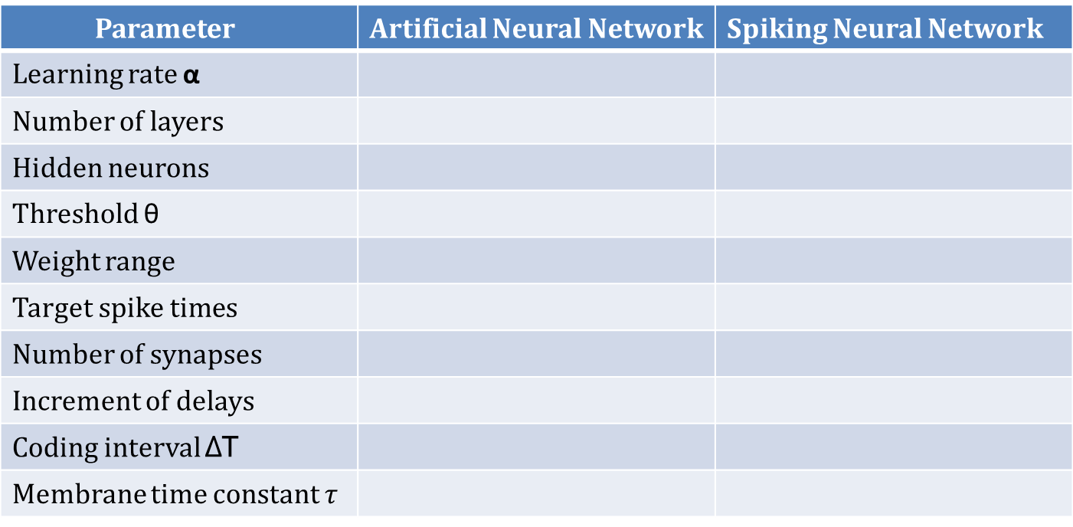
Parameter List:
Parameter | Artificial Neural Network | Spiking Neural Network
Learning rate α
Number of layers
Hidden neurons
Threshold θ
Weight range
Target spike times
Number of synapses
Increment of delays
Coding interval ∆T
Membrane time constant $\text{τ}$

Slide 18
Automated Algorithm configuration:
Previous methods:
Exhaustive search
Hill Climbing, genetic algorithms
Here: use ParamILS [Hutter, Hoos, Leyton-Brown, Stutzle’2009]
Based on Stochastic Local Search with Adaptive capping
Developed for optimizing SAT and MILP solvers
Given ranges of parameters, ParamILS can optimize:
Given objective function of the output (e.g., min error)
Computational resources (e.g., running time)
Number of successes
Etc…

Slide 19
Results with benchmark datasets
Dataset | SpikeProp | Configured SpikeProp | ANN | Configured ANN | ANN with astrocytes (AAN) | Configured AAN
Breast Cancer | 97% ±0.6 | 98.5% | 87% | 96% | 93% | 97%
Iris | 96.1%±0.6 | 98.6% | 80% | 89% | 88% | 91%

Slide 20
Input/output encoding:
Input:
Encoded directly, no need for Gaussian/cosine receptive field representation
Coding interval is the range of data
9 input neurons for the Breast Cancer dataset
4 input neurons for Iris dataset
Output:
Single output neuron
Cross-validation:
Train the network on first half of the data, test on the second half

Slide 21



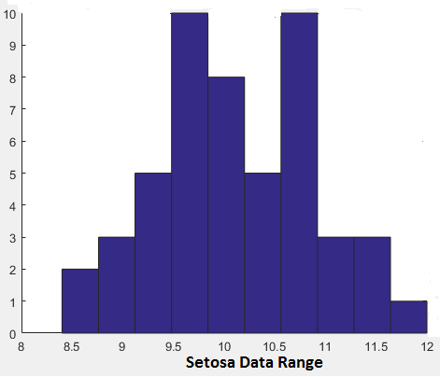
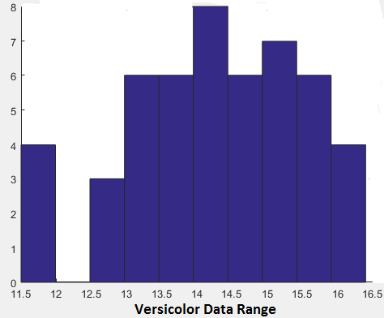
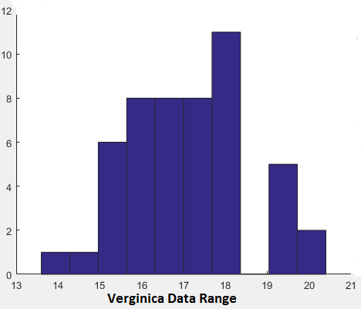
Benchmark datasets
Setosa
Versicolor
Verginica

Slide 22
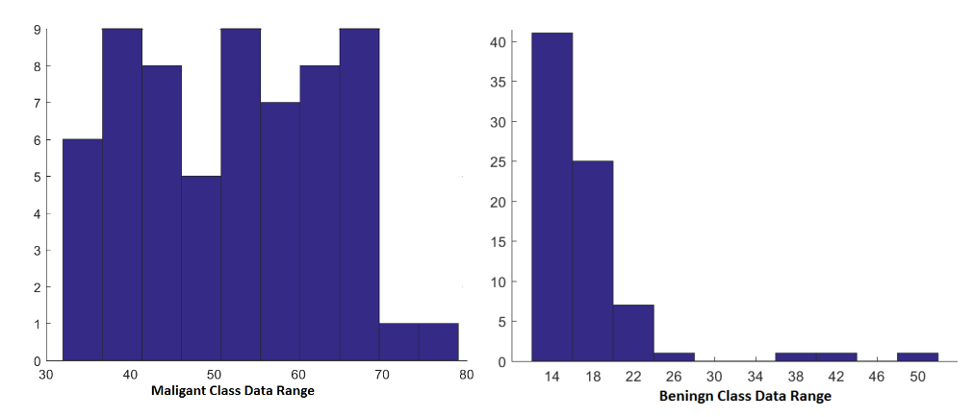
Wisconsin Breast Cancer Dataset

Slide 23
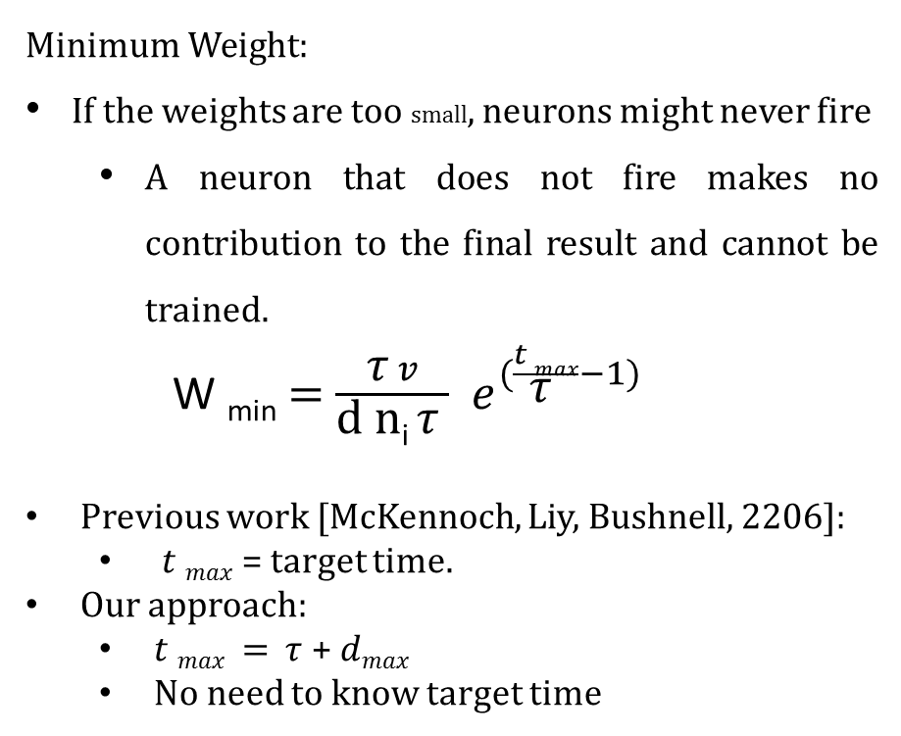
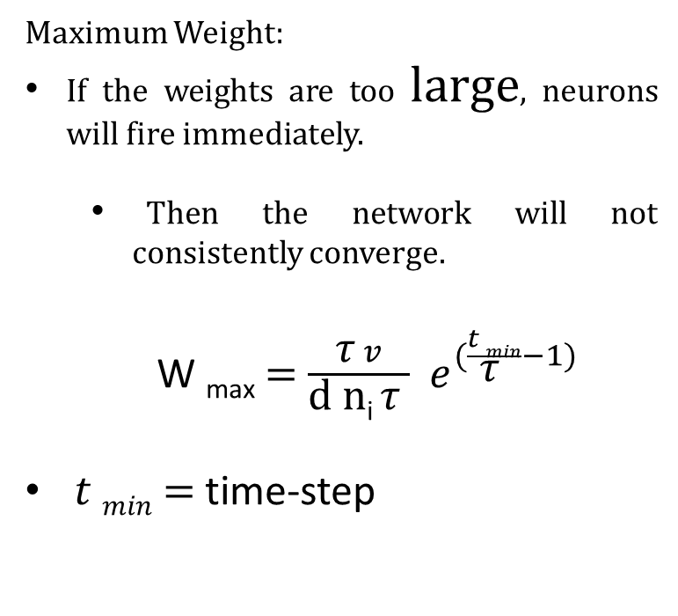
Weight Range:
Minimum Weight:
If the weights are too small, neurons might never fire
A neuron that does not fire makes no contribution to the final result and cannot be trained.
W _{min} $=$ $\frac{\text{τ} v}{\text{d} \text{n}\text{i} \text{τ} }{ e}^{(\frac{t max}{\text{τ} }−1)}$
Previous work [McKennoch, Liy, Bushnell, 2206]:
$t max$ = target time.
Our approach:
$t max$ $=$ $\text{τ}$ + $dmax$
No need to know target time
Maximum Weight:
If the weights are too large, neurons will fire immediately.
Then the network will not consistently converge.
W _{max} $=$ $\frac{\text{τ} v}{\text{d} \text{n}\text{i} \text{τ} }{ e}^{(\frac{t min}{\text{τ} }−1)}$
$t min$ $=$ time-step

Slide 24

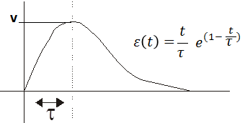
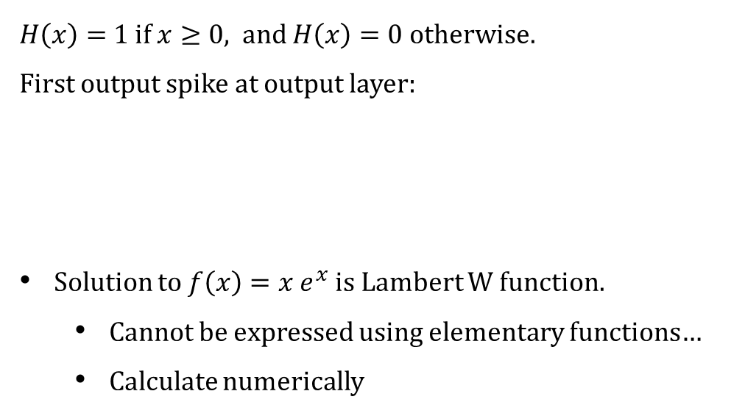

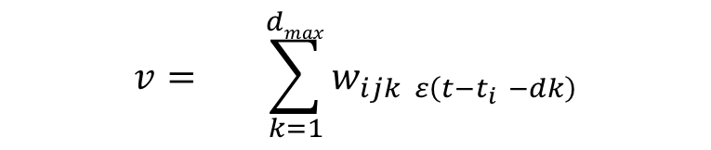
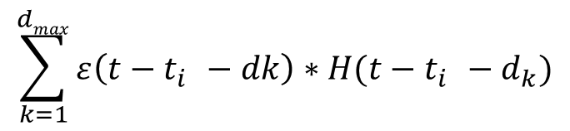

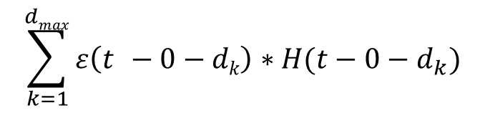
First output Spike Time:
First spike at hidden layer: smallest t satisfying
$$v= \sum_{k=1}^{dmax}{w_{ijk ε\left({t−t}_{i }−dk\right)}}$$
$$\sum_{k=1}^{dmax}{ε\left(t_{ }−0−dk\right)∗H(t−0−d_{k})}$$
$$v≤wimax ni$$
$H\left(x\right)=$1 if $x≥0$, and $H\left(x\right)=0$otherwise.
First output spike at output layer:
Solution to $f\left(x\right)=x e^{x}$ is Lambert W function.
Cannot be expressed using elementary functions…
Calculate numerically
$$\sum_{k=1}^{dmax}{ε\left({t−t}_{i }−dk\right)∗H({t−t}_{i }−d_{k})}$$
$$v≤whmax nh$$
First spike depend on maximum weight and last spike depend on minimum weight of network.

Slide 25


Last Output Spike Time :
First spike at hidden layer: smallest t satisfying
$$v= \sum_{k=1}^{dmax}{w_{ijk ε\left({t−t}_{i }−dk\right)}}$$
$$\sum_{k=1}^{dmax}{ε\left(t_{ }−0−dk\right)∗H(t−0−d_{k})}$$
$$v≤wimin ni$$
$H\left(x\right)=$1 if $x≥0$, and $H\left(x\right)=0$otherwise.
First output spike at output layer:
Solution to $f\left(x\right)=x e^{x}$ is Lambert W function.
Cannot be expressed using elementary functions…
Calculate numerically
$$\sum_{k=1}^{dmax}{ε\left({t−t}_{i }−dk\right)∗H({t−t}_{i }−d_{k})}$$
$$v≤whmin nh$$
First spike depend on maximum weight and last spike depend on minimum weight of network.

Slide 26
Conclusion
We looked at training SNNs
Using automated algorithm configuration, optimized Spike-Prop to achieve better accuracy
Derived formulas for weight and range
Formulated a conjecture about target times

Slide 27
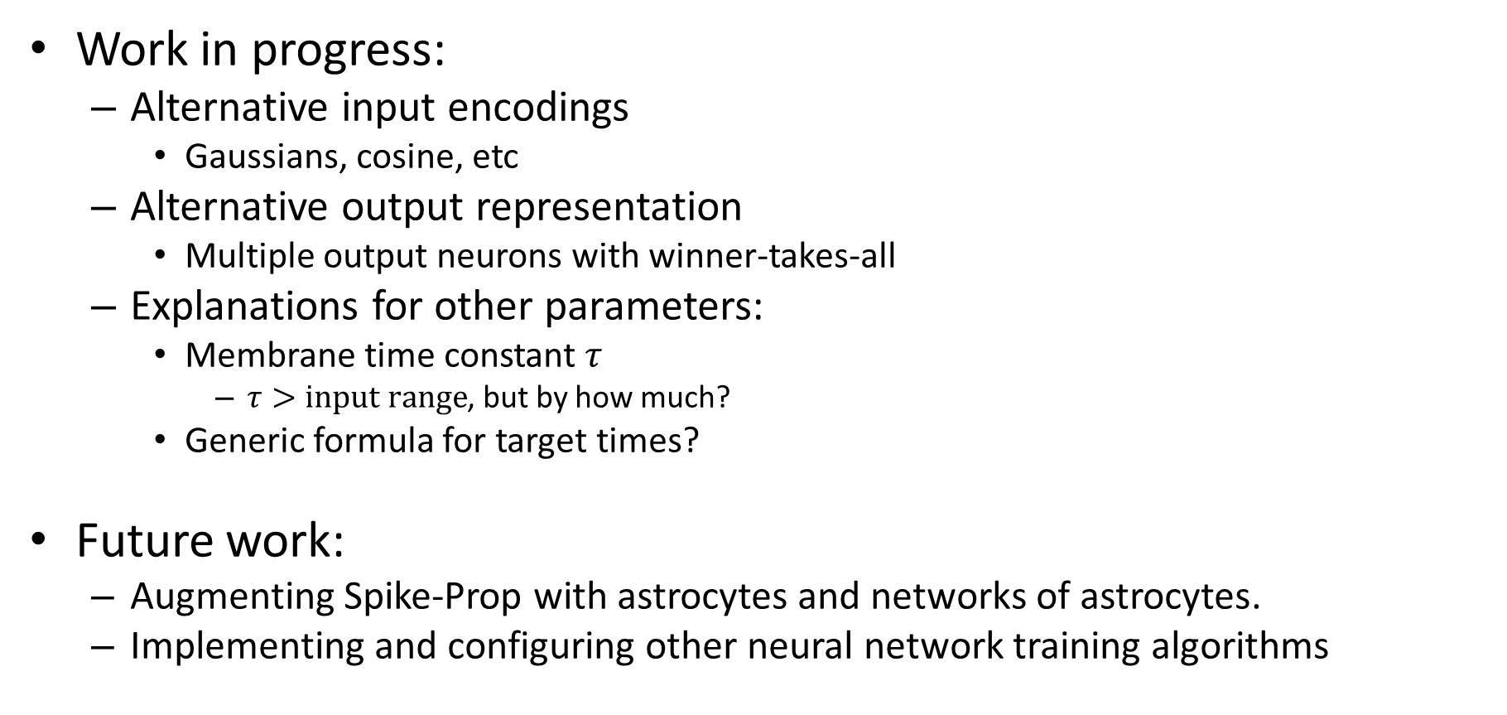
Work in Progress
Work in progress:
Alternative input encodings
Gaussians, cosine, etc
Alternative output representation
Multiple output neurons with winner-takes-all
Explanations for other parameters:
Membrane time constant $τ$
$τ>input range$, but by how much?
Generic formula for target times?
Future work:
Augmenting Spike-Prop with astrocytes and networks of astrocytes.
Implementing and configuring other neural network training algorithms

Slide 28
Thank you

Slide 29
References
Sander M. Bohte, Joost N. Kok, and Han La Poutr ́e. Error-backpropagation in temporally encoded networks of spiking neurons. Neurocomputing, 48:17–37,2002.
S. McKennoch, Dingding Liu, and L.G. Bushnell. Fast Modifications of the SpikeProp Algorithm. pages 3970–3977, 2006.
Hong, Xiurui Liu, Xie, Guisong Qu, Malu Zhang, and J ̈urgen Kurths. An efficient supervised training algorithm for multilayer spiking neural networks. PloS one , 11(4):e0150329, 2016.
Filip Ponulak. ReSuMe - New Supervised Learning Method for Spiking Neural Networks, 2005
https://mattmazur.com/2015/03/17/a-step-by-step-backpropagation-example/
http://slideplayer.com/slide/9765249/

