Slide 1



ADVANCE DATABASES AND BIG DATA MANAGEMENT
KICK STARTER
DREAM MAKER OR PROMISE BREAKER
PRESENTED BY:
ASHA JUSTIN
PRIYANKA SABNANI

Slide 2
TABLE OF CONTENTS
Problem statement………………………………………………
Project Description………………………………………
Business uses from the project………………………………
Data set………………………………………………………………
Model……………………………………………………………………
Data manipulation……………………………………………………
Analysis and Graphs……………………………………………
Limitations………………………………………………………… Conclusion……………………………………………………………
Lessons Learned…………………………………………………
References…………………………………………………………

Slide 3

PROBLEM STATEMENT
KICKSTARTER is an American public benefit corporation based in New York. The company's stated mission is to "Help bring creative projects to life”. As of December 2019, Kickstarter has received more than $4.6 billion in pledges from 17.2 million backers to fund 445,000 projects.
KICKSTARTER management team now wants to create a database which can track details about their creators, backers and projects.
They would like to track who are people creating projects with them, who are the people backing these projects and the performance of their company.

Slide 4

PROJECT DESCRIPTION
This project will help the management team understand about their creators and backers based on their previous interactions with KICKSTARTER.
2
They can limit the amount of backers for the projects if needed based on the data presented by the project.
1
They can also track the performance of the creators and can reward them for successful projects.
They can also track the health of the company based on the success or failure of the individual projects or certain category of projects.
3
4

Slide 5





BUSINESS USES FROM THE PROJECT
CAPITAL
SOURCE
SUCCESS
RATE
ADVANCE
INSIGHTS
PEOPLE
INVOLVED
CRITICAL
DECISIONS
KICKSTARTER is main sources of initial capital for small businesses and start-up companies that are looking to launch their first products.
This project will help them understand trending projects in market with their success rates.
This project will help the management team predict the success or failure of the project before its released.
It will also help them understand about the creators and backers assigned with various types of projects.
This project will help the management team to make critical decisions which will support in the growth of their organization.

Slide 6
WHAT CAN THE DATA TELL US
Most successful projects by Country or Category
Minimum Goal Amount for a successful project
Creators with most successful projects
Having Face Book friends/shares effect success of a project
Which countries have projects with maximum profit
Who are the people creating different projects
What are the reasons for success / failure of the projects

Slide 7
DATA SET
KICKSTARTER campaigns make ideas into reality. It’s where creators share new visions for creative work with the communities that will come together to fund them. KICKSTARTER data set contains :
1
Data set contains details for 18000+ unique projects
5
Project details based on Category & Subcategory
2
Project details by the countries they were developed
6
Project details based on their status and profit / loss
3
Details about creators and backers of the project
7
Details about Creators and the rewards they have received from individual projects
4
Details about project with details of Amount Funded Vs the Goal Amount
8
Details about the start and end date of the projects

Slide 8
DATA IMPORT
How we arrived at our final database:
1
5
Created cubes and generated reports to analyze the dataset
Raw data was downloaded from Kaggle
2
Selected certain fields that pertained to our study
6
Alternatively moved data to HDFS (Horton Sandbox)
3
Normalized data to Second Normal Form (2NF) and Third Normal Form (3NF)
7
Performed Data evaluation and analysis with Microsoft PowerBI
4
Linked Data to Excel and then exported to SQL (ETL)

Slide 9
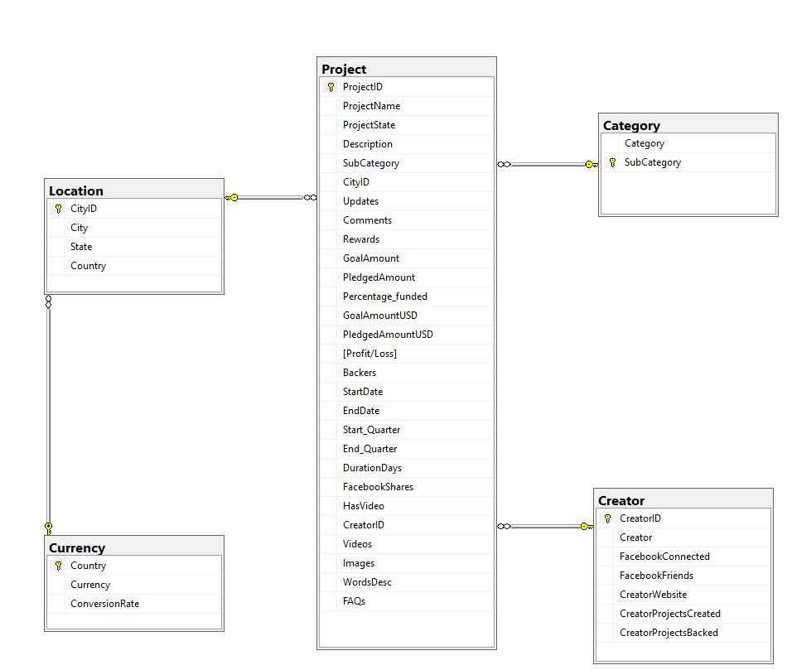
DATAWARE HOUSE MODEL – SQL

Slide 10
MODELS
2 TYPES
MODEL 1
MODEL 2
Model was built using Visual Studio
Data exported to SQL sever from Microsoft Excel using Visio – Integration Services Project (ETL Process)
Created Cubes using Mining Project services in Visio. Used cubes to analyze project details for KICKSTARTER
Created Reports which can be accessed the top management team to support important decision for the company
Model was built using Horton Sandbox
Data was exported to online SharePoint from the local drive
Accessed VM and connected into Horton Sandbox command prompt( Shell in a Box)
Extracted data from SharePoint to local drive of Horton Sandbox
Moved data to HDFS using command prompt
Created tables and uploaded data in Hive
Connected Hive to an external data visualization tool(Microsoft Power BI) through ODBC
Joined tables by managing relationship between tables
Analyzed the data set using the visualization tool
Predicted output based on the findings from the tool

Slide 11
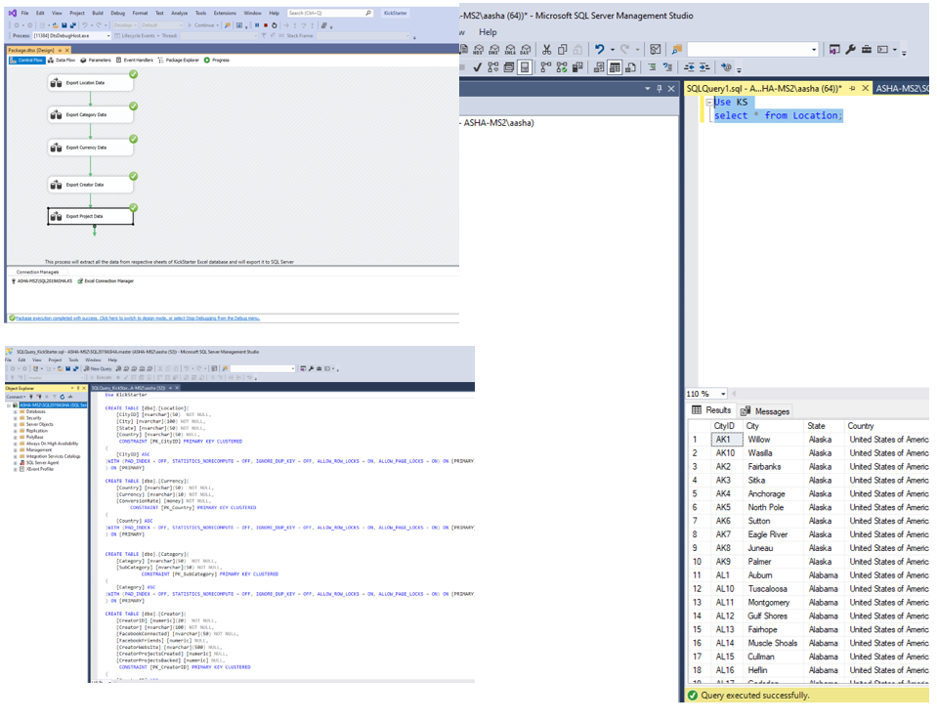
MODEL 1 – VISUAL STUDIO
SAAS
1
Tables created in SQL
Data exported to SQL Server from MS Excel
2

Slide 12
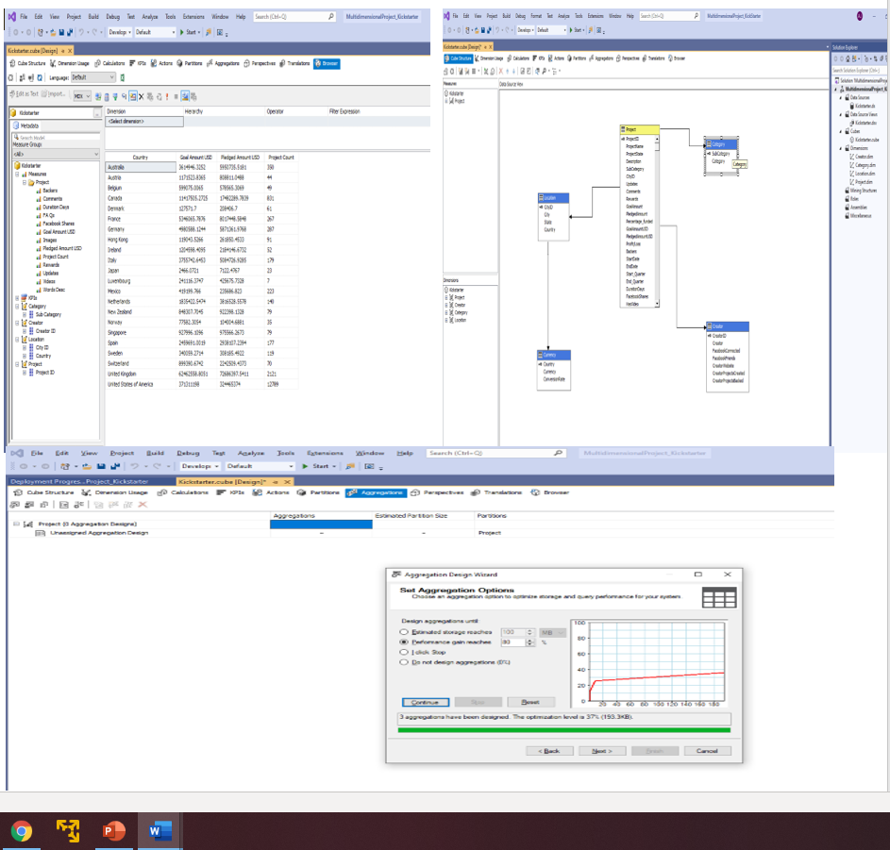
MODEL 1 – VISUAL STUDIO
1
Created Cubes to analyze data
Completed Analysis to understand distribution of data within different levels
2

Slide 13
CUBE ANALYSIS
United States of America has most projects as compared to other countries
US also sees a good number in terms of Goal Amount and Pledged amount
Profit & Loss status by each country
Images uploaded by Country
Categories with Maximum projects
Days taken to complete the project by Country / Category
Backers by each project / Category

Slide 14
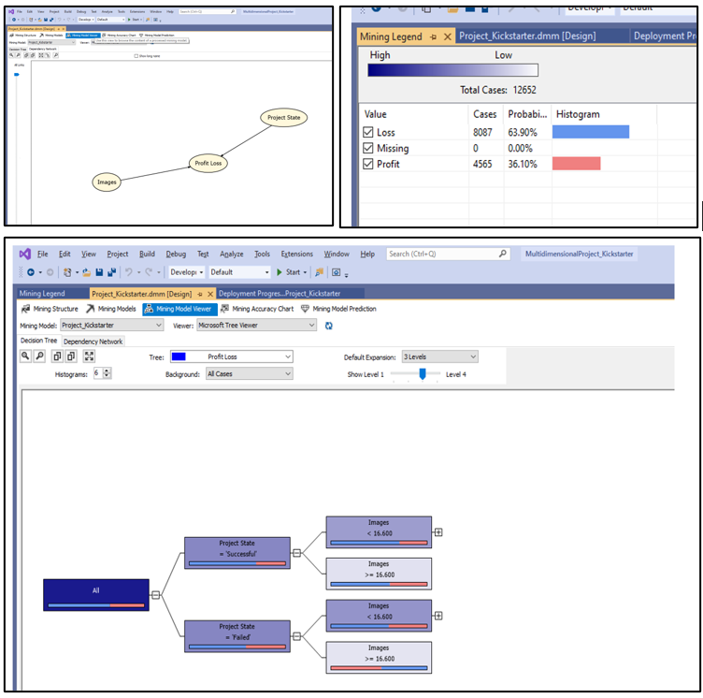
Created Mining Projects to predict success / failure based on the inputs available in the data set
DEPENDENCY NETWORK
Project State and the images uploaded for each project can predict if the success rate of the project
Shows the probability of the success / failure of the project based on the input parameter
DECISION TREE
Will predict the output of the future projects based on the probability
MINING LEGEND
CLASSIFICATION MATRIX
Will give how efficient the model will be in predicting the output based on input variables
How good are these predictors in predicting the model
LIFT CURVE

Slide 15
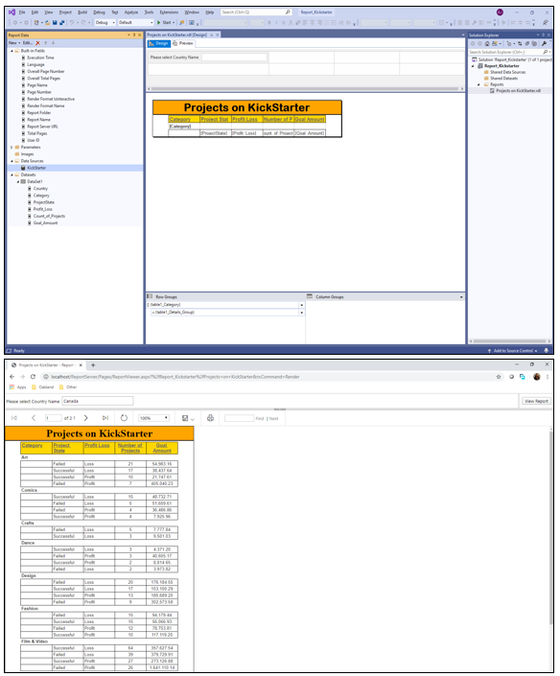
MODEL 1 – VISUAL STUDIO
1
Created Reports using SSRS
Deployed reports on SharePoint for access
REPORT ANALYSIS
Can create multiple static reports which will present different analysis based on management requirements
Demo report created shows Goal Amount and number of projects by Project Category, State & Profit / Loss by each country
Report user can select from the list or update Country details in the validation column and the report will be generated accordingly. Demo report shows details for Canada.
Reports access can be managed as per the requirements from top management
2
3
4
5
6

Slide 16
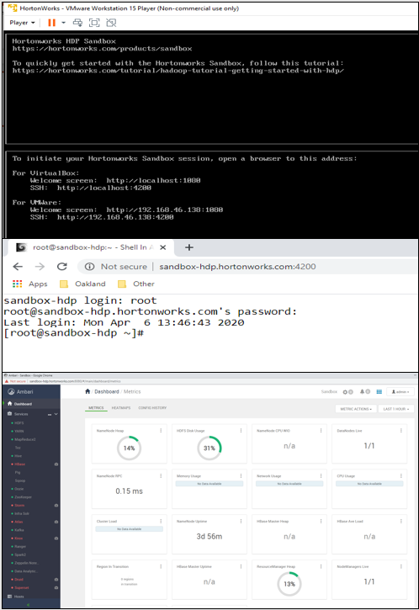
MODEL 2 – HORTONWORKS SANDBOX & MS POWERBI
Sandbox is a pre-configured environment that contains the developments from Apache Hadoop, specifically the Hortonworks Data Platform. The Sandbox comes packaged in a virtual environment that can run in the cloud or on your personal machine.
CONFIGURING HORTONWORKS SANDBOX
Installed HW SandBox and mapped it to VMWare
Updated terminal access to Sbox (Shell in a Box) – user credentials
Initiated Setup for Web access of Sbox( Ambari)
.
Explored Ambari view to understand different tools and metrics available
Authorized Login Credentials to access all the services in Ambari and Shell in a BoxExplored Resource Manager to ensure a
ll services are working as needed

Slide 17
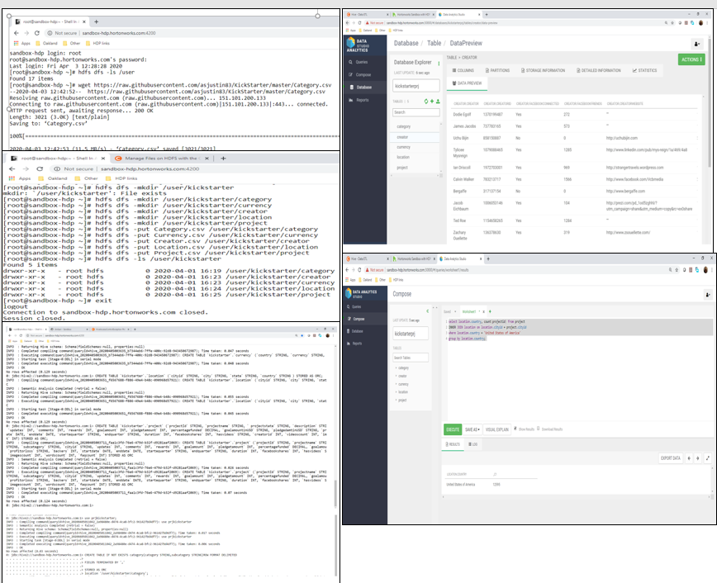
DATA UPLOAD TO HSANDBOX (ETL)
1
Uploaded Data to GitHub from local drive
Imported raw format of the file to local drive of Sandbox
Created directories in HDFS and moved data from local drive of Sandbox to HDFS through command prompt
Verified data upload in web access also
Created external and ORC(Optimized Row Columnar) tables in hive (Beeline hive)
Uploaded data from HDFS to external tables and then to ORC tables
Verified tables through web access
Executed SQL queries to check the data issues both in command prompt and web access.
2
3
4
5
6
7
8

Slide 18
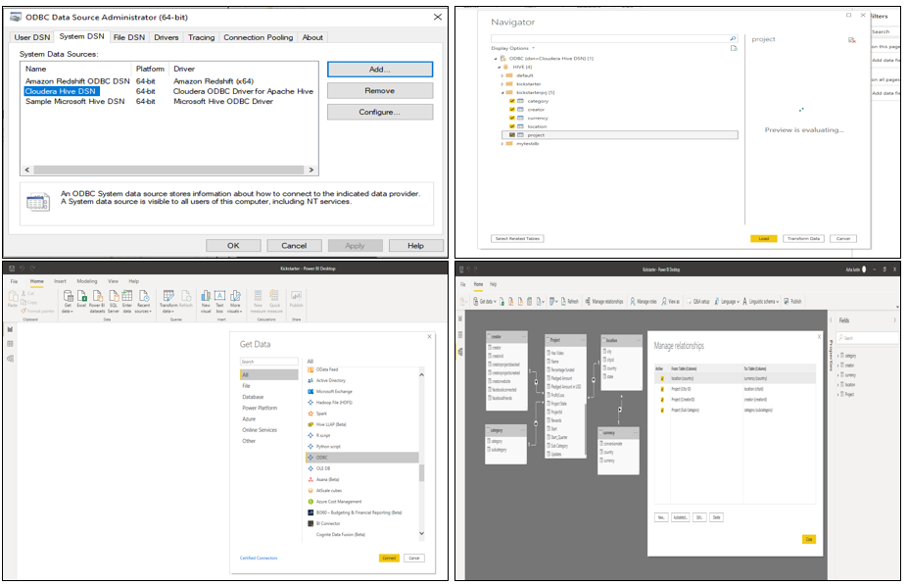
DATA VISUALIZATION (MICROSOFT POWERBI)
1
Established connection for ODBC
Connected Hive to PowerBI through ODBC
Selected database and respective tables to be exported
Loaded tables with data into PowerBi
Checked if the data exported in tables is per required format
Established primary / foreign key relationships between tables
Created data visualization to understand , analyze and predict data
2
3
4
5
6
7

Slide 19
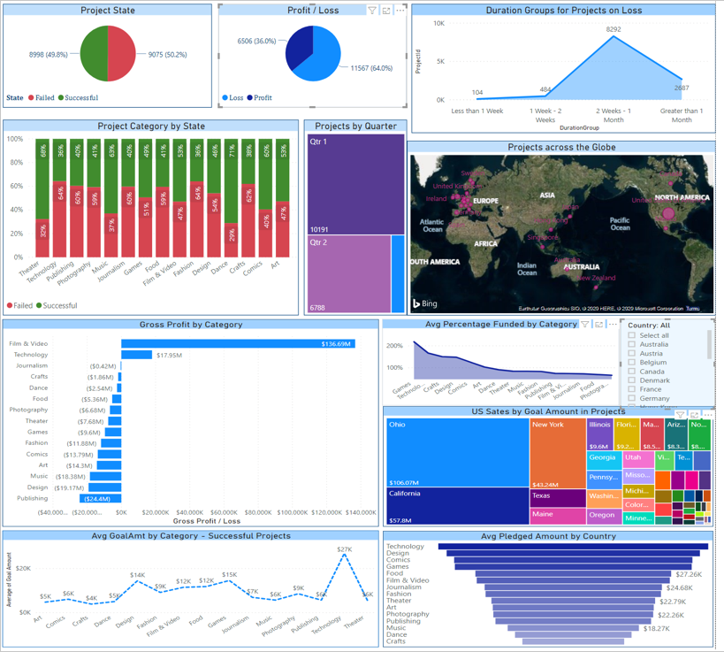
ANALYSIS AND GRAPHS

Slide 20
OVERVIEW
1
4
KICKSTARTER sees an approx. an equal number of success and failure with project numbers, but the projects making profit are less.
Dance and theatre projects have a good success rate when compared to other categories
2
5
Quarter 1 & 2 see a high raise in projects numbers as compare to Q3 & Q4
Projects on loss usually take more than 15 days to complete
3
6
Film and Video , Technology projects see a hike in gross profit
Technology projects are the most expensive.

Slide 21





OVERVIEW
ANALYSIS AND GRAPHS CONT…
MAX IN USA
Maximum numbers of projects created at Kickstarter are in USA.
MAX FUNDING
Games and Technology has the maximum funding when compared to other categories
.
PUBLISHING PROJECTS
Publishing projects see a huge loss in their projects due to lack of backers
OHIO & CALIFORNIA
Ohio and California are among the top states in US by Goal amount required for the projects
SUB CATEGORIES
Design, Video , Documentary , Games ,Fashion Food and Art are some of the common subcategories of projects updated on Kickstarter

Slide 22




CHALLENGES
MDX Queries
DATA
CONFIGURATION
PROGRAMMING
Writing MDX queries to analyze data in Visual studio cubes
Analyze & Predict data using different techniques
Installation and Configuration of Horton Works Sandbox
Enhancing Data Visualization Techniques in PowerBi

Slide 23
CONCLUSIONS
Who are the people creating projects in different categories – Playing Cards
Average Goal Amount for a successful project by Category - $9.6K
Which categories have projects with maximum profit – Film & Video
What are the reasons for success / failure of the projects – More duration , Less backers, No website
Most successful projects by Country or Category – US & Film & Video
Having Facebook connection /website effect success of a project – FB connection ~ No
Creator Website ~ Yes
Creators with most successful projects – Benjamin Hennessey (13 projects)

Slide 24
LESSONS LEARNED
Extensive data visualization and data analysis using Microsoft PowerBi
Deep understanding of data and details related to it
Working with Hive
Data prediction using above techniques
Learned to create cubes & reports with MS Visual Studio
Data Analysis using cubes and data mining techniques
Dealing with big data

Slide 25
REFERENCES
1
https://www.cloudera.com/tutorials/learning-the-ropes-of-the-hdp-sandbox.html
https://www.cloudera.com/tutorials/getting-started-with-hdp-sandbox.html
https://powerbi.microsoft.com/en-us/
https://towardsdatascience.com/using-machine-learning-to-predict-kickstarter-success-e371ab56a743
https://docs.microsoft.com/en-us/sql/mdx/mdx-function-reference-mdx?view=sql-server-ver15
2
3
4
5

Slide 26
THANK YOU!
ANY QUESTIONS?

