Slide 1
Open-Sampling
Tian-Shuang Wu
Tutor：Shen-Huan Lyu
tianshuangwu@hhu.edu.cn
2024/4/2

Slide 2
Contents
1
Research Background
2
Related Works
3
Open-Sampling
4
Experiments
5
Conclusion

Slide 3
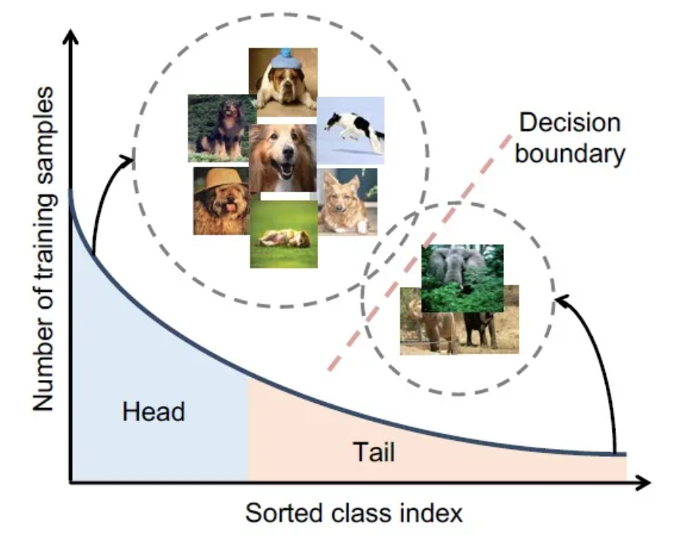
Research Background
Issue：Long-tailed Datasets
the training dataset suffers from
extreme class imbalance
biased learning of the model
（Overfitting）

Slide 4
Contents
1
Research Background
2
Related Works
3
Open-Sampling
4
Experiments
5
Conclusion

Slide 5
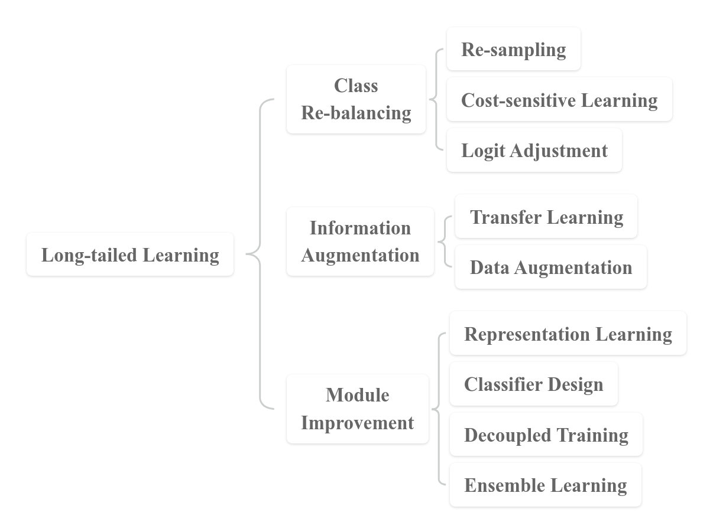
Long-tailed Learning

Slide 6
Re-sampling
Under-sampling
Over-sampling
remove examples from the majority classes
repeated samples for the minority classes

Slide 7
Other methods for long-tailed datasets
Re-weighting: assign adaptive weights for different classes or samples
Transfer-learning based methods：transfer features learned from head classes with abundant training instances to under-represented tail classes
Two-stage training methods: apply decoupled training where the classifier is re-balance during the fine-tuning stage

Slide 8
Contents
1
Research Background
2
Related Works
3
Open-Sampling
4
Experiments
5
Conclusion

Slide 9

Theoretical Motivation
How to achieve a balance
between
re-balancing the label distribution
and
keeping non-toxicity ?
test class distribution: usually balanced
training dataset distribution: long-tailed
to re-balance
in-distribution samples
OOD instances
challenging
& expensive
From a Bayesian perspective，
proved non-toxic

Slide 10
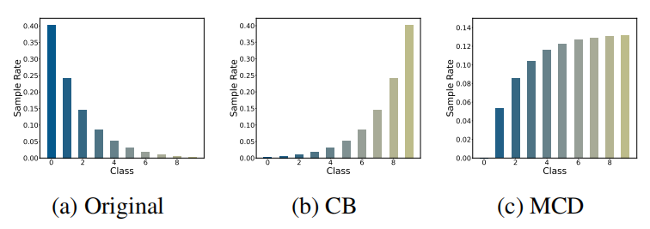
Open-Sampling
Complementary Sampling Rate：

Slide 11
Contents
1
Research Background
2
Related Works
3
Open-Sampling
4
Experiment
5
Conclusion

Slide 12
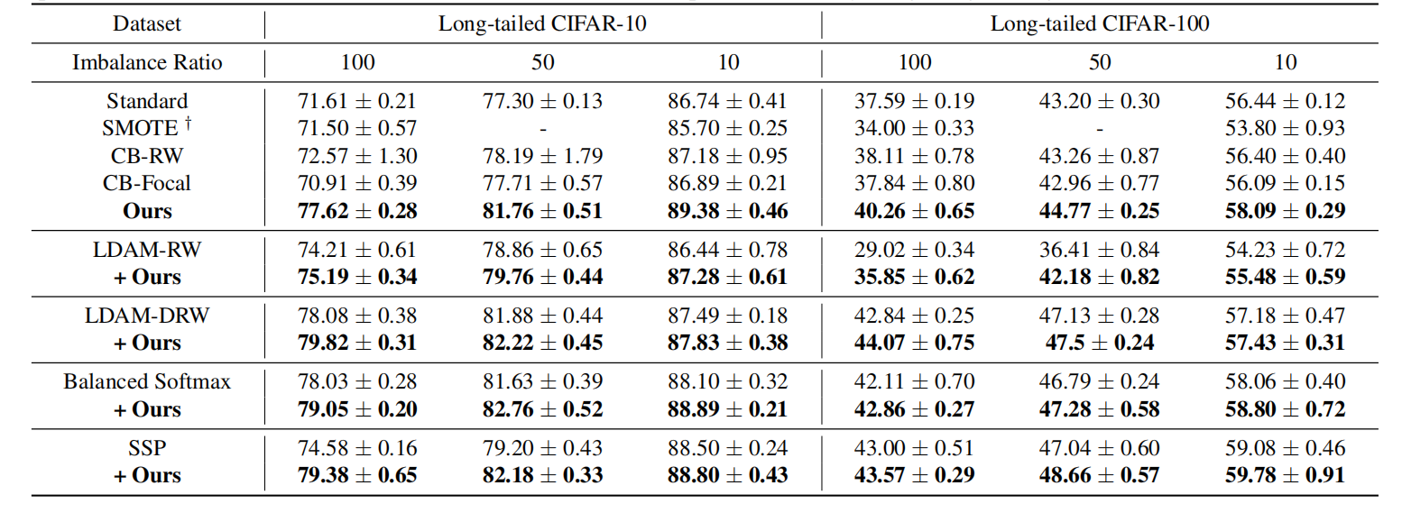
Results on long-tailed CIFAR

Slide 13
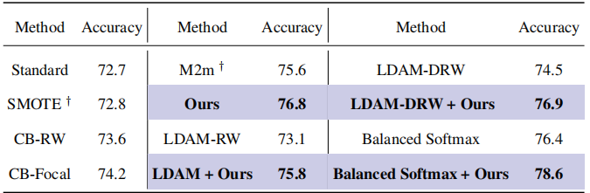
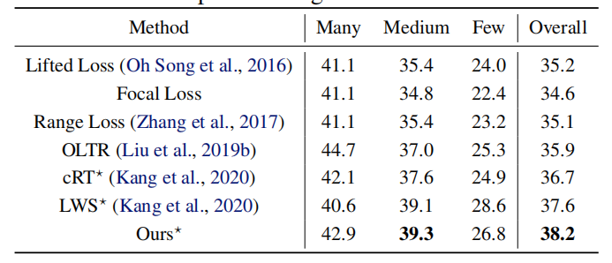
Results on CelebA-5 & Places-LT

Slide 14
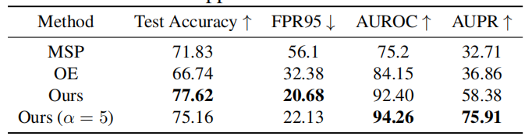
OOD detection under class imbalance

Slide 15
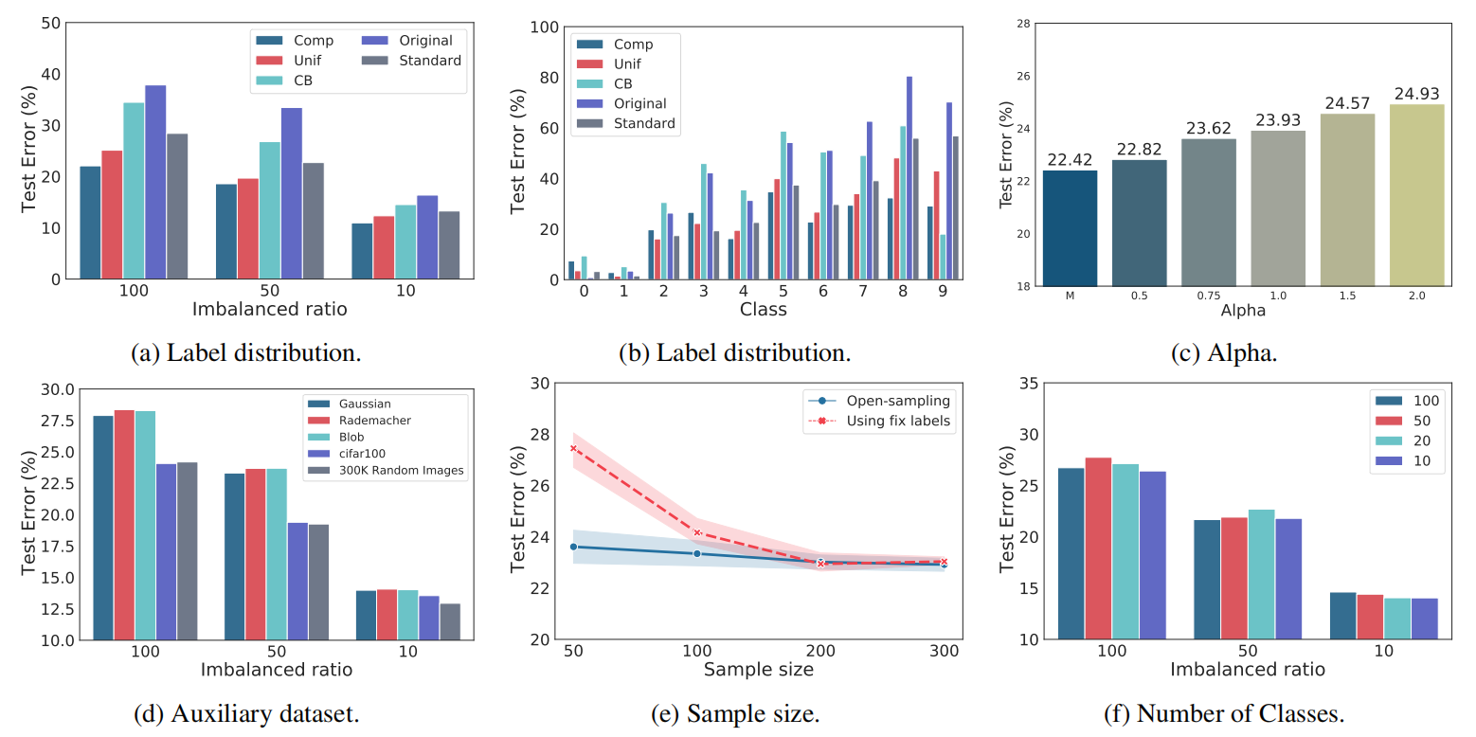
Open-Sampling

Slide 16
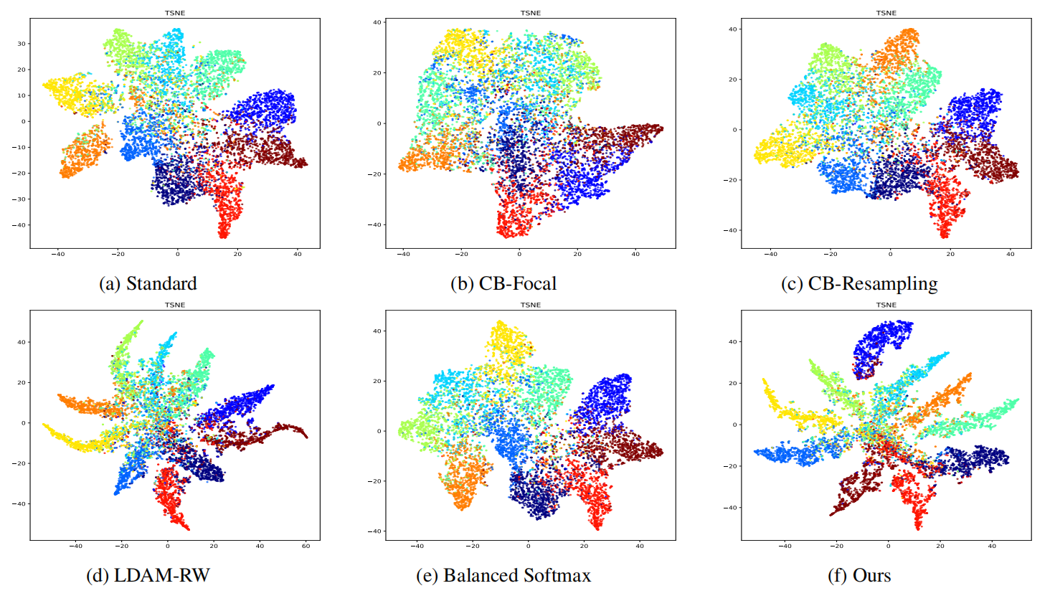
Open-Sampling

Slide 17
Contents
1
Research Background
2
Related Works
3
Open-Sampling
4
Experiments
5
Conclusion

Slide 18
Conclusion
It is a simple yet effective method termed Open-sampling, by introducing OOD instances to re-balance the class priors of the training dataset
not only re-balances the training dataset, but also promotes the neural network to learn more separable representations
not expect vanilla Open-sampling to achieve state-of-the-art results compared with many complicated methods,but it can outperform existing data re-balancing methods and improve existing state-of-the-art methods

Slide 19
Thank you for your
listening and guidance

