Slide 1

BrightPath

Slide 2
INTRODUCTION
BrightPath is an academy dedicated to supporting youth in their mental health, academic performance, stress reduction, and overall development. Our focus is on helping young individuals grow, achieve their goals, and navigate life transitions effectively. We guide them in overcoming fears and developing the skills needed to balance responsibilities, find a good job, raise a family, and still dedicate quality time to their loved ones, while maintaining good habits and a balanced lifestyle.

Slide 3
By analyzing data on these key areas, we can identify where to focus our efforts in creating a supportive, depression-free environment that helps youth thrive, improve their grades, and lead successful lives.
I searched through this dataset, which is a CSV file, to understand students' lifestyles, including their habits regarding sleep, socialization, and the number of hours they spend on activities such as studying, sleeping, and engaging in physical activities like sports and gym workouts. Various questions were asked to the students, and their responses were analyzed. A total of 2,000 students replied with their answers.

Slide 4
The core question behind this analysis is: How do lifestyle factors such as sleep habits, physical activity, and social interactions affect student stress levels and overall well-being? We aim to understand how these factors impact academic performance, mental health, and long-term success for students.
The purpose of this analysis is to identify key lifestyle factors that influence student stress levels, academic performance, and overall health. By analyzing these factors, we can develop recommendations to help students lead healthier, balanced lives and improve their academic success.

Slide 5
Students themselves, who will gain insights into how their habits affect their health and performance.
Schools and educational institutions, who can use the results to implement wellness programs and support services.
Parents who are looking for ways to help their children manage stress and improve their academic outcomes.
Health professionals and counselors working with students to promote well-being and reduce stress.
Youth organizations and mental health initiatives aiming to support student health.

Slide 6
The main dataset for this analysis is the student_lifestyle_dataset.csv, which includes data on various factors such as:
Sleep habits
Physical activity levels
Social interaction frequency
Academic performance (e.g., GPA)
Stress levels

Slide 7
The data was collected through a survey, and 2,000 students participated in providing their responses.
Each response from a student represents an individual sample/unit of analysis. The key features collected include:
Social_Hours_Per_Day (hours spent socializing daily)
Sleep_Hours_Per_Day (hours of sleep)
Physical_Activity_Hours_Per_Day (hours spent on physical activities)
High_Stress_Level (stress levels rated by the students)
Academic Performance (GPA)

Slide 8
To conduct this analysis, I used
Jupyter Notebook for coding, data exploration, and visualization
Pandas for data manipulation and cleaning
Seaborn and Matplotlib for data visualization, including generating heatmaps and correlation plots
Python for running the analysis and modeling

Slide 9
From the analysis, several key insights were identified:
Sleep and physical activity have a negative correlation with stress levels, meaning that students who sleep more and engage in more physical activity tend to have lower stress.
Social interaction frequency had a weak impact on stress levels, suggesting that it doesn't significantly affect student stress.
Lifestyle factors such as sleep and physical activity are more influential in managing stress and improving overall well-being than social interactions.

Slide 10

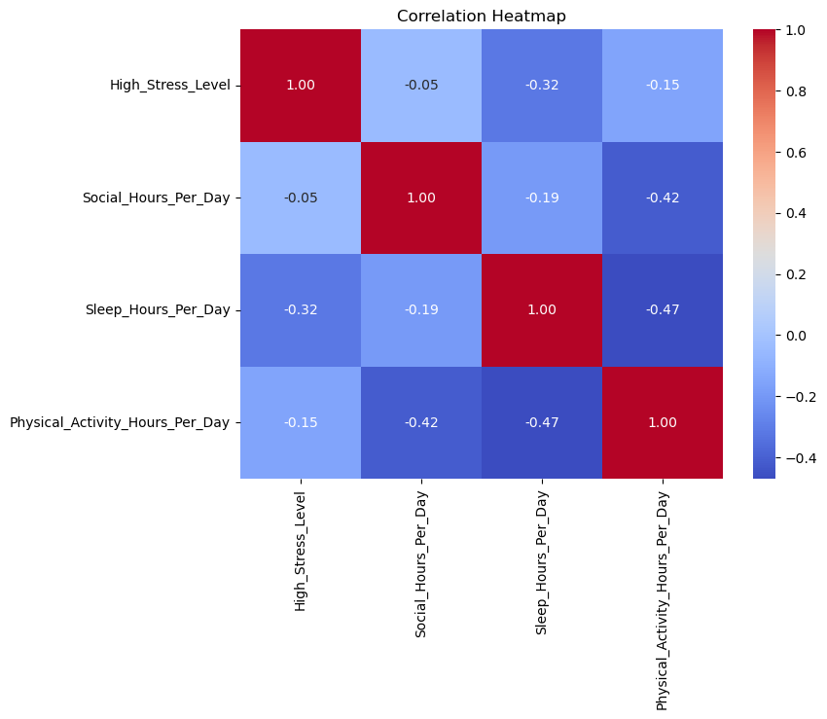
Correlation Heatmap: A heatmap that visualizes the correlation between various factors (sleep, physical activity, social hours, and stress).
This heatmap reveals that High_Stress_Level has a negative correlation with both Sleep_Hours_Per_Day and Physical_Activity_Hours_Per_Day, indicating that students who sleep more or engage in more physical activity tend to experience lower stress levels.

Slide 11

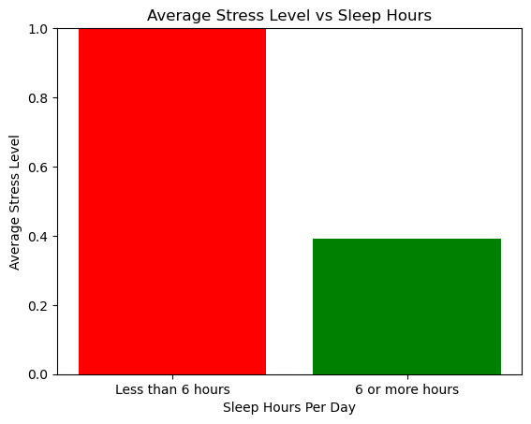



Average Stress Level (less than 6 hours of sleep): 1.0 Average
Stress Level (6 hours or more of sleep): 0.3923654568210263
Consistently getting less than 6 hours of sleep seems to increase stress levels.

Slide 12
There are some questions that I still want to get answers to, such as understanding longitudinal effects:
How do lifestyle habits change over time, and how does this affect long-term success.

Slide 13
To sum up, this project shows how important lifestyle habits are for students' well-being, academic success, and future happiness. We found that getting enough sleep and staying active are more closely linked to reducing stress than how often students socialize. This means that if we help students focus on improving their sleep and exercise, it can help them feel less stressed and perform better in school. In the future, we should also look at how these habits change over time and how they affect students' success in life. By helping students develop healthy habits, we can set them up for a better and more successful future.

