Slide 1
Big Mountain Resort Case Study

Slide 2
The problem
Context
Problem statement
Big Mountain Resort is one of the most popular resorts among skiers and riders in Montana.
Big Mountain ticket price is set to be above the average price for resorts in its market segment
Devalorization of its installations compared to the other resorts,
Curbing the investment strategy.
Objective : a new ticket pricing strategy and consider a number of changes.
How can Big Mountain Resort increase revenues by revising their ticket pricing strategy to boost their facility investments and compensate for the recent $1.540,000 in operating costs this season?

Slide 3
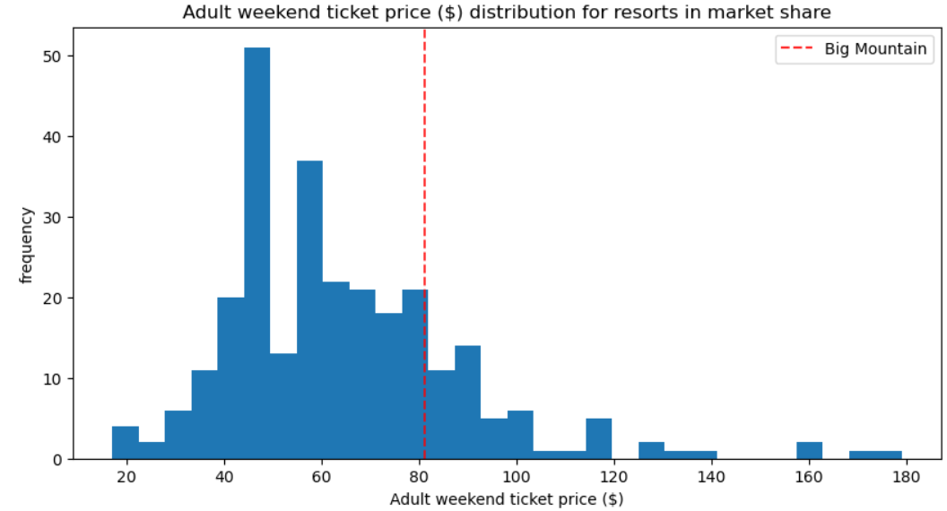
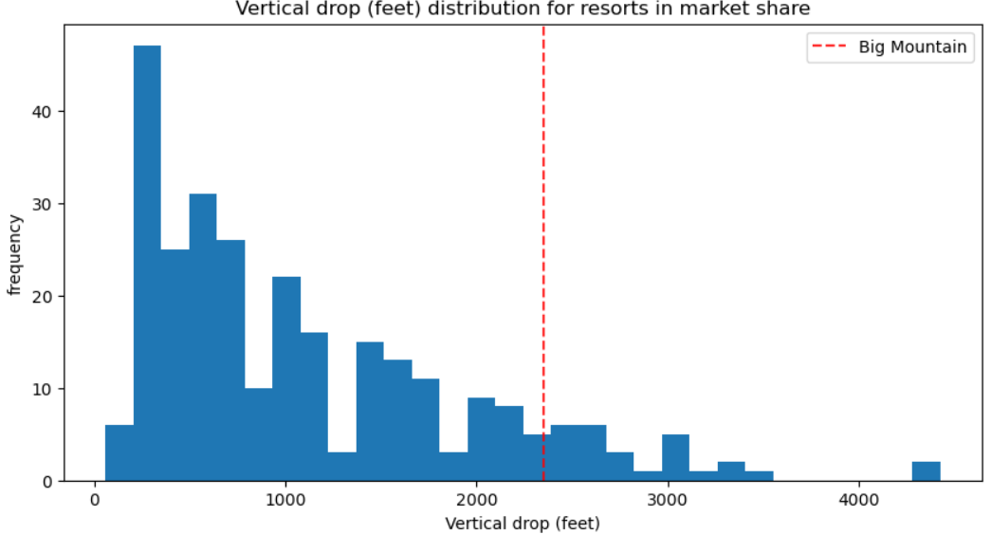
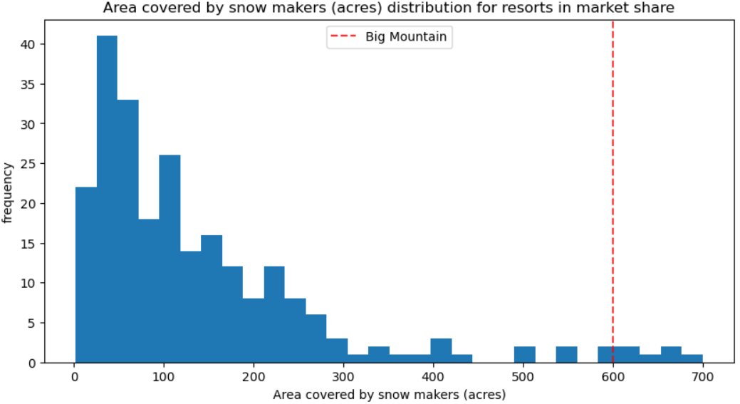
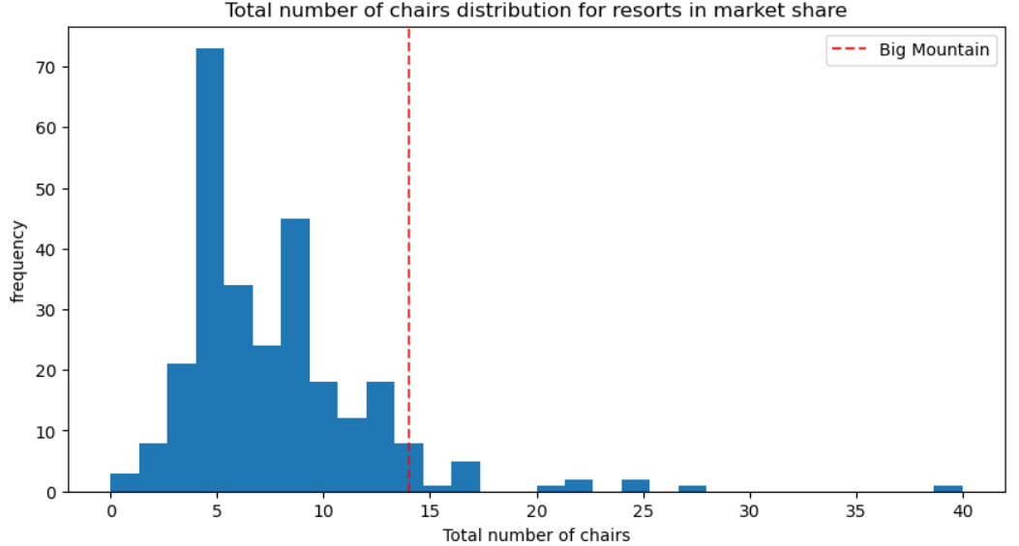
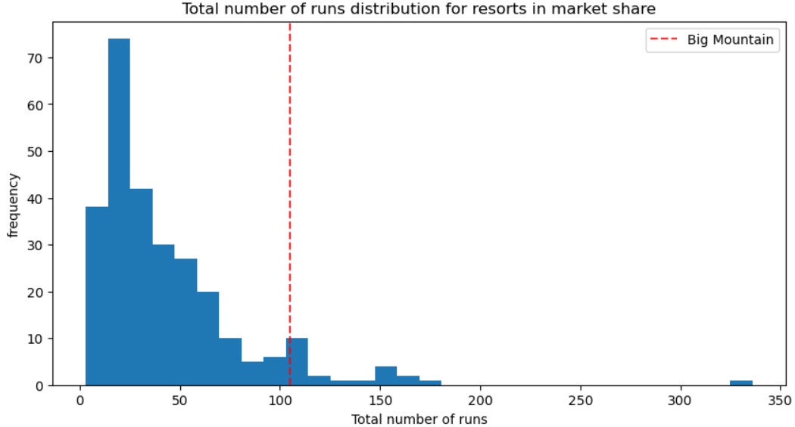
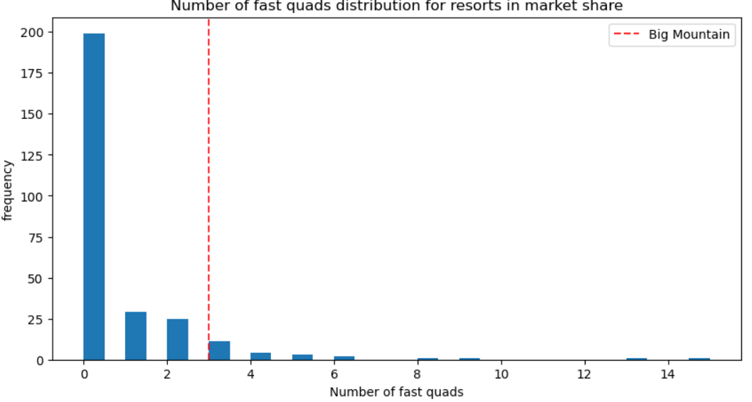
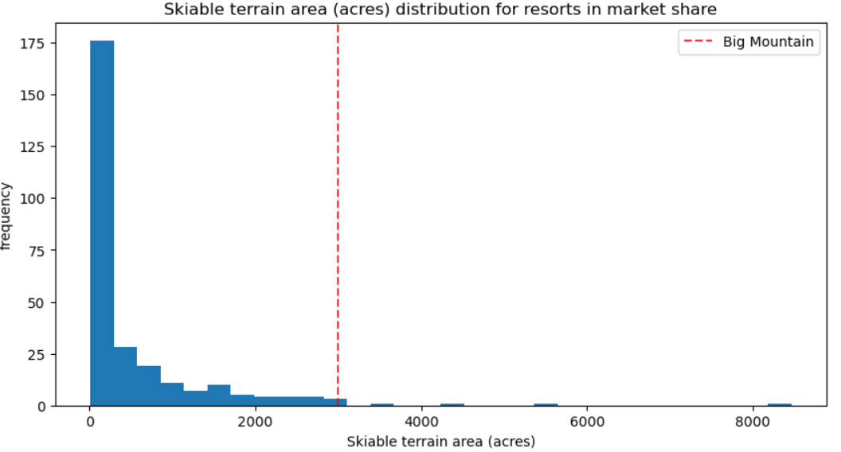
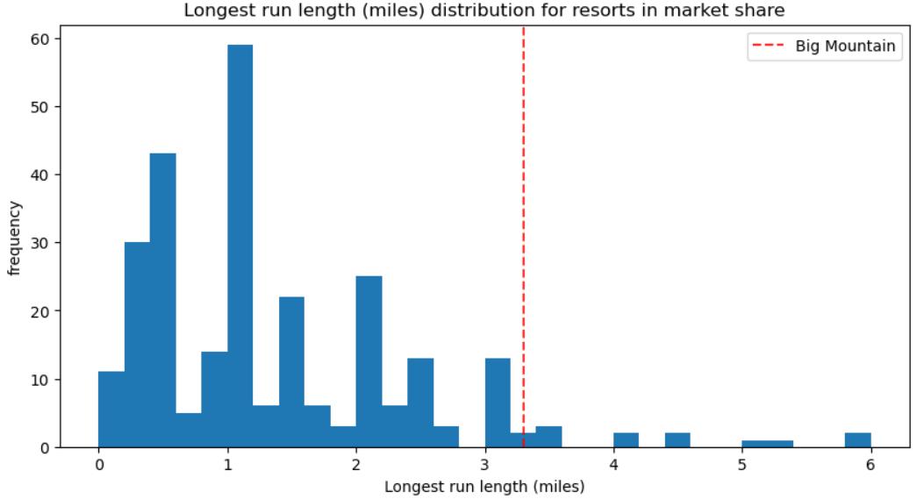
Current situation
Actual price
Attractions
1 Ticket: $81.00
Big Mountain is very well placed in terms of
vertical drop
snow-making area
number of chairs
number of fast quads
number of runs
skiable terrain
longest runs length

Slide 4
Recommendation
Predicted Ticket Price : $95.87
Winning scenario
Adding a run,
Increasing the vertical drop by 150 feet,
Installing an additional chairlift.
Impact
Ticket price increase by $1.99 ⇒ Revenue increase by $3,474,638
Expenses of the additional chair : $1,540,000
Profit : $1,934,638 from the revenue increase
⇒ $1,11/ticket.
Expected number of visitors 350,000
Number of days per skier
5

Slide 5
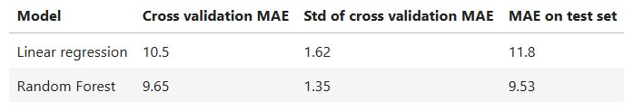
Modeling Results
Model Selection
Refitting The Model On All Available Data : MAE = $10.39

Slide 6
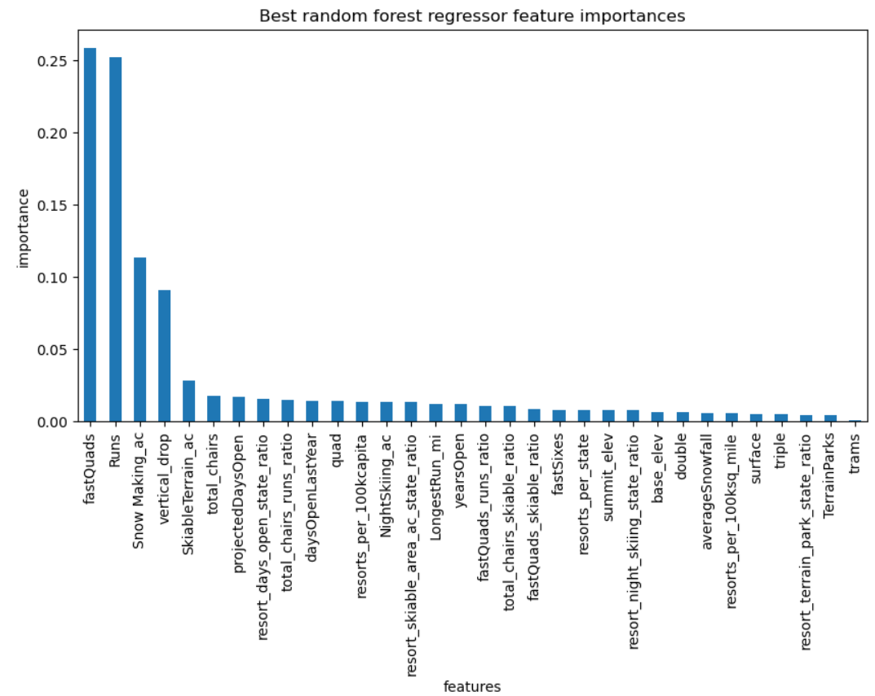
Modeling Results
Most Important features
fastQuads
Runs
Snow Making_ac
vertical_drop

Slide 7
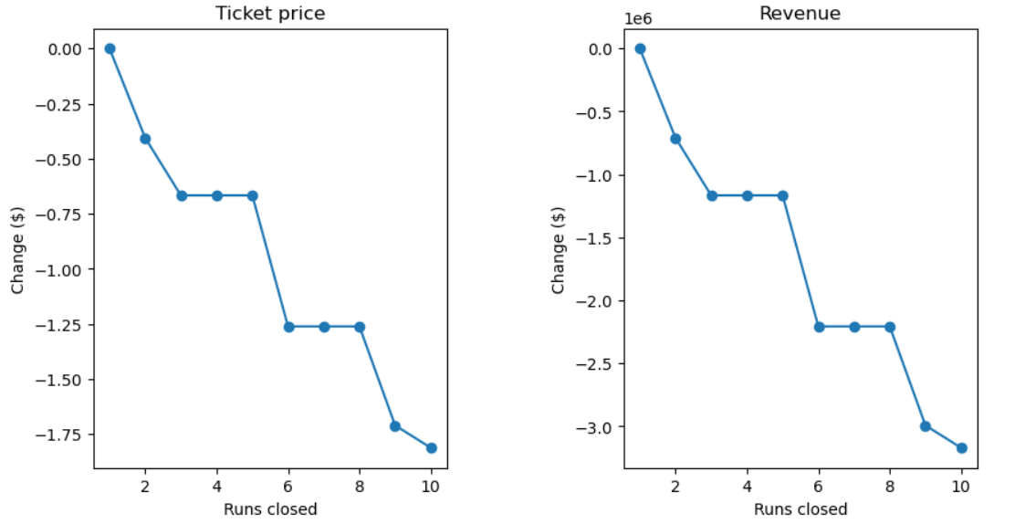
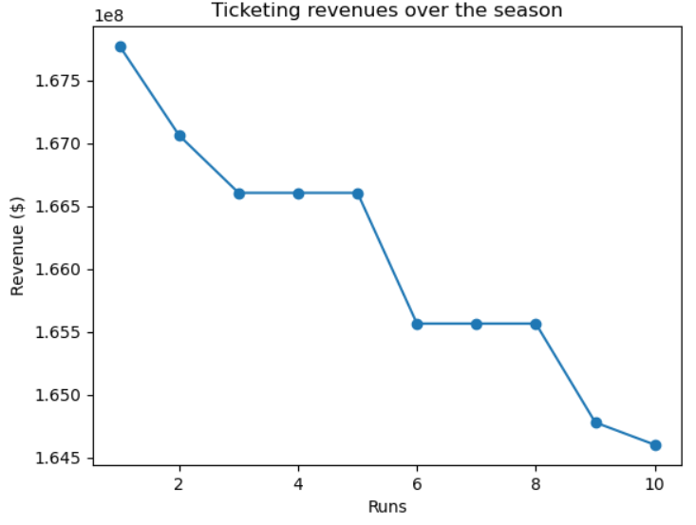
Modeling Results
Other Modeling Scenarios
Scenario 1 : Closing up to 10 of the least used runs.

Slide 8

Modeling Results
Other Modeling Scenarios
Scenario 3 : Adding a run, increasing the vertical drop by 150 feet, installing an additional chairlift, adding 2 acres of artificial snow
Impact
Similar results to the winning scenario,
No difference with the small increase in the snow-making area.
Operating costs increase

Slide 9
Modeling Results
Other Modeling Scenarios
Scenario 4 : Increasing the longest run by 0.2 miles and adding 4 acres of snow-making capability
Impact
Null predicted increase,
Operating costs increase

Slide 10
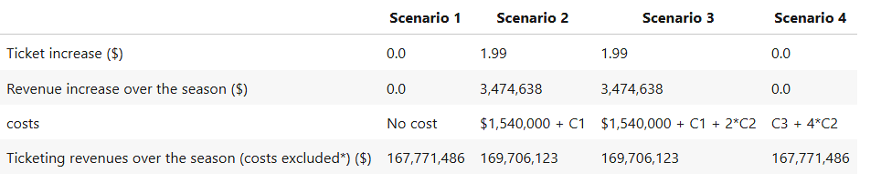
Modeling Results
Scenarios Comparison
For the first scenario, 1 run is closed
The predicted ticket price is the new price for Big Mountain which is $95.87.
The additional operating cost of the new chairlift per ticket is $0.88
C1: The cost of increasing the vertical drop by 150 feet
C2: Snow-making cost for 1 acre
C3: the cost of increasing the longest run
*We only include the cost of the chairlift which is estimated to be $1,540,000

Slide 11
Suggestions
Scenario 1 could be considered
If C1 > $1,934,637, close one run.
If C1 >>> $1,934,637 and C4 is high
Close a second run and test
Then close 3 runs and test
Then close 3 other runs and test
If C4 > $177,536, close the last two runs
C1: The cost of increasing the vertical drop by 150 feet
C4: The cost of operating one run

Slide 12
Conclusion
Model prediction suggests Big Mountain resort is undercharging
Missing useful data
The cost of increasing the vertical drop by 100 feet,
Snow-making cost per acre,
The cost of increasing the longest run,
The costs of operating a run

