Slide 1

DEPARTMENT OF ARTIFICIAL INTELLIGENCE & MACHINE LEARNING
SCHOOL OF COMPUTING
10214AM701 MAJOR PROJECT
(In-house)
INITIAL REVIEW
“ PrepSense: An AI-Powered Adaptive Interview Intelligence Platform”
SUPERVISED BY
PRESENTED BY
Dr. S. Alex David ,
1.ASHWIN KUMAR N ( VTU26113 ) ( 23UEAM0004 )
2.SABREEN ANJUM B ( VTU24729 )( 23UEAM0052 )

Slide 2
PROJECT TITLE JUSTIFICATION
The title “PrepSense: An AI-Powered Adaptive Interview Intelligence Platform” accurately represents the main purpose and capabilities of the proposed system.
PrepSense represents the platform’s goal of helping students, freshers, and job seekers prepare effectively for interviews.
AI-Powered highlights the use of Artificial Intelligence and technologies such as Large Language Models, Speech-to-Text, Text-to-Speech, and computer vision.
Adaptive indicates that the interview is not static. The system analyzes the candidate’s previous responses and performance and dynamically adjusts the difficulty and type of subsequent questions.
Interview Intelligence Platform reflects that the system goes beyond conducting mock interviews by analyzing technical knowledge, communication, speaking pace, confidence, facial expressions, and overall performance, followed by a detailed personalized report.

Slide 3
OBJECTIVE & SCOPE OF THE PROJECT
OBJECTIVE
To develop an AI-powered adaptive interview platform that simulates real-world interviews.
To analyze candidates’ technical knowledge and communication skills.
To provide personalized performance reports and recommendations for improvement.
SCOPE
Adaptive Interview Flow: The system continuously analyzes candidate performance and adjusts the next question and difficulty level accordingly.
AI-Based Conversational Interaction: The platform supports natural interview interaction using Speech-to-Text and Text-to-Speech, creating a more realistic interview experience.
Contextual Interview Memory: The system maintains conversation history and candidate context to make subsequent questions more relevant and personalized.

Slide 4
LITERATURE REVIEW
Key research papers reviewed — Papers 1 to 8 of 15
Research Article | Authors | Methods and Findings | Remarks and Challenges
1. A Multimodal AI Framework for Real-Time Emotion and Confidence Conflict Detection in Mock Interviews | Rai et al. IEEE Affective Computing, 2025 | Fuses facial, vocal and text cues in real time; flags mismatch between what a candidate says and the confidence actually shown. | Compute-heavy; sensitive to lighting and mic quality. Gives feedback only — no adaptive questioning.
2. Revolutionizing Interview Preparation: An AI-Driven Mock Interview System for Skill Assessment | Thawali et al. IJRASET, 2024 | End-to-end mock interview pipeline — resume parsing, question bank, NLP answer scoring and report generation. | Fixed question bank; difficulty never adapts to the candidate. No voice or facial analysis.
3. A Review on AI-Interview Simulator | Kaur et al. IJRPR, 2025 | Survey of interview simulators; proposes reinforcement-learning based question sequencing to control difficulty. | Largely conceptual; RL needs large interaction datasets and is unstable under sparse rewards.
4. A Context-Aware Generative AI Framework for Automated Mock Interview Assessment | Zhang et al. IEEE Trans. Affective Comput., 2025 | Context-aware LLM generates follow-up questions and grades answers to a rubric; context beats one-shot prompting. | Hallucination and inconsistent scoring; long interviews overflow the model context window.
5. BERT-Based Semantic Answer Evaluation for Technical Interviews | Singh et al. Intl. Journal of AI Research, 2024 | BERT embeddings with cosine similarity score answers semantically rather than by keyword matching. | Needs a reference answer per question; penalises correct but unconventional responses.
6. LLM-Based Conversational Agents for Professional Training | Ouyang et al. NeurIPS, 2023 | Instruction-tuned, RLHF-aligned LLMs sustain coherent multi-turn professional role-play dialogue. | High latency and inference cost; interviewer persona drifts over long sessions.
7. Interview Bot Development with NLP and Machine Learning | Pasaribu et al. IEEE ICDAT, 2024 | Speech input → NLP preprocessing → intent/answer classification → scored reply; a working bot is demonstrated. | Classifier-driven, so question variety is limited; accuracy drops on accented or noisy audio.
8. Automatic Interview Scoring Using Deep Neural Networks | Li & Prakash Semantic Scholar, 2023 | DNN predicts fluency, clarity and overall rating from recorded interviews; correlates well with human raters. | Black-box score with no actionable feedback; dataset bias affects fairness across accents.

Slide 5
LITERATURE REVIEW
Key research papers reviewed — Papers 9 to 15 of 15
Research Article | Authors | Methods and Findings | Remarks and Challenges
9. Real-Time Speech Recognition for Interview Transcription Using Transformer ASR | Kumar et al. JAAFR, 2025 | Whisper-family transformer ASR gives low-latency transcription with low WER on conversational speech. | Needs a GPU for true real time; degrades with background noise, cross-talk and technical jargon.
10. Stressed Speech Emotion Recognition Using Teager Energy and Spectral Feature Fusion | Bandela et al. Hindawi, 2023 | Fuses Teager-energy operator features with MFCC/spectral features to detect stress; fusion beats single feature sets. | Trained on acted stress corpora; generalisation to spontaneous interview speech is unproven.
11. Speech Emotion Recognition: A Systematic Review (2014–2023) | Khare et al. Information Fusion, Elsevier, 2024 | Systematic review of SER features, datasets and models; multimodal fusion consistently outperforms audio-only. | Datasets are small, acted and language-biased; cross-corpus accuracy drops sharply.
12. Deep Learning-Based Real-Time Sequential Facial Expression Analysis Using Geometric Features | Köksal & Gumus arXiv / IEEE, 2024 | Uses sequential geometric landmark features (distances, angles) instead of raw pixels — lightweight and real time. | Sensitive to head pose, occlusion (spectacles, hands) and poor webcam lighting.
13. A Comprehensive Survey and Evaluation of MediaPipe Face Mesh for Human Emotion Recognition | IEEE Survey IEEE Conf. Publication, 2024 | Benchmarks MediaPipe FaceMesh (468 landmarks) for emotion recognition at video frame rate on CPU alone. | Landmark accuracy falls at extreme angles; subtle expressions such as mild nervousness stay hard to classify.
14. Facial Expression Recognition for Real-Time Student Progress Tracking via Deep Learning | Aly M. Multimedia Tools & Appl., Springer, 2024 | CNN-based FER tracks learner engagement in real time and links facial expression to measured performance. | Raises privacy and consent concerns; expression is only an indirect proxy for engagement.
15. Adaptive-RAG: Learning to Adapt Retrieval-Augmented LLMs through Question Complexity | Jeong et al. NAACL, 2024 | A classifier routes each query to no-retrieval, single-step or multi-step RAG by complexity, balancing accuracy and cost. | Requires labelled complexity data; misrouting either wastes compute or loses accuracy.

Slide 6
SUMMARY OF FINDINGS & GAPS IDENTIFIED
Summary of Findings
Gaps Identified
• LLMs can conduct coherent, context-aware interview dialogue and grade answers against a rubric.
• Semantic scoring with transformer embeddings evaluates answers far better than keyword matching.
• Transformer ASR such as Whisper makes real-time, low-error interview transcription practical.
• Voice stress and prosody features are reliable indicators of candidate confidence.
• MediaPipe and DeepFace enable CPU-capable, real-time facial engagement analysis from an ordinary webcam.
• Multimodal fusion of text, voice and face consistently outperforms any single modality.
• Complexity-aware routing balances answer quality against compute cost.
• Question difficulty is drawn from fixed banks — it does not adapt to the candidate's live performance.
• Most systems analyse a single modality; text, voice and face are rarely fused into one interview score.
• No conversational memory — follow-up questions ignore earlier answers and the candidate's resume.
• Output is usually a single opaque score, not actionable, personalised improvement guidance.
• Complexity-aware retrieval has not yet been applied to interview question generation.
PrepSense addresses all five gaps: an adaptive multi-agent interviewer that fuses text, voice and facial analysis, remembers the whole conversation, and returns a personalised improvement report.

Slide 7
TOOLS TO BE USED IN THE PROJECT
Frontend: Next.js, React, TypeScript, Tailwind CSS
Backend: FastAPI (Python), PostgreSQL, Prisma ORM
AI/LLM: Qwen3 8B, Gemini API, LangChain
Speech Processing: Faster-Whisper, Kokoro TTS
Computer Vision: MediaPipe, DeepFace
RAG & Memory: FAISS
Deployment: Docker, Vercel, GPU Server

Slide 8
SOCIETAL IMPORTANCE OF THE PROJECT
Improves Employability: Helps students, freshers, and job seekers improve their interview skills and become better prepared for employment opportunities.
Provides Accessible Interview Practice: Offers a personalized AI-based interview experience that can help candidates practice without depending entirely on human interviewers.
Promotes Continuous Skill Improvement: Identifies candidates’ strengths and weaknesses and provides personalized recommendations to improve their technical and communication skills.

Slide 9
PROPOSED SOLUTION / METHODOLOGY
A multi-agent AI pipeline in which eight specialised agents run one adaptive interview loop.
1
Resume & Role Intake
2
Interview Planning
3
Question Generation
4
Answer Capture
Resume Agent extracts skills, projects and experience from the uploaded CV; the candidate selects a target job role.
Planner Agent builds the interview strategy — topic coverage and the starting difficulty level.
Interviewer Agent (Qwen3 8B / Gemini) generates a role-specific question; Kokoro TTS speaks it aloud.
Candidate replies through microphone and webcam; Faster-Whisper converts speech to text in real time.
5
Multimodal Analysis
6
Evaluation & Memory
7
Adaptive Loop
8
Report Generation
Voice Agent measures pace, fillers and confidence; Emotion Agent reads eye contact and facial expression.
Evaluator Agent scores technical depth and communication; Memory Agent stores context in FAISS.
Planner Agent uses that score to set the next question's topic and difficulty — steps 3 to 6 then repeat.
Report Agent compiles strengths, weaknesses, analytics and personalised recommendations.
↺ Steps 3 to 6 repeat for every question — each answer changes the one that follows

Slide 10
JUSTIFICATION OF THE CHOSEN SOLUTION
Multi-agent design, not one giant prompt
Qwen3 8B locally, Gemini in the cloud
1
Each agent is independently testable, replaceable and debuggable — far more reliable than a single monolithic LLM call.
2
Local Ollama inference means zero API cost and full data privacy while developing; Gemini provides scale at deployment.
Faster-Whisper for speech-to-text
MediaPipe and DeepFace for vision
3
Roughly 4× faster than baseline Whisper at comparable accuracy — the only way to keep the interview conversational.
4
Both run on CPU with an ordinary webcam, so the candidate needs no specialised hardware.
LangChain and FAISS for memory
Complexity-aware adaptive logic
5
Gives the interviewer genuine conversational memory, so follow-up questions build on earlier answers — closing gap 3.
6
Adaptive-RAG style routing sets question difficulty from live performance — closing gaps 1 and 5.
Outcome: a realistic, adaptive interview with measurable, explainable feedback — not a static question bank.

Slide 11
EXPECTED OUTCOMES OF THE PROJECT
Tangible Results:
Development of a functional AI-powered adaptive interview platform.
Generation of personalized interview questions and performance reports based on candidate responses.
Implementation of technical, communication, voice, and facial analysis for comprehensive interview evaluation.
Impact / Benefits:
Helps students, freshers, and job seekers improve interview preparedness and employability.
Provides personalized feedback by identifying strengths, weaknesses, and areas for improvement.
Provides a realistic and adaptive interview experience that bridges the gap between conventional mock interviews and real-world recruitment.

Slide 12
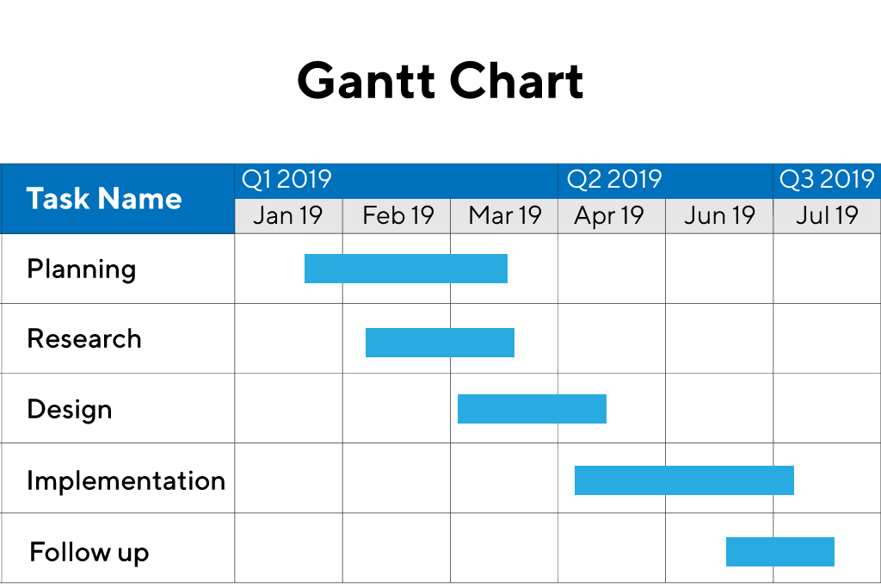
TIMELINE OF THE PROJECT
Task
AUG 2026
SEP 2026
OCT 2026
NOV 2026
DEC 2026
Literature Survey & Requirement Analysis
System Design & Architecture Finalisation
Frontend, Backend & Database Setup
LLM Agents — Planner, Interviewer, Resume
Speech Module — Faster-Whisper & Kokoro TTS
Vision Module — MediaPipe & DeepFace
Memory, RAG & Adaptive Difficulty Logic
Evaluator & Report Agent
Integration, Testing & Optimisation
Deployment, Documentation & Final Review
Planning & Design
Core Development
Integration & Delivery
Milestones: R0 Initial Review – Aug • R1 – Oct • R2 – Nov • Final – Dec 2026

Slide 13



THANK YOU

