Slide 1
Pattern Recognition
Presented By
Sabrina Yesmin
ID: 1703310201411
Presented To
Dr. Kaushik Deb
Dept. of Computer Science & Engineering,
Chittagong University of Engineering & Technology

Slide 2
Title
Alphanumeric character recognition using Ncc ( Normalize cross correlation ) or Template Matching.

Slide 3
Alphanumeric characters are those in layouts meant for English language users that are made up of the combined set of the 26 alphabetic characters, A to Z, and the 10 Arabic characters, 0 to 9.
In this slide, I am talking about A to Z characters.

Slide 4

Goal
(a) Candidate
(b) Template
(c) Outline
Figure: Processing example of alphanumeric character recognition.

Slide 5
Goal
In figure (a) , first I choose a Letter A which is called candidate.
Then I choose Template where’s my all character’s are presents shown in figure (b).
Then in figure (c) we can see that candidate A with matched with template A.

Slide 6
Motivation
To learn a method which is recognize numeric characters.
To Recognize alphabets by using normalize cross correlation.
To learn how to match a character from a dataset.

Slide 7
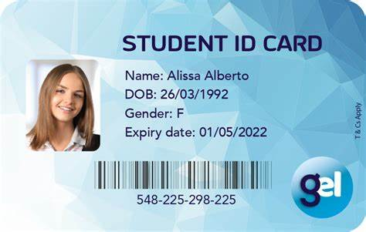
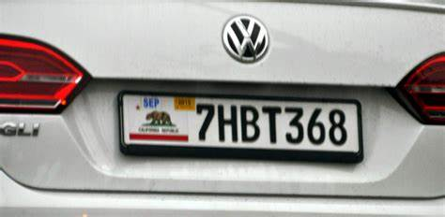
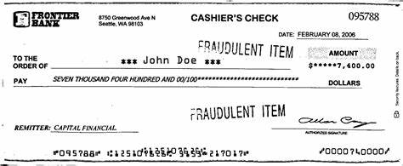
Applications
NID card
License Plate
Bank Check
Figure: Examples of Character recognition applications.

Slide 8
Challenges
Uneven Size.
Real time recognition.
Geomatrical Distortion.

Slide 9
Propose Framework
Character recognition
Segmented plate characters
Normalizing by size
Candidate and template characters
A
Candidate alphanumeric characters
Measuring the similarity by NCC
A B C D E F G H I J K L M N O P Q R S T U V W X Y Z
Templates
Best matches{ NCC res }
Recognition results
The Proposed Character recognition scheme

Slide 10
Processing Example
First I read candidate and template file.
Then I show the figure of both candidate and template.
Then we convert rgb to gray by using rgb2gray function in matlab.
Then we convert gray to binary.
Then use ncc I find the template match with the candidate.
In array i sort the value of ncc and find the maximum value of matched characters.

Slide 11
Conclusion
In this project by using ncc we recognize alphanumeric characters.
NCC’s Merit
Simple and easy to implement.
NCC’s Demerit
Take long computation time

Slide 12
Reference
https://images.search.yahoo.com/search/images

Slide 13
Thank You

