Slide 1
Spotify Playlists with Moosic

Slide 2
Drop Dimensions
Key = of little meaningfulness
Loudness = Loudness does not say much about the music. It is more about the production.
Mode = Same as key
Liveness = Not important if a song is performed live or not
Tempo = Tempo also depends on how a song is counted. Can be misleading
Type = Not available
Duration = Any song can have any length
Time signature = Good for distinguishing classical from modern music. Most modern music is in 4/4
HTML = No use here
Keep: danceability, energy, speechiness, acousticness, valance, instrumentalness

Slide 3
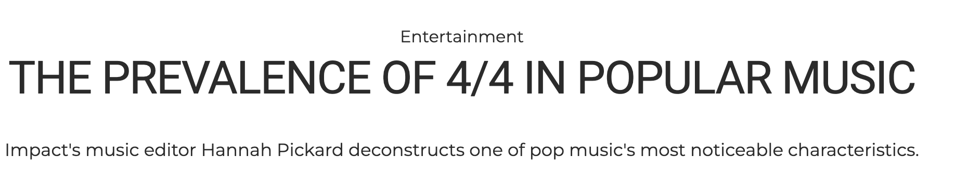
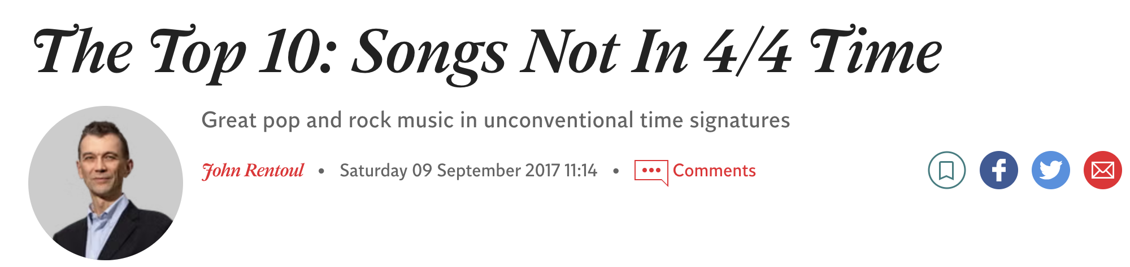

Slide 4
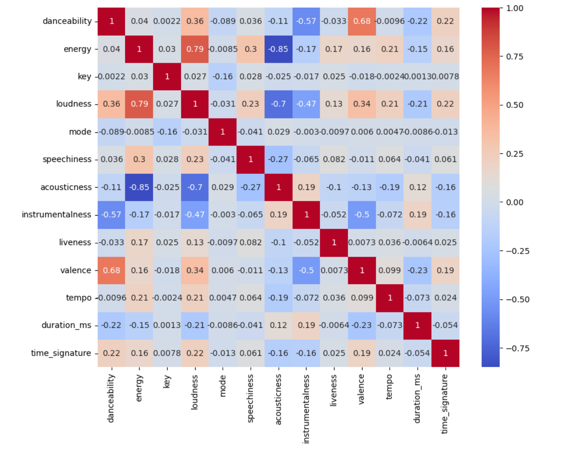
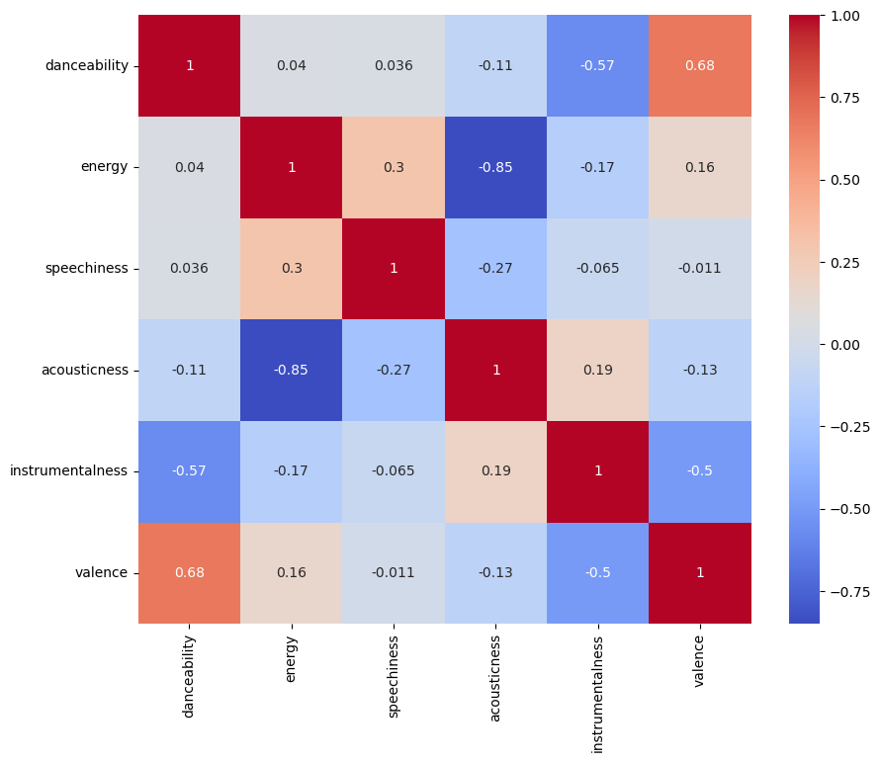
Dimensions

Slide 5
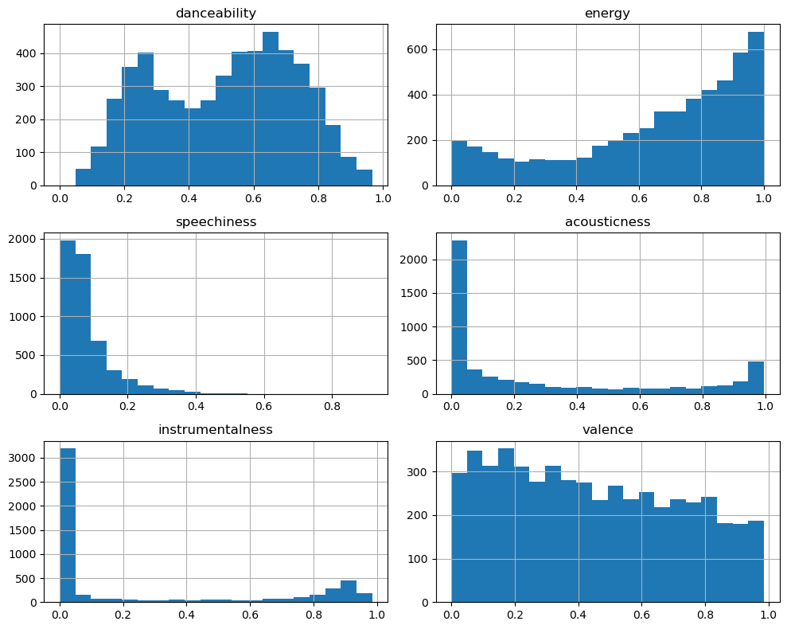
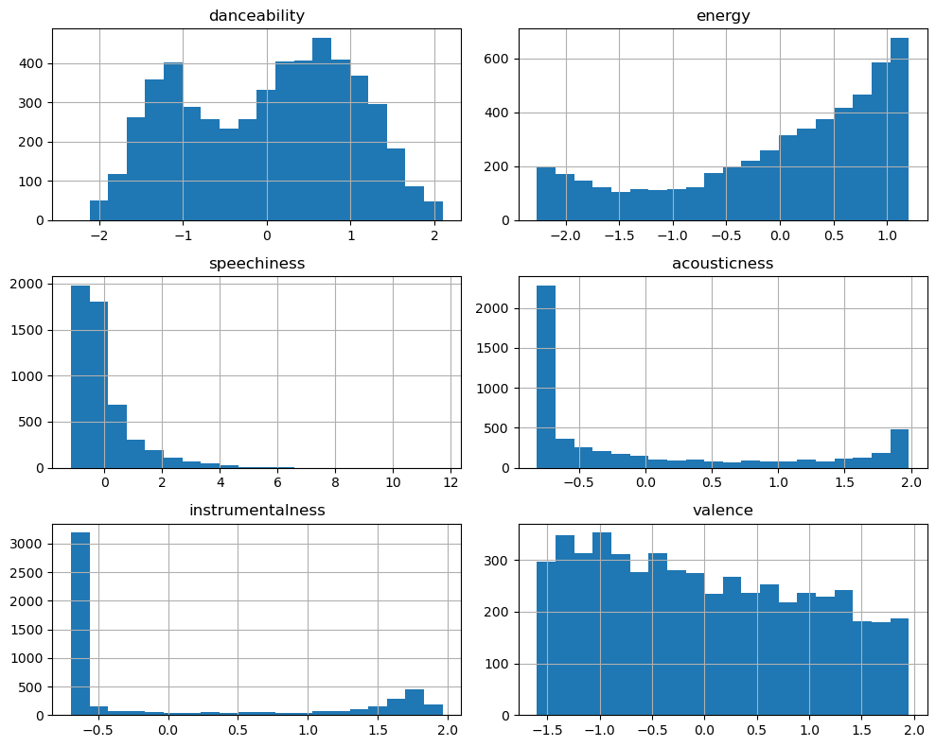
Scaler → StandardScaler
Before scaling
After scaling
To compensate for the slight difference in magnitude
To center the mean around 0
Reduces the variance

Slide 6
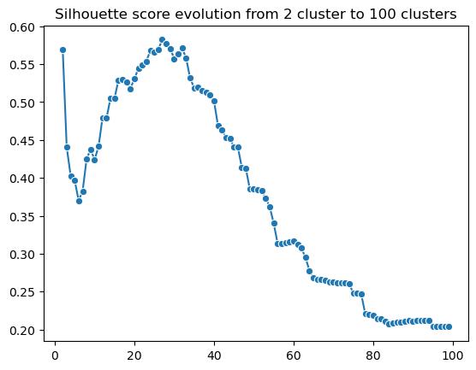
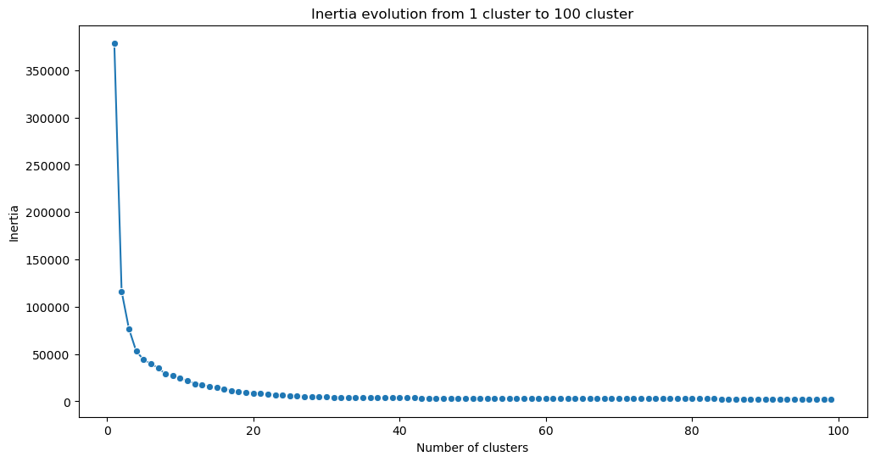
Number of Clusters Pt. I
k = 27
k = 5

Slide 7
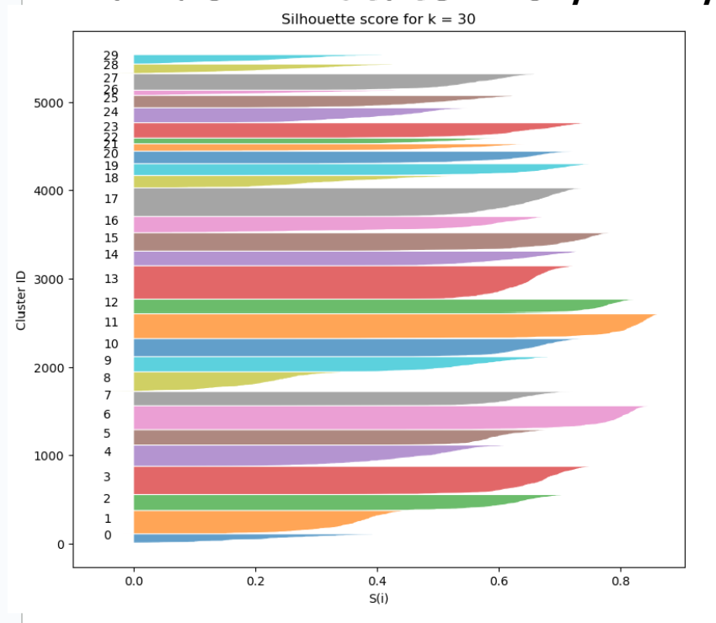
Number of Clusters Pt. II
Target: keep the size of all the playlists
between 50 and 250 → k = 30

Slide 8
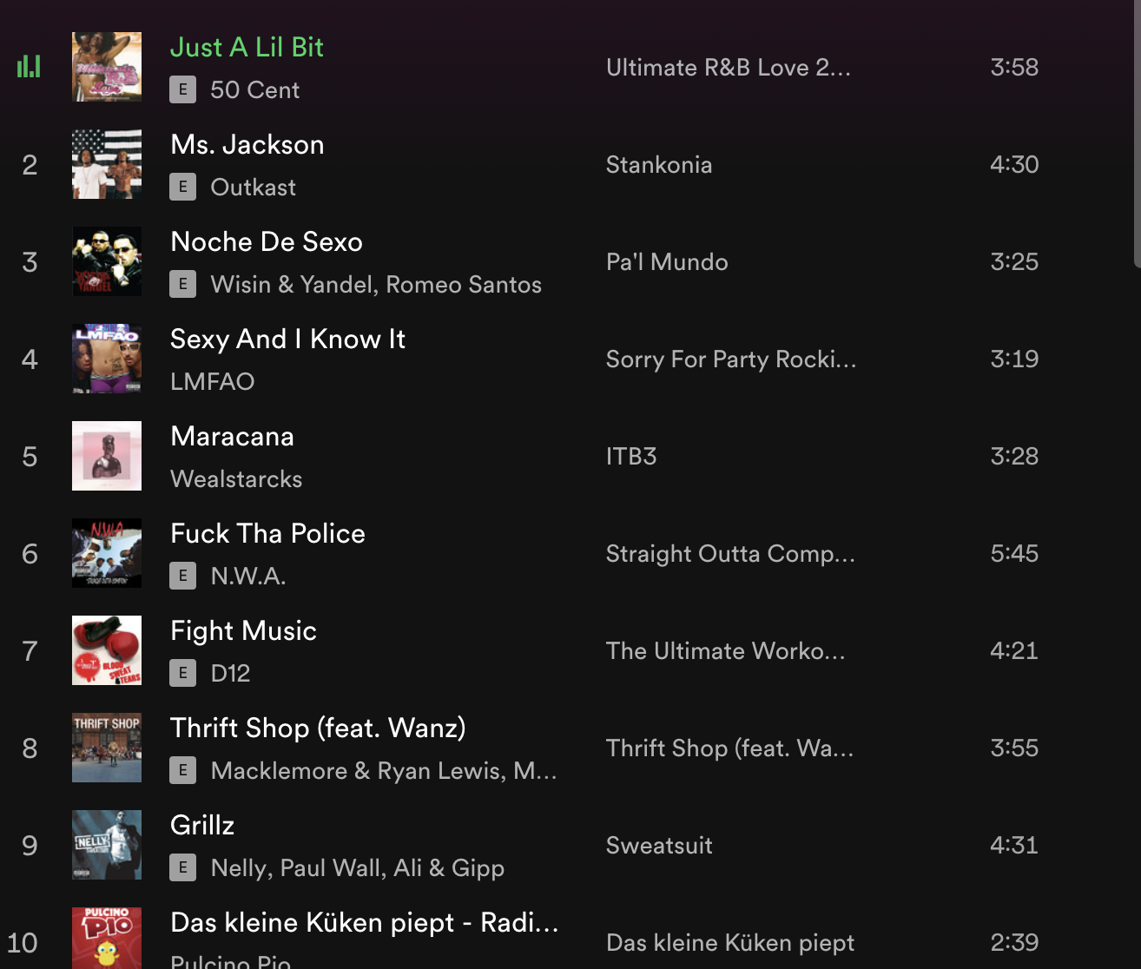
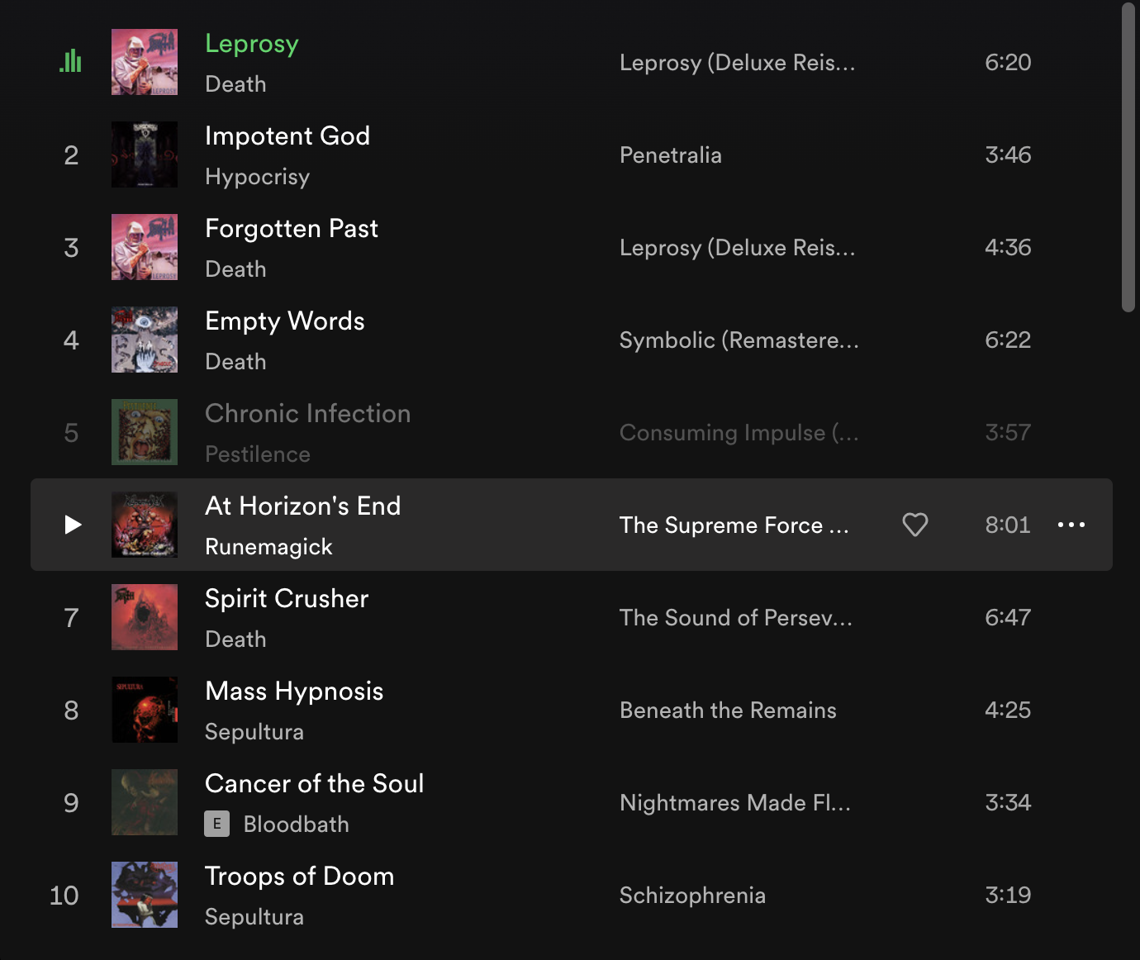
Mood-Clusters
Hip Hop
Metal

Slide 9
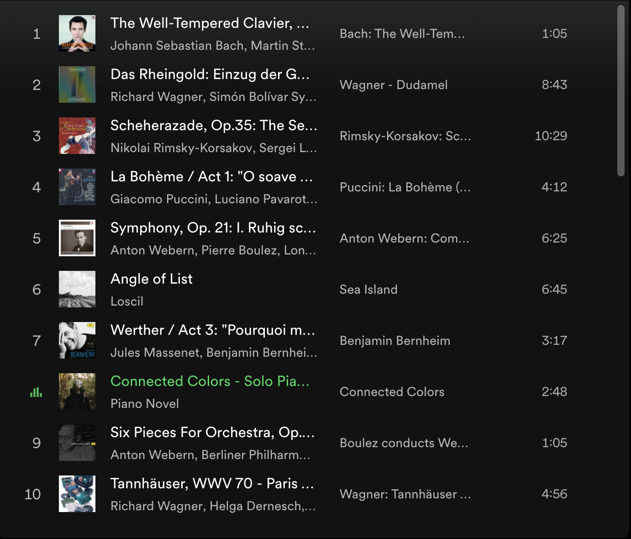
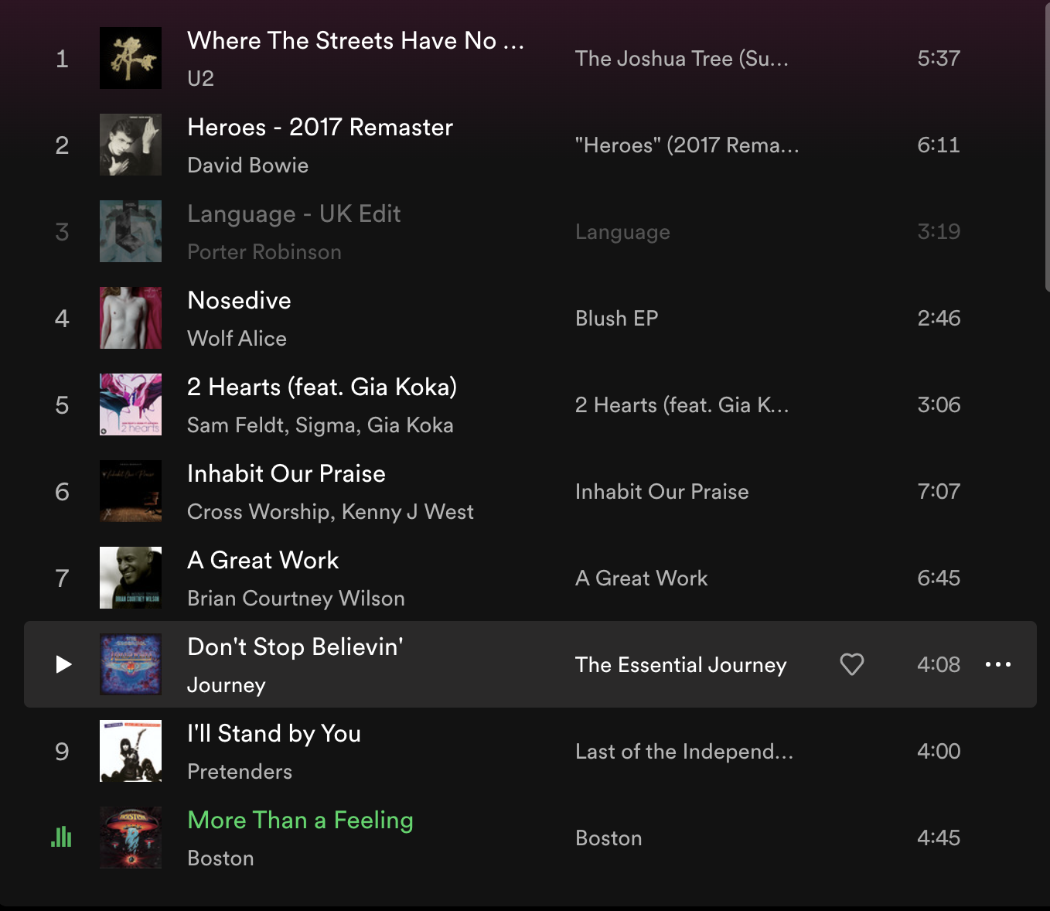
Mood-Clusters
Piano and Ambient
Classic Rock

Slide 10
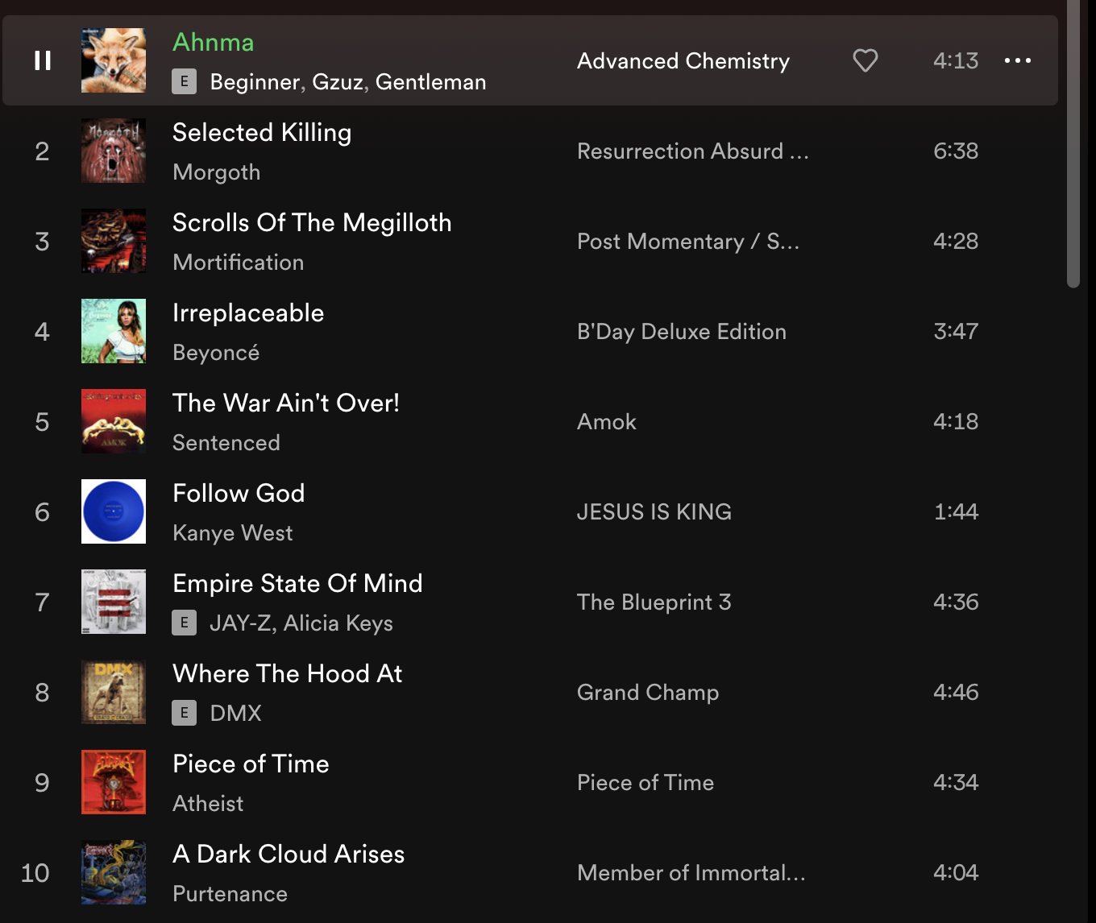
Mood-Clusters
Hip Hop
Metal and Hip Hop

Slide 11
Conclusion
Are Spotify’s audio features able to identify “similar songs”, as defined by humanly detectable criteria?
YES!
Is K-Means a good method to create playlists? Would you stick with this algorithm moving forward, or explore other methods to create playlists?
YES!

Slide 12
random_state = 0 / 21 / 42
0:
inertia: k = 8 or 9
shilouette: k = 4
21:
inertia: k = 4 or 5
shilouette: 27
knife graph for k=30 looks much better
42:
inertia: k = 5 or 6
shilouette: 27
knife graph without negative values

