Slide 1


Department of
Mathematics, Informatics
and Geosciences
AI & MV Business Unit
Bachelor's Degree in Artificial Intelligence and Data Analytics
Cross-View Association of Identical Parts Across Non-Overlapping 3D Scans: Identifiability, Shift Ambiguity and Evaluation
Candidate
Sabrina Ciccolo
Supervisor
Prof. Alejandro Rodriguez Garcia
Academic Year 2025/2026

Slide 2
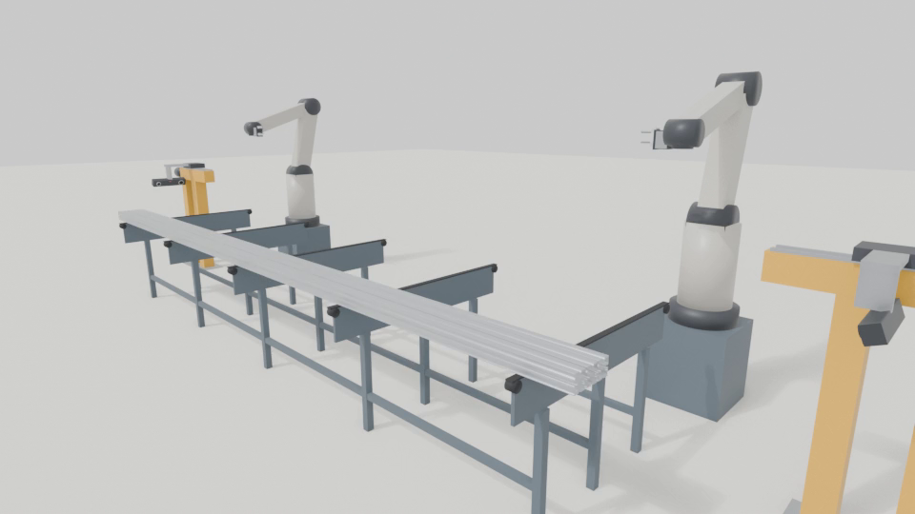
The rig
2

Slide 3
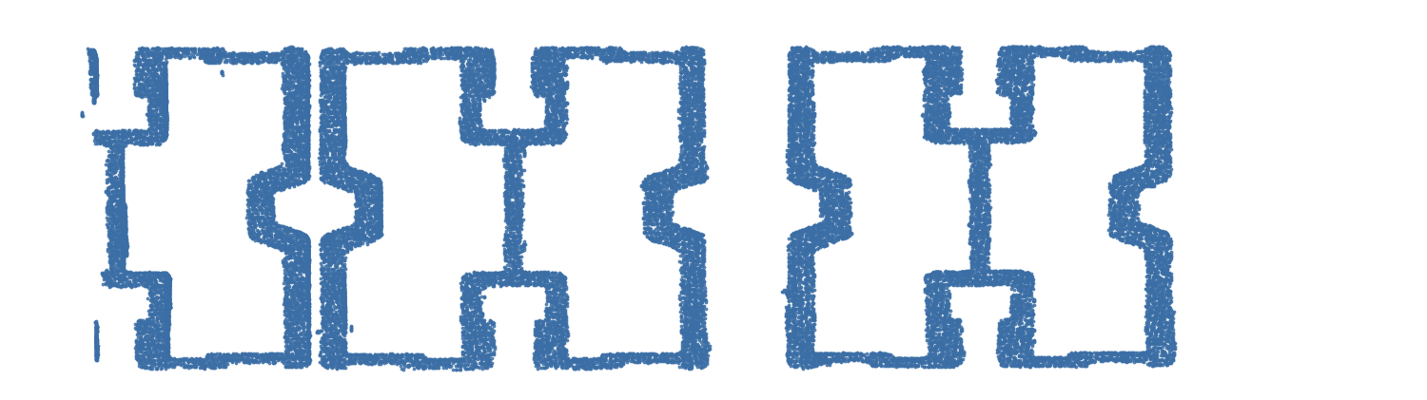
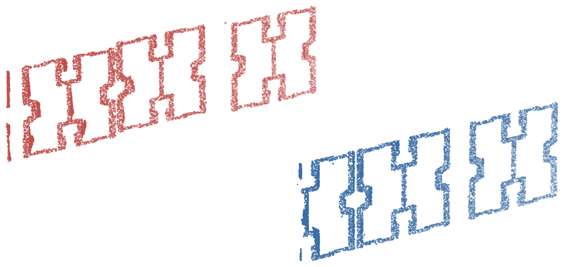
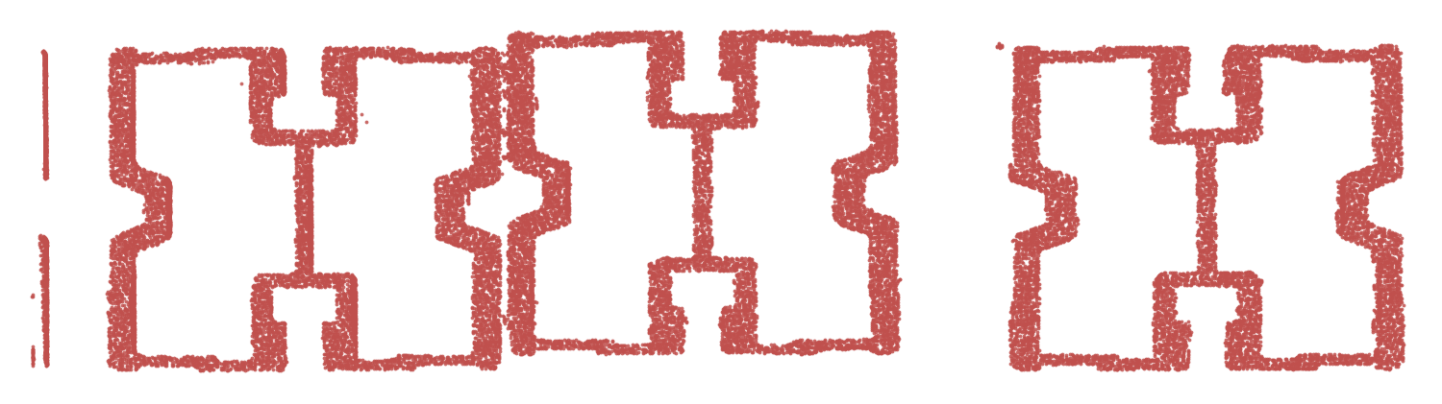
What the scanners see
Point clouds
2D projections
scanner 1
scanner 2
3

Slide 4
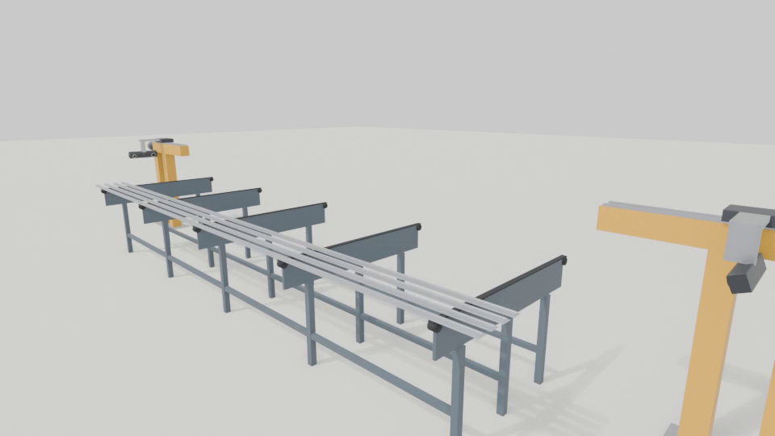
The problem
4

Slide 5
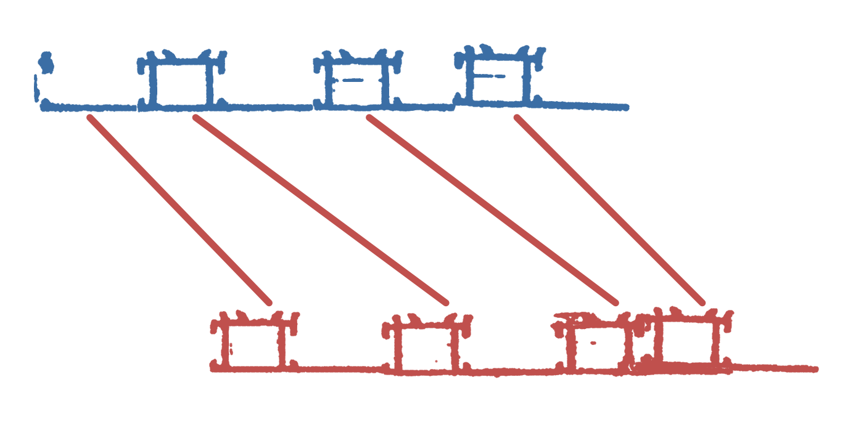
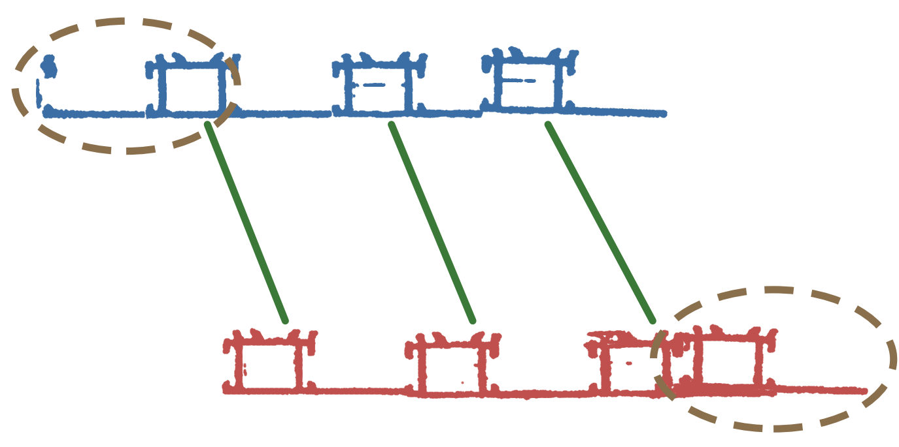
The shift
Pairing by order
Correct pairing
Two faces are left unpaired
5

Slide 6
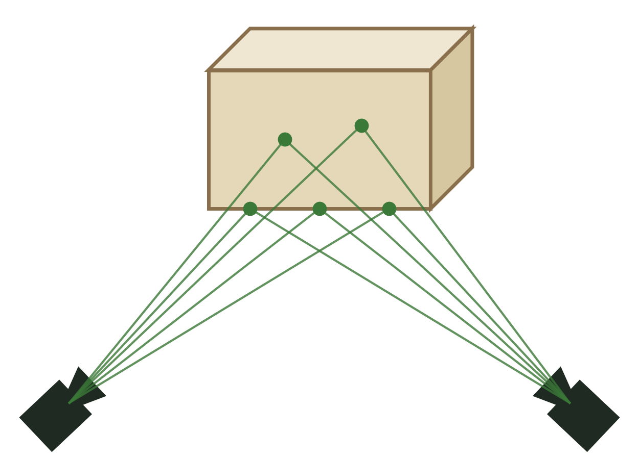
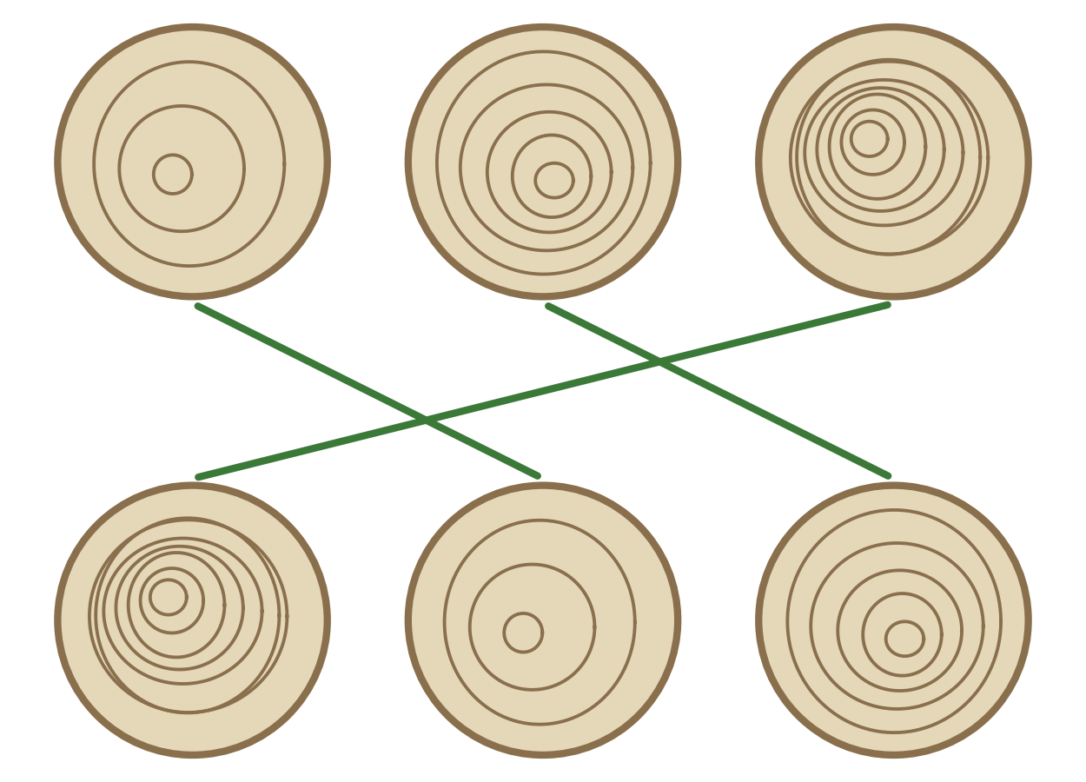
State of the art
Geometry
Appearance
The views see the same surface
The objects look different
6

Slide 7
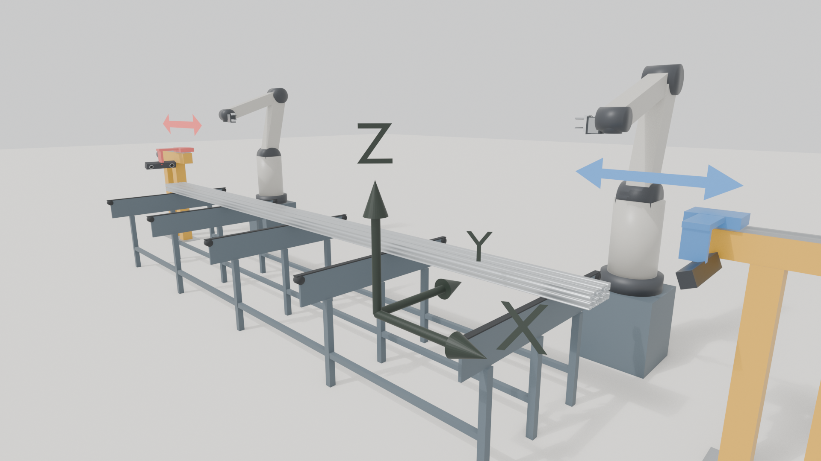
The reference frame
X along the bars: 4.9 m instead of 6
Y along the belt: estimated per scene
Z vertical: constant
Median error below 1 mm
The distance between the carriages can be recovered, the absolute position cannot
7

Slide 8

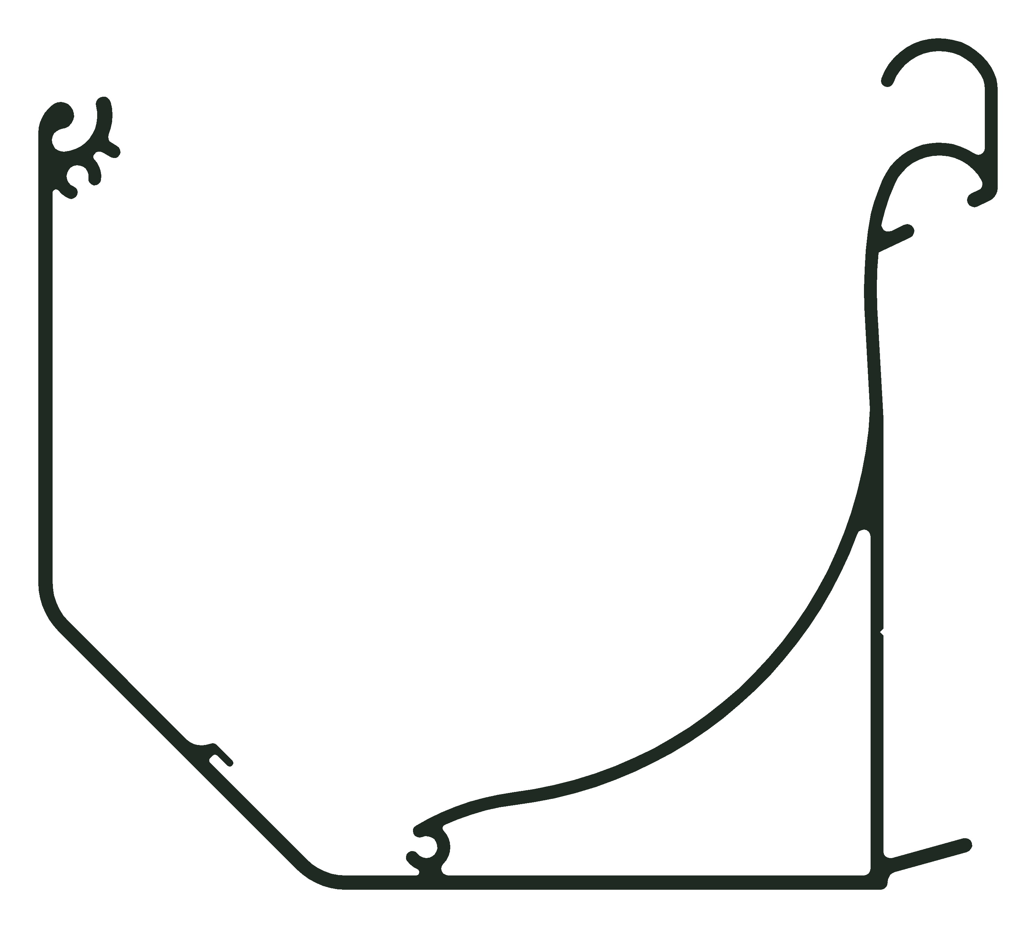
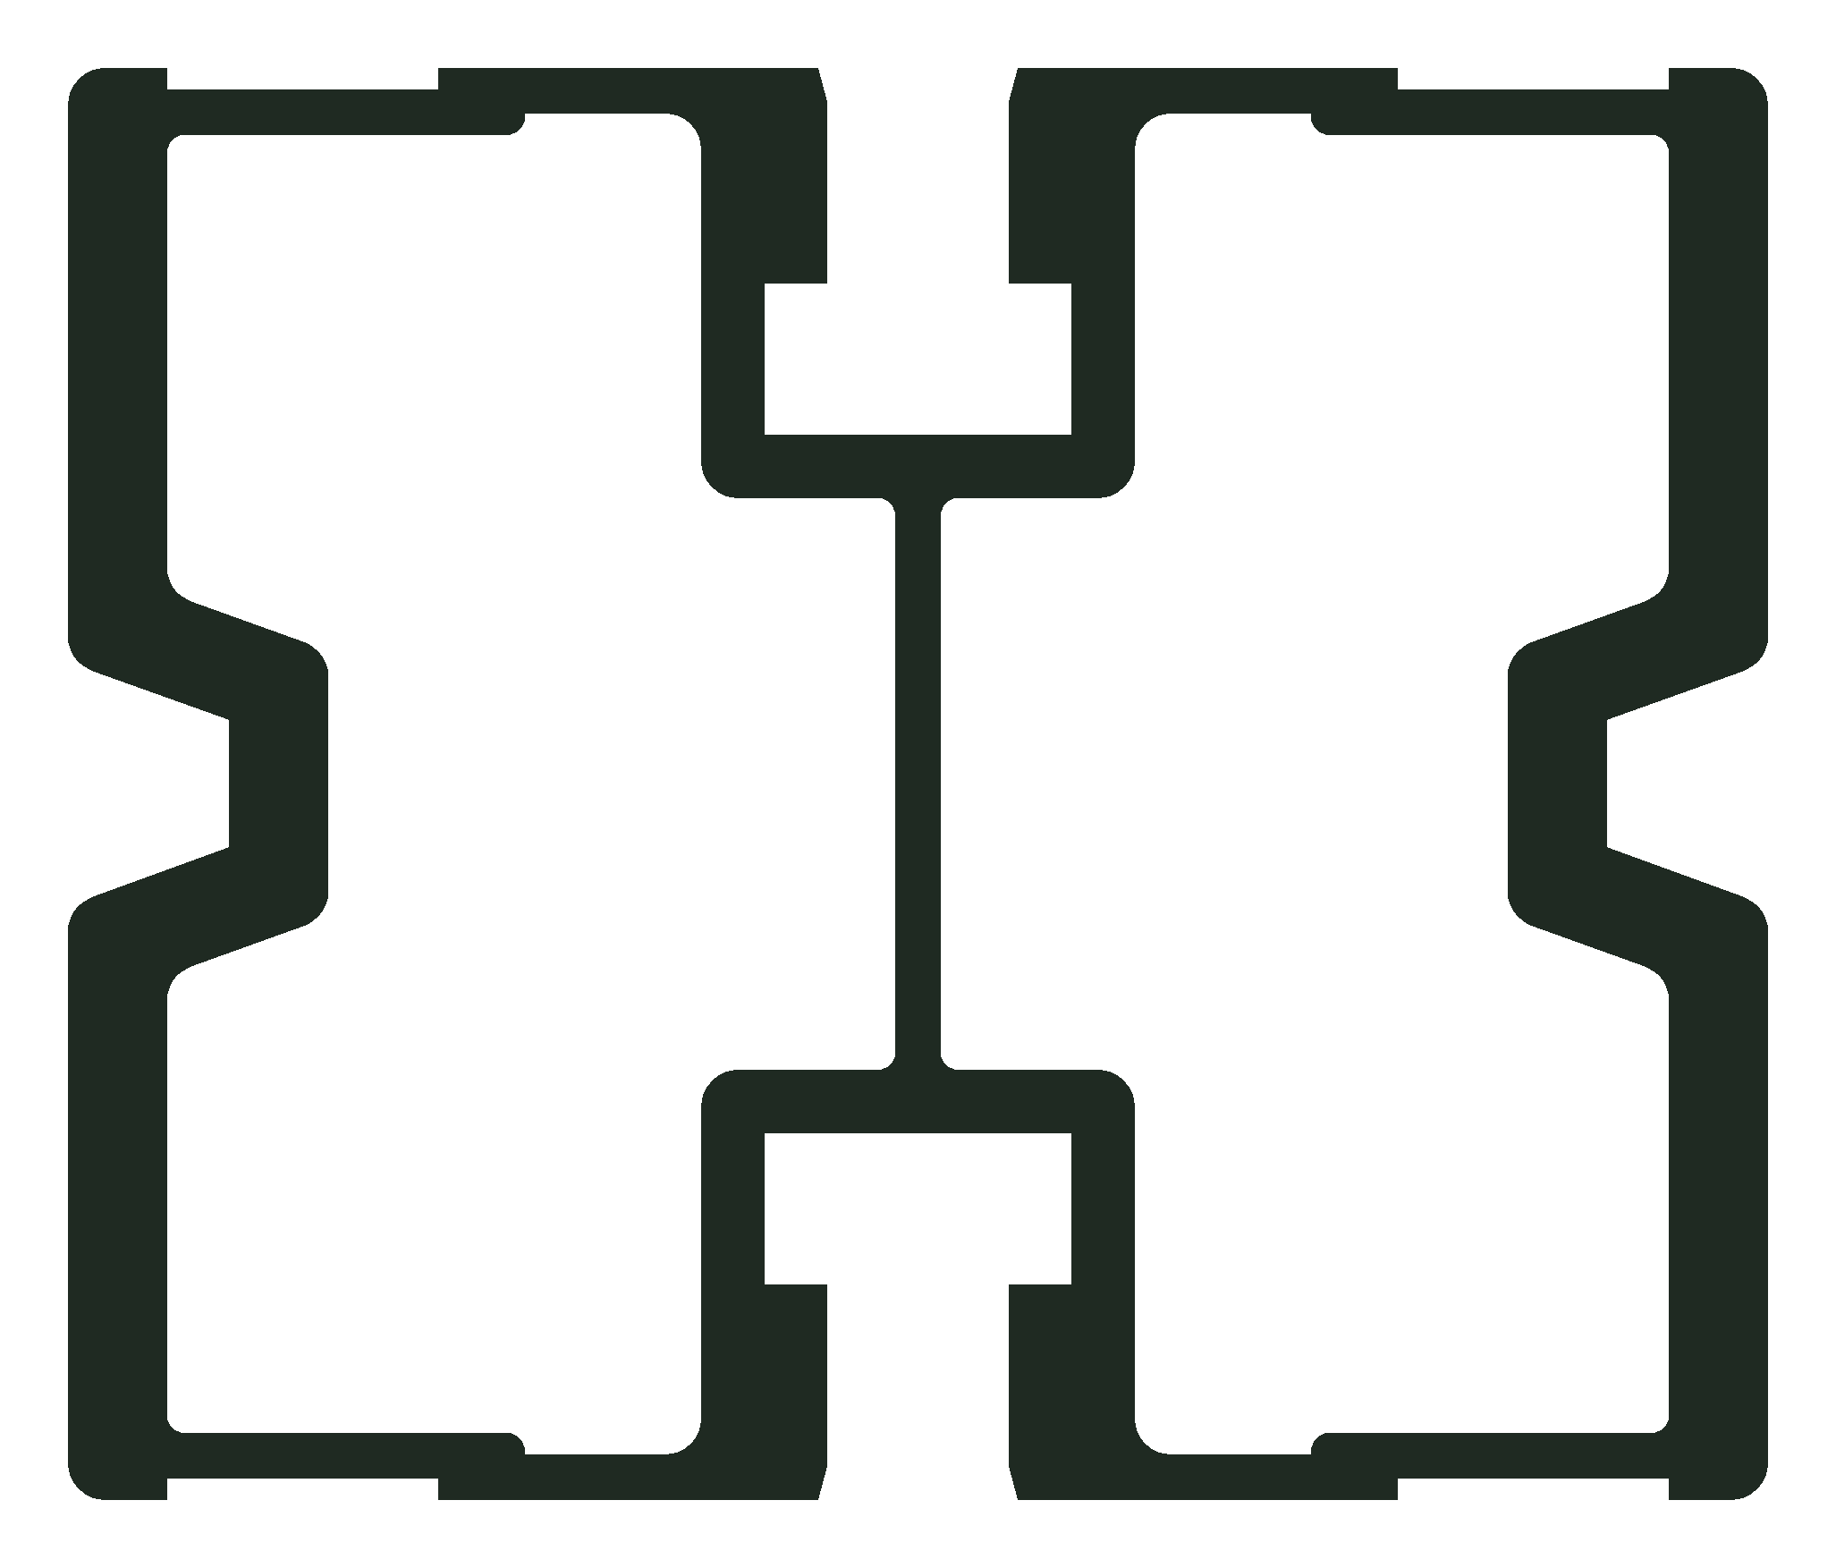
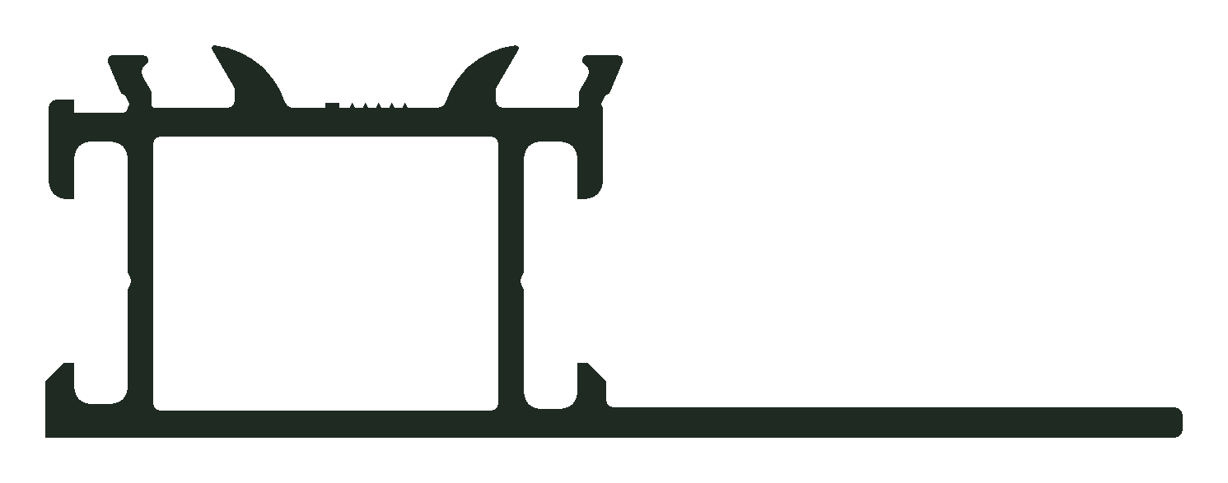
The bar profiles
L profile
square profile
heavy profile
complex profile
8

Slide 9
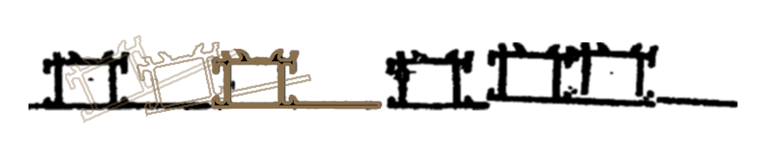
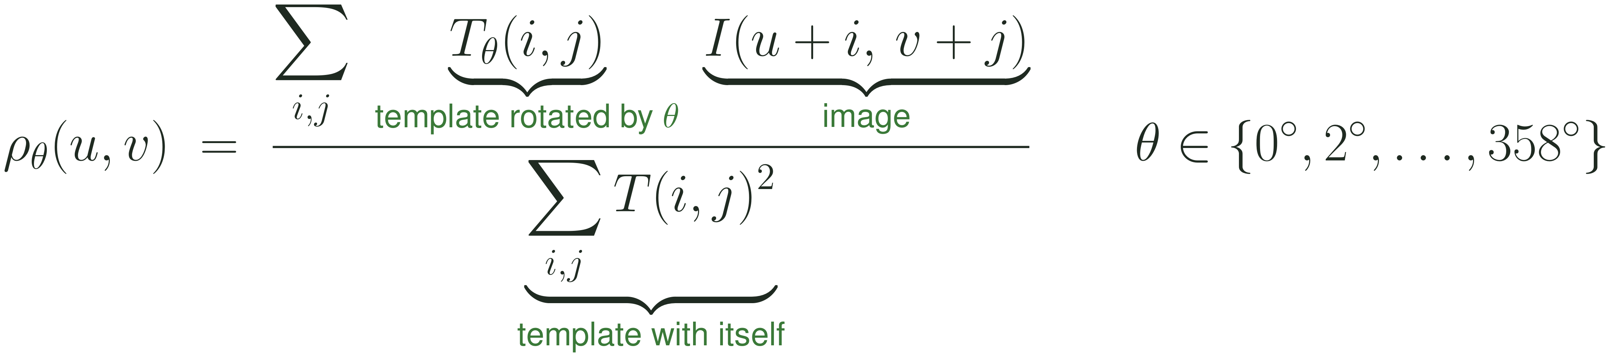
Finding the faces
9

Slide 10
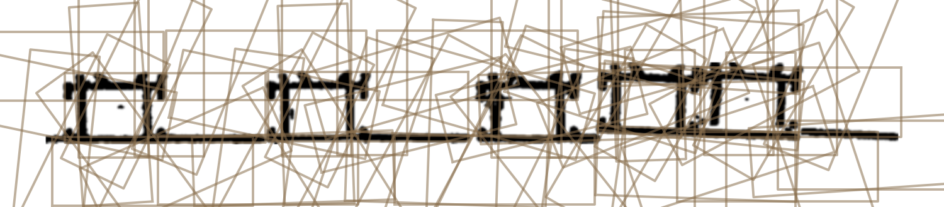
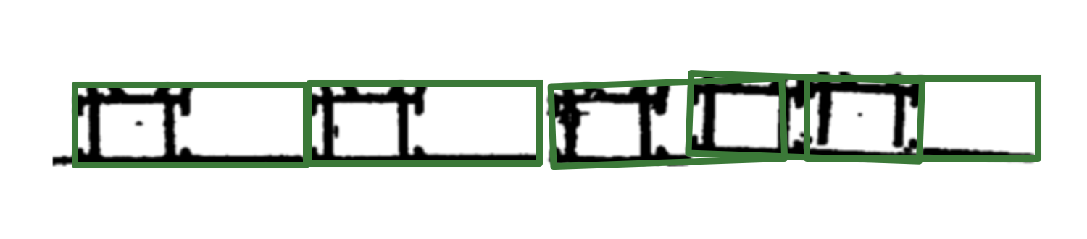
Selecting the faces
Candidates
Selected faces
10

Slide 11
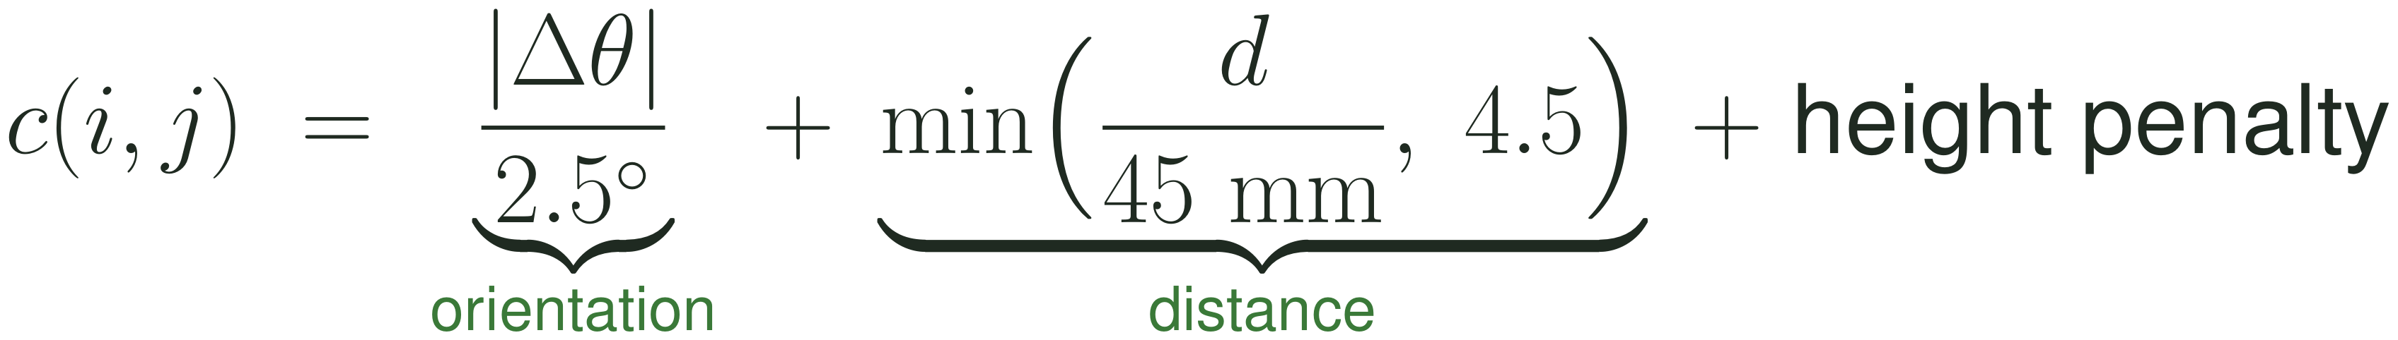
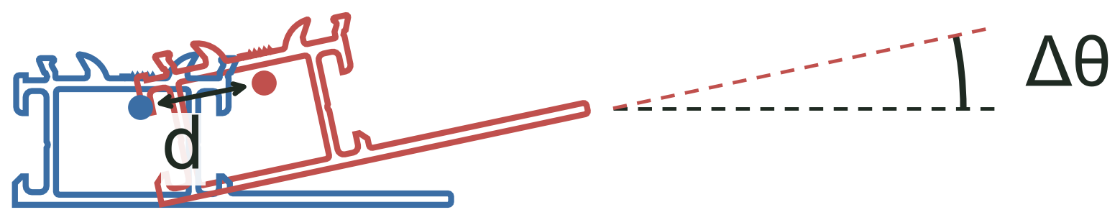
The cost function
●● Centroids of the two faces
Δθ orientation difference
d distance between the centroids after realignment
Height penalty: faces at different heights
11

Slide 12
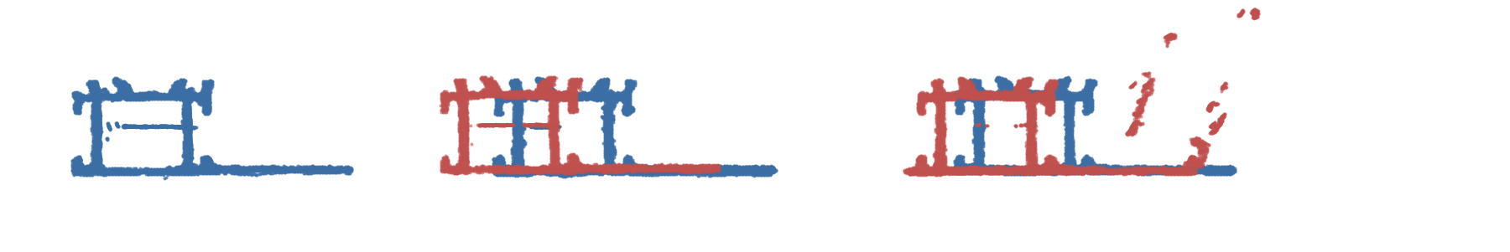
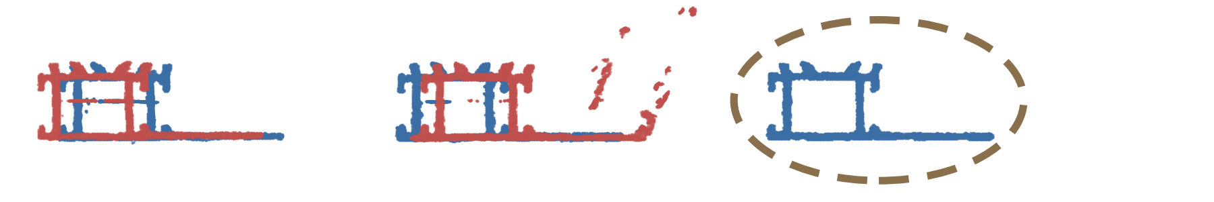
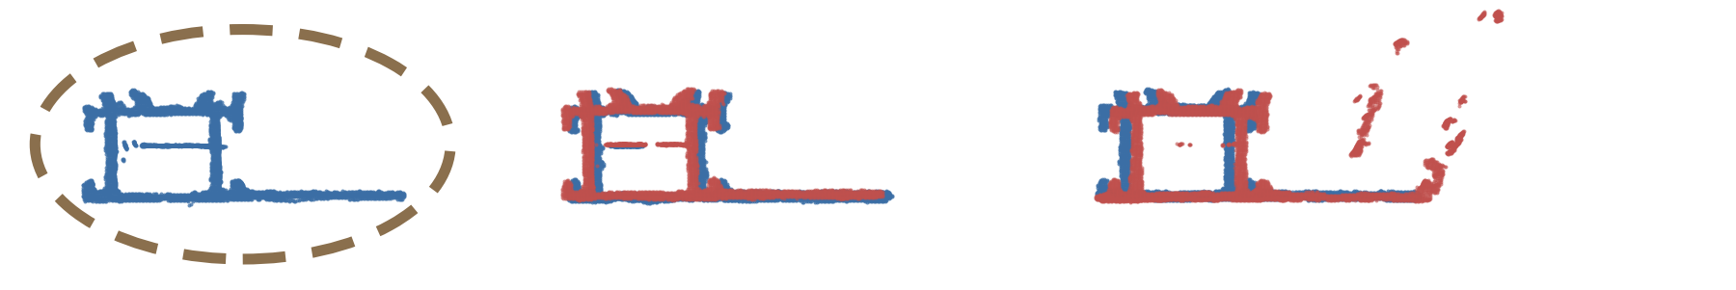
Shift ambiguity
The two views do not see the same bars
As they arrive
True pairing
1 unpaired face
Shift
1 unpaired face
Almost equal costs
12

Slide 13
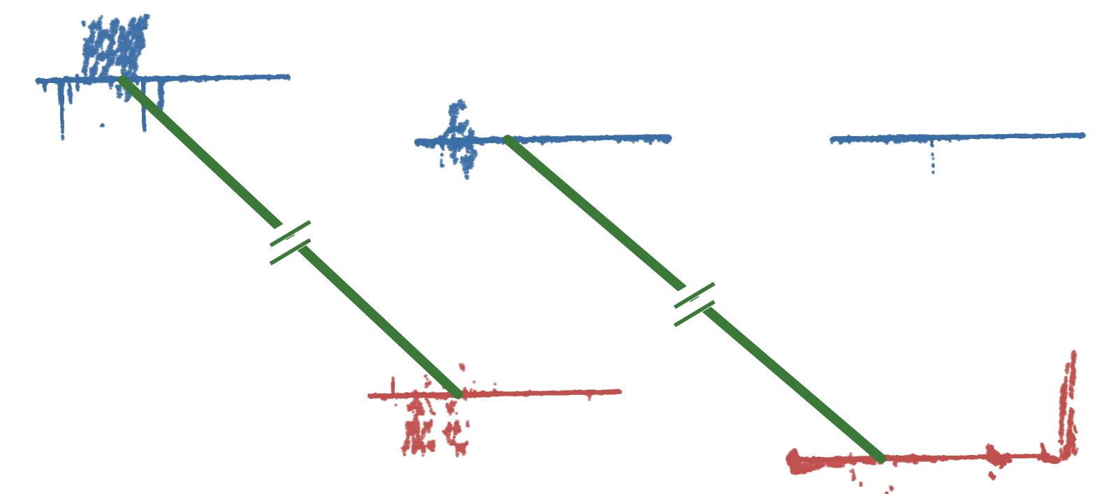
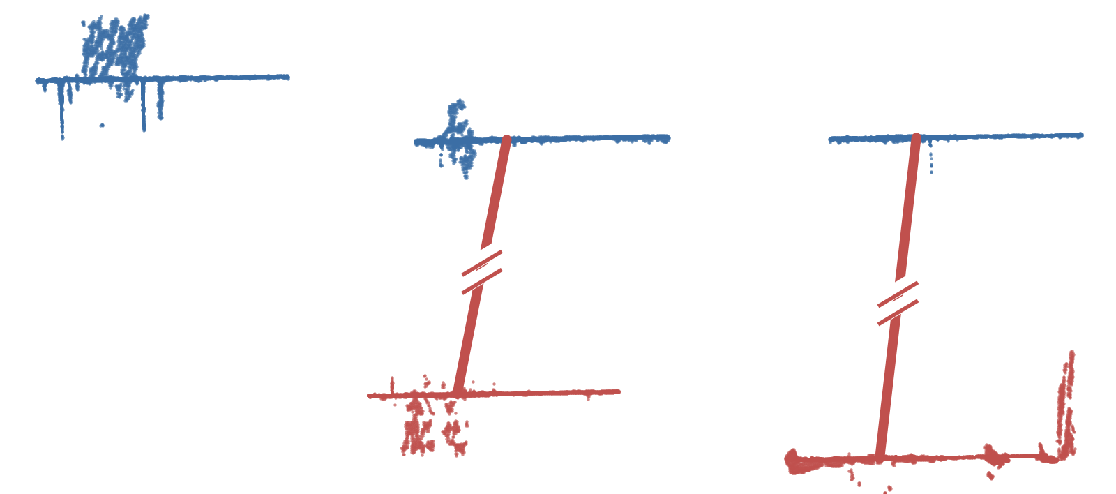
Depth
The same scene seen from above
True pairing
Correct lengths
Shift
One bar 17 mm shorter
It helps only if one bar sticks out from the others
13

Slide 14
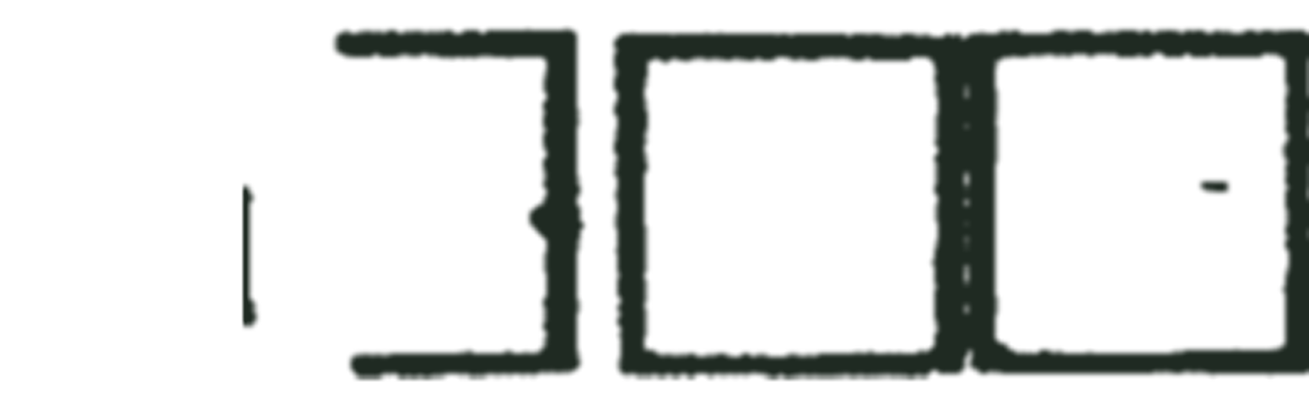
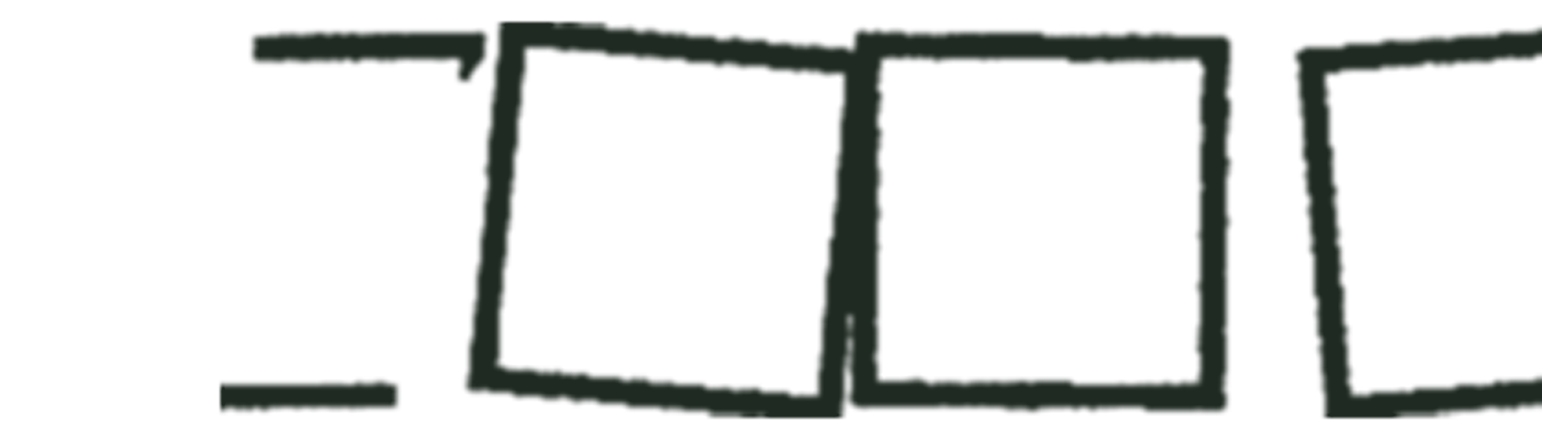
Synthetic twin
Real scan
Synthetic twin
14

Slide 15
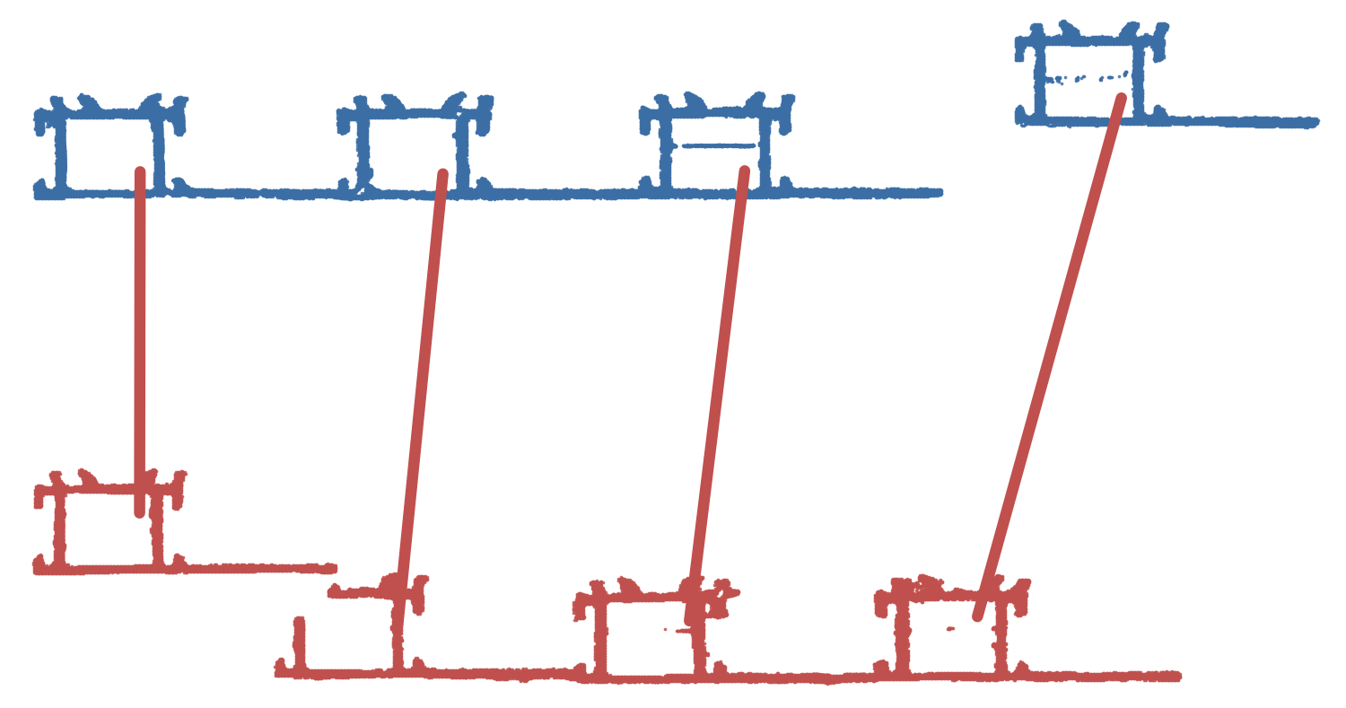
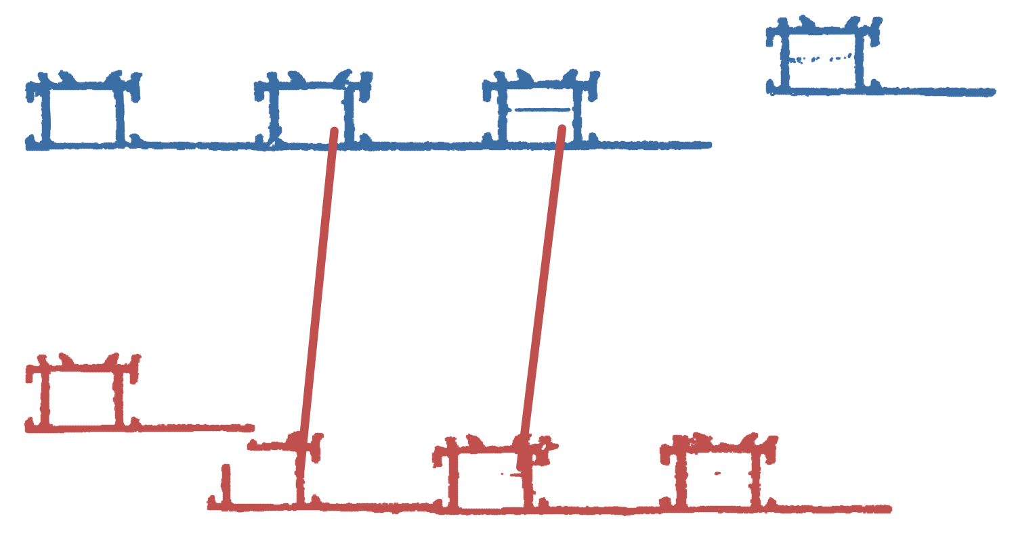
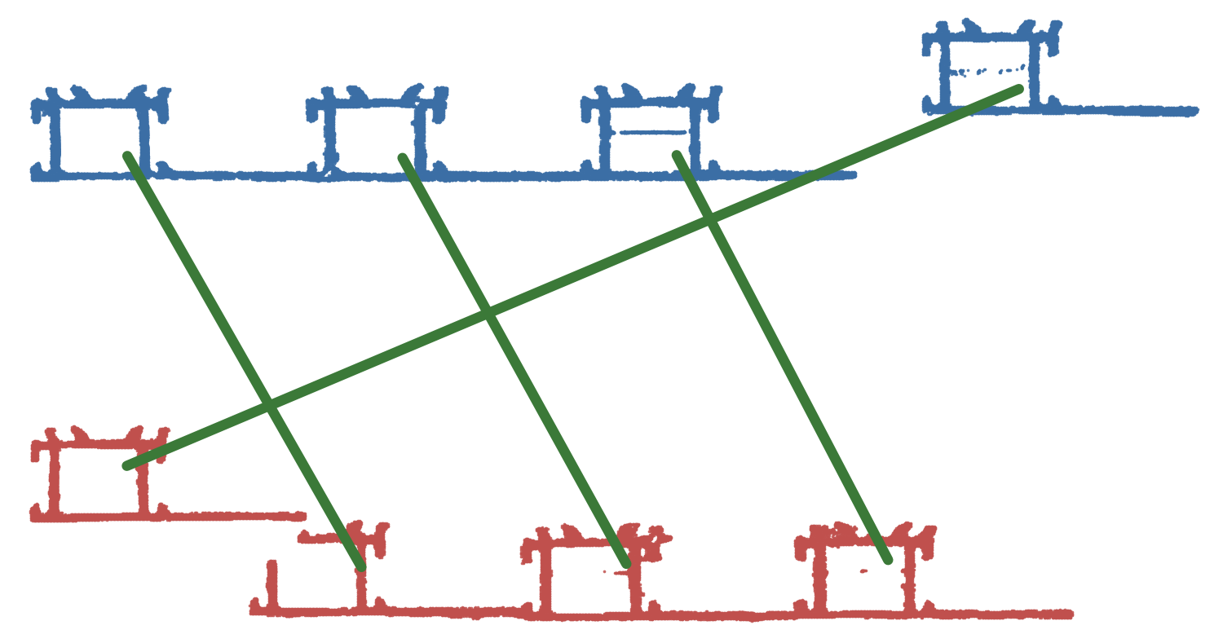
A bar lying crosswise
Hungarian algorithm
0 of 4
Monotonic alignment
0 of 4
Original system's heuristic
0 of 4
Hybrid method
4 of 4
15

Slide 16
Results
Hybrid method on the 108 real scenes
True pairs recovered
Completely wrong scenes
92.9%
5
against 83.5% for the original system's heuristic
against 14
The 5 wrong scenes are all shifts, in scenes where the views do not see the same bars
16

Slide 17
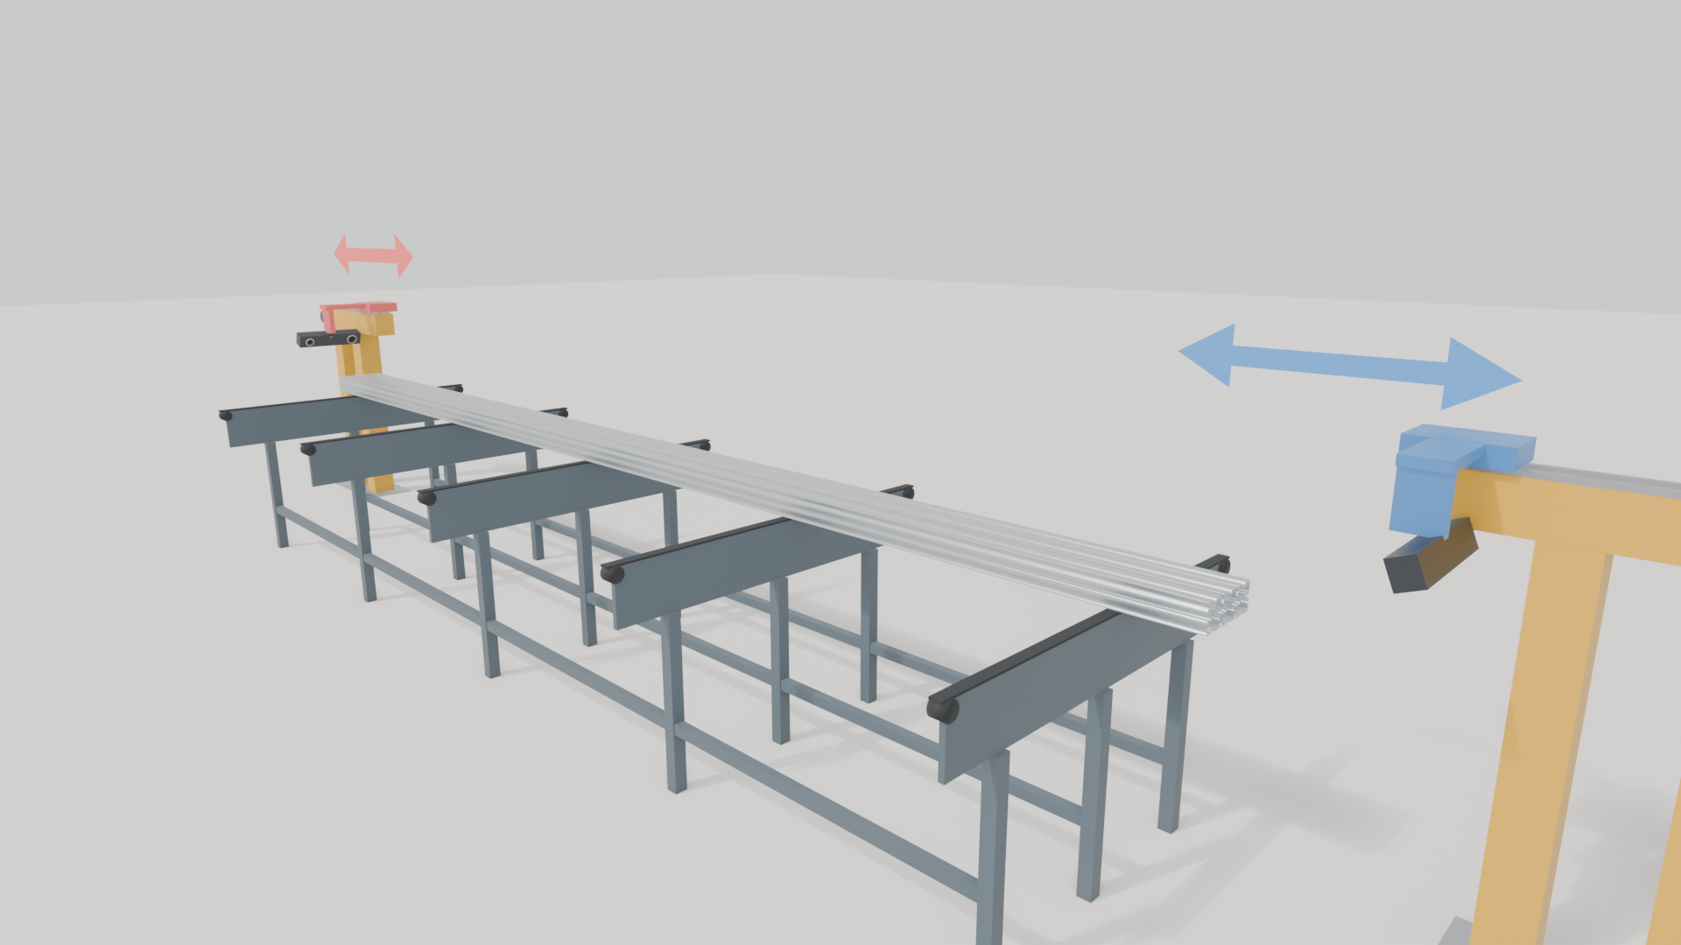
Conclusions
Calibration
Shift ambiguity
Hybrid method
Results
92.9%
of the true pairs, against 83.5% for the original system's heuristic
5
Each bar paired with its neighbour
Crosswise bar:
4 of 4
completely wrong scenes, against 14
Future work
Use these analyses to design new rigs, for example to choose how wide the scan window must be
Flag the scenes at risk of a shift instead of pairing them automatically
17

Slide 18
Thank you for your attention

