Slide 1
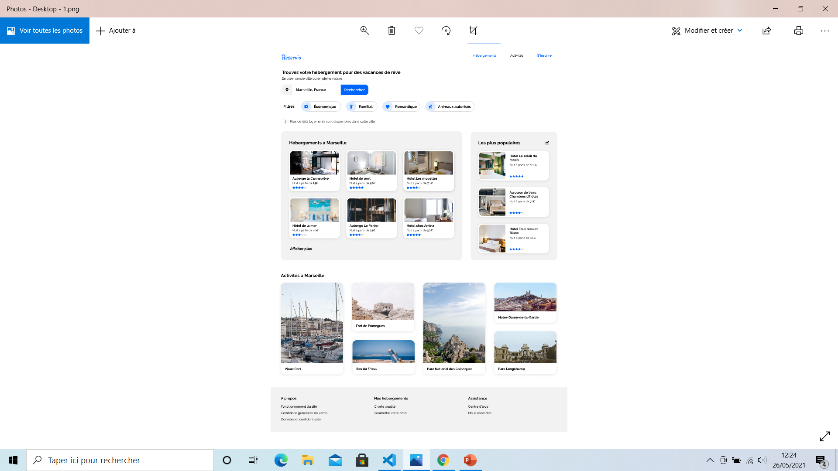
Maquette html de la page

Slide 2
HEADER
SECTION1
SECTION2
FOOTER

Slide 3
LOGO
NAV UL LI*3
<H1>
<P>
Div ( i class + imput type text+ imput type button)
<p>
Div( span iclass *4)
<p> iclass
Div class
Div class
<h1>
<h1>
x6
Div class (img + spanclass+span class + span)
Div class (img + spanclass+span class + span)
x3
<a> #
Div class
<figure> <img><figcaption></figure>x 6
Div class ( <p>, <a>,<a>) x3

