Slide 1
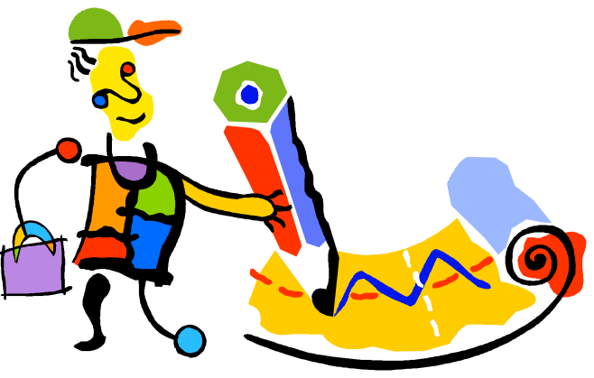

Why Should I Sketch?
Chapter 1.2 in Sketching User Experiences: The Workbook

Slide 2
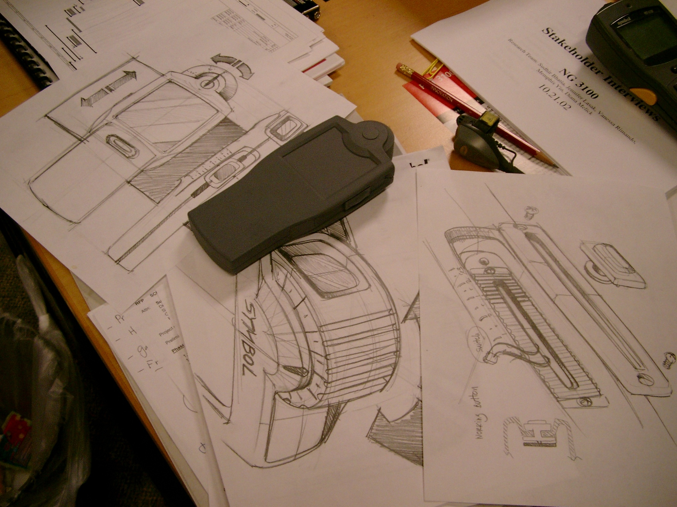
Sketching is about Design
Notes:
Fundamental idea:
Sketching is about design.
It is a fundamental tool that helps designers express, develop and communicate design ideas
It is a critical part of a process that begins with idea generation, to idea design, to design choices, to engineering

Slide 3
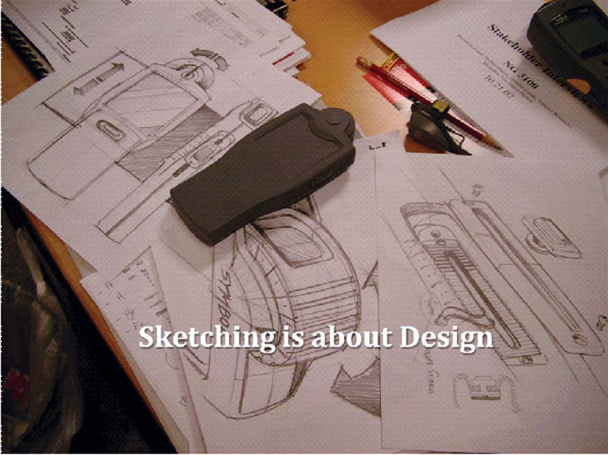
Sketching is about design
  Sketching is not about drawing
  It is about design.
  Sketching is a tool to help you:
    express
    develop, and
    communicate design ideas
  Sketching is part of a process:
    idea generation,
    design elaboration
    design choices,
    engineering

Slide 4
Why Sketch?
  Create
    early ideation
    think openly about ideas
    think through ideas
    force you to visualize how things come together
    brainstorming: generate abundant ideas without worrying about quality
    invent and explore concepts
  Record
    ideas you develop
    ideas that you come across
    archive ideas for later reflection
  Reflect, share, critique, decide
    communicate ideas to others
    invite responses, criticisms, and alternatives;
    choose ideas worth pursuing

Slide 5
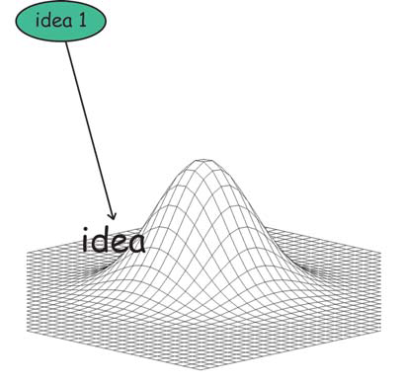
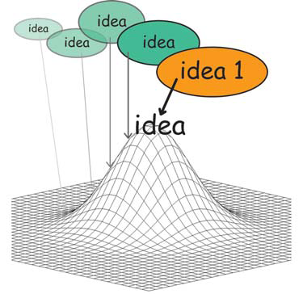
Exploring an idea
Getting the Design Right
Generate an idea Iterate and develop it

Slide 6
Exploring an idea
Getting the Design Right
Generate an idea Iterate and develop it
But is it the best idea?

Slide 7
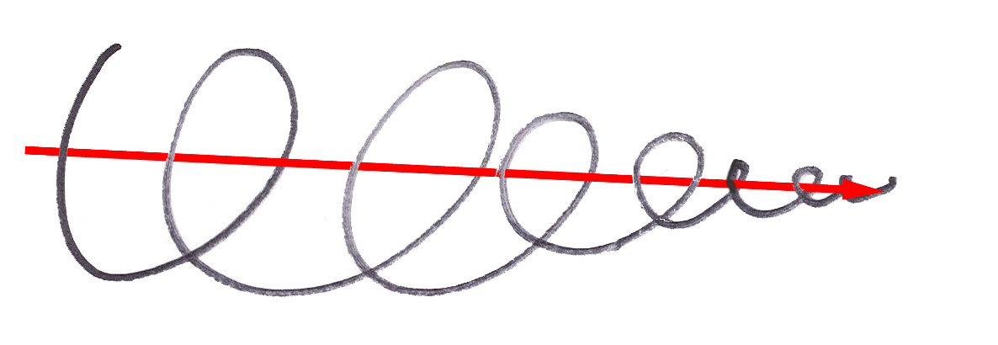
Exploring an idea
Getting the Design Right
Slide contributed by Bill Buxton
Notes:
Exploring a single idea will propel you down one path, towards a single convergence point

Slide 8
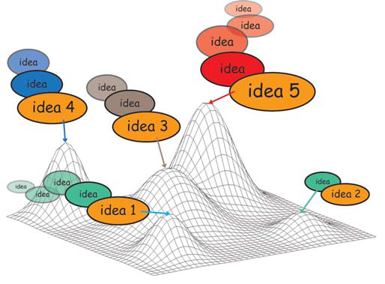
Exploring an idea
Getting the Design Right
The Problem
  fixates on first idea
  local hill climbing issue did you reach local vs. global maxima?

Slide 9

Exploring an idea
Example: Cell phone design
Iterative design

Slide 10

Exploring an idea
Example: Cell phone design
How do we get here with only iterative improvements?

Slide 11
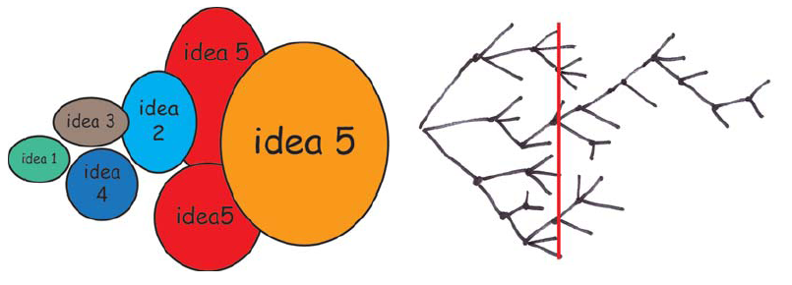
Exploring alternatives
Getting the Right Design¹
… a designer that pitched three ideas would probably be fired. I'd say 5 is an entry point for an early formal review (distilled from 100's) … if you are pushing one you will be found out, and also fired … it is about open mindedness, humility, discovery, and learning. If you aren't authentically dedicated to that approach you are just doing it wrong!
Alistair Hamilton
VP Design
Symbol Technologies
¹Bill Buxton coined the expression ‘Getting the Design Right vs. Getting the Right Design’
Notes:
With alternatives, you can compare multiple solutions at any point in time, and choose one or more branches to follow

Slide 12
Exploring alternatives
Getting the Right Design
  generate many ideas and variations
  reflect on all ideas
  choose the ones that look most promisting
  develop them in parallel
  add new ideas as they come up
  then iterate your final choice

Slide 13
Elaboration and Reduction
  Elaborate - generate solutions. These are the opportunities
  Reduce - decide on the ones worth pursuing
  Repeat - elaborate and reduce again on those solutions
Elaboration
opportunity seeking
Reduction
decision-making
Design process
Source: Laseau,P. (1980) Graphic Thinking for Architects & Designers. John Wiley and Sons

Slide 14
Elaboration and Reduction
Design is choice.
There are two places where there is room for creativity
creativity you bring to enumerating meaningfully distinct options from which to choose
creativity you bring to defining the criteria, or heuristics, according to which you make your choices.
Source: Laseau,P. (1980) Graphic Thinking for Architects & Designers. John Wiley and Sons

Slide 15
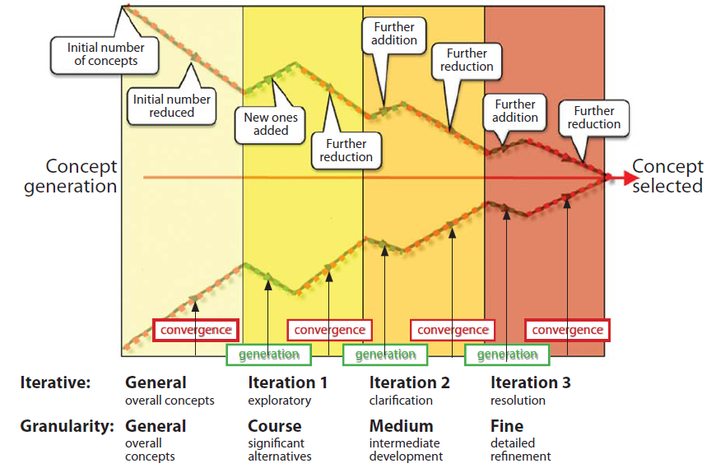
The Design Funnel
  Alternate generation of ideas and convergence until resolution
Modified from Pugh, S. (1990) Total design: Integrated methods for successful products engineering.
Addison-Wesley. P. 75

Slide 16
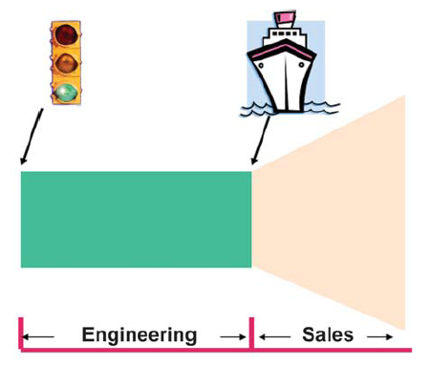
The Product View: The Statis Quo
  product ideas judged at start
  given red light (stop) or green light (go ahead)
  product built, but may be deficient due to lack of design evolution

Slide 17
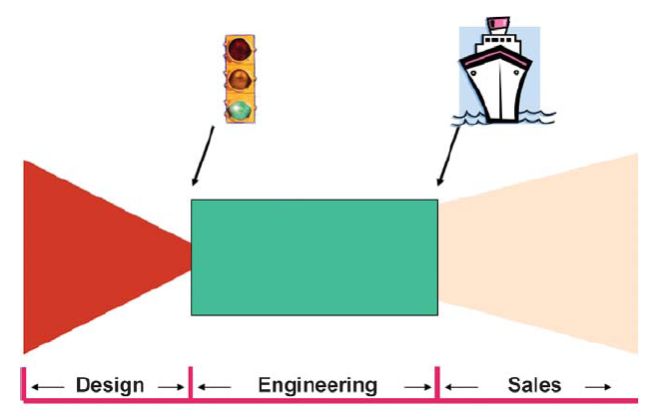
The Product View : Integrating Design
  many designs considered in parallel
  reduction filters and eliminates design until convergence
  one or more designs can be considered for green light

Slide 18
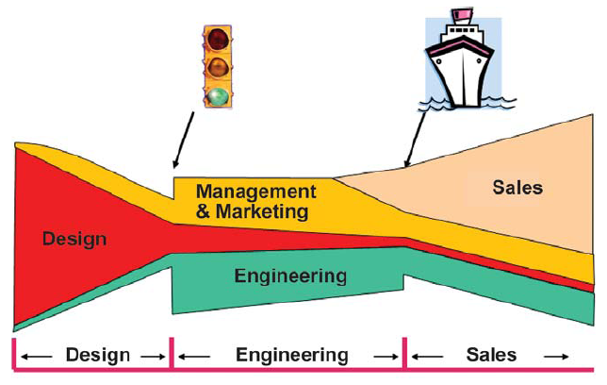
The Product View: No Silos
  Actually an interplay between many different players

Slide 19
You now know
1. Sketching is about design, not just drawing
2. The design process
  get the right design
  then get that design right
3. The design funnel is
  an interplay between elaboration and reduction
  generate and elaborate designs
  choose and reduce between designs
4. Design in product development
  use the design funnel to develop ideas with
  the best ones considered for green/red light appraisal

Slide 20



Permissions
You are free:
  to Share — to copy, distribute and transmit the work
  to Remix — to adapt the work
Under the following conditions:
Attribution — You must attribute the work in the manner specified by the author (but not in any way that suggests that they endorse you or your use of the work) by citing:
  “from presentations accompanying the book ‘Sketching User Experiences, the Workbook’, by S. Greenberg, S. Carpendale, N. Marquardt and B. Buxton”
Noncommercial — You may not use this work for commercial purposes, except to assist one’s own teaching and training within commercial organizations.
Share Alike — If you alter, transform, or build upon this work, you may distribute the resulting work only under the same or similar license to this one.
With the understanding that:
Not all material have transferable rights — materials from other sources which are included here are cited
Waiver — Any of the above conditions can be waived if you get permission from the copyright holder.
Public Domain — Where the work or any of its elements is in the public domain under applicable law, that status is in no way affected by the license.
Other Rights — In no way are any of the following rights affected by the license:
  Your fair dealing or fair use rights, or other applicable copyright exceptions and limitations;
  The author's moral rights;
  Rights other persons may have either in the work itself or in how the work is used, such as publicity or privacy rights.
Notice — For any reuse or distribution, you must make clear to others the license terms of this work. The best way to do this is with a link to this web page.

