Slide 1
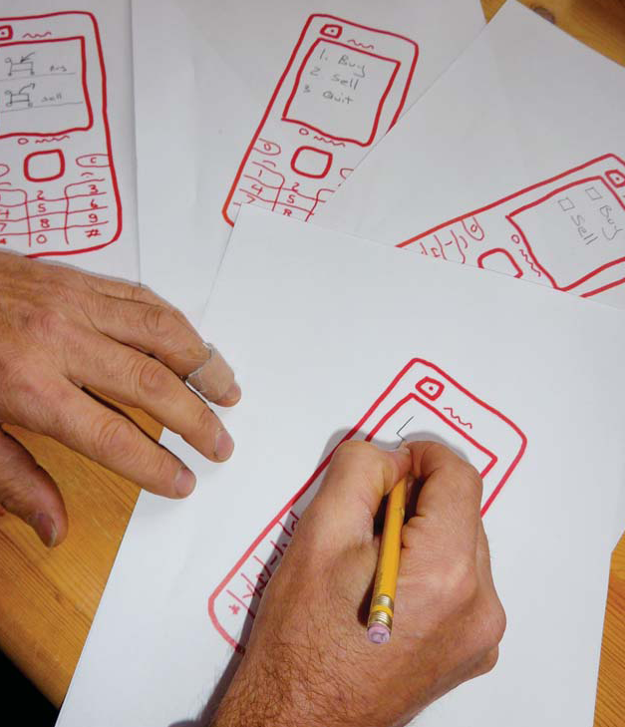
Templates
Chapter 3.8 in Sketching User Experiences: The Workbook

Slide 2
Parts of your Sketch are Constant
pre-determined contents
fixed locations
hardware
window appearance
standard controls
standard borders…

Slide 3
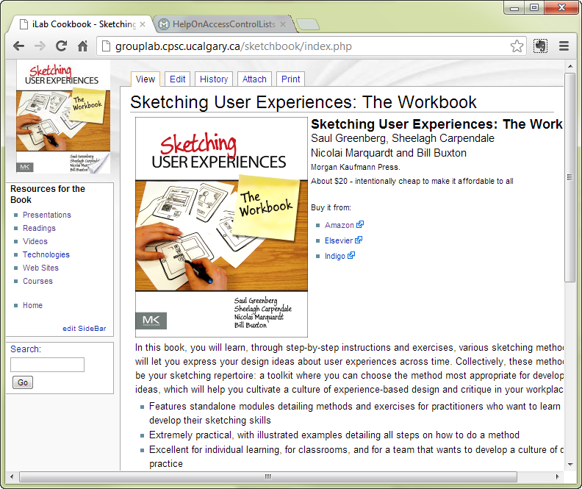
Parts of your Sketch are Constant

Slide 4
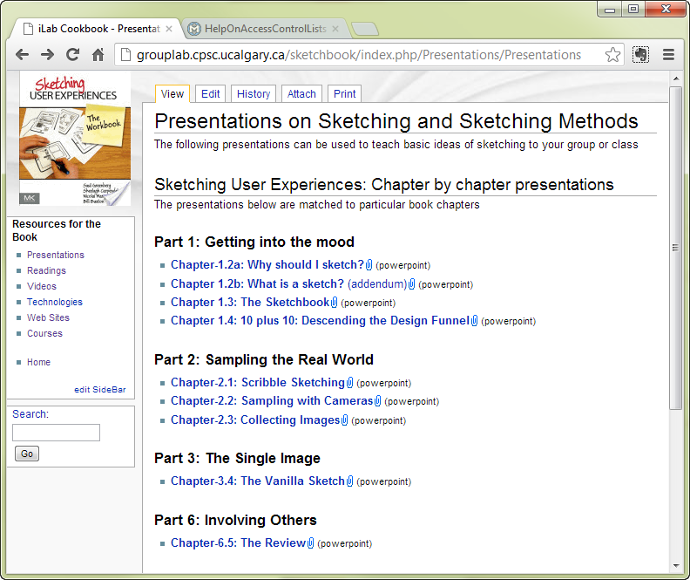
Parts of your Sketch are Constant

Slide 5
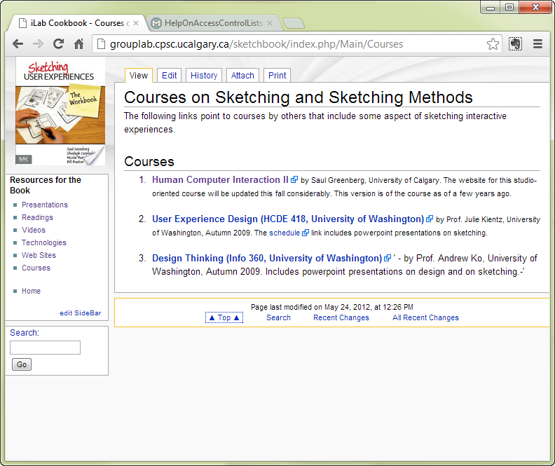
Parts of your Sketch are Constant

Slide 6
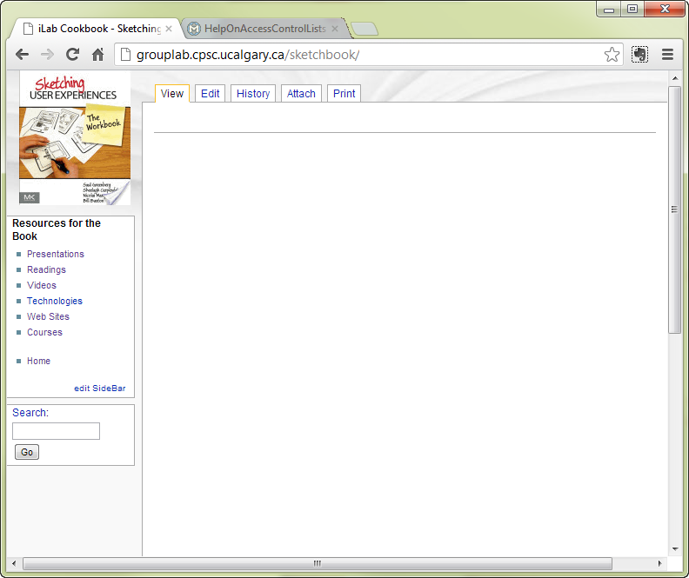
Parts of your Sketch are Constant

Slide 7
The Template
pre-draw the constant parts of your sketch
leave space for sketches, annotations & notes
make copies
sketch over those templates
Why?
focus on design aspects that change
faster to generate single drawing
faster to generate multiple ideas
imposes design constraints

Slide 8
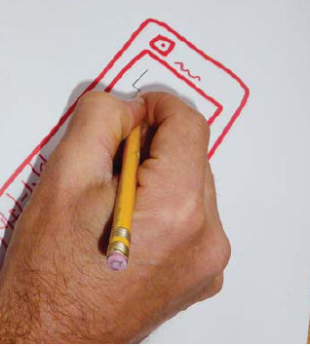
Making a Template – Paper method 1
Sketch the fixed parts
Photocopy or scan / print it

Slide 9
Making a Template – Paper method 1
Use those copies for your sketches

Slide 10
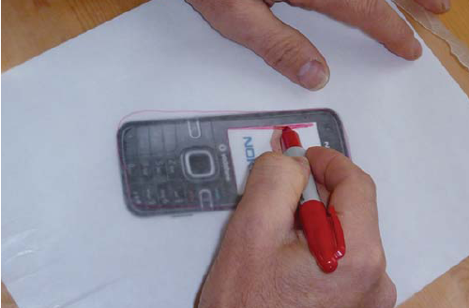
Making a Template – Paper method 2
If an image is available
trace over it
copy / print as before

Slide 11
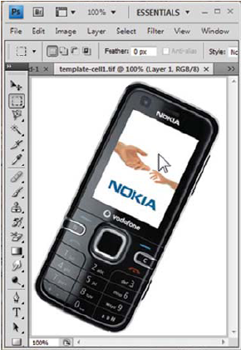
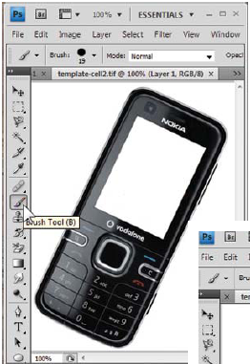
Making a Template – Digital method 1
Copy image into bitmap editor
Delete those portions that don’t change

Slide 12
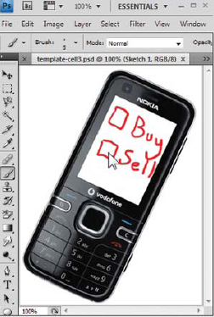
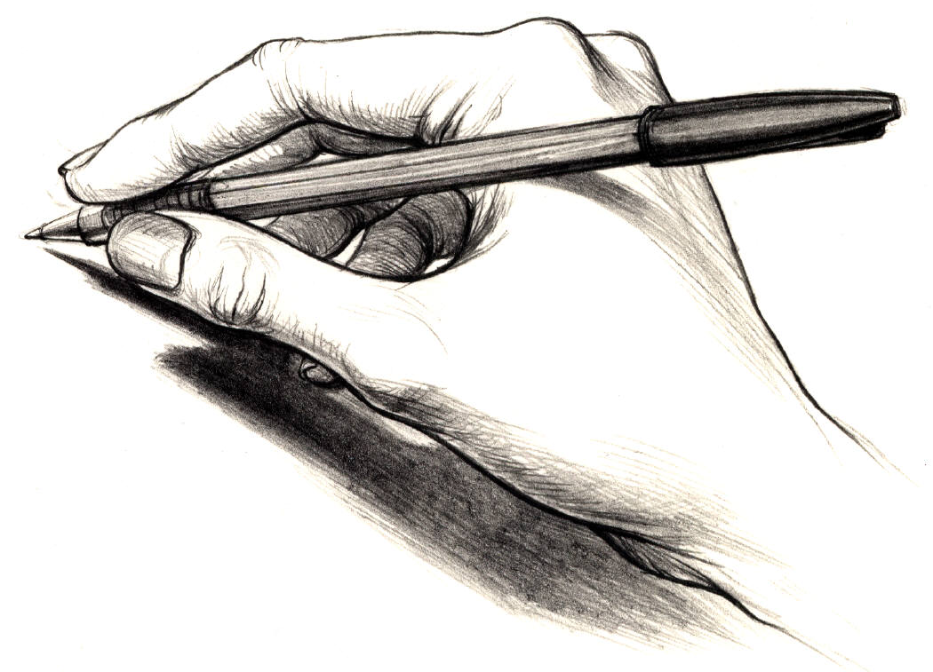
Making a Template – Digital method 1
print it and sketch on paper copies (very easy) or

Slide 13

Making a Template – Digital method 1
Or sketch over this image using a drawing tool
drawing with a mouse is terrible

Slide 14
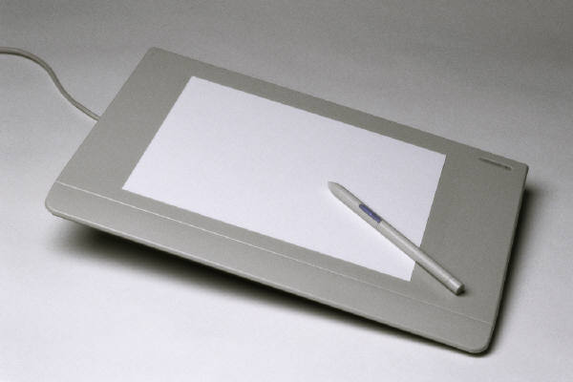
Making a Template – Digital method 1
sketch over this image using a drawing tool
digitizers are better,
tablets are best

Slide 15
Problem
strange juxtaposition of image fidelity

Slide 16
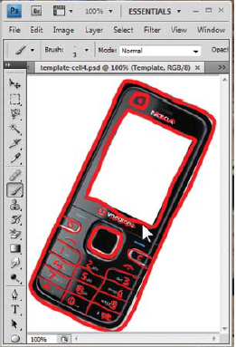
Making a Template – Digital method 2
copy image into layered editor (e.g., photoshop)
trace that image onto a layer

Slide 17
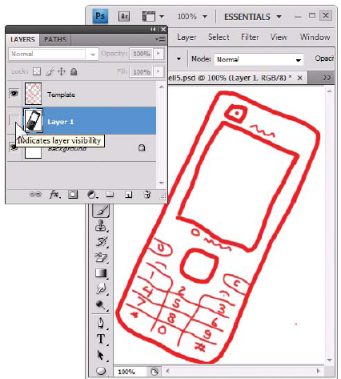
Making a Template – Digital method 2
hide the background layer

Slide 18
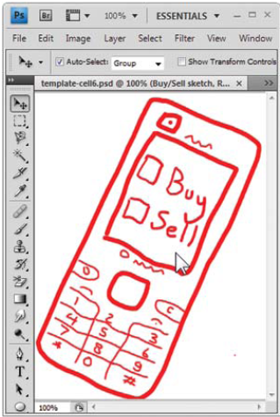
Making a Template – Digital method 2
sketch in another layer atop this layer

Slide 19
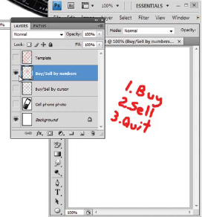
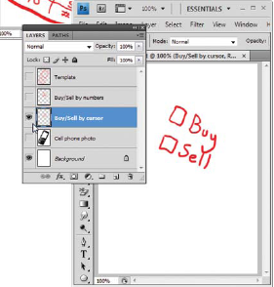
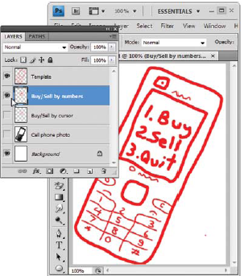
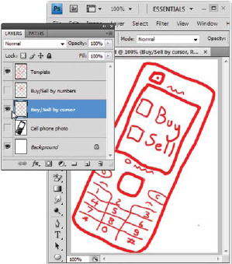
Making a Template – Digital method 2
can use multiple sketch layers to try alternate designs

Slide 20
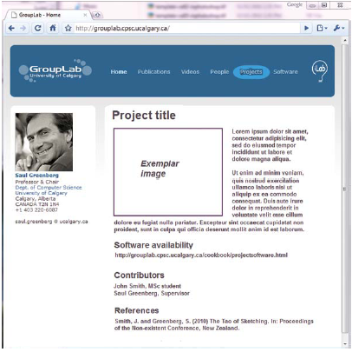
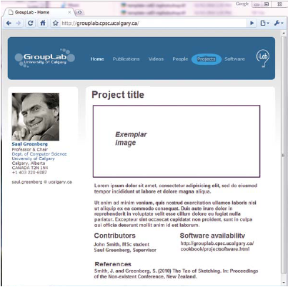
Template Fidelity Should Match
Two high fidelity layout designs in a template

Slide 21
Exercise
  For each method described above
  make a template of a touch tablet of your choice
  use it to rapidly sketch out several ideas for a finger-painting application where a person can select
    different paints
    different textures

Slide 22
You now know
Templates
capture fixed parts of your interface
leave white space for drawings, annotations & notes
Template can be
drawn from scratch or
based on photos of existing interfaces or
based on traces over existing interfaces
Used in digital or paper form
Rapidly reused and built upon via layers

Slide 23



Permissions
You are free:
  to Share — to copy, distribute and transmit the work
  to Remix — to adapt the work
Under the following conditions:
Attribution — You must attribute the work in the manner specified by the author (but not in any way that suggests that they endorse you or your use of the work) by citing:
  “from presentations accompanying the book ‘Sketching User Experiences, the Workbook’, by S. Greenberg, S. Carpendale, N. Marquardt and B. Buxton”
Noncommercial — You may not use this work for commercial purposes, except to assist one’s own teaching and training within commercial organizations.
Share Alike — If you alter, transform, or build upon this work, you may distribute the resulting work only under the same or similar license to this one.
With the understanding that:
Not all material have transferable rights — materials from other sources which are included here are cited
Waiver — Any of the above conditions can be waived if you get permission from the copyright holder.
Public Domain — Where the work or any of its elements is in the public domain under applicable law, that status is in no way affected by the license.
Other Rights — In no way are any of the following rights affected by the license:
  Your fair dealing or fair use rights, or other applicable copyright exceptions and limitations;
  The author's moral rights;
  Rights other persons may have either in the work itself or in how the work is used, such as publicity or privacy rights.
Notice — For any reuse or distribution, you must make clear to others the license terms of this work. The best way to do this is with a link to this web page.

