Slide 1
Week 5 Final
CST 499
Sabrina Blasz
Professor Charmelia Butler

Slide 2
SRS Document
The SRS document helps plan out a software project.
Describes what the software will do and how it will perform
Helps with communicating the software requirements to developers and stake holders

Slide 3
SRS Document Key Aspects
Introductions - Portal to give functionality to students and teachers to help during and after the school year. Features will be created and tested before final is sent to users and will continue to be tested after deployment.
In Scope - Student registration, student login, profile page, add and remove classes from schedule. Added to a waitlist. Will be used by many different school. Information for each class will be included.
Test Methodology - The Waterfall method will be used as it is the simplest for introductory developers and project managers. This is also a simple project to initially create and deploy. Future development may take on a different method

Slide 4
UML Design Models
These models contain model elements, such as use cases, classes, and packages. One or more diagrams that show a specific perspective of a system
Three types of models:
  Structural
  Behavioral
  Architectural

Slide 5
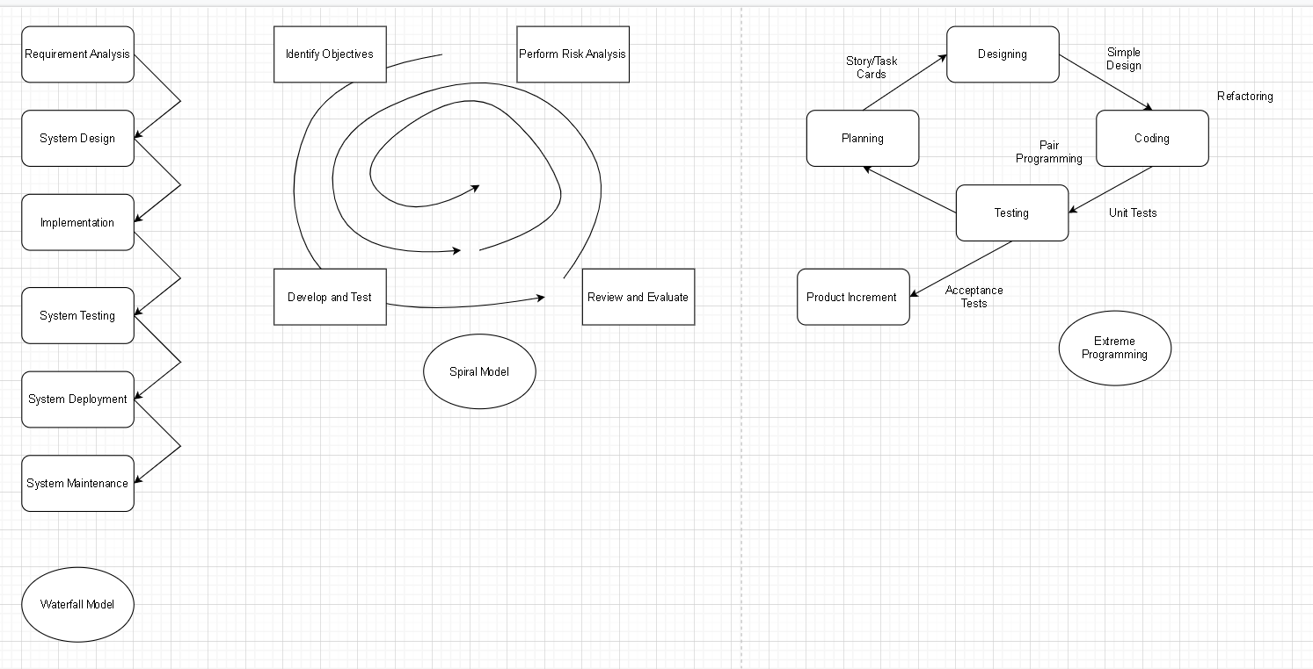
My UML Design Models

Slide 6
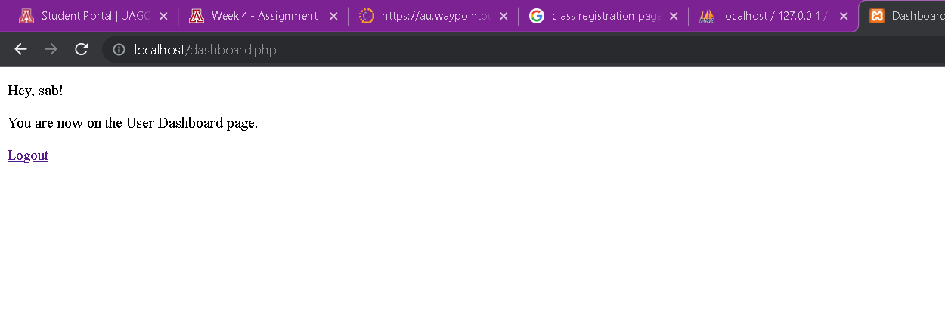
Landing Page

Slide 7
Landing Page Design
Very simple
Welcomes user by using the name they entered
Provides a logout button
A button for class registration would be added next

Slide 8
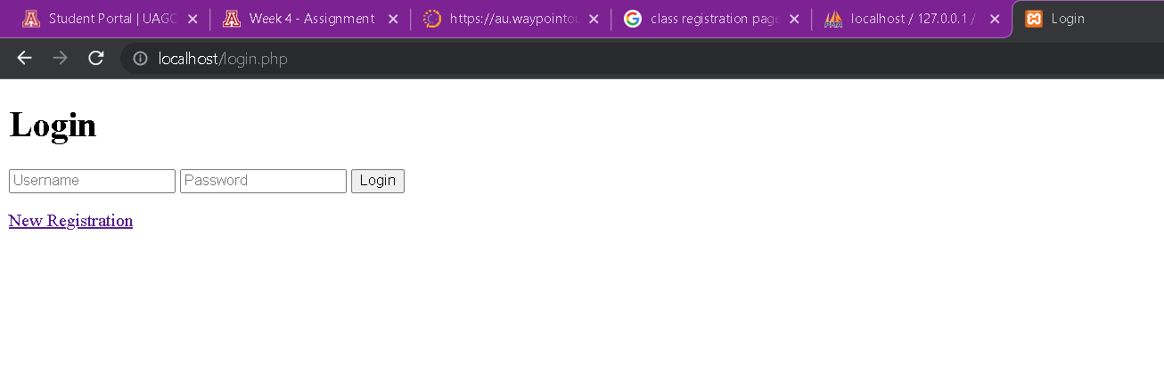
Login Page

Slide 9
Login Page Design
Field for username and password
Login button in a clear place
Registration button below for new users
More colors or pictures could enhance the overall look of this page

Slide 10
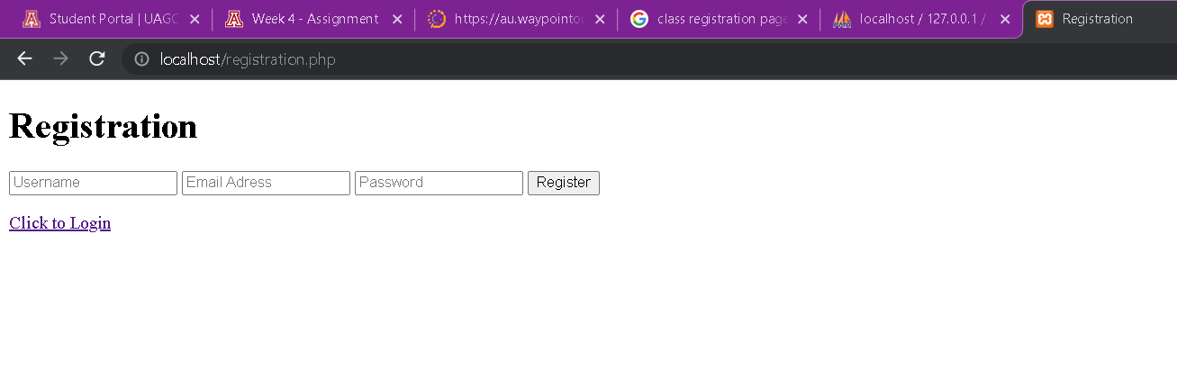
Enrollment Page

Slide 11
Enrollment Page Design
Simple layout for easy registration
Fields for username, password, and email are required
After info is submitted, user can easily go right to the login screen with the button below
Additional information fields can be added when new features are added to the project

Slide 12
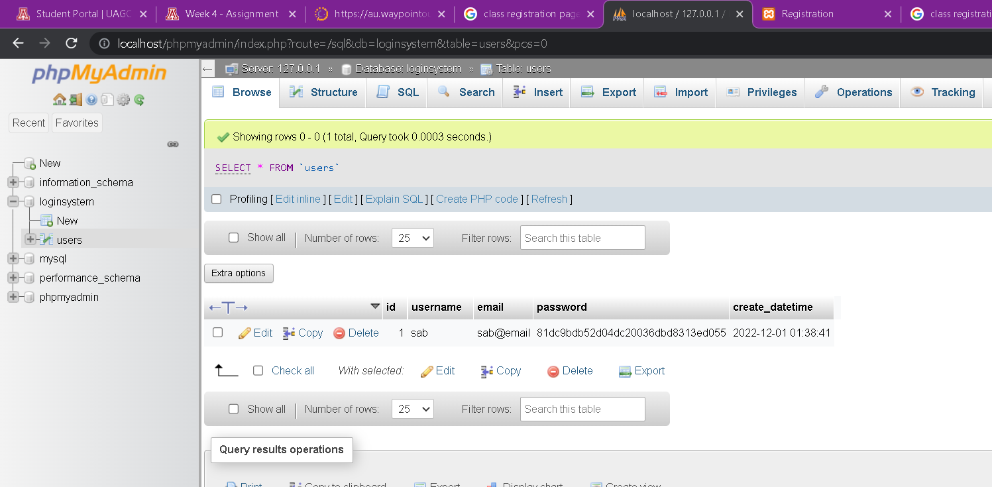
MySQL Database

Slide 13
MySQL Database Explained
1 table with 5 columns was added
Columns:
  ID
  Username
  Email
  Password
  Date/time
A .php file was needed to connect the web page to the database
Database can easily be monitored and changed with admin login

Slide 14
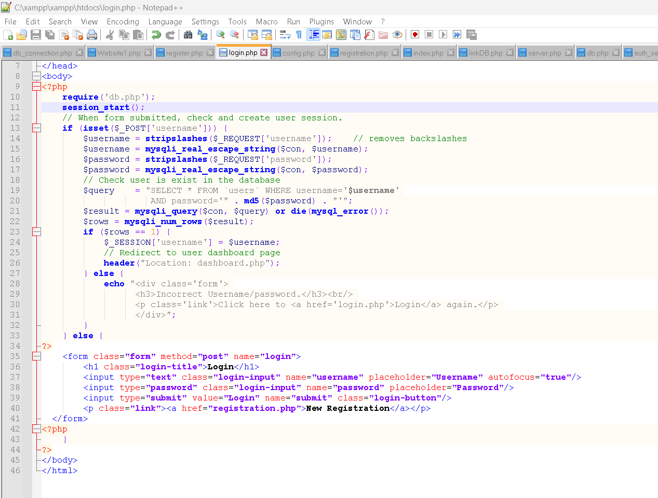
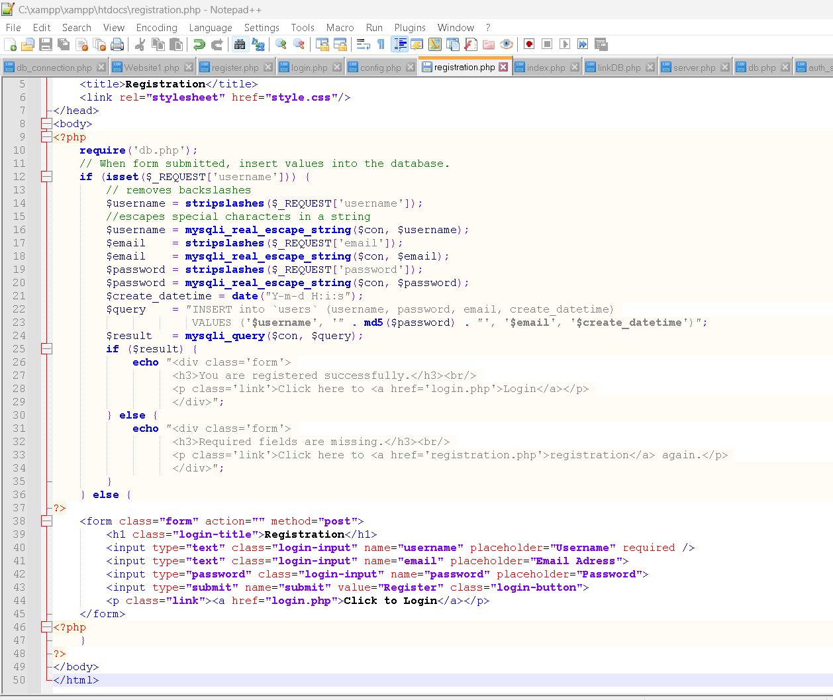
PHP Code

Slide 15
PHP Code Discussed
A form is declared to start a session for the user
String fields are declared where user can enter their info
If/else statements are used so the system can check if a user has already registered
Inputs are added to their respective database columns when submit button is pressed
A stylesheet file was used to arrange the elements

Slide 16
References
Tsui, F., Karam, O., & Bernal, B. (2018). Essentials of software engineering (4th ed.). Jones & Bartlett Learning.
Spillner, A., Linz, T., & Schaefer, H. (2014). Software testing foundations: A study guide for
the certified tester exam (4th ed.).
Rocky Nook.

Slide 17
References Continued
Guru99. (n.d.) Test plan template: Sample document with web application example Links to an external site.. https://www.guru99.com/
test-plan-for-project.html
Chikh, A., & Alajmi, H. (2014, January 17–19) Towards a dynamic software requirements specification Links to an external site.
2014 World Congress on Computer Applications
and Information Systems (WCCAIS), Hammamet,
Tunisia.
https://doi.org/10.1109/WCCAIS.2014.6916656

