Slide 1
MEDIQA-Chat Tasks @ ACL-ClinicalNLP
Students: Toma Sabin-Sebastian
Popa Andrei-Ionut

Slide 2

Table of contents
Objective
Dataset
Subtasks
Approaches
Chat-GPT 4 comparison
Conclusion

Slide 3
Objective
The main objective of this project is to develop models capable of generating clinical notes from doctor-patient conversations and vice versa, supporting data augmentation and automation in the medical domain.
Project Overview: Clinical Note ↔ Dialogue Generation

Slide 4
dataset
Feature | MTS-Dialog | ACI-BENCH
Dialogue length | Longer, multi-turn (~15–20 turns) | Shorter, assistant-like (~6–10 turns)
Note length | Shorter, section-based summaries | Longer, full clinical documentation
Source | MIMIC-IV real doctor-patient conversations | Transcribed audio & ASR-generated transcripts
Style | Natural, informal, turn-by-turn exchanges | Structured, goal-oriented, sometimes prompted
MTS-Dialog — Used for Dialogue2Note A dataset of over 13,000 real-world doctor-patient conversations aligned with structured clinical notes.
ACI-BENCH — Used for Note2Dialogue The largest public dataset of clinical notes aligned with doctor-patient conversations, including ambient speech and automatic transcripts.

Slide 5
Subtasks objectives and Approaches
Subtask | Objective | Approach (Models Used)
Subtask A | Generate specific sections of a clinical note from a medical conversation | T5-Small, T5-Base, T5-Flan-Base, GPT4
Subtask B | Generate a full clinical note summarizing the entire conversation | T5-Base,GPT4
Subtask C | Generate a synthetic doctor-patient dialogue based on a full clinical note | T5-Base,T5-Base improved, GPT4

Slide 6

Subtask A
Baseline Model: T5-Small
100 rows on training set, 25 evaluation and 10 test set, 1 epoch
Exemple:
doctor: it is good to see you again. how have you been?
patient: it is good to see you too. i have been good.
doctor: have any changes to your medical history or social history since last time i saw you?
patient: no. no changes.
Results:
INTERPREATION:
1. ROUGE Scores (ROUGE-1 and ROUGE-L)
This indicates some overlap of unigrams and longest common subsequences with the reference notes, but relatively low overall.
Test performance drops slightly, especially in ROUGE-L, which shows weak structural coherence in the generated notes.
2. BLEU Score is meaning no n-gram matches (likely up to 4-gram) between model’s output and reference notes — this is a red flag for fluency or relevance.
BLEU is generally harsher than ROUGE in low-resource abstractive summarization, but 0.0 suggests severely mismatched phrasing.
Model is repeating or copying directly, not summarizing into a structured clinical note.​

Slide 7

Subtask A
Model: T5-SMALL :Full dataset, 3 epochs
Exemple:
"The patient is in good shape. She has no heart issues, genital or urinary tract issues. She has no muscle or movement issues. She has no muscle or movement issues. She has no muscle or movement issues.“
The model shows basic understanding of medical dialogue but struggles with factual accuracy and abstraction. It often hallucinates details, repeats phrases, and copies input verbatim instead of generating structured clinical notes.
Results:
INTERPRETATION:
All metrics are quite low despite using the full dataset. BLEU improved compared to THE small-data run, but ROUGE dropped significantly.
This suggests that THE model:
Does better at fluency (BLEU) in short spans.
But fails to match the content and structure of reference summaries (low ROUGE-L).
And possibly hallucinates or misses key facts (as seen in your prediction samples).

Slide 8

SUBTASK A
Model: T5-FLAN BASE: 2 EPOCH
Exemple:
1.Patient has a history of blood clots.
2.Patient's father died of thoracic aortic aneurysm and his mother died of stroke.
3.Patient has been feeling better lately.
4.Patient is allergic to Bactrim and adhesive tape.
5.Patient doesn't have a history of alcohol or drug abuse.
Model sometimes captures simple facts, but most predictions are overly short and miss clinical details. Some predictions repeat phrases and often misinterpretates negated facts.
Interpretation:
ROUGE-1 and ROUGE-L are noticeably improved compared to the earlier runs, indicating better lexical and structural overlap with reference summaries.
Bleu scores remain low, especially on the test set — suggesting limited n-gram precision and that the model may still struggle with grammatical fluency or verbatim phrasing.
The model is beginning to capture relevant content from the dialogues more consistently.
Rouge-l improvement suggests better handling of sequence structure and note format.
Results:

Slide 9
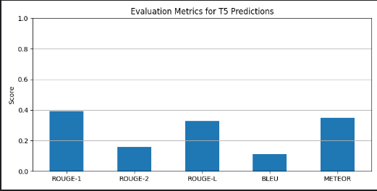
SUBTASK A
Model: T5-base
Fine-Tuning Details:
Training Framework: HuggingFace Trainer
Max input length: 512 tokens
Max output length: 128 tokens
Batch size: 2 per device (memory-optimized)
Epochs: 3 Mixed Precision: FP16 enabled on CUDA
Exemple:
The patient is a 55-year-old African-American male who comes in today for a routine physical. He has a history of right contrast temporal mass. He has had new seizures and is concerned that this could be a high grade glioma.
Results
Interpretation: The T5 model performs reasonably well in generating semantically relevant outputs, as shown by the ROUGE and METEOR scores. Although the BLEU score is low the results suggest that the model captures key information and maintains partial structure from the reference dialogues.

Slide 10
Chat-gpt 4 Predictions for subtask a
Predictions:
Patient presents with congestion and frequent coughing, reports choking sensation.
2. Lives with parents, 2.5 y/o brother, and 5.5 y/o stepbrother. Siblings have cold symptoms and vomiting. Recent travel to father's family. Exposure to indoor pets. Positive smoke exposure from mother.
3. History of Huntington disease, dementia, and hypertension. Followed by PCP, neurologist (Dr. Townsend), and psychiatrist (Dr. Smith).
4. Resides at Life Care Center. Denies tobacco, alcohol, or IV drug use.
5. 83-year-old female with progressive dysphagia (1 year), dysarthria, leg cramps, and worsening bilateral arm weakness.

Slide 11
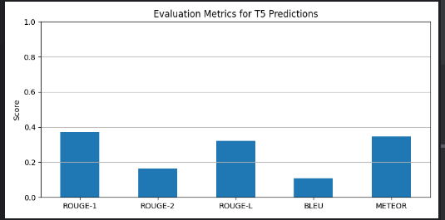
SUbTAsk b-Full Note Generation
Approach:
We reused the T5 model trained on the Dialogue2Note dataset and evaluated it on a new test set that includes full conversations.
Exemple:
The patient is a 2-and-a-half-year-old male and a 5-and-a-half-year-old stepson who are sick at home. The little one was taken to ER with an inhaler of albuterol. The little one was sick with flu shortly after delivery and the mother was sick with flu shortly after delivery. The patient's mother was visiting dad's family. The family does smoke at home.
Results
Interpretation:
The model generalizes moderately well to unseen data. ROUGE and METEOR scores indicate the model preserves semantic relevance and captures partial structure of full notes, though BLEU shows limitations in exact phrasing.

Slide 12
Chat-gpt 4 Predictions for subtask B
Predictions:
The patient presents with complaints of significant congestion and persistent coughing. She reports a sensation of choking associated with the symptoms.
The patient lives with her mother, father, a 2.5-year-old brother, and a 5.5-year-old maternal stepbrother, both of whom are currently ill with cold symptoms including vomiting and diarrhea. The younger brother was evaluated in the ER and discharged with an albuterol inhaler. A maternal nephew is also reported to have an ear infection. The patient’s mother reports she had the flu shortly after delivery. There was recent holiday travel to visit the paternal side of the family. The household includes exposure to cats and dogs indoors. The patient has second-hand smoke exposure from the mother.
3. An 83-year-old woman presenting with progressive dysphagia for the past year, dysarthria, right arm weakness initially, leg cramps, and now progressive bilateral upper extremity weakness.

Slide 13
Subtask C – Note2Dialogue Generation
Model: T5-based
Example:
[doctor] hi , ms. lee . how are you ? [patient] i'm doing okay . [doctor] i'm doing okay . [patient] i'm doing okay . [doctor] i'm doing okay . [patient] i'm doing okay . [doctor] i'm doing okay . [patient] i'm doing okay . [doctor] i'm doing okay . [patient] i'm doing okay . [doctor] okay . [patient] i'm doing okay . [doctor] okay . [patient] i was at a birthday party and i ran my back into the railing of the staircase and twisted my back . [doctor] okay . [patient] i ran my back into the railing of the staircase and twisted my back . [doctor] okay . [patient] i ran my back into the railing of the staircase and twisted my back . [doctor] okay .
Training Configuration Comparison
Setting | Model 1 (Default) | Model 2 (Tuned)
Epochs | 3 | 10
Learning Rate | 5e-4 | 3e-4
Batch Size | 2 | 4
Warmup Steps | 0 | 500
Gradient Accumulation Steps | 1 | 2
The second model is trained with a more stable learning setup: lower learning rate, longer training (more epochs), warm-up steps, and regularization. These adjustments aim to improve generalization and model robustness for complex generation tasks.

Slide 14
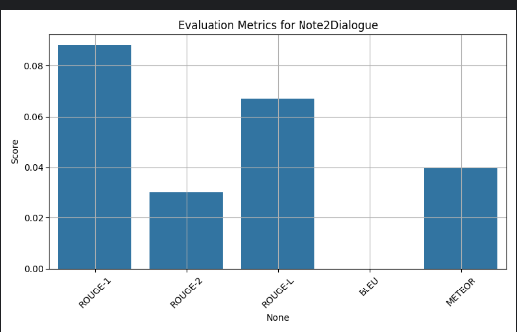
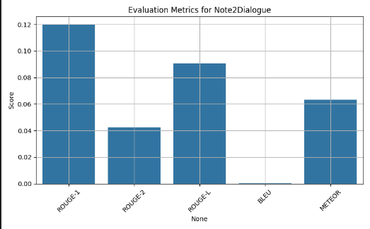
Subtask C – Note2Dialogue Generation
Results:
Interpretation:
The tuned model outperformed the base model across all key metrics (ROUGE-1, ROUGE-L, METEOR), indicating better ability to generate coherent and relevant doctor-patient conversations. BLEU scores remained very low for both models, which is common in open-ended generation tasks where exact n-gram overlap is rare. These improvements confirm that fine-tuning the training parameters has a clear positive impact on performance.

Slide 15
Chat-gpt 4 Prediction for subtask c
Doctor: Hi Gregory, what happened to your ankle?
Patient: I slipped on ice yesterday. It’s swollen and hurts.
Doctor: Can you walk on it?
Patient: Barely. I’ve been using ice, elevation, and ibuprofen.
Doctor: Good. X-rays show no fracture — just a sprain.
Patient: That’s a relief.
Doctor: I’m giving you an Aircast and crutches for a few days. Keep icing and take NSAIDs as needed.
Patient: Okay. When can I play soccer again?
Doctor: We’ll check in two weeks. Let me know if anything gets worse.
Patient: Will do. Thanks!

Slide 16
Conclusion
We trained T5 models to generate clinical notes and synthetic dialogues from doctor-patient data. Results show promising coherence, especially for Dialogue2Note, with room for improvement through tuning and post-processing.

Slide 17
Future work
Train on Transcripts from Real Audio Use ASR outputs (automatic speech recognition) to simulate real-world use cases.
Evaluate with Medical Professionals Collect qualitative feedback from clinicians to assess realism, usefulness, and trustworthiness.
Integrate Post-processing Heuristics
Automatically correct hallucinated medical terms or ensure section consistency in generated dialogues.

Slide 18
THANK YOU

