Slide 1

Project:Deepfake Detection
Organization:
Deepfake Detection
Image · Video · Audio
Sabudh Foundation
A Study of Deepfake Detection with Focus on Images
Team Members:
Vanshika Vaidya
Gunuru Hemanth Kumar
Navroop Singh
Liyakat Hussain
IMAGE
VIDEO
AUDIO
Mentors:
Mr .Bappaditya Chakraborty
Date: 23 March 2026

Slide 2
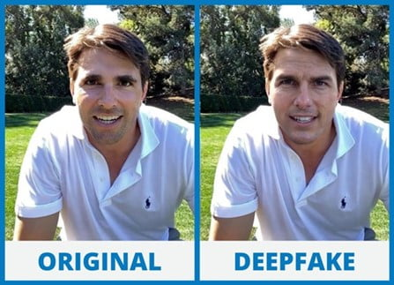
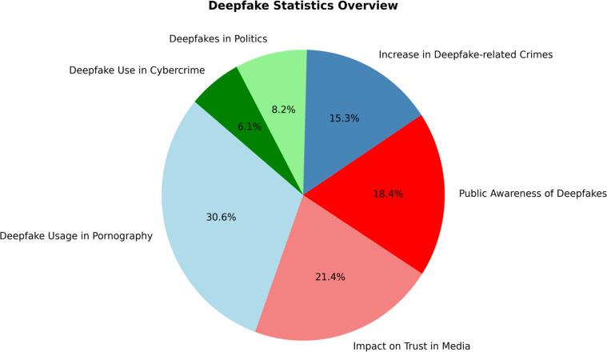
Introduction & Project Overview
Brief Introduction
Deepfake technology uses artificial intelligence, particularly deep learning, to create or manipulate images, videos, and audio that appear realistic to humans. It combines “deep learning” and “fake” to generate synthetic media that can mimic human appearance and behavior. With the rapid advancement of AI, deepfakes have become more advanced and difficult to detect. These manipulated contents pose serious challenges such as misinformation, identity theft, and threats to digital security. [10]
[9]

Slide 3
Importance & Relevance
Misinformation & Fake News
Non consensual Media Manipulation
Biometric Security
Fake Images/videos can make people appear to say or do things they never did.
Makes it harder to trust online content.
Faces can be placed into inappropriate appear to say or do things they never did.
Deepfakes can fool face recognition system.
It creates risks for security and social harm.
Fraud & Scams
Legal & Forensic Impact
Scale of the Problem
Voice cloning and fake media used in scams.
Can trick people into transferring money.
Difficult to verify if digital evidence is real.
Affects legal investigations.
Fake content is increasingly rapidly online.
Need for better deep fake detection systems.

Slide 4
Research Gaps
Generalisation Gap (All Modalities)[1][3][5]
New Generation Methods[6][1]
01
Models often work well on specific datasets.
Performance may drop on unseen or different data.
02
New models produce different types of fake images.
Some existing methods struggle to detect these.
Audio Detection [7]
Multimodal (Audio-Visual) Detection [6]
03
Audio deepfakes detection is less explored compared to images.Limited datasets for training and evaluation.
Mismatch between style and content.
04
Many studies focus on a single modality.
Combining audio and visual information is still developing.
Explainability[7]
Real-World Conditions
05
Many models do not clearly explain their predictions.
This is important for real world applications.
06
Performance can be affected by compression and low quality data.
Real world Scenarios are more challenging than controlled datasets.

Slide 5
Challenges
IMAGE Detection Challenges
VIDEO Detection Challenges
AUDIO Detection Challenges
Different deepfake methods create different types of fake images.
Models may not work well on unseen data.
Small changes on noise can affect detection.
Compression reduces important details.
Models do not always explain their decision clearly.
Need to analyze multiple frames.
High computational cost.
Hard to capture temporal consistency.
Voice cloning is becoming very realistic.
Hard to distinguish real and fake speech.
Limited datasets for training.

Slide 6
Project Objectives
Study of Deepfake Detection
Image Based Focus
01
Study deepfake detection technique across image, video and audio domain.
02
Focus mainly on image deepfake detection and understand how fake images are identified.
Comparison of Methods
Understanding Challenges
03
Compare different approaches used in literature and analyze their strengths and limitations.
04
Study key challenges such as generalization, noise and real world conditions.
Reliability Analysis
Explainability
05
Analyze how well existing models perform on different datasets on unseen data.
06
Understand how models make decisions and identify limitations in interpretability.

Slide 7
Review of Existing Literature : Field Evolution
CNN Based Image Methods[1]
Phase 1
2020–2022
Focus on image based deepfake detection using CNNs
Detect visual artifacts and texture inconsistencies
High accuracy on known datasets but poor generalization
Improved Deepfake Models
Phase 2
2022–2024
Researchers start combining spatial and temporal features in audio and video. [6]
Some work explores audio-visual consistency. [7]
Detection becomes more challenging as deepfake quality improves.[9]
Advanced Deepfake Detection
Phase 3
2024–2025
Recent work includes audio and video based detection methods. [6]
Multimodal approaches combine different data sources. [7]

Slide 8
IMAGE Detection : Techniques & Methods
Basic Feature Extraction
CNN Based Image Detection
Frequency Based Analysis
Extract features like edges, textures and color patterns.
Helps in distinguishing real vs fake images.
Used as input for detection methods.
Use CNN models to learn patterns in images.
Detect visual inconsistencies in fake images.
Focus on facial regions and textures.
Analyze images in frequency domain.
Detect hidden patterns not visible in pixel scale.
Useful for identifying manipulation artifacts
Attention Based Detection
Generalization Focus
Combined Approach
Focus on important regions in images.
Helps locate manipulated areas.
Improves detection performance.
Study how models perform on unseen data.
Compare results across different datasets and identify limitations in current approaches.
Combine spatial and frequency features.
Aim for better performance in real world conditions.

Slide 9
VIDEO Detection : Techniques & Methods
Frame Level Detection
Temporal Consistency
Facial Movement Analysis
Apply image based detection to individual frames.
Analyze each frame separately.
Combine results for final decision.
Compare multiple frames over time.
Detect inconsistencies in motion.
Helps identify fake video.
Analyze facial expressions and movements.
Look for unnatural changes across frames
Audio Visual Consistency
Each Detect GAN generated artifacts
Identify upsampling patterns
GAN Fingerprint (Video)
[1] [2] [4]
Check if lip movement matches audio.
Detect mismatch between speech and audio.

Slide 10
AUDIO Detection : Techniques & Methods
Feature Based Methods
Self Supervised (wav2vec/HuBERT)
Spectrogram Based Methods
Use speech features like frequency and pitch.
Helps identity difference between real and fake audio.
Pre-Trained on large speech datasets.
Learn general audio representations,
Fine tuned for deepfake detection.
Convert audio into visual representation.
Apply CNN models to detect patterns.
Captures both time and frequency information.
Speech Pattern Analysis
Style Linguistic Mismatch
Analyze rhythm, tone and speaking style.
Detect unnatural variations in speech.
Detect mismatch between style and content.
Real speech-> consistent, fake-> inconsistent.

Slide 11
Commonly Used Tools & Frameworks
IMAGE
timm (PyTorch Image Models)
IMAGE
InsightFace / MTCNN / RetinaFace
Pretrained XceptionNet, EfficientNet, DeiT, ViT, Swin Transformer in one library
Face detection, 5-landmark alignment, 1.3x crop — critical +17% accuracy boost
IMAGE
PyWavelets + torch.fft
VIDEO
OpenCV + dlib / InsightFace (video)
Haar DWT for frequency branch; FFT for GAN fingerprint detection
Per-frame face tracking, alignment, and extraction from video streams
VIDEO
PyTorch LSTM / Temporal Transformer
VIDEO
FaceForensics++ Codebase
Sequence modelling across frames for temporal consistency analysis
Official preprocessing scripts: face extraction, landmark detection, compression simulation
AUDIO
librosa / torchaudio
AUDIO
HuBERT / wav2vec 2.0
Audio loading, MFCC/LFCC/CQCC feature extraction, spectrogram generation
Foundation models for self-supervised audio representation learning and anti-spoofing
ALL
albumentations / audiomentations
ALL
Deep Learning Frameworks(Pytorch/TensorFlow)
Image/audio augmentation: compression simulation, noise addition — essential for robustness
Used for building and training deep learning models. Supports image, video, and audio tasks. Provides flexibility for experimentation

Slide 12
Key Datasets : Image, Video & Audio
Dataset | Modality | Year | Scale | Fake Types Covered | Key Feature
Face Forensics | Image + Video | 2019 | 1.8M+ images; 5,000 videos | FaceSwap, DeepFakes, Face2Face, NeuralTextures | Universal benchmark; 3 compression levels
DFFD | Image | 2020 | 2.6M images | All 4: identity, expression, attribute, full synthesis | Only dataset with FaceAPP & StyleGAN fakes
Celeb-DF v2 | Image + Video | 2020 | 590 videos; ~87K frames | High quality celebrity identity swap | Harder than FF++; cross-dataset eval standard
DFDC (Facebook) | Image + Video | 2020 | 100K+ videos | Multiple methods; diverse actors | Closest to real world deepfakes; Kaggle competition
WildDeepfake | Video | 2020 | 707 videos; 7,314 faces | Multiple; collected from internet | Real world conditions; hardest benchmark
FakeAVCeleb | Video + Audio | 2021 | 19,500 fake videos | Video manipulation + voice cloning | First multimodal audio-video dataset
ASVspoof 2019/2021 | Audio | 2019/21 | 121K utterances (2019) | TTS synthesis + voice conversion | Gold standard audio anti-spoofing benchmark
DFWild-Cup | Image | 2025 | 8 datasets combined | All major generation methods | Most recent; diverse generation methods

Slide 13
Methodology
IMAGE Pipeline
1
Face Detection & Extraction Detect and crop the face from the input image.
2
Spatial Feature Extraction Analyse pixel-level patterns to find visible manipulation artifacts.
3
Frequency Feature Extraction Convert the image to frequency domain to reveal hidden generation traces.
4
Fusion & Classification Combine both features and classify as Real or Fake.

Slide 14
Strengths & Weaknesses by Modality
Approach | Modality | Strengths | Weaknesses
CNN Spatial (XceptionNet) | Image | High accuracy in-domain; fast; widely reproducible | Generalisation gap; no localisation; loses artefacts under compression
CNN + Attention (FFD) | Image | Detection + pixel localisation; explainable; modular | Partial manipulation IoU 0.401; no compression study; no diffusion coverage
Freq. Domain (FMSI, FreqNet) | Image | Generalises across methods; catches GAN fingerprints | Frequency artefacts destroyed by compression; heavier compute
Foundation Models (CLIP) | Image | Best cross-dataset generalisation; 0.03% fine-tuning | Requires CLIP as base; less interpretable; high base model size
CNN (EfficientNet-B0) + GRU | Video | Captures spatial + temporal inconsistencies; efficient feature extraction; detects cross-frame artefacts | Sensitive to video compression (H.264); limited to visual modality; less powerful than transformer-based models
rPPG (biological signal) | Video | Detects physiological signals (heartbeat variations); robust to compression; difficult to spoof | Requires high-quality video and stable lighting; sensitive to motion; challenging for real-time use
Feature Based Method(MFCC-Based methods) | Audio | Simple and fast.Uses basic speech features(frequency,pitch). Easy to Intercept. | Fails on unseen data. Sensitive to noise and compression.
Spectrogram-Based methods (CNN or Mel-spectogram)00 | Audio | Captures time and frequency information. Works well with CNN models. Useful for detecting hidden patterns. | Performance affected by low quality audio. Requires Preprocessing.
Multi Model Detection (Audio-video sync models) | Video+Audio | Uses both audio and visual information. Detects mismatch between lip movement and speech. | Requires both audio and video data. More complex and computational expensive. Difficult to train and implement.

Slide 15
Next Steps
Planned Next Steps
IMAGE
Deeper study of attention-based image detection methods and compare localisation approaches from literature
Review more recent papers on frequency domain methods and their generalisation performance
IMAGE
VIDEO
Study temporal consistency models in detail and compare LSTM vs Transformer-based approaches
AUDIO
Expand literature review on audio deepfake detection review more datasets and benchmark results
Finalize methodology: decide on algorithms, tools, and datasets based on literature findings
ALL
Define evaluation metrics and selection criteria for the system to be built in next phase.
ALL

Slide 16
References
[1] H. Zhao et al., “Multi-attentional deepfake detection,” 2021. https://arxiv.org/abs/2103.02406
[2] Y. Li et al., “Detecting deepfake videos by creating spatio temporal discrepancies,” 2022. https://arxiv.org/abs/2207.10402
[3] A. Yadav et al., “Face NeSt: Deepfake detection using nested attention architecture,” 2024. https://www.sciencedirect.com/science/article/abs/pii/S0952197623016275
[4] Z. Yan et al., “Deepfake detection using spatio temporal transformer,” 2024. https://arxiv.org/abs/2312.04961
[5] H. Dang et al., “On the detection of digital face manipulation,” CVPR, 2020. http://cvlab.cse.msu.edu/project-ffd.html
[6] “Recent Advances in Deepfake Detection,” arXiv:2406.02951, 2024.https://arxiv.org/pdf/2406.02951v1
[7] Y. Zhu, S. Koppisetti, T. Tran, and G. Bharaj, “: Style Linguistics Mismatch Model for Generalized Audio Deepfake Detection,” Advances in Neural Information Processing Systems (NeurIPS), vol. 37, 2024. Available: https://proceedings.neurips.cc/paper_files/paper/2024/file/7d6930fd71740eae21224a5ffb70cb8c-Paper-Conference.pdf
[8] Y. Li and S. Lyu, “Exposing deepfake videos by detecting face warping artifacts,” https://arxiv.org/abs/1911.05351
[9] S. Singh, “Unmasking digital deceptions: An integrative review of deepfake detection, multimedia forensics, and cybersecurity challenges,” 2025. [Online]. Available:https://pmc.ncbi.nlm.nih.gov/articles/PMC12508882/
[10] U. M. G. and P. B. M., “Deep fake video/image detection using deep learning,” Global Journal of Engineering and Technology Advances, vol. 20, no. 2, pp. 74–80, Aug. 2024. [Online]. Available: https://doi.org/10.30574/gjeta.2024.20.2.0148

Slide 17
Thank You
Questions & Discussion
IMAGE
VIDEO
AUDIO
Deepfake Detection — Image · Video · Audio | Sabudh Foundation | March 2026

