Slide 1





Text to Speech
Literature Review & Progress
16-09-2024
Presented by :Rohan Singh
Muskan Saini
Manorma
Muskan
MehakPreet Kaur
Project Mentor(s) :
Partha Sarathi Mukherjee
Gurjot Singh

Slide 2

Introduction
Project Overview
A Text-to-Speech (TTS) system focuses on converting written text into spoken language using AI and speech synthesis techniques. The process typically involves text preprocessing to normalize and structure input, linguistic analysis to understand pronunciation and prosody, and waveform generation to produce audio output. Modern TTS systems use deep learning models to create natural-sounding speech that closely mimics human intonation and rhythm, making it applicable in various areas such as virtual assistants, accessibility tools, and voice-activated systems. The overall goal is to produce intelligible and expressive speech from text input.
The key components of a Text-to-Speech (TTS) system are:
Text Processing (Preprocessing):
Linguistic Analysis:
Prosody Generation:
Waveform Synthesis:

Slide 3


Project objectives
01
02
03
04
Naturalness:
Produce speech that sounds natural and human-like, including proper intonation, rhythm, and inflection.
Handle all Text Types:
The system should be versatile enough to handle different types of text, including:
General text ,Technical text , Numerical data , Abbreviations and acronyms, Punctuation
Enable Independent Reading
TTS systems empower visually impaired individuals to independently consume text-based materials without requiring assistance from others.
Real-Time Processing:
An ideal TTS system should process input text and generate speech in real time or with minimal delay, making it suitable for applications like live conversations, assistive devices, and virtual assistants.

Slide 4
Literature review-
Key research findings on the topic
Deep learning models, including WaveNet, Tacotron, and Transformer-based architectures, have revolutionized TTS technology. These models leverage neural networks to synthesize high-quality, natural-sounding speech.
End-to-end systems, such as Tacotron and FastSpeech, have simplified the TTS process by removing intermediate steps and directly converting text into speech.
Modern TTS systems have improved significantly in their ability to model prosody (intonation, rhythm, and stress) and expressiveness, resulting in more natural and emotionally rich speech.
Gaps identified
Despite advancements, TTS systems still struggle to fully replicate human-like naturalness and emotional expressiveness, especially in spontaneous or conversational speech.
TTS systems often fail to handle the full range of linguistic variability, such as dialects, accents, informal speech, and code-switching (mixing languages in the same sentence).

Slide 5
Techniques and Tools from Literature
Common technique used
Formant Synthesis : Formant synthesis is a method of creating artificial speech by mimicking the way the human vocal tract works
.
Statistical Parametric Synthesis : This technique uses statistical models (like Hidden Markov Models or Gaussian Mixture Models) to generate speech parameters, which are then used to synthesize speech.
End-to-End Deep Learning (Tacotron) : End-to-end models like Tacotron and Tacotron 2 take text as input and directly convert it into spectrograms, which are then converted into audio by a vocoder (like WaveNet or Griffin-Lim).
Concatenative Synthesis : This technique uses pre-recorded speech segments (phonemes, diphones, or syllables) and concatenates them to form words and sentences.
Tools highlighted
Tacotron : Google's end-to-end deep learning-based TTS model.
WaveNet : A generative model that produces high-quality audio waveforms. It can be used as a vocoder to convert mel-spectrograms into audio
FastSpeech : It is a speech synthesis model that improves on Tacotron’s speed and stability.
TensorFlow / PyTorch : General-purpose deep learning frameworks often used to build TTS models.

Slide 6
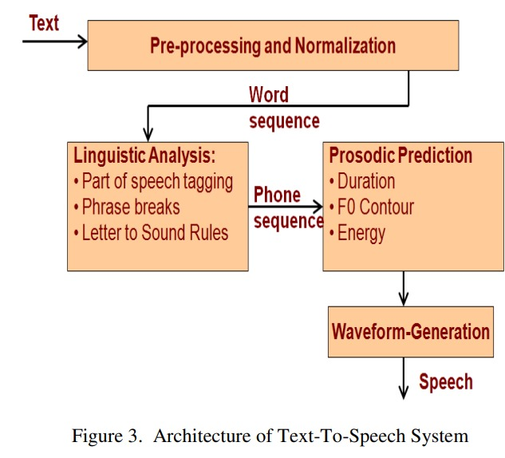
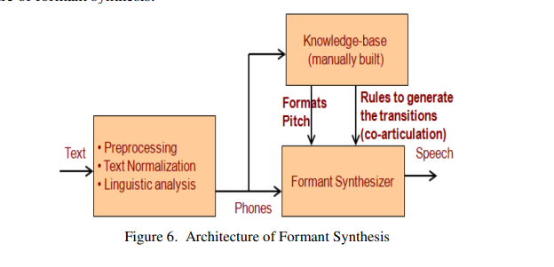
Architecture
Architecture of Statistical Parametric Synthesis (SPS)

Slide 7
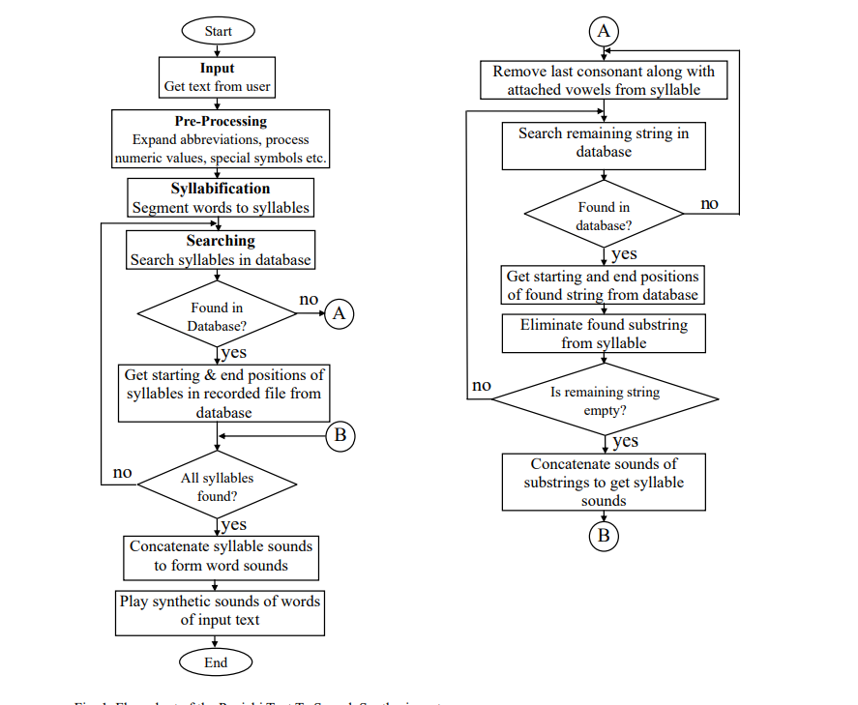

Slide 8
Project Progress So Far
Completed Tasks
Research: Conducted an extensive review of research papers related to text-to-speech (TTS) systems, including recent advancements and methodologies.
Datasets: Identified and evaluated various datasets suitable for training and testing TTS models, ensuring they meet the requirements for high-quality speech synthesis.
Initial Findings
Initial findings reveal that modern neural-based TTS methods like Tacotron and WaveNet produce highly natural speech.
It also suggests that datasets with high-quality, diverse speech samples (e.g., varied accents, emotions, and speech contexts) are likely to produce better TTS results.
It show that there is a limited availability of high-quality Punjabi language datasets for TTS synthesis. While some datasets exist, they often lack the diversity and volume needed to train neural models effectively.
The integration of hybrid approaches and advanced neural vocoders shows potential in improving both the quality and efficiency of TTS systems

Slide 9
Next Steps
Immediate Goals
Preprocess Data: Complete preprocessing tasks for the datasets, such as cleaning, normalizing, and converting text and audio into suitable formats for model training.
Select TTS Model and Set Up the Environment We will choose the most promising TTS model (e.g., Tacotron 2, FastSpeech ) and set up the development environment for implementation.
Long-Term Plans
Advance Naturalness and Expressiveness: Invest in research and development to further improve the naturalness, expressiveness, and emotional range of synthesized speech, leveraging cutting-edge neural network architectures and hybrid synthesis methods
Optimize Model Efficiency: Improve the efficiency of TTS models to reduce computational costs and make them more accessible for various applications.

Slide 10
Use Cases
Accessibility for Visually Impaired Users:TTS systems provide accessibility by converting digital text (e.g., web pages, emails, and e-books) into speech, helping visually impaired users to access and interact with digital content independently.
Example: Screen readers like JAWS or NVDA use TTS technology to help visually impaired individuals navigate computers.
Language Learning Tools: TTS can be integrated into educational apps and platforms to help learners hear correct pronunciations and practice listening skills.
Example: Language learning apps like Duolingo use TTS to provide pronunciation examples.
In-Vehicle Systems: TTS can be used in car navigation systems and infotainment systems to read out directions, notifications, or texts to minimize distractions while driving.
Example: GPS navigation systems use TTS to vocalize driving instructions.

Slide 11

Thank you

