Slide 1


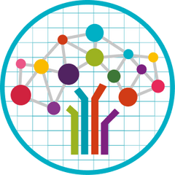


Text to Speech
Presented by : Muskan Saini
Manorma
Rohan Singh
Muskan
Mehakpreet Kaur
Anandita Singh
Project Mentor(s) :
Partha Sarathi Mukherjee
Gurjot Singh
08-11-2024

Slide 2


Problem Statement..
Develop a text-to-speech model that converts text into natural, intelligible speech in real-time, addressing challenges in pronunciation, intonation, and accessibility, particularly for underrepresented languages like Punjabi, to enhance digital inclusivity
Introduction..
A Text-to-Speech (TTS) system converts written text into natural-sounding speech using deep learning. It begins by processing and normalizing the input text, then applies linguistic analysis to determine pronunciation and prosody. Acoustic features are generated and then converted into audio using neural vocoders like WaveNet. The result is clear, expressive speech that closely mimics human intonation. TTS systems are essential for applications in virtual assistants, accessibility services, and interactive voice-activated platforms.

Slide 3


Project objectives..
Naturalness
Produce speech that sounds natural and human-like, including proper intonation, rhythm, and inflection.
High-Quality Audio Output
Focus on producing clear, high-resolution audio that is pleasant to listen to, minimizing distortions and background noise.
Enable Independent Reading
TTS systems empower visually impaired individuals to independently consume text-based materials without requiring assistance from others.

Slide 4
Datasets Explored..
CMU-synthesis Dataset (15.45 GB)
The CMU-synth dataset is a synthetic Punjabi dataset generated using CMU's Clustergen text-to-speech model.
Drawback: The audio output resembles that of a robotic voice.
Common Voice Mozilla Dataset (99.84 MB)
Common Voice is a publicly available voice dataset, powered by the voices of volunteer contributors around the world
Drawback: A key drawback of this dataset is its limited size, which makes it challenging to train a robust and generalizable model.
Google-synthesis Dataset (4.92 GB)
The Google-synth dataset comprises a synthetic Punjabi dataset that has been generated using Google's Cloud Text-to-Speech service.
Drawback: The audio output resembles that of a robotic voice.
IIT Madras Dataset (13.9 GB) :-
This data was collected on payment basis using the following vendors -- Mediscribe India, Desicrew, and Crescendo to ensure high quality of audio
Drawback: The IIT Madras dataset contains some English words mixed into the Punjabi data.

Slide 5

Why IIT Madras Dataset ?..
This Datset was gathered through a paid collection process using services from three vendors: Mediscribe India, Desicrew, and Crescendo , likely to ensure high-quality data.
Diverse Linguistic Content: The IIT Madras dataset includes a wide range of sentences and vocabulary, reflecting various aspects of everyday communication in Punjabi, which can enhance the robustness of TTS systems.
High-Quality Recordings: The audio files in the dataset are recorded by native speakers, ensuring high-quality pronunciation, intonation, and natural speech patterns that are essential for effective speech synthesis.
Research Credibility: Being associated with IIT Madras, a reputable institution, lends credibility to the dataset.
Open Access: If the dataset is freely available, it allows researchers and developers to access high-quality resources without financial constraints
Drawbacks and Solutions :-
Con: The IIT Madras dataset contains some English words mixed into the Punjabi data, which may affect the authenticity of the language model.
Solution: We have addressed this issue by using Google Translate to convert the English words into Punjabi, enhancing the dataset's linguistic integrity.

Slide 6
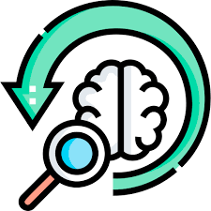
Exploratory Data Analysis..
utterance_id transcription
0 KaInDe_utt00000001 hello
1 KaInDe_utt00000002 hello
2 KaInDe_utt00000004 ਸਤਿ ਸ਼੍ਰੀ ਅਕਾਲ ਮਾਸੀ
3 KaInDe_utt00000006 ਬਸ ਵਧੀਆ ਤੁਸੀਂ ਦੱਸੋ
4 KaInDe_utt00000007 ਮੈਂ ਵਧੀਆ ਘਰ ਸਭ ਠੀਕ ਮੰਮੀ ਪਾਪਾ ਦਾਦੀ
5 KaInDe_utt00000009 ਜੀ ਸਾਰੇ ਹਾਂਜੀ ਤੁਸੀਂ ਦੱਸੋ
6 KaInDe_utt00000010 ਮੈਂ ਵਧੀਆ ਸਭ ਵਧੀਆ ਤੇਰੇ ਭੇਣ ਭਰਾ ਵੀ ਵਧੀਆ ਮਸਤੀਆਂ ਕ...
7 KaInDe_utt00000011 ਪਾ ਦੋ ਬਥੇਰੇ course ਚੱਲਦੇ ਪਏ ਬੱਚਿਆਂ ਨੇ ਅੱਜਕਲ
8 KaInDe_utt00000012 ਕਿਹੜੇ course
9 KaInDe_utt00000014 ਛੋਟੇ ਛੋਟੇ ਬੱਚੇ ਅਮ institute ਵਿੱਚ ਵੀ ਕਰਦੇ ਪਏ ਨੇ...
transcription_length word_count unique_word_count punctuation_count
5 1 1 0
5 1 1 0
18 4 4 6
18 4 4 6
33 8 8 10
24 5 5 11
128 29 26 39
43 9 9 11
12 2 2 2
83 16 13 14
Most Common Words:
ਤੇ: 23210
ਹੈ: 22299
ਵੀ: 22270
ਦੇ: 19427
ਨੂੰ: 15767
ਉਹ: 14632
ਦਾ: 13838
ਦੀ: 13805
ਨੇ: 13055
ਵਿੱਚ: 12448
ਆ: 12158
ਤਾਂ: 11716
ਸੀ: 11564
ਹਾਂ: 10014
ਕਿ: 9637
ਹੀ: 9417
ਇਹ: 9025
ਮੈਂ: 8980
ਨਾ: 8769
ਨਾਲ: 8178
Total Unique Words: 55173

Slide 7
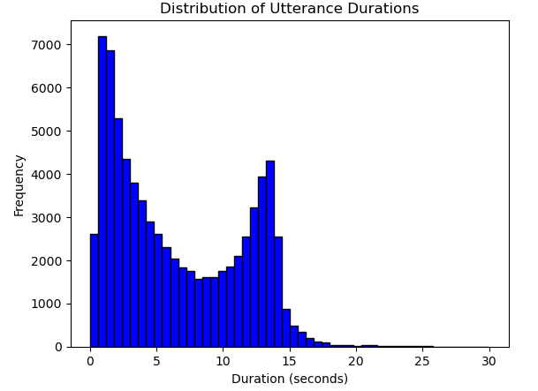
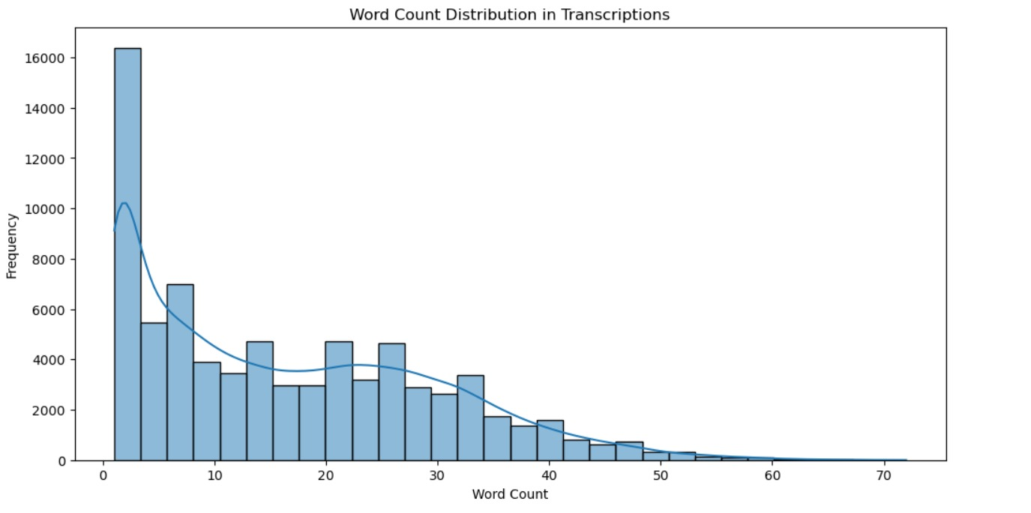
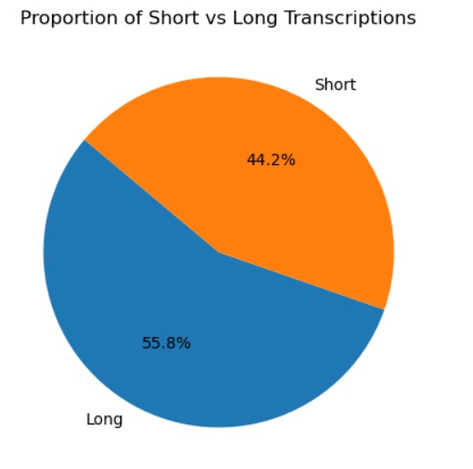

Slide 8
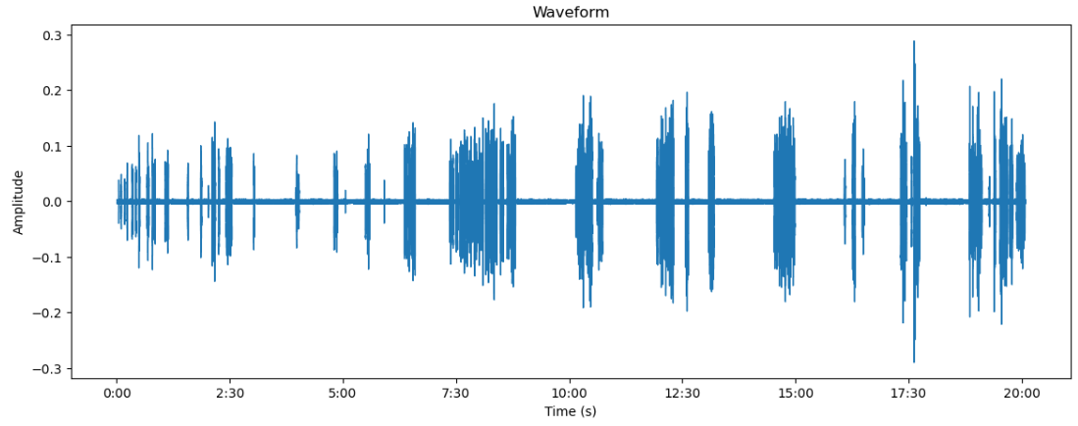
Audio File Analysis..
Total duration | 500259.07 seconds
Average duration | 6.56 seconds
Max duration | 29.97 seconds
Min duration | 0.05 seconds

Slide 9
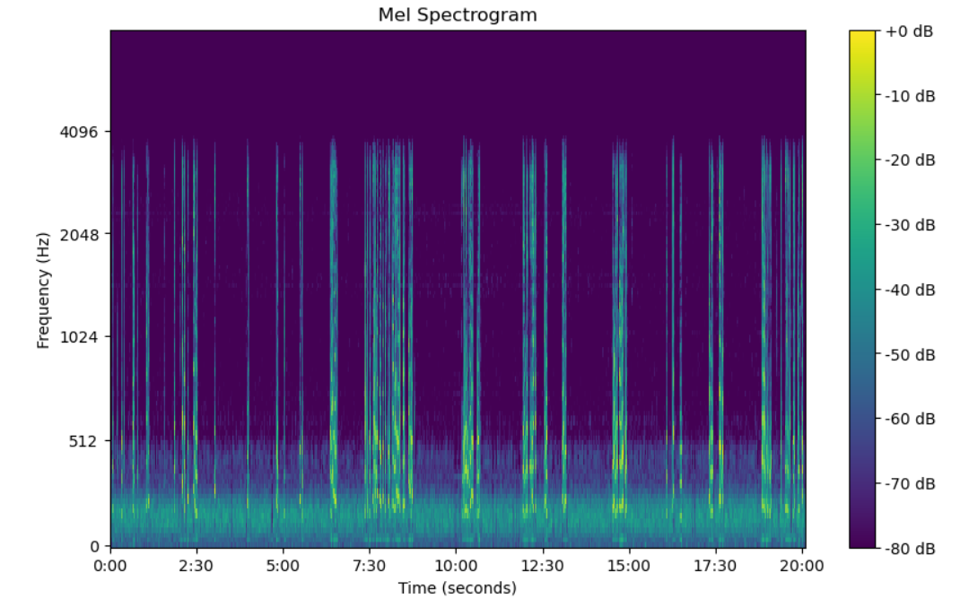
Mel Spectrogram..
A Mel spectrogram is a visual representation of audio frequencies in the Mel scale, which approximates human auditory perception. It captures the power or intensity of various frequencies in the audio signal over time, offering a way to analyze sound in a way that reflects human hearing characteristics.
Mel Scale :- It is a way of measuring sound frequencies that better matches how humans actually hear sounds.
Visualizing a Mel Spectrogram :-
In a Mel spectrogram plot:
The x-axis represents time, showing how sound evolves.
The y-axis represents frequency, but in the Mel scale rather than linear Hertz.
The color intensity represents amplitude, with brighter colors indicating higher intensity (louder parts of the sound).
The legend shows the dB scale, where 0 dB is the highest intensity visible, and -80 dB represents the quietest level shown.

Slide 10
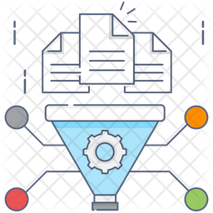
Pre-Modeling Data Preparation
We've already done some basic preprocessing steps, including reading and loading the text data, utterance durations, speaker-to-utterance mappings, and wav file paths.
We identify and translate any English words in the transcriptions into Punjabi. This step involves recognizing non-Punjabi words and replacing them with their Punjabi equivalents. For example, "hello" is translated to "ਸਤ ਸ੍ਰੀ ਅਕਾਲ" and "course" to "ਕੋਰਸ". The translated words are then reintegrated into the transcription to ensure consistency across the dataset. This ensures that the target language, facilitating more accurate analysis or modeling.
There are no null or incomplete entries in the dataset.
Unique utterance IDs: 76294
Non-empty transcriptions: 76294
As part of the preprocessing steps for the audio data, we performed feature extraction using Mel-spectrograms to transform the raw audio into a form suitable for model training.

Slide 11
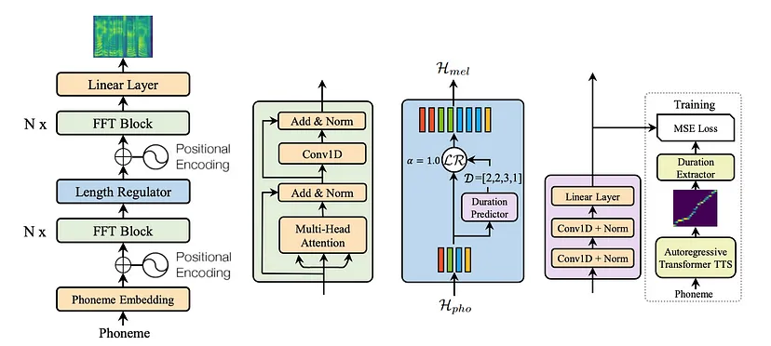
Model Selection :- (FastSpeech2)

Slide 12


Future Prospects and Enhancements
StreamLit
Streamlit is a popular open-source framework for building data-driven web applications with minimal effort, especially used in Python. It’s widely used for creating interactive dashboards and applications for machine learning, data analysis, and other data-centric tasks.
Key Features of Streamlit:
Simple Syntax: You only need Python code, and Streamlit takes care of the frontend.
Real-time Interactivity: Automatically reruns the app whenever you change the code.
No Frontend Development Needed: No need to learn HTML, CSS, or JavaScript.
Supports Widgets: You can add buttons, sliders, inputs, and more for user interaction.
Integration with Python Libraries: Easily integrates with libraries like pandas, NumPy, TensorFlow, PyTorch, Matplotlib, Plotly, etc.
Gradio
Gradio is another popular Python library used to build interactive user interfaces for machine learning models, data science workflows, and AI applications. It's known for its simplicity and ease of use, making it an excellent choice for quickly creating demos or web applications for machine learning.
Key Features of Gradio:
Quick Prototyping: You can create UIs for your models in just a few lines of code.
Customizable Interfaces: Supports different input types (text, images, audio, etc.) and output types.
Integrated with ML models: It allows you to wrap your machine learning model and create interactive applications with it.
Sharing & Collaboration: You can easily share your app by generating a shareable link.
Compatible with Cloud Platforms: Easily deployable on Hugging Face Spaces, Google Colab, or locally.

Slide 13
Use Cases
Accessibility for Visually Impaired Users:TTS systems provide accessibility by converting digital text (e.g., web pages, emails, and e-books) into speech, helping visually impaired users to access and interact with digital content independently.
Example: Screen readers like JAWS or NVDA use TTS technology to help visually impaired individuals navigate computers.
Language Learning Tools: TTS can be integrated into educational apps and platforms to help learners hear correct pronunciations and practice listening skills.
Example: Language learning apps like Duolingo use TTS to provide pronunciation examples.
In-Vehicle Systems: TTS can be used in car navigation systems and infotainment systems to read out directions, notifications, or texts to minimize distractions while driving.
Example: GPS navigation systems use TTS to vocalize driving instructions.

Slide 14

Thank you

