Slide 1
Nested Loop
- Faisal ahmed

Slide 2
Definition
A nested loop is a loop that is inside of another loop.
This allows the inner loop to execute a certain number of times for each iteration of the outer loop.
Example: 1. Pyramid 2. Multiplication Table

Slide 3
Example – Pyramid
1 1 4 3 2 1 1 2 3 4
1 2 2 1 4 3 2 1 2 3
1 2 3 3 2 1 4 3 1 2
1 2 3 4 4 3 2 1 4 1
1
2 1 2
3 2 1 2 3
4 3 2 1 2 3 4

Slide 4
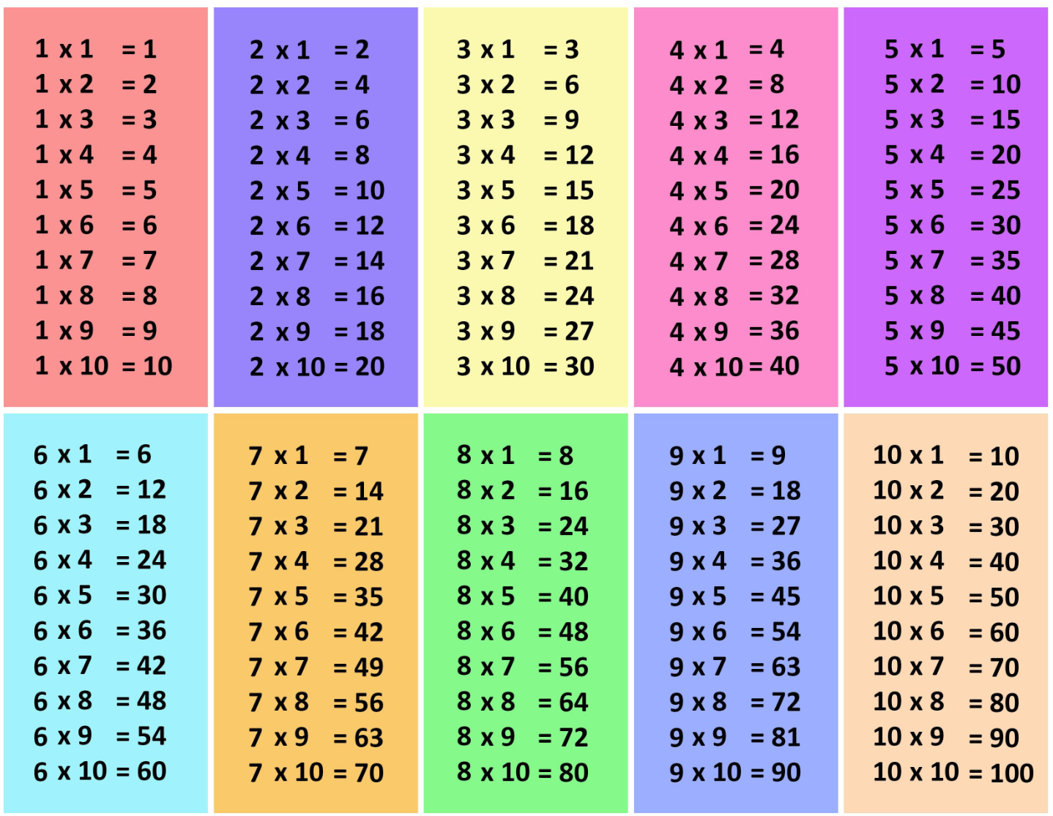
Example – Multiplication Table

