Slide 1
BASH SCRIPTING
Managing Running systems
Basics

Slide 2
Boot, reboot, and shut down a system safely
To reboot or shutdown a Linux machine we’ll often use the systemctl (system control) command.
To reboot:
sudo systemctl reboot
sudo systemctl start nginx
sudo systemctl stop/status mysql-server
To shutdown:
sudo systemctl poweroff
Rarely, you might find yourself in situations where the system refuses to reboot or shutdown normally.
sudo systemctl reboot --force
sudo systemctl poweroff --force

Slide 3
Scheduling Reboot
The shutdown command is better suited for scheduled reboots or shutdowns.
To shutdown at 02:00 AM:
sudo shutdown 02:00
The time is in 24-hour format, so you can use anything between 00:00 and 23:59.
If you want to shutdown x minutes later, use +x instead. To shutdown after 15 minutes:
sudo shutdown +15
To reboot instead, add the -r, reboot option:
sudo shutdown -r 02:00
sudo shutdown -r +15
sudo shutdown -r +1 'Scheduled restart to do an offline-backup of our database'

Slide 4
Diagnose and manage processes
Types of Processes:
Foreground Processes: They run on the screen and need input from the user. For example Office Programs
Background Processes: They run in the background and usually do not need user input. For example Antivirus.
You can use the command “fg” to continue a program which was stopped and bring it to the foreground.
fg jobname
You can use the command “&” to continue a program which was stopped and bring it to the foreground.
firefox bg

Slide 5
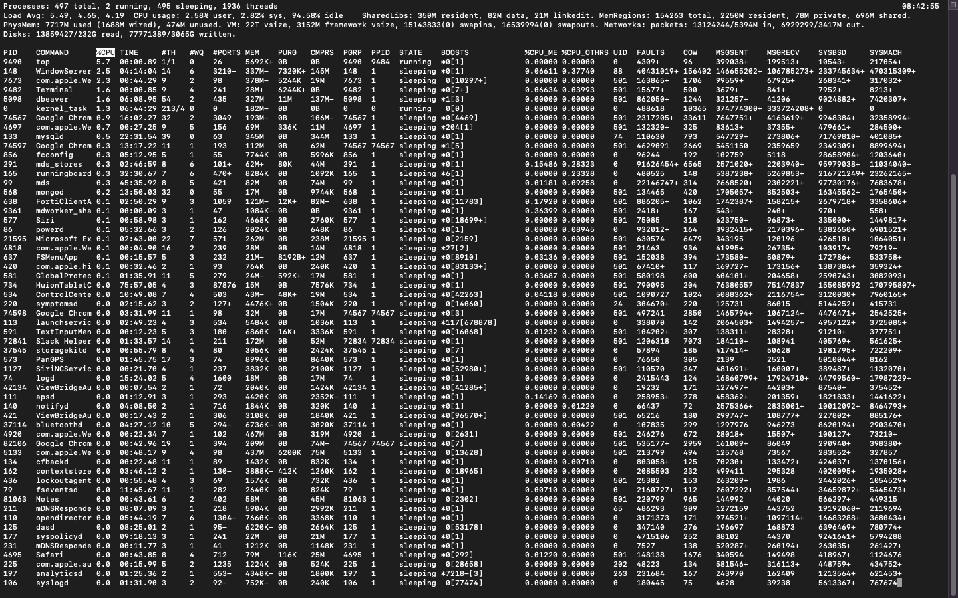
TOP

Slide 6
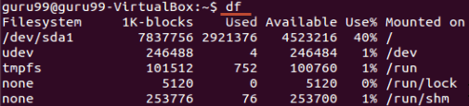
DF
DF
This utility reports the free disk space(Hard Disk) on all the file systems.
If you want the above information in a readable format, then use the command
'df -h'

Slide 7

FREE
This command shows the free and used memory (RAM) on the Linux system.
You can use the arguments
free -m to display output in MB
free -g to display output in GB

Slide 8
Locate and analyze system log files
System logs
System logs deal with exactly that - the Ubuntu system - as opposed to extra applications added by the user. These logs may contain information about authorizations, system daemons and system messages.
Authorization log
Location: /var/log/auth.log
Keeps track of authorization systems, such as password prompts, the sudo command and remote logins.
Daemon Log
Location: /var/log/daemon.log
Daemons are programs that run in the background, usually without user interaction. For example, display server, SSH sessions, printing services, bluetooth, and more.
Debug log
Location: /var/log/debug
Provides debugging information from the Ubuntu system and applications.
Kernel log
Location: /var/log/kern.log
Logs from the Linux kernel.
System log
Location: /var/log/syslog

Slide 9
Locate and analyze system log files
Application logs
Some applications also create logs in /var/log. Below are some examples.
Apache logs
Location: /var/log/apache2/ (subdirectory)
Apache creates several log files in the /var/log/apache2/ subdirectory. The access.logfile records all requests made to the server to access files. error.log records all errors thrown by the server.
X11 server logs
Location: /var/log/Xorg.0.log
The X11 server creates a seperate log file for each of your displays. Display numbers start at zero, so your first display (display 0) will log to Xorg.0.log. The next display (display 1) would log to Xorg.1.log, and so on.
Non-human-readable logs
Not all log files are designed to be read by humans. Some were made to be parsed by applications. Below are some of examples.
Login failures log
Location: /var/log/faillog
Contains info about login failures. You can view it with the faillog command.
Last logins log
Location: /var/log/lastlog
Contains info about last logins. You can view it with the lastlog command.
Login records log
Location: /var/log/wtmp

Slide 10
Locate and analyze system log files
Application logs
Some applications also create logs in /var/log. Below are some examples.
Apache logs
Location: /var/log/apache2/ (subdirectory)
Non-human-readable logs
Not all log files are designed to be read by humans. Some were made to be parsed by applications. Below are some of examples.
Login failures log
Location: /var/log/faillog
Contains info about login failures. You can view it with the faillog command.
Last logins log
Location: /var/log/lastlog
Contains info about last logins. You can view it with the lastlog command.
Login records log
Location: /var/log/wtmp

Slide 11
Schedule tasks to run at a set date and time
Cron is a daemon used to execute scheduled commands automatically.
The commands for a cron job are stored in the crontab file on a Linux system, which is usually found in /etc/crontab. Display the contents of your crontab file with $ crontab -l.
Edit the crontab file with $ crontab -e.
$ <minute> <hours> <day_of_month> <month> <day_of_week> <command_to_run>
minute: 0 to 59
hours: 0 to 23
day of the month: 1 to 31
month: 1 to 12
day of the week: 0 (Sunday) to 6 (Saturday)
# Scan my home directory for viruses
0 10 * * 1 clamscan -ir /home/don
# Backup my home directory
0 9 * * 2 tar -zcf /var/backups/home.tgz /home/don
Additionally, most modern cron systems feature shortcuts to common values, including:
@hourly : Run once an hour (0 * * * *)
@daily : Run once a day (0 0 * * *)
@weekly : Run once a week (0 0 * * 0)
@monthly : Run once a month (0 0 1 * *)
@reboot : Run once after reboot

Slide 12
Assignment

