Slide 1
Advanced SaC
Jordy Aaldering & Thomas Koopman
Software Science
Radboud University Nijmegen

Slide 2
User defined types
What does this function do? double[2] conj(double[2] z)
{ return [z[0], -z[1]]; }

Slide 3
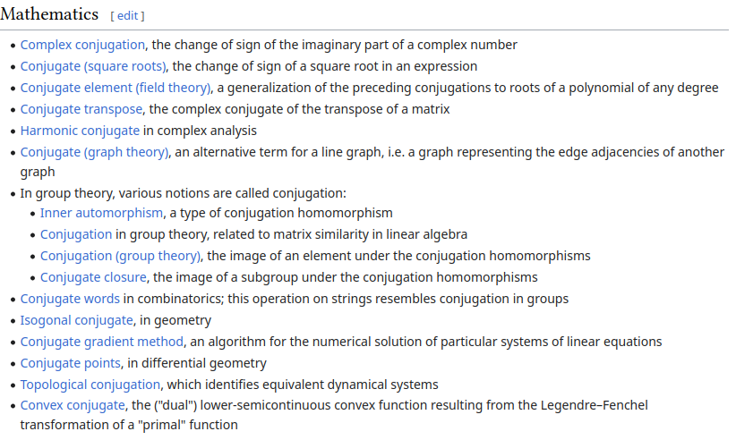
User defined types

Slide 4
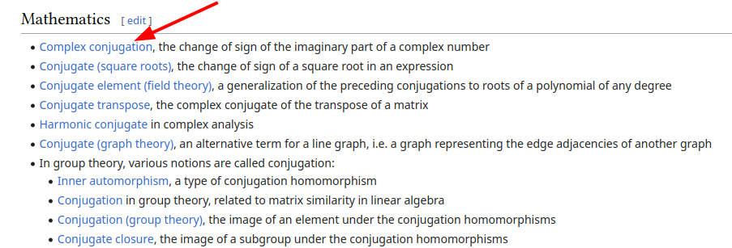
User defined types
This is much better! complex conj(complex z)
{ return toc(real(z), -imag(z)); }

Slide 5
User defined types
User defined-types allow the programmer to deal with the second version, but the compiler with the first.
typedef double[2] complex;
Helper functions can be defined in a module / stdlib, abstracting all this away.

Slide 6
User defined types
typedef double[2] complex;
double real(complex z)
{
return ((double[2])z)[0];
} complex toc(double real, double imag)
{
return (complex)[real, imag];
}
double norm(complex z)
{
return sqrt(real(z) * real(z) + imag(z) * imag(z));
}

Slide 7
User defined types: exercise
Define a complexf that uses float instead of double
Overload the necessary functions taking complex with complexf versions
Can you still compile and run Tier1 after a search replace? (e.g. sed -i 's/complex/complexf/g' *sac )

Slide 8
Records
Alternatively, we could define complex numbers as a record
struct Complex {
double real;
double imag;
};

Slide 9
Records
double real(struct Complex z)
{
return z.real;
} complex toc(double real, double imag)
{
return Complex{ real, imag };
}
double norm(struct Complex z)
{
return sqrt(z.real * z.real + z.imag * z.imag);
}

Slide 10
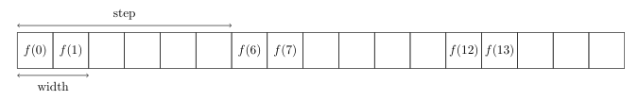
Partitions
We may want to have different functions on different subarrays
Such a subarray is called a partition x = { iv -> f(iv) | [0] <= iv < [16] step [6] width [2] }

Slide 11
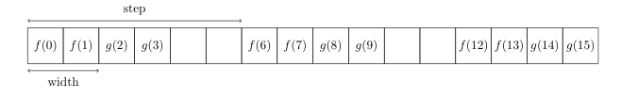
Partitions (2)
We can have multiple partitions x = { iv -> f(iv) | [0] <= iv < [16] step [6] width [2];
iv -> g(iv) | [2] <= iv < [16] step [6] width [2] }
Implicit partitions are filled with 0s

Slide 12
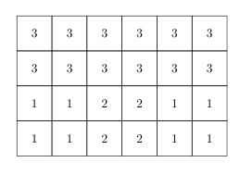
Partitions: exercise
Try to make the following picture in SaC

Slide 13
Rotate
Shift all elements to the right (or left if negative)
Wrap around values that go out of bounds
Works for higher dimensions as well
1 | 2 | 3 | 4 | 5
rotate([1], [1,2,3,4,5])
rotate([2], [5,1,2,3,4])
rotate([-1], [3,4,5,1,2])
5 | 1 | 2 | 3 | 4
3 | 4 | 5 | 1 | 2
2 | 3 | 4 | 5 | 1

Slide 14
Rotate
When is this useful?
Neighbors of elements at the edge
1 | 2 | 3 | 4 | 5
6 | 7 | 8 | 9 | 10
11 | 12 | 13 | 14 | 15
16 | 17 | 18 | 19 | 20
21 | 22 | 23 | 24 | 25
25 | 21 | 22 | 23 | 24
5 | 1 | 2 | 3 | 4
10 | 6 | 7 | 8 | 9
15 | 11 | 12 | 13 | 14
20 | 16 | 17 | 18 | 19
rotate([1,1], arr)
4 partitions
1 partition

Slide 15
Rotate: exercise
Implement rotate
relax.ipynb
Task 1 and 2

