Slide 1
Mandelbrot in SaC
Jordy Aaldering & Thomas Koopman
Software Science
Radboud University Nijmegen

Slide 2
Complex numbers
Complex numbers consist of the set ℂ = {a + bi | a, b ∈ ℝ}
Examples: 5 + 3i, 0.2 + 4i, 929 + 1992i, etc.
A multiplication and addition defined by i^2 = -1
(5 + 3i) + (10 + 2i) = (10 + 5) + (3 + 2)i = 15 + 5i
(5 + 3i) * (10 + 2i) = 5 * 10 + 5 * 2i + 3i * 10 + 3i * 2i = 50 + 10i + 30i + 6i^2 = 50 + 40i + 6 * -1 = 44 + 40i

Slide 3
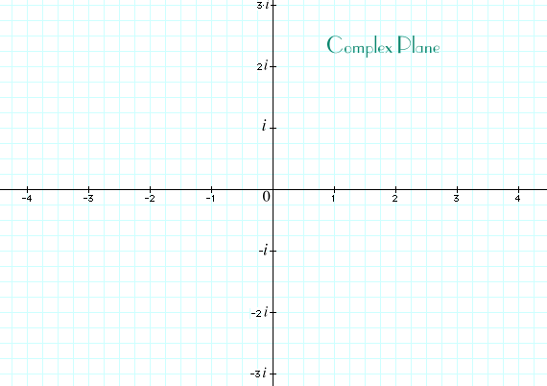
Complex numbers
In a + bi, we call a the real part, and b the imaginary part.
We can graph this in the plane

Slide 4
Complex numbers
The SaC standard library supports complex numbers
To get 5 + 3i: toc(5, 3)
To get the real (imaginary) part of z: real(z) (imag(z))

Slide 5
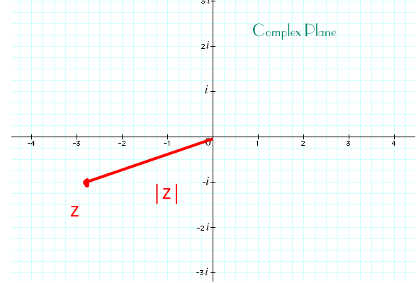
Complex numbers
Distance between complex number z = a + bi and the origin is called the norm (or |z|)
Pythagoras: norm(z) = sqrt(a^2 + b^2)

Slide 6
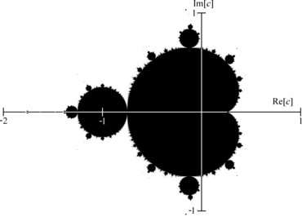
Mandelbrot
For any c, define series zn + 1 = zn * zn + c, z0 = c
The Mandelbrot set are those points c for which this series does not escape

Slide 7
Mandelbrot
There is no algorithm to determine whether c is in the Mandelbrot set
But, when |zn| > 2, for any n, it is definitely not in the set

Slide 8

Mandelbrot approximation
Compute the sequence until |zn| > 2 or a maximum iteration count is reached. If the max iteration count is reached, assume c is in the set.

Slide 9
Mandelbrot exercise 1
Implement the functions in Tier1_template.sac
When done, rename to Tier1.sac and run `make tier1`. You can run bin/tier1 to get an interactive picture. Zoom in by selecting a window.
Too slow? Get free multithreading with `make tier1_mt`, and run bin/tier1_mt <number of cores>

Slide 10
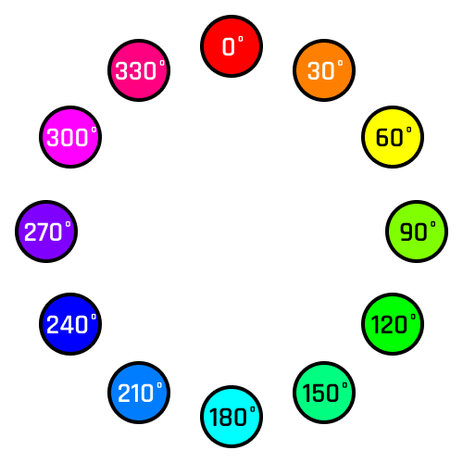
Prettifying Mandelbrot
Previous picture was monochrome red
We will now the HSB colour scheme, represented by a number in [0, 360)

Slide 11
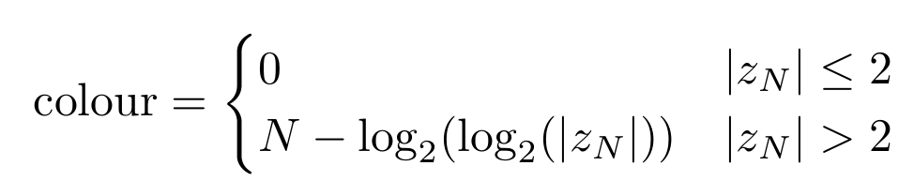
Prettifying Mandelbrot
Let N be the escape time of a sequence. In order to smooth-out the picture, we compute
and then normalize to a value in [0, 360) by doing colour * 360 % 360

Slide 12
Prettifying Mandelbrot: exercise
Fill in Tier2_template.sac
You may want to use where: [1, 2, 1, 1] = where([true, false, true, true], 1, 2) (Ternary operator: ? In C, and merge in Fortran)

