Slide 1
Mandelbrot in SaC 2
Jordy Aaldering & Thomas Koopman
Software Science
Radboud University Nijmegen

Slide 2
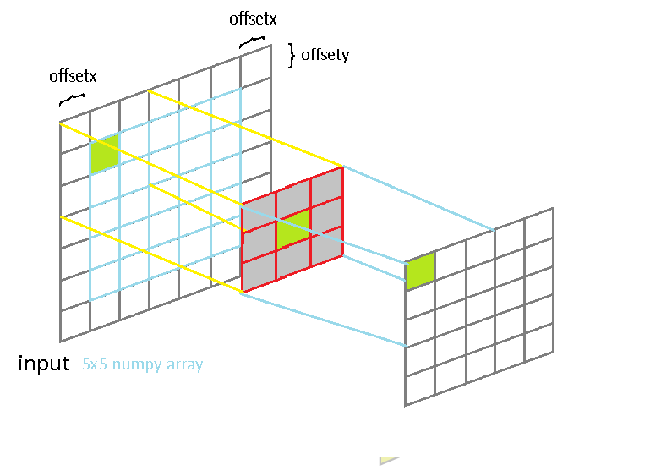
Relaxations
A relaxation replaces each pixel by a weighted average of its neighbours

Slide 3
Relaxations
For 3 x 3 weights: out[iv] = (weights[0, 0] * in[iv - [1, 1]] + weights[0, 1] * in[iv - [1, 0]] + … weights[2, 2] * in[iv + [1, 1]]
) / sum(weights)

Slide 4
Mandelbrot tier 3
Implement relax in Tier3_template.sac
There are many ways of doing this. Experiment a little and see what is fastest
color is a typedef for int[3], containing the rgb values. Cast your img to an int[m, n, 3] and apply the relaxation on each of the three colours.

Slide 5
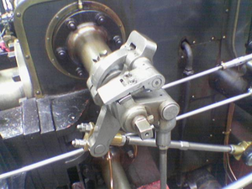
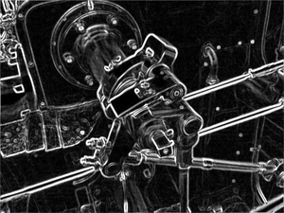
Sobel edges
The same computation can be used to sharpen instead of smoothen

Slide 6
Sobel edges
If a pixel has the same colours above and below, the weights [[1, 2, 1], [0, 0, 0], [-1, -2, -1]] turn each pixel to 0. So this magnifies edges
See Tier4 (trivial to implement)

