Slide 1

AI PERSONAL ASSISTANT
Full-Stack AI PERSONAL ASSISTANT
by:
ADARSH SINGH(Er No. 221B024) · ADITYA SACHAN (Er No. 221B029) · LAXMIKANT SHUKLA (Er No.221B220)
Under the supervision of:
DR. KB MEENA (KBM 2)
Jaypee University of Engineering & Technology, Guna

Slide 2
2. Problem Statement
What Problem Are We Solving?
Existing voice assistants use generic, robotic voices with no personalization. There is no accessible platform that combines voice cloning with an intelligent LLM backend deployable on consumer hardware without a GPU — forcing companies to choose between quality and cost.
Why is this Important?
User Experience
Data Privacy
Technical Gap
71% of customers report frustration with robotic AI voices. Human-sounding speech increases trust and satisfaction in automated support.
GPU-heavy models (XTTS v2, RVC) are impractical on standard servers. A CPU-only pitch-matching approach makes voice personalization affordable and accessible.
No existing open-source tool integrates cloud LLM intelligence + CPU voice cloning in one monorepo deployable on consumer hardware without a GPU.
3
Jaypee University of Engineering & Technology, Guna

Slide 3
1. Introduction
Overview
Objectives
What it does:
A full-stack AI voice cloning platform that bridges three runtimes (Node.js, Python Flask, Google Gemini) into one seamless experience.
Pipeline:
1. Upload a voice sample (6–20 sec)
2. LLM generates an intelligent answer
3. Edge TTS synthesizes speech, pitch-shifted to match your voice
4. Audio returned to browser for playback
Real-World Use Case:
Customer support automation — a company records one agent's voice; the AI answers queries in that natural human voice.
[1]
Build voice profile CRUD with file upload
[2]
Integrate Google Gemini 2.5 Flash as the primary LLM with 3-model fallback
[3]
Implement CPU-based voice cloning via Edge TTS + autocorrelation pitch matching + ffmpeg pitch shift
[4]
Create REST API with 3-level fallback chain
[5]
Build interactive React/Next.js frontend
[6]
Design monorepo architecture (npm workspaces)
2
Jaypee University of Engineering & Technology, Guna

Slide 4
3. Literature Review
Technology / Work | Key Findings | Limitations / Gaps
XTTS v2 — Coqui AI (2023) Zero-shot TTS & voice cloning | Clones any voice from 6–20 s of audio; supports 17 languages; open-source & free | Requires Python 3.11; large model (1.8 GB); first-load latency 30–60 s
Ollama + LLaMA 3 — Meta (2024) Local LLM inference engine (prototype only — production uses Google Gemini API) | Runs 8B-param model on CPU; fully private; no API key; offline capable | Inference takes 30–90 s on CPU; not real-time; requires 8+ GB RAM
ElevenLabs / Resemble AI Commercial voice cloning APIs (active — used for persona voices) | High-quality output; fast inference (<1 s); easy REST integration | Paid service ($0.30/1K chars); sensitive data leaves system; rate limits
GPT-4 / Claude API Cloud LLM for customer support (primary in production) | High accuracy; context-aware; production-ready; sub-second responses | Requires API key; usage costs; no voice output; privacy concerns for support data
4
Jaypee University of Engineering & Technology, Guna

Slide 5
4. Work Plan
Week | Work | Status
Week 1 | Project setup: environment config, monorepo (npm workspaces), TypeScript | ✓ Completed
Week 2 | Backend API: Express.js routes, Zod validation, error handling middleware | ✓ Completed
Week 3 | Python Flask voice server: F0 estimation via autocorrelation, Edge TTS integration, pitch shifting via ffmpeg | ✓ Completed
Week 4 | LLM integration: Google Gemini 2.5 Flash with 3-model fallback chain, persona system prompts | ✓ Completed
Week 5 | Next.js frontend: voice recorder, chat UI, audio playback, API client | ✓ Completed
Week 6-8 | End-to-end integration testing & cross-service debugging | ✓ Completed
Week 9 | In-memory store optimisation, end-to-end testing, deployment pipeline & project documentation | ✓ Completed
* Weekly progress must align with reports submitted to the supervisor.
5
Jaypee University of Engineering & Technology, Guna

Slide 6
5. Individual Contribution
Member Name | Enrollment No. | Contribution
ADARSH SINGH | 221B024 | Backend API development (Express.js), Gemini API integration, Zod validation, fallback chain design, and error handling middleware
ADITYA SACHAN | 221B029 | Python Flask voice server, autocorrelation-based F0 pitch estimation, Edge TTS integration, ffmpeg pitch shifting pipeline, and audio synthesis
LAXMIKANT SHUKLA | 221B220 | Next.js / React frontend, Web Audio API microphone recording, chat UI, audio playback, and REST API client abstraction
6
Jaypee University of Engineering & Technology, Guna

Slide 7
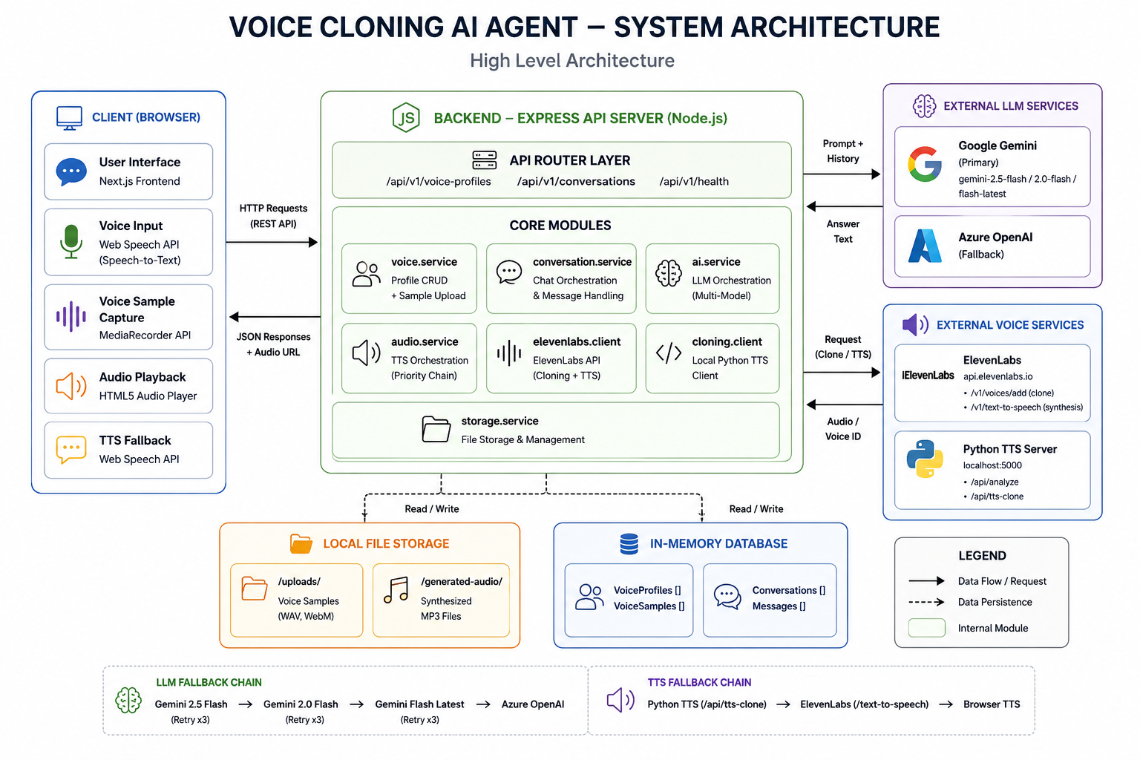
6. Work Done: System Architecture & Data Flow
Data Flow: User speaks → Next.js (:3000) → Express API (:4000) → Google Gemini generates text → Python Flask (:5000): F0 estimate + Edge TTS + ffmpeg pitch shift → MP3 → Browser plays audio
7
Jaypee University of Engineering & Technology, Guna

Slide 8
Technology Stack & REST API
Technology Stack
Key REST API Endpoints
Backend
Node.js 24 · Express.js · TypeScript · Zod · Multer · uuid
GET
/voice-profiles
List all voice profiles
Frontend
Next.js 15 · React 19 · TypeScript · Web Audio API
POST
/voice-profiles
Create a new voice profile
POST
/:id/samples
Upload voice audio sample
AI / LLM
Google Gemini 2.5 Flash (primary) · Azure OpenAI (fallback) · Ollama (prototype only)
POST
/:id/submit
Activate voice profile (F0 analysis + Edge TTS match)
Voice
Edge TTS (Microsoft) · Flask 3.1 · Python 3.11 · ffmpeg · numpy/scipy
POST
/conversations
Start a new conversation
Database
In-Memory store · Prisma ORM · PostgreSQL (Docker)
POST
/:id/ask
Ask → AI voice response
Infra
npm Workspaces · tsx hot-reload (Docker optional)
Python: POST /api/analyze { speaker_wav } → { profile_id, f0_hz, voice_id } | Python: POST /api/tts-clone { text, profile_id } → MP3 audio
8
Jaypee University of Engineering & Technology, Guna

Slide 9
CONCLUSION
Future Scope
Conclusion
References (IEEE)
PostgreSQL via Prisma ORM — persistent DB, multi-user support
XTTS v2 (Coqui) on GPU — true neural cloning, sub-1s TTS
Redis/Bull queue — async TTS for concurrent users
JWT auth & multi-user management
CDN (Cloudflare R2 / S3) — global audio delivery
Multi-language — XTTS v2 (17 langs) + Gemini multilingual
Docker Compose + CI/CD — one-command cloud deployment
Successfully delivered a full-stack AI voice assistant with persona switching:
3-tier: Next.js → Express API → Python Flask
Edge TTS + ffmpeg pitch clone — CPU-only, ±5 semitone
Gemini 2.5 Flash — 4-level AI fallback chain
4–6 s response time, no GPU required
9 Edge TTS voices + 8 ElevenLabs personas
Outcome Achieved:
Voice personalisation at zero GPU cost — autocorrelation + Edge TTS + Gemini, 4–6 s on standard hardware.
[1] E. Casanova et al., 'XTTS: A Massively Multilingual Zero-Shot TTS,' arXiv:2406.04904, Jun. 2024. [2] Meta AI Research, 'LLaMA 3: Open Foundation Models,' Meta AI Technical Report, Apr. 2024. [3] J. Achiam et al., 'GPT-4 Technical Report,' OpenAI, arXiv:2303.08774, 2023. [4] J. Shen et al., ‘Tacotron 2: Natural TTS via WaveNet,’ ICASSP, 2018. [6] E. Casanova et al., ‘XTTS v2: Multilingual Zero-Shot TTS,’ github.com/coqui-ai/TTS [7] Microsoft, ‘Edge TTS — Neural TTS,’ github.com/rany2/edge-tts
9
Jaypee University of Engineering & Technology, Guna

Slide 10
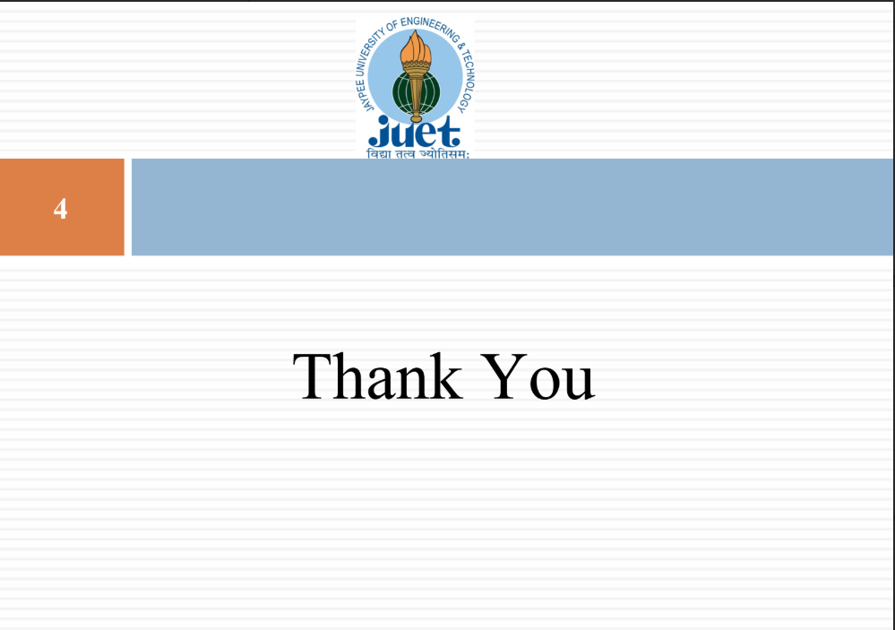
10

