Slide 1

ぷよの操作
→ 右回転
← 左回転
↓ 落下
LOADING...

Slide 2
https://fonts.google.com/specimen/ZCOOL+KuaiLe?preview.text=LOADING...&preview.text_type=custom

Slide 3


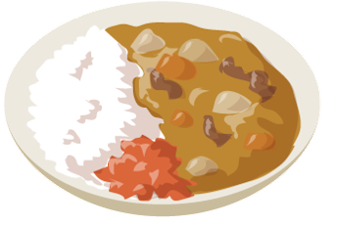



SCORE
1,440
+

Slide 4

SCORE
1,440
+

Slide 5
SCORE
1,490
+

