Slide 1

I Use Arch BTW!
Here is where your
presentation begins

Slide 2
01
Linux
Why use Linux

Slide 3
Linux
Absolutely Free
Revive Old Computer
01
02
Linux can run on Computers with very low specifications.
Linux is a free operating system with the open source community at its backbone.
Safe & Secure
Customization
03
04
Linux is extremely secure due to its open source nature and niche market
You can customise your linux machine in any way you see fit.

Slide 4

Arch Linux
Arch Linux is an independent Linux distribution that adheres to the principles of simplicity, modernity, pragmatism, user centrality, and versatility.

Slide 5
What’s So special about Arch !

Slide 6
The DIY approach gives you control over every aspect of your operating system
Arch is created, supported and owned by the community
It’s always updated with the latest software and security patches

Slide 7
Installation

Slide 8
Installation Overview
Establish a Network Connection
Install Essential Packages and generate the fstab file
Step 1
Step 2
Step 3
Step 4
Partition the disk and mount the filesystems
Install a bootloader

Slide 9
Obstacles I encountered during the install
Getting wireless connectivity
Bootloader
I created a config file for iwd and followed a thread i found on archwiki.
Initially i tried using systemd boot but later switched to grub to simplify things.

Slide 10
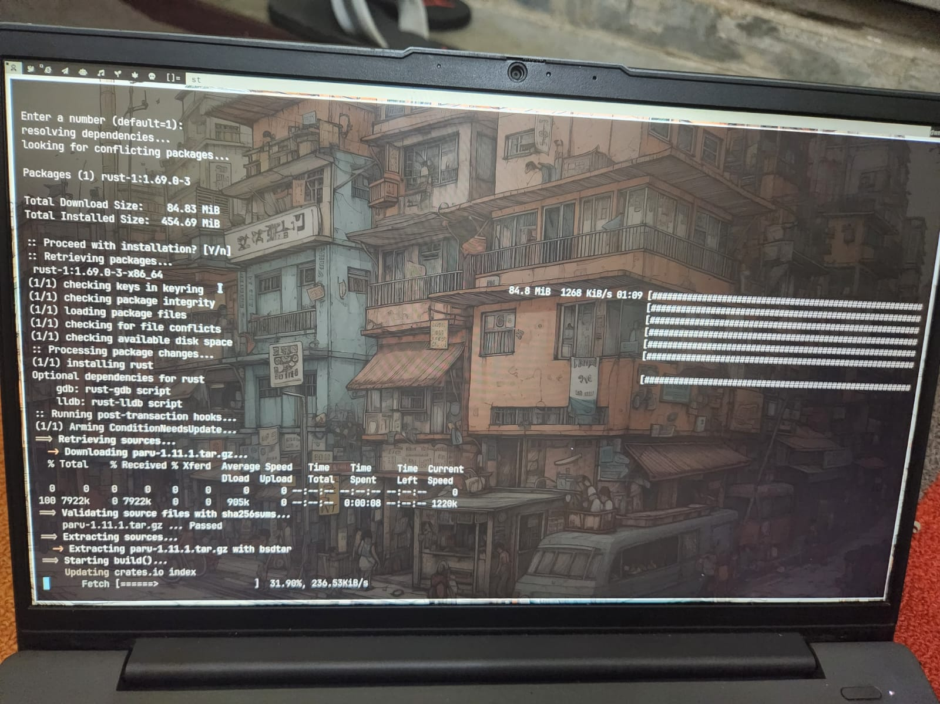
My Custom Setup
Arch
Dwm
Dwmblocks
Dmenu
Pywall to get matching colour theme for the terminal and taskbar
St terminal
A blurred transparent effect on the terminal
A startup script which ran on boot to setup everything
Zsh syntax highlighting
Paru as an AUR
Tabliss and pywalfox for firefox

Slide 11
THE BIG PROBLEM
When i was trying to set a theme for discord it kept crashing when i clicked on the open theme folder
I decided that I should install a file manager for the system
Hence I installed Dolphin and qt5ct to do the same
My system suddenly crashed and threw me into an emergency environment and I couldn’t boot

Slide 12
What I learnt
I learnt the basic structure of linux
The essence of what it takes for an operating system to run
How to customise configuration files according to my liking
Some basic bash scripting
A lot of bash commands (eg, chmod, cat, echo, cp, mv, etc.)
And most importantly,
How to read through wikis and forums

Slide 13
Thank You!
=

