Slide 1
Team Project SS21
Blockchain Based Order and Access Management
Sachith Liyanagama, 769617
Ken Freise, 746041
Shakil Ahammed, 769709

Slide 2
Content
Concept
Current Method Of Order Management …………………………………………………………………………………………………….
Proposed Method for Order Management ………………………………………………………………………………………………….
Blockchain
What is Ethereum? …………………………………………………………………………………………………………………………………….
Smart Contracts ………………………………………………………………………………………………………………………………………..
Blockchain Oracle ……………………………………………………………………………………………………………………………………..
Communication with Blockchain ……………………………………………………………………………………………………………….
Project Content
Ganache …………………………………………………………………………………………………………………………………………….......
Smart Contracting structure used in the project …………………………………………………………………………………….
INTRANAV RTLS API Add-On ……………………………………………………………………………………………………………………….
Internal Processing API ……………………………………………………………………………………………………………………………..
Client Portal ………………………………………………………………………………………………………………………………………………
Project Status …………………………………………………………………………………………………………………………………….….
Demonstration …………………………………………………………………………………………………………………………………….…
Page 3
Page 4
Page 5
Page 6
Page 7
Page 8
Page 9
Page 10
Page 11
Page 12
Page 13
Page 14
Page 15

Slide 3
Current Method of Order Management
Traditional Order management
INTRANAV®
Current Ordering Process
Customer
INTRANAV®
Sales
Request Quotation
Customer
Sales Department
Send Quotation
Purchase Order
Process and Send Order along with the Authorization Key
INTRANAV®
Certificate Authority
(Auth Key Generator)
Customer
Business Department
INTRANAV®
RTLS Platform
Rest API
Microservice
Customer
End Application
Manage Asset & Access the Data using Authorization Key

Slide 4
Proposed Method of Order Management
Using Ethereum Blockchain
INTRANAV®
Amazon® AWS*
Customer
INTRANAV®
Order Management
Ethereum Blockchain Simulation
New Order
Customer
Application
Regular Customer Request Processing
Rest API
INTERNAL
Access
History Contract
Request Pay
Asset Contract
Payment
INTRANAV®
Certificate Authority
(Auth Key Generator)
Rest API
User
&
Asset Manager
Open Requests Contract
SEND Key
MAIN Contract
INTRANAV®
RTLS Platform
Get Auth & Asset Management
Oracle Service Contract
Asset Management
Access the Data using Authorization Key

Slide 5
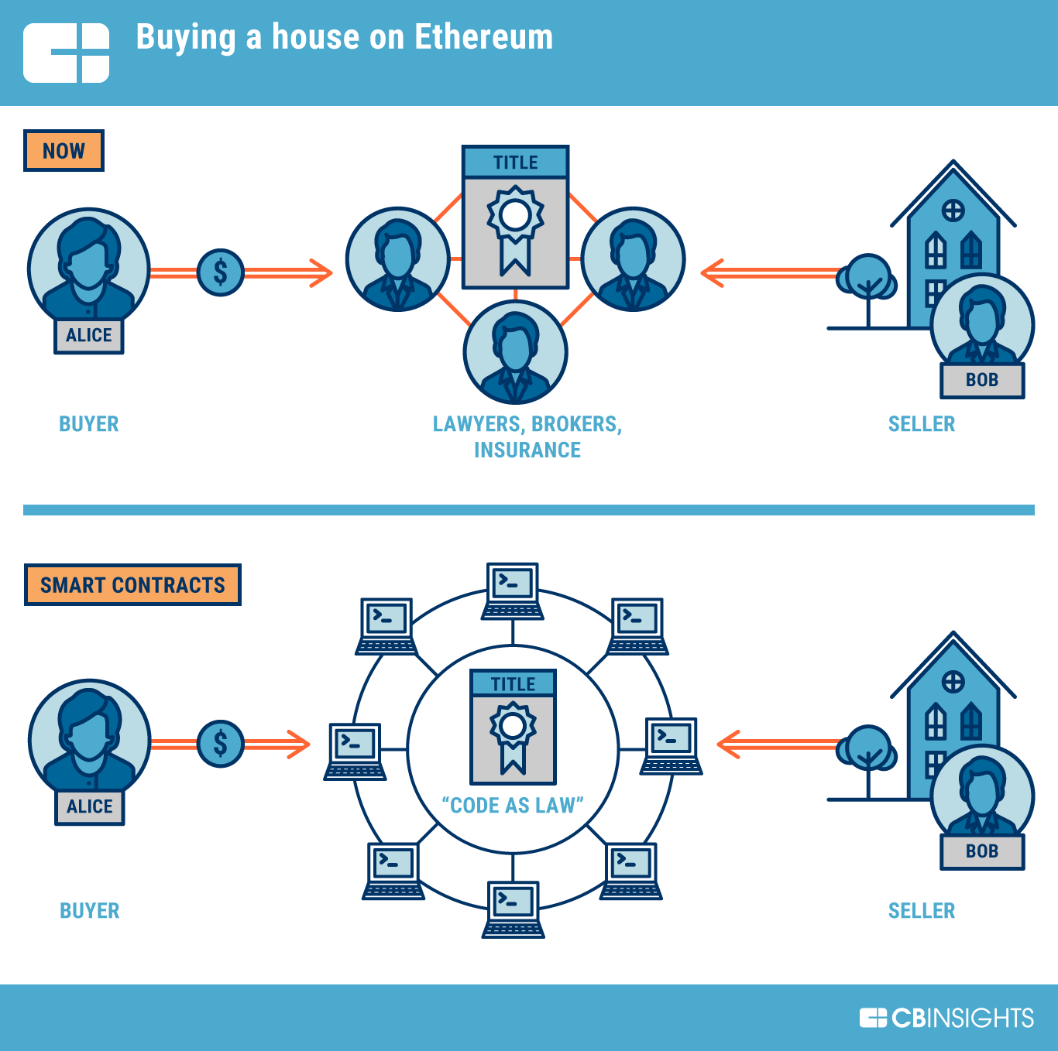
What is Ethereum?
Ethereum Blockchain
What is Blockchain?
Blockchain is a specific type of database.
It differs from a typical database in the way it stores information; blockchains store data in blocks that are then chained together. As new data comes in it is entered into a fresh block. the most common use so far has been as a ledger for transactions.
What is Ethereum?
Ethereum is a technology that lets you send cryptocurrency to anyone for a small fee. It also powers applications that everyone can use and no one can take down.
Ethereum builds on Bitcoin's innovation, with some big differences.
Both let you use digital money without payment providers or banks. But Ethereum is programmable, so you can also use it for lots of different digital assets – even Bitcoin!
Ethereum is for more than payments. It's a marketplace of financial services, games and apps that can't steal your data or censor you.

Slide 6
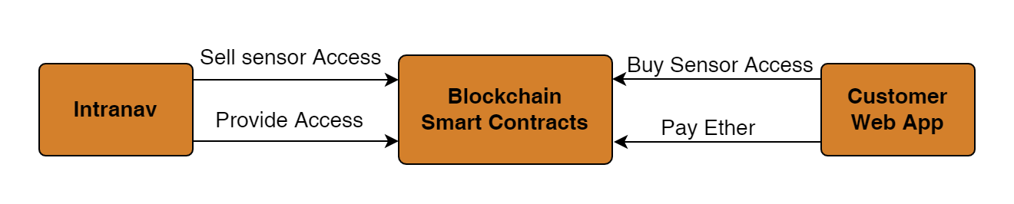
Smart Contracts
What is Smart Contract?
It’s a digital contract
Smart Contracts can be deployed on a blockchain
Written in a Programming language (solidity for Ethereum).
Limitation in size (24 KB).
Can‘t use external API to get data.
Each node needs to calculate(Mine) same result for same input for a contract method

Slide 7
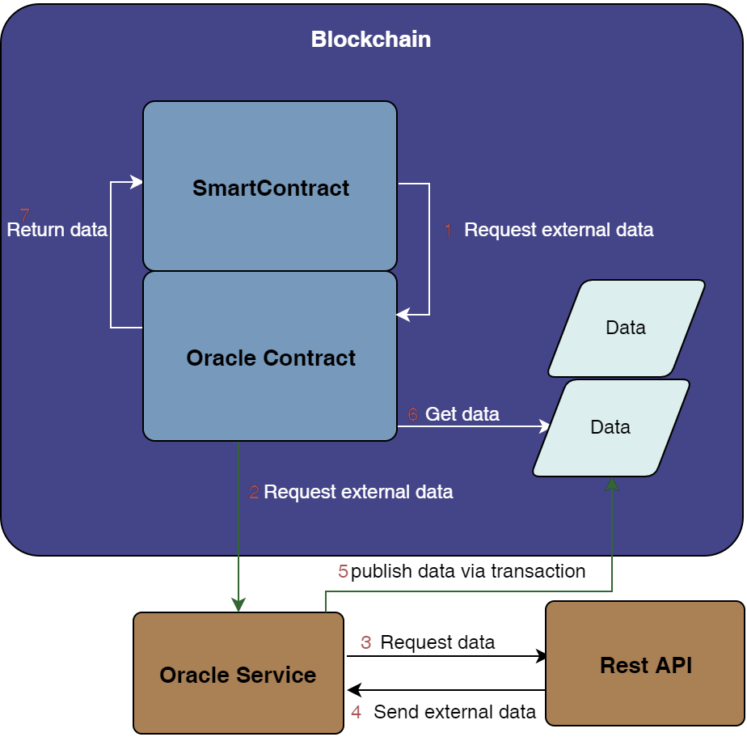
Blockchain Oracle
How does an Oracle Work?
Inside Smart Contract call oracle function to get external data.
2. The Oracle contract requests the data from Oracle Service
3. The Oracle Service invoke a Rest API
4. The Oracle Service gets the data
5. The Oracle Service publishs the data on the blockchain
6. Oracle Contract callback function gets the data
7. The Oracle Contract returns the data
8. All nodes can mine the same result, since the data is published

Slide 8


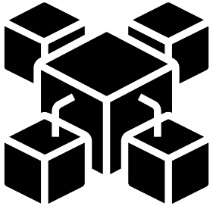
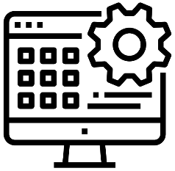
Communication with Blockchain
Description and Available APIs
JSON RPC API
Ethereum JSON-RPC APIs use a namespace system. RPC methods are clustered into several categories, depending on their usage. All method names are composed of the namespace, an underscore, and the actual method name within the namespace.
For example, the eth_call method resides in the eth namespace.
It will request data either from the node, execute an EVM function and return a response, or transmit data to the Ethereum network.
Invoke
Callback
API
HTTP
Write Data
Notify Events
Websockets
Application
Blockchain
Different Languages and available API libraries
Language | API Library
.Net Framework (C#, F#) | Nethereum
Java, JavaScript | web3J, web3.js & Ethers.js
Golang | Geth (Go-Ethereum)
Others (If no API library exists) | JSON-RPC

Slide 9
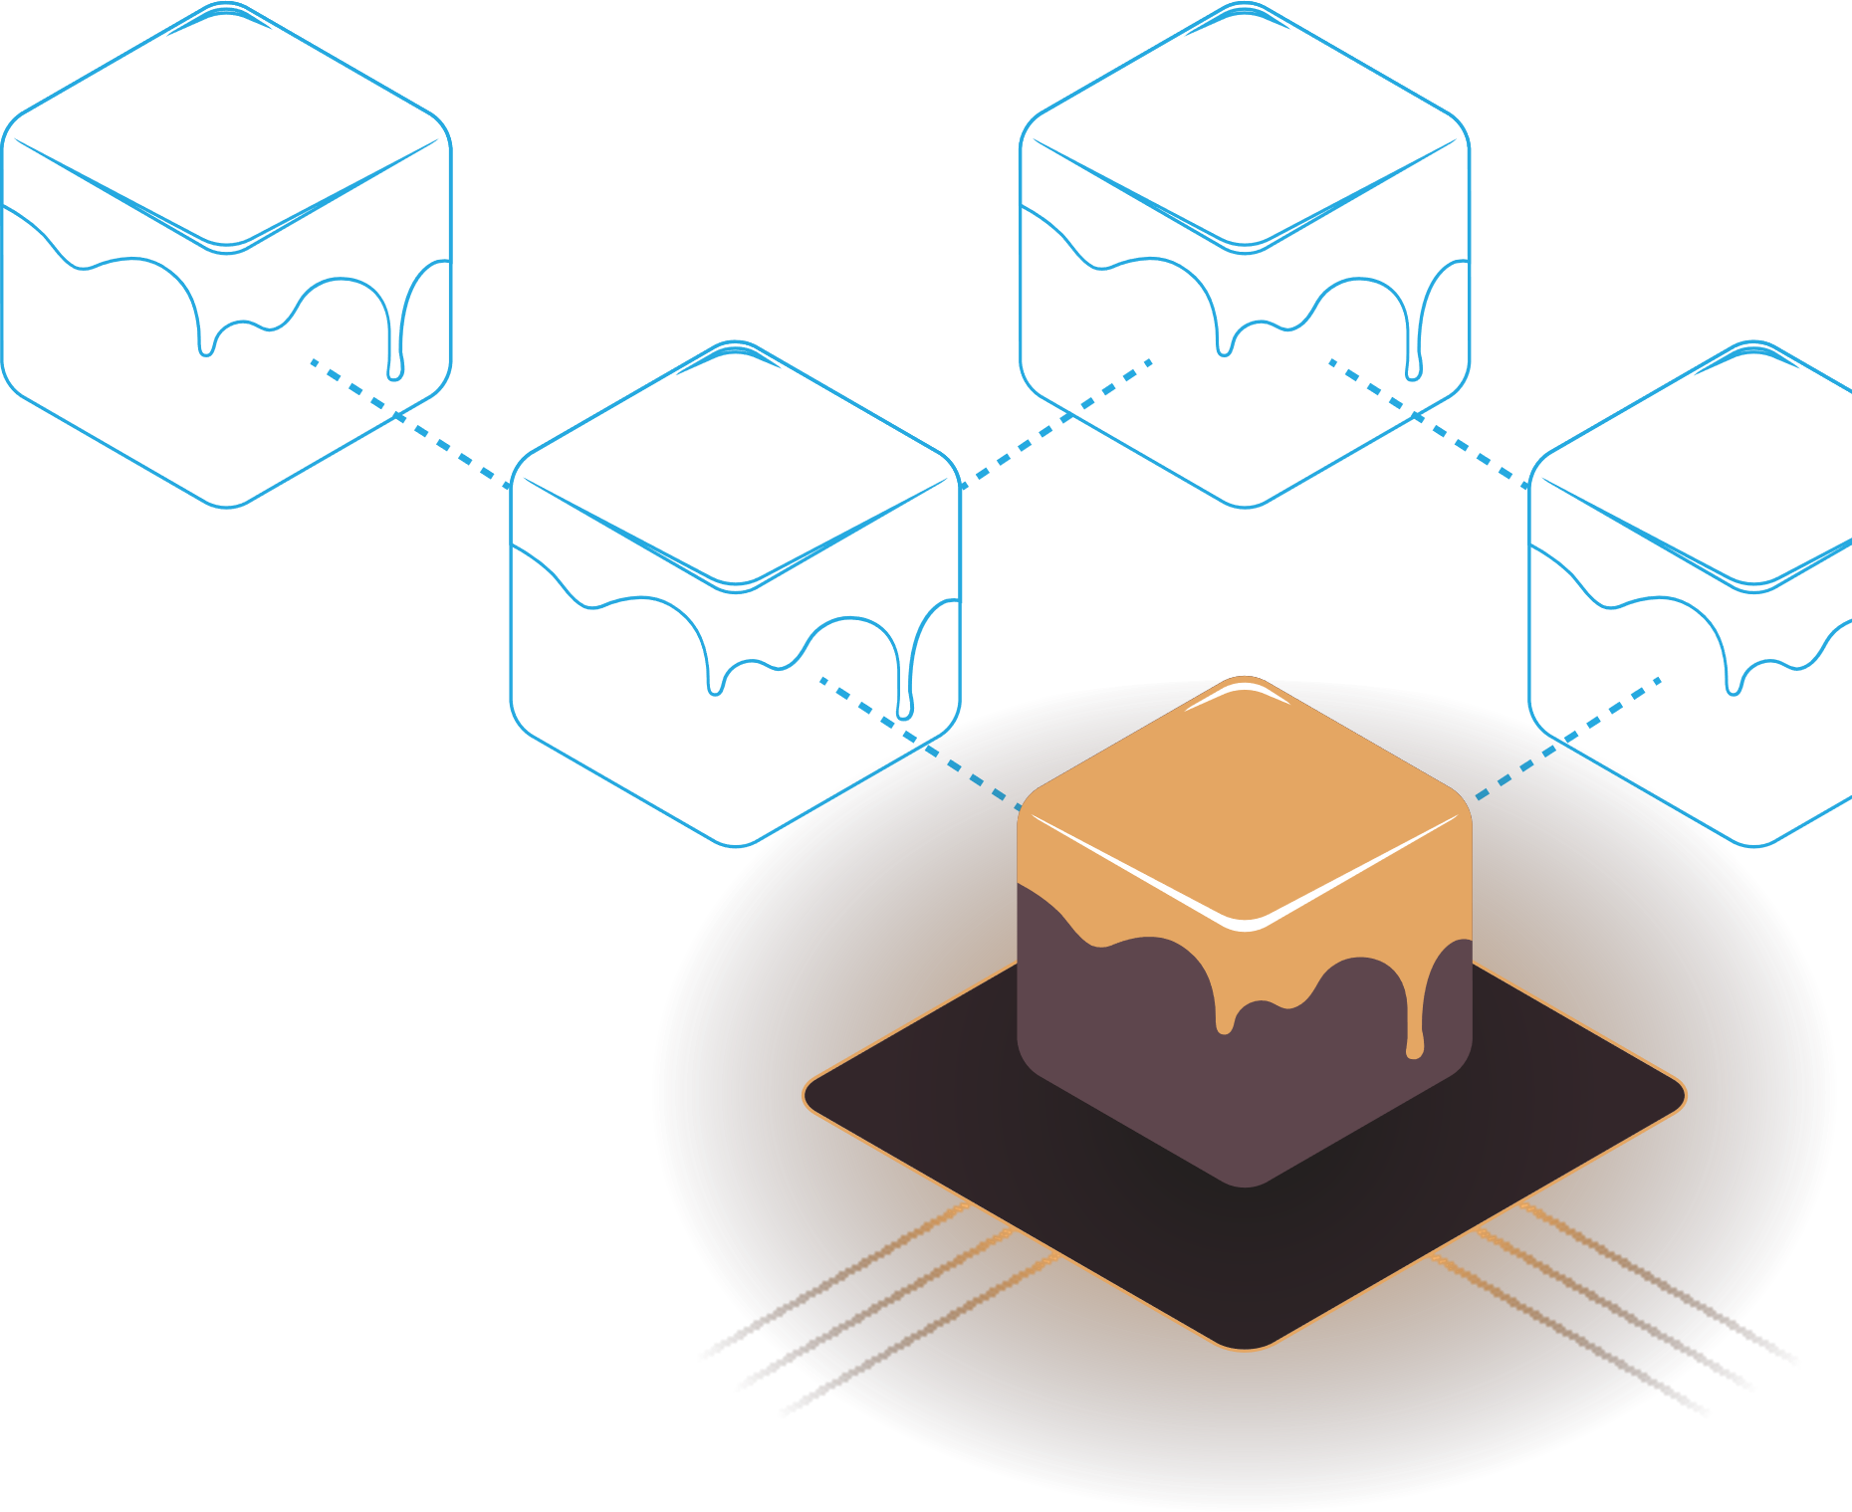

Ganache
Ethereum Simulation Environment
What is Ganache?
Ganache is a personal blockchain for rapid Ethereum and Corda distributed application development. You can use Ganache across the entire development cycle; enabling you to develop, deploy, and test your dApps in a safe and deterministic environment.
Types of Ganache:
UI- Ganache UI is a desktop application supporting both Ethereum and Corda technology.
CLI- The command-line tool, ganache-cli (formerly known as the TestRPC), is available for Ethereum development.
How to Use Ganache CLI?
ganache-cli is written in JavaScript and distributed as a Node.js package via npm.
ganache-cli utilizes ganache-core internally, which is distributed with optional native dependencies for increased performance. If these native dependencies fail to install on your system ganache-cli will automatically fallback to ganache-core’s pre-bundled JavaScript build.

Slide 10
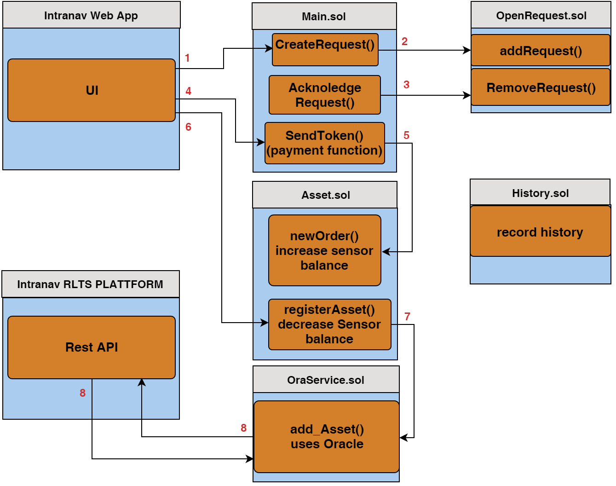
Smart Contracting Structure
Contracting Process
1. The Customer creates the Request.
2. The Request will be inserted into open Requests.
3. Administrator can query the open requests and process accordingly.
4. Once acknowledged, the required amount will be calculated based on the request.
5. After successful payment in Ethereum, the clients quota increases with the new amount. Similarly, an authentication token will be requested from the REST API via Oracle Service.
6. Now the Customer can register an asset.
7. The Asset Smart Contract invoke a Oracle function.
The Oracle Service makes an Rest API call to add an asset
Notes:
How does it work?
The Customer uses the Web interface to request Sensor access
The Request gets added to open Requests
After the admin acknloedge the Request it gets removed from open requests
Now the Customer can pay Ether
After successfull payment the sensor balance gets increased
Now the Customer can register an asset
The Asset Smart Contract invoke a Oracle function
The Oracle Service makes an Rest API call to add an asset

Slide 11
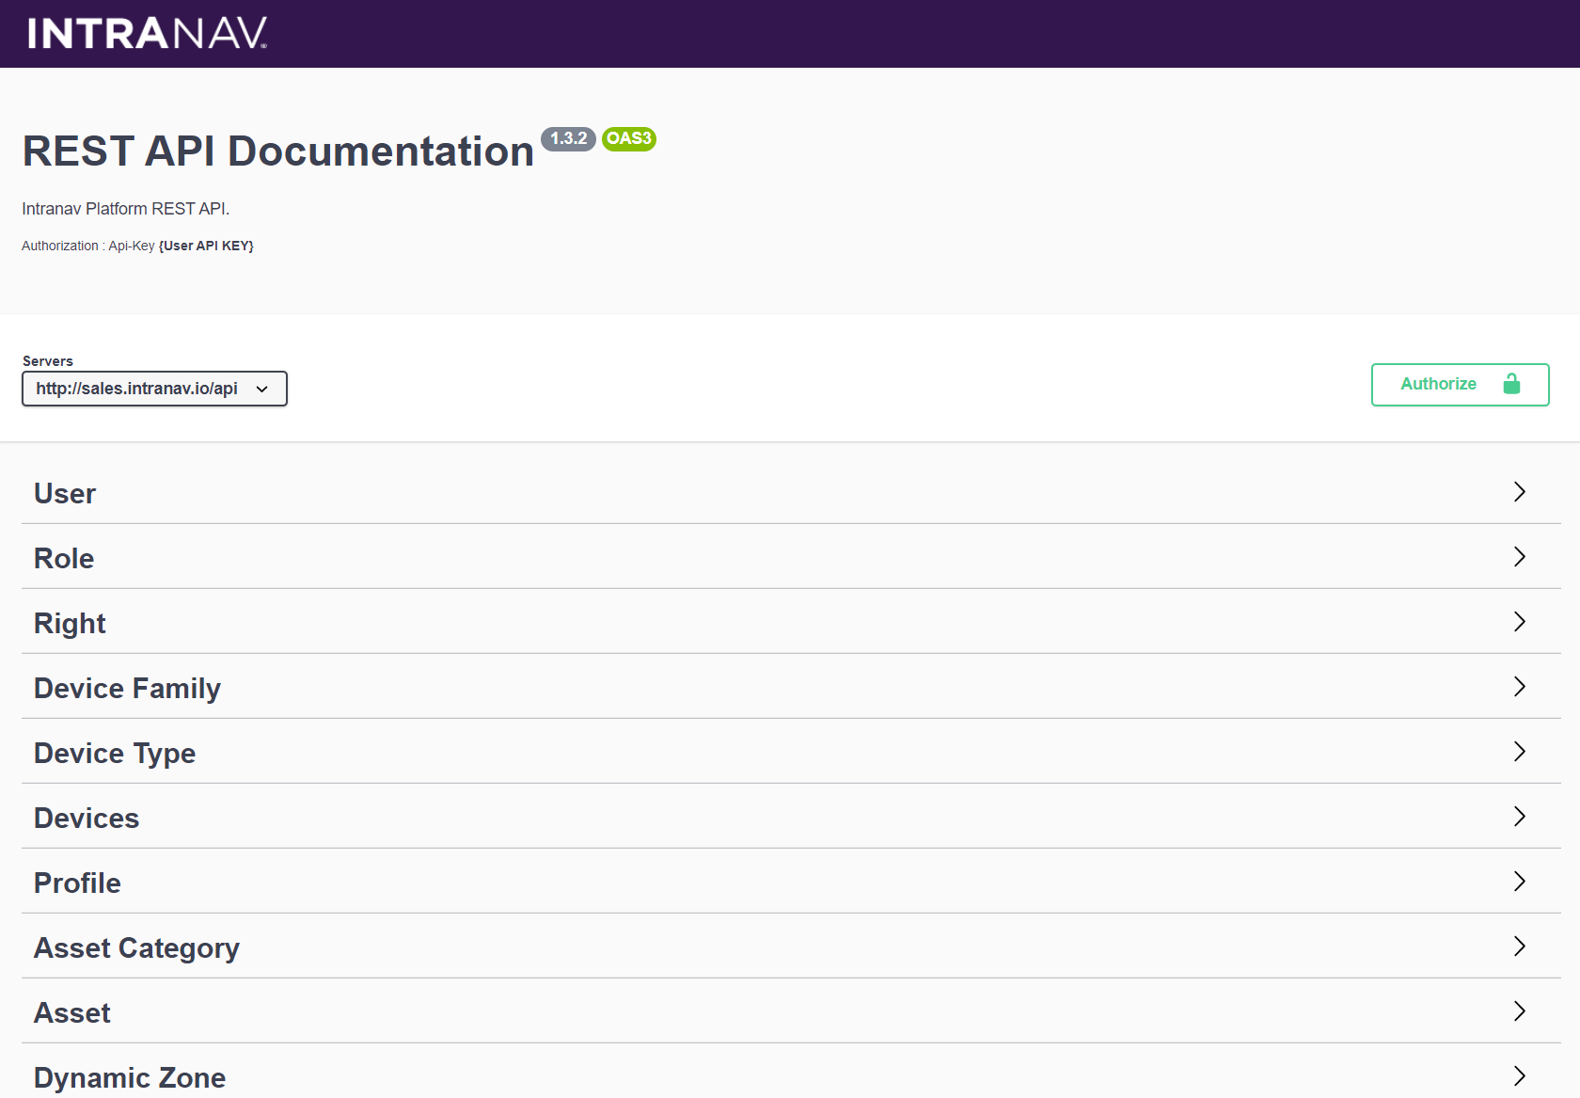
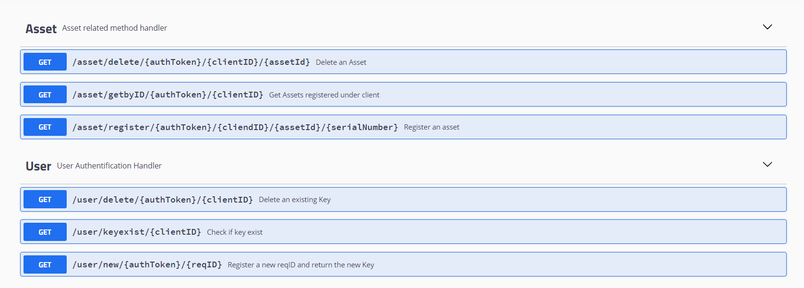
INTRANAV RTLS API Emulation
Sample API functions which can be integrated to the existing system
Created using,
Language : Java
Framework : Openliberty
Type : Microservice
Backend Communication : None (Simulation Only)
Used libraries :
Java Security – AES code generation
Source : https://github.com/SachiHarshitha/HDa_TeamProject_SS21/tree/master/03_CompanyRestAPI

Slide 12
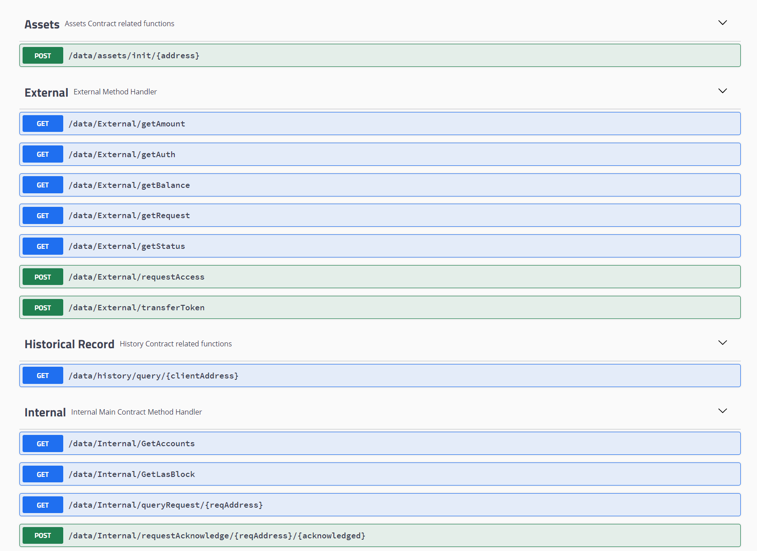
Internal Process API
Internal Management API with All Access, Using Administrator Ethereum Account.
Created using,
Language : Java
Framework : Openliberty
Type : Microservice
Backend Communication : Direct
Used libraries :
web3j – Blockchain to App
Source : https://github.com/SachiHarshitha/HDa_TeamProject_SS21/tree/master/04_InternalRestAPI

Slide 13
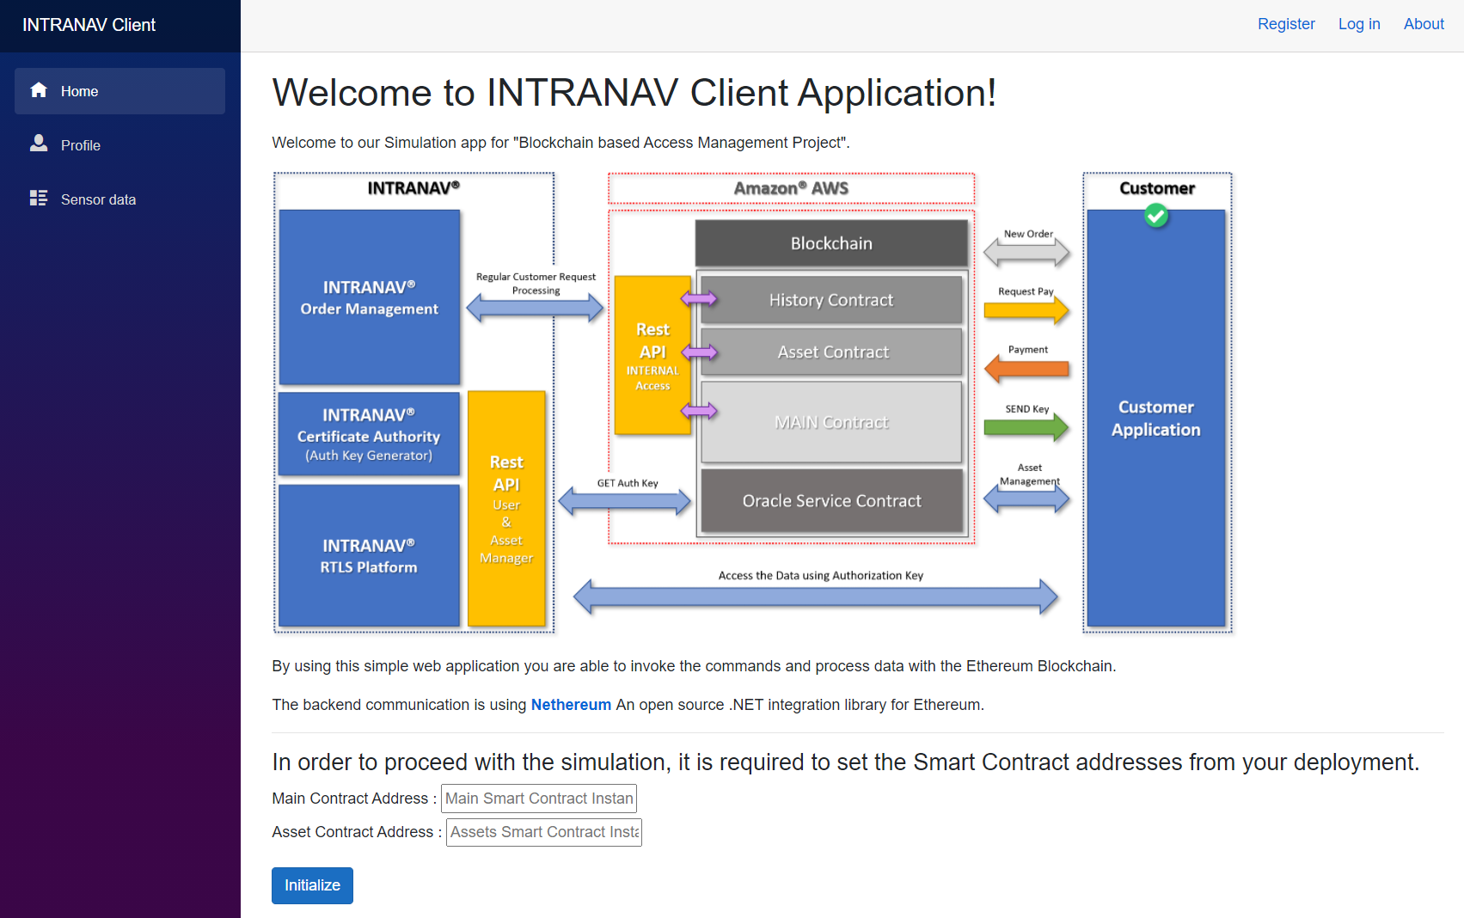
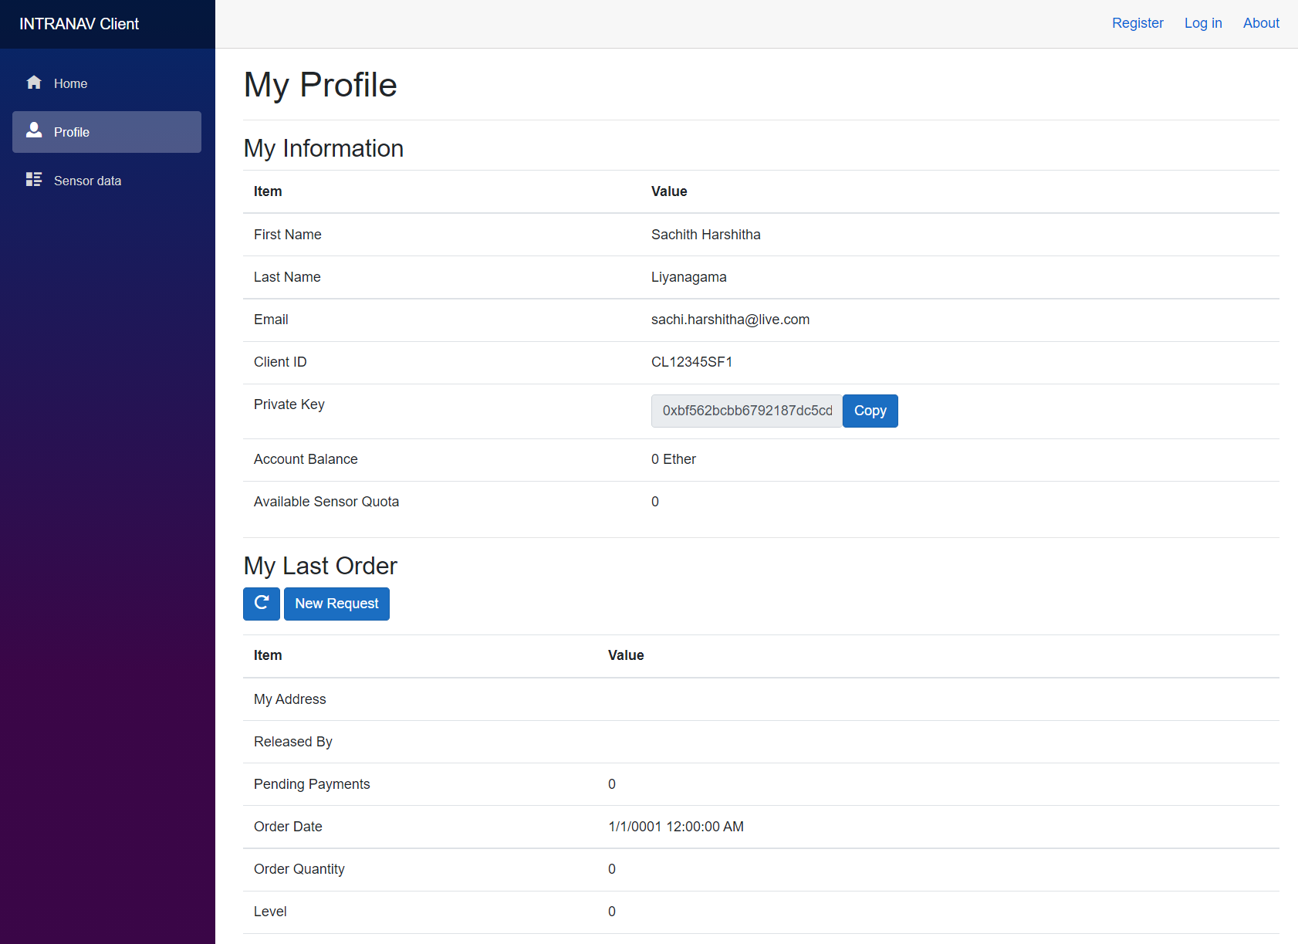
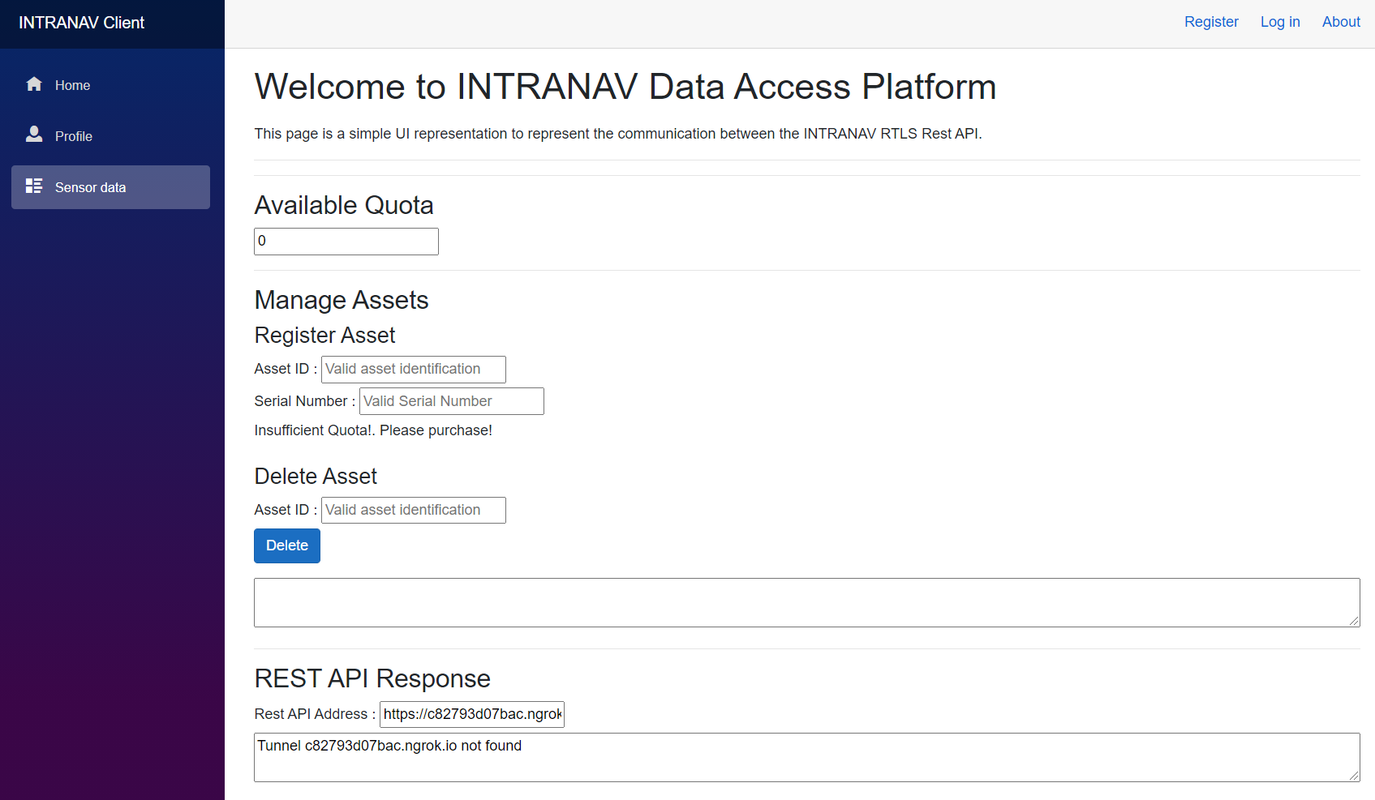
Client Portal
Conceptual Client Portal Application which could be used to decouple the client only processes
Created using,
Language : C#
Framework : .Net Core
Type : Blazor Server Application
Backend Communication : Direct
Used libraries :
Nethereum – Blockchain to App
RestSharp – Rest API to App
Source : https://github.com/SachiHarshitha/HDa_TeamProject_SS21/tree/master/05_ClientWebApp

Slide 14
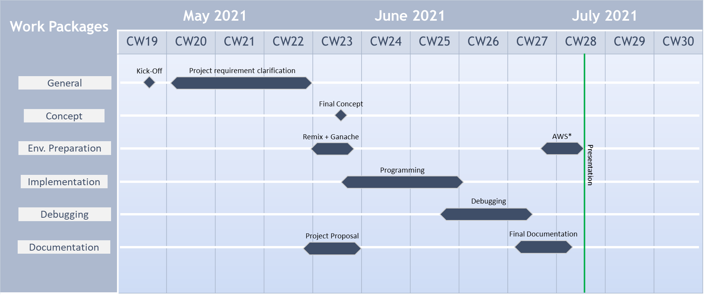
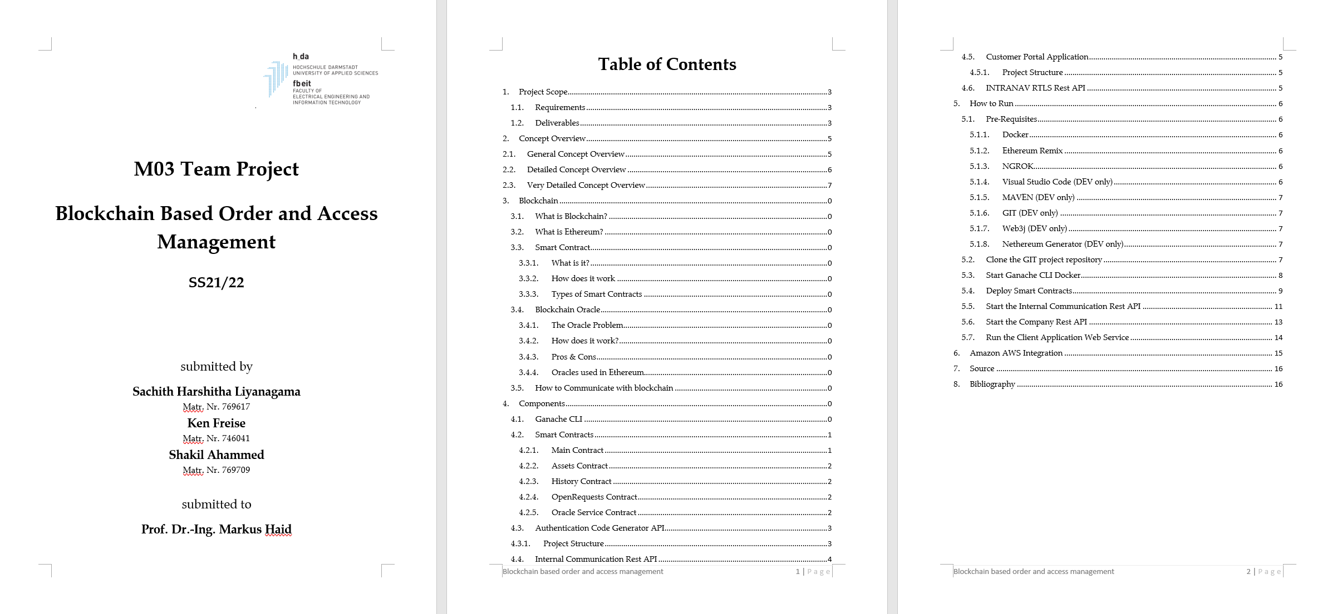
Project Status
Timeline
Deliverables
01. Report
02. Source Code
Can be found in project path.
Project Path
Github : https://github.com/SachiHarshitha/HDa_TeamProject_SS21
03. Running Application Demonstration
Will be attached later.

Slide 15
Application Demonstration

