Slide 1
Team Project SS21
Blockchain Based Order and Access Management
By Sachith Liyanagama,
Ken Freise,
Shakil Ahammed

Slide 2
Content

Slide 3
Current Method of Order Management
Traditional Order management
INTRANAV®
Current Ordering Process
Customer
INTRANAV®
Sales
Request Quotation
Customer
Sales Department
Send Quotation
Purchase Order
Process and Send Order along with the Authorization Key
INTRANAV®
Certificate Authority
(Auth Key Generator)
Customer
Business Department
INTRANAV®
RTLS Platform
Rest API
Microservice
Customer
End Application
Manage Asset & Access the Data using Authorization Key

Slide 4
Proposed Method of Order Management
Using Ethereum Blockchain
INTRANAV®
Amazon® AWS*
Customer
INTRANAV®
Order Management
Blockchain
New Order
Customer
Application
Regular Customer Request Processing
Rest API
INTERNAL
Access
History Contract
Request Pay
Asset Contract
Payment
INTRANAV®
Certificate Authority
(Auth Key Generator)
Rest API
User
&
Asset Manager
MAIN Contract
SEND Key
INTRANAV®
RTLS Platform
Get Auth & Asset Management
Oracle Service Contract
Asset Management
Access the Data using Authorization Key

Slide 5
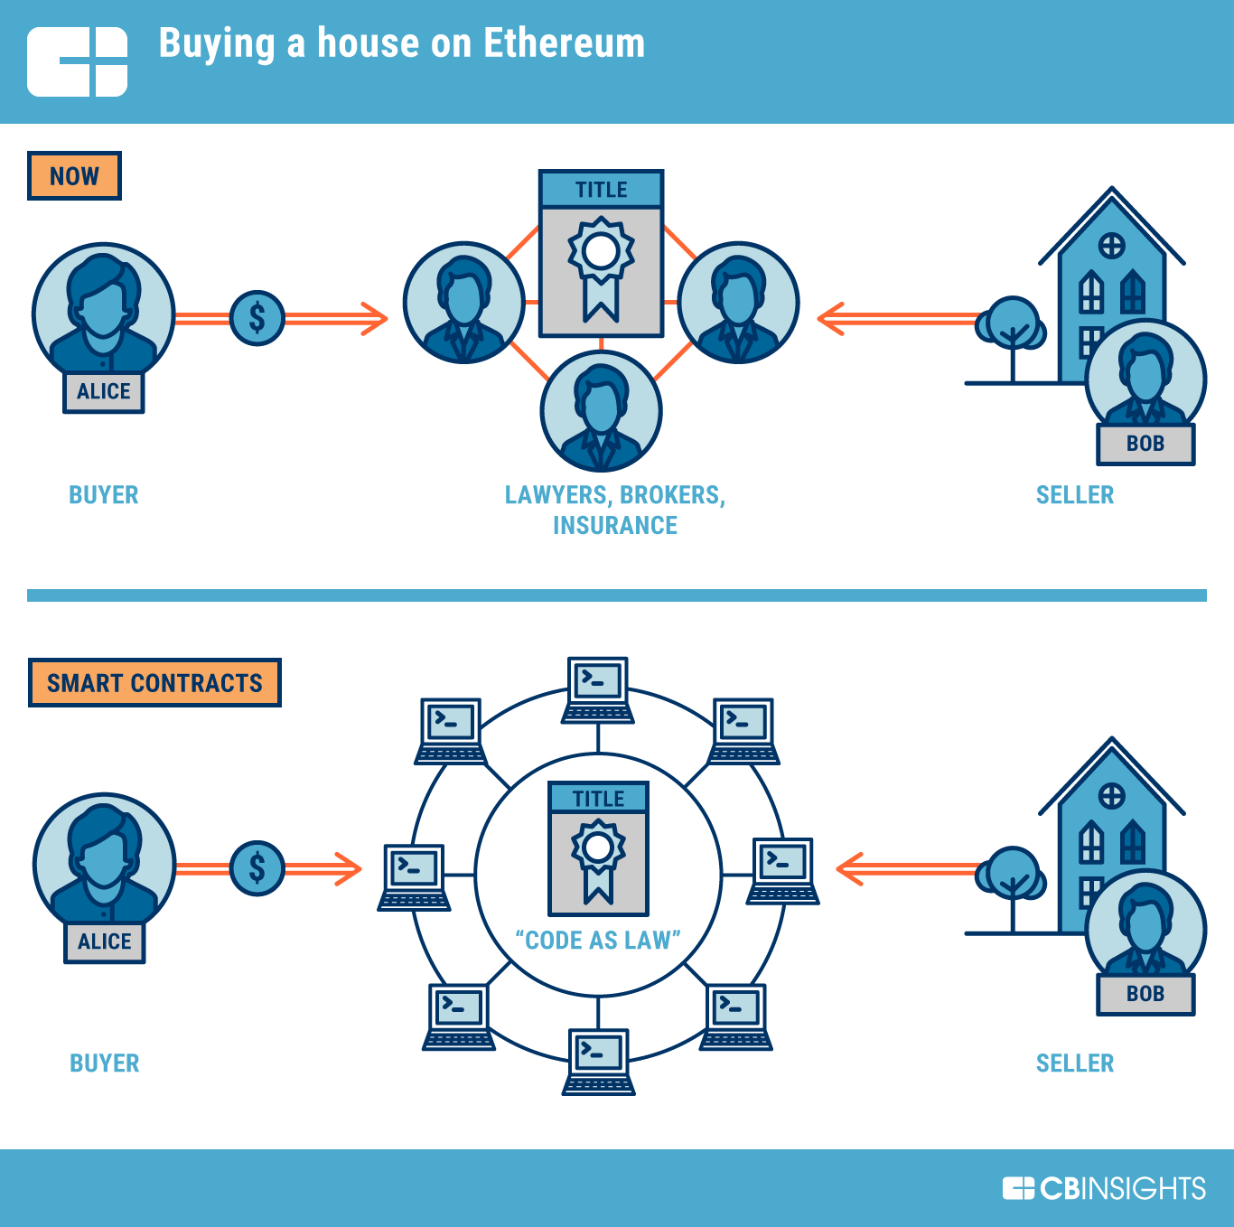
What is Ethereum?
It's the world's programmable blockchain.
What is Blockchain?
What is Ethereum?
Ethereum is a technology that lets you send cryptocurrency to anyone for a small fee. It also powers applications that everyone can use and no one can take down.
Ethereum builds on Bitcoin's innovation, with some big differences.
Both let you use digital money without payment providers or banks. But Ethereum is programmable, so you can also use it for lots of different digital assets – even Bitcoin!
Ethereum is for more than payments. It's a marketplace of financial services, games and apps that can't steal your data or censor you.

Slide 6
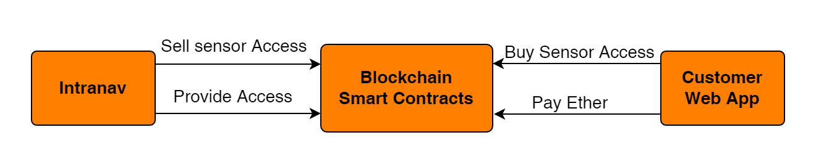
Smart Contracts
What is Smart Contract?
It’s a digital contract
Smart Contracts can be deployed on a blockchain
Written in a Programming language (solidity for Ethereum).
Limitation in size (24 KB).
Can‘t use external API to get data.
Each node needs to calculate(Mine) same result for same input for a contract method

Slide 7
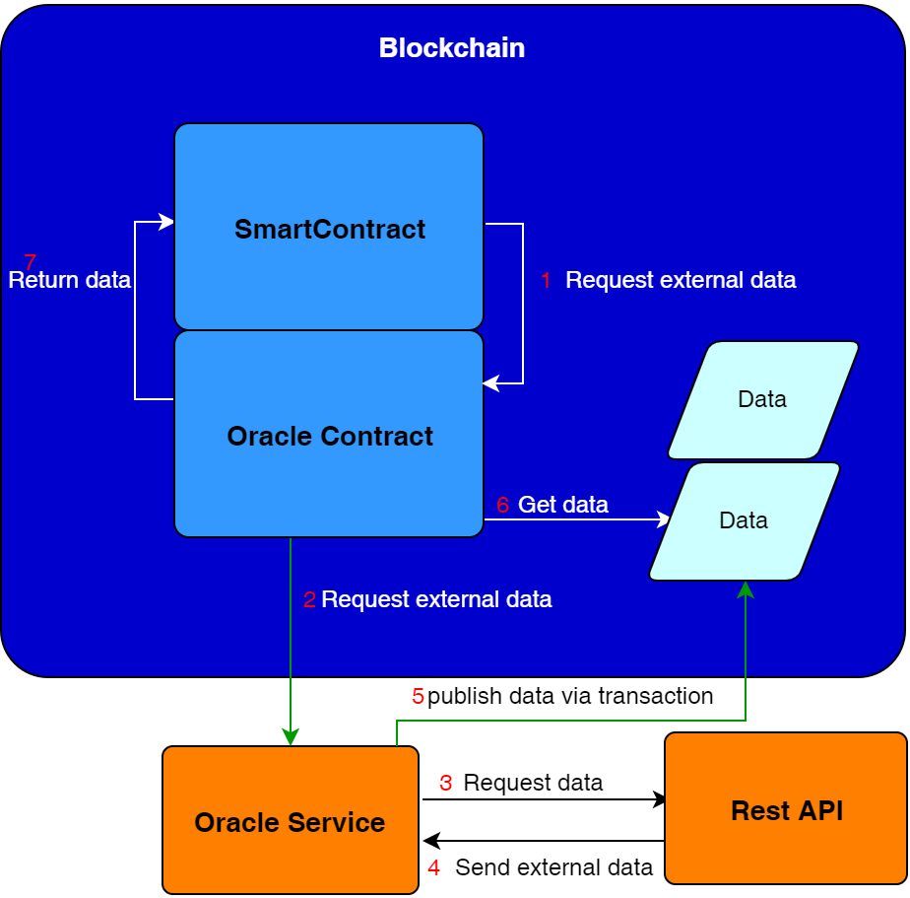
Blockchain Oracle
How does oracle work?
Inside Smart Contract call oracle function to get external data
The Oracle contract requests the data from Oracle Service
The Oracle Service invoke a Rest API
The Oracle Service gets the data
The Oracle Service publishs the data on the blockchain
Oracle Contract callback function gets the data
The Oracle Contract returns the data
All nodes can mine the same result, since the data is published

Slide 8
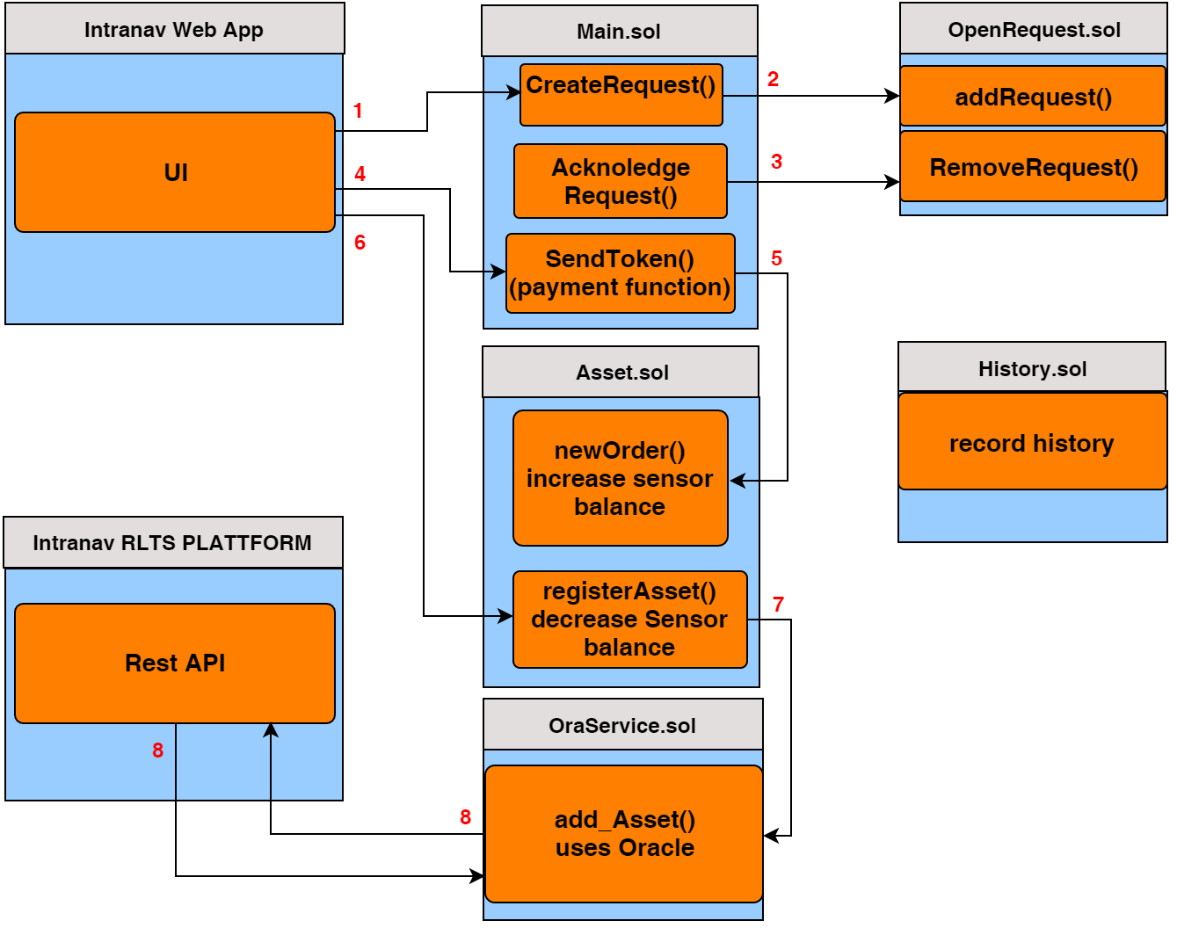
Smart Contracting Structure
How does oracle work?
The Customer uses the Web interface to request Sensor access
The Request gets added to open Requests
After the admin acknloedge the Request it gets removed from open requests
Now the Customer can pay Ether
After successfull payment the sensor balance gets increased
Now the Customer can register an asset
The Asset Smart Contract invoke a Oracle function
The Oracle Service makes an Rest API call to add an asset

Slide 9

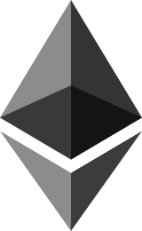
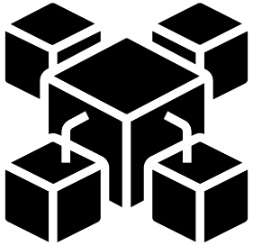

Communication with Blockchain
How does it work
Ethereum JSON-RPC APIs use a namespace system. RPC methods are clustered into several categories, depending on their usage. All method names are composed of the namespace, an underscore, and the actual method name within the namespace.
For example, the eth_call method resides in the eth namespace.
It will request data either from the node, execute an EVM function and return a response, or transmit data to the Ethereum network.
Invoke
Callback
LIBRARY
HTTP
Write Data
Notify Events
Websockets
Application
Blockchain
Different Languages and available libraries
 | cpp-ethereum | go-ethereum | Nethereum | Web3J | Web3js
JSON-RPC 1.0 | Yes
JSON-RPC 2.0 | Yes | Yes
Batch requests | Yes | yes
HTTP | Yes | Yes

Slide 10
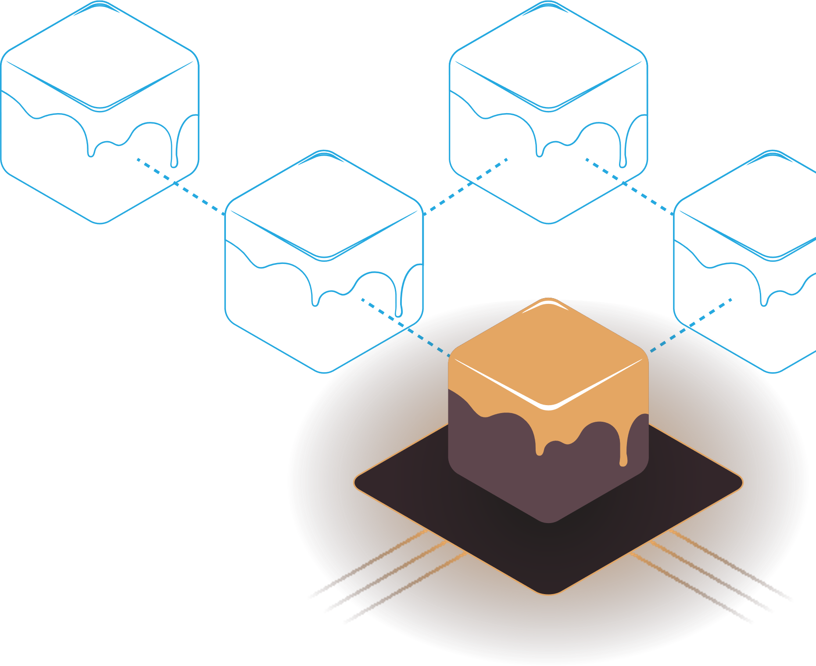

Ganache
Ethereum Simulation Environment
What is Ganache?
Ganache is a personal blockchain for rapid Ethereum and Corda distributed application development. You can use Ganache across the entire development cycle; enabling you to develop, deploy, and test your dApps in a safe and deterministic environment.
Types of Ganache:
UI- Ganache UI is a desktop application supporting both Ethereum and Corda technology.
CLI- The command-line tool, ganache-cli (formerly known as the TestRPC), is available for Ethereum development.
How to Use Ganache CLI?
ganache-cli is written in JavaScript and distributed as a Node.js package via npm.
ganache-cli utilizes ganache-core internally, which is distributed with optional native dependencies for increased performance. If these native dependencies fail to install on your system ganache-cli will automatically fallback to ganache-core’s pre-bundled JavaScript build.

Slide 11
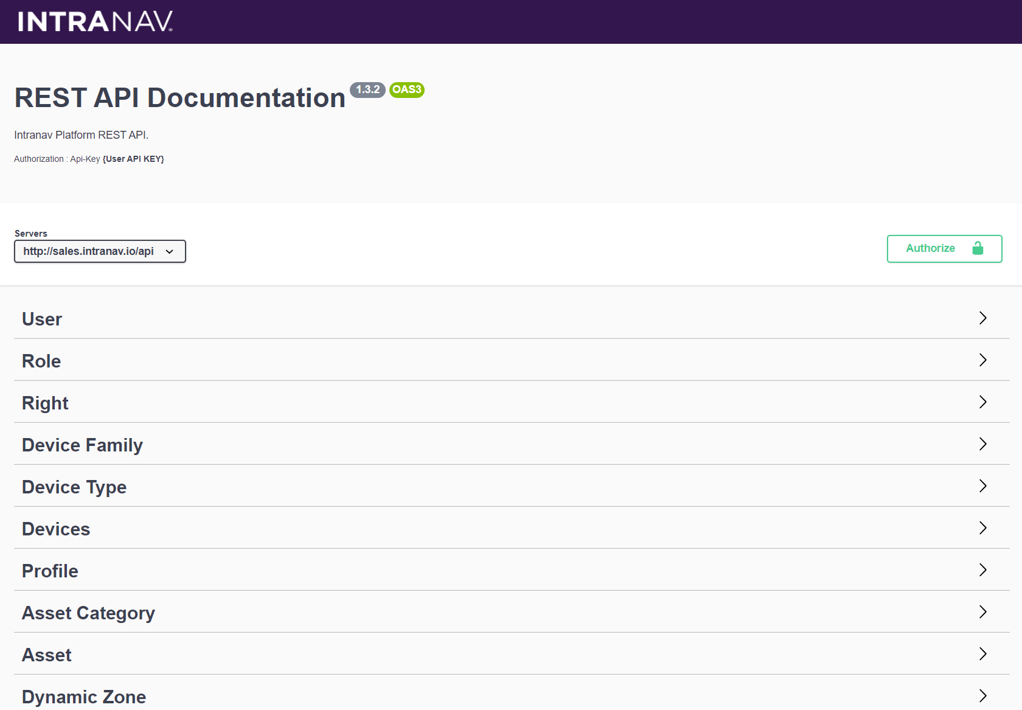
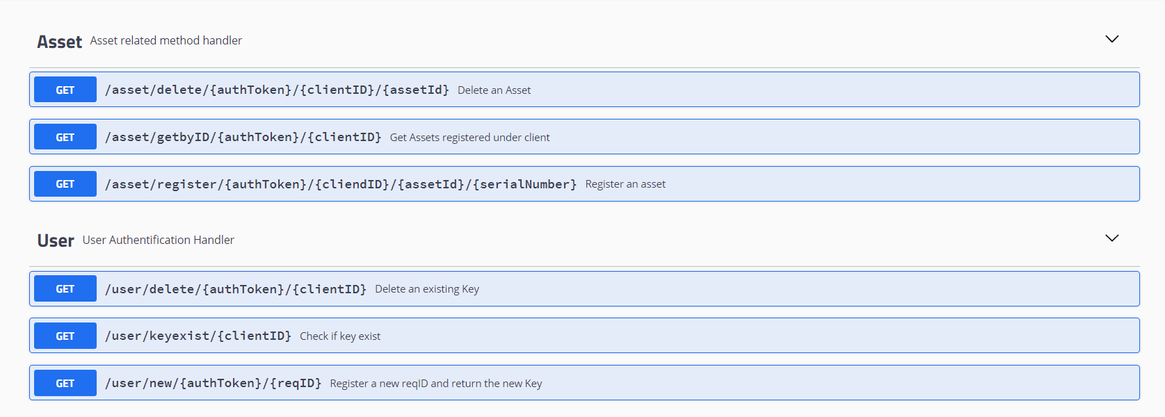
INTRANAV RTLS API Emulation
Sample API functions which can be integrated to the existing system
Created using,
Language : Java
Framework : Openliberty
Type : Microservice
Backend Communication : None (Simulation Only)
Used libraries :
Java Security – AES code generation
Source : https://github.com/SachiHarshitha/HDa_TeamProject_SS21/tree/master/03_CompanyRestAPI

Slide 12
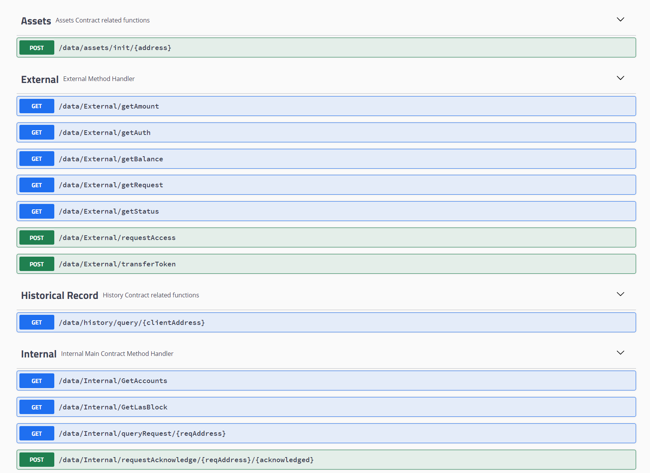
Internal Process API
Internal Management API with All Access, Using Administrator Ethereum Account.
Created using,
Language : Java
Framework : Openliberty
Type : Microservice
Backend Communication : Direct
Used libraries :
web3j – Blockchain to App
Source : https://github.com/SachiHarshitha/HDa_TeamProject_SS21/tree/master/04_InternalRestAPI

Slide 13
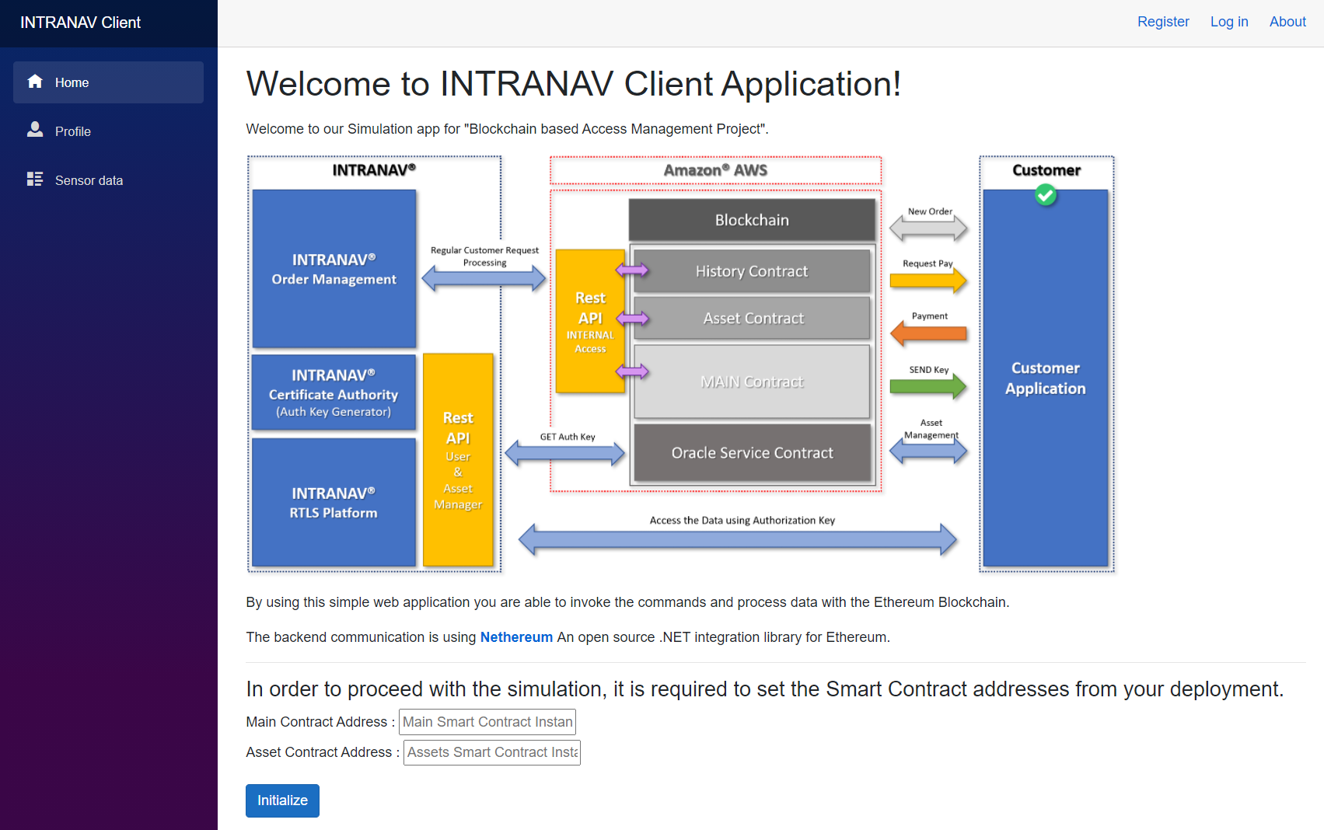
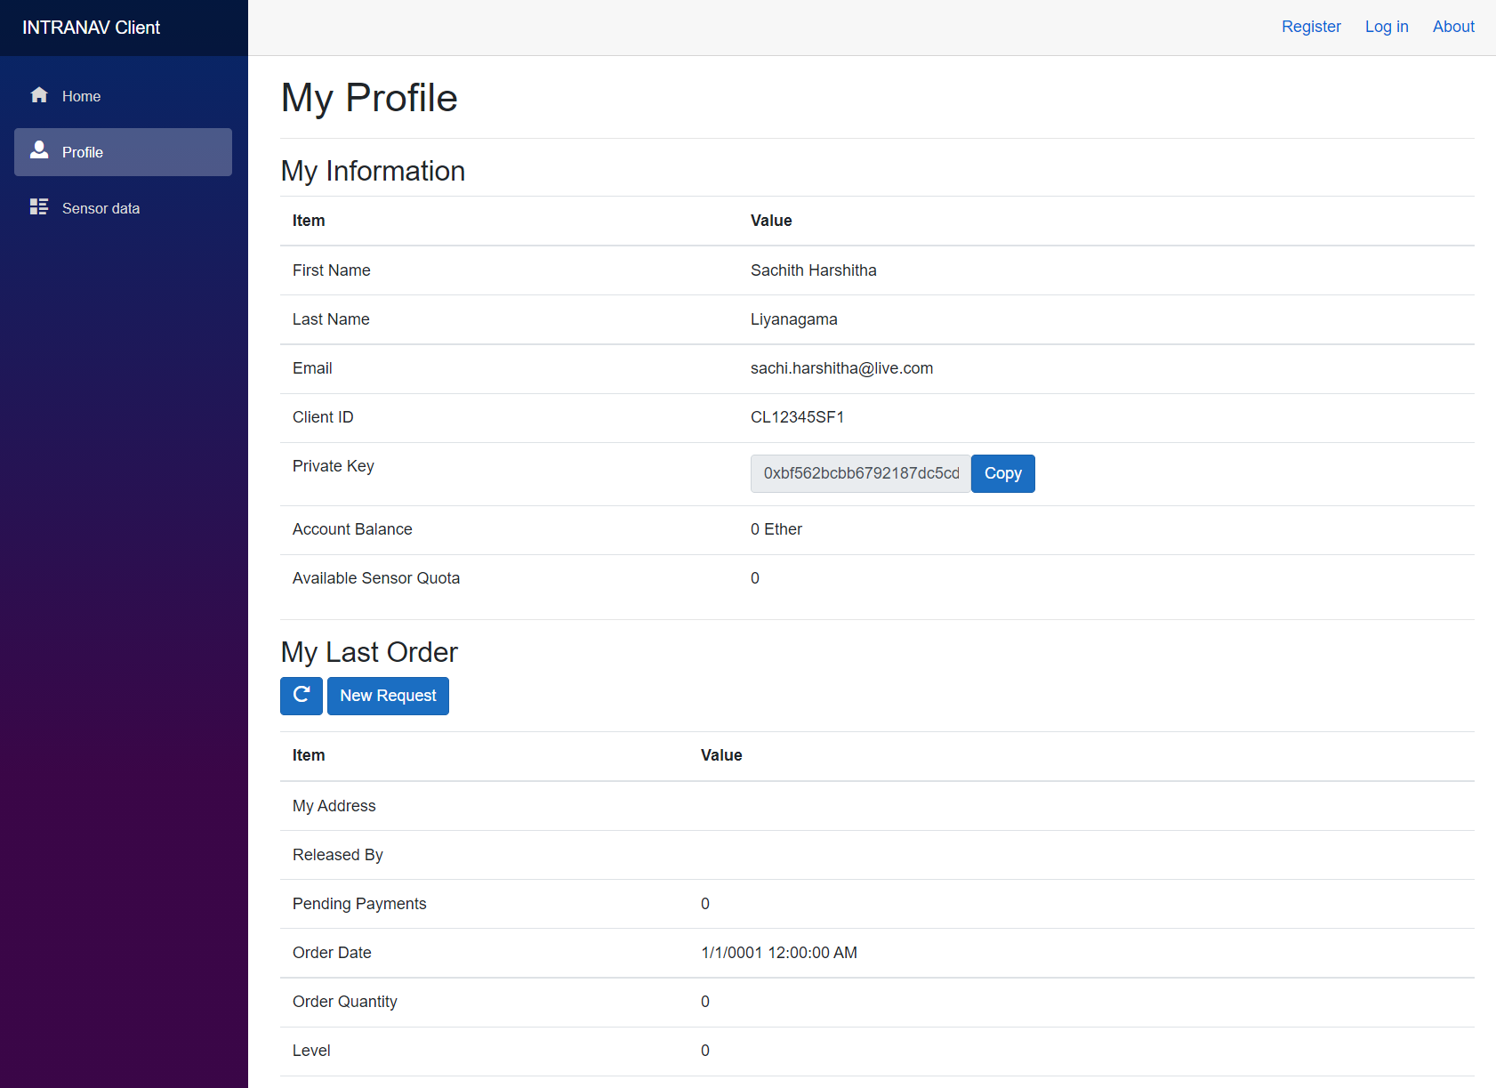
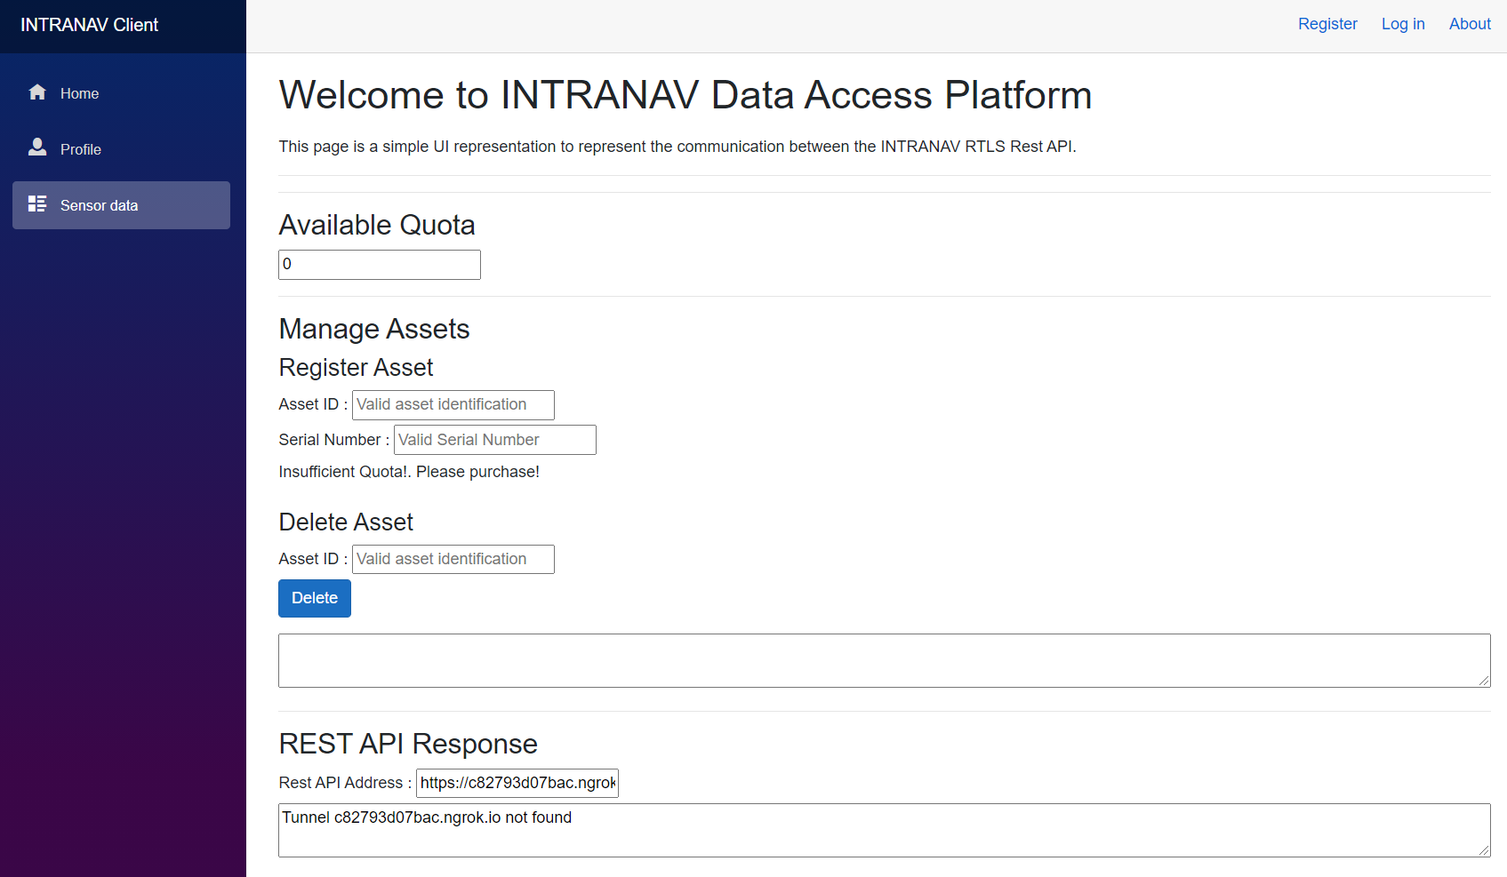
Client Portal
Conceptual Client Portal Application which could be used to decouple the client only processes
Created using,
Language : C#
Framework : .Net Core
Type : Blazor Server Application
Backend Communication : Direct
Used libraries :
Nethereum – Blockchain to App
RestSharp – Rest API to App
Source : https://github.com/SachiHarshitha/HDa_TeamProject_SS21/tree/master/05_ClientWebApp

Slide 14
Summary

