Slide 1
Team Project SS21
Blockchain Based Order and Access Management
By Sachith Liyanagama,
Ken Freise,
Shakil Ahammed

Slide 2
Content

Slide 3
About Us

Slide 4
Current Method of Order Management
Traditional Order management
INTRANAV®
Current Ordering Process
Customer
INTRANAV®
Sales
Request Quotation
Customer
Sales Department
Send Quotation
Purchase Order
Process and Send Order along with the Authorization Key
INTRANAV®
Certificate Authority
(Auth Key Generator)
Customer
Business Department
INTRANAV®
RTLS Platform
Rest API
Microservice
Customer
End Application
Manage Asset & Access the Data using Authorization Key

Slide 5
Proposed Method of Order Management
Using Ethereum Blockchain
INTRANAV®
Amazon® AWS*
Customer
INTRANAV®
Order Management
Blockchain
New Order
Customer
Application
Regular Customer Request Processing
Rest API
INTERNAL
Access
History Contract
Request Pay
Asset Contract
Payment
INTRANAV®
Certificate Authority
(Auth Key Generator)
Rest API
User
&
Asset Manager
MAIN Contract
SEND Key
INTRANAV®
RTLS Platform
Get Auth & Asset Management
Oracle Service Contract
Asset Management
Access the Data using Authorization Key

Slide 6
What is Ethereum?

Slide 7
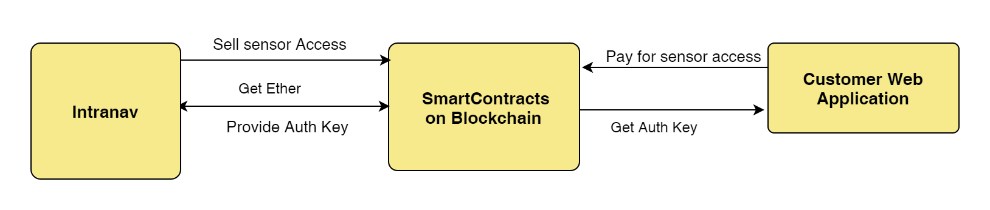
Smart Contracts
Written in a Programming language (solidity)
Limitaded in size
Can‘t use API to get external data
Each node needs to find same result for same input for a contract method

Slide 8
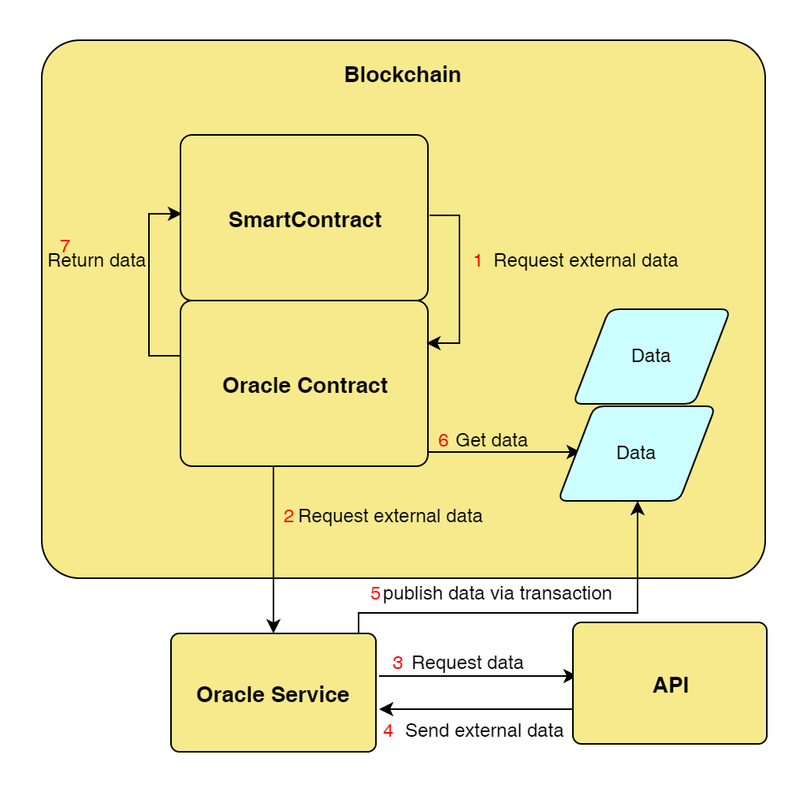
Blockchain Oracle

Slide 9
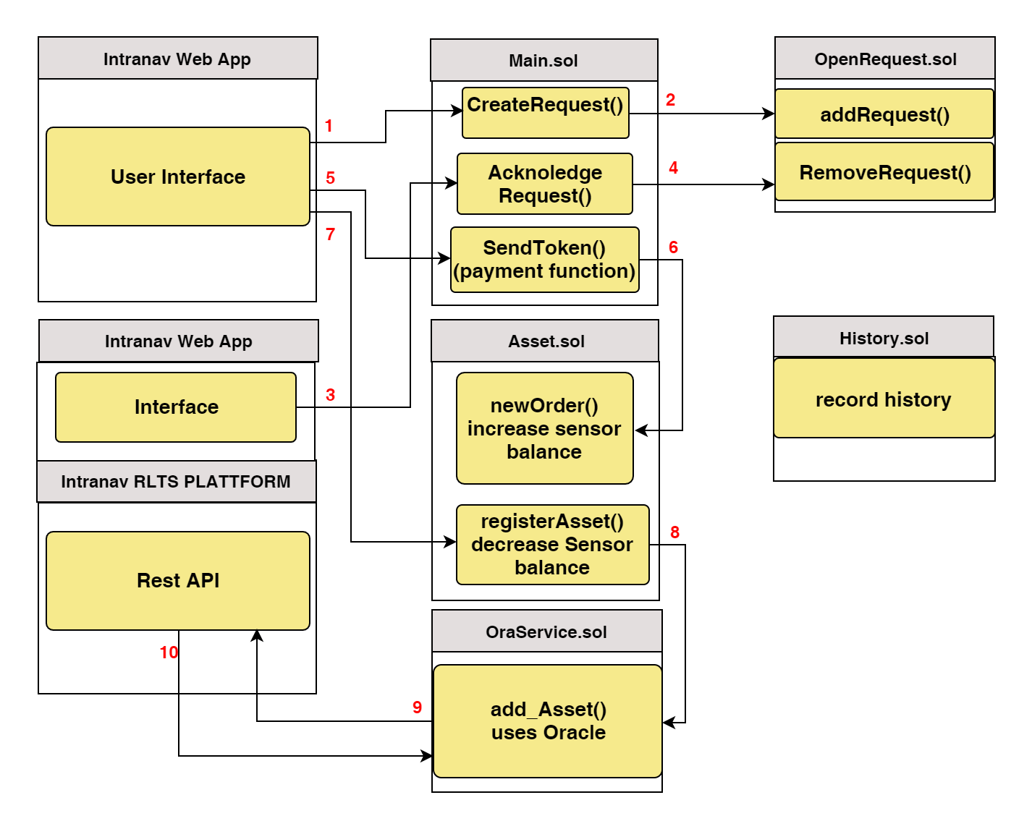
Smart Contracting Structure

Slide 10
How to Communicate with Blockchain?
How does it work
Different Languages and available libraries

Slide 11
Ganache
What is Ganache
Types of Ganache.
UI
CLI
How to Use Ganache CLI

Slide 12
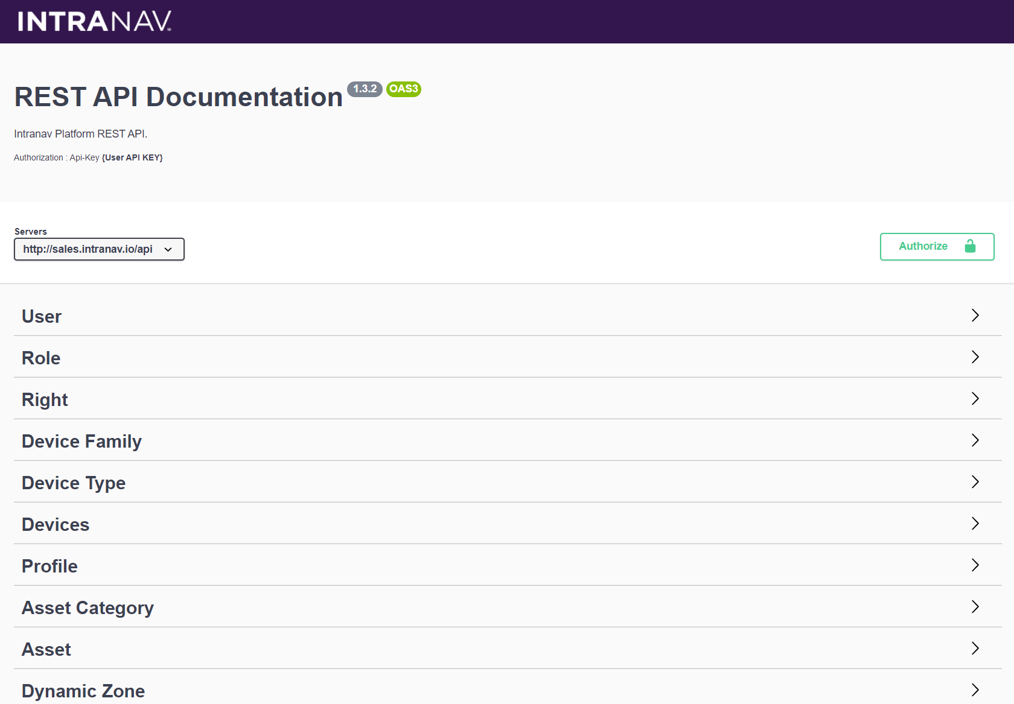
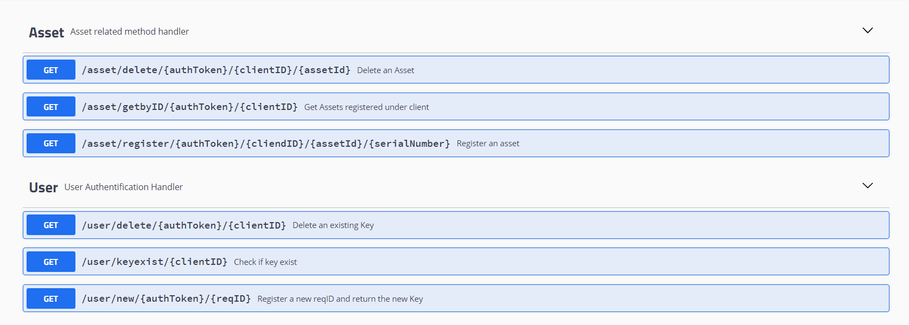
INTRANAV RTLS API Emulation
Sample API functions which can be integrated to the existing system
Created using,
Language : Java
Framework : Openliberty
Type : Microservice
Backend Communication : None (Simulation Only)
Used libraries :
Java Security – AES code generation
Source : https://github.com/SachiHarshitha/HDa_TeamProject_SS21/tree/master/03_CompanyRestAPI

Slide 13
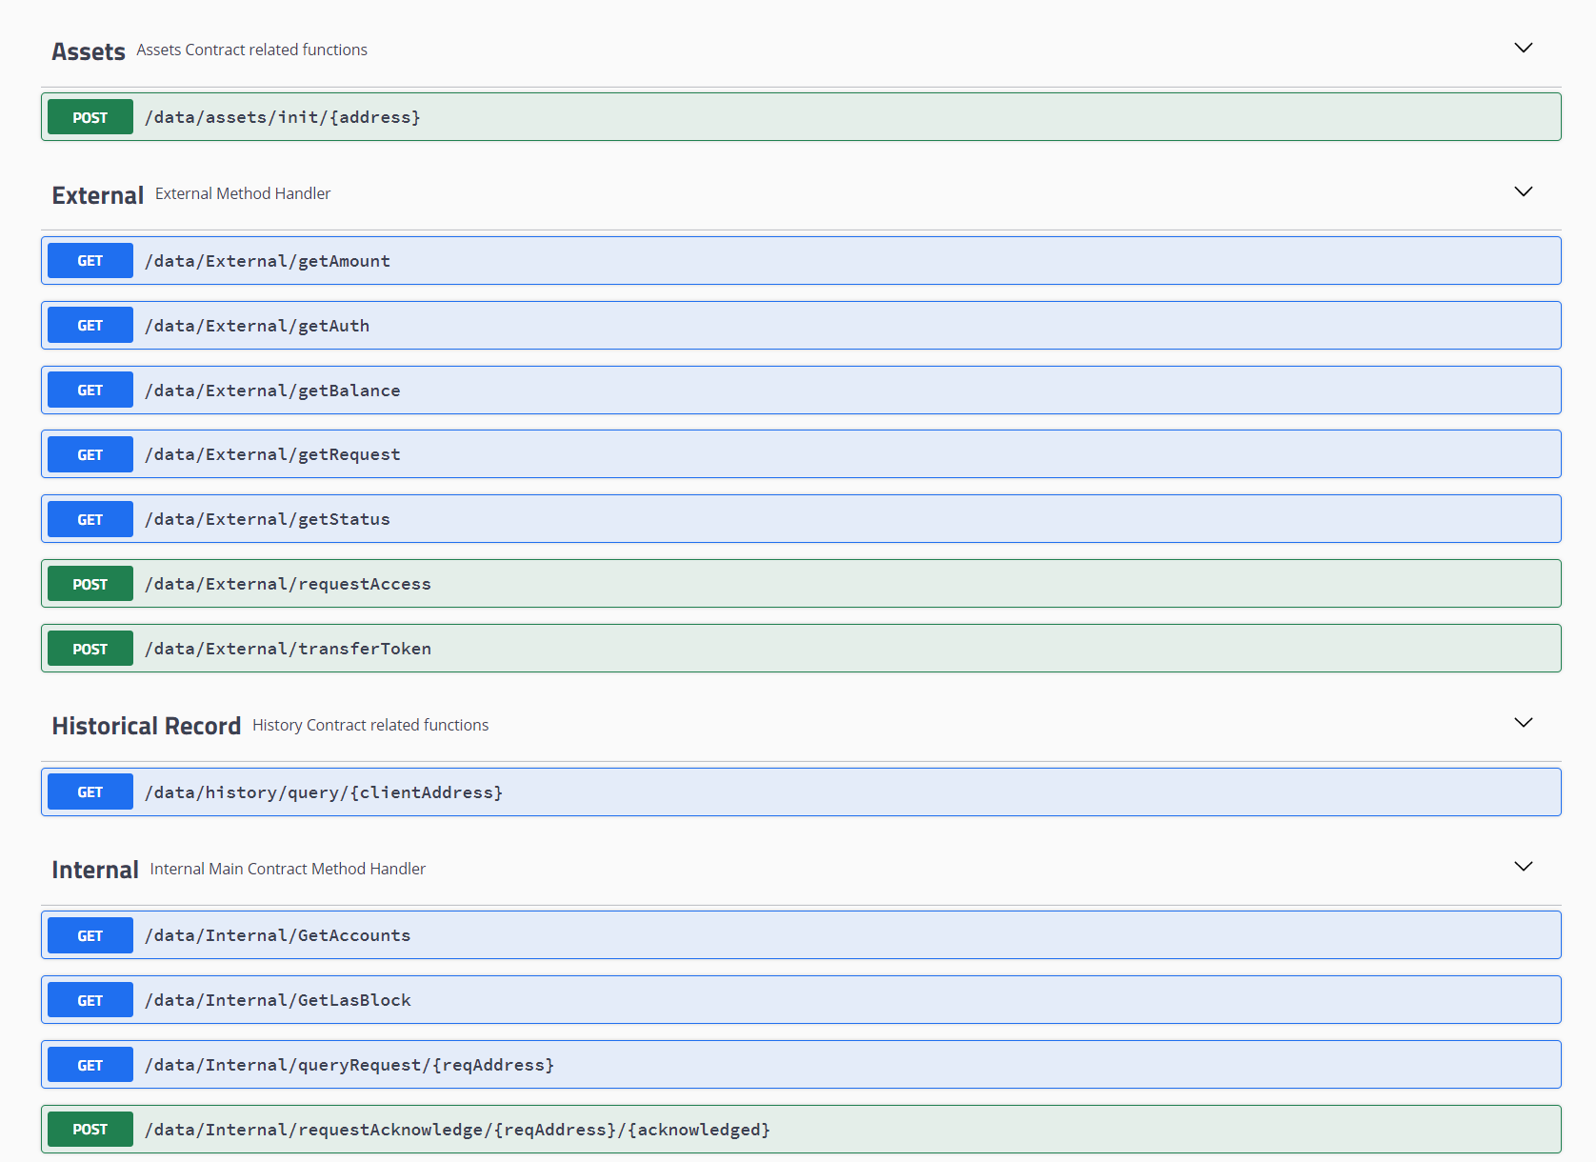
Internal Process API
Internal Management API with All Access, Using Administrator Ethereum Account.
Created using,
Language : Java
Framework : Openliberty
Type : Microservice
Backend Communication : Direct
Used libraries :
web3j – Blockchain to App
Source : https://github.com/SachiHarshitha/HDa_TeamProject_SS21/tree/master/04_InternalRestAPI

Slide 14
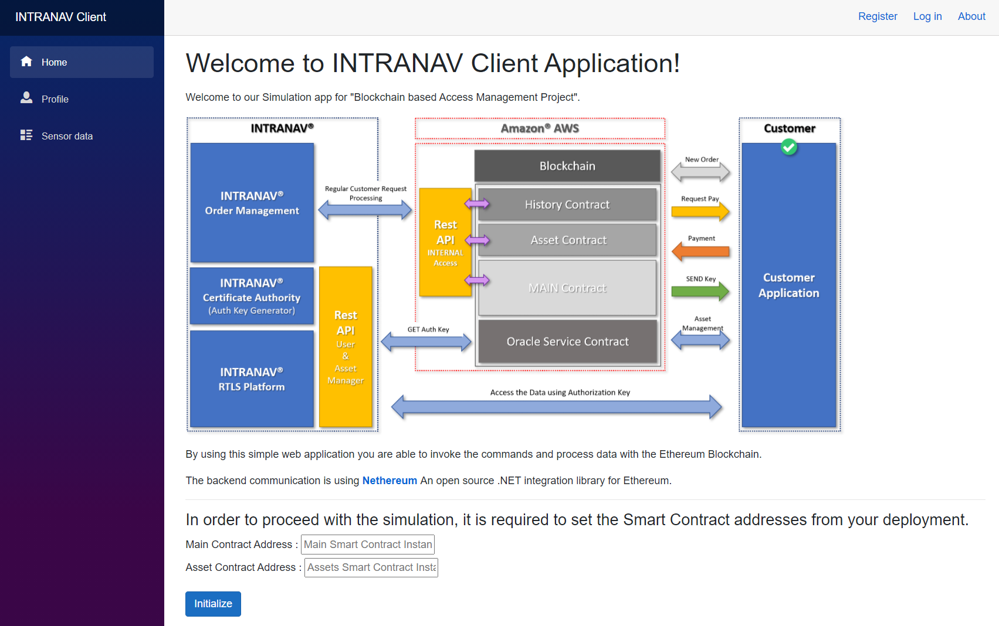
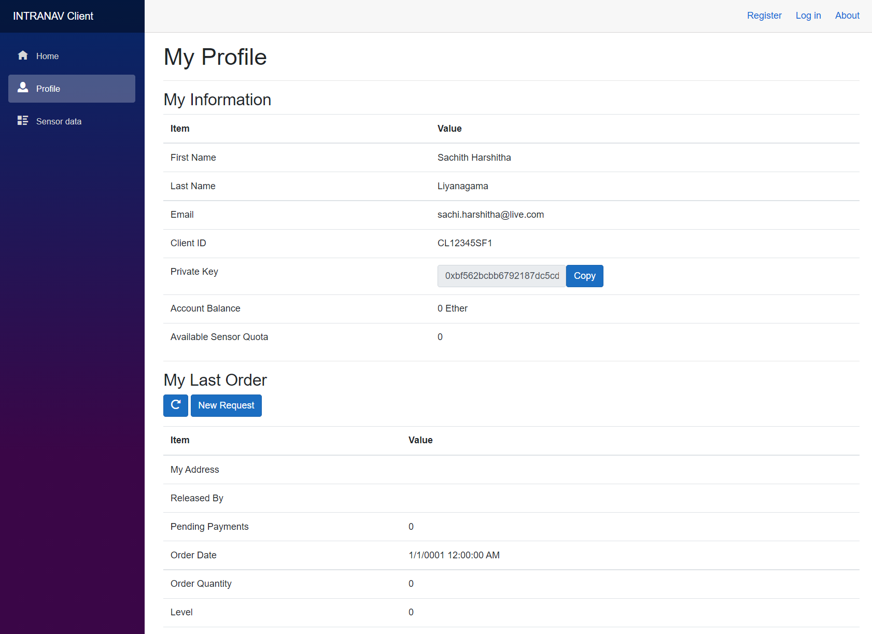
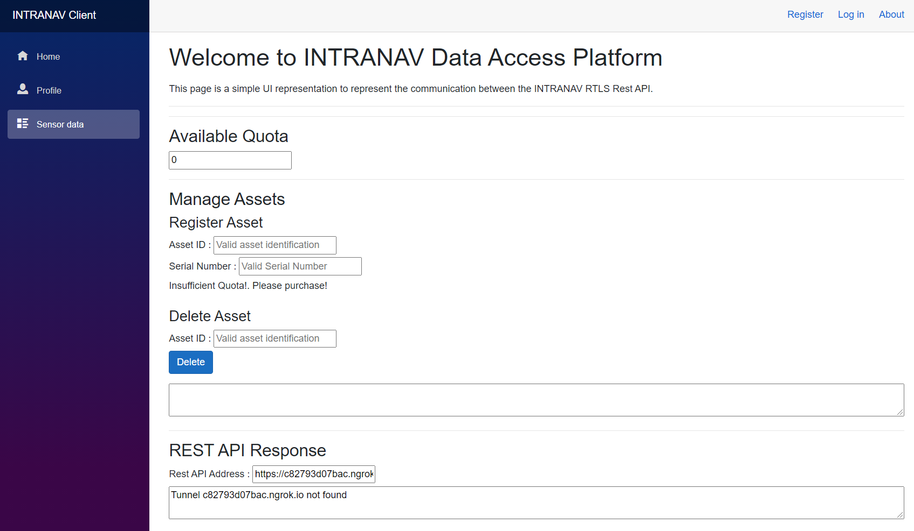
Client Portal
Conceptual Client Portal Application which could be used to decouple the client only processes
Created using,
Language : C#
Framework : .Net Core
Type : Blazor Server Application
Backend Communication : Direct
Used libraries :
Nethereum – Blockchain to App
RestSharp – Rest API to App
Source : https://github.com/SachiHarshitha/HDa_TeamProject_SS21/tree/master/05_ClientWebApp

Slide 15
Summary

