Slide 1
Data set description :
1) The training folder train_new_tsv consists of three types of information about the 1,200+ subjects. They are:
a) the targets (ADHD diagnosis and sex)
b) functional MRI connectome matrices
c) socio-demographic information, e.g., subject’s “handedness” or “parent’s education level”, emotions (“Strength and Difficulties Questionnaire”), and parenting information (“Alabama Parenting Questionnaire”). These include both quantitative and categorical metadata.
2) The test folder test_tsv consists of unseen data frames for 300+ subjects. These data frames are as follows:
a) functional MRI connectome matrices
b)socio-demographic, emotions, and parenting information.

Slide 2
Target Variables :
ADHD_Outcome: Type of Diagnosis (0=Other/None, 1=ADHD) Sex_F: Sex of participant (0=Male, 1=Female)

Slide 3
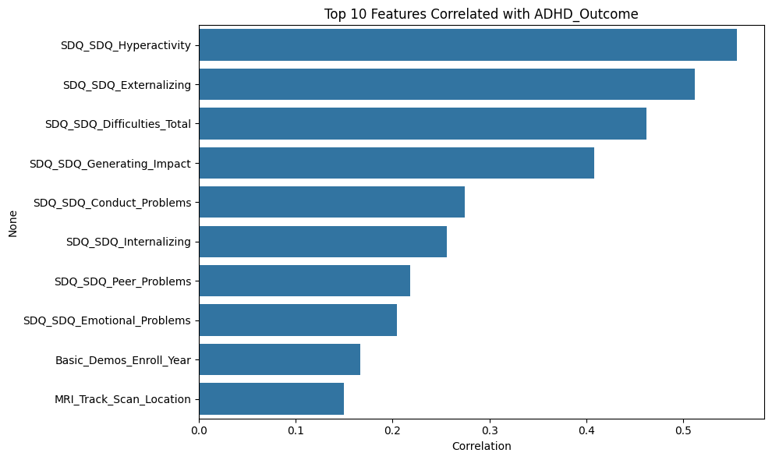
Basic Analysis :

Slide 4
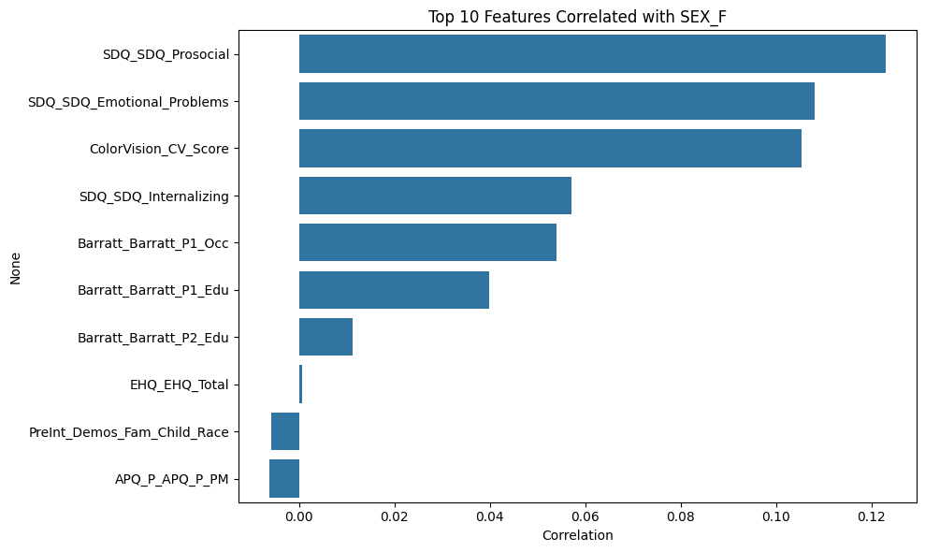

Slide 5
PREPROCESSING

Slide 6
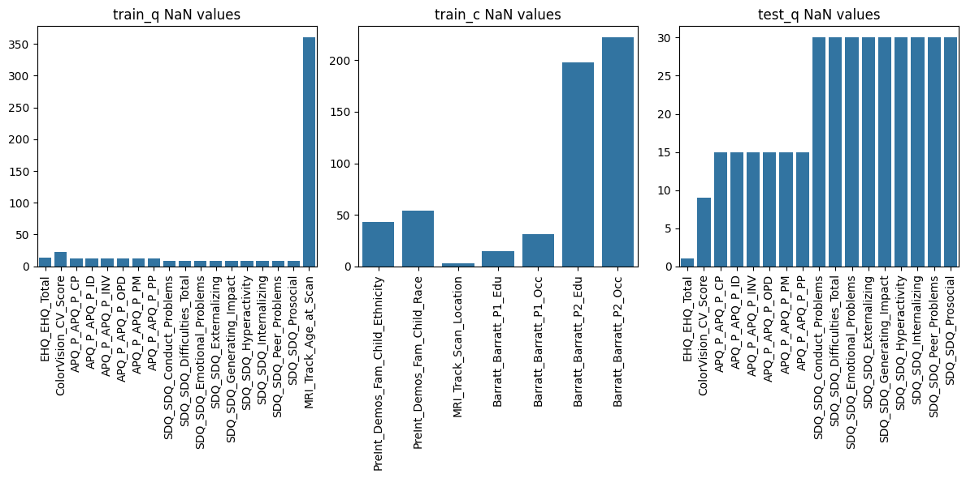
Presence Of Missing Values:

Slide 7
How Did We Handle The Missing Values?
Quantitative features: Mean imputation.
Categorical features: Mode imputation.

Slide 8
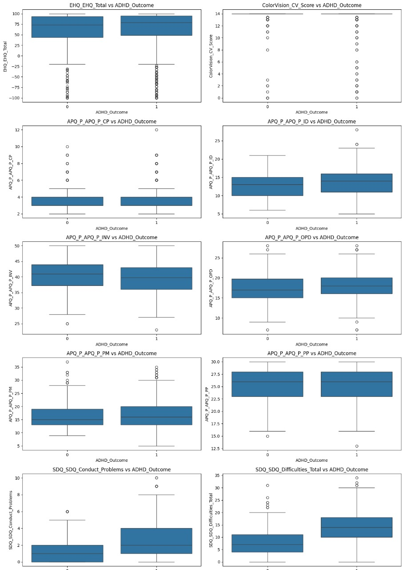

Slide 9
Methods for Outlier Handling:
Imputation: Replacing outliers with more reasonable values (e.g., mean, median, boundaries).
Removal: Deleting outlier data points (use with caution).
Treating them separately: Modeling outliers differently if they represent a distinct phenomenon.

Slide 10
Managing Categorical Data:
Grouping Rare Values :
Problem: Some categorical values (e.g., a very specific ethnicity) might appear only a few times. This can lead totoo many columns after converting to numbers (sparse data).
Solution: We grouped infrequently occurring categories into a single, common category.
Strategy: Any category with a frequency less than 15 was relabeled as 'other'.

Slide 11
Ensuring Consistency:
Problem: What if a category exists in the training data but not the test data, or vice-versa? Or if the order is different? This can cause errors or incorrect model behavior during prediction.
Solution: We created a master list of all possible categories for each feature, combining both train and test data.
Strategy:Identified all unique categories present in both train and test sets for each categorical feature.Ensured both datasets only contain these globally recognized categories.Stored this master list in a category_dict for later use by One-Hot Encoding.
Why: Guarantees that numerical conversion (One-Hot Encoding) will produce the exact same set of columns for both training and testing, preventing dimension mismatches.

Slide 12
Feature Selection:
Selected top 200 correlated features (excluding targets) for Sex_F and ADHD_Outcome based on correlation analysis (sex_corr, adhd_corr).
Excluded target columns (Sex_F, ADHD_Outcome) from feature sets to prevent leakage.
Key interaction features for ADHD modeling:
APQ_P_APQ_P_INV, APQ_P_APQ_P_PP, SDQ_SDQ_Hyperactivity, MRI_Track_Age_at_Scan, SDQ_SDQ_Generating_Impact.
Added predicted sex probability (sex_proba) as a feature and created interaction features by multiplying sex_proba with the above key features.

Slide 13
Feature Engineering:
Combined quantitative, categorical, and functional connectome data into train_combined and test_combined.
Generated interaction features (I_{col}) by multiplying selected features with sex_proba to capture combined effects for ADHD prediction.
Applied stratification based on combinations of ADHD_Outcome and Sex_F to handle class imbalance.

Slide 14
Which Technique Did We Use For Dimentionality Reduction?
Principal Component Analysis (PCA) is a powerful dimensionality reduction technique used in data analysis and machine learning.
PCA helps to simplify complex datasets by: Reducing the number of variables. Identifying the most important patterns in the data. Creating a new set of uncorrelated variables.
Our Application: Reduced hundreds of functional connectivity features down to 100 principal components.

Slide 15
MODEL BUILDING

Slide 16
Training Methods
Models Used:
Sex_F Prediction:
CatBoostClassifier:
Parameters: iterations=500, learning_rate=0.05, depth=6, scale_pos_weight=1.5, random_state=42.
Trained on features_sex (top 200 correlated features) with sample weights to handle class imbalance.
ADHD_Outcome Prediction:
Calibrated RandomForestClassifier:
Base model: Random ForestClassifier with n_estimators=200, max_depth=10, class_weight='balanced', random_state=42.
Calibration: Sigmoid method with 3-fold cross-validation.
Trained on features_adhd plus sex_proba and interaction features, with sample weights.

Slide 17
H2O AutoML:
Explored multiple models (GBM, GLM, DRF, XGBoost , Stacked Ensembles) for initial evaluation.
Metrics: AUC, log loss, AUC-PR, mean per-class error, RMSE, MSE.
Best model: GBM_2 with AUC=0.54108, but results indicated poor performance (AUC ~0.5, F1 scores low).
Training Workflow:
Sex_F Model:
Trained on full training data using train_combined[features_sex].
Predicted probabilities (sex_proba) for both training and test sets.
ADHD_Outcome Model:
Incorporated sex_proba and interaction features.
Trained on full training data with train_combined[features_adhd + sex_proba + interactions].

Slide 18
Sample Weights:
Used compute_sample_weight with balanced strategy for both targets.
For final model, weighted samples with combinations == "11" (ADHD=1, Sex_F=1) given double weight.
Evaluation: Used F1 score (weighted by class balance) for threshold optimization.
Out-of-fold predictions (sex_oof, adhd_oof) used to assess model performance and tune thresholds.
Statistical tests (Kolmogorov-Smirnov and Mann-Whitney U) compared test and OOF prediction distributions.

Slide 19
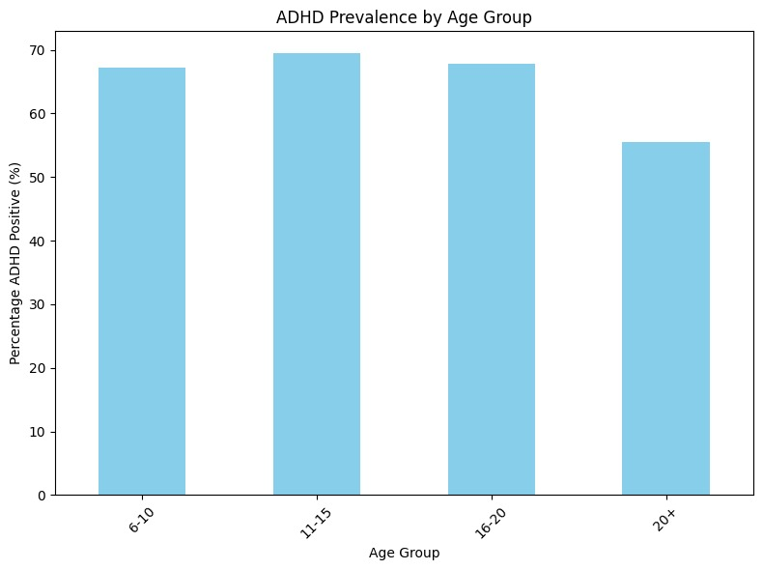
Q1: Which specific age groups within our dataset exhibit a higher prevalence of ADHD?

Slide 20
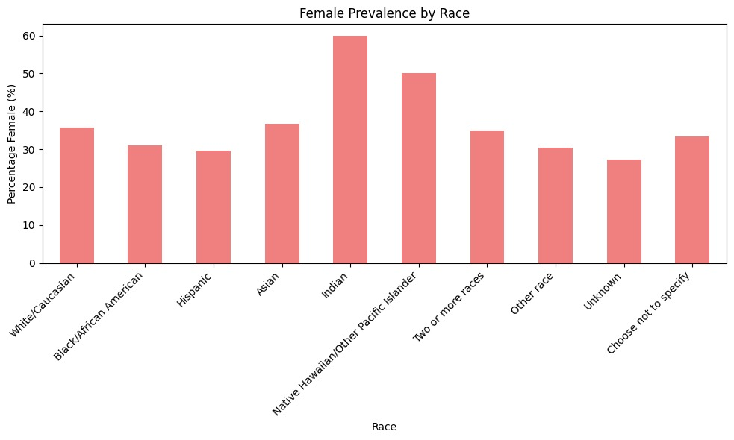
Q2: Do some racial or ethnic groups in our dataset have a higher percentage of ADHD diagnoses compared to others?

Slide 21
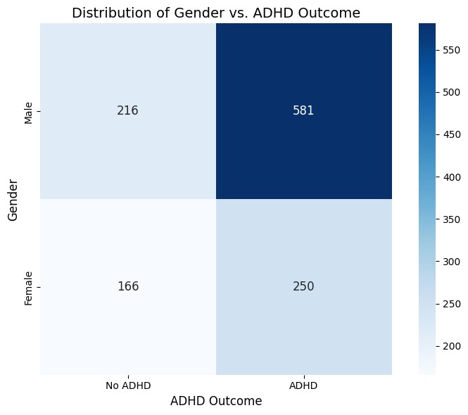
Q3:How does the number of ADHD diagnoses compare between male and female individuals in this dataset?"

Slide 22
THANK YOU

