Slide 1
PROJECT TITLE
CAPSTONE PROJECT
Presented By: Sachidanandam - Alagappa College of Technology - Leather technology

Slide 2
OUTLINE
Problem Statement
Proposed System/Solution
System Development Approach
Algorithm & Deployment
Result
Conclusion
Future Scope
References

Slide 3
Problem Statement
The objective of this analysis is to explore and analyse Netflix's vast dataset to gain insights into user behaviour, content performance, and other relevant metrics. This will enable Netflix to make data-driven decisions regarding content creation, recommendation algorithms, and overall platform enhancement.

Slide 4
Proposed Solution
Define Objectives: Clearly define the objectives of your analysis.
Data Collection: Gather the necessary data from Netflix's API (if available) or other reliable sources
Data Preprocessing: Clean and preprocess the data to ensure accuracy and consistency.
Exploratory Data Analysis (EDA): Conduct exploratory data analysis to gain insights into the dataset.
Feature Engineering: Create new features that might be useful for analysis or modeling.
Modeling: Apply appropriate modeling techniques to address your objectives
Evaluation: Evaluate the performance of your models using appropriate metrics such as accuracy, precision, recall, or Mean Absolute Error (MAE), depending on the specific task.
Interpretation and Actionable Insights: Interpret the results of your analysis and derive actionable insights
Visualization and Reporting: Present your findings in a clear and visually appealing manner. Use charts, graphs, and dashboards to communicate key insights effectively.
Iterate and Improve: Continuously iterate on your analysis and models based on feedback and new data.

Slide 5
System Approach
Analysing Netflix using a systems approach involves examining the company within the broader context of its various interconnected components and their relationships. Here's a breakdown of how you might approach this analysis:
Identifying Components:
Netflix as the focal point: This includes its business model, content library, technology infrastructure, and customer base.
External factors: Market trends, competition, regulatory environment, and technological advancements.
Interconnections:
How each component interacts with and influences others. For example, Netflix's content library affects its customer acquisition and retention, while its technology infrastructure enables content delivery and personalized recommendations.
External factors such as market trends can impact content acquisition strategies and subscriber growth.
Feedback Loops:
Feedback mechanisms within the system, such as user ratings shaping content recommendations or subscriber data informing content production decisions.
Market feedback influencing content acquisition strategies and pricing decisions.

Slide 6
System Approach
Emergent Properties:
Properties that arise from the interactions of the system's components. For Netflix, this might include its brand reputation, customer loyalty, and its ability to disrupt traditional media industries.
The emergence of binge-watching culture or the impact of Netflix Originals on pop culture could be considered emergent properties.
Boundaries:
Defining the boundaries of the system helps in understanding what is included within the analysis and what is external to it. For Netflix, this might involve delineating its operations from those of its competitors or distinguishing between its streaming and DVD rental services.
Dynamic Nature:
Recognizing that the system is not static but evolves over time in response to internal and external influences.
For Netflix, this could involve analyzing how the company's strategy has evolved since its founding, its response to new competitors or technological developments, and shifts in consumer behavior.

Slide 7
System Approach
Modeling and Analysis:
Using tools like system dynamics modeling or causal loop diagrams to represent the various components, relationships, and feedback loops within the system.
Conducting quantitative analysis where possible, such as forecasting subscriber growth or evaluating the impact of different content acquisition strategies.
Strategic Implications:
Drawing insights from the analysis to inform strategic decision-making. This might involve identifying opportunities for growth, mitigating risks, or optimizing resource allocation.
Understanding how changes in one part of the system might ripple through to affect other parts, and vice versa

Slide 8
Algorithm & Deployment
Data Collection:
Obtain access to Netflix data. This might include information about users, their viewing habits, ratings, etc. Netflix provides certain datasets for research purposes, or you might need to collect data through web scraping (be sure to adhere to terms of service and legalities).
Data may also include metadata about movies/shows such as genre, release date, cast, crew, etc.
Data Cleaning and Preprocessing:
Remove duplicates, handle missing values, and correct any errors in the data.
Standardize data formats and units if necessary.
Convert categorical data into numerical representations through techniques like one-hot encoding or label encoding.
Normalize or scale numerical features if required.
Perform exploratory data analysis (EDA) to gain insights into the data.
Feature Engineering:
Create new features from existing ones if it adds value to your analysis.
Feature selection: Decide which features are relevant for your analysis. You might use techniques like correlation analysis, feature importance from models, or domain knowledge to select features.
Algorithm Selection:
Determine the type of analysis you want to perform (e.g., recommendation, user segmentation, content analysis).
Select appropriate algorithms. For recommendation systems, this might include collaborative filtering, content-based filtering, or hybrid methods. For user segmentation, clustering algorithms like k-means might be useful.

Slide 9
Algorithm & Deployment
Model Training:
Split the data into training and testing sets.
Train the selected models using the training data.
Tune hyperparameters using techniques like grid search or random search.
Evaluate models using appropriate evaluation metrics (e.g., RMSE for recommendation systems).
Deployment:
Once you have a trained model that performs well, deploy it into production.
This could involve setting up APIs for real-time recommendations or batch processing pipelines for periodic analysis.
Monitor the deployed model's performance and update as needed.
Feedback Loop:
Continuously collect feedback from users or monitor system performance.
Refine models based on feedback and updated data.
Regularly retrain models to keep them up to date.

Slide 10
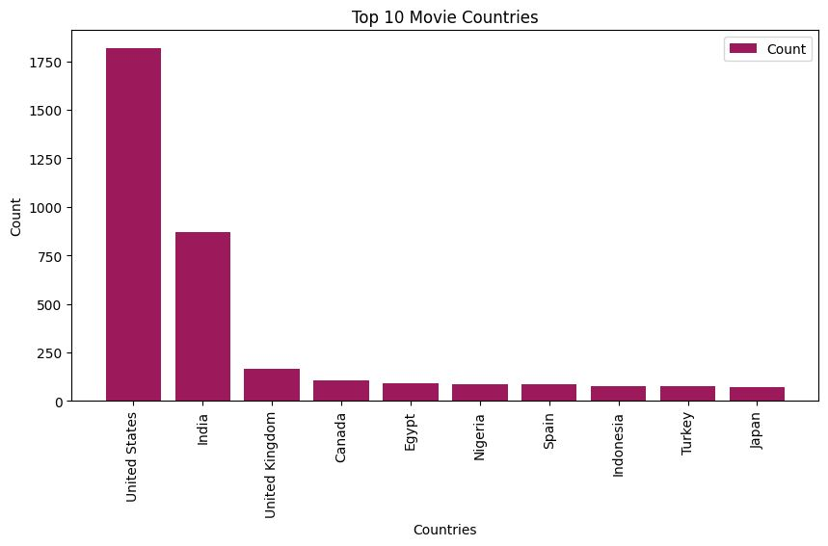
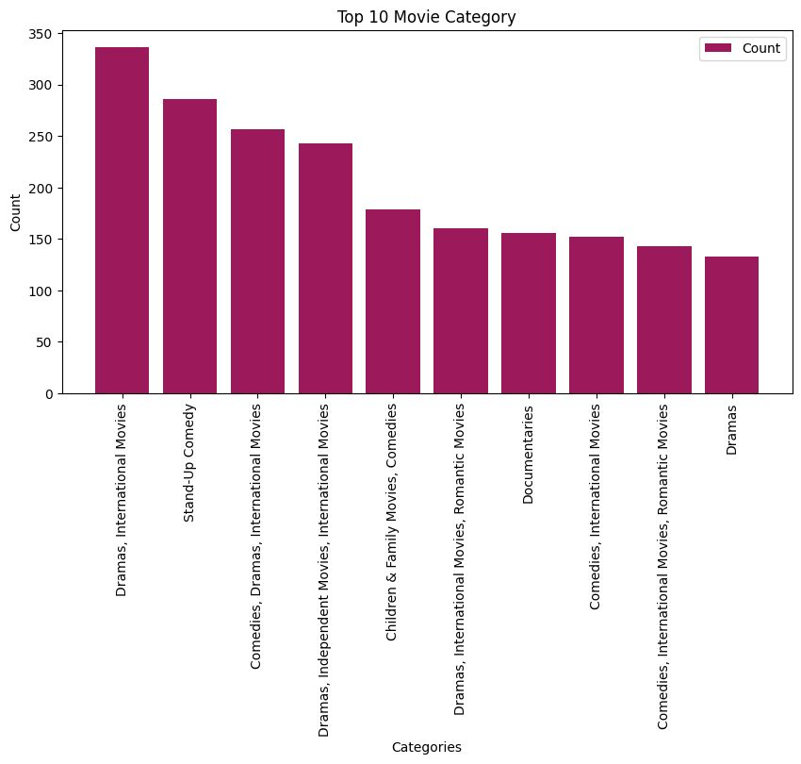
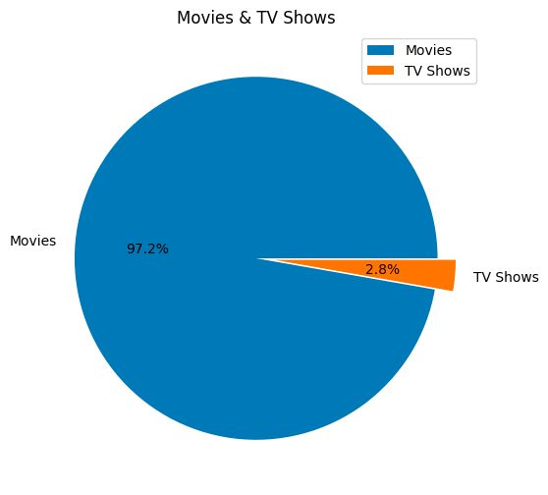
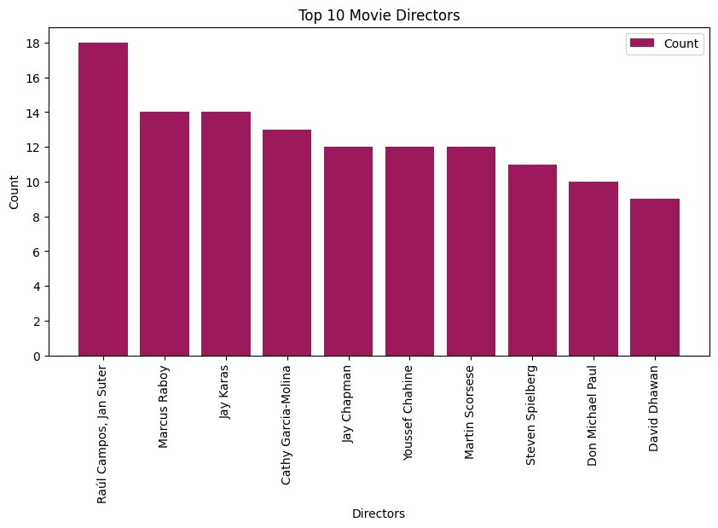
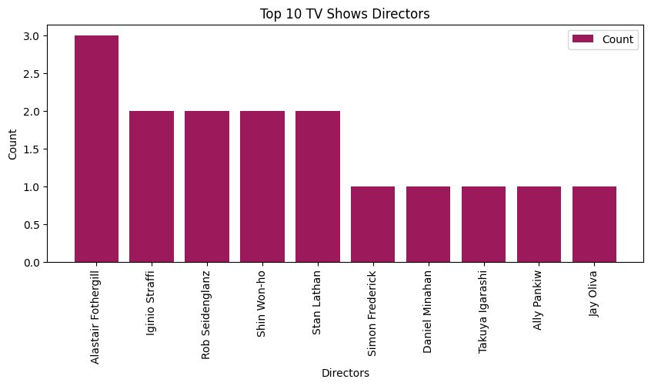
Result

Slide 11
Conclusion
In conclusion, Netflix remains a dominant force in the streaming industry, boasting a vast library and global reach. Its continuous investment in original content, innovative algorithms, and subscriber-centric approach fortifies its position. However, increasing competition and content production costs pose challenges. Nevertheless, with a strong brand, adaptability, and strategic acquisitions, Netflix is poised to sustain its growth and shape the future of entertainment.

Slide 12
Future scope
The future scope for Netflix analysis is promising, with opportunities for leveraging advanced data analytics and AI technologies. By delving into viewer preferences, content consumption patterns, and engagement metrics, analysts can optimize content creation, acquisition, and recommendation algorithms. Predictive analytics can forecast audience trends, aiding in strategic decision-making for content production and licensing. Sentiment analysis of user reviews and social media chatter can provide valuable insights into audience sentiment and brand perception. Moreover, integrating demographic data and viewer segmentation techniques can personalize user experiences, enhancing customer satisfaction and retention. As Netflix expands globally, opportunities for cross-cultural analysis and content localization will further enrich the scope of analysis, driving innovation and growth in the streaming industry.

Slide 13
References
https://www.kaggle.com/datasets/shivamb/netflix-shows/data
https://www.forbes.com/
https://www.investopedia.com/
https://seekingalpha.com/
https://www.cnbc.com/world/?region=world

Slide 14
THANK YOU

