Slide 1

NETNAIJA
Data Wrangling and Analysis
Achimugu A . S
20th May 2022

Slide 2
Outline
Introduction
Executive Summary
Methodology
Results
Conclusion
Appendix

Slide 3
Introduction
Netnaija is media download center created in March of 2016. The project aims at scraping data from the movies section that has been uploaded from 2016 till date and answering some questions from the data.Questions intended to be answered are
1. Which year has the highest number of upload?
2. number of movies uploaded by month in the year 2019
3. What movies has highest movie length?
4. Stars with most number of movies
5. Find movies which Scott Adkin was an actor
6. How long from on average from offical release of movie to site upload
7. Trend between release and Update
8. Compared top 4 genre with others genre in a pie chart
9. What movie got movie people talking most and what is the summary
10. Trend in upload

Slide 4
Executive Summary
Data was scraped from Netnaija with beautifulllsoup and request library. Scraped data contains 3073 rows and 13 columns.
Pandas was used to clean wrangle the data and after the process 82% of row and 11 columns were left for the analysis
Answer were gotten to initally proposed questions after the anlaysis. Question like star with the most number of movie and How long from on average from offical release of movie to site upload were found to Nicolas Cage and 7 days

Slide 5
Section 1
Methodology

Slide 6
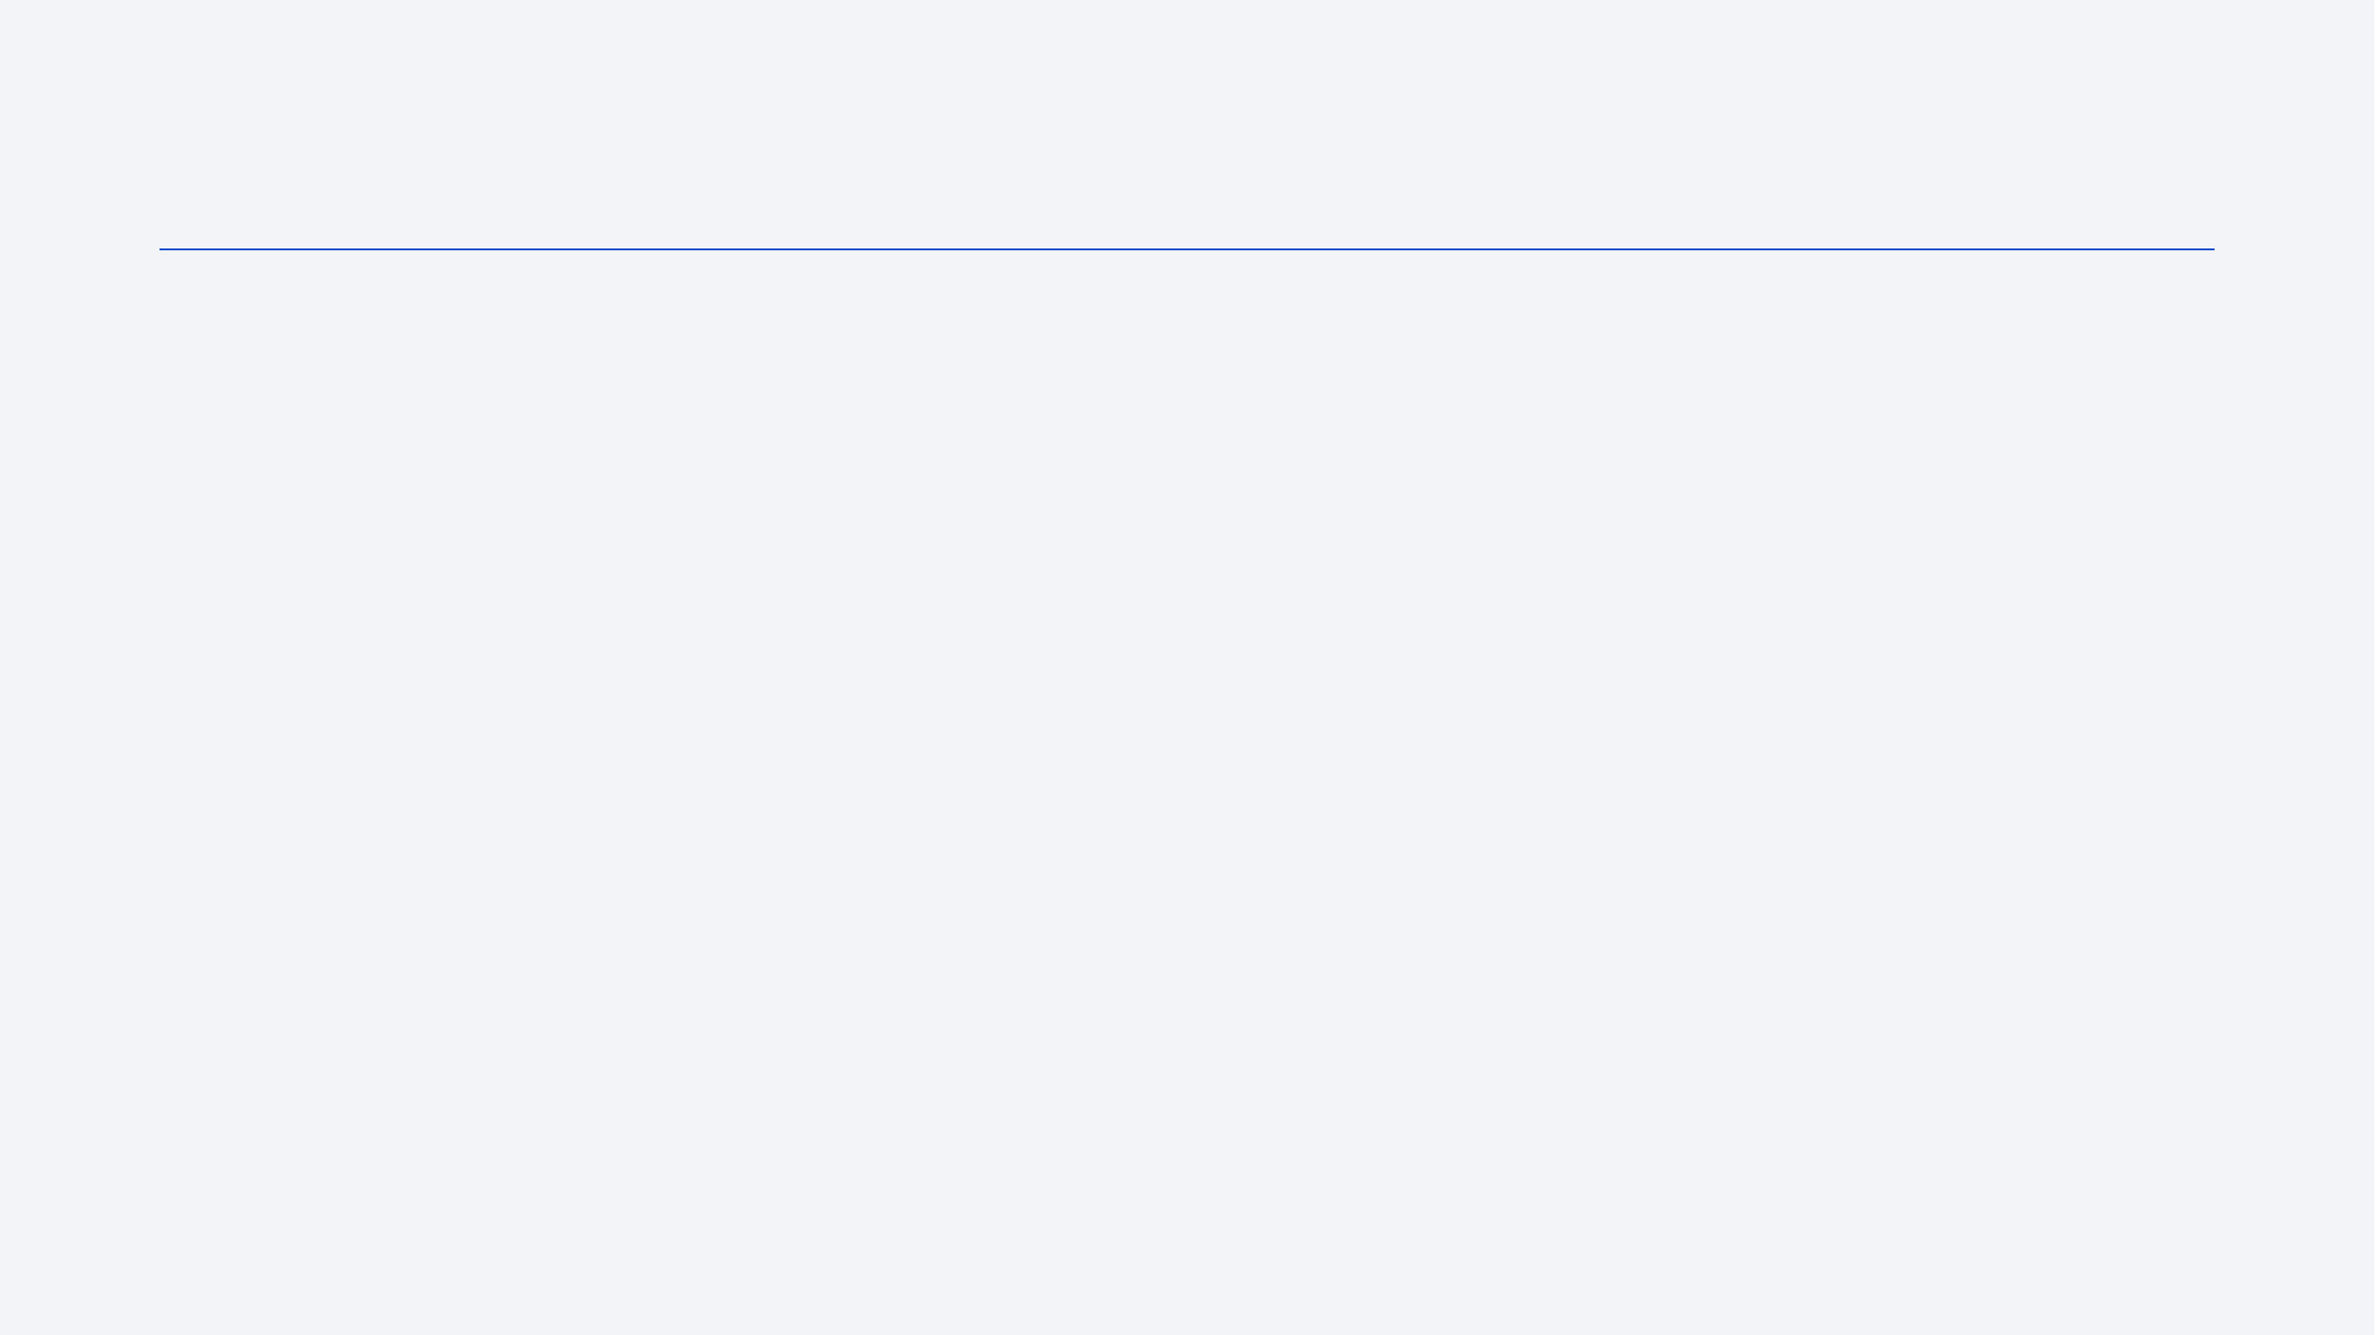
Methodology
Executive Summary
Data collection methodology:
  Describe how data was collected
Perform data wrangling
  Describe how data was processed
Perform exploratory data analysis (EDA) using visualization and SQL
Perform interactive visual analytics using Folium and Plotly Dash
Perform predictive analysis using classification models
  How to build, tune, evaluate classification models

Slide 7
Data Collection
For the purpose of the analysis, Each movie title, movie link, movie type, time of upload, movie length, number of comment, movie summary, Genre, Release Date, Stars, movie Languages, movie Subtitles, IMDB links were scraped. Not all not all feature listed were present in some movie in which case I replaced them with missing

Slide 8
Data Collection
Getting response from HTML
Creating pandas dataframe
Creating Beautifulsoup object
Extracting all columns

Slide 9
Data Wrangling
After getting the scraped data, pandas package was used to do some cleaning by droping duplicate rows, removing parantenses and semi colon present in the data. Columns that were not significant to the analysis were also droped. Regex was to parse the movie from the title added it to the upload date and each column was casted to the appropriate date type. Nan values were removed, replaced or left alone depending on the column and final index was set to be the upload date.
After the process 82% of row and 11 columns were left for the analysis

Slide 10
EDA with Data Visualization
Visualisation was done with Seaborn amd matplotlib Pie graph plot, Bar plot and Line plot;
Pie Chart was used to compare the genre of movies. Action, drama, comedy, Thriller and the rest genre which was grouped as other
Bar chart was used to show the comparisons between Total Upload by Month(2019),Total Upload by Year. Year and months are both categorical data hence the choice of Bar chart.
Line plot was used to show the Yearly_avg between Release and Uplaod and Trend in number of upload

Slide 11

Section 2

Slide 12
Section 2
Insights drawn
from EDA

Slide 13
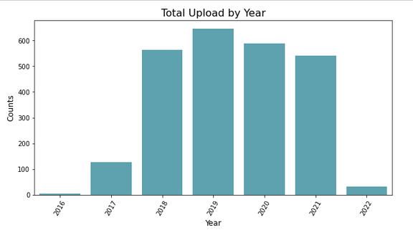
Uploads by Year
1. Which year has the highest number of upload?
2019 has the highest number of upload with 646 movies followed by a decline in 2020 and 2021 with a count of 589 and 541 respectivly

Slide 14
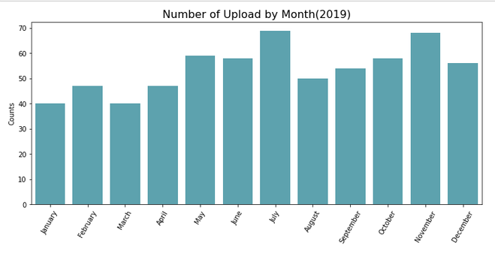
Number of Upload by Month in 2019
2. Find the number of movies by month in the year 2019
July is the highest with a count of 68 while january and march are the lowest with 40

Slide 15

Movie with the highest length
3. What movies has highest movie length
Title Zack Snyder's Justice League
Lenght
04:02:03
Summary
Determined to ensure Superman's ultimate sacrifice was not in vain, Bruce Wayne aligns forces with Diana Prince with plans to recruit a team of metahumans to protect the world from an approaching threat of catastrophic proportions
Stars Henry Cavill, Ben Affleck, Gal Gadot

Slide 16
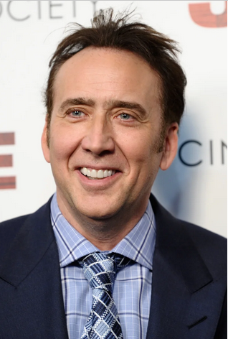


Stars with most number of movies
4. 3 stars with most number of movies
Nicolas Cage
Bruce Willis
Samuel L. Jackson

Slide 17








Movies Scott Adkins acted
5. Find movies which Scott Adkin was an actor
Titles
One Shot
Dead Reckoning
Seized
Legacy of Lies
Debt Collectors
Avengement
Incoming
Accident Man

Slide 18
Launch Success Yearly Trend

Slide 19
All Launch Site Names
Find the names of the unique launch sites
Present your query result with a short explanation here

Slide 20
Launch Site Names Begin with 'CCA'
Find 5 records where launch sites begin with `CCA`
Present your query result with a short explanation here

Slide 21
Total Payload Mass
Calculate the total payload carried by boosters from NASA
Present your query result with a short explanation here

Slide 22
Average Payload Mass by F9 v1.1
Calculate the average payload mass carried by booster version F9 v1.1
Present your query result with a short explanation here

Slide 23
First Successful Ground Landing Date
Find the dates of the first successful landing outcome on ground pad
Present your query result with a short explanation here

Slide 24
Successful Drone Ship Landing with Payload between 4000 and 6000
List the names of boosters which have successfully landed on drone ship and had payload mass greater than 4000 but less than 6000
Present your query result with a short explanation here

Slide 25
Total Number of Successful and Failure Mission Outcomes
Calculate the total number of successful and failure mission outcomes
Present your query result with a short explanation here

Slide 26
Boosters Carried Maximum Payload
List the names of the booster which have carried the maximum payload mass
Present your query result with a short explanation here

Slide 27
2015 Launch Records
List the failed landing_outcomes in drone ship, their booster versions, and launch site names for in year 2015
Present your query result with a short explanation here

Slide 28
Rank Landing Outcomes Between 2010-06-04 and 2017-03-20
Rank the count of landing outcomes (such as Failure (drone ship) or Success (ground pad)) between the date 2010-06-04 and 2017-03-20, in descending order
Present your query result with a short explanation here

Slide 29

Section 3

Slide 30
<Folium Map Screenshot 1>
Replace <Folium map screenshot 1> title with an appropriate title
Explore the generated folium map and make a proper screenshot to include all launch sites’ location markers on a global map
Explain the important elements and findings on the screenshot

Slide 31
<Folium Map Screenshot 2>
Replace <Folium map screenshot 2> title with an appropriate title
Explore the folium map and make a proper screenshot to show the color-labeled launch outcomes on the map
Explain the important elements and findings on the screenshot

Slide 32
<Folium Map Screenshot 3>
Replace <Folium map screenshot 3> title with an appropriate title
Explore the generated folium map and show the screenshot of a selected launch site to its proximities such as railway, highway, coastline, with distance calculated and displayed
Explain the important elements and findings on the screenshot

Slide 33

Section 4

Slide 34
<Dashboard Screenshot 1>
Replace <Dashboard screenshot 1> title with an appropriate title
Show the screenshot of launch success count for all sites, in a piechart
Explain the important elements and findings on the screenshot

Slide 35
<Dashboard Screenshot 2>
Replace <Dashboard screenshot 2> title with an appropriate title
Show the screenshot of the piechart for the launch site with highest launch success ratio
Explain the important elements and findings on the screenshot

Slide 36
<Dashboard Screenshot 3>
Replace <Dashboard screenshot 3> title with an appropriate title
Show screenshots of Payload vs. Launch Outcome scatter plot for all sites, with different payload selected in the range slider
Explain the important elements and findings on the screenshot, such as which payload range or booster version have the largest success rate, etc.

Slide 37

Section 5

Slide 38
Classification Accuracy
Visualize the built model accuracy for all built classification models, in a bar chart
Find which model has the highest classification accuracy

Slide 39
Confusion Matrix
Show the confusion matrix of the best performing model with an explanation

Slide 40
Conclusions
Point 1
Point 2
Point 3
Point 4
…

Slide 41
Appendix
Include any relevant assets like Python code snippets, SQL queries, charts, Notebook outputs, or data sets that you may have created during this project

Slide 42


