Slide 1

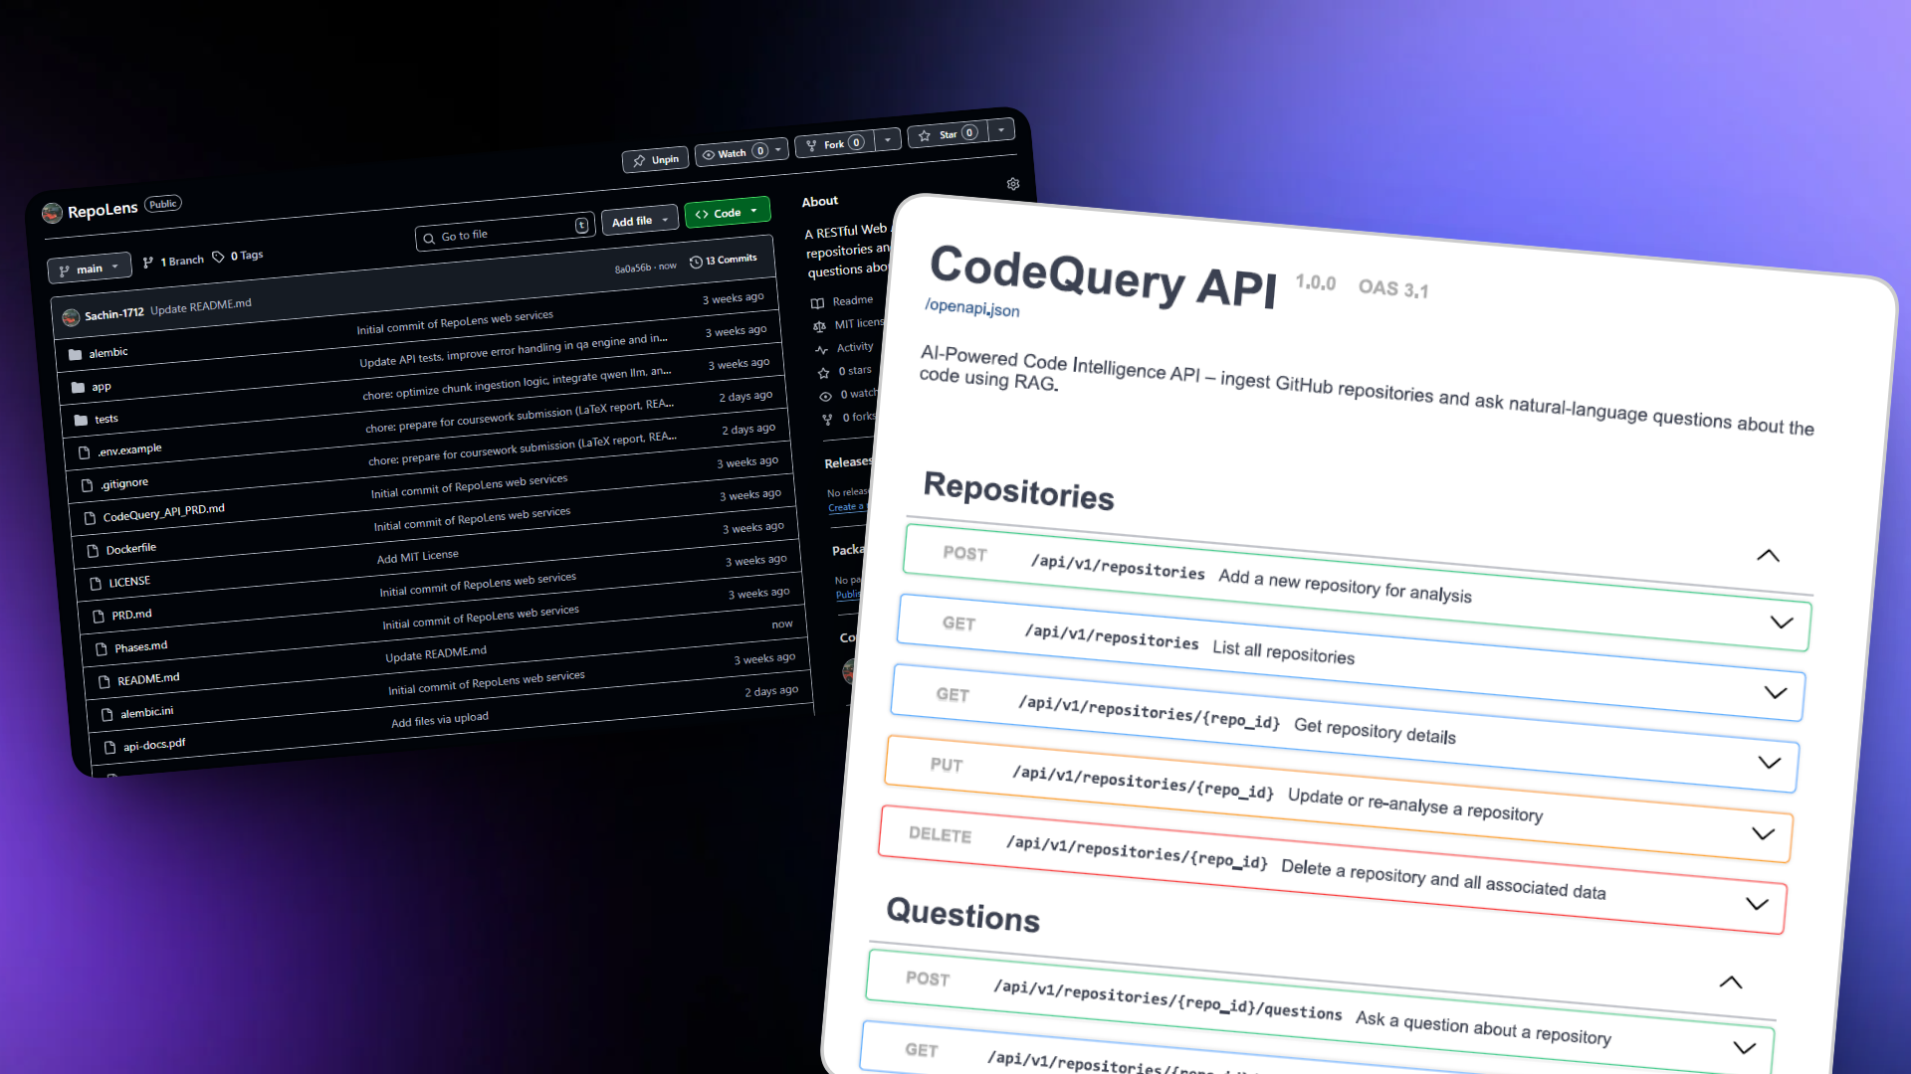
CodeQuery: AI-Powered Code Intelligence
sc23sss@leeds.ac.uk

Slide 2
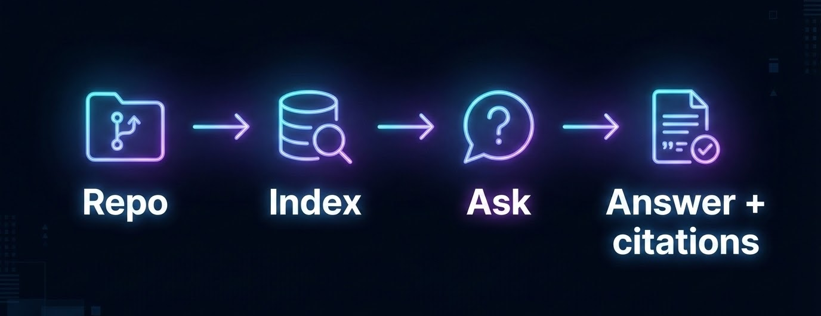
Why CodeQuery?
Ingests cloned GitHub repositories for semantic search.
Answers natural language questions via RAG.
Designed for local execution and data privacy.
Lightweight fallback mode when LLM is offline.
Notes:
The core service is an asynchronous FastAPI application exposing RESTful endpoints. We use semantic HTTP status codes, such as 202 Accepted for long-running ingestion. The entire stack is containerised via Docker Compose, meaning you can spin up the lightweight database and API instantly, or scale up with Celery and local LLMs using profiles."

Slide 3
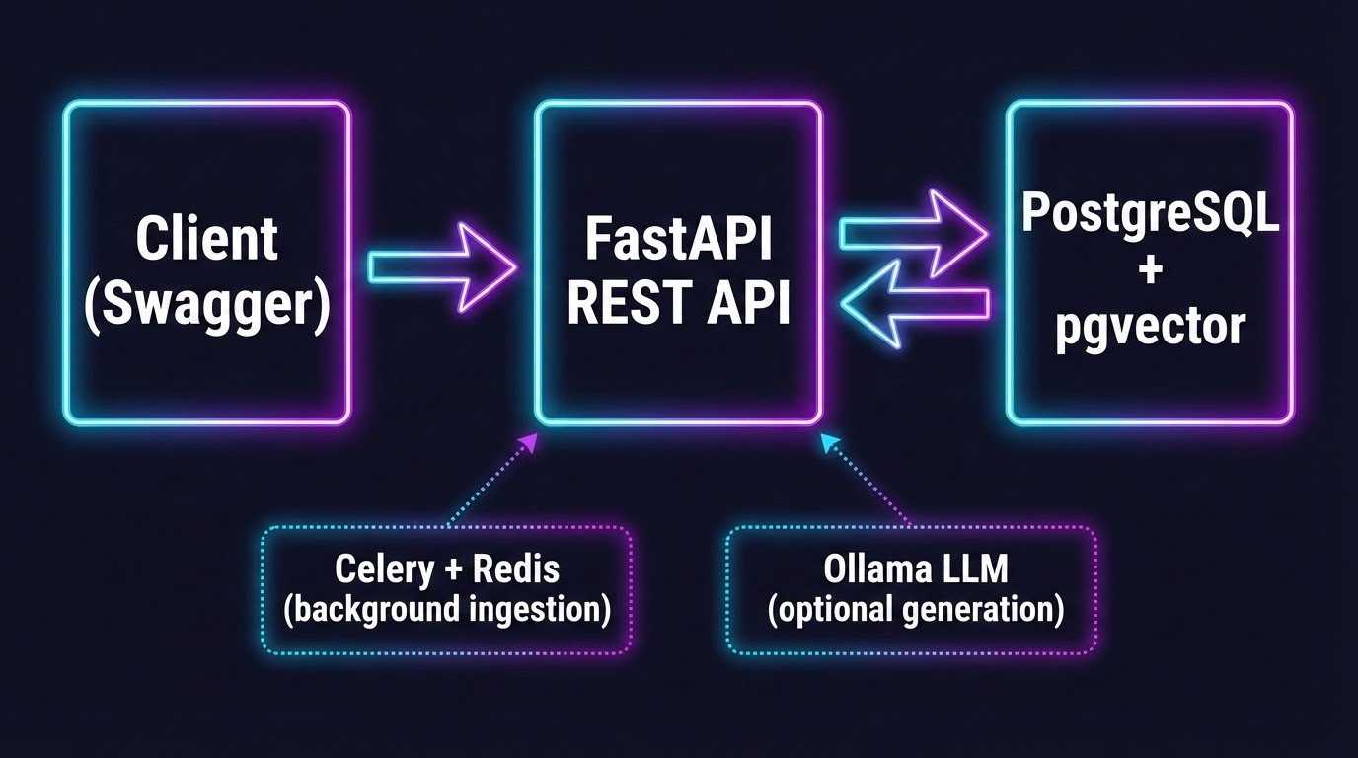
System at a glance
Notes:
The core service is an asynchronous FastAPI application exposing RESTful endpoints. We use semantic HTTP status codes, such as 202 Accepted for long-running ingestion. The entire stack is containerised via Docker Compose, meaning you can spin up the lightweight database and API instantly, or scale up with Celery and local LLMs using profiles."

Slide 4
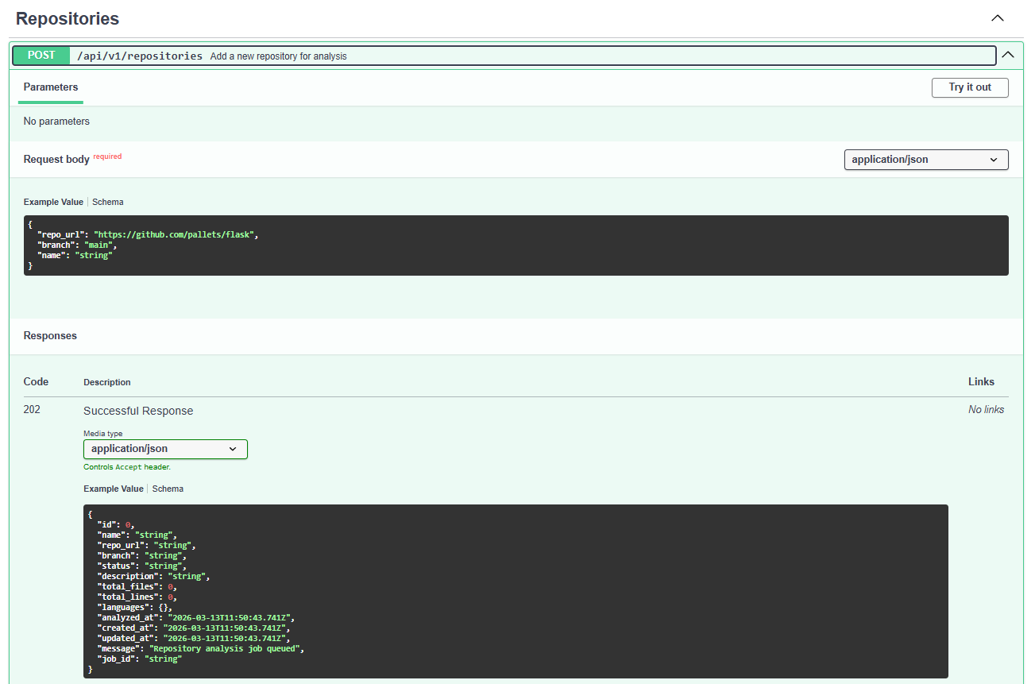
REST API and endpoints
Repositories: CRUD
Analysis: status + statistics
Questions: ask + sources/citations
Correct JSON + status codes
Notes:
The core service is an asynchronous FastAPI application exposing RESTful endpoints. We use semantic HTTP status codes, such as 202 Accepted for long-running ingestion. The entire stack is containerised via Docker Compose, meaning you can spin up the lightweight database and API instantly, or scale up with Celery and local LLMs using profiles."

Slide 5
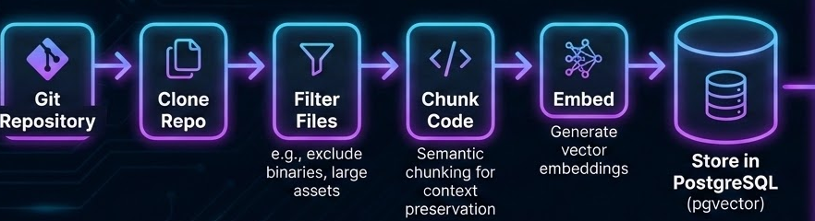
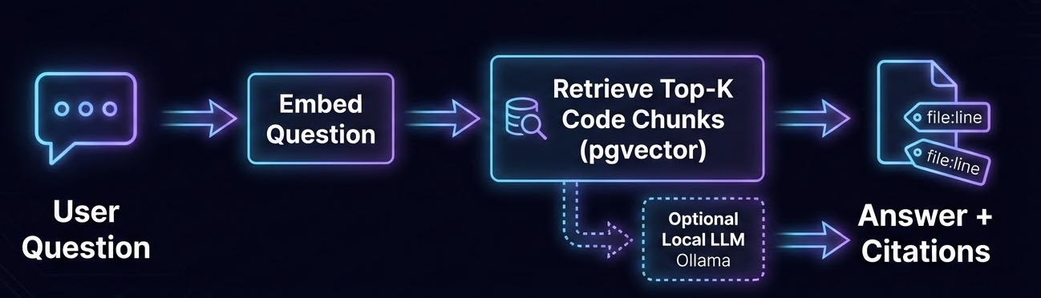
Ingestion Pipeline
RAG Workflow
Notes:
When a repository is submitted, the ingestion pipeline clones it, filters out irrelevant files, and chunks the code into meaningful segments. These chunks are embedded and stored in PostgreSQL using the pgvector extension. This robust data model allows us to maintain relational links between a repository, its code chunks, and user questions while enabling lightning-fast similarity searches.

Slide 6
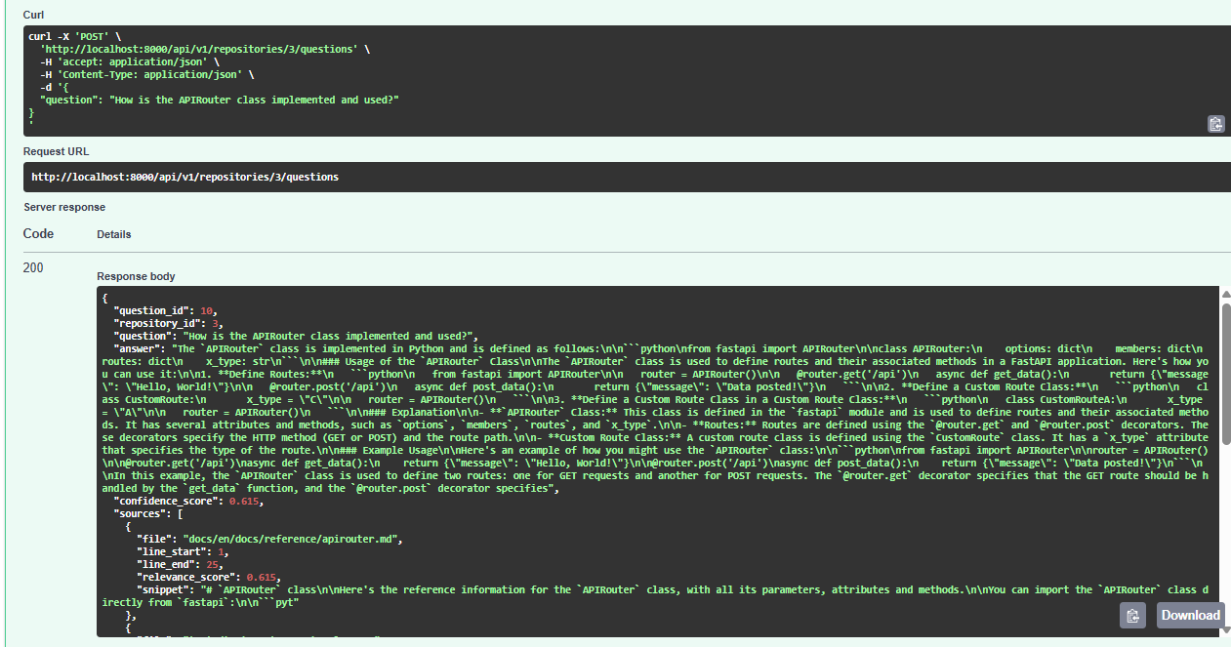
Example output with LLM
Notes:
When a repository is submitted, the ingestion pipeline clones it, filters out irrelevant files, and chunks the code into meaningful segments. These chunks are embedded and stored in PostgreSQL using the pgvector extension. This robust data model allows us to maintain relational links between a repository, its code chunks, and user questions while enabling lightning-fast similarity searches.

Slide 7
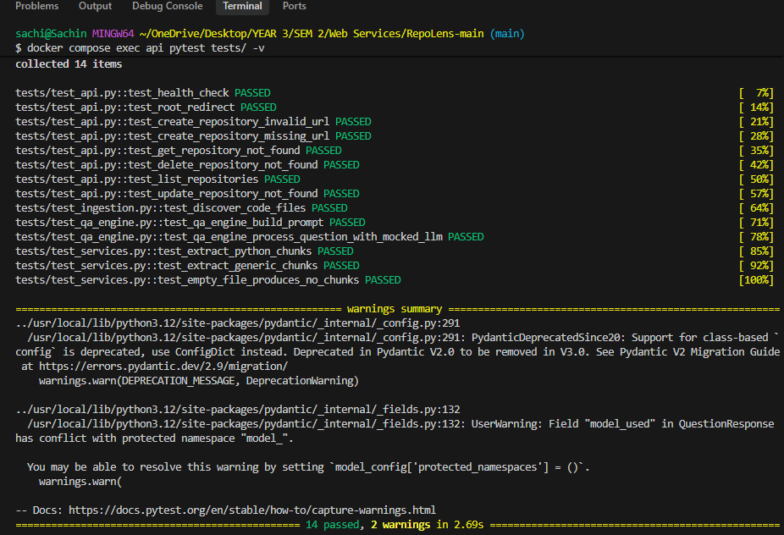
Testing & Quality Assurance
Comprehensive pytest suite ensuring robust endpoints.
Isolated testing for ingestion tools and chunking logic.
Runs reproducibly in Docker
Notes:
When a repository is submitted, the ingestion pipeline clones it, filters out irrelevant files, and chunks the code into meaningful segments. These chunks are embedded and stored in PostgreSQL using the pgvector extension. This robust data model allows us to maintain relational links between a repository, its code chunks, and user questions while enabling lightning-fast similarity searches.

Slide 8
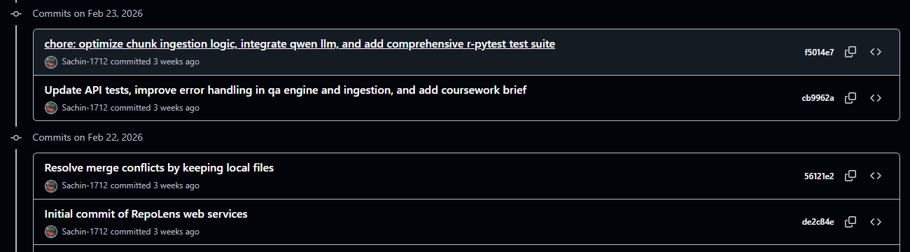
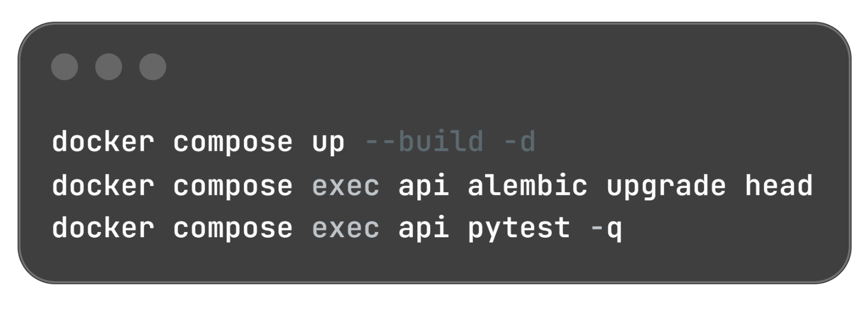
Version Control & Reproducible Builds
Iterative development driven by Git version control.
Clear, descriptive commit history demonstrating progression.
Containerised environments via Docker Compose.
Complete separation of concerns (API, DB, Workers).
Notes:
When a repository is submitted, the ingestion pipeline clones it, filters out irrelevant files, and chunks the code into meaningful segments. These chunks are embedded and stored in PostgreSQL using the pgvector extension. This robust data model allows us to maintain relational links between a repository, its code chunks, and user questions while enabling lightning-fast similarity searches.

Slide 9
THANKS!
All deliverables are linked in the github repository: https://github.com/Sachin-1712/RepoLens

