Slide 1

IDS PROJECT
TEAM DATA ANALYZERS
K SACHIN NAYAK
K SASI KIRAN REDDY
SP NITHESH KUMAR

Slide 2

INTRODUCTION
DATA SET: CRICKET(IPL)
Data set is related to IPL Teams, Wins, Toss Wins,
Venue,City Name, Man of the Match,etc.
We are going analyze the number wins by each team,
Toss wins by each team, Home Wins, Away Wins,
Predict the strongest team, etc through this
dataset.

Slide 3
Match_Id | Match_Date | Team_Name_Id | Opponent_Team_Id | Venue_Name | Toss_Winner_Id | Won_By | Match_Winner_Id | Man_Of_The_Match_Id | First_Umpire_Id | Second_Umpire_Id | City_Name
335987 | 18-Apr-08 | 2 | 1 | M Chinnaswamy Stadium | 2 | 140 | 1 | 2 | 470 | 477 | Bangalore
335988 | 19-Apr-08 | 4 | 3 | Punjab Cricket Association Stadium, Mohali | 3 | 33 | 3 | 19 | 471 | 487 | Chandigarh
335989 | 19-Apr-08 | 6 | 5 | Feroz Shah Kotla | 5 | 9 | 6 | 90 | 472 | 512 | Delhi
335990 | 20-Apr-08 | 7 | 2 | Wankhede Stadium | 7 | 5 | 2 | 11 | 473 | 476 | Mumbai
335991 | 20-Apr-08 | 1 | 8 | Eden Gardens | 8 | 5 | 1 | 4 | 474 | 486 | Kolkata

Slide 4

DATA CLEANING
Data cleansing or data cleaning is the process of :
• Detecting and correcting (or removing) corrupt or inaccurate records from a record set, table, or database
• Identifying incomplete, incorrect, inaccurate or irrelevant parts of the data and then replacing, modifying, or deleting the dirty or coarse data.

Slide 5
Won_By
140
33
9
5
5
6
9
6
3
66
7
?
10
4
13
Won_By 17 33 9 5 5 6 9 6 3 66 7 17 10 4 13
DATA CLEANING
Attribute: Won_By
METHOD:
MEAN SUBSTITUITION
The missing and the outliers are substituted
by the
mean value

Slide 6
Venue_Name
M Chinnaswamy Stadium
Punjab Cricket Association Stadium, Mohali
Feroz Shah Kotla
Wankhede Stadium
Eden Gardens
Sawai Mansingh Stadium
Rajiv Gandhi International Stadium, Uppal
MA Chidambaram Stadium, Chepauk
Rajiv Gandhi International Stadium, Uppal
Punjab Cricket Association Stadium, Mohali
?
MA Chidambaram Stadium, Chepauk
Dr DY Patil Sports Academy
Venue_Name M Chinnaswamy Stadium Punjab Cricket Association Stadium, Mohali Feroz Shah Kotla Wankhede Stadium Eden Gardens Sawai Mansingh Stadium Rajiv Gandhi International Stadium, Uppal MA Chidambaram Stadium, Chepauk Rajiv Gandhi International Stadium, Uppal Punjab Cricket Association Stadium, Mohali Punjab Cricket Association Stadium, Mohali MA Chidambaram Stadium, Chepauk Dr DY Patil Sports Academy
Data Cleaning:
Attribute:
Venue_Name
Method:
Single Imputation:
HOT DECK

Slide 7
City_Name
Bangalore
Chandigarh
Delhi
Mumbai
Kolkata
Jaipur
Hyderabad
Chennai
Hyderabad
Chandigarh
?
Chennai
Mumbai
Data Cleaning:
Attribute:
City_Name
Method:
Single Imputation:
HOT DECK
City_Name Bangalore Chandigarh Delhi Mumbai Kolkata Jaipur Hyderabad Chennai Hyderabad Chandigarh Chandigarh Chennai Mumbai

Slide 8
DATA VISUALISTION
A form of visual communication
Helps people understand significance of data by placing it in a visual context.
Patterns and trends are difficult if not impossible to detect by looking at textual data.
Much easier to recognize with data visualization software.
Communicate information clearly using
Plots of various types
Info graphics
Maps, schematic diagrams (e.g. train routes)

Slide 9
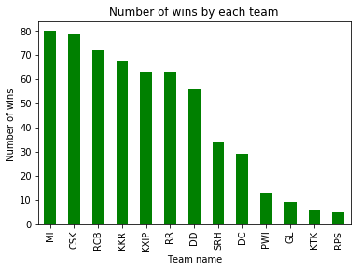
Team Vs Number of Match Wins

Slide 10
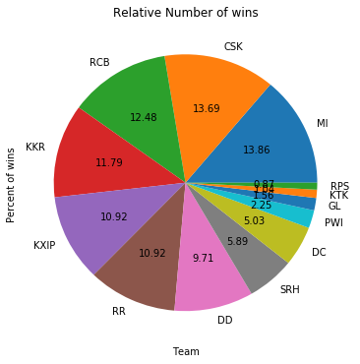

Slide 11
From the bar Chart and pie chart
we can infer that:
Mumbai Indians is leading in terms
Number of wins with almost 80.
DC,PWI,GL,KTK,RPS have relatively lower
Number of wins as they have played
less matches when compared to others.

Slide 12
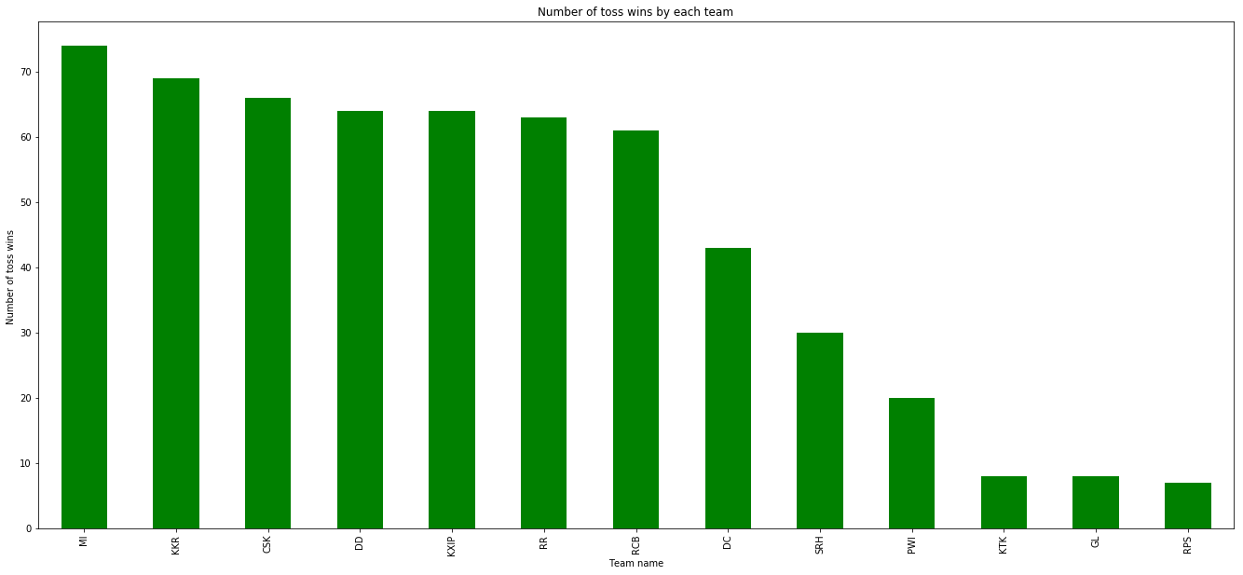
Team Vs Number of Toss Wins

Slide 13
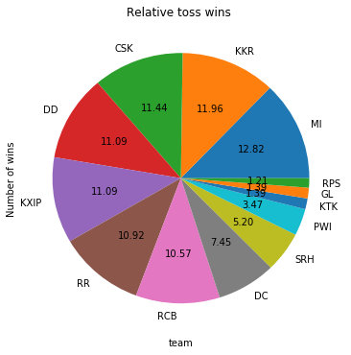

Slide 14
From the bar Chart and pie chart
we can infer that:
Mumbai Indians is leading in terms
Number of toss wins with more than70+.
DC,PWI,GL,KTK,RPS have relatively lower
Number of toss wins as they have played
less matches when compared to others

Slide 15
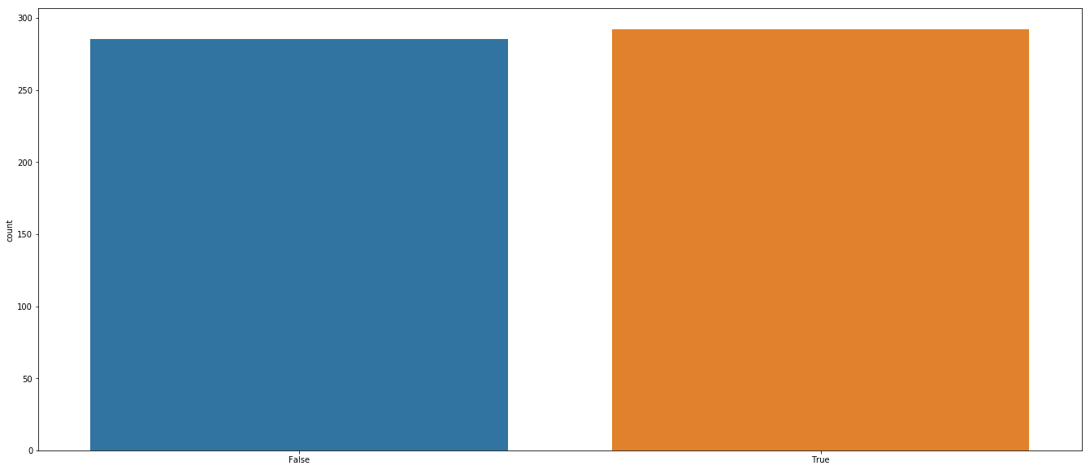
Toss winner VS Match Winner

Slide 16
From above graph
we conclude that:
It is highly likely that a
toss winner is a
match winner.

Slide 17
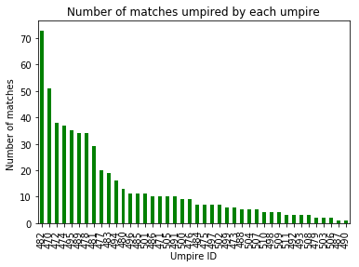
Frequency of each umpire:First Umpire

Slide 18
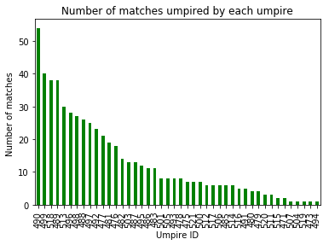
Frequency of each umpire : Second Umpire

Slide 19
From the above graphs
We can conclude that:
Umpire with Id 482 has umpired
Most of the matches as first umpire.
Umpire with Id 490 has umpires
Most of matches as
second umpire.

Slide 20
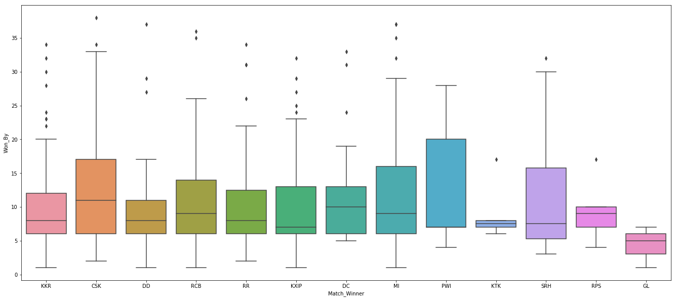
Box Plot: Match_winner VS Won_by

Slide 21
Median of the team CSK
is the highest as it has considerably
Won by a large margin of runs compared
To others

Slide 22
Number Of wins by Home Team vs away Team

Slide 23
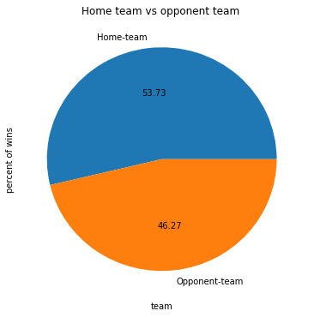
Percent of wins:
Home team VS Away Team

Slide 24
From the above graphs and Pie charts
We can conclude that:
Team Playing in the homeground
has a higher Winning ratio
when compared to
away team.

Slide 25
HYPOTHESIS TESTING
Hypothesis tests are
statistical procedures
that evaluate
two mutually
exclusive statements
about a population

Slide 26
INPUT
#hypothesis testing
#let p be the probability that a team wins if it wins the toss
#from this we come to know that p= 0.506
# H0 :p = 0.506
#H1 :p! = 0.506
#let n be the number of trials
#then the mean will be np
n= len(df['Match_Winner'])
p=0.506
mean = n*p
x= 280 # no of instances the team wins if wins the toss
#X ~ Binom(n= 577 ,p=0.506)
p_value=binom.cdf(x,n,p)
# p_value = 0.17
#since p_value > 0.05 we can say H0 is plausible
#So there is 0.5 plausibility that a team will win if it wins the toss
OUTPUT:
0.16993815578297905

Slide 27
THANK YOU

