Slide 1

iBox: Internet in a Box
Data-informed network simulation
Sachin Ashok, Sai Surya Duvvuri, Nagarajan Natarajan, ​
Venkat Padmanabhan, Sundar Sellamanickam​, Johannes Gehrke
HotNets 2020

Slide 2

State of Network Simulation
Packet-level simulation mechanism → string together network of simulated components
  E.g., ns-2/ns-3 (Berkeley, USC, UW), NetEm, OPNET, QualNet
  Realistic component-level behaviour …
  … but not informed by actual data (network config, cross-traffic, etc.)
Trace-driven simulation → replay real traces
  E.g., Cellsim/Mahimahi (MIT)
  Informed by actual data …
  … but not a realistic recreation of network behavior as it does not account for behavior of sender under test
Calibrated emulator/simulators → learning network parameters
  E.g., Pantheon (Stanford)
  Learn values for network parameters …
  … but cross-traffic modeling and support for behaviors such as reordering are absent
  (more on this later)
Can we do better?

Slide 3

iBox: Network Path Simulator
Build model for this path
New Input
packet time series at S
(î₁ = (t̂_{1,} ŝ₁), î₂, î₃, …)
R
S
Learning From Real World
Running Simulations
packet time series at S
(i₁ = (t₁, s₁), i₂, i₃, …)
iBox
Network Path
Simulator
Network Model Training
Predicted output
packet time series at R
(ô₁,ô₂,ô₃,…)
packet time series at R
(o₁,o₂,o₃,…)

Slide 4



iBox: Internet in a Box
✓ Speed up iteration
✓ Avoid regressions
✓ Reduce overhead
Teams
Zoom
xCloud
…
iBox Network Path Simulator
Offline testing
Flighting
Flighting
TCP BBR
TCP Cubic
SILK codec
…
ML-based congestion control
Data-informed network simulation

Slide 5
Spectrum of Approaches
Network model based
(iBoxNet)
1. Network parameters
2. Cross traffic modelling
3. Ensemble test
4. Instance test
…
Machine learning based
(iBoxML)
1. LSTM network
2. Generalization
3. Control loop bias
4. Error propagation
…
Combinations
(iBoxNet + ML)
1. Reordering models to modulate iBoxNet
2. Behavior discovery
…

Slide 6
1. iBoxNet: Network Model-based Simulator
Starting simple

Slide 7

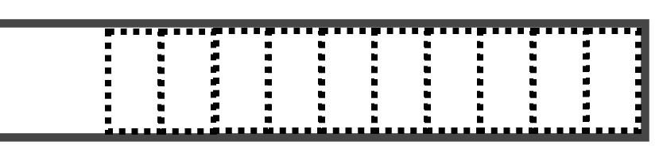
iBoxNet: Network Model-based Simulator
Use simplified model to capture key characteristics of network path
R
o₁,o₂,o₃,…
S
i₁,i₂,i₃,…
C (cross traffic)
B (buffer size)
b (bottleneck bandwidth)
d (propagation delay)

Slide 8
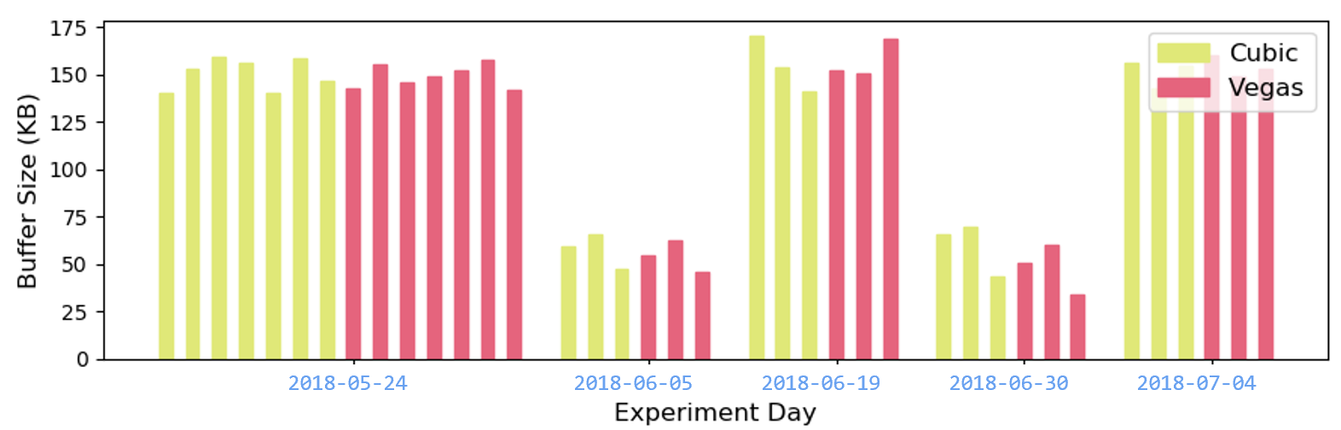
iBoxNet Training:
Estimating Network Model Parameters
Estimate of basic parameters:
  b (bottleneck bandwidth) based on peak receiving rate
  d (propagation delay) based on minimum delay
  B (buffer size) based on b and the difference between the min and max delays
We can combine information from multiple flows to get better estimates

Slide 9
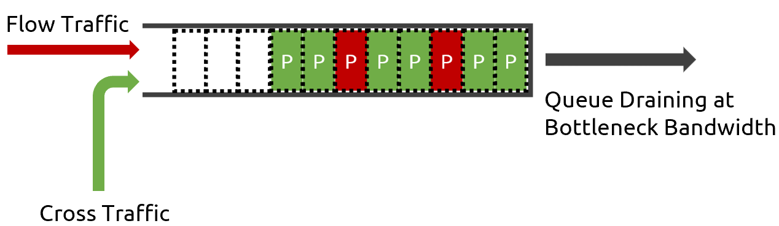
iBoxNet Training:
Estimating Network Model Parameters
Cross traffic estimation
  C_{est} = {Q(k) – Q(k - n) + drainTime * b – ∑s_{i}} / ∑τ_{i}
  Q(k) = queue occupancy estimated at the kth packet
  drainTime: duration when we’re sure buffer was draining at bottleneck bandwidth
    ⇒ conservative estimate of C
  ∑τi: Sum of all inter packet times in window
  ∑si: Sum of all packet sizes in window

Slide 10



iBoxNet Pipeline
Input-output packet traces for training
iBoxNet Parameters
(b, d, B, C)
Sample from distribution
Training
Simulation
C (cross traffic)
B (buffer size)
b (bottleneck bandwidth)
d (propagation delay)
Sender under test

Slide 11
Evaluation
Used data from Pantheon TCP testbed (Stanford) [1]
  Distributed testbed operated by Stanford​
  Nodes in 9 countries (India, China, USA etc.) across various networks​ (cellular, ethernet etc.)
  Tests based on many flavors of TCP (Cubic, Vegas, LEDBAT, BBR, …)​
Evaluation in the form of A/B tests
  Focus here on India cellular data (very different from simple iBoxNet model)
  Control/training (A): TCP Cubic (most widely deployed flavor in the Internet)
  Treatment/testing (B): TCP Vegas (very different from Cubic)
[1]: Francis Y. Yan, Jestin Ma, Greg Hill, Deepti Raghavan, Riad S. Wahby, Philip Levis, and Keith Winstein,
Pantheon: the training ground for Internet congestion-control research in USENIX ATC 18

Slide 12
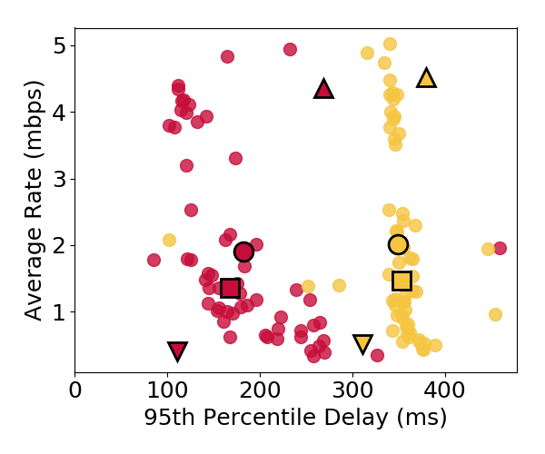
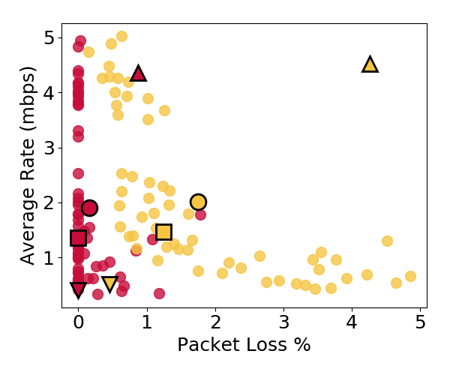
Ensemble Test: A (Cubic) vs. B (Vegas)
Ground Truth (India Cellular)
Ground truth: Vegas achieves lower delay & packet loss than Cubic

Slide 13
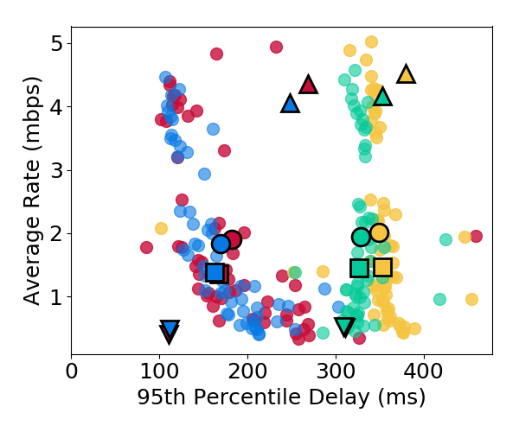
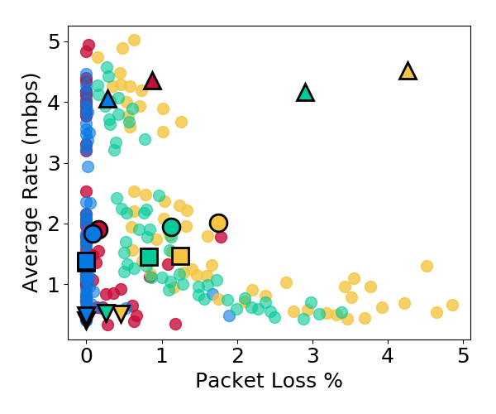
Ensemble Test: A (Cubic) vs. B (Vegas)
Ground Truth (India Cellular) and Inference (iBoxNet)
iBoxNet model trained on Cubic yields a good match (passes KS test) for Vegas too!

Slide 14

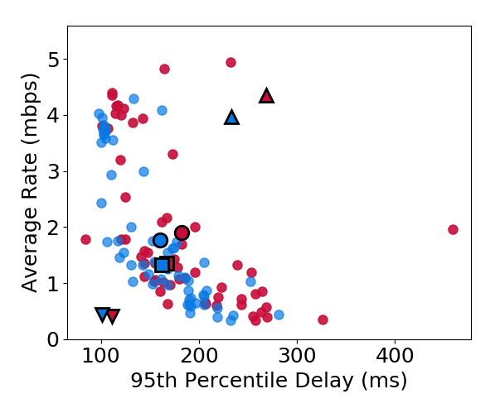
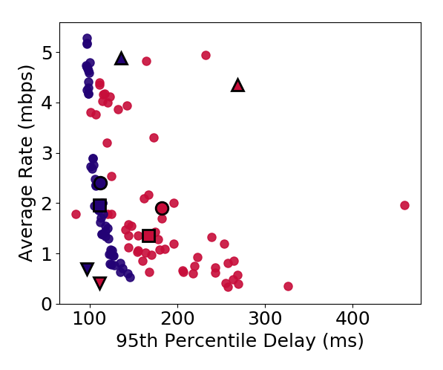
Importance of Modeling Cross-Traffic
w/ cross-traffic parameter
w/o cross-traffic parameter
Match is much worse when cross-traffic parameter is excluded from iBoxNet

Slide 15
iBoxNet: Pros and Cons
+ Simplicity → speedy simulation
+ Interpretability
- Simplistic (e.g., cross-traffic is non-reactive)
- Lack of generalization to unmodelled behaviours
  E.g., packet reordering, burstable bandwidth, random loss, RED

Slide 16
2. iBoxML: Machine Learning-based Simulator
Towards generalization

Slide 17
Deep LSTM Model for Delay Prediction
d̂_{t}
d̂_{t}
Observation Model
s_{t}
s_{t}
Training
Prediction
LSTM
LSTM
State-Space
Model
LSTM
LSTM
x_{t}
d_{t-1}
x_{t}
d̂_{t-1}
Sending
rates
Observed delays
Sending
rates
Predicted delays

Slide 18
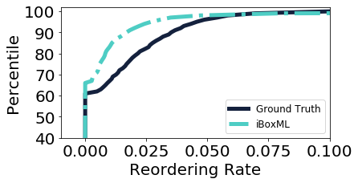
Generalization example: Packet Reordering
Distribution of reordering rate over 1-sec intervals
iBoxNet
iBoxML captures reordering implicitly
Moderate match with ground truth despite iBoxML being unaware of reordering

Slide 19
iBoxML Challenges
Lack of speed
  E.g., 2.2 ms per prediction on Nvidia V100 (5.5 Mbps with 1500-byte packets)
  But need µs prediction time to support gigabit speeds
Error propagation
  Prediction errors can compound over time
Control loop bias

Slide 20
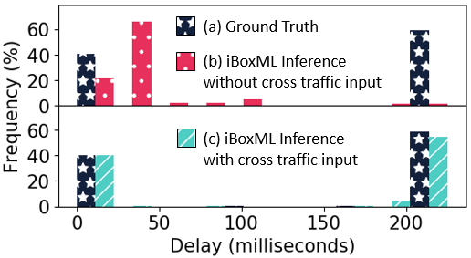

Challenge: Control Loop Bias
Data is plentiful but is “tainted” by control loop governing protocol
Example: with TCP, Skype, etc.
  Control loop: Low Delay (d) ⇒ High Sending Rate (x)
  Data with sustained high rate would correspond to sustained low delay
  Therefore, ML model could learn: High Sending Rate (x) ⇒ Low Delay (d)
X
Augment state with network context, specifically cross-traffic

Slide 21
3. iBoxNet + ML: Melding Network & ML Models
Best of both worlds

Slide 22

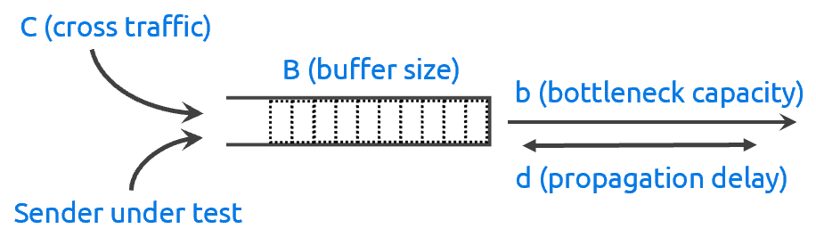
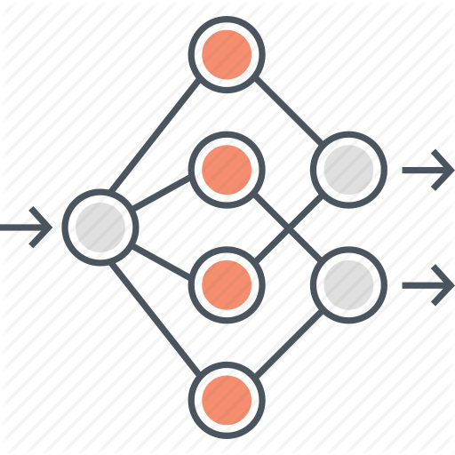
iBoxNet + ML: Melding Network & ML Models
Use ML to only modulate the operation of iBoxNet
Ground Truth Traces
Behaviour
Discovery
“diff”
Simulation Traces
Cycle of
perpetual
renewal
+
Create “purpose-built” ML models to
incorporate “important” behaviours
ML models

Slide 23
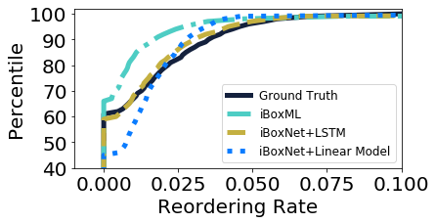
Example: Incorporating Packet Reordering
Use behavior discovery module (SAX [1]) to identify reordering as an important “diff”
Use ML model to predict occurrence of reordering and adjust iBoxNet delays
Augmenting iBoxNet with “purpose-built” ML models
helps recreate realistic reordering behaviour
[1]: J. Lin, E. Keogh, S. Lonardi, and B. Chiu. A symbolic representation of time series, with implications for streaming algorithms
In Proceedings of the 8th ACM SIGMOD Workshop on Research Issues in Data Mining and Knowledge Discovery, DMKD ’03

Slide 24
Conclusion and Future Work
Data-informed network simulation is an interesting research direction
Melding network domain knowledge with ML is key
Future Work
  Reactive Cross Traffic model
  Generalization to more interesting behaviors via behavior discovery loop
  Enabling large scale A/B tests
iBoxNet models (derived from Pantheon data for now) are available for public download at aka.ms/ibox
Questions?

