Slide 1









Distributed tracing without the pain!
Speakers:
Sachin Ashok 🌽
Vipul Harsh 🌽
P. Brighten Godfrey 🌽
Radhika Mittal 🌽
Srinivasan Parthasarathy ✦
Larisa Shwartz ✦
🌽
✦

Slide 2




Debugging microservices is hard!
Many complex systems must interact to produce even a single end-to-end response
API
Gateway

Slide 3

End-to-end distributed tracing
Can’t be answered by out-of-the-box
Span-level tracing
Backend
requests
End-to-end traces provide visibility
Which service contributes most to the delay experienced by the slowest 1-2% of the requests?
Spans
Incoming
requests
How much time did high priority requests take at a particular service?
API
Gateway

Slide 4
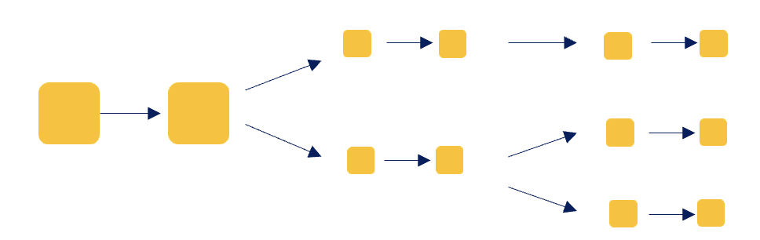
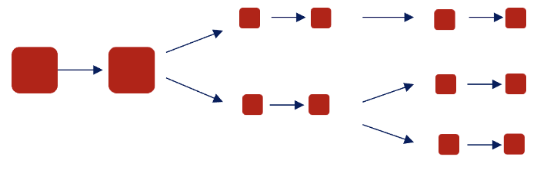
Span-level vs End-to-end tracing
Can’t be answered by out-of-the-box
Span-level tracing
Which service contributes most to the delay experienced by the slowest 1-2% of the requests?
Span-level tracing
End-to-end tracing

Slide 5
Main challenge of end-to-end tracing
Backend
requests
Incoming
requests
API
Gateway
Is this the right matching?
Or is this the right matching?

Slide 6
How end-to-end tracing happens today:
Header Propagation
Backend
requests
1000
999
Incoming
requests
999
1000
1000
The Global IDs are replicated across subsequent related requests by intermediate services
999
API
Gateway
When new requests arrive, the gateway adds Global IDs to them

Slide 7

How end-to-end tracing happens today:
Header Propagation
1000
999
999
1000
1000
999
API
Gateway
Buy-in …
… from 100s of loosely-coupled
services is hard
☹

Slide 8




How end-to-end tracing happens today:
Header Propagation
1000
999
999
Proprietary
Apps ☹
1000
1000
Header propagation is a pain.
999
API
Gateway
Legacy
Apps ☹

Slide 9
Can we enable end-to-end, distributed tracing without app instrumentation?

Slide 10
What information can we get from Envoy without app instrumentation?
Backend
requests
Incoming requests
Not known: Incoming request – Backend request mappings
the mappings are buried inside application logic
?
API
gateway
Outgoing responses from front-end
envoy
Known: Incoming request – Outgoing response mappings
via spans obtained from side-cars

Slide 11
How can we reconstruct end-to-end traces without header propagation?
Incoming
requests to front-end
Backend
requests
API gateway
envoy
Responses back to the front-end
Outgoing
responses from front-end

Slide 12
How can we reconstruct end-to-end traces without header propagation?
Incoming
requests to front-end
Timings
Request 1: T_{in} = 1s, T_{out} = 1.02s
Backend
requests
API gateway
envoy
Responses back to the front-end
Outgoing
responses from front-end

Slide 13
How can we reconstruct end-to-end traces without header propagation?
Incoming
requests to front-end
Timings
Constraints
This mapping is not possible
Backend
requests
API gateway
envoy
This timing is not possible
Responses back to the front-end
Outgoing
responses from front-end

Slide 14
How can we reconstruct end-to-end traces without header propagation?
Timings
Constraints
Call graph
Microservice call topology

Slide 15
How can we reconstruct end-to-end traces without header propagation?
Timings
Constraints
Call graph
Trace-reconstruction algorithm
Most likely mapping
Backend
requests
Incoming
requests
API gateway
envoy

Slide 16
How can we reconstruct end-to-end traces without header propagation?
Timings
Constraints
Call graph
Trace-reconstruction algorithm
Most likely mapping
Backend
requests
Incoming
requests
API gateway
envoy

Slide 17
How can we reconstruct end-to-end traces without header propagation?
Timings
Constraints
Call graph
Trace-reconstruction algorithm
Most likely mapping
Incoming
requests
API gateway
envoy

Slide 18
Reconstruction accuracy for various RPS
Our algorithm
Baseline schemes for comparison
Simple ordering-based baselines perform poorly since outgoing requests get increasingly reordered at high load

Slide 19
Reconstruction accuracy for various RPS
Our algorithm
High reconstruction accuracy even at high loads
Baseline schemes for comparison
Simple ordering-based baselines perform poorly since outgoing requests get increasingly reordered at high load

Slide 20
“Which service contributes most to the delay experienced by the slowest 2% of the requests?"

Slide 21
“Which service contributes most to the delay experienced by the slowest 2% of the requests?"
Developer view with spans only: look at 98%ile latency of each service
With reconstructed end-to-end traces

Slide 22
“Which service contributes most to the delay experienced by the slowest 2% of the requests?"
Far from ground truth
Close to ground truth
Developer view with spans only: look at 98%ile latency of each service
With reconstructed end-to-end traces

Slide 23
Summary: distributed tracing without instrumenting app
Use information from Envoy
  span timings
  request parameters
  http headers
96% reconstruction accuracy vs 77% of 2 baselines for a benchmark application
In the works
Deal with various idiosyncrasies of complex applications
  Asynchronous execution
  Buffering/Batching of requests
  Response caching
Checkout our prototype: https://github.com/Sachin-A/disttrace
Come talk to us about your use case!

Slide 24
Thank you!

