Slide 1


PROPOSAL FOR ISOMORPHIC LABS
Turn Your $2.1B Series B Into Data Infrastructure That Scales
A cloud data & analytics partner for Isomorphic Labs, as IsoDDE scales across every therapeutic program.
Prepared by AtliQ Technologies | September 2026

Slide 2

THE MOMENT
Put the $2.1B to Work Before the Data Catches Up
Thrive Capital, Alphabet, GV, MGX, Temasek, CapitalG, and the UK Sovereign AI Fund just backed the next phase of IsoDDE.
$2.1B
$2.7B
7
Series B, led by
Thrive Capital
Total capital raised
to date
Institutional investors
in this round
What this raise means operationally
Scaling IsoDDE across multiple concurrent drug design programs means a step change in structured and unstructured biological data volume, more research sites generating data in parallel, and tighter demands on cost control as compute and data infrastructure spend grows with the pipeline.
AtliQ Technologies
2

Slide 3
THE RISK
Fix the Pipeline Sprawl Before It Slows You Down
Three things tend to break first when a research org scales this fast.
1
2
3
Fragmented pipelines
Slower decisions
Runaway cost
New therapeutic programs and sites each spin up their own data flows, and warehousing struggles to keep pace with the sprawl.
Leadership and research teams need live visibility into program progress and spend, not static reports built days later.
Compute and storage costs scale with every new program unless there is active, built-in cost control from day one.
AtliQ Technologies
3

Slide 4
THE PLAN
Scale Every Program on One Data Platform
One platform for warehousing, live dashboards, automated pipelines, and cost control.
Unified data warehousing
One warehouse for every program and site, so new research lines plug in without a new pipeline build each time.
1
Live BI dashboards
Real-time visibility for research and leadership teams, so decisions don't wait on a weekly report cycle.
2
Automated pipelines
New data sources onboard in days, not months, so infrastructure scales at the same pace as your pipeline.
3
Built-in cost controls
Spend guardrails baked into the platform, so a bigger data footprint doesn't mean a runaway compute bill.
4
AtliQ Technologies
4

Slide 5
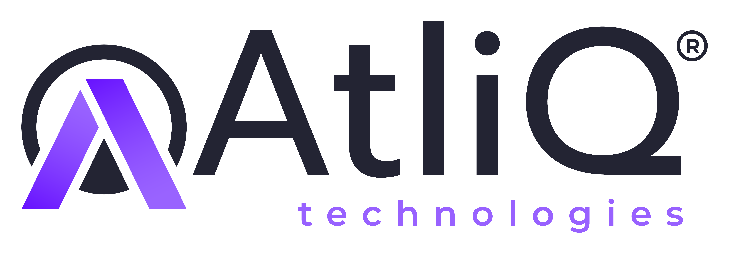
Let Us Handle the Data,
So You Can Scale the AI.
A 20-minute call to map your growth to a plan, then a 30-day scale test on your own data.
Book the 20-min call →
AtliQ Tech · data.atliq.tech · partnerships@atliq.tech

