Slide 1








Task 3
Student feedback analysis
Vishnu Ram Sachin
Data Science & Analytics
Future Interns

Slide 2



OutLine
Introduction
Problem Statement
Objectives
Executive Summary
Methodology
Results
Visualization - Charts
Dashboard
Discussion
Findings & Implications
Conclusion
Vishnu Ram Sachin
Data Science & Analytics
Future Interns

Slide 3
Introduction
This report presents an analysis of student feedback data collected to evaluate and enhance a course.
The feedback, gathered from over 1,000 students, covers various aspects of the course, including the instructor's subject expertise, teaching methodology, course structure, and overall relevance
Vishnu Ram Sachin
Data Science & Analytics
Future Interns

Slide 4

Problem Statement
The goal is to address low student satisfaction by identifying the specific areas of the event that received the lowest feedback ratings. The analysis aims to pinpoint which aspects, such as course content, instructor support, or assignment difficulty, are most negatively impacting students' overall experience

Slide 5

Objectives
Primary Objective :
To analyze the average satisfaction score to get a clear picture of how students perceive the event
Secondary Objective :
To Investigate the relationship between different feedback categories and overall satisfaction
To determine which factors have the most significant impact on student happiness.
To pinpoint the highest and lowest rated feedback categories.

Slide 6

Executive Summary
Based on an analysis of the student feedback data, the event received a moderate overall satisfaction score of 5.71 out of 10
7.50 for being Well versed with the subject. This suggests that students found the content and delivery of the material to be accurate and reliable
Correlation analysis shows that improving assignment difficulty and doubt-solving willingness will have the most significant impact on increasing overall student satisfaction
Key weaknesses were identified in student support. The lowest rated areas were Degree of difficulty of assignments (5.43)

Slide 7

Methodology
Research Design- Descriptive
Descriptive research methods were employed to understand the data, identify key trends, and present the findings
Data Analysis
The analysis was performed using Google Colab with the pandas library for data manipulation and matplotlib and seaborn for data visualization.

Slide 8
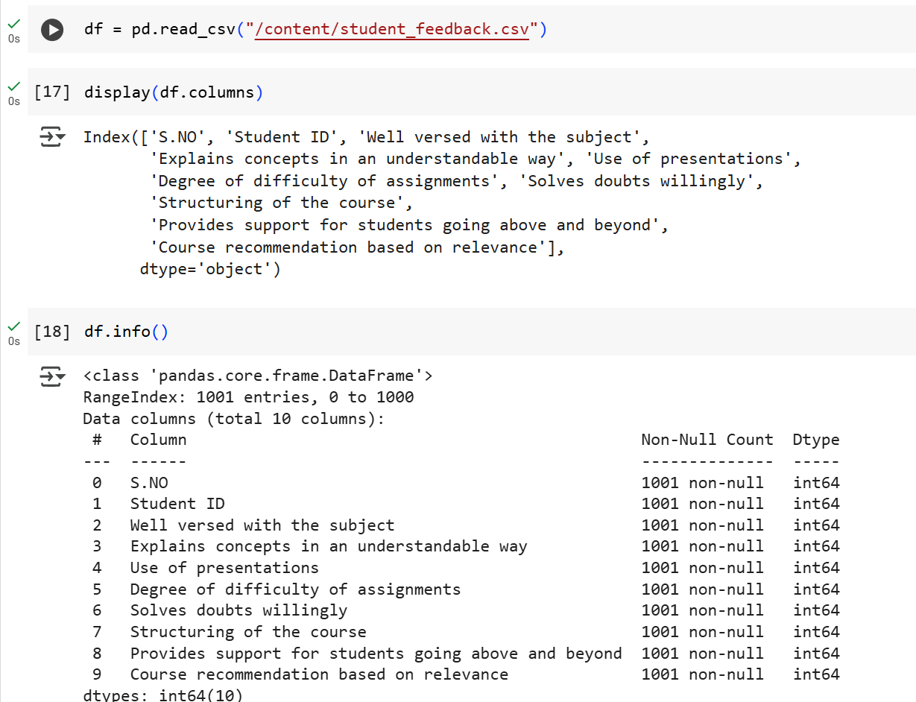
Results

Slide 9
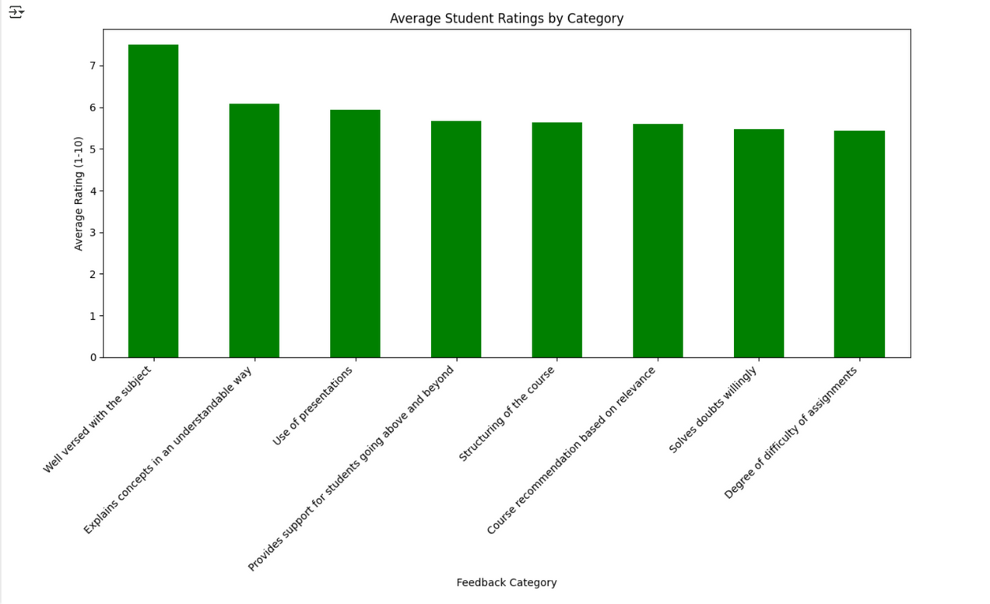
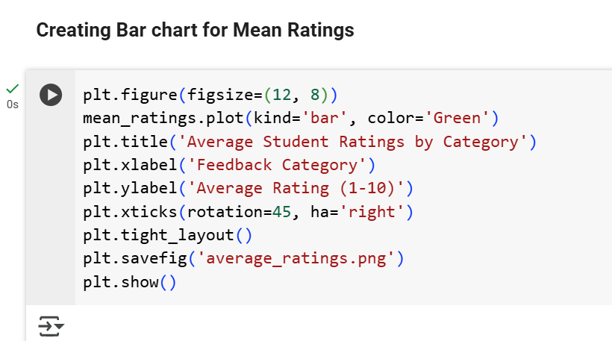
Results

Slide 10
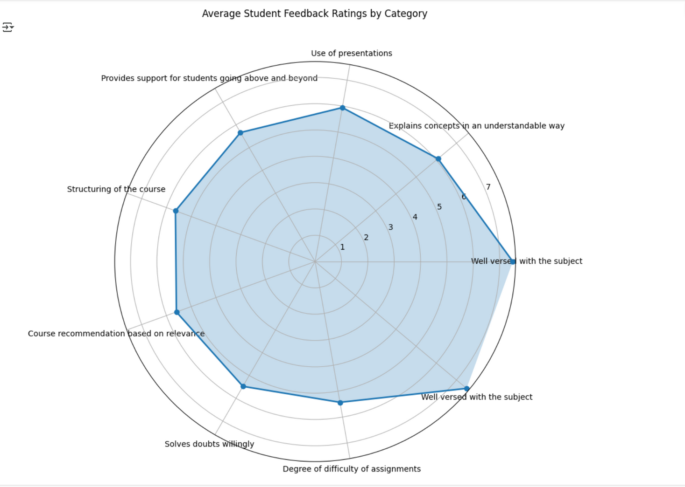
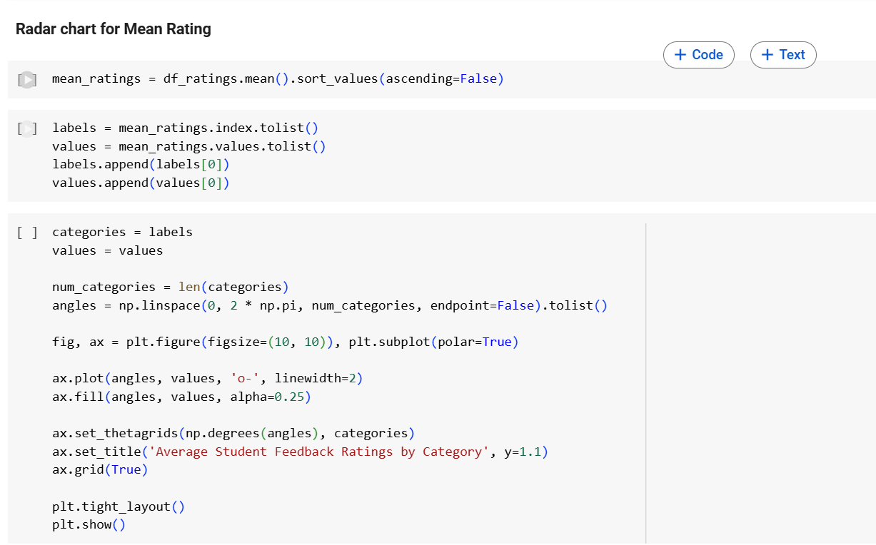
Results

Slide 11
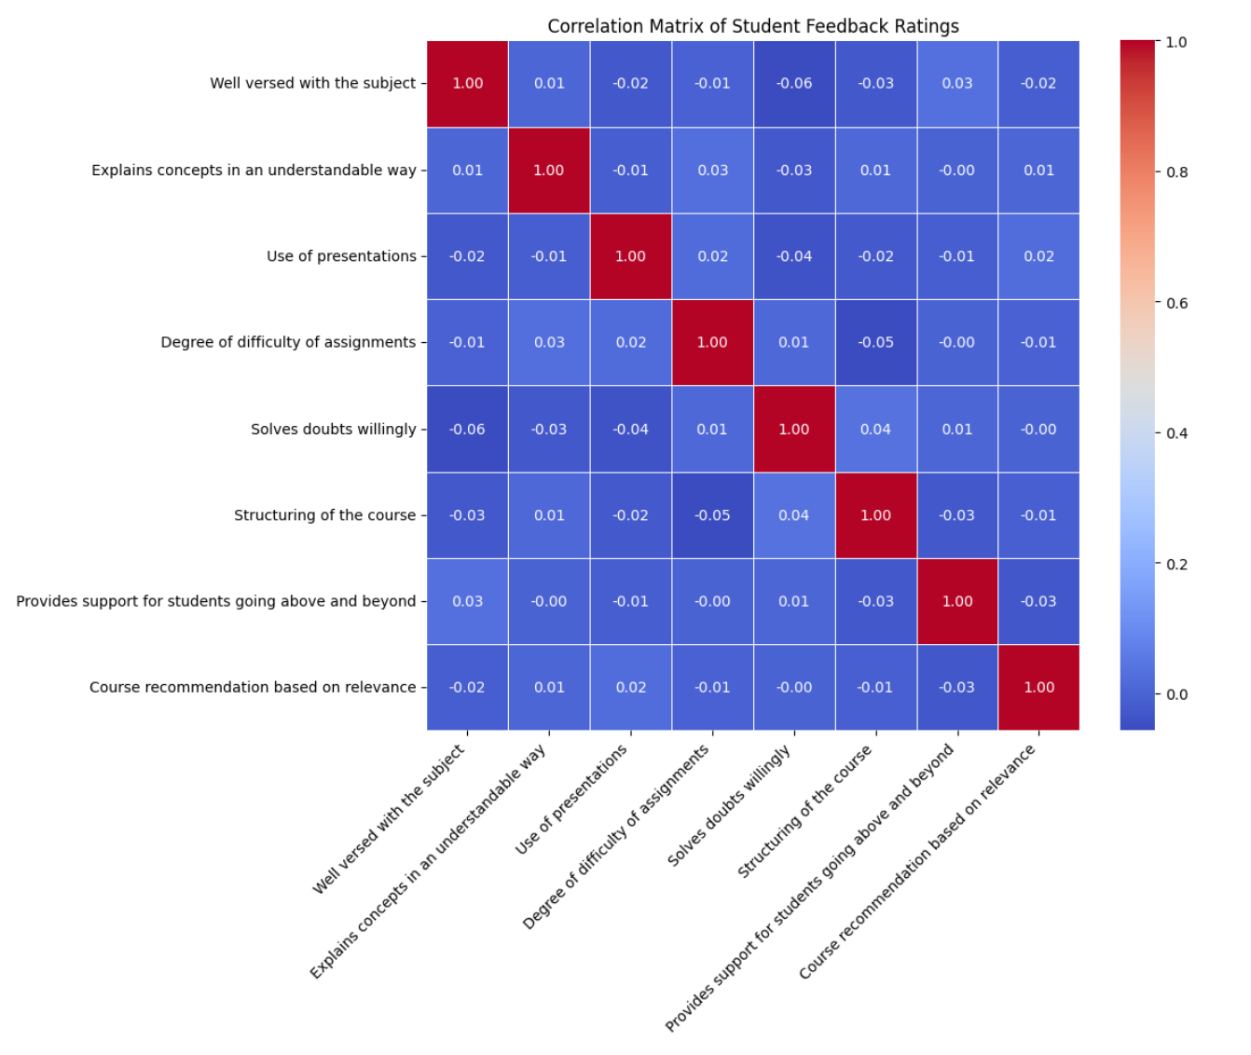
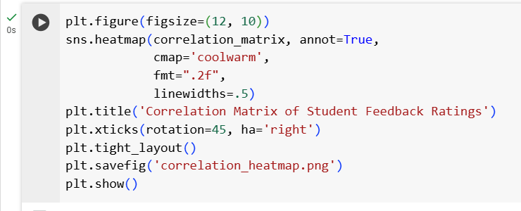
Results

Slide 12
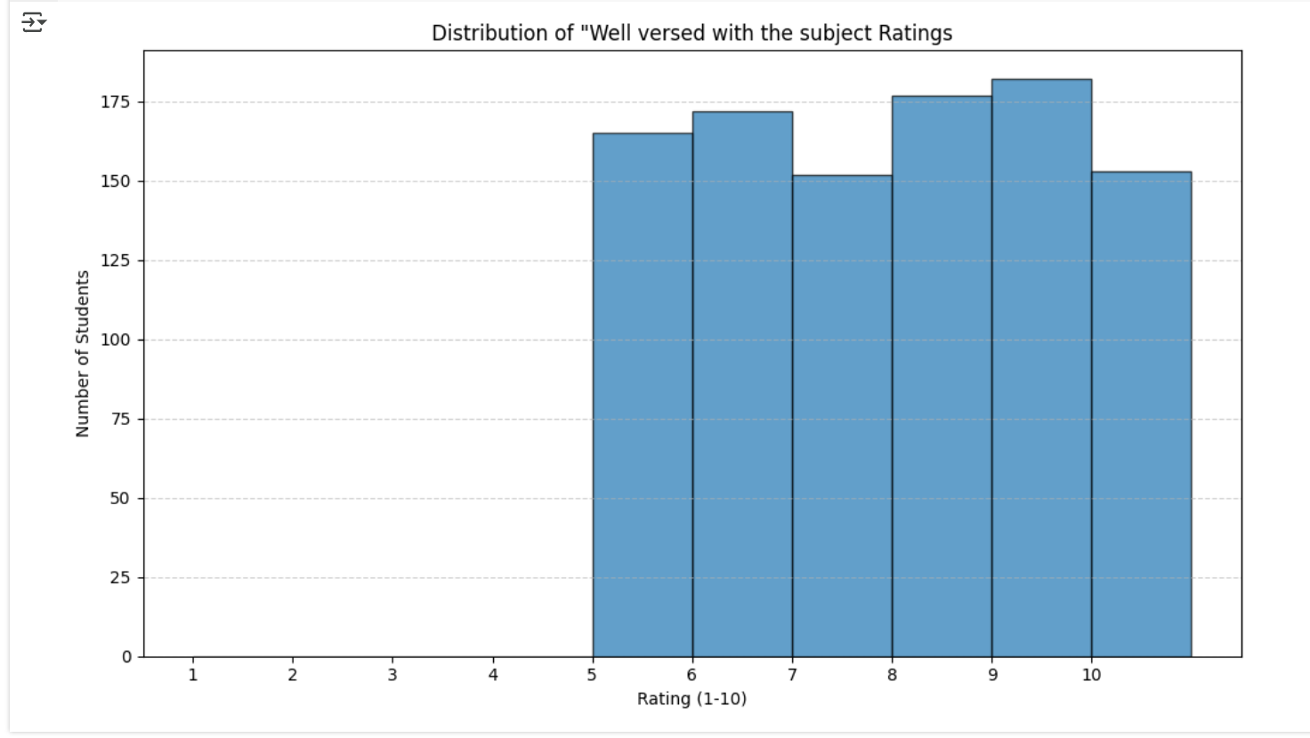
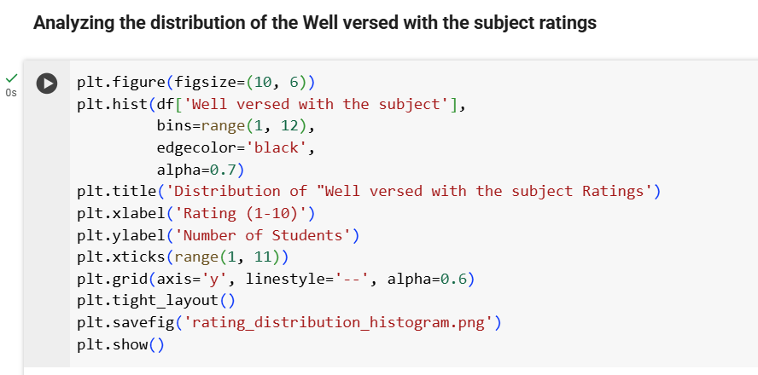
Results

Slide 13
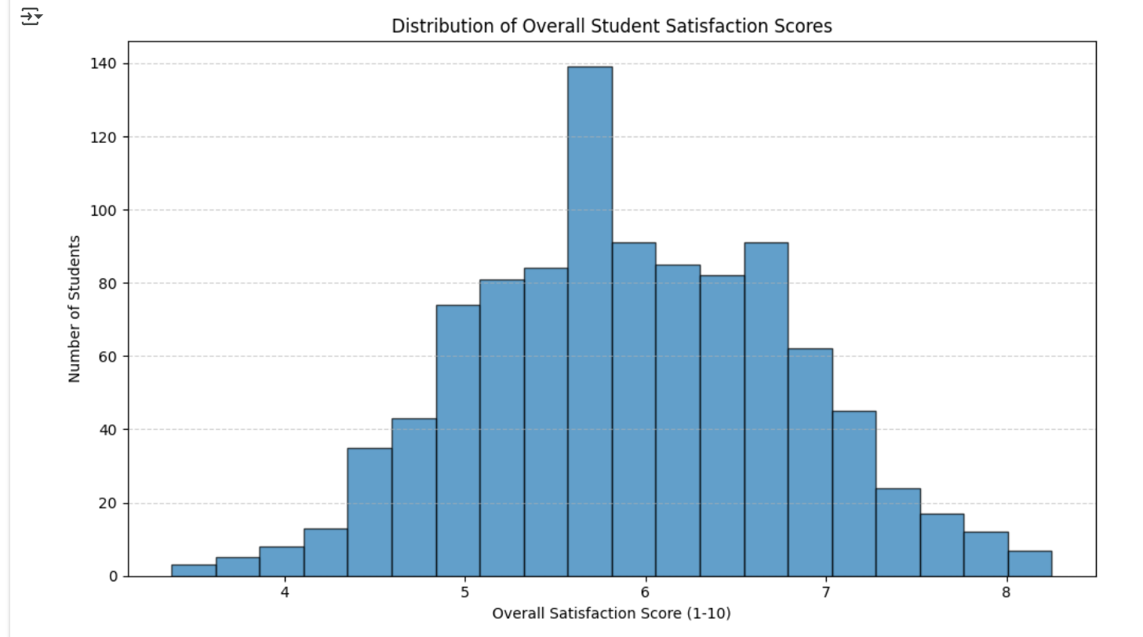
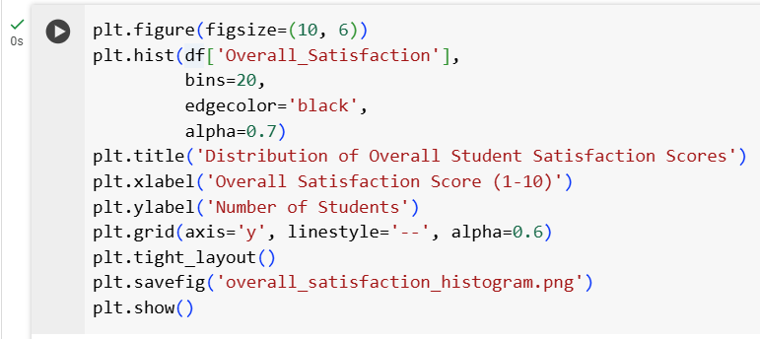
Results

Slide 14
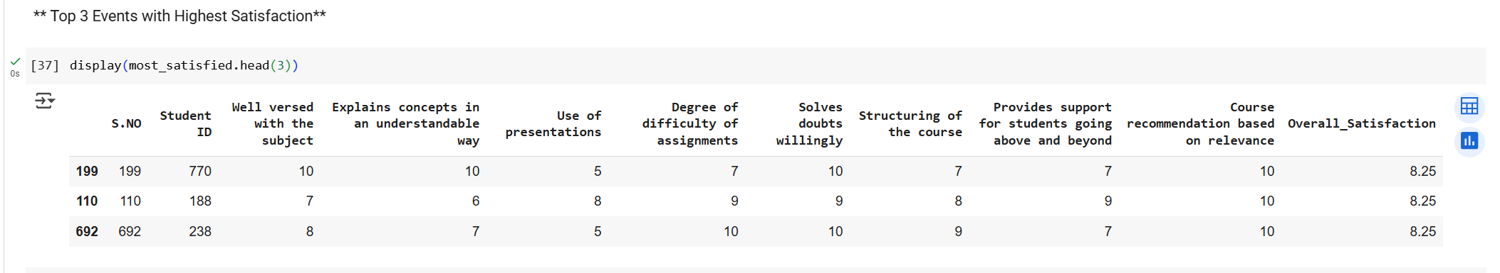
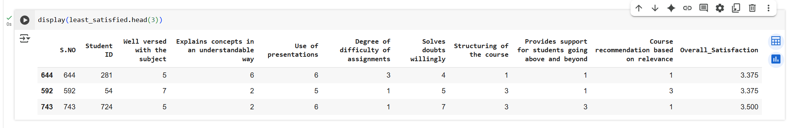
Results
Top 3 Highest Satisfaction
Top 3 Lowest Satisfaction

Slide 15
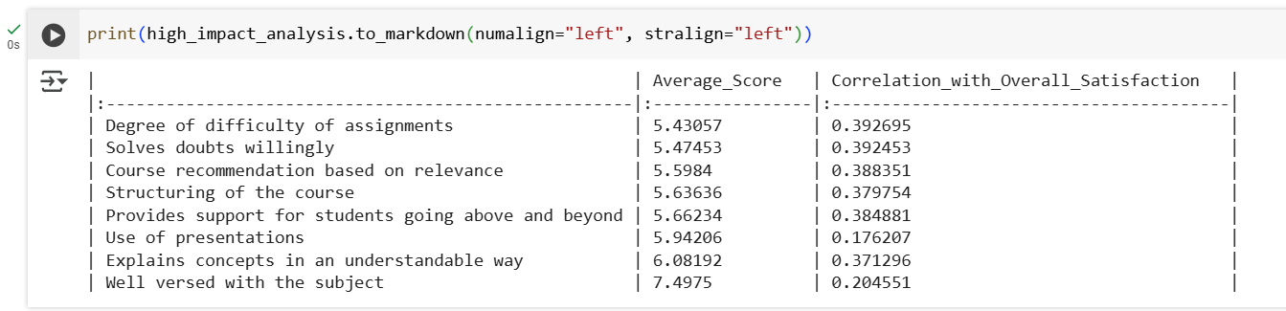
Results

Slide 16

Discussion
The instructor's strong subject knowledge was a key strength, receiving the highest average rating
The lowest ratings were related to the practical and support aspects of the course.
Students found the "Degree of difficulty of assignments" challenging and felt there was a lack of support for doubts. This indicates a gap between the theoretical content and its practical application

Slide 17

Conclusion
The core issue affecting student satisfaction is the lack of support, specifically with assignments and doubt solving. To improve, we should focus on revising assignments to be more manageable and increasing instructor availability for student questions

