Slide 1
Microprocessor
Chapter-2
8085 Architecture and Instruction Set

Slide 2
Introduction
8085 is an 8 bit microprocessor designed by Intel in 1977 using NMOS technology.
The acronym of NMOS is a negative channel metal oxide semiconductor; it is pronounced as en-moss. It is a kind of semiconductor that charges negatively.
It has 16 bit address bus which can address upto 64 KB. So, it has 16 bit program counter.
It has 16 bit stack pointer.
It has 6 general purpose 8 bit registers. They are: B, C, D, E, H, L. These six registers can be arranged in pairs: BC, DE, HL to store 16 bit of data.

Slide 3
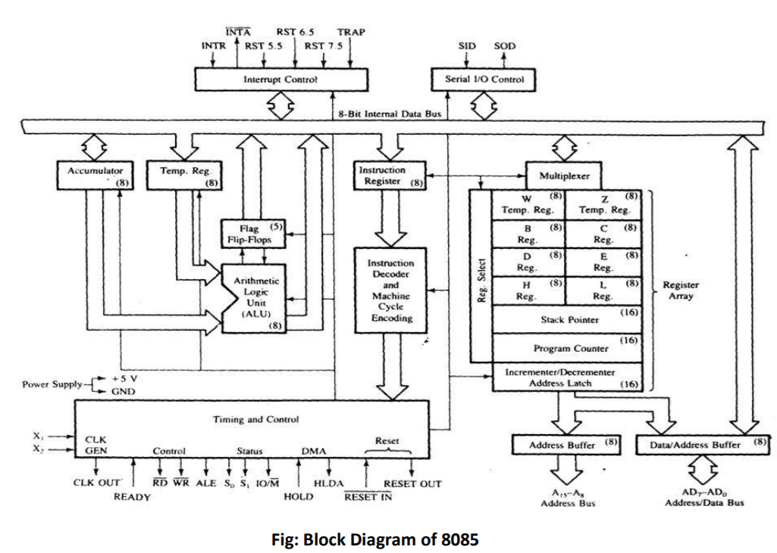
8085 Microprocessor Architecture & Functional Units

Slide 4
Introduction
8085 consists of the following functional units −
Accumulator It is an 8-bit register used to perform arithmetic, logical, I/O & LOAD/STORE operations. It is connected to internal data bus & ALU.
Arithmetic and logic unit As the name suggests, it performs arithmetic and logical operations like Addition, Subtraction, AND, OR, etc. on 8-bit data.
General purpose register There are 6 general purpose registers in 8085 processors, i.e. B, C, D, E, H & L. Each register can hold 8-bit data. These registers can work in pair to hold 16-bit data and their pairing combination is like B-C, D-E & H-L.
Program counter It is a 16-bit register used to store the memory address location of the next instruction to be executed. Microprocessor increments the program whenever an instruction is being executed, so that the program counter points to the memory address of the next instruction that is going to be executed.

Slide 5
Introduction
8085 consists of the following functional units −
Stack pointer It is also a 16-bit register works like stack, which is always incremented/decremented push & pop operations.
Temporary register It is an 8-bit register, which holds the temporary data of arithmetic and logical operations.
Flag register It is an 8-bit register having five 1-bit flip-flops, which holds either 0 or 1 depending upon the result stored in the accumulator. It gives the status of the current result.
These are the set of 5 flip-flops –
- Sign (S)
- Zero (Z)
- Auxiliary Carry (AC)
- Parity (P)
- Carry (C)

Slide 6
Introduction
Sign flag(S): After any operation if result is negative sign flag becomes set i.e. if result is positive sign flag becomes reset i.e. 0.
Zero flag (Z): After any arithmetic or logical operation if result is 0 the zero flag becomes set i.e. 1 otherwise it becomes reset i.e. 0.
Auxiliar carry flag (AC): if intermediate carry is generated this flag is set to 1 otherwise it is reset to 0.
Parity flag (P): If after any arithmetic or logical operation the result has be even parity, an even number of 1 bits, the parity register becomes set i.e. 1, otherwise it becomes reset.
Carry Flat (CY): Carry is generated when performing n bit operation and the result is more than n bits, then this flag becomes set i.e. 1 otherwise it becomes reset i.e. 0. During subtraction (A-B), if A>B it becomes reset and if A<B it becomes set. So carry flag is also called borrow flag.

Slide 7
Introduction
Sign flag(S): After any operation if result is negative sign flag becomes set i.e. if result is positive sign flag becomes reset i.e. 0.
Zero flag (Z): After any arithmetic or logical operation if result is 0 the zero flag becomes set i.e. 1 otherwise it becomes reset i.e. 0.
Auxiliar carry flag (AC): if intermediate carry is generated this flag is set to 1 otherwise it is reset to 0.
Parity flag (P): If after any arithmetic or logical operation the result has be even parity, an even number of 1 bits, the parity register becomes set i.e. 1, otherwise it becomes reset.
Carry Flat (CY): Carry is generated when performing n bit operation and the result is more than n bits, then this flag becomes set i.e. 1 otherwise it becomes reset i.e. 0. During subtraction (A-B), if A>B it becomes reset and if A<B it becomes set. So carry flag is also called borrow flag.

Slide 8
Introduction
Instruction register and decoder: It is an 8 bit register. When an instruction is fetched from memory then it is stored in the instruction register. Instruction decoder decodes the information present in the instruction register. Here the instruction is decoded and decoded information is given to the timing and control circuit where the instruction is executed.
Stack pointer (SP): It is a 16 bit special purpose register. It holds address of the top of the stack. Stack is a set of memory locations operating in LIFO method. SP is decremented on every PUSH operation and incremented on every POP operation.
Serial I/O control: It controls the serial data communication using the instruction SID (Serial Input data) and SOD (Serial output data).
Address buffer and Address data buffer: This content stored in stack pointer and program counter is loaded into the address buffer and address-data buffer to communicate with the CPU. The memory and I/O chips are connected to these buses. The memory and I/O chips are connected to these buses. CPU can exchange the desired data with memory and I/O chips.

Slide 9
Introduction
Temporary Registers (WZ): This is a 16 bit register pair. It is used by microprocessor to hold temporary values in some instruction like CALL/JMP/LDA/XCHG, etc. The programmer has no access to this register.
INR/DCR register: This is 16 bit shift register. It is used to increment PC after every insruction byte is fetched and increment or decrement SP after a POP or PUSH operation respectively. It is not available for programmer.

Slide 10
Introduction
Interrupt Control: This block is responsible for controlling hardware interrupts of 8085. 8085 supports the following interrupts:
Trap: This is an edge as well as level triggered vectored interrupt. It cannot be masked by SIM instruction and can neither be displayed by DI instruction . Value for TRAP is 4.5. To calculate memory location value: 4.5X8=(0036)₁₀ i.e. 0024H. IT has highest priority Its vector address is 0024h i.e. control is transferred to 0024h memory location.
RST 7.5: RST means restart. This is an edge triggered, vectored interrupt. It can be masked by SIM instruction and can also be disabled by DI instruction. It has second highest priority. Its vector address is 003ch. Here maskable interrupt means it can be disabled or ignored by instruction of CPU.
RST 6.5: This is a level triggered vectored interrupt. It can be masked by SIM instruction and can also be displayed by DI instruction. It has third highest priority. Its vector address is 0034h
RST 5.5: This is a level triggered vectored interrupt. It can be masked by SIM instruction can also be displayed by DI instruction. It has fourth highest priority. Its vector address is 002CH.

Slide 11
Introduction
Interrupt Control: This block is responsible for controlling hardware interrupts of 8085. 8085 supports the following interrupts:
INTR: This is level triggered, non-vectored interrupt. It cannot be masked by SIM instruction but can be disabled by DI instruction. It has lowest priority. It has acknowledgement signal INTA’. The address for ISR is fetched from external hardware. INTA’ is an acknowledgement signal for INTR.
Here vectored interrupts are those interrupts which have fixed vector address (starting address of sub-routine) and after executing these program control is transferred to that address.
Maskable interrupts are those which can be disabled or ignored by microprocessor.

Slide 12
Introduction
Software Interrupt : Software interrupts vector addresses are given by:
Interrupt Vector Address
RST 0 00h
RST 1 08h
RST 2 10h
RST3 18h
RST4 20h
RST5 28h
RST6 30h
RST7 38h

Slide 13
Introduction
Timing and control unit: We use timing and control unit in 8085 for generation of timing signals and signals to control. All operations and functions both interior and exterior of a microprocessor are controlled by this unit.
- Control signals: Ready, RD’, WR’, ALE
- Status Signals: S0, S1, IO/M’
- DMA signals: HOLD, HLDA
- Reset signals: RESET IN, RESET OUT

Slide 14
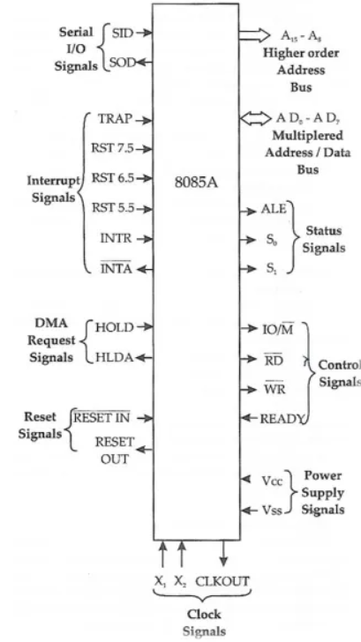
Pin diagram 8085
8085 microprocessor is of 40 pins and we can divide into nine groups: address and data bus, control signals, status signals, interrupt signals, clock signals, reset signals, DMA request signals, serial I/O signals, power supply signals.

Slide 15
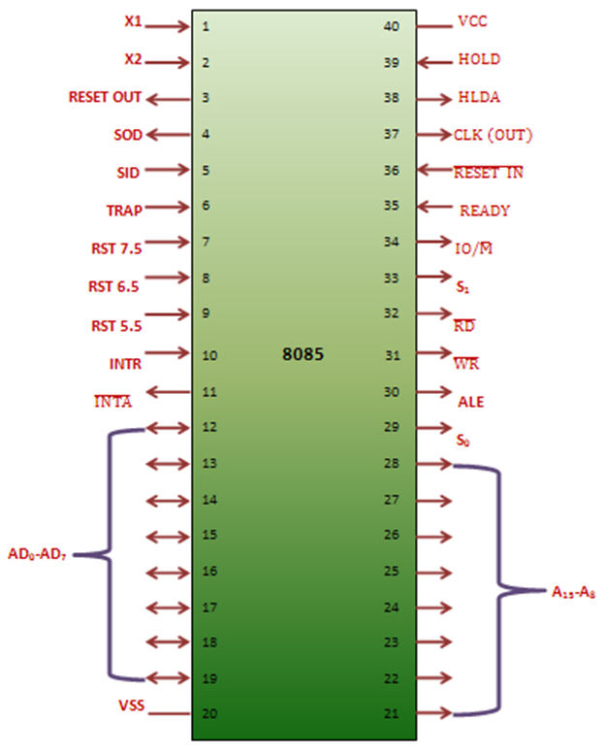
Pin diagram 8085
Address and Data Bus
Address bus (A8-A15): High order address bus. The address bus pins are ranges from A8-A15.
Address and Data bus (Pins AD0-AD7): Lower order address/data bus. These pins are multiplexed i.e. it performs two tasks. The address bus is used to connect with IO devices or memory. The 8085 has another pin, which helps in demultiplexing these 8 pins i.e. ALE (Address Latch Enable). For first machine cycle, you can access address lines. These are then latched to an external latch. At second cycle 8 address bits are latched and we source the data lines from AD0-AD7.

Slide 16
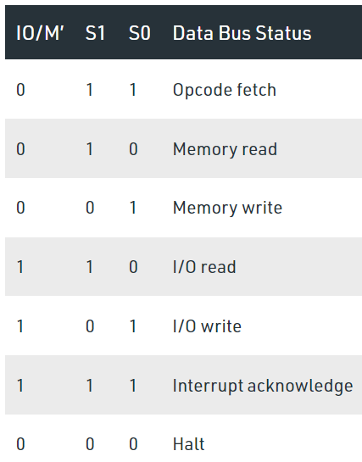
Pin diagram 8085
Status Signals (IO/M)
The status signal IO/M (also can be termed as control signals) resolves whether the address is intended for memory or input/output. When the IO/M is high then the address of the address bus is used for the devices of input/output devices. When the IO/M is low then the address of the address bus is used for the memory.
Status signals (S0-S1)
The status signals S0, S1 gives different functions as well as status based on their status.

Slide 17
Pin diagram 8085
Status Signals
ALE (Address Latch Enable): ALE is used to separate the AD0-AD7 bus to A0-A7 bus and D0-D7 bus. It goes high during first T state of a machine and enables a lower 8 bits of the address if its value is 1 and otherwise data bus is activated.

Slide 18
Pin diagram 8085
Control Signals (RD’, WR’, IO/M’)
RD’ (Read): This is an active low input. When goes low, the microprocessor reads data from either I/O device or from memory.
WR’ (Write): Another active low pin. When it goes low, the data on the data bus is written to a memory location or an I/O device.
Ready: This pin used for synchronize slower peripheral devices with fast microprocessor. A low value causes the microprocessor to enter into wait state. The microprocessor remains in wait state until the input at this pin goes high.

Slide 19
Pin diagram 8085
DMA signals (Pins HOLD and HLDA)
HOLD: The hold pin can be used to communicate to the microproessor control mechanism that an external device is requesting the use of address bus and data bus just like DMA controller.
HLDA: Hold acknowledge. It indicates that HOLD request has been received. After the removal of HOLD request the HLDA goes low.
Serial I/O signals (Pins SID and SOD):
SID (Serial Input data) pins accepts serial input data. The data transfers from the pin to the 7th bit of the accumulator when a RIM(Read interrupt mask) instruction executes.
SOD(Serial Output data) pin outputs serial data onto the 7th bit of the accumulator when a SIM (set interrupt mask) instruction is executed.

Slide 20
Pin diagram 8085
Power supply signals (Pins Vcc and Vss)
Vcc – +5v power supply
Vss – Ground Reference
X1, X2: These X1 and X2 pins are also called crystal input pins. 8085 microprocessor can generate clock signals internally. To generate internal clock signals, 8085 microprocessor requires external inputs from X1 and X2 pins.
The frequency is internally divided by two. Since the basic operating timing frequency is 3 MHz, a 6 MHz crystal is connected externally.
CLK (output)- Clock output is used as the system clock for peripheral and devices interfaced with microprocessor.
Note: Because the operating frequency of 8085 Microprocessor is half (1/2) of Crystal frequency ( frequency offered by Crystal oscillator).

Slide 21
Pin diagram 8085
Reset signals
RESETIN:
It is active low signal.
If this pin in 0, then microprocessor will get reset. When microprocessor is reset, then all registers including PC program counter will get cleared to zero. i.e. PC=0000H
So microprocessor will fetch it’s next instruction from 0000h location of address.
During reset operation all the buses are in high impedence state or tristated, so power consumption is also very less.
At first it clears PC and IR. Then at second, disable all interrupts (except trap). At third disable SOD pin, fourthly all buses are tristated and finally gives high output to RESET OUT pin.
RESETOUT
It is active high signal
When this pin is active high, it will reset interfaced device with it. All the peripherals are connected to Reset out along with clock out.

Slide 22
Addressing Mode of 8085 microprocessor
The different ways in which microprocessor access the data is referred to as addressing mode.
In Assembly language statements, the addressing mode is indicated in the instruction itself.
There are five types of addressing mode in 8085. They are:
Register Addressing mode
Immediate addressing mode
Direct addressing mode
Register indirection addressing mode
Implied Addressing mode

Slide 23
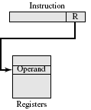
Addressing Mode of 8085 microprocessor
Register Addressing mode:
Operands are in registers that reside within the CPU
The particular register is selected from a register field in the instruction.
It is carried out with 8 bit registers A, B, C, D, E, H, L.
Mov a, b

Slide 24

Addressing Mode of 8085 microprocessor
Immediate Addressing mode:
Operand is specified in the instruction itself.
In other words, an immediate-mode instruction has an operand field rather than an address field.
Immediate mode of instructions is useful for initializing register to constant value.
Example: mvi a,05h

Slide 25
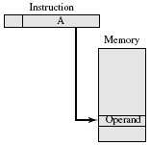
Addressing Mode of 8085 microprocessor
Direct Addressing mode:
In this mode the effective address is equal to the address part of the instruction.
the operand resides in memory and its address is given directly by the address field of the instruction.
Example: LDA 4000h

Slide 26
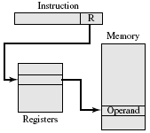
Addressing Mode of 8085 microprocessor
Register Indirect Addressing mode:
In this mode the instruction specifies a register in the CPU whose contents give the address of the operand in memory.
Before using a register indirect mode instruction, the programmer must ensure that the memory address of the operand is placed in the processor register with a previous instruction.

Slide 27
Addressing Mode of 8085 microprocessor
Implied Addressing mode:
Operands are specified implicitly in the definition of the instruction.
For example, the instruction CMC is an implied mode instruction as the operand in carry flag is implied in the definition of the instruction.
Example: STC, CMC, DAA

Slide 28
Instruction set of 8085 microprocessor
Instruction is a binary pattern designed inside a microprocessor to perform a specific function.
The entire group of instructions that a microprocessor supports is called instruction set.
8085 has 246 instructions.
Each instruction is represented by an 8 bit binary value.
These 8 bits of binary value is called op-code or instruction byte.
8085 instruction set can be classified into following categories:
Data transfer instruction
Arithmetic instruction
Logical instruction
Branching instruction
Control Instruction

Slide 29
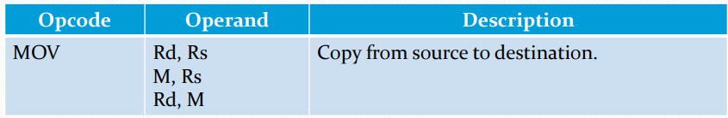
Instruction set of 8085 microprocessor
Data transfer instructions
These instructions move data between registers or between memory and registers.
These instruction copy data from source to destination.
While copying, the contents of source are not modified.
This instruction copies the contents of the source register into the destination register.
The contents of the source register are not altered.
If one of the operands is a memory location, its location is specified by the contents of HL registers.
Example: MOV B, C
MOV B,M

Slide 30
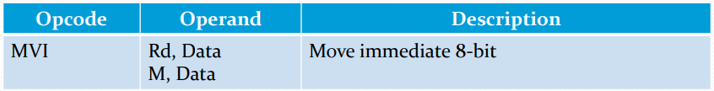
Instruction set of 8085 microprocessor
Data transfer instructions
The 8 bit data is stored in the destination register or memory.
If the operand is a memory location, its location is specified by the content of H-L registers.
Example: MVI B, 57H,
MVI M, 57H
The content of a memory location, specified by a 16 bit address in the operand are copied to the accumulator.
The content of source are not altered.
Example: LDA 2034H

Slide 31
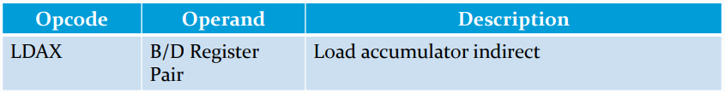
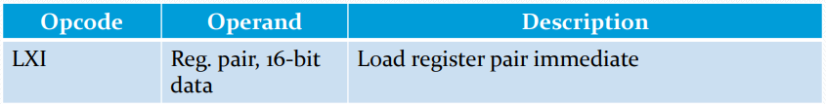
Instruction set of 8085 microprocessor
Data transfer instructions
The contents of the designated register pair point to a memory location.
This instruction copies the content of that memory location into the accumulator.
The content of either the register pair or the memory location are not altered.
Example: LDAX B
This instruction loads 16 bit data in the register pair.
Example: LXI H, 2034h

Slide 32
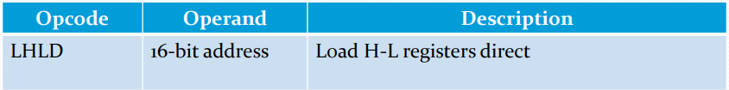
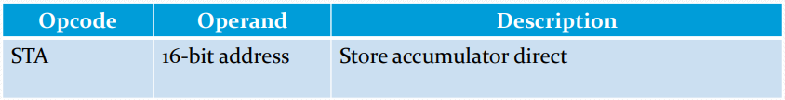
Instruction set of 8085 microprocessor
Data transfer instructions
This instruction copies the content of memory location pointed out by 16 bit address into register L.
It copies the content of next memory location into register H.
Example: LHLD 2040H
The contents of accumulator are copied into the memory location specified by the operand.
Example: STA 2500H

Slide 33
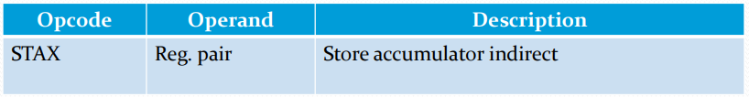

Instruction set of 8085 microprocessor
Data transfer instructions
The contents of accumulator are copied into the memory location specified by the contents of the register pair.
Example: STAX B
The content of register L are stored into memory location specified by the 16 bit address.
The content of register H are stored into the next memory location.
Example: SHLD 2550H

Slide 34
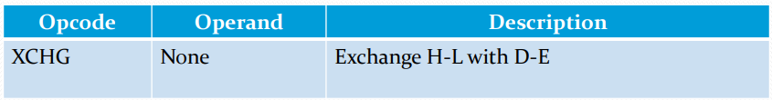
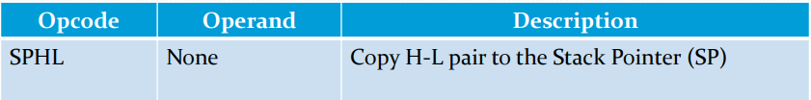
Instruction set of 8085 microprocessor
Data transfer instructions
The contents of register H are exchanged with the contents of register D. The content of register L are exchanged with the content of register E.
During this, WZ register is used as a temporary register to exchange the value between HL and DE register.
Example: XCHG
This instruction loads the contents of H-L pair into SP.

Slide 35
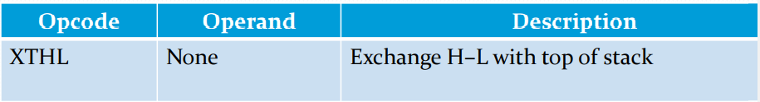
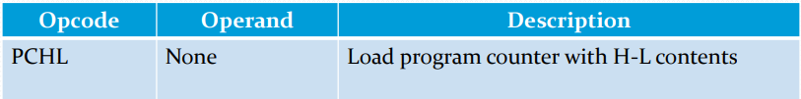
Instruction set of 8085 microprocessor
Data transfer instructions
The contents of L register are exchanged with the location pointed out by the contents of SP.
The content of H register are exchanged with the next location (SP+1)
Example: XTHL
The contents of registers H and L are copied into the program counter (PC).
The contents of H are placed as the high order byte and the contents of L as the low order byte.
Example: PCHL

Slide 36

Instruction set of 8085 microprocessor
Data transfer instructions
The content of register pair are copied into stack.
SP is decremented and the contents of high order registers (B, D, H, A are copied into stack
SP is again decremented and contents of low order registers (C, E, L, flags are copied into stack.
Example: PUSH B

Slide 37
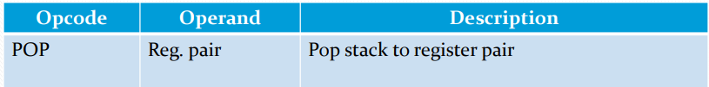
Instruction set of 8085 microprocessor
Data transfer instructions
The content of top of stack are copied into register pair.
The contents of location pointed out by SP are copied to low order register (C, E, L, Flags).
SP is incremented and the contents of location are copied to high order register (B, D, H, A).
Example: POP H

Slide 38

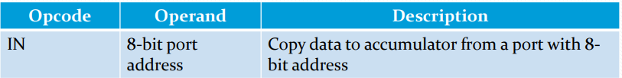
Instruction set of 8085 microprocessor
Data transfer instructions
The contents of accumulator are copied into the I/O port.
Example: OUT 60H
The contents of I/O port are copied into accumulator.
Example: IN 8C H

Slide 39
Instruction set of 8085 microprocessor
Arithmetic instructions
These instructions perform the operationslike:
Addition
Subtraction
Increment
Decrement

Slide 40
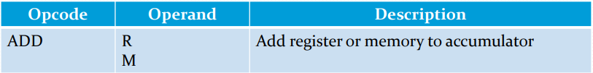
Instruction set of 8085 microprocessor
Arithmetic instructions: Addition
Any 8-bit number or the contents of register or the content of memory location can be added to the contents of accumulator.
The result is stored in accumulator
No two other 8 bit registers can be added directly. i.e. contents of B register cannot be added directly to the content of register C.
The contents of registers or memory are added to the contents of accumulator.
The result is stored in accumulator.
If the operand is memory location, its address is specified by H-L pair.
All flags are modified to reflect the result of addition.
Example: ADD B
ADD M

Slide 41

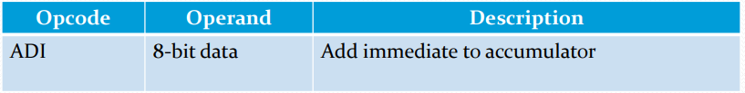
Instruction set of 8085 microprocessor
Arithmetic instructions: Addition
The content of register or memory and Carry flag are added to the content of accumulator.
The result is stored in accumulator.
If the operand is memory location, its address is specified by H-L pair.
All flags are modified to reflect teh result of addition.
Example: ADC B or ADC M
The 8 bit data is added to the contents of accumulator.
The result is stored in accumulator.
All flags are modified to reflect the result of the addition.
Example: ADI 45

Slide 42
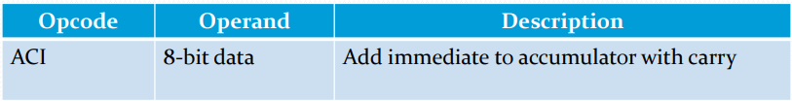
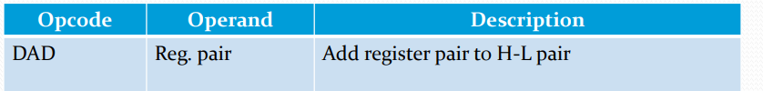
Instruction set of 8085 microprocessor
Arithmetic instructions: Addition
The 8 bit data and the carry flag are added to the contents of accumulator.
The result is stored in accumulator.
All flags are modified to reflect the result of addtion.
Example: ACI 45H
The 16 bit contents of register pair are added to the contents of H-L pair.
The result is stored in H-L pa ir. If the result is larger than 16 bits, then CY is set. No other flags are changed.
Example: DAD B

Slide 43
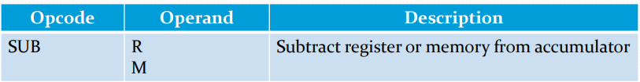
Instruction set of 8085 microprocessor
Arithmetic instructions: subtraction
The content of register or memory location are subtracted from the content of the accumulator.
The result is stored in accumulator
If the operand is memory location, its address is specified by HL pair.
All flags are modified to reflect the result of subtraction.
Example: SUB B
SUB M

Slide 44
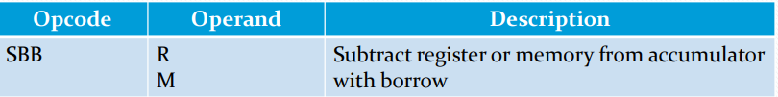
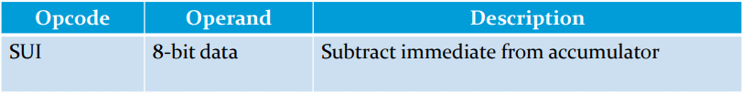
Instruction set of 8085 microprocessor
Arithmetic instructions: subtraction
The content of register or memory location and borrow flag i.e.CF are subtracted from the contents of the accumulator.
The result is stored in accumulator
If the operand is memory location, its address is specified by HL pair.
All flags are modified to reflect the result of subtraction.
Example: SBB B or SBB M
The 8 bit data is subtracted from the content of the accumulator.
The result is stored in accumulator
All flags are modified to reflect the result of subtraction.
Example: SUI 45h

Slide 45
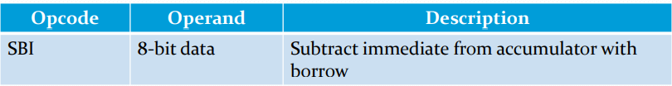
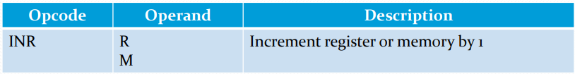
Instruction set of 8085 microprocessor
Arithmetic instructions: subtraction
The 8 bit data and borrow flag (CF) is subtracted from the contents of accumulator.
The result is stored in accumulator.
All flags are modified to reflect the result of subtraction.
Example: SBI 45H
The contents of register or memory location are incremented by 1f.
The result is stored in same place.
If operand is a memory location, its address is specified by the contents of HL pair.
Example: INR B or INR M

Slide 46
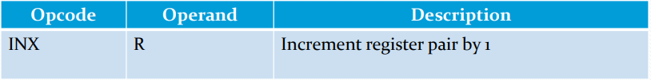

Instruction set of 8085 microprocessor
Arithmetic instructions:
The contents of register are incremented by 1.
The result is stored in same place.
INX H
The contents of register or memory location are decremented by 1.
The result is stored in the same place.
If the operand is a memory location, its address is specified by contents of HL pair.
Example: DCR B or DCR M.

Slide 47

Instruction set of 8085 microprocessor
Arithmetic instructions:
The contents of register pair are decremented by 1.
The result is stored in the same place.
Example: DCX H

Slide 48

Instruction set of 8085 microprocessor
Logical instruction
Used to perform logical operation on data stored in registers, memory and status flag.
Logical operations are:
AND (ANA, ANI)
OR(ORA, ORI)
XOR (XRA, XRI
Rotate
Compare
Complement

Slide 49
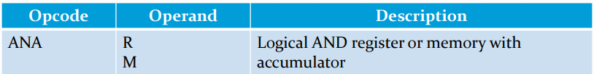
Instruction set of 8085 microprocessor
Logical instruction : AND, OR, XOR
Perform logical operations on any 8 bit data, or contents of register or memory location with the contents of accumulator.
The result is stored in accumulator.
The contents of accumulator are logically ANDed with the contents of register or memory.
The result is placed in the accumulator.
If the operand is a memory location, its address is specified by teh contents of HL pair.
S, Z, P are modified to reflect the result of operation.
CY is reset and AC is set.
Example: ANA B or ANA M

Slide 50
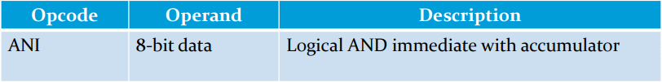
Instruction set of 8085 microprocessor
Logical instruction : AND, OR, XOR
The contents of accumulator are logically ANDed with 8 bit data.
The result is placed in the accumulator.
S, Z, P are modified to reflect the result.
CY is reset, AC is set.
Example: ANI 86H.

Slide 51

Instruction set of 8085 microprocessor
Logical instruction : AND, OR, XOR
The contents of the accumulator are logically ORed with the contents of register or memory.
The result is placed in the accumulator.
If the operand is a memory location, its address is specified by the contents of HL par.
S,Z, P are modified to reflect the result.
CY and AC are reset.
Example: ORA B or ORA M

Slide 52
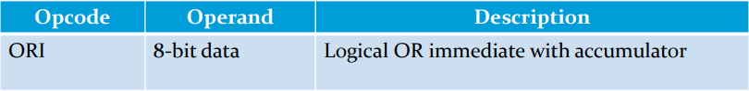
Instruction set of 8085 microprocessor
Logical instruction : AND, OR, XOR
The contents of accumulator are logically ORed with 8 bit data.
The result is placed in the accumulator.
S, Z, P are modified to reflect the result.
CY and AC are reset.
Example: ORI 86H

Slide 53
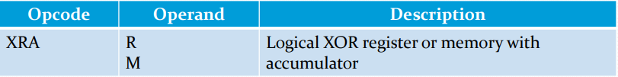
Instruction set of 8085 microprocessor
Logical instruction : AND, OR, XOR
The contents of accumulator are XORed with the contents of register or memory.
The result is placed in the accumulator.
If the operand is a memory location, its address is specified by the contents of HL pair
S, Z, P are modified to reflect the result of the operation.
CY and AC are reset.
Example: XRA B or XRA M

Slide 54
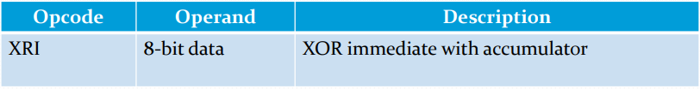
Instruction set of 8085 microprocessor
Logical instruction : AND, OR, XOR
The contents of the accumulator are XORed with the 8 bit data.
The reuslt is placed in the accumulator.
S, Z, P are modified to reflect the result.
CY and AC are reset
Example: XRI 86h

Slide 55
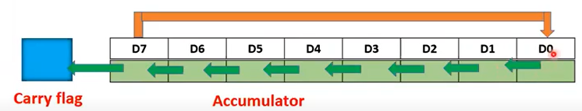
Instruction set of 8085 microprocessor
Rotate
Each bit in the accumulator can be shifted either left or right to the next position.
There are 4 categories of Rotate instruction. They are:
RLC (Rotate Accumulator left)
Each bit is shifted to the adjacent left position. Bit D7 becomes D0. Carry flag is modified according to bit D7.

Slide 56
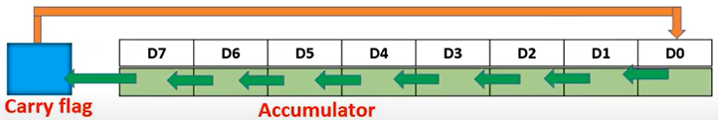
Instruction set of 8085 microprocessor
Logical instruction :
Rotate
RAL (Rotate Accumulator left through carry)
Each bit is shifted to the adjacent left position. Bit D7 becomes carry bit and carry flag bit is shifted to DO . Carry flag is modified according to bit D7.

Slide 57
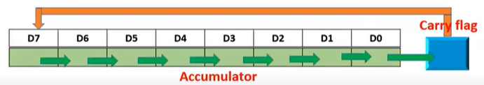
Instruction set of 8085 microprocessor
Logical instruction :
Rotate
RAR (Rotate Accumulator Right through carry)
In this instruction, each bit is shifted to the adjacent right position. Bit D0 becomes the carry bit and carry bit shifted to D7, Carry flag is modified according to bit D0.

Slide 58
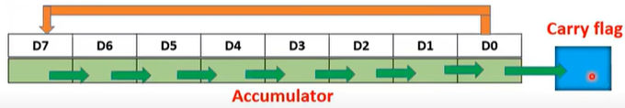
Instruction set of 8085 microprocessor
Logical instruction :
Rotate
RRC (Rotate Accumulator left through carry)
Each bit is shifted to the adjacent right position. Bit D0 becomes D7. Carry flag CY is modified according to the bit D0
What is the application of Rotate instructions?
The rotate instructions are primarily used in arithmetic multiply and divide operations and for serial data transfer.

Slide 59
Instruction set of 8085 microprocessor
Logical instruction
The contents of register are incremented by 1.
The result is stored in same place.
INX H
The contents of register or memory location are decremented by 1.
The result is stored in the same place.
If the operand is a memory location, its address is specified by contents of HL pair.
Example: DCR B or DCR M.

Slide 60

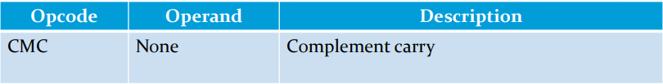
Instruction set of 8085 microprocessor
Complement:
The content of accumulator can be complemented. In this operation, each 0 is replaced by 1 and 1 by 0.
No flags are affected.
Instruction used for this is CMA.
The carry flag is complemented.
No other flags are affected.
Example: CMC

Slide 61
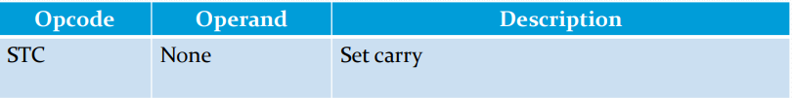
Instruction set of 8085 microprocessor
STC
The carry flag is set to 1.
No other flags are affected.
Example: STC

Slide 62
Instruction set of 8085 microprocessor
Compare Instruction
Any 8 bit data or then contents of register or memory location can be compares for Equality, Greater than, Less than with the contents of accumulator.
The result is reflected in status flag.

Slide 63
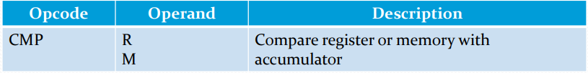
Instruction set of 8085 microprocessor
Logical Instruction
The content of operand (register or memory) are compared with contents of accumulator.
However both contents are preserved.
The result of comparison is shown by setting the flag of PSW as:
If (A) < (reg/mem): carry flag is set.
If (A)=(reg/mem) : zero flag is set
If (A)>(reg/mem) : carry and zero flags are reset.

Slide 64





Instruction set of 8085 microprocessor
Logical Instruction
The content of operand (register or memory) are compared with contents of accumulator.
However both contents are preserved.
The result of comparison is shown by setting the flag of PSW as:
If (A) < (reg/mem): carry flag is set.
If (A)=(reg/mem) : zero flag is set
If (A)>(reg/mem) : carry and zero flags are reset.

Slide 65
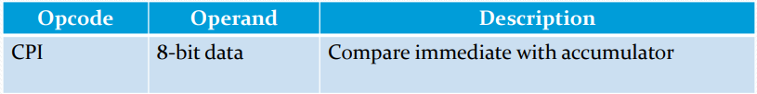
Instruction set of 8085 microprocessor
Logical Instruction
The 8 bit data is compared with the contents of accumulator.
The values being compared remain unchanged.
The result of comparison is shown by setting the flags of PSW as:
If (A)< data ; carry flag is set
If (A)=data ; zero flag is set
If (A)>data ; carry and zero flag are reset.

Slide 66
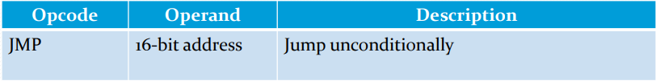
Instruction set of 8085 microprocessor
Branching Instruction
The branching instruction alter the normal sequential flow.
These instructions alter either unconditionally or conditionally.
The program sequence is transferred to the memory location specified by 16 bit address given in the operand.
JMP 2034H

Slide 67
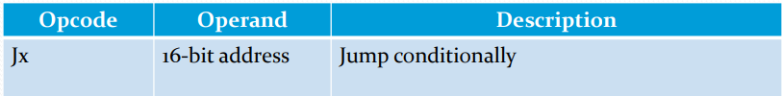
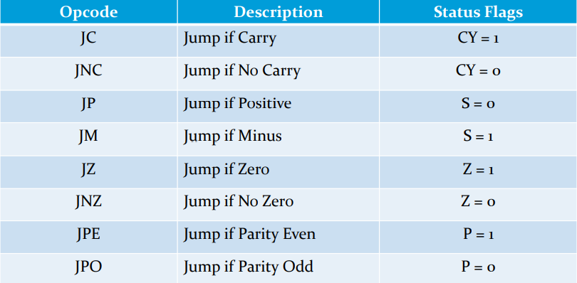
Instruction set of 8085 microprocessor
Branching Instruction
The program sequence is transferred to the memory location specified by 16 bit address given in the operand based on the specified flag of PSW.Example: JZ 2034H

Slide 68

Instruction set of 8085 microprocessor
Branching Instruction
The program sequence is transferred to the memory location specified by 16 bit address given in the operand.
Before the transfer, the address of the next instruction after CALL (the contents of program counter) is pushed into the stack.
Example: CALL 2034H

Slide 69
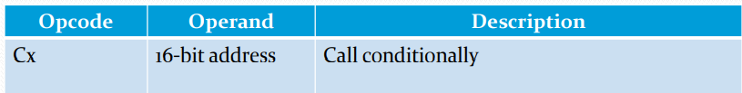
Instruction set of 8085 microprocessor
Branching Instruction
The program sequence is transferred to the memory location specified by the 16 bit address given in the operand based on specified flag of PSW.
Before the transfer, the address of next instruction after the call (the contents of program counter) is pushed onto the stack.
Example: CZ 2034H

Slide 70
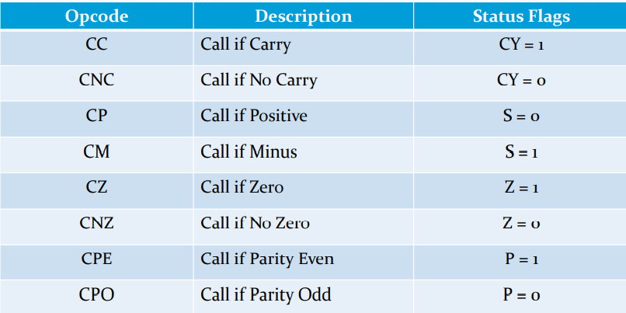
Instruction set of 8085 microprocessor
Branching Instruction

Slide 71
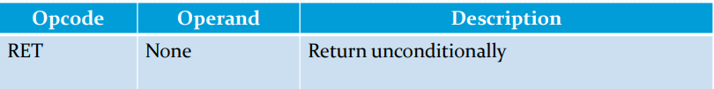
Instruction set of 8085 microprocessor
Branching Instruction
The program sequence is transferred from the subroutine to the calling program.
The two bytes from the top of the stack are copied into the program counter and program execution begins at the new address.
Example: RET

Slide 72
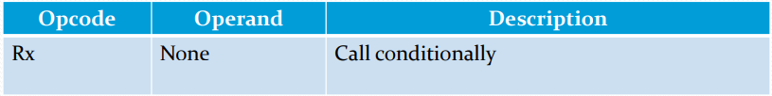
Instruction set of 8085 microprocessor
Branching Instruction
The program sequence is transferred from the subroutine to the calling program based on the specified flag of PSW.
The two bytes from the top of the stack are copied into the program counter and program execution begins at the new address.
Example: RZ

Slide 73

Instruction set of 8085 microprocessor
Branching Instruction

Slide 74

Instruction set of 8085 microprocessor
Branching Instruction
The RST instruction jumps the control to one of eight memory locations depending upon the number.
These are used as software instructions in a program to transfer program execution to one of the eight locations.
Example: RST 3

Slide 75

Instruction set of 8085 microprocessor
Branching Instruction

Slide 76

Instruction set of 8085 microprocessor
Control Instruction
The control instructions control the operation of microprocessor.
NOP stands for No Operation. When this instruction encounter, no operation is performed.
The instruction is fetched and decoded but not operation is executed.
Example: NOP

Slide 77


Instruction set of 8085 microprocessor
Control Instruction
The CPU finishes executing current instruction and halts any further execution.
An interrupt or reset is necessary to exit from the halt state.
Example: HLT
The interrupt enable flip-flop is reset and interrupts except TRAP are disabled.
No flags are affected.
Example: DI

Slide 78

Instruction set of 8085 microprocessor
Control Instruction
The interrupt enable flip-flop is set and all interrupts are enabled.
No flags are affected.
This instruction is necessary to reenable the interrupts (except TRAP).
Example: EI

Slide 79


Instruction set of 8085 microprocessor
Control Instruction
This is a multipurpose instruction used to read the status of interrupt 7.5, 6.5, 5.5 and read serial data input bit.
The instruction loads eight bits in accumulator with following interpretations:
Exampe: RIM

Slide 80


Instruction set of 8085 microprocessor
Control Instruction
This is multipurpose instruction used to implement 8085 interrupts 7.5, 6.5, 5.5 and serial data output.
The instruction interprets the accumulator content as follows;
Exampe: SIM

Slide 81
Program List: Assignment
Write ALP to add two 8 bit number from memory location 2050H and 3050H and display the result in output port 03H.
Write ALP to add two number from the location 2050H and 2051H and store the result in memory location 2055H.
Write ALP to add two 8 bit number input from input port 01H and 02H and display the result in output port 05H.
Write ALP to subtract two 8 bit number from the location 20H and 25H and display the result in output port 02H
Write ALP to add two number from the location 2050H and 2051H and store the result in memory location 2055H.
Write ALP to find 1’s complement of a number stored in memory location 2020H and store the result in memory location 3030H.
Write ALP to find 2’s complement of number stored in memory location 40H and store the result in memory location 5000H
Write program to perform the right shift on 8 bit number for three times and store the result in memory location 2050H.
Write ALP to add two 16 bit numbers and store the result in the memory location 2055h, 2056h.

Slide 82
Program List: Assignment
Write ALP to subtract two 16 bit numbers where first 16 bit number is in the location 2050H and second number from the memory location 2052H and store the result in memory location 2055H.
Write ALP to multiply two 8 bit numbers. Store the result in memory lcoation 2050H
Write ALP to divide 8 bit numbers and store the quotient in memory location 2055H and remainder in memory location 2056H.
Write ALP to find whether a number is odd or even.
Write ALP to count number of 1’s in given 8 bit number.
Write ALP to display number from 1 to 10.
Write ALP to find the sum of numbers from 1 to 10.
Write ALP to display all odd numbers from 1 to 10.
Write ALP to display all even numbers from 1 to 20.
Write ALP to display all even number from 20 to 50.
Write ALP to find sum of 10 numbers in array.
Write ALP to find the greatest number among 10 different numbers.

Slide 83
Program List: Assignment
Write ALP to print fibonacci series upto 8th term.
Write ALP to sort 10 different numbers in ascending order in array.
Write ALP to multiply tow 8 bit numbers 43H and 07H and stored the result in memory address 3050.

