Slide 1
Microprocessor
Chapter-3
Instruction Cycle

Slide 2
Introduction
Instruction or code is stored in memory.
For a instruction : MVI A, 44h
It has two part first is opcode and the second one is operand. Sometimes Instruction may contains two operands.
Instruction cycle:
Time required to execute and fetch one complete instruction is called instruction cycle.
It is the time require to complete the execution of an instruction.
It consists:
Fetch cycle – This the time required by μp to fetch the instruction from the memory to instruction register is called fetch cycle. The next instruction is fetched by the address stored in program counter (PC) and then stored in the instruction register.
Decode instruction – Decoder interprets the encoded instruction from instruction register
Reading effective address – The address given in instruction is read from main memory and required data is fetched. The effective address depends on direct addressing mode or indirect addressing mode.
Execution cycle – consists memory read (MR), memory write (MW), input output read (IOR) and input output write (IOW)

Slide 3
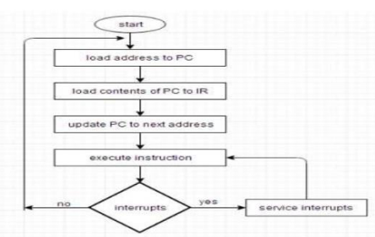
Introduction
Upon the completion of step 4, the control goes back to step 1 to fetch, decode, and execute the next instruction. This process continues indefinitely unless a HALT instruction is encountered.

Slide 4
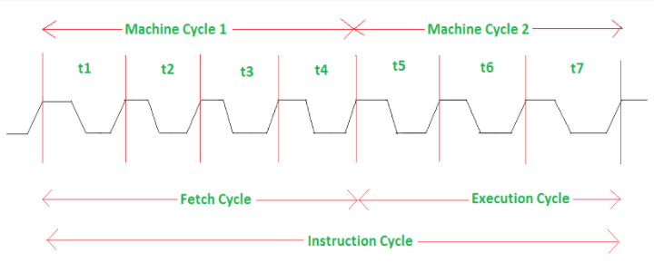
Introduction
T-state is defined as one subdivision of operation performed in one clock period. These subdivisions are internal states synchronized with the system clock, and each T-state is precisely equal to one clock period.
One time period of frequency of microprocessor is called t-state.
A t-state is measured from falling edge of one clock pulse of the falling edge of next clock pulse
Since 8085 works at 3MHz, one T-state = 1/3 microseconds=0.333 microseconds.

Slide 5
Introduction
Machine cycle
The time required for the microprocessor to access memory or an IO device either for a read operation or a write operation is called a machine cycle.
As the data bus of 8085 is 8-bit, one machine cycle will transfer one byte (8-bit). Instructions that require to read or write 16 bit data from memory, need multiple machine cycles.
An instruction cycle consists of various machine cycles.
The most important and compulsory machine cycle of every instruction is OPCODE FETCH . It is the first machine cycle of every instruction.
There are other machine cycles like memory read, memory write, I/O read, etc.
Machine cycles contain T-states.
Following are the different types of machine cycle:
Opcode fetch, which takes 4 to 6 t-states
Memory Read, which takes 3 t-states
Memory Write, which takes 3 t-states
I/O Read, which takes 3 t-states
I/O Write, which takes 3 t-states

Slide 6
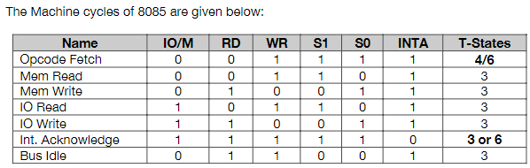
Introduction
Machine cycle

Slide 7
Opcode fetch
This cycle is used to fetch the opcode from memory.
This the first machine cycle of every instruction.
It is a compulsory machine cycle.
It is generally of 4T states but some times instruction require a 6T state for opcode fetch.
During T1:
A15-A8 contains higher byte of adddress (PCH)
As ALE is high AD7-AD0 contains lower byte of address (PCL)
Since it is an opcode fetch cycle, S1 and S0 goes high.
Since it is memory read operation IO/M goes low.
During T2:
As ALE goes low, address is removed from AD7-AD0.
As RD goes low, data appears on AD7-AD0
As μp is reading data (opcode from memory), there is a propagation delay between sending the address and arrival of data. This is the time required for data to travel from memory to μp. Note: it is shown by dots between address and data.

Slide 8
Opcode fetch
During T3:
Data remains on AD7-AD0 till RD is low. This the time given to μp to capture data (opcode) from the data bus into store it to instruction register.
During T4:
T4 state is used by the μp to decode the opcode.
This is how an opcode fetch cycle is different from memory read cycle.

Slide 9
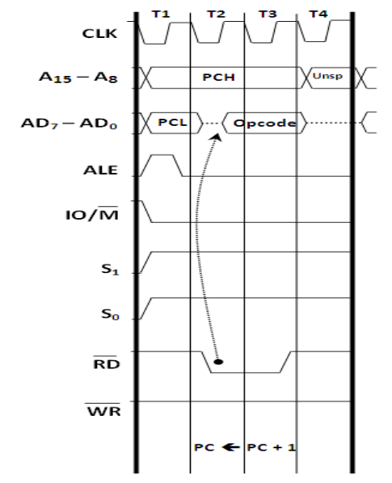
Opcode fetch: Timing diagram
Timing diagram show what is happening in the buses. Decoding is an internal operation and hence is not shown in the timing diagram.

Slide 10
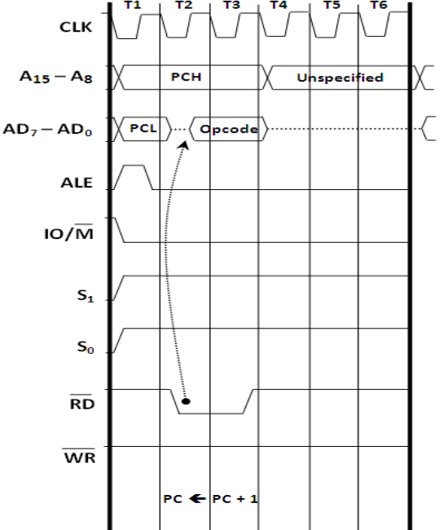
Operand fetch: Timing diagram
Instructions that use a 6T Opcode Fetch are:
SPHL INX n PUSH CALL (all typos) __ RC (Conditional Rh RSTn
T5 and T6 are used for internal operation, so nothing happens in buses during that time, so nothing is shown in the timinig daigram

Slide 11
Memory Read
This cycle is used to fetch one byte from the memory to μp
This cycle can be used to fetch the operand bytes of an instruction or any data from the memory.
It is not compulsory machine cycle.
It requires 3T-states.
During T1:
A15-A8 contains the higher byte of address (PCH).
As ALE is high, AD7-AD0 contains the lower byte of the address (PCL).
In memory read cycle, S1 goes high and S0 remains low.
Similarly IO/M goes low.
During T2:
ALE goes low.
Address is removed from AD7-AD0.
As RD goes low, data appears on AD7-AD0.
During T3:
Data remains on AD7-AD0 as RD is low.

Slide 12
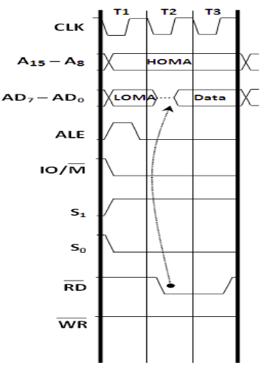
Memory Read
Note:
In read operation, there is propagation delay.

Slide 13
Memory Write
This cycle is used to send(write) one byte into the memory.
It is also not compulsory machine cycle.
It requires 3T-states.
During T1:
A15-A8 contains the higher byte of address (PCH).
As ALE is high, AD7-AD0 contains the lower byte of the address (PCL).
In memory write cycle, S0 goes high and S1 remains low.
Similarly IO/M goes low as it is memory operation.
During T2:
ALE goes low.
Address is removed from AD7-AD0.
Data appears on AD7-AD0 and WR goes low.
During T3:
Data remains on AD7-AD0 as WR is low.

Slide 14
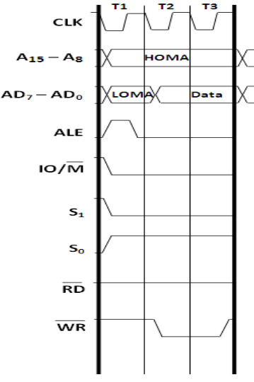
Memory Write
Note:
In write operation, there is no propagation delay.

Slide 15
IO Read
This cycle is used to fetch one byte from the IO port to μp
It is not compulsory machine cycle.
It requires 3T-states.
During T1:
The low 8-bits of IO port addresses are duplicated into higher order address bus A15-A8.
As ALE is high, AD7-AD0 contains the lower byte of the address (PCL).
In I/O read cycle, S1 goes high and S0 remains low.
Similarly IO/M goes high .
During T2:
ALE goes low.
Address is removed from AD7-AD0.
As RD goes low, data appears on AD7-AD0.
During T3:
Data remains on AD7-AD0 as RD is low.

Slide 16
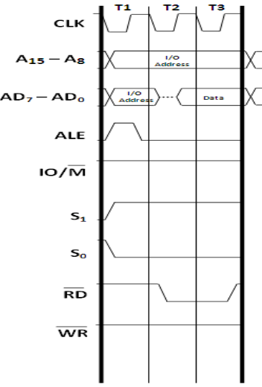
IO Read
Note:
In read operation, there is propagation delay.

Slide 17
IO Write
This cycle is used to send(write) one byte into the IO port from μp.
It is also not compulsory machine cycle.
It requires 3T-states.
During T1:
The low 8-bits of IO port addresses are duplicated into higher order address bus A15-A8.
As ALE is high, AD7-AD0 contains the lower byte of the address (PCL).
In I/O write cycle, S0 goes high and S0 remains high.
Similarly IO/M goes high .
During T2:
ALE goes low.
Address is removed from AD7-AD0.
Data appears on AD7-AD0 and WR goes low.
During T3:
Data remains on AD7-AD0 as RD is low.

Slide 18
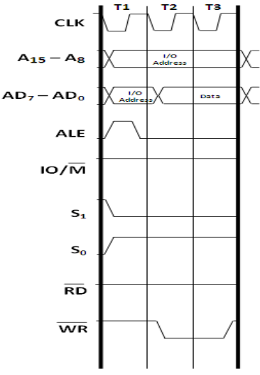
IO Write
Note:
In write operation, there is no propagation delay.

