Slide 1

PPE Ordering Platform
End-to-end distribution for Emirates Global Aluminium
Website · Android · iOS | Order → Approval → Fulfilment → Invoice
Prepared by Prosafe Systems
Notes:
One platform replacing the manual PPE ordering cycle between EGA employees and PROSAFE stores.

Slide 2
OVERVIEW
One platform, from the employee's phone to the invoice
EGA employees order their personal protective equipment against an approved price list. The platform holds the allocation for every employee, reserves the stock the moment it is picked, routes anything over the limit to EGA for approval, and carries the order through PROSAFE fulfilment to delivery, acknowledgement and invoicing — with every document mirrored into the ERP.
4
10
39
8
modules
master files
PPE items
order states
Employee · Approver
Store · Admin
Employees, items,
price lists and more
Real EGA catalogue
with photographs
Tracked from placement
through to complete
Built to the Mobile App SRS2 specification and the EGA Data List workbooks.

Slide 3
01
The platform
What it runs on, and who uses which part of it

Slide 4
ACCESS
Three ways in, one system behind them
1
2
3
Web portal
Android app
iOS app
Every module runs in the browser — and the only place the Admin Module lives.
The employee ordering app, ready for the Google Play Store.
The same app, built from one shared codebase.
Used by PROSAFE stores, administrators and EGA approvers
Used by EGA employees on the shop floor
Used by EGA employees on the shop floor
The apps and the website talk to the same server, so an order placed on a phone is on the storekeeper's screen instantly — there is no separate mobile database to reconcile.

Slide 5
ROLES
Four modules, deliberately kept apart
1
Employee Module
2
Approver Module
Shop against the approved price list · Order and Approval carts · own orders · acknowledge deliveries · raise returns · My Limits
EGA's client approval — approve line by line or reject, and see every order that passed through approval
3
Store Module
4
Admin Module
PROSAFE fulfilment — delivery notes, re-save, return confirmation, DO consolidation, invoicing, inventory across stores
Log-in control and shopping profiles, plus every master file. No access to fulfilment or inventory
A store user never sees Users or Masters; an administrator never sees Fulfilment or Inventory. Separation is enforced on the server, not just hidden in the menu.

Slide 6
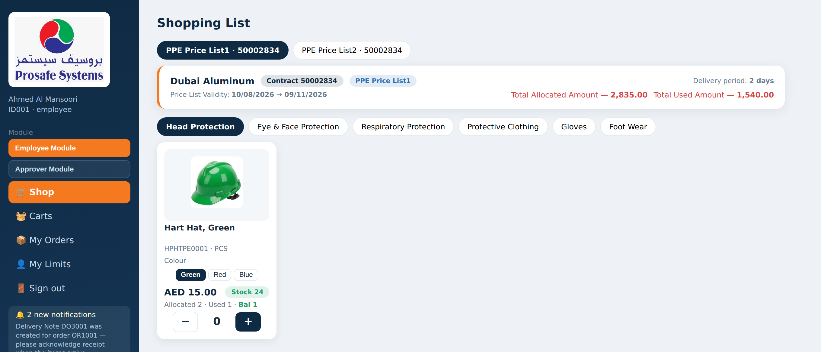
MULTIPLE ROLES
One log-in can hold two modules
A person can be assigned the Employee role, the Approver role, or both.
When they hold both, a Module switcher appears — sidebar on the web, a bar above the tabs on the phone.
Switching changes what the whole session can do, checked on the server on every request.
Store and Admin stay standalone: those log-ins hold that module on its own.
Why it matters
A supervisor who approves for EGA and also orders their own PPE needs one set of credentials, not two.
Notes:
The orange 'Employee Module' / 'Approver Module' buttons in the sidebar are the switcher.

Slide 7
02
Getting people in
The Employee Master, registration and activation

Slide 8
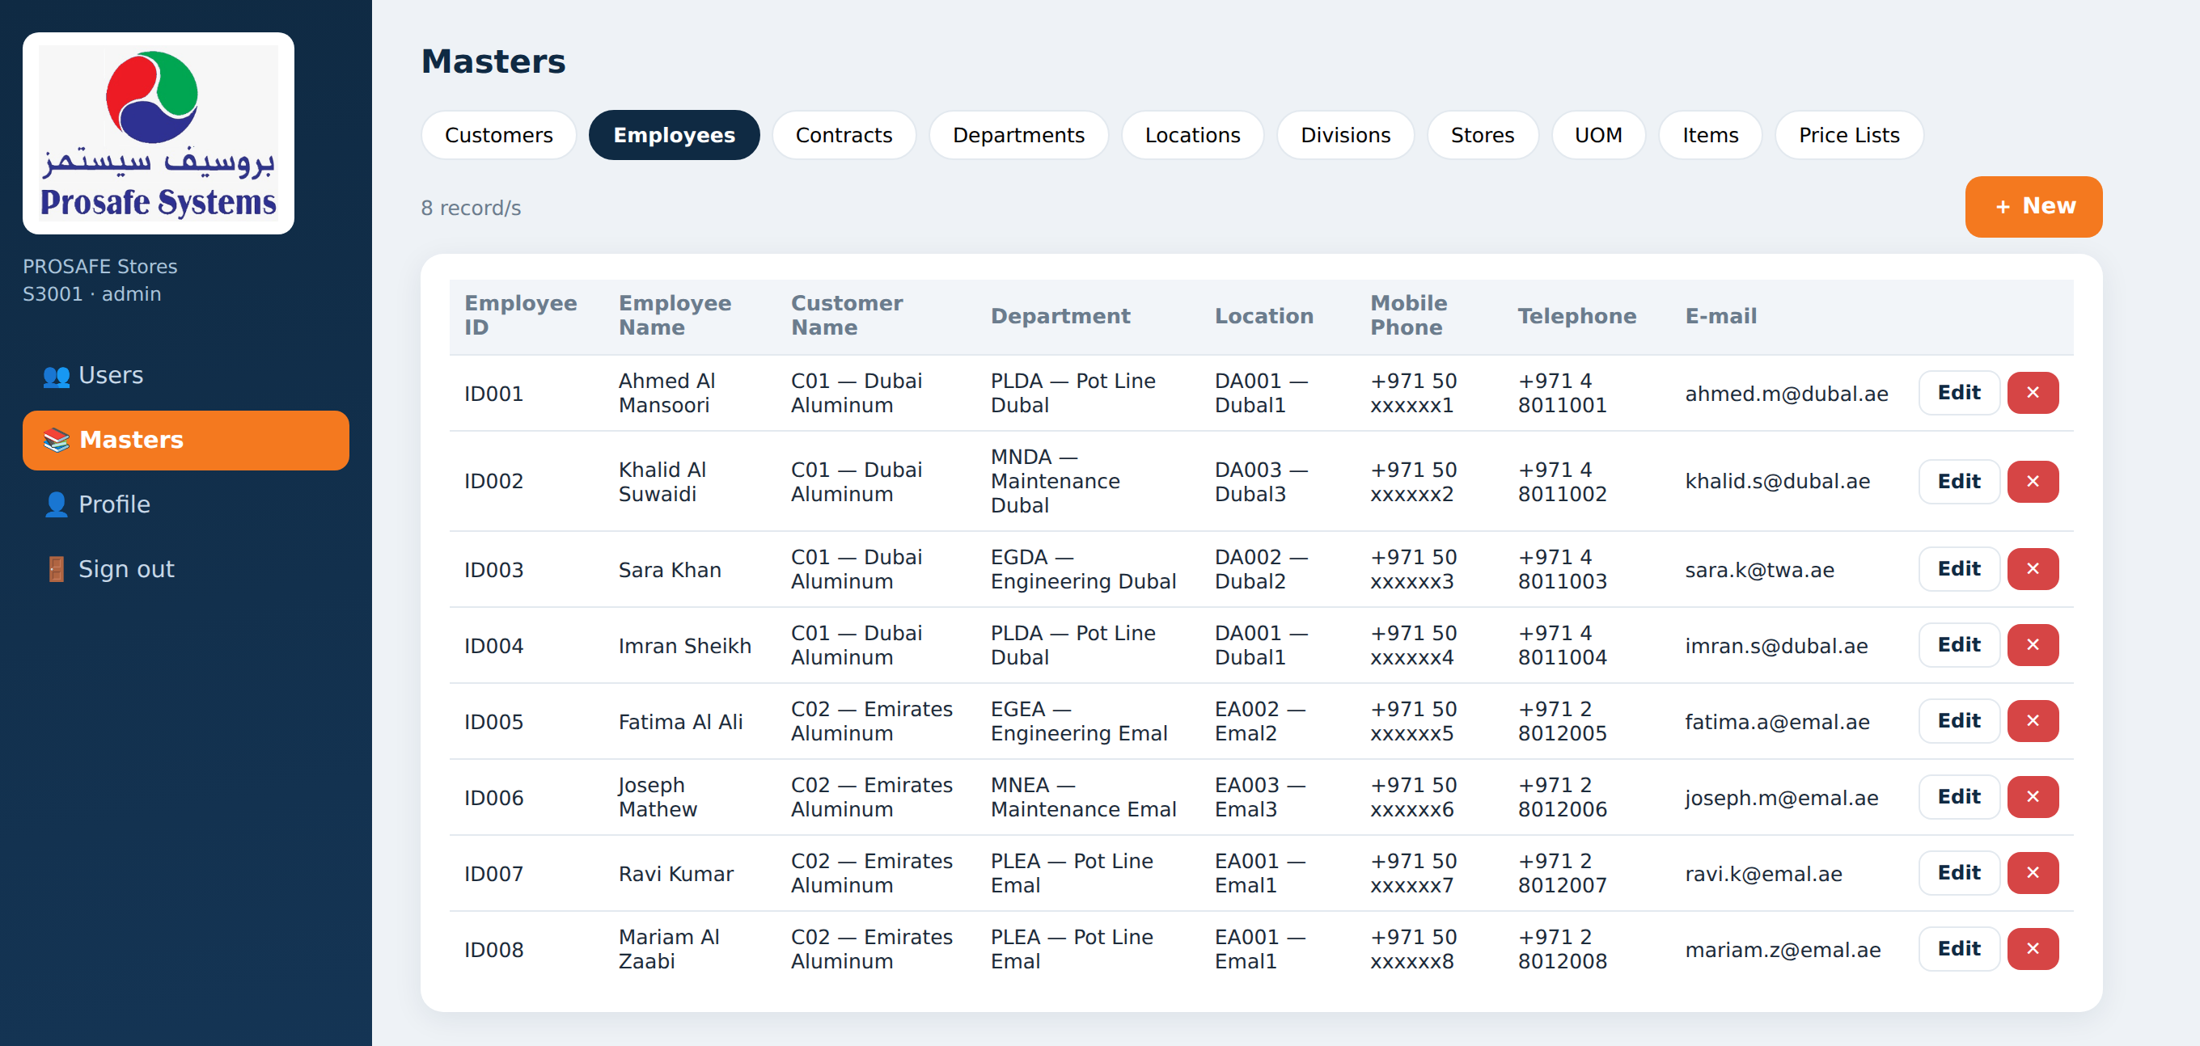
MASTER DATA
The Employee Master is the gate
PROSAFE loads the EGA employee list: Employee ID, name, customer, department, location, mobile, telephone and e-mail.
Nobody can register unless they are on this list.
It is maintained in the Admin Module and can be edited at any time.
It is the single place an employee's department or location is corrected.

Slide 9
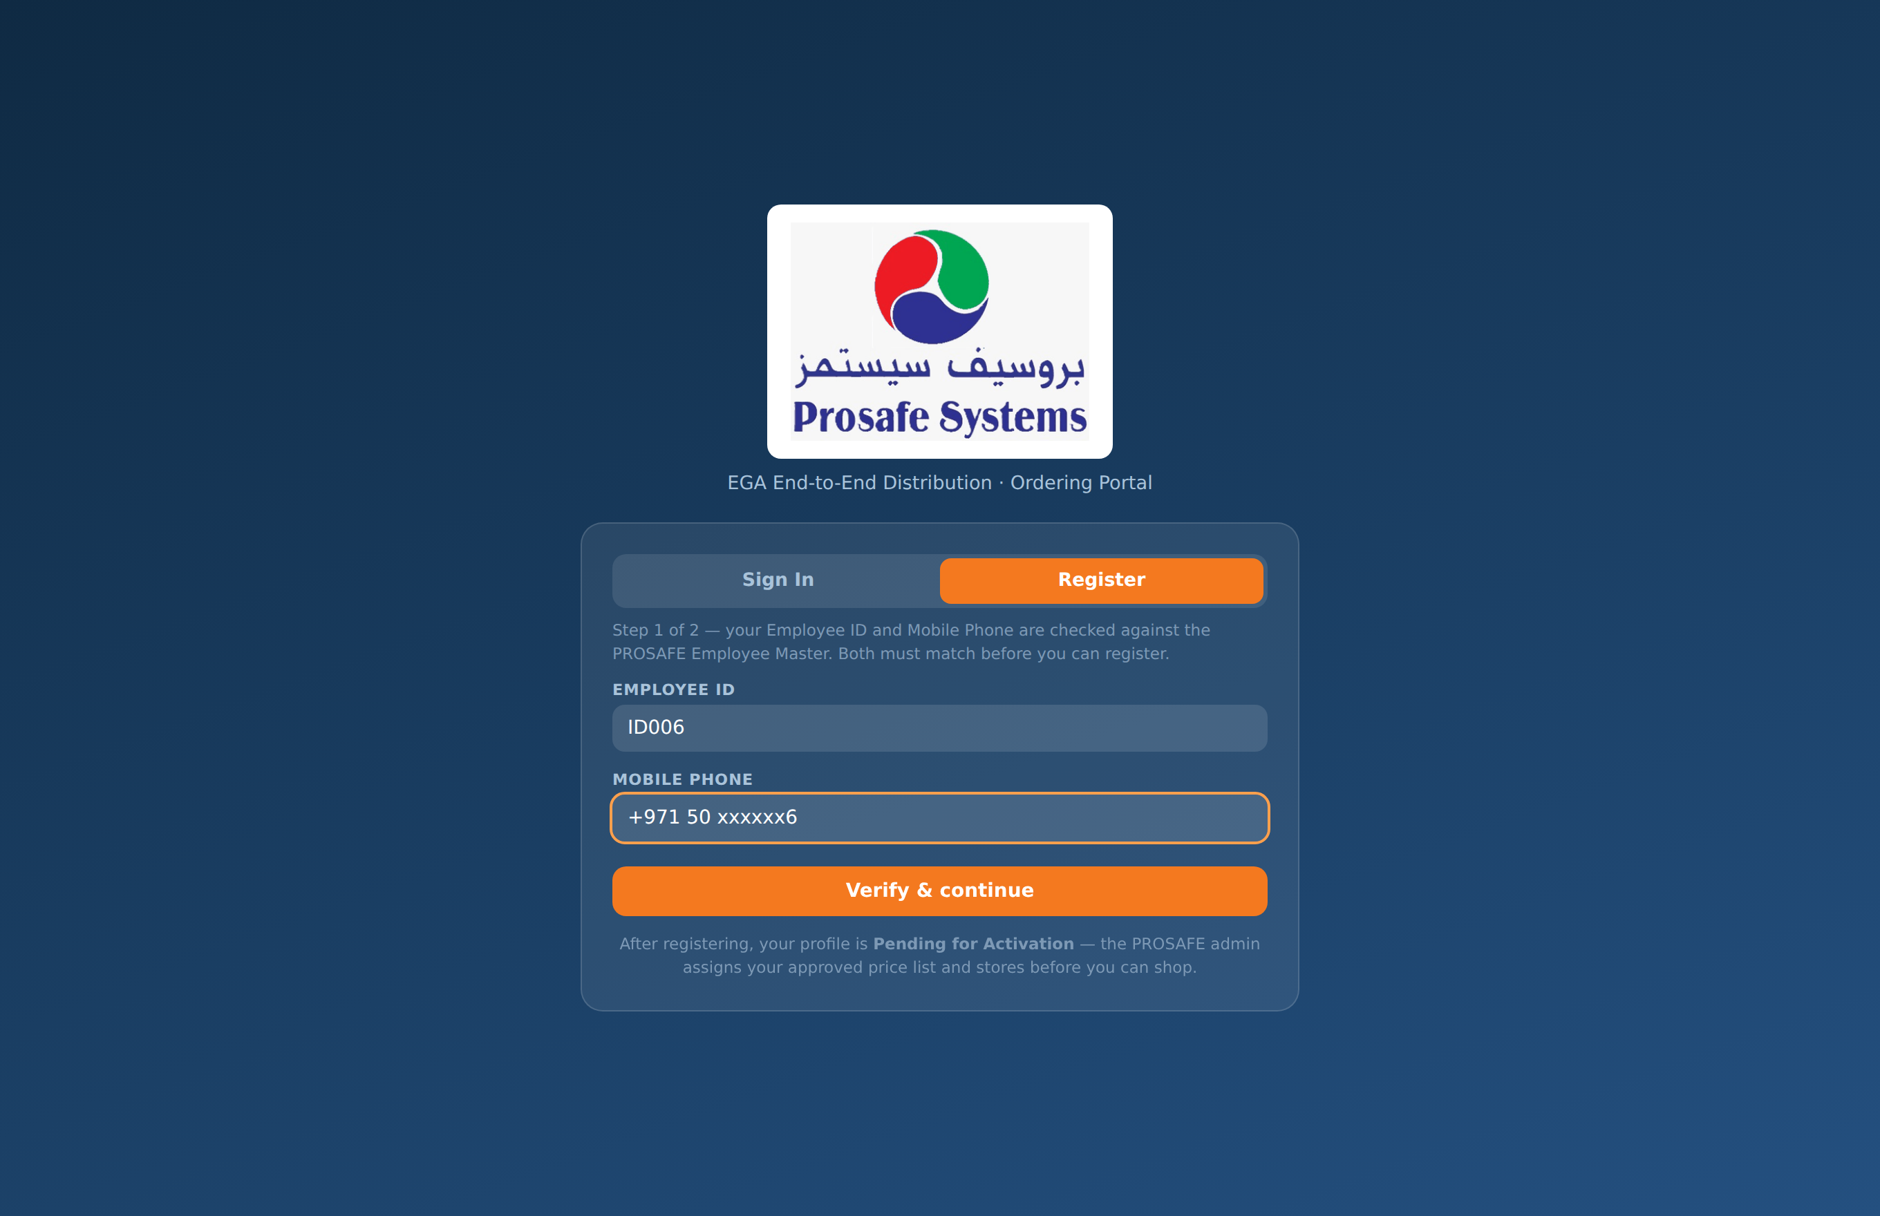
REGISTRATION · STEP 1
Two data points are checked before anything else
The employee gives their Employee ID and Mobile Phone.
Both are checked against the Employee Master — the ID must exist and the mobile number must match that same record.
If either fails, registration stops here and no account is created.
Refused
“Employee ID and Mobile Phone do not match the Employee Master — registration is not possible. Please contact your PROSAFE administrator.”

Slide 10
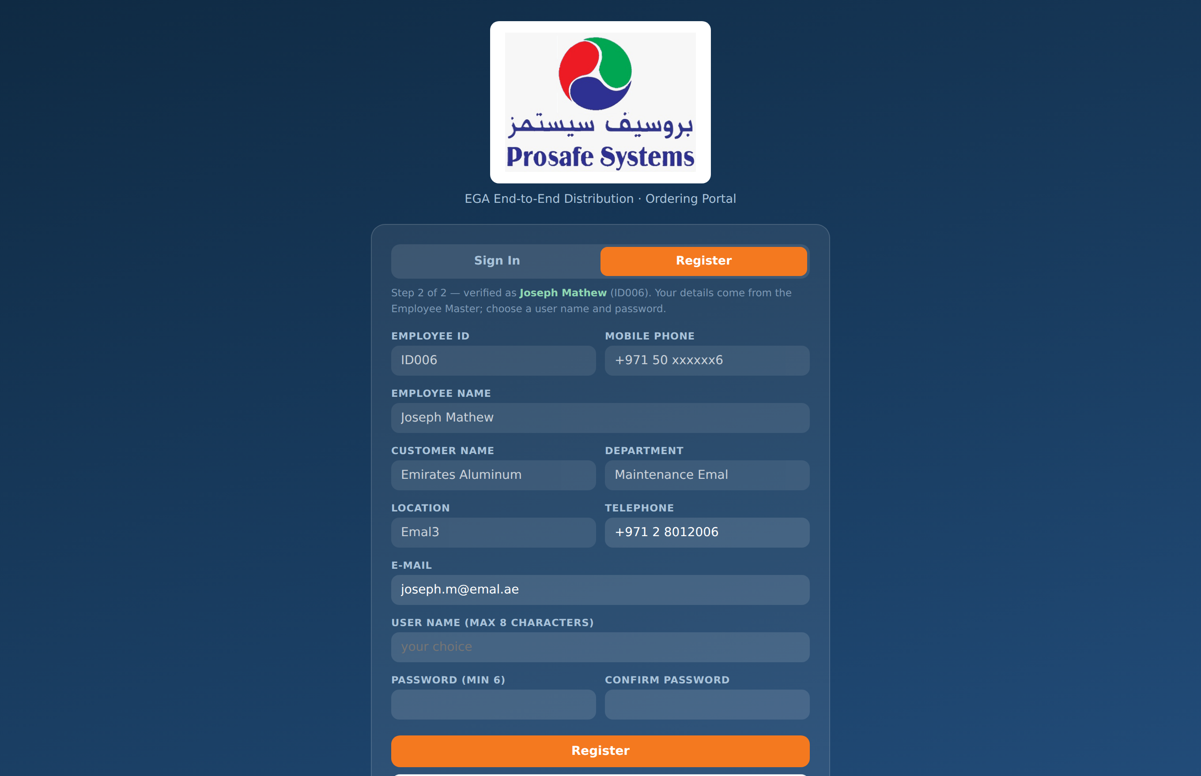
REGISTRATION · STEP 2
The rest of the form fills itself in
Name, customer, department and location come straight from the master — the employee cannot mistype them.
They choose only a user name (up to 8 characters) and a password (minimum 6, confirmed).
Either the user name or the e-mail address signs them in afterwards.
The profile is created as Pending for Activation — it cannot order yet.
The employee's record and their log-in always agree, because only one of them was ever typed.

Slide 11
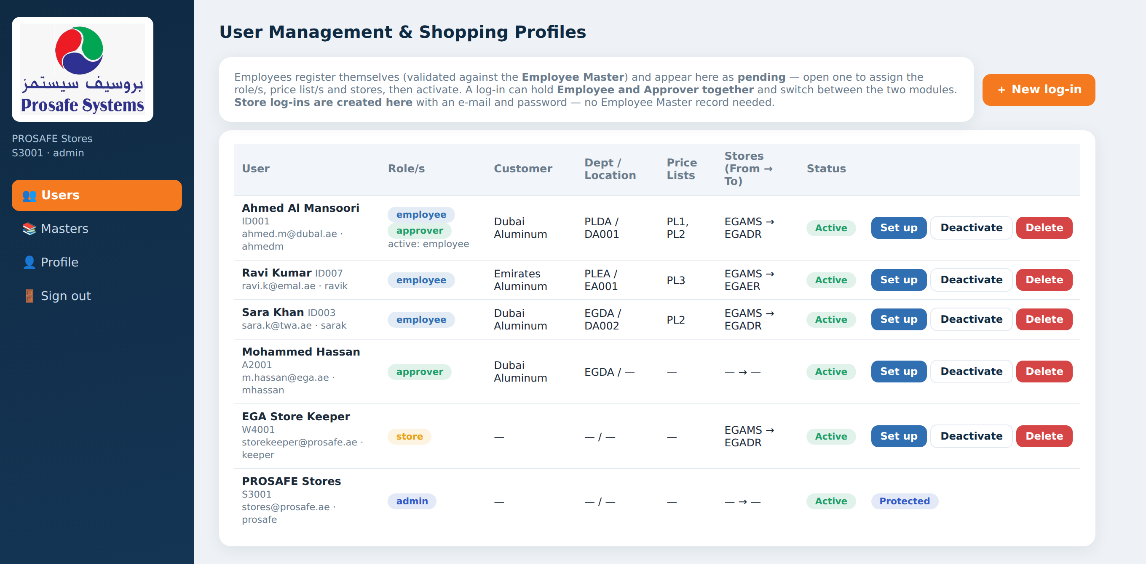
ACTIVATION
The administrator opens the door
1
Assign the role
Employee, Approver, or both.
2
Assign price list/s
Each one becomes a shopping tab.
3
Set the stores
Main store to draw from, reservation store to hold in.
4
Activate
The employee can now shop.
Until then the employee sees “Account awaiting activation”, so nobody can order against a price list they were never granted.

Slide 12
03
Ordering
The shopping list, the allocation and the ten-minute cart

Slide 13
EMPLOYEE MODULE
The shopping list
Price lists as tabs
An employee granted more than one price list gets one shopping tab per list.
Live allocation
Total Allocated and Total Used are shown at the top and update as they shop.
Real photographs
Every one of the 39 items carries its own product photo.
Live main-store stock
The stock figure on each card is the real quantity in the main store.
Size and colour
Variants sit on one card — pick the size or colour, not a separate product.

Slide 14
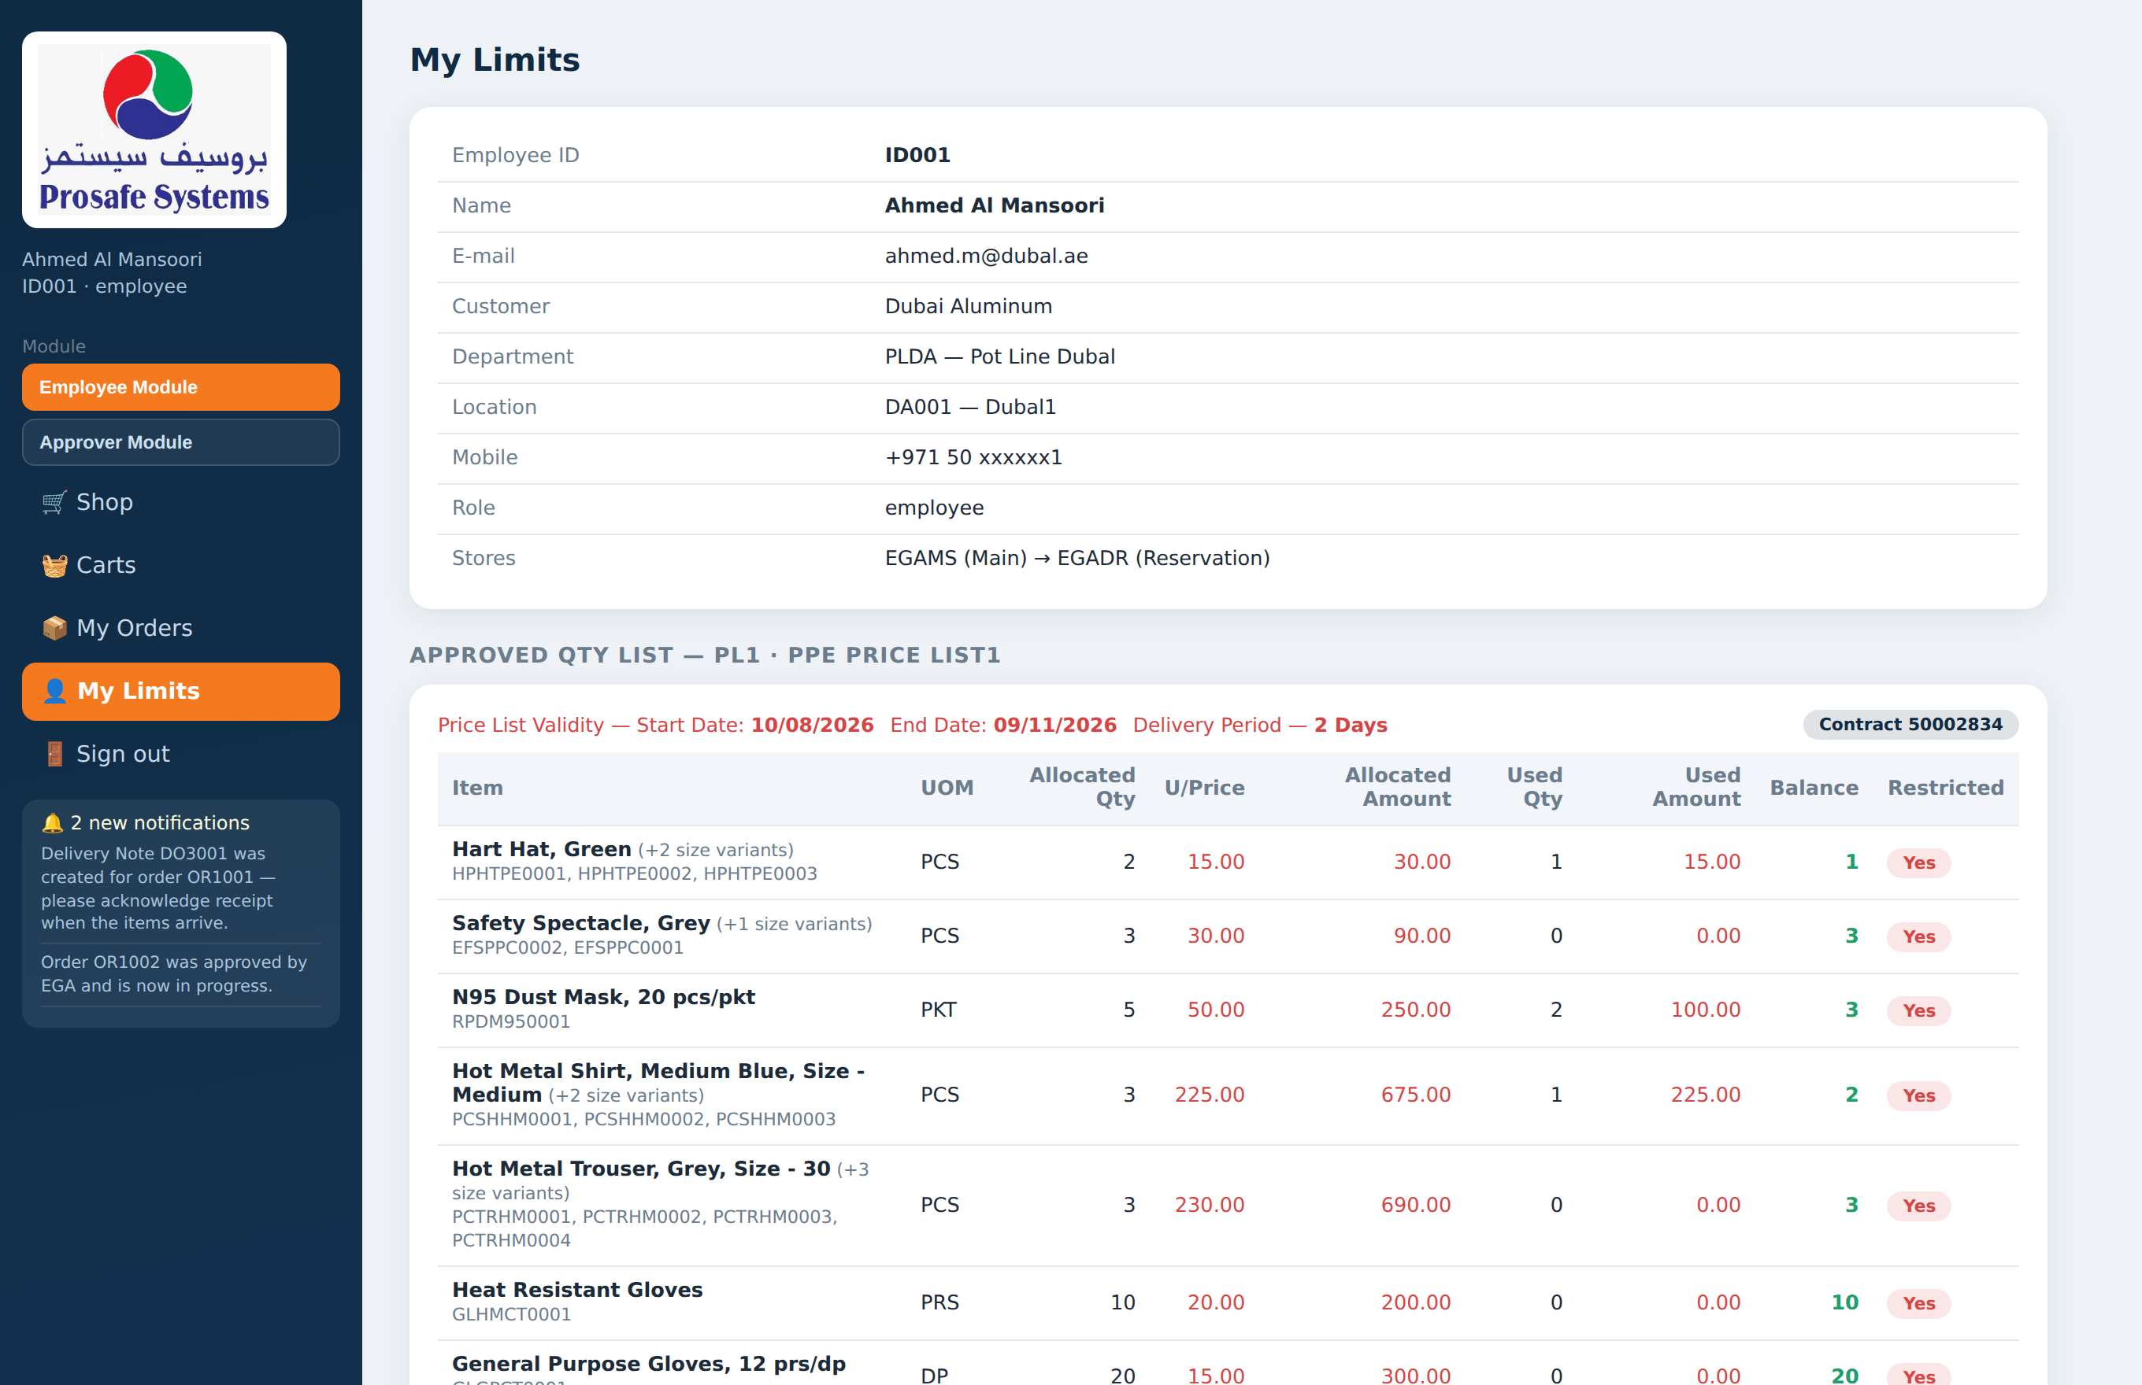
EMPLOYEE MODULE
My Limits — the approved quantity list
Every line of the price list with its allocated quantity, unit price and allocated amount.
Used quantity and used amount move as orders are placed.
Balance is what the employee has left to spend against that line.
Validity dates and the delivery period are shown against the contract.
The employee can see this at any time — no need to ask the store.

Slide 15
ALLOCATION
Size and colour variants share one allocation
An employee allocated two hard hats has two hard hats — not two of each colour. The allocation belongs to the price-list line, and every variant on that line draws from it.
PRICE LIST LINE 1 · ALLOCATED 2 · AED 15.00 EACH
Hard Hat, Green
Hard Hat, Red
Hard Hat, Blue
HPHTPE0001
HPHTPE0002
HPHTPE0003
2 green
1 green + 1 red
2 green + 1 blue
Allowed — the line is used up
Allowed — still two hats in total
Over the limit — goes to EGA for approval

Slide 16
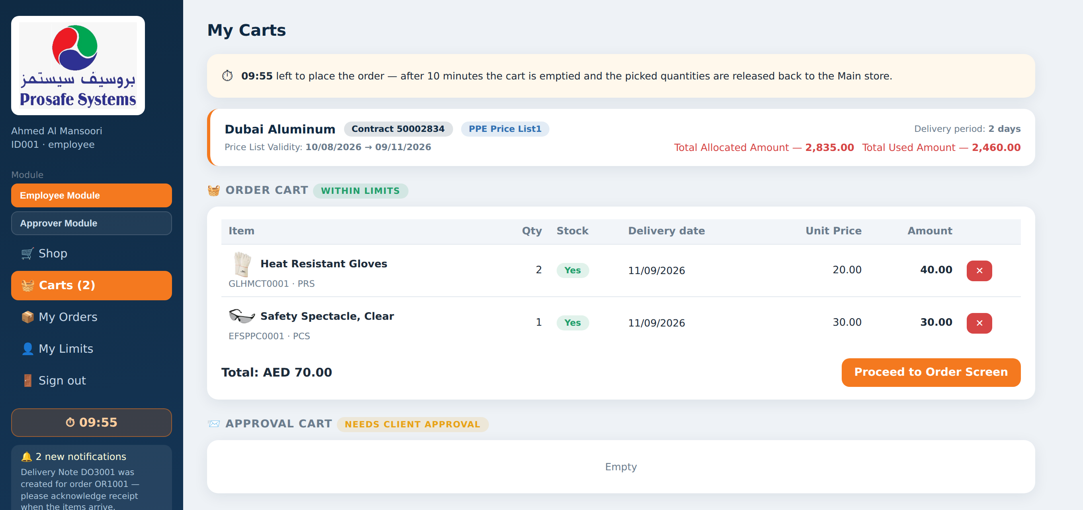
STOCK RESERVATION
Picking an item reserves it — for ten minutes
The moment a quantity is picked, that stock is held against the employee in the main store — two people cannot pick the last pair of boots.
A countdown runs in the sidebar and on the phone.
If the order is not placed within ten minutes the cart is emptied and the held stock goes straight back.
The employee is told what happened and can simply shop again.
Stock on the shopping screen is therefore real — not a figure that was true an hour ago.

Slide 17
TWO CARTS
Within the limit, or over it
Order Cart
Within limits
Approval Cart
Needs client approval
Everything picked inside the employee's remaining balance.
Placing it creates the order immediately.
The sales order is raised in the ERP straight away.
No EGA involvement is needed.
Anything beyond the allocated quantity, or a restricted item.
Placing it sends the order to EGA for approval.
The sales order is raised only once EGA approves.
EGA has three days to decide.
Both carts debit the used quantity the moment the order is placed, so an employee cannot spend the same allocation twice while an approval is pending.

Slide 18
04
From order to delivery
What the system does once the order is placed

Slide 19
ORDER PLACEMENT
Four things happen at once
1
The order is raised
2
Stock moves store to store
A document reference is issued and the order is timestamped.
The reserved quantities transfer from the main store to the reservation store on an issue and a receipt voucher.
3
The allocation is debited
4
The ERP is updated
Used quantity and used amount move against the employee's price-list line.
A sales order is created in the ERP and its reference is shown on the order.
The employee sees the order and its delivery date immediately; the storekeeper sees it on the Fulfilment screen at the same moment.

Slide 20
DELIVERY DATES
Promised only when the stock is there
Each line of the order gets its own delivery date, decided by the stock actually available in the main store when the order is placed.
Stock available
No stock
Partial stock
Delivery date = order date + the delivery period on the price list (currently two days).
The line is marked “DOD to be advised” — no date is invented.
The line is split: the available quantity gets a date, the remainder becomes a DOD line.
A firm date the employee can rely on.
It is filled in later, when stock arrives.
The employee gets what exists now.
No line is ever given a delivery date the store cannot meet.

Slide 21
APPROVAL
EGA has three days
An over-limit order sits in the Approver Module with a visible deadline.
If nobody acts within three days the order cancels itself automatically.
The allocation is credited back and the reserved stock returns to the main store.
The employee is notified — nothing is left hanging.
Approved
The sales order is raised and
the order moves to fulfilment.
Rejected
The allocation and the stock
are both credited back.
Approval is line by line
EGA can approve three of the five requested and reject the rest — the unapproved part is credited straight back.
No decision in 3 days
Cancelled automatically,
with the same credits.

Slide 22
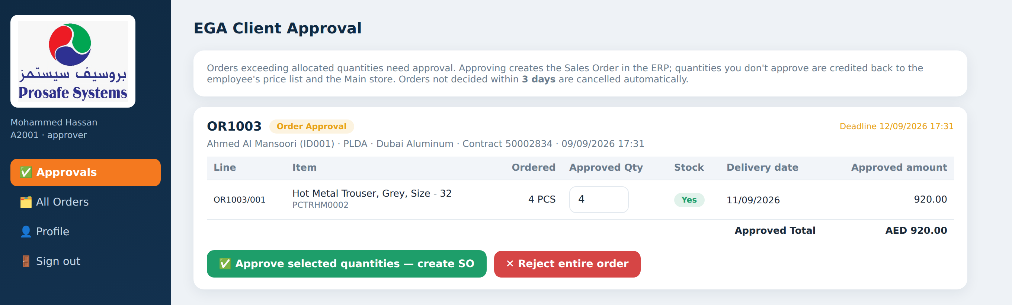
APPROVER MODULE
Approving line by line
Every line, every figure
Change the quantity
Reject with a reason
Ordered quantity, unit price, allocated and used balance are all on screen.
The approver types the quantity they will allow on each line.
A rejected order returns the allocation and the stock immediately.

Slide 23
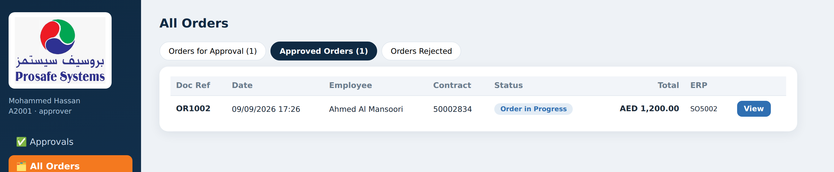
APPROVER MODULE
Three buckets, nothing else
Orders for Approval
Approved Orders
Orders Rejected
Waiting on EGA right now.
Everything EGA has released, whatever happened to it afterwards.
Turned down, with the reason recorded.
The approver's screen carries only the approval cycle — fulfilment and inventory belong to the Store Module.

Slide 24
05
Fulfilment
Delivery, acknowledgement, returns and invoicing

Slide 25
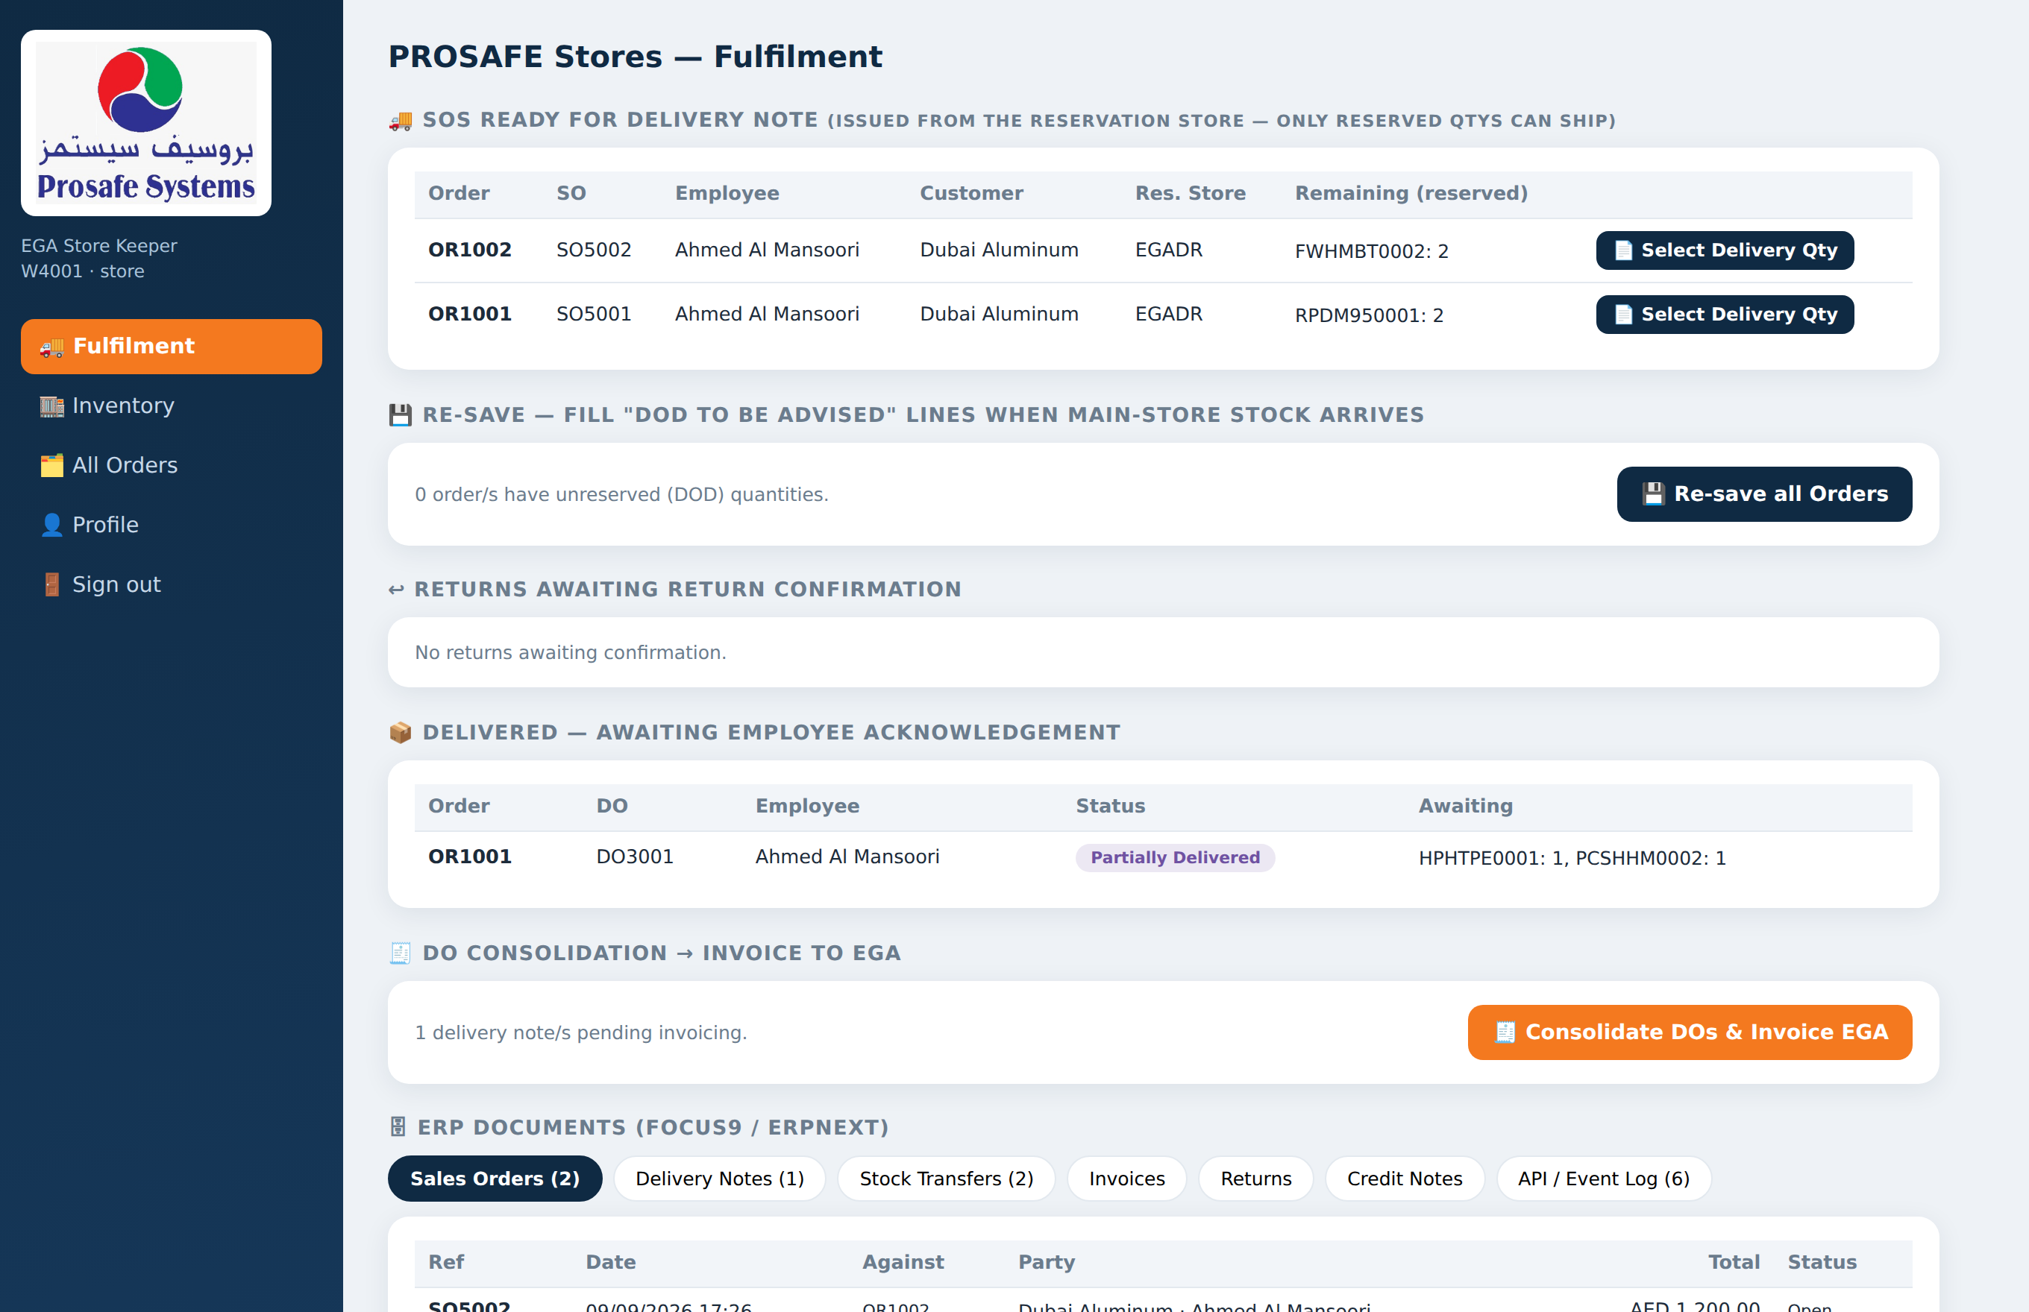
STORE MODULE
One screen for the whole store day
Ready for delivery note
Orders with stock reserved and waiting to ship.
Re-save
Fill the DOD lines the moment stock arrives.
Returns to confirm
Employee returns awaiting the store's check.
Awaiting acknowledgement
Delivered, not yet confirmed received.
Consolidate and invoice
Turn delivery notes into an invoice to EGA.
ERP documents
Every sales order, delivery note and voucher raised.

Slide 26
RE-SAVE
Turning “DOD to be advised” into a real date
When a delivery lands in the main store, the lines that had no date can be filled in — one order at a time, or every waiting order at once.
1
2
3
4
Stock arrives
→
Store re-saves
→
Stock is secured
→
Date is set
New quantities are received into the main store.
One order, or “Re-save all Orders” for every waiting order.
The quantity transfers to the reservation store against that order.
The line gets a real delivery date and the employee is notified.
Nobody has to remember which orders were short. The store sees the count of waiting orders and clears them in one action.

Slide 27
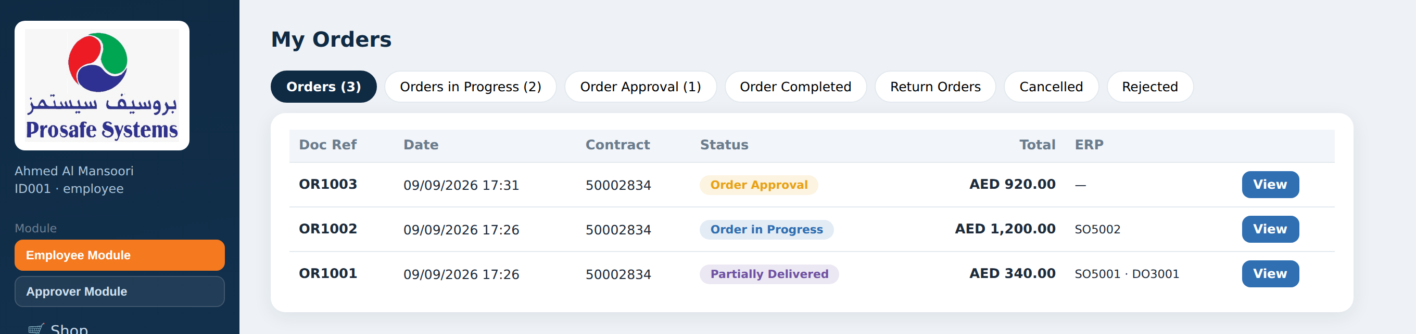
DELIVERY
Issued from the store, confirmed by the employee
1
2
3
Store issues the delivery note
Employee acknowledges receipt
The order updates itself
Only quantities actually reserved for that order can be shipped, and it is issued from the reservation store.
They confirm what arrived on their own screen — the old receipt-voucher step is gone.
Partially delivered, partially received or complete, with nothing keyed twice.

Slide 28
RETURNS
Three days, and the store has the last word
Employee raises the return
Within three days of acknowledging receipt, with a quantity and a reason for each line.
1
Store confirms it
The returned goods are checked before anything is credited.
2
Everything is credited
The allocation is credited back, the stock goes into the main store, and a credit note is raised.
3
Nothing is credited on the employee's word alone, and the credit note is raised automatically once the store confirms.

Slide 29
INVOICING
Delivery notes become one invoice to EGA
Delivery notes accumulate as orders are shipped.
The store consolidates the outstanding ones into a single invoice to EGA.
The invoice is raised in the ERP and shown in the document list.
Undelivered balances can be cancelled by the store, which credits the employee's allocation back.
Sales Orders
raised on placement or approval
Delivery Notes
issued from the reservation store
Stock Transfers
issue and receipt vouchers
Credit Notes
Every document the platform raises is mirrored into the ERP.
raised on confirmed returns
Invoices
consolidated to EGA

Slide 30
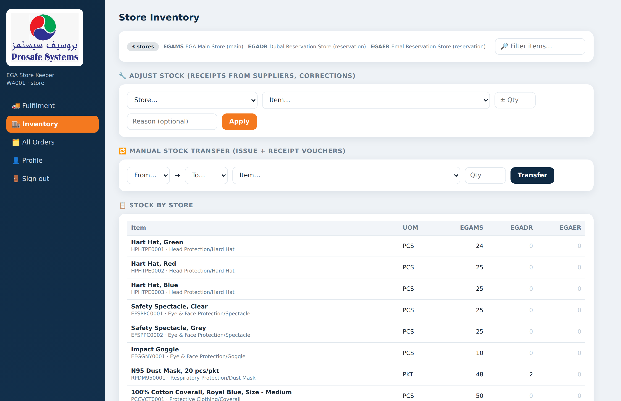
STORE MODULE
Stock, store by store
Quantities held in the main store and in each reservation store, item by item.
Manual adjustments for goods received or written off.
Transfers between stores on issue and receipt vouchers.
The same figures the employee sees as “stock” when shopping.
Reservation-store quantities are the goods already committed to orders.

Slide 31
ORDER LIFECYCLE
Eight states, visible to everyone
Order Approval
Order in Progress
Partially Delivered
DO Created — Receive
Waiting on EGA
Approved or within limits
Some lines shipped
Awaiting the employee
Partially Received
Order Complete
Cancelled
Rejected
Some lines acknowledged
Delivered and acknowledged
By employee, store or timeout
Turned down by EGA
The employee, the approver and the store all read the same state — nobody has to telephone to ask where an order is.

Slide 32
06
Control and data
What the administrator holds, and what is loaded today

Slide 33
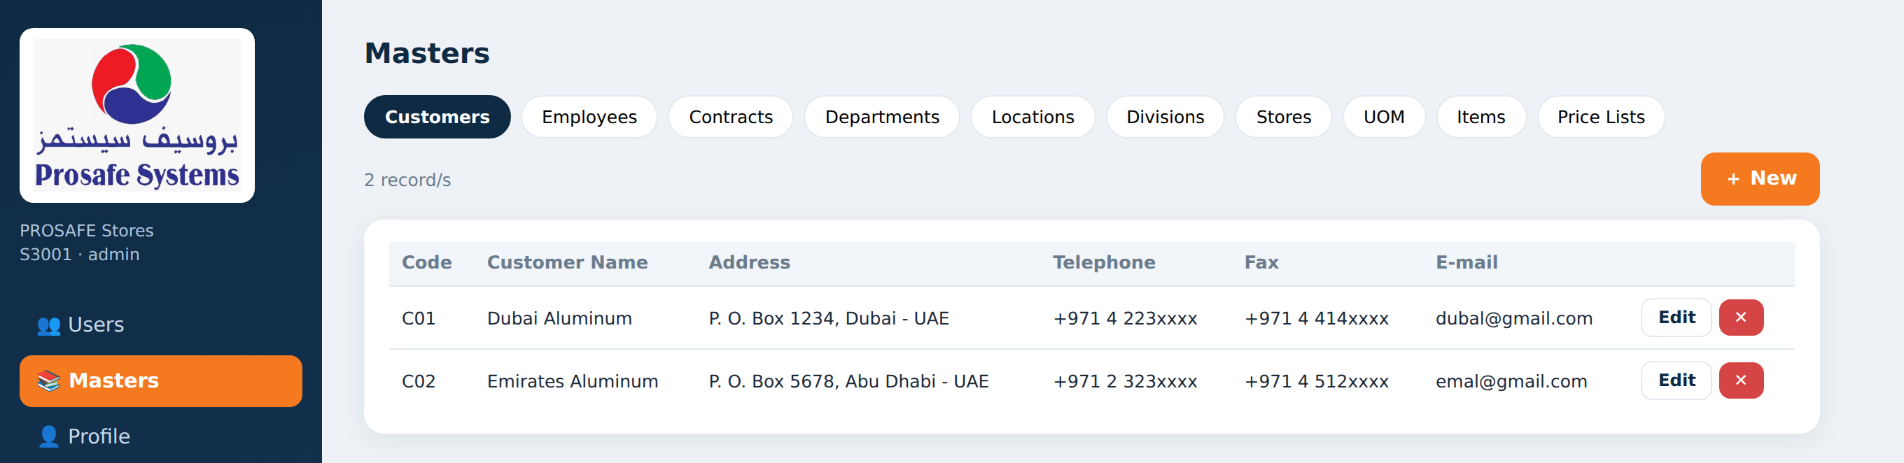
ADMIN MODULE
Ten master files, all editable
Customers
Employees
Contracts
Departments
Locations
EGA entities
who may register
reference and value
EGA structure
sites
Divisions
Stores
UOM
Items
Price Lists
store grouping
main and reservation
units of measure
the PPE catalogue
allocations and prices
Items carry their own group and category, so the shopping tabs follow the catalogue without a separate master to maintain.

Slide 34
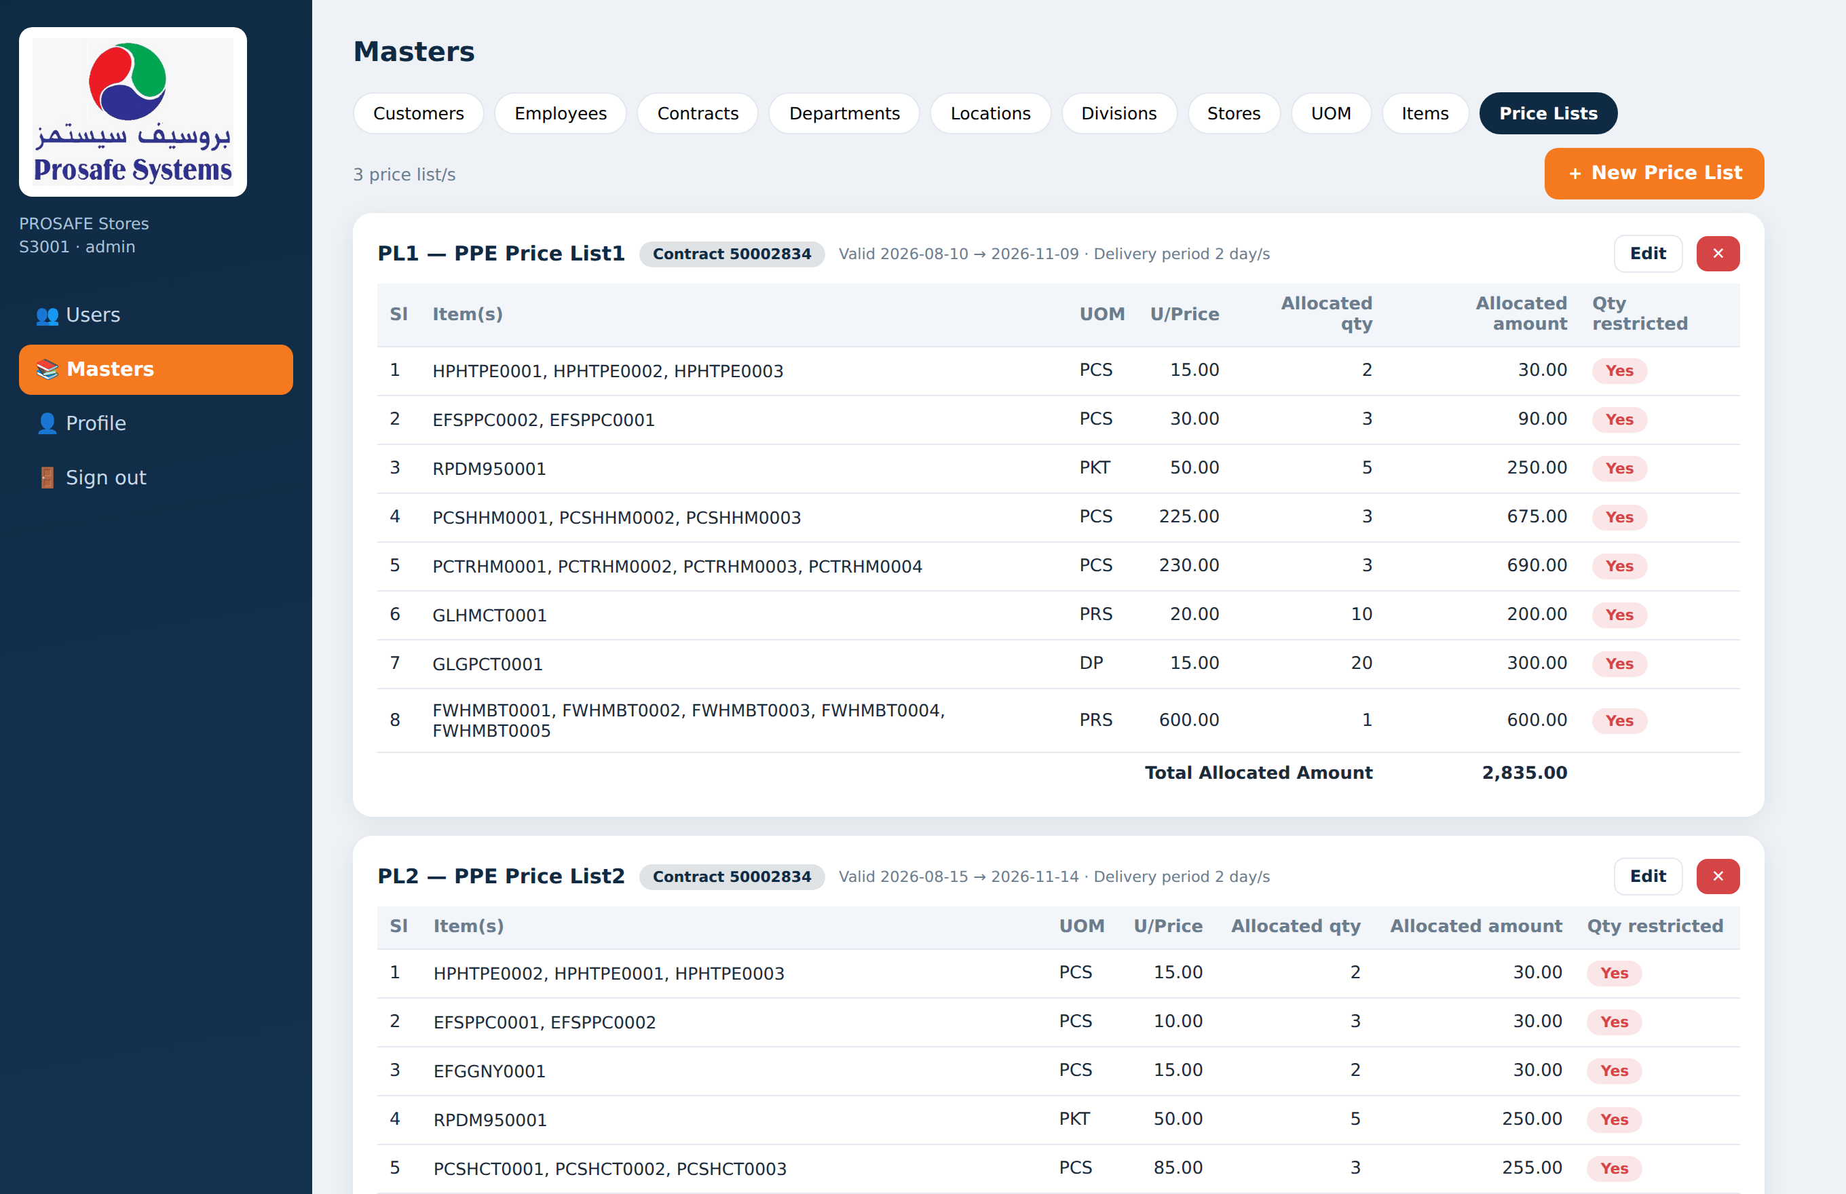
PRICE LISTS
Where the allocation is set
Each price list belongs to a contract and carries validity dates and a delivery period.
Every line sets the allocated quantity and the unit price for one item — with its size or colour variants.
A line can be marked restricted, so any quantity at all needs EGA approval.
An employee can be granted several price lists; each becomes its own shopping tab.
Changing an allocation here changes what every employee on that list may order.

Slide 35
LOADED TODAY
The live EGA data set
39
PPE items
Head, eye and face, respiratory, clothing, gloves and footwear — every one with a photograph
3
price lists
Across two contracts, each with its own validity dates and two-day delivery period
3
stores
One main store and two reservation stores, one per EGA entity
2
EGA entities
Dubai Aluminum and Emirates Aluminum, with six departments and six locations
Taken directly from the EGA Data List workbooks — master list, price lists and store inventory.

Slide 36
INTEGRATION
The ERP, notifications and the audit trail
Into the ERP
Nothing goes unnoticed
Sales orders, delivery notes, stock transfers, returns, credit notes and invoices are all posted to the ERP.
ERPNext is connected and working today; the Focus 9 connector is built and waiting on Focus Softnet's API.
If the ERP is unreachable the order still goes through — the call is retried and then flagged for re-sync, never silently lost.
Employees are notified when an order is approved, a delivery note is raised, a DOD line is filled or a cart expires.
Every order carries its own history — who did what, and when.
The store can read the full event log, including any ERP call that needs attention.
Employees can delete their own account and data at any time.

Slide 37
STATUS
Where it stands, and what comes next
Live today
Next
Website deployed and in use
Database loaded with the EGA data
All four modules complete
ERPNext integration working
Publish the Android app to Google Play
Connect Focus 9 when its API is released
Push notifications to the phone
Pilot with a first EGA department
What changes for EGA
Every employee knows their entitlement and their balance without asking. Every order carries a delivery date the store can actually meet. Every approval, delivery, return and invoice is recorded once, in one place, and posted to the ERP — with no paper in between.

Slide 38
Thank you
PROSAFE × EGA — PPE Ordering Platform
Questions and a live walkthrough on request.

