Slide 1
Security Challenges in IoT
30 January 2021

Slide 2
Outline Introduction
Technologies used in IoT
RFID Technolog
EPC Technology
Security Challenges in IoT
Solutions
Cryptographic Algorithms
Conclusion
References

Slide 3
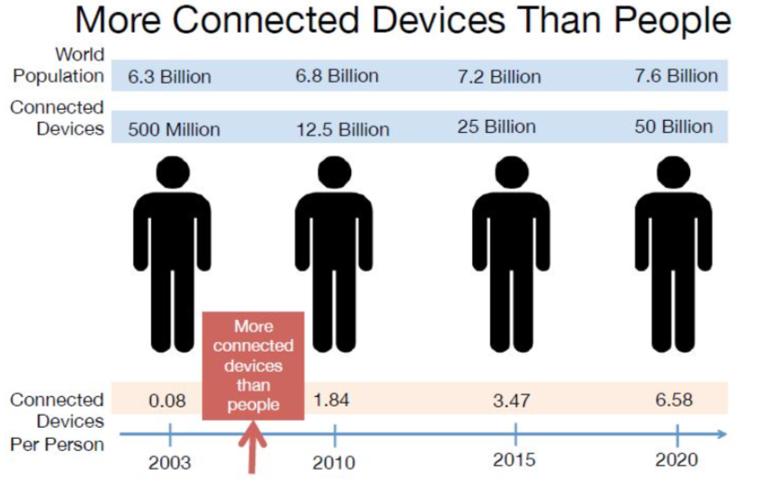
Introduction
Definition
Intelligent interactivity between human and things to exchange information and knowledge for new value creation

Slide 4

Introduction (Cont’d)
􏰀 Smart systems and Internet of Things are driven by a combination of

Slide 5
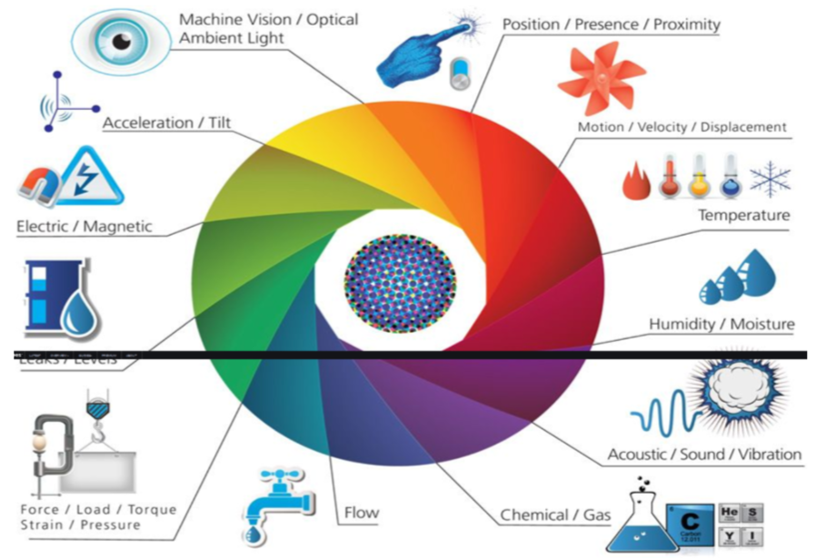
Introduction (Cont’d)
Sensors and Actuators

Slide 6
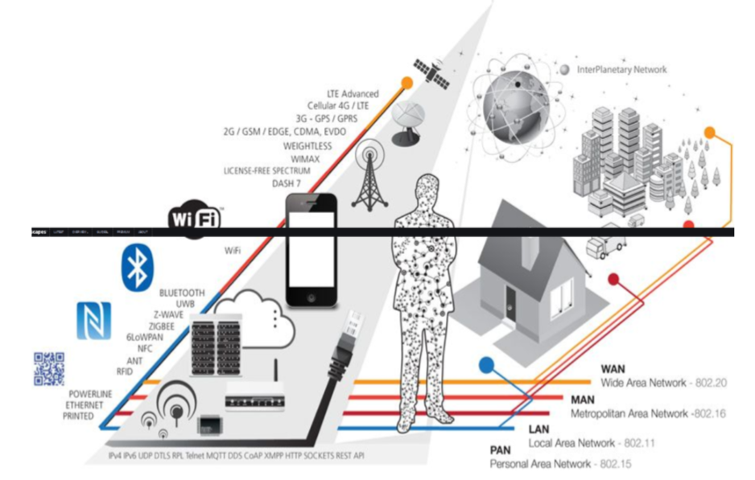
Introduction (Cont’d)
Connectivity

Slide 7
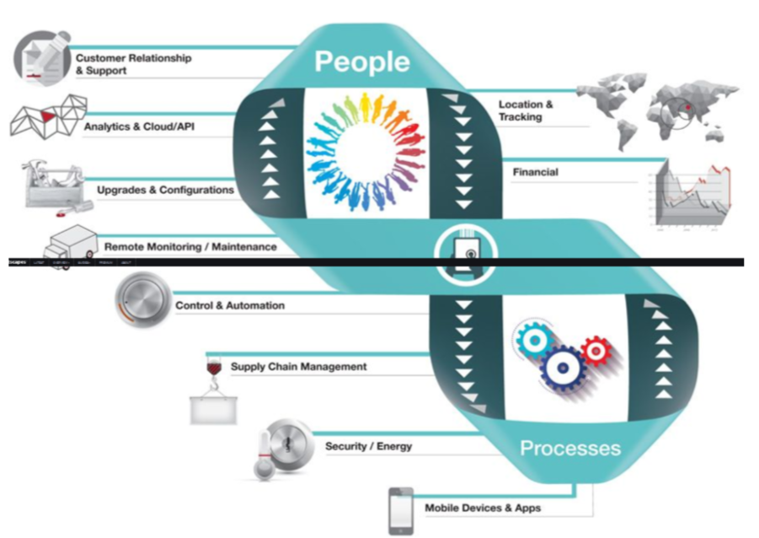
Introduction (Cont’d)
People and Processes

Slide 8
Introduction (Cont’d) Applications
Smart Home
Wearable’s
Connected Cars
Industrial Internet
Smart Cities
IoT in agriculture
Smart Retail
Energy Engagement
IOT in Healthcare
IoT in Poultry and Farming

Slide 9
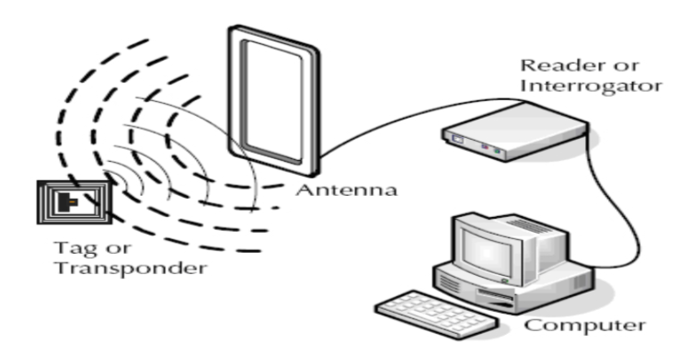
Technologies used in IoT RFID Technology
Radio Frequency Identification Technology
Use of radio waves to read and capture information stored on a tag attached to an object

Slide 10
Technologies used in IoT (Cont’d) Classifications for RFID tags
Class 0/class 1
basic radio frequency (RF) passive capability
tags are factory programmed
Class 2
Additional functionality - encryption and read-write RF Memory
tags are user-programmable
Class 3
Batteries are found on board that will power logic in the computer circuit
longer range and broadband communications

Slide 11
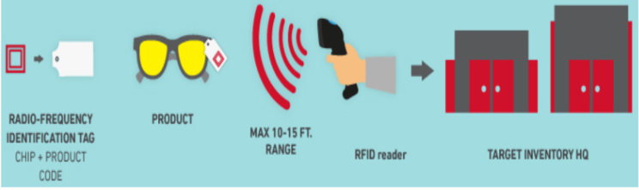
Technologies used in IoT (Cont’d) Classifications for RFID tags(Cont’d)
Class 4
Active tags
Peer-to-peer communications and additional sensing
Class 5
contain enough power to activate other tags
classified as a reader

Slide 12
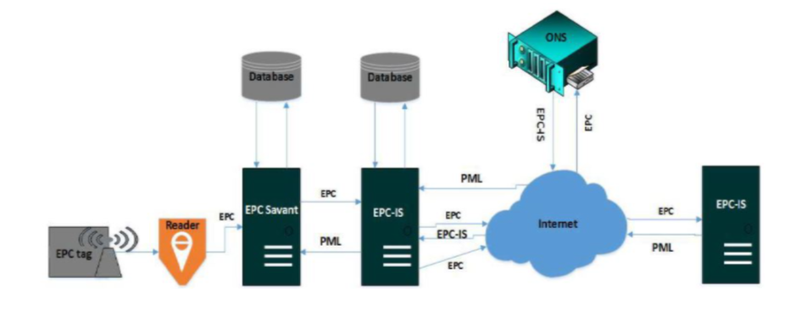
Technologies used in IoT (Cont’d) EPC Technology
Electronics Product Code Technology
A universal identifier that provides a unique identity for every physical object anywhere in the world, for all time

Slide 13
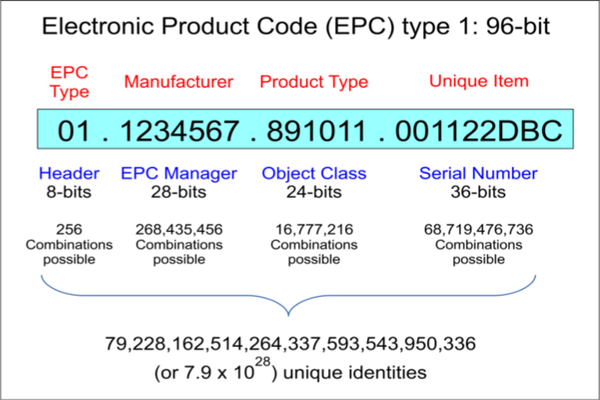
Technologies used in IoT (Cont’d)
Electronics Product Code - 96 bits which is divided into four categories

Slide 14
Security Challenges in IoT Key challenge areas are
Access control
Confidentiality
Integrity
Availability
Privacy
Standardization
Data deluge

Slide 15
Solutions
Solutions
IoT devices are huge in number and it quite difficult to update these
devices one by one
High security codes
Data loss can happen if the attacker cracks the code
Devices must be connected to a central power station
But if central power station reaches its empty level

Slide 16
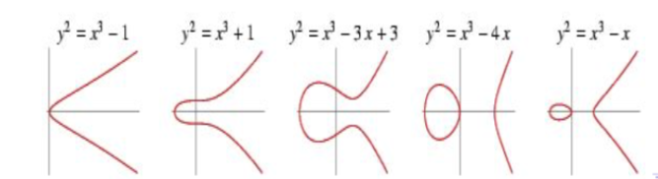
Solutions(Cont’d) Cryptographic Algorithms
ECC - Elliptic Curve Cryptography
public-key Cryptography
supports authenticated key exchange protocols
smaller keys, cipher text and signature
very fast key generation
fast encryption and decryption
uses less memory and CPU cycles
An elliptic curve is a plane curve defined by an equation of the form
y2 = x3 + ax + b

Slide 17
Solutions(Cont’d) Cryptographic Algorithms
HMAC - Hash Based Message Authentication Code
hash function and a secret key
verify both the data integrity and the authentication of a
message
strength depends upon the cryptographic strength of the
underlying hash function, the size of its hash output, and on
the size and quality of the key.
less affected by collisions
HMAC(K,m)=H((K′ ⊕opad)||H(K′ ⊕ipad)||m)

Slide 18
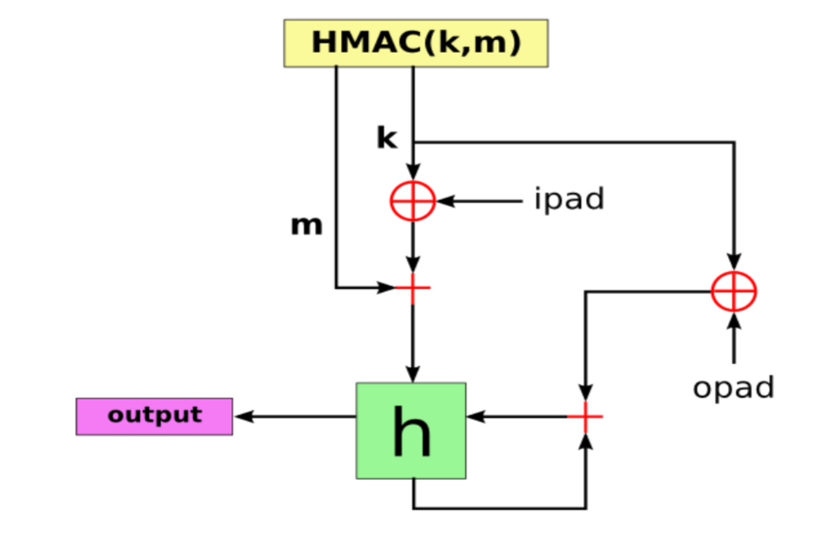
Solutions(Cont’d) Cryptographic Algorithms

Slide 19
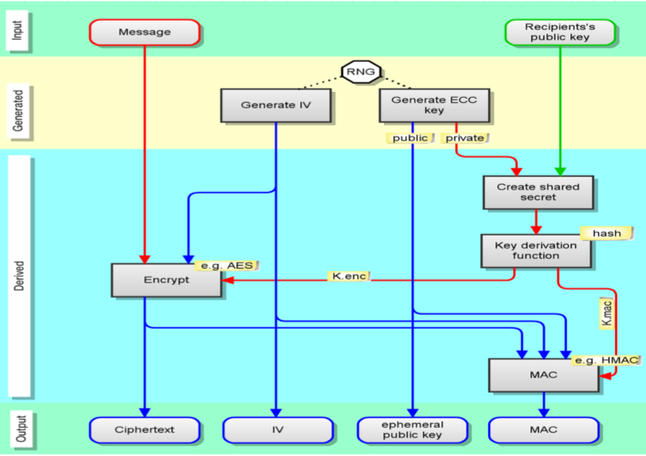
Solutions(Cont’d) Cryptographic Algorithms

Slide 20
Conclusion
Billions of devices are connected to the Internet
Companies behind these devices are not designing them with
security in mind
Leaving IoT devices unsecured, is like leaving the back door to your house unlocked
Various solutions to security challenges were discussed
Cryptographic encryption techniques like ECC and HMAC can be used to provide better protection

Slide 21
References
Aditya Parashar, Sachin Rishishwar Security Challenges In IoT 3rd International Conference on Advances in Electrical, Electronics, Information, Communication and Bio-Informatics (AEEICB17)
Ankush B. Pawar, Dr.Shashikant Ghumbre A survey on IoT applications, security challenges, and counter measures 2016 International Conference on Computing, Analytics and Security Trends (CAST)
3. Mohsen Hallaj Asghar RFID and EPC as key technology on Internet of Things (IoT) IJCST Vol. 6, Issue 1, Jan - March 2015
4. Xiaolin Jia, Quanyuan Feng, Taihua Fan, Quanshui Lei1 RFID Technology and Its Applications in Internet of Things (IOT) 978-1-4577-1415-3/12/2012 IEEE

Slide 22


