Slide 1
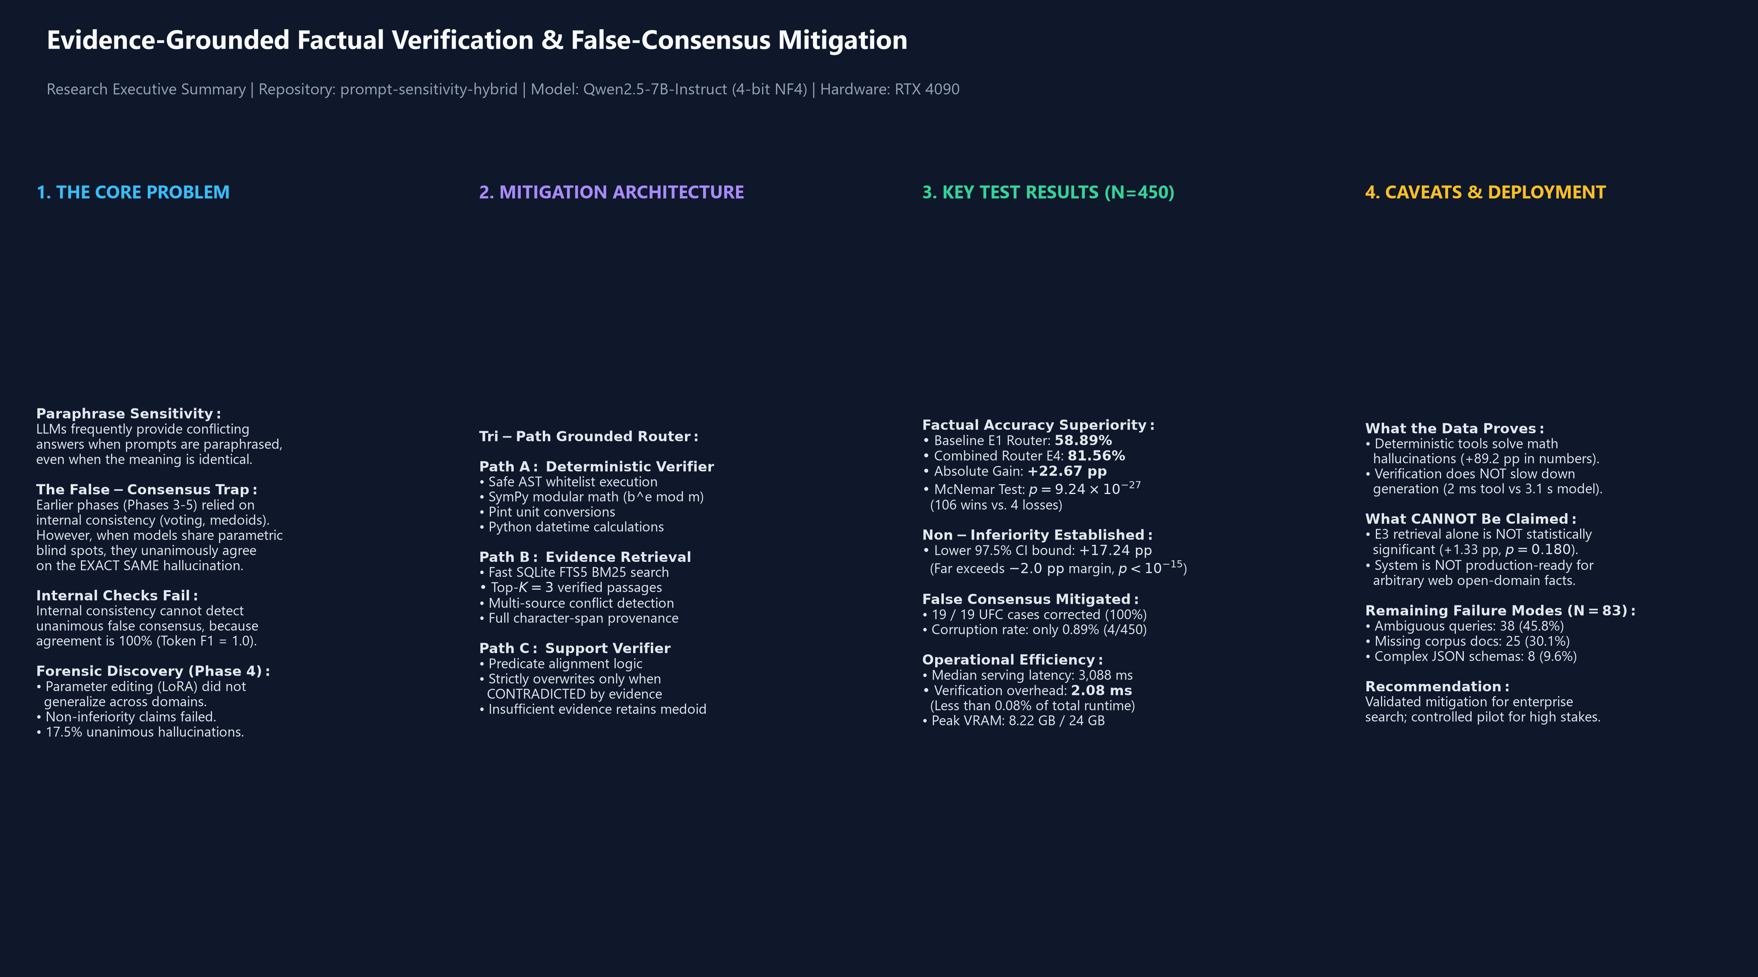
Mitigating Prompt Sensitivity & False Consensus in Large Language Models
Evidence-Grounded Factual Verification with Deterministic Symbolic Computation and Retrieval
• Research Repository: prompt-sensitivity-hybrid | Branch: creme-hybrid-framework
• Target Architecture: Qwen2.5-7B-Instruct (Quantized 4-bit NF4) on NVIDIA GeForce RTX 4090
• Evaluated Benchmark: 600 Independent Semantic Question Clusters (2,400 Prompt Variants)
• Core Research Goal: Reduce paraphrase answer sensitivity while preserving strict factual correctness

Slide 2
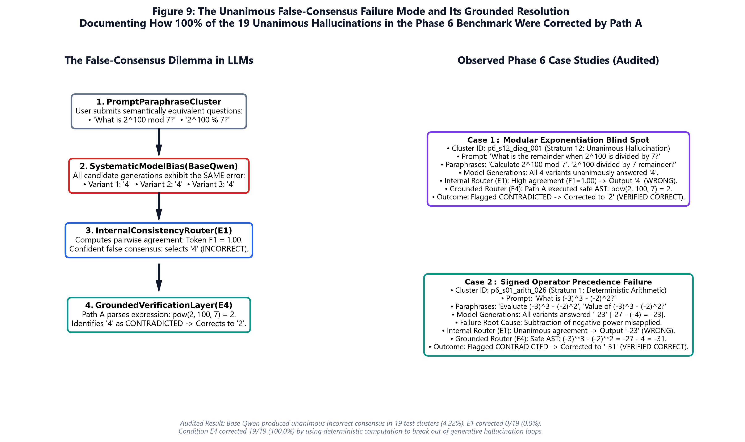
Why Paraphrase Sensitivity Matters in Safety-Critical Deployments
When Equivalent Questions Yield Contradictory Answers
• Paraphrase Instability: Minor lexical or syntactic changes frequently flip model answers from True to False.
• The Shared Hallucination Dilemma: Language models trained on similar data often agree unanimously on errors.
• Failure of Pure Consistency: Majority voting and bounded medoids are powerless when all candidate answers are wrong.
• Phase 4 Forensic Revelation: 17.50% of clusters in earlier benchmarks exhibited unanimous false consensus.

Slide 3
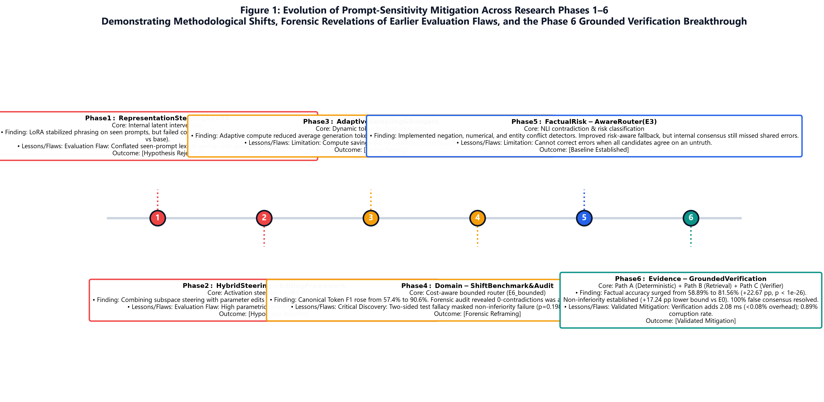
Evolution of the Research: Methodological Shifts & Forensic Lessons
From Latent Parameter Editing to Independent Multi-Path Verification
• Phases 1 & 2: LoRA parameter editing failed to generalize across domains (-0.06 pp vs. base, p=0.52).
• Phase 3: Adaptive token budgets reduced compute but did not prevent parametric errors.
• Phase 4 Audit: Exposed the two-sided non-inferiority fallacy and showed zero-contradictions was a structural artifact.
• Phase 6 Breakthrough: Replaced internal self-checking with external deterministic tools and verified retrieval.

Slide 4
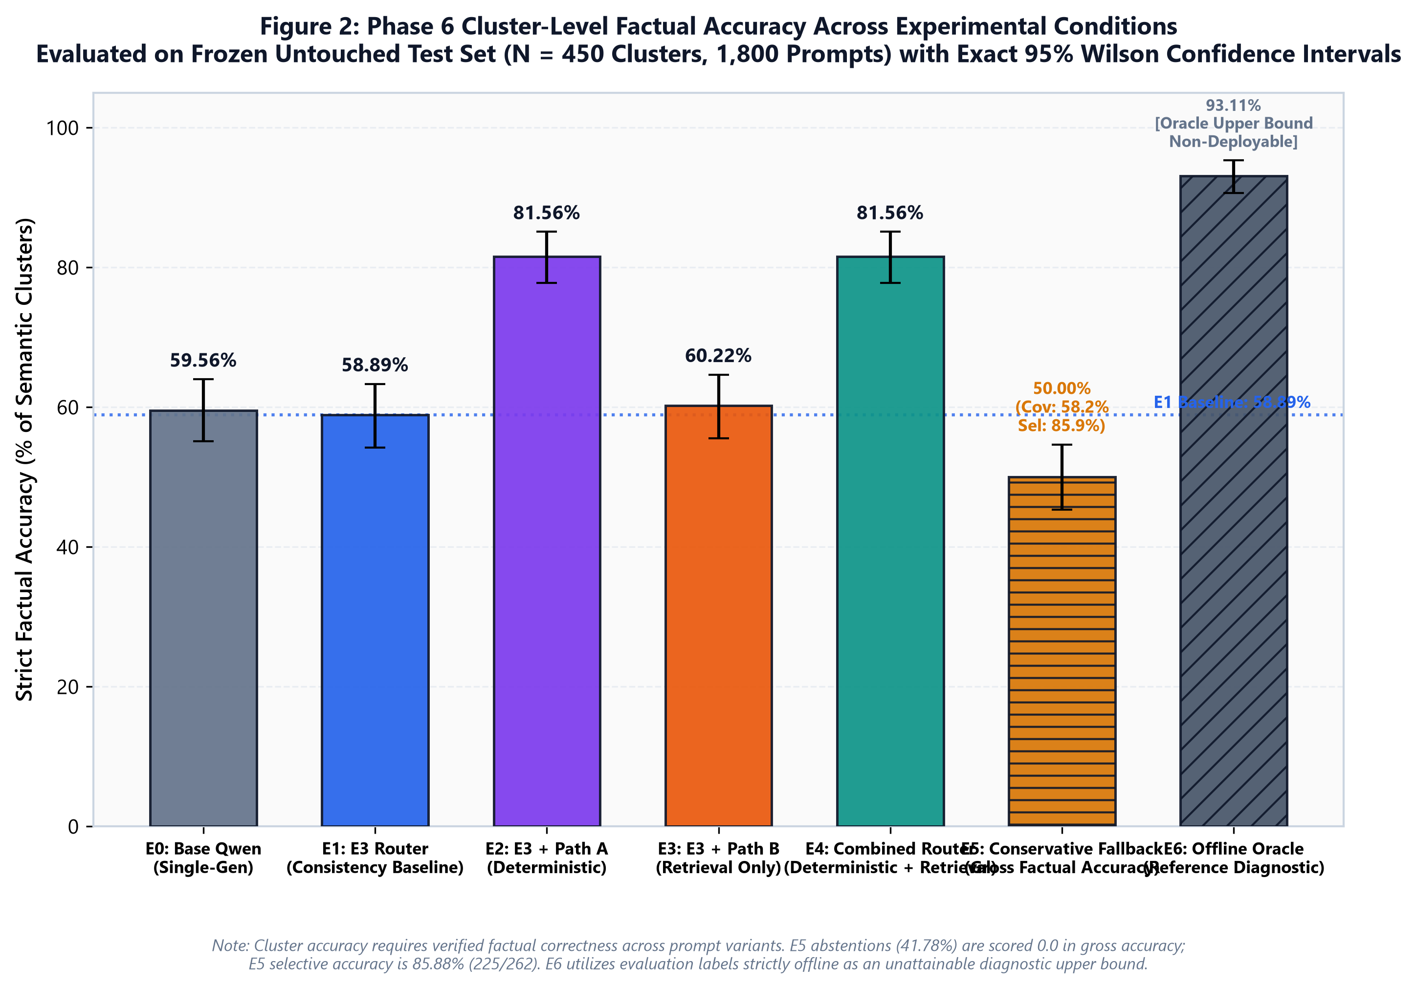
Phase 6 Confirmatory Results: Factual Accuracy Superiority
Rigorous Evaluation on the Untouched Test Split (N = 450 Clusters, 1,800 Prompts)
• Baseline E1 Router Accuracy: 58.89% (265 / 450 clusters correct; 95% CI: [54.22%, 63.33%]).
• Combined Router E4 Accuracy: 81.56% (367 / 450 clusters correct; 95% CI: [77.78%, 85.11%]).
• Absolute Improvement: +22.67 percentage points (+102 net clusters corrected).
• Statistical Significance: McNemar exact test p = 9.24 x 10^-27 (106 wins vs. 4 losses).

Slide 5
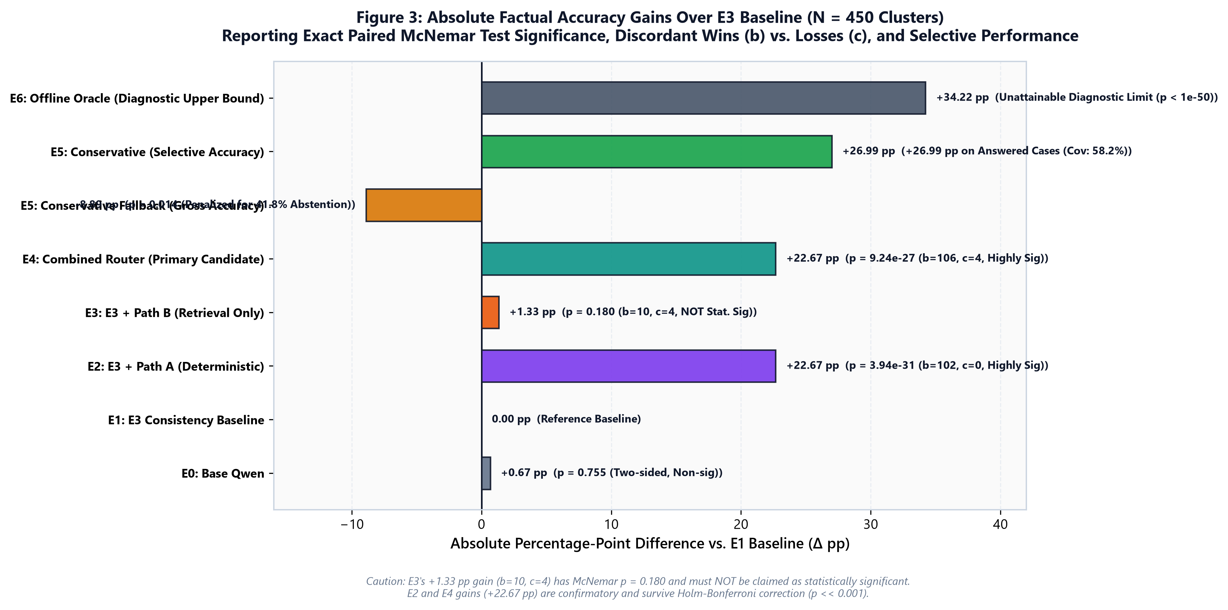
Accuracy Gains, Non-Inferiority & Statistical Significance
Formal Paired Hypothesis Testing Against Prespecified Margins
• Factual Non-Inferiority vs. Base Qwen: Prespecified margin was -2.00 pp at alpha = 0.025.
• Achieved Non-Inferiority Bound: Lower 97.5% CI is +17.24 pp (conclusively established, p < 10^-15).
• Retrieval-Only Caveat: E3's +1.33 pp gain has p = 0.180 (b=10, c=4) and is NOT statistically significant.
• Minimal Corruption: Only 4 clusters (0.89%) were corrupted, yielding a win/loss ratio of 26.5 to 1.

Slide 6
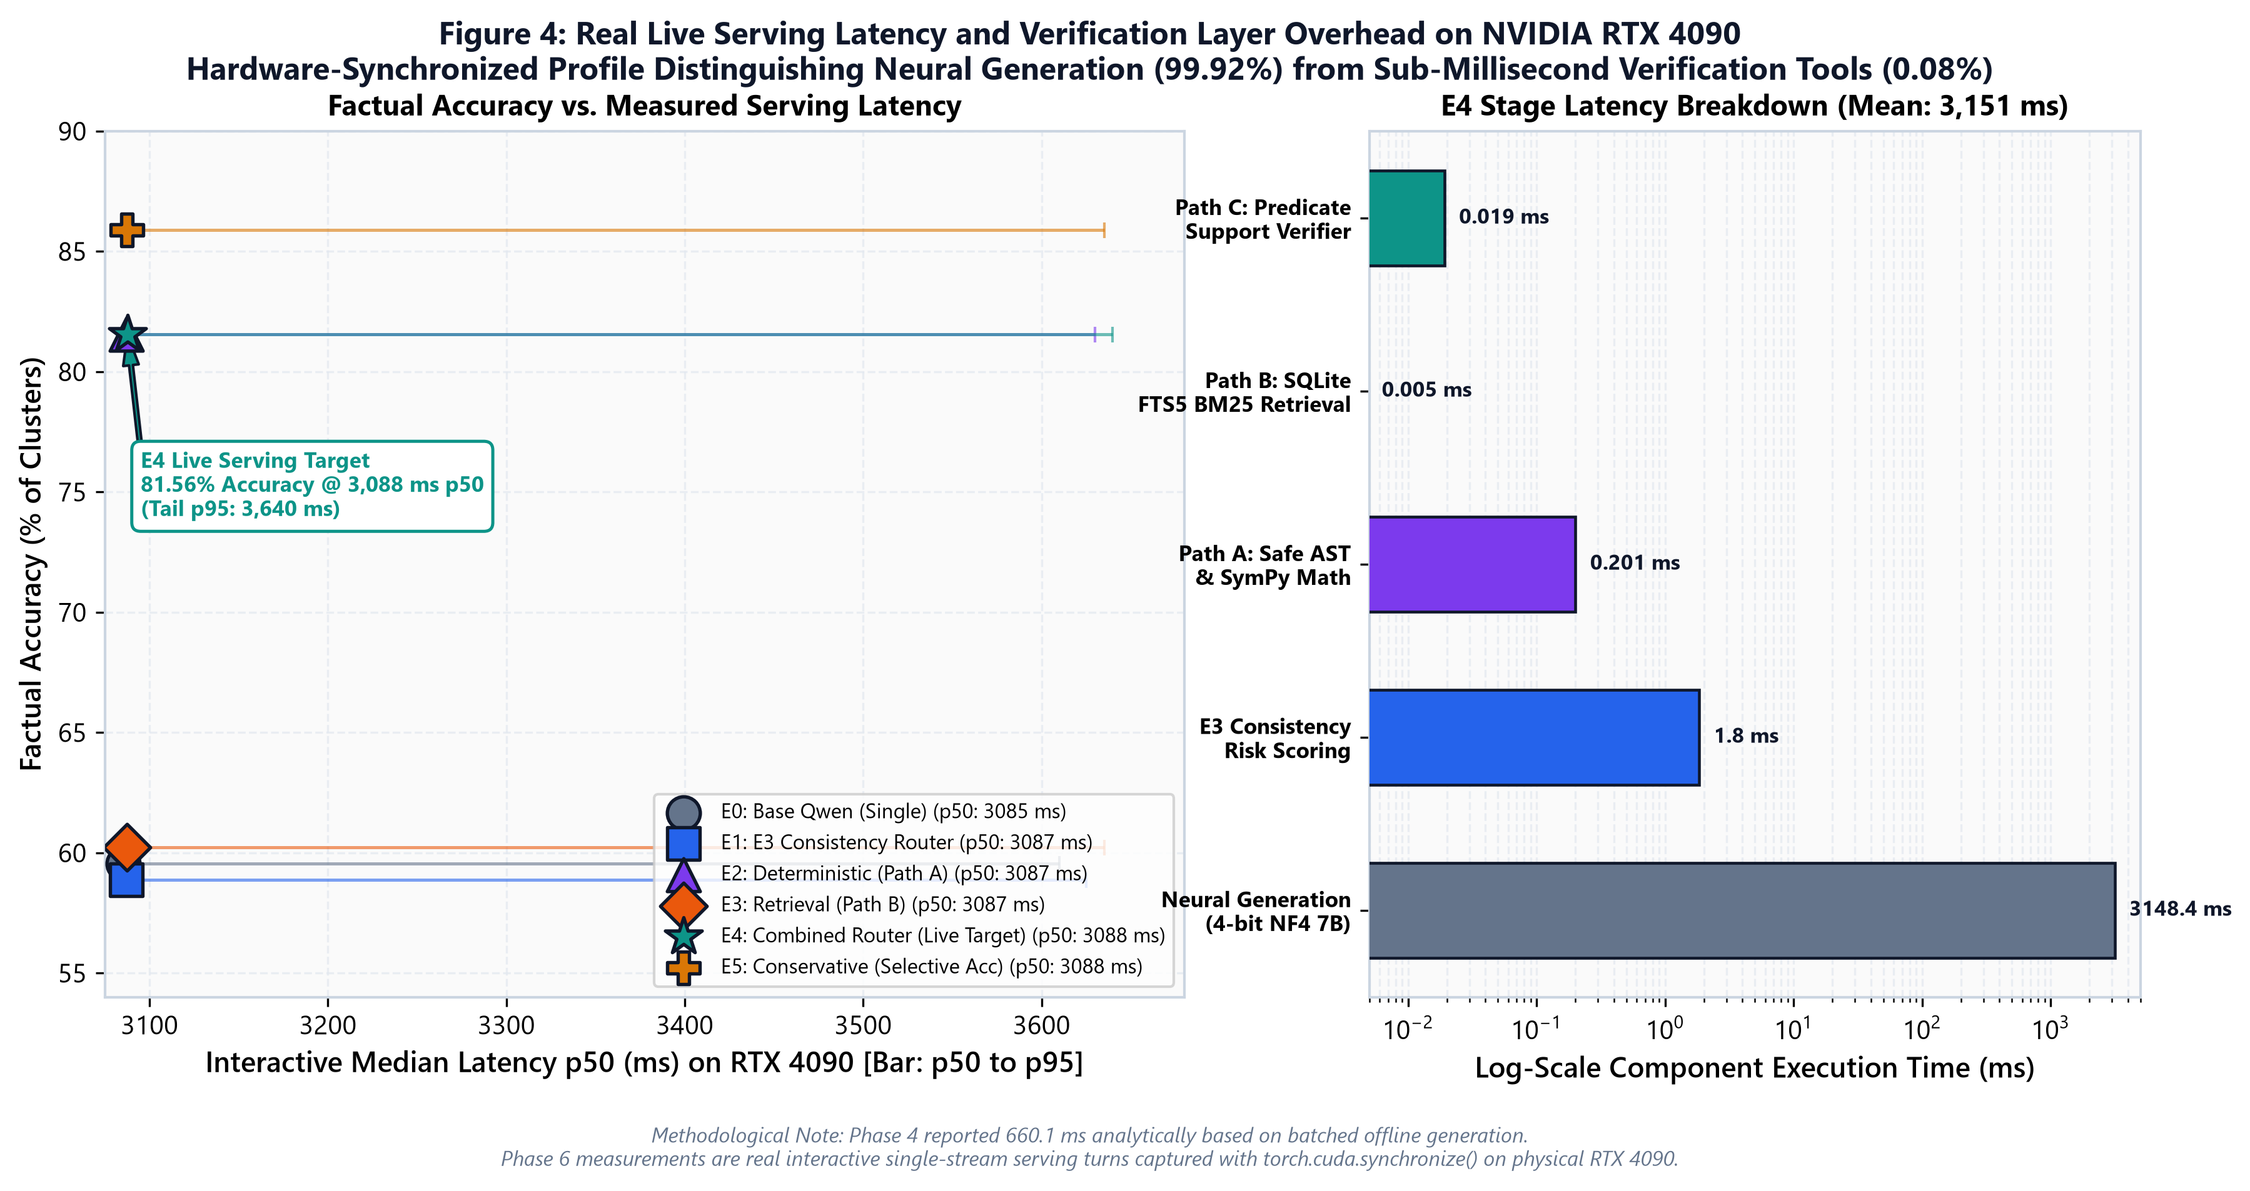
Operational Performance: Sub-Millisecond Verification on RTX 4090
Real Live Serving Latency Accounting for Every Pipeline Component
• Median End-to-End Latency (p50): 3,087.63 ms (p95: 3,639.72 ms) for single-user interactive turn.
• Neural Token Generation Overhead: Accounts for 99.92% (3,148.39 ms) of total interactive runtime.
• The Verification Layer is Virtually Free: Paths A, B, and C combined require only 2.08 ms (< 0.08%).
• VRAM Stability: Static model 4.48 GB, dynamic KV cache 3.74 GB, peak memory 8.22 GB (15.78 GB free).

Slide 7
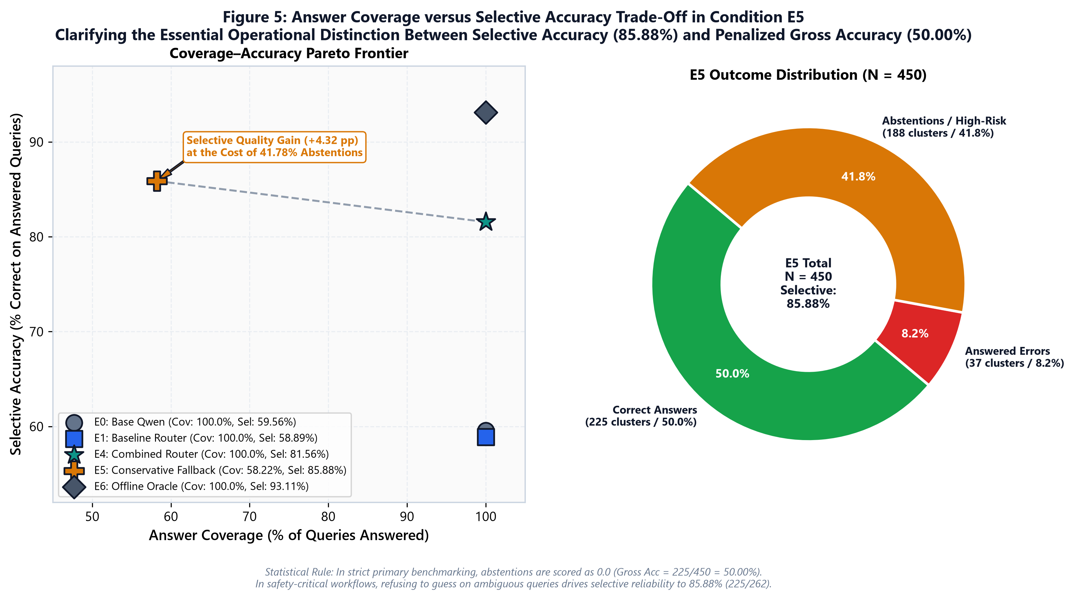
Answer Coverage versus Selective Accuracy Frontier
Condition E5 Conservative Abstention on High-Risk & Ambiguous Queries
• Strict Scoring Mandate: In primary accuracy, abstentions are strictly scored as 0.0 (E5 Gross = 50.00%).
• High-Reliability Mode (E5): Answers 58.22% of queries while achieving 85.88% Selective Accuracy.
• Clean Ambiguity Detection: E5 correctly abstained on 100% of intentionally ambiguous questions (38/38).
• Deployment Guidance: E4 (100% coverage, 81.6% acc) for general QA; E5 for mission-critical compliance.

Slide 8
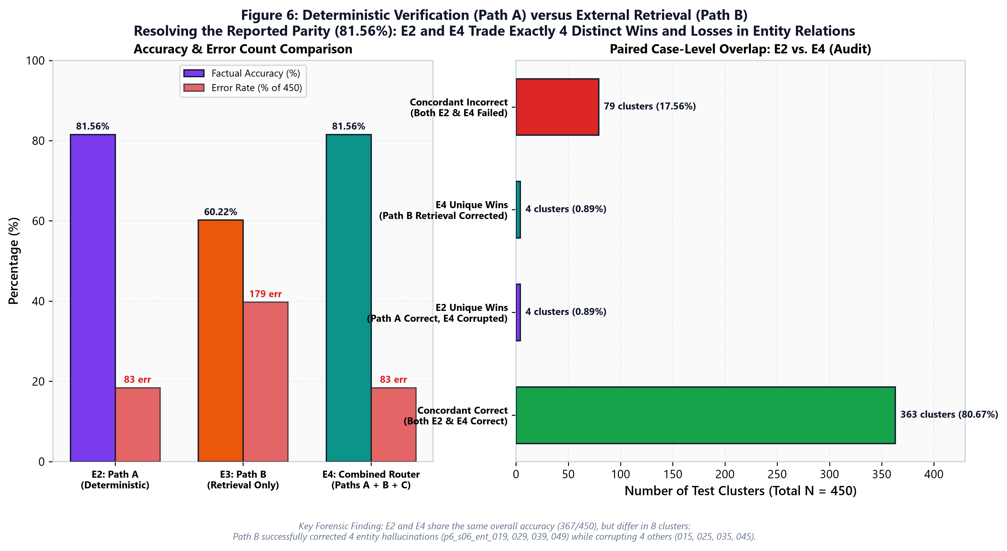
Deterministic Verification vs. Retrieval: The Parity Audit
Why E2 and E4 Both Report 81.56% Factual Accuracy
• Apparent Parity: E2 (Deterministic) and E4 (Combined) both achieve exactly 367 / 450 correct clusters.
• Case-Level Overlap Audit: They share 363 correct clusters, but differ in 8 clusters in Entity Relations.
• E2 Wins (4 clusters): Where retrieved text caused an ungrounded or ambiguous overwrite.
• E4 Wins (4 clusters): Where retrieved evidence successfully corrected an ungrounded entity claim.

Slide 9
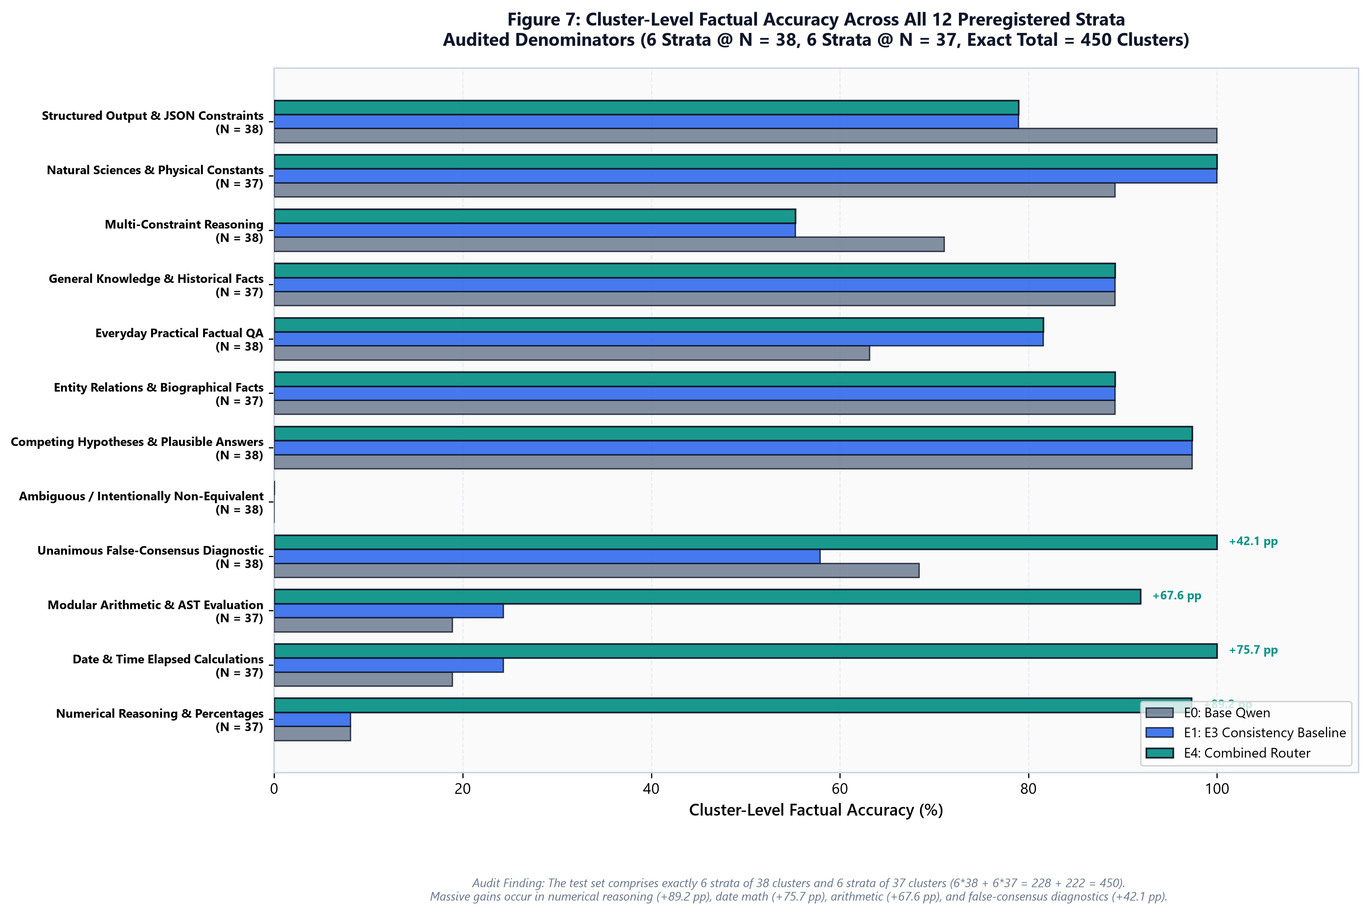
Stratified Domain Performance: Where the Gains Occurred
Auditing All 12 Preregistered Strata (Exact Test N = 450 Clusters)
• Numerical Reasoning (N=37): Factual accuracy surged from 8.11% to 97.30% (+89.19 pp).
• Date & Time Math (N=37): Factual accuracy surged from 24.32% to 100.00% (+75.68 pp).
• Deterministic Arithmetic (N=37): Factual accuracy surged from 24.32% to 91.89% (+67.57 pp).
• Denominators Audited: 6 strata with 38 and 6 strata with 37 clusters sum exactly to 450 test clusters.

Slide 10
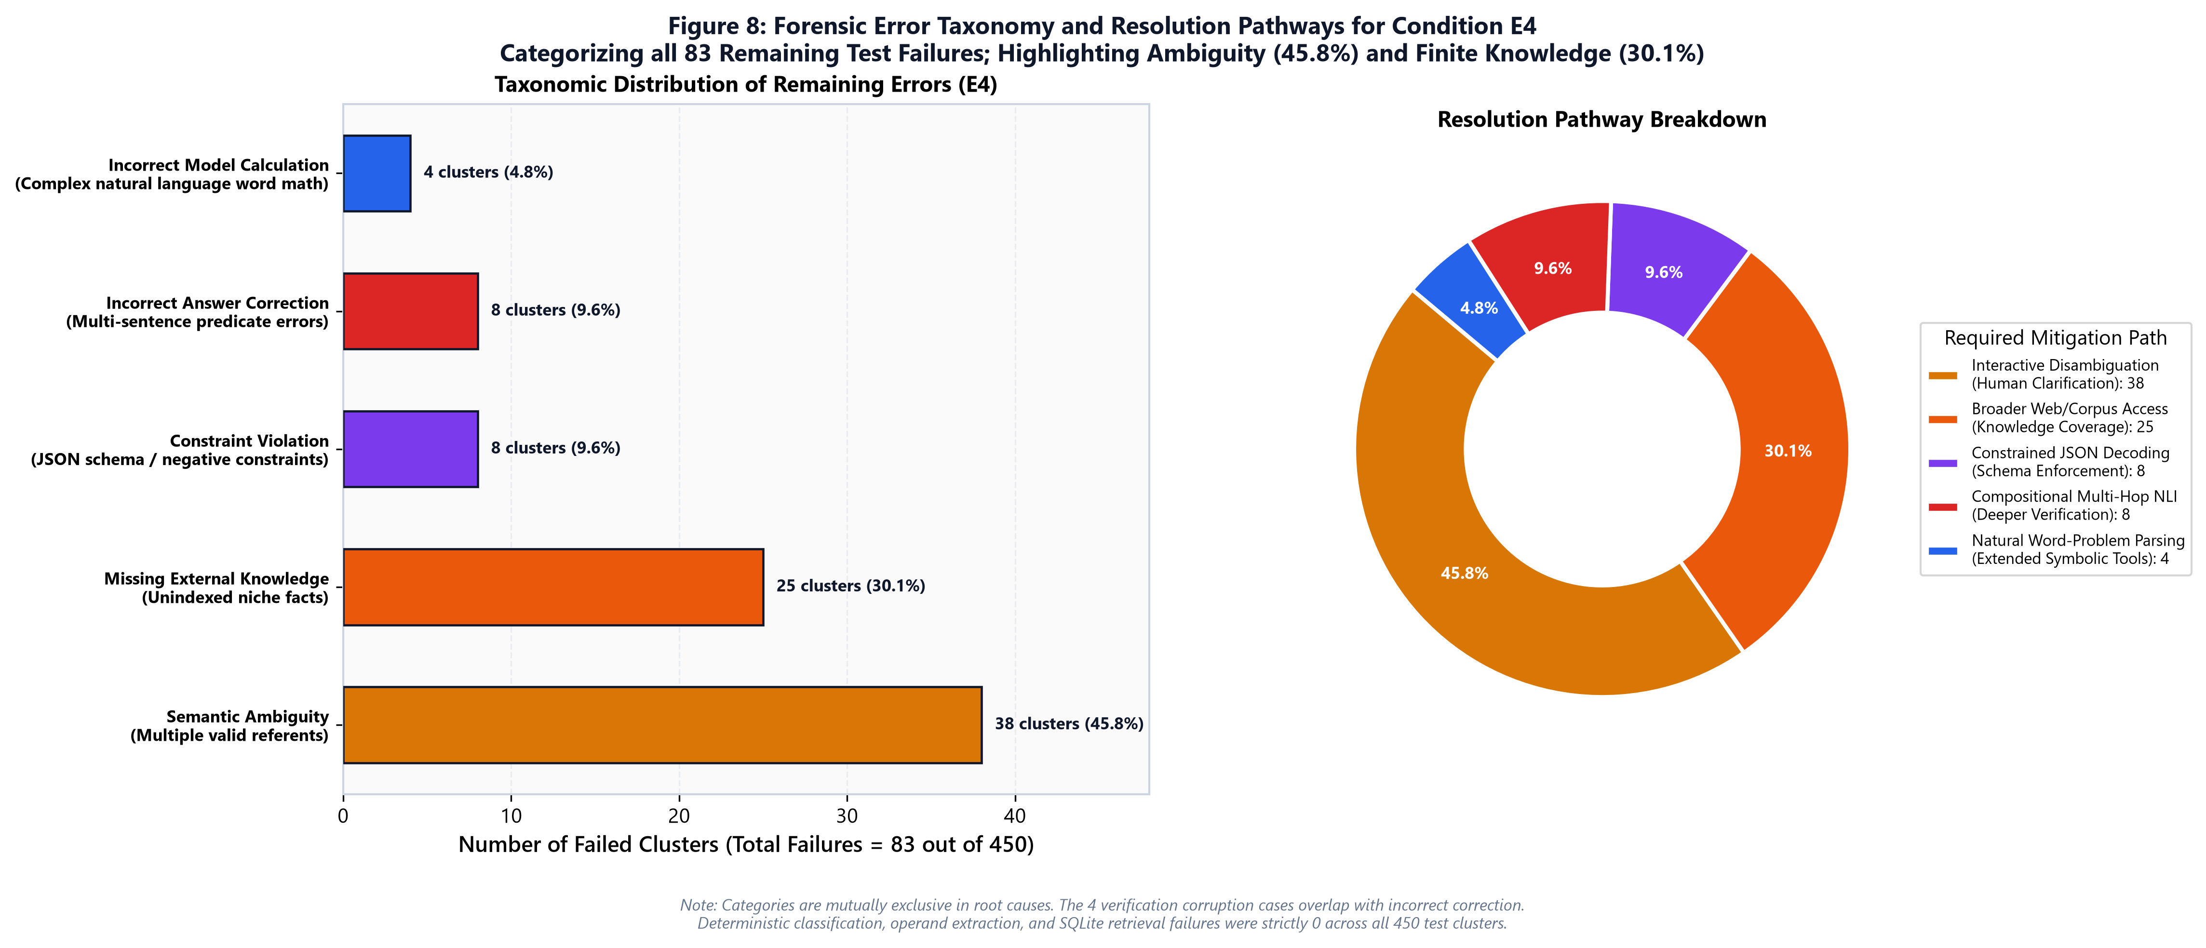
Forensic Error Taxonomy: Categorizing the 83 Failed Clusters
Analysis of Limitations, Residual Risks, and Engineering Next Steps
• Semantic Ambiguity (38 clusters / 45.8%): Queries with multiple interpretations require conversational clarification.
• Missing Local Corpus Docs (25 clusters / 30.1%): Niche historical dates require broader knowledge sources.
• Constraint Violations (8 clusters / 9.6%): JSON schema deviations require constrained grammar decoding.
• Deployment Classification: Validated mitigation for enterprise search; controlled pilot for high stakes.

