Slide 1
01 / PROBLEM
The problem is fragmented telemetry
Every device speaks a different dialect
RAW EVENT
Teams need one evidence-preserving path into analytics, SIEM and investigation.
→
Formats
Syslog · JSON · XML · CSV · CEF · LEEF
NORMALIZED
EVENT
Sources
Firewall · router · IDS · perimeter logs
Evidence has to survive the journey.
Risks
Parser drift · lost context · weak provenance
LOGFLUX · SIH PS 26156
Notes:
The SIH problem asks for a universal preprocessing layer across heterogeneous perimeter sources.

Slide 2
02 / ARCHITECTURE
LOGFLUX turns a message into a verifiable event
01
02
03
04
COLLECT
→
PRESERVE
→
NORMALIZE
→
OPERATE
TCP · UDP · TLS
HTTP · file
Raw bytes
SHA-256 · receipt
LOGFLUX schema
OCSF-inspired
Graph · cases
ECS · JSONL
Unknown or drifted events enter a review queue. A signed parser can then replay retained events as a new revision.
SQLite dashboard · broker / columnar lab remains a separate experiment
LOGFLUX · SIH PS 26156
Notes:
This is the shipped processing path. The receiver commits raw bytes before normalization.

Slide 3
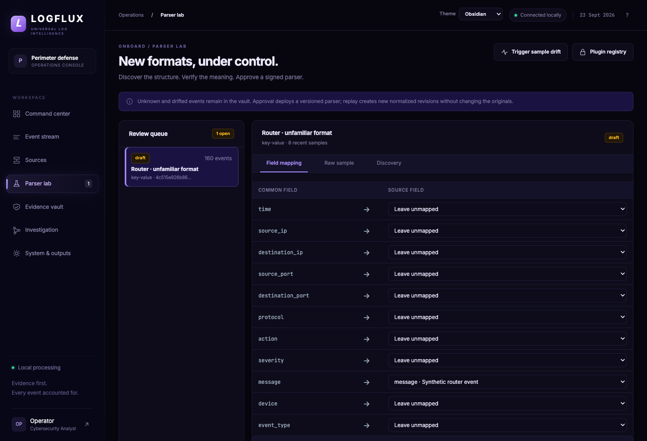
03 / LIVE WORKFLOW
The demo is a real control loop
A
Capture
Real TCP / UDP / TLS listeners
B
Review
Optional Qwen3 + semantic assertions
C
Approve
Ed25519 signed versioned plugin
D
Replay
New revision, original bytes unchanged
LOGFLUX · SIH PS 26156
Notes:
The screenshots are from the running local application. Synthetic traffic is labeled; the same UI accepts real device transports.

Slide 4
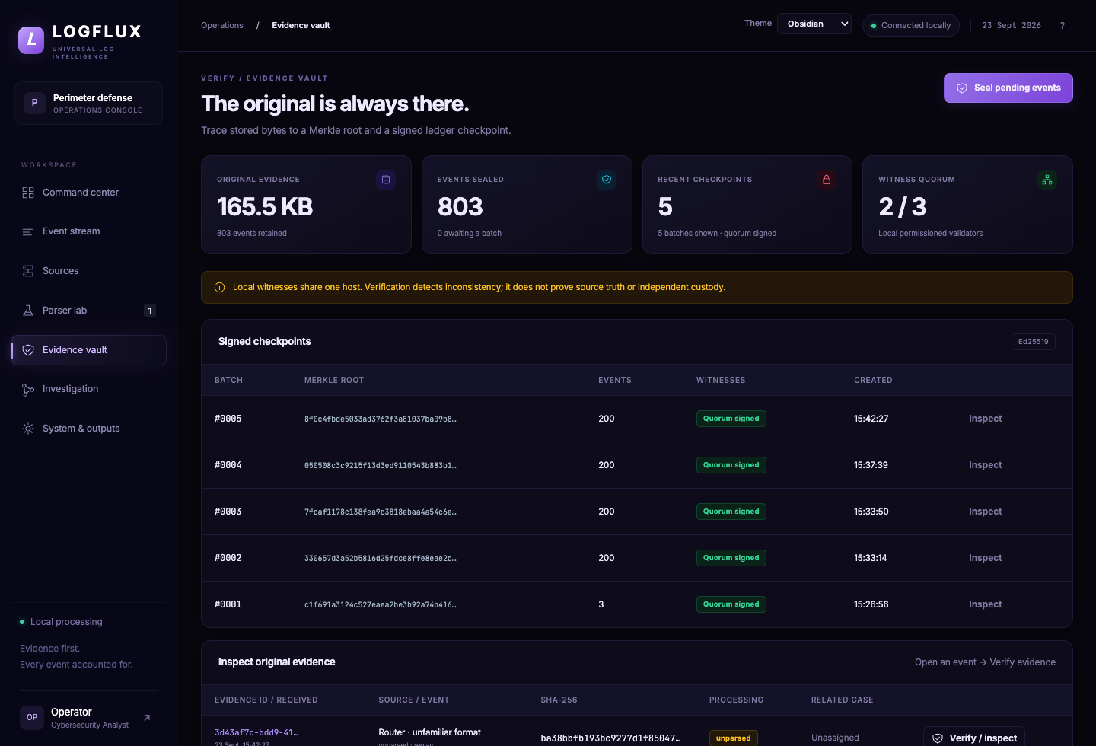
04 / EVIDENCE
Evidence verification is visible to the operator
VERIFIED
Raw bytes
Manifest
Merkle proof
Ledger quorum
2-of-3 signatures
Network services tested
Independent custody pending
LOGFLUX · SIH PS 26156
Notes:
The event inspector shows exact bytes, lineage and proof checks. Local witnesses share one host in this demonstrator.

Slide 5
05 / EVALUATION
What is shipped and what comes next
SHIPPED NOW
NEXT VALIDATION
WASM attack tests · real socket load
Docker restart + evidence verified
Reviewed parsers · native Bulk output
Broader real-device acceptance
Full OCSF conformance
Replicated storage and failover
Independent witness administrators
81 tests passed · TCP: 500 events/s for 120 s · 60,000 / 60,000 received
LOGFLUX · SIH PS 26156
Notes:
Close by separating measured prototype behavior from production validation still required.

