Slide 1




NEURAL NETWORK BASED VEHICLE CLASSIFICATION FOR INTELLIGENT TRAFFIC CONTROL
JAI SRI GURUDEV
SJB INSTITUTE OF TECHNOLOGY
BGS HEALTH AND EDUCATION CITY
KENGERI, BENGALURU-560060
Presented by
Sachin Pokharia
Smitha K
Vaishnavi R Hegde
Varun Kumar H N
Under the guidance of
Mrs Divyashree J,
Asst. professor, Dept. of CSE,SJBIT

Slide 2
INTRODUCTION
Why do we need to monitor vehicular movement?
Exponential increase in growth of vehicles, carelessness of drivers and general apathy towards maintaining discipline.
Ease of availability of technology.
Digital age of cameras and other electronic devices.
Need for automating the system.
Unnecessary man power utilization, cost-effective, speed of operations.

Slide 3
Why is the system “intelligent”?
System can detect as well as classify, mimicking human intelligence.
Two major steps.
Detection and classification.
Existing system
Only manual system in our country until now.

Slide 4
LITERATURE SURVEY
Published work | Proposals | Drawbacks
D. Beymer, P. McLauchlan, B. Coifman, and J. Malik, “A real-time computer vision system for measuring traffic parameters,” in Proc. of IEEE Conf. Computer Vision and Pattern Recognition, Puerto Rico, June 1997. | Feature-based method along with occlusion reasoning for tracking vehicles | Computationally expensive.
A. J. Lipton, H. Fujiyoshi and R. S. Patil, “Moving target classification and tracking from real-time video,” in Proc. of the IEEE Workshop on Applications of Computer Vision, pp. 8-14, 1998 | Categorize moving objects as vehicles or humans | Cannot categorize vehicles into subclasses.

Slide 5
Published work | Proposals | Drawbacks
O. Masoud and N.P. Papanikolopoulos, “Robust pedestrian tracking using a model-based approach,” IEEE Conference on Intelligent Transportation Systems, pp.November 2007 | Pedestrians are tracked and counted using a single camera | Not suitable for vehicle tracking
S. Gupte, O. Masoud, R. F. K. Martin, and N. P. Papanikolopoulos. Detection and Classification of Vehicles. IEEE Transactions on Intelligent Transportation Systems, 2002 | Suggestive method for using dimensions of vehicles and pedestrians. | Obtaining exact dimensions of moving objects is complicated.
K.P. Karmann and A. von Brandt, “Moving object recognition using an adaptive background memory” | Segmentation approach using adaptive background subtraction(using Kalman filter) | It needs to be initialized with an image of the background without any vehicles present

Slide 6
PROBLEM STATEMENT
The objective of the project is to provide an intelligent system to decongest traffic at toll booths, by implementing a method that can detect vehicles from a video stream and classify them into the said categories.

Slide 7
REQUIREMENT ANALYSIS
Functional Requirements
The system should be able to detect vehicles in a video stream.
Isolate the object of interest.
Classify object of interest based on the knowledge gained by continuous training.
Non-Functional Requirements
Accurate classification.
Modifiable and adaptable to other traffic situations.
Minimal development cost as it has to be implemented on a large scale.

Slide 8
System Requirements
Hardware Requirement : 8 GB main memory
Intel i5 processor with 2GB graphics support.
Software Requirement : Windows 8 and above OS
MATLAB R2015a.

Slide 9
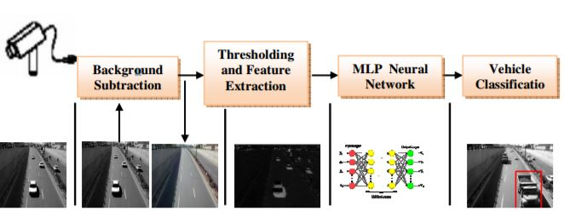
DATA FLOW DIAGRAM

Slide 10
SYSTEM DESIGN
Obtaining the image
Multi layer Perceptron Neural Network
Camera
Pre process vectors
Create Training data set
Train Neural Network
Image pre-processing
Edge detection
Background subtraction
Morphological operations
Identification of the vehicle
Feature Extraction
Vertices
Topological Structure

Slide 11
a
IMPLEMENTATION
The project is implemented as a culmination of three different modules listed here:
Detection of vehicles in the video and adding them to the database.
Setting up of neural network.
Object tracking in real time video stream.

Slide 12
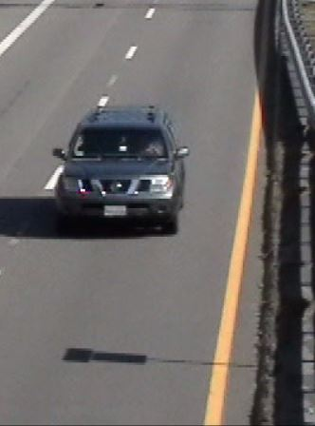
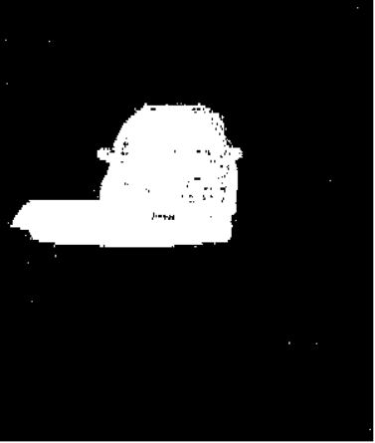
Detection and creation of database
In this step, certain frames from the video stream are selected in order to create a database for identification using neural network.
This is achieved using Background subtraction method.
The output of background subtraction is saved as a matrix for future use.
These matrices constitute the dataset that are required to train the neural network.
Fig: Image and its equivalent background subtracted image

Slide 13
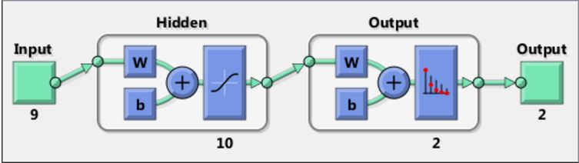
Setting up of neural network
Effectively a problem of pattern recognition.
Need a neural network to classify inputs into a set of target categories.
Arrange input vectors and target classes as matrix columns.
Patternnet
Divide samples for training, validation and testing.
2 layer feed forward network with a sigmoid transfer function in hidden layer.
Fig: Example of a neural network

Slide 14
Object tracking
Motion based tracking of moving objects in a video from a stationary camera.
Motion of each track is estimated using a Kalman filter.
The algorithm works in a two-step process.
Prediction
Weighted average
Structure of a track used in Kalman filter object.
id
bbox
kalmanFilter
age
totalVisibleCount
consecutiveInvisibleCount

Slide 15
Program flow
Detection and DB creation
Module 1
provide features as input matrices
Setting up of
neural network
Module 2
Call to database
Call to NN
train neural network on provided DB
Object tracking and classification
Module 3

Slide 16
Conclusion
Choice of the specific algorithms as explained.
Challenges faced.
Steps taken to solve these challenges.
Further improvements planned.

Slide 17
REFERENCES
[1] Gupte, Surendra, et al. "Detection and classification of vehicles." IEEE Transactions on intelligent transportation systems 3.1 (2002): 37-47.
[2] Hsieh, Jun-Wei, et al. "Automatic traffic surveillance system for vehicle tracking and classification." IEEE Transactions on Intelligent Transportation Systems 7.2 (2006): 175-187.
[3] Zhang, Guohui, Ryan Avery, and Yinhai Wang. "Video-based vehicle detection and classification system for real-time traffic data collection using uncalibrated video cameras." Transportation Research Record: Journal of the Transportation Research Board 1993 (2007): 138-147.
[4] Goyal, Kamini, and Dapinder Kaur. "A Novel Vehicle Classification Model for Urban Traffic Surveillance Using the Deep Neural Network Model." (2016).

Slide 18
THANK YOU

