Slide 1
Transfer Learning in Turbulent Systems
-Sachin Prasad
19MF3AI23
Supervisors:
Prof. Rajaram Lakkaraju,
Prof. Adway Mitra

Slide 2
Introduction to 2D turbulence

Slide 3
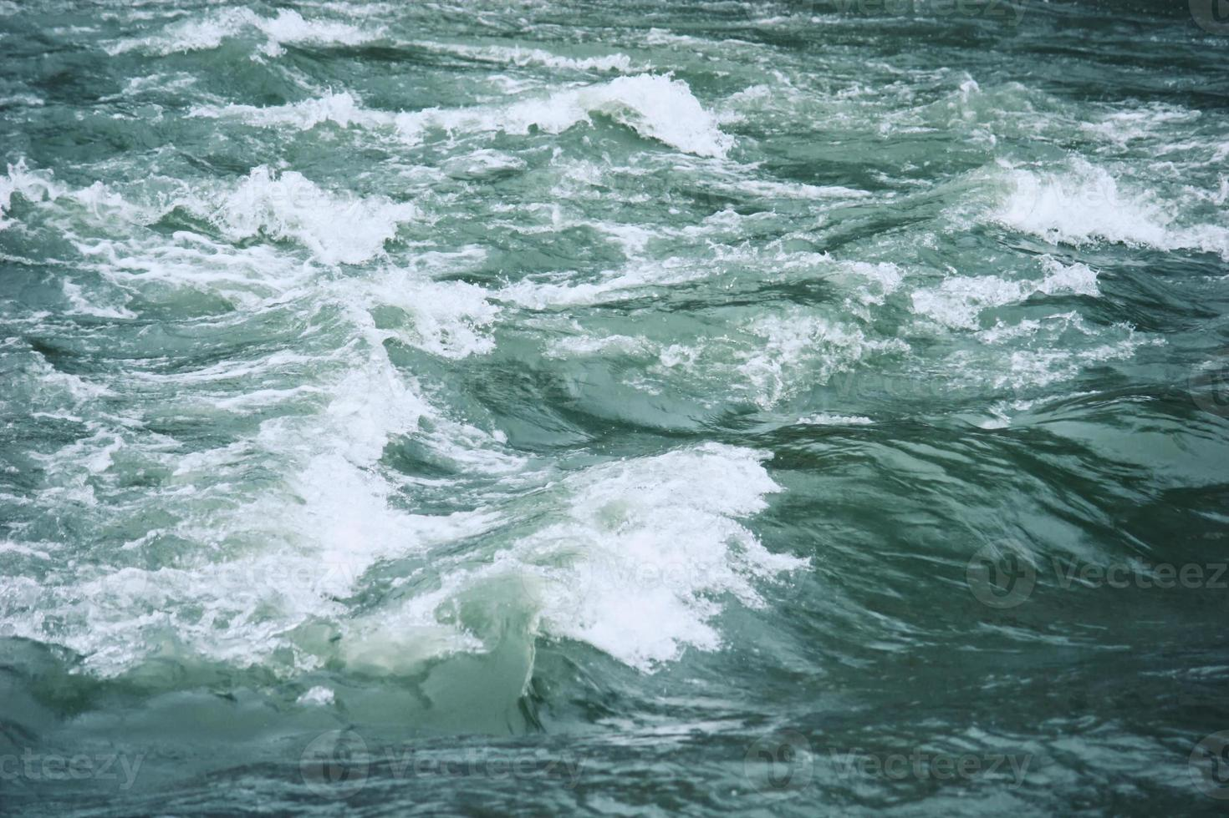
Turbulence
Turbulence is fluid motion characterized by chaotic changes in pressure and flow velocity.
Turbulence is commonly observed in everyday phenomena such as surf, fast flowing rivers, smoke from a chimney, and most fluid flows occurring in nature or created in engineering applications are turbulent.

Slide 4
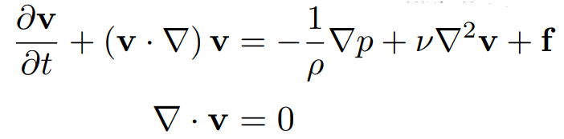
Navier Stokes Equation
The Navier–Stokes equations are nonlinear partial differential equation

Slide 5
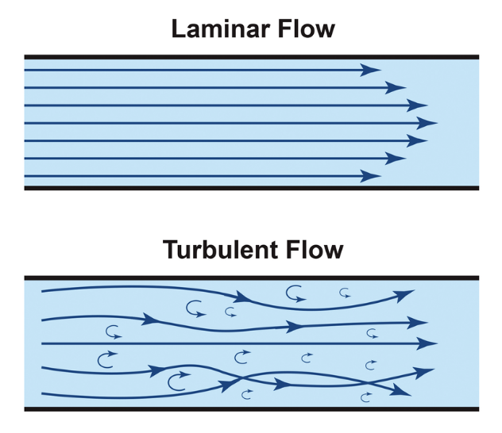
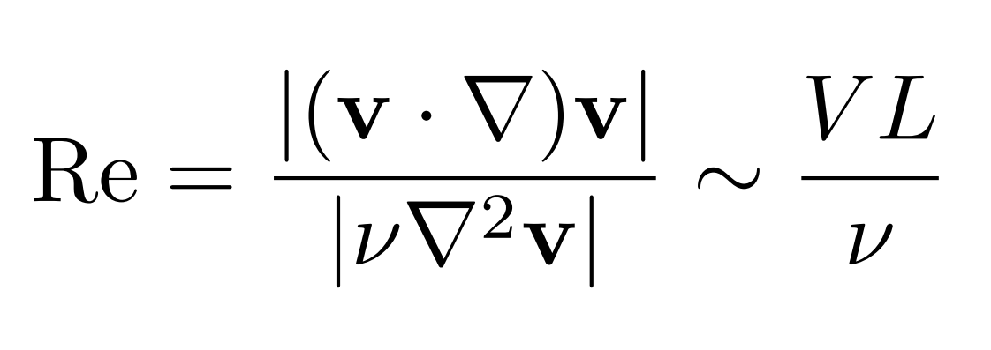
Reynolds Number
It is the ratio of the inertial force to the viscous force.
Higher Reynolds number implies the flow is more turbulent.

Slide 6
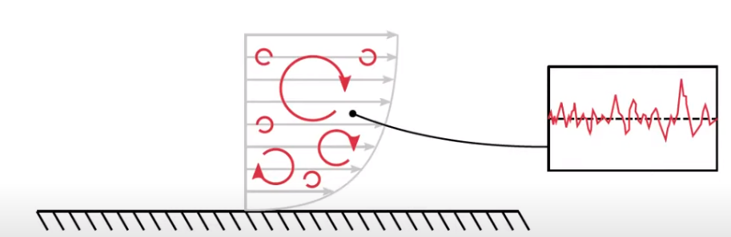
Eddies
Eddies are fluid currents whose flow direction differs from that of the general flow.
Turbulent flows contain eddies with a range of sizes and energies.

Slide 7
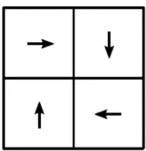

How to resolve an Eddy
We need a minimum of 4 cells to resolve an eddy.
Eddy
CFD Mesh

Slide 8
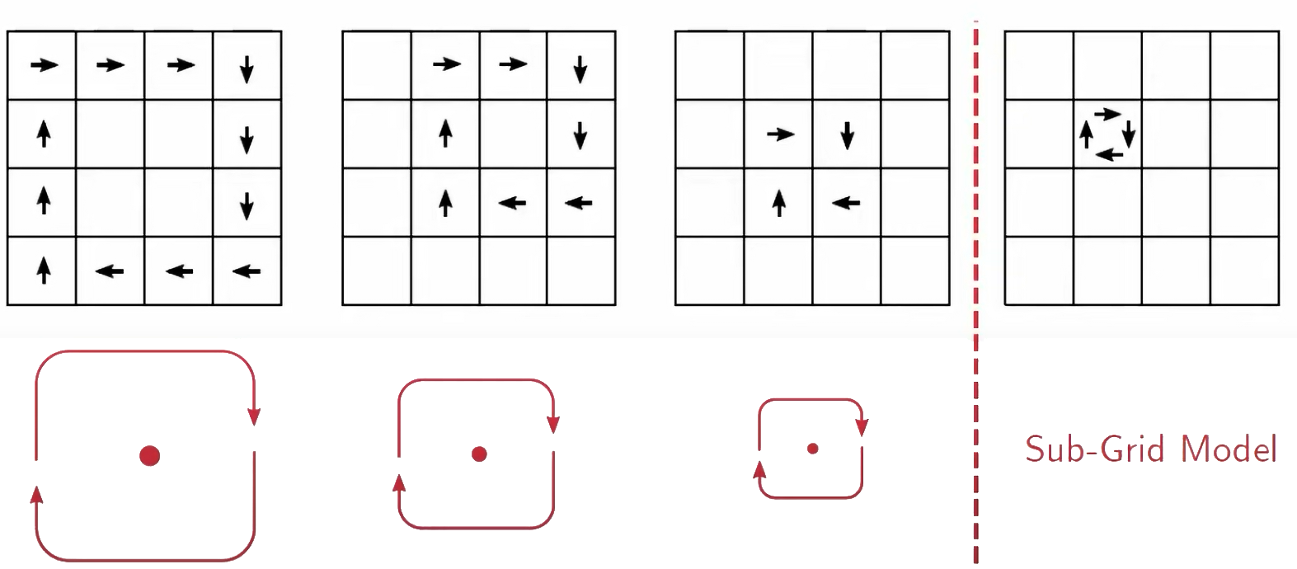
Eddies in CFD

Slide 9
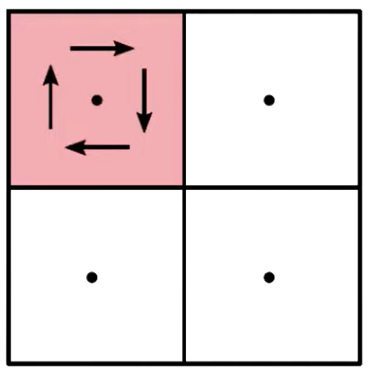
Eddies in CFD
The mesh cannot resolve eddies smaller than the mesh size itself because we only know the velocity at the cell centroids.
A sub-grid scale model is used for these eddies.
We cannot model the SGS eddies but we can model the stress they exert back on the main flow.

Slide 10
DNS vs LES
In Direct Numerical Simulations (DNS), we solve the extensive range of temporal and spatial scales of a turbulent flow, from very large to very small. It is used to develop simplified turbulence models that are less expensive to calculate but practically impossible for engineering applications.
In Large Eddy Simulations (LES), the smallest scales of turbulence are spatially filtered out while the largest, most energy containing scales are resolved directly. A sub-grid model is used to represent the effects of the smaller scales.

Slide 11
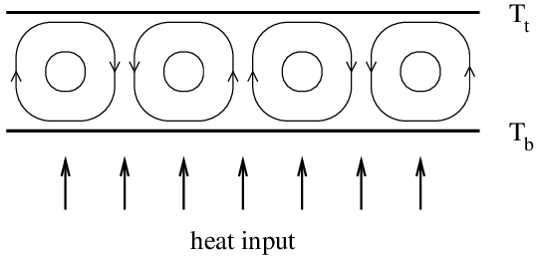
Rayleigh Benard Convection
Rayleigh-Benard convection is an idealized setup used to study thermal convection.
A layer of fluid is confined between two plates which are heated at the bottom and cooled at the top. This causes the hot fluid to rise due to buoyancy while the cold fluid falls.

Slide 12
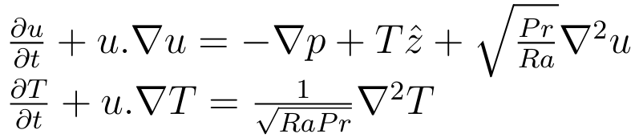
Governing Equations
We solve the incompressible Navier-Stokes equation along with the heat equation to compute the velocity field u and the temperature field T respectively.

Slide 13
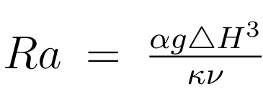
Rayleigh Number
The Rayleigh number is used to express heat transfer in natural convection. The magnitude of the Rayleigh number is a good indication as to whether the natural convection boundary layer is laminar or turbulent.

Slide 14
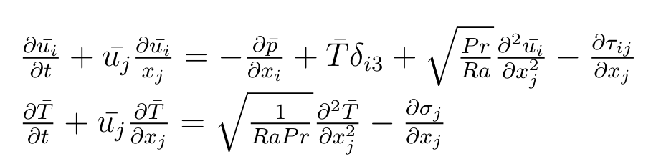

LES Equations
Filtering the DNS equations gives us the Large-eddy simulation (LES) equations. The velocity, pressure and temperature field are implicitly filtered by the grid spacing, and decomposed into resolved and unresolved parts as $u_{i}=\overline{u_{i}}+ u_{i}′$ , $T_{i}=\overline{T_{i}}+ T_{i}′$ , $p_{i}=\overline{p_{i}}+ p_{i}′$.

Slide 15
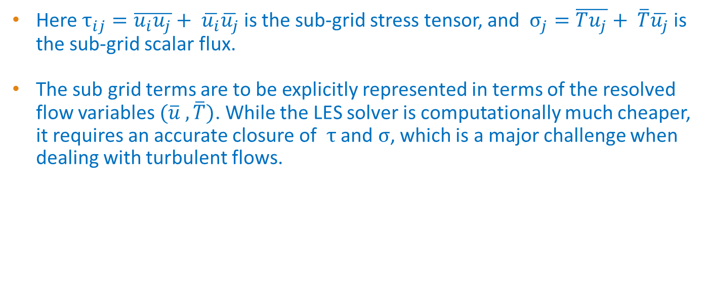
Sub-grid Terms
Here $τ_{ij}=\overline{u_{i}u_{j}}+ \overline{u_{i}}\overline{u_{j}}$ is the sub-grid stress tensor, and $σ_{j}=\overline{Tu_{j}}+ \overline{T}\overline{u_{j}}$ is the sub-grid scalar flux.
The sub grid terms are to be explicitly represented in terms of the resolved flow variables $(\overline{u} , \overline{T})$. While the LES solver is computationally much cheaper, it requires an accurate closure of $τ$ and $σ$, which is a major challenge when dealing with turbulent flows.

Slide 16
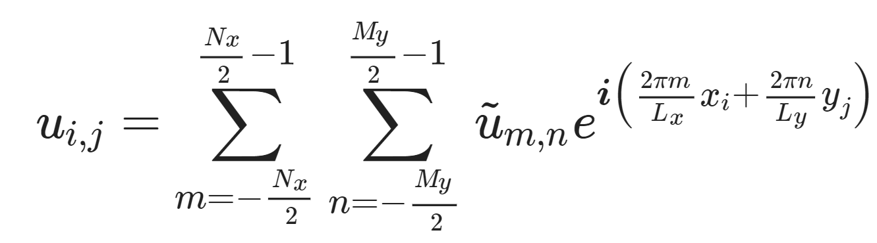
Pseudo Spectral method
We define the forward Fourier transform of a discrete field u as:

Slide 17
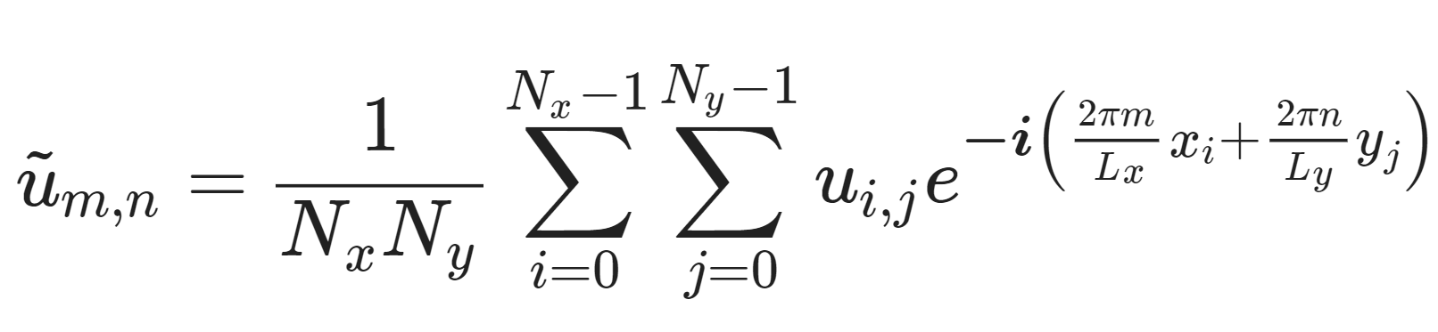
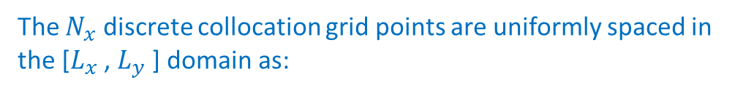


Its opposite transform, the backward Fourier transform as:
The $N_{x}$ discrete collocation grid points are uniformly spaced in the [$L_{x}$ , $L_{y}$ ] domain as:
$$x_{i}=iL_{x}/N_{x}$$
$$y_{i}=iL_{y}/N_{y}$$

Slide 18
Time Integration
The Runge–Kutta methods are a family of implicit and explicit iterative methods which include the Euler method, used in temporal discretization for the approximate solutions of simultaneous nonlinear equations.
We use the 4th order Runge-Kutta method for time integration.

Slide 19
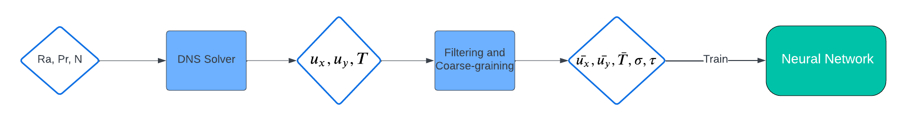
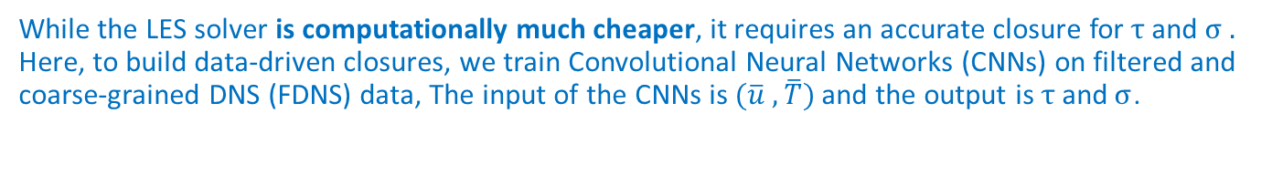
Role of Deep Learning
While the LES solver is computationally much cheaper, it requires an accurate closure for$τ \text{and} σ .$ Here, to build data-driven closures, we train Convolutional Neural Networks (CNNs) on filtered and coarse-grained DNS (FDNS) data, The input of the CNNs is $(\overline{u} , \overline{T})$and the output is $τ \text{and} σ$.

Slide 20
Transfer Learning in data driven turbulence modelling

Slide 21
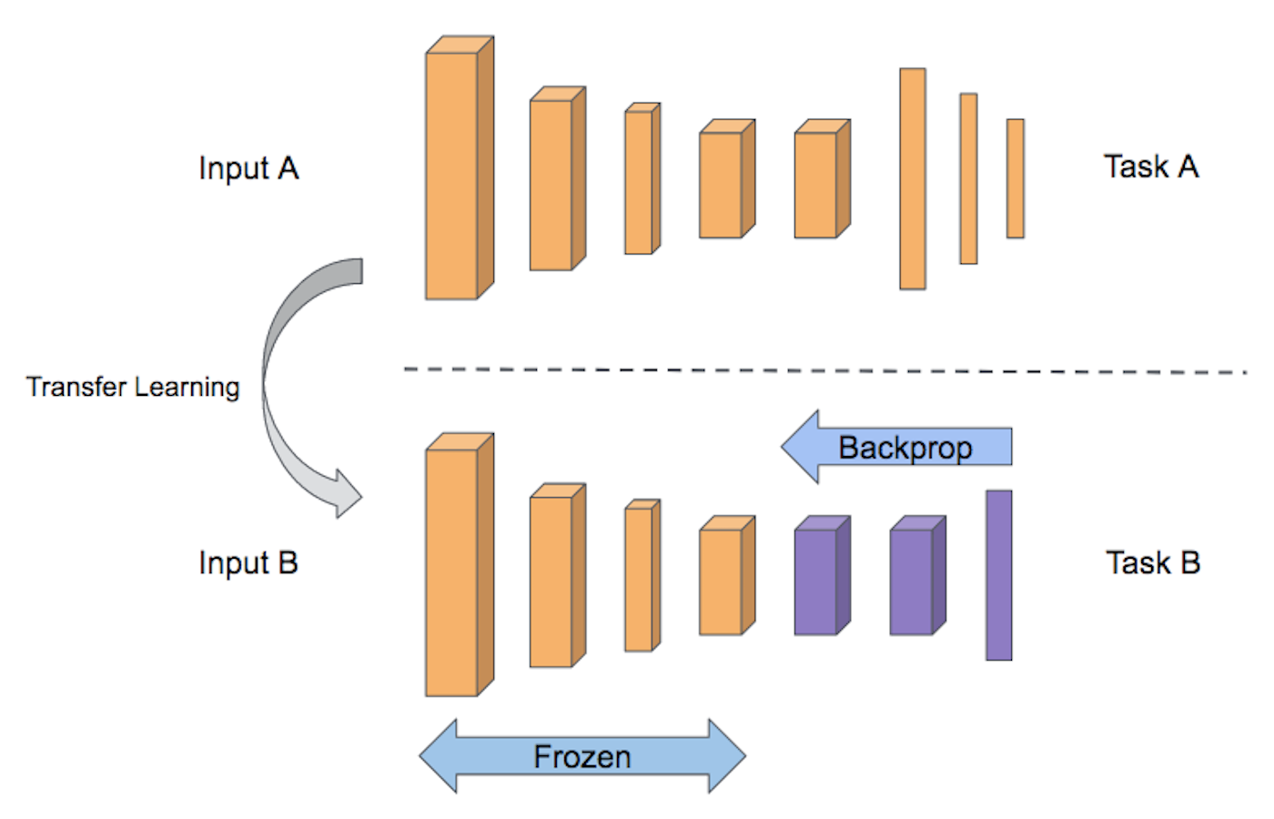
Transfer Learning
Transfer learning enables neural networks to generalize out-of-distribution via targeted re-training.
It is becoming a powerful tool in scientific machine learning applications such as weather/climate prediction and turbulence modeling.

Slide 22
Closing the generalization gap using transfer learning
Transfer Learning enables our CNN based SGS closures to effectively generalize between systems of different Rayleigh Numbers.
A network trained on data for a certain Rayleigh number will fail to generalize to systems having higher Rayleigh number because of development of more small scale features.
Transfer Learning helps to close this generalization gap.

Slide 23
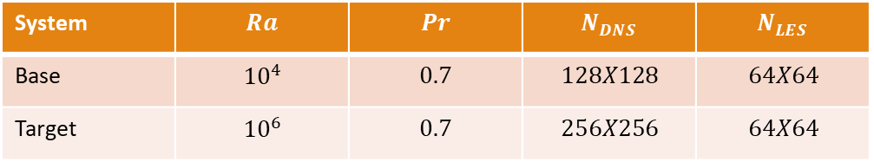
Training Procedure
We consider the following parameters for the base and target system:
System | $$Ra$$ | $$Pr$$ | $$N_{DNS}$$ | $$N_{LES}$$
Base | $${10}^{4}$$ | $$0.7$$ | $$128X128$$ | $$64X64$$
Target | $${10}^{6}$$ | $$0.7$$ | $$256X256$$ | $$64X64$$

Slide 24
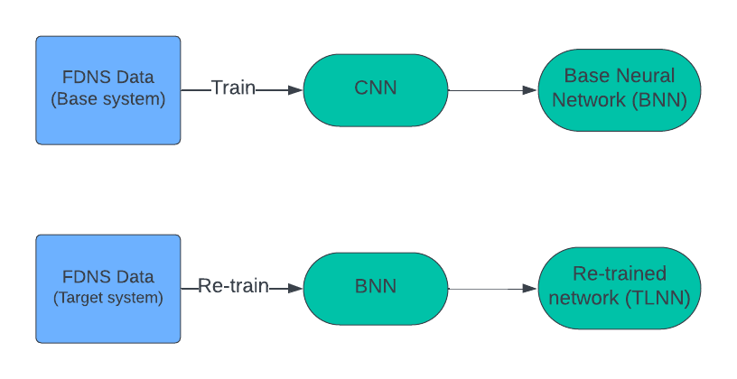
Training Procedure
We first train a CNN on snapshots from the base system, and then re-train the layers (1 layer each time) using much fewer (10%) snapshots from the target system.

Slide 25
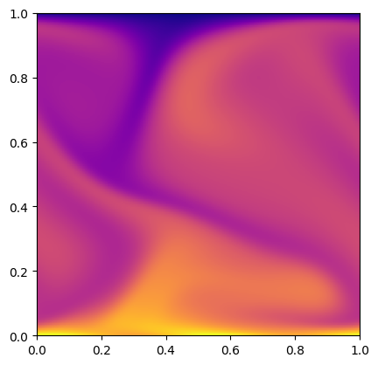
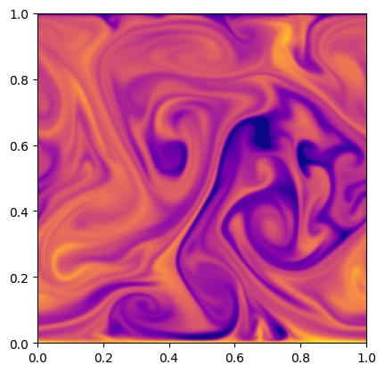
Temperature Field
Base system
Target system

Slide 26
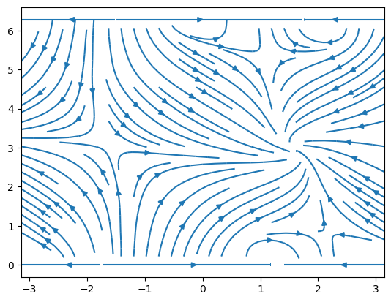
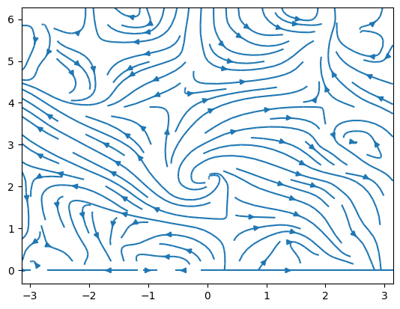
Velocity Field
Base system
Target system

Slide 27
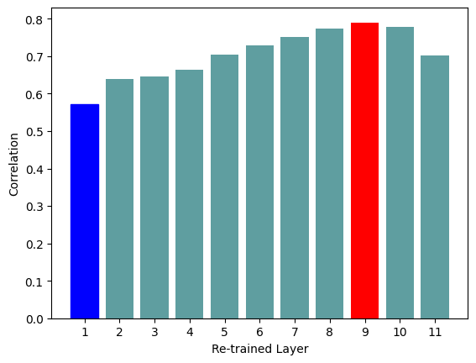
Results
We can see that re-training layer 9 gives us the best performance, and re-training layer 1 gives us the worst performance. The deeper layers in general gives us better performance than re-training the shallower layers.

Slide 28
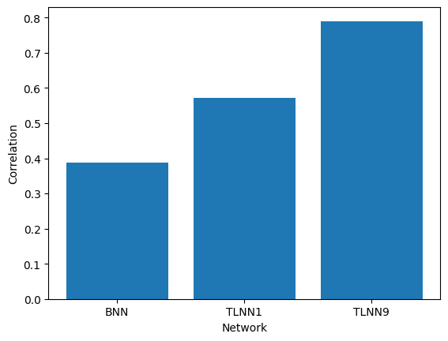
Results
Regardless of which layer we re-train, the performance drastically improves compared to the base network. Therefore, transfer learning can be a useful method to train sub-grid models for a system where large amounts of training data are not available.

Slide 29
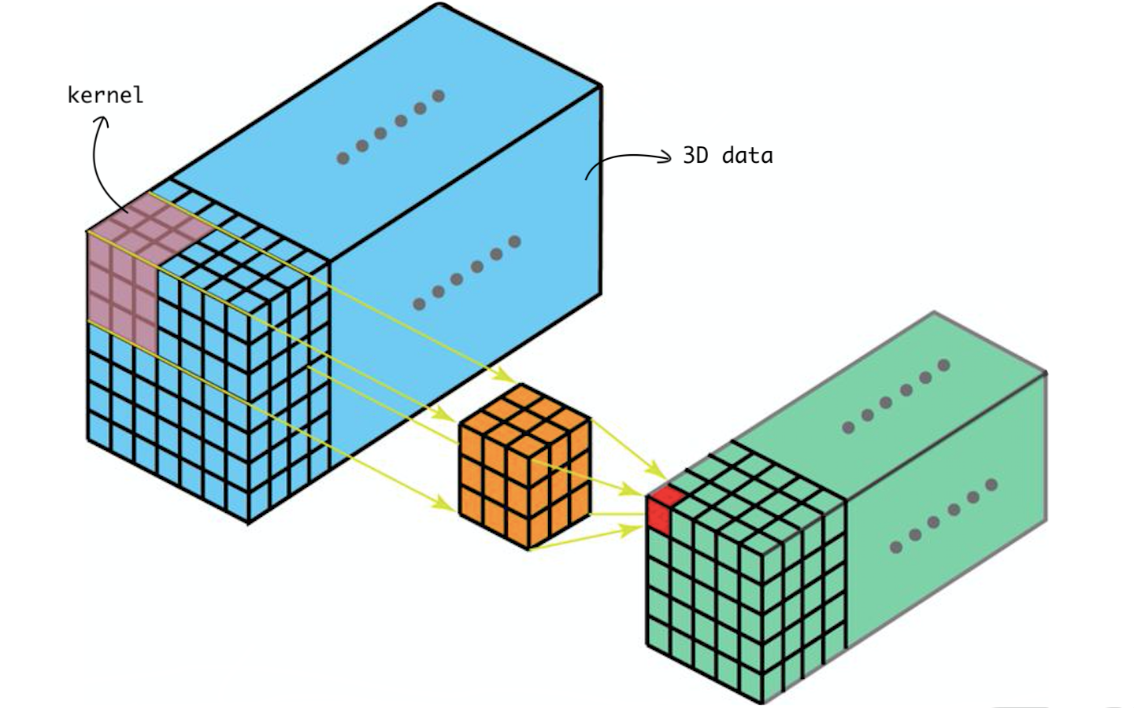
Future Scope
3D turbulence: We can extend this framework to 3 dimensions to create more accurate sub-grid models which can be used in weather/climate prediction models. For creating sub-grid models, we can use 3d convolutional layers.

Slide 30

Future Scope
Multi-phase flow: We can also try to model multi-phase flows, where we have 2 or more phases in our fluid. Multiphase flow occurs regularly in many natural phenomena. We can use neural networks to create data-driven closures for this type of flow.

