Slide 1
Information Retrieval using Deep Learning and NLP on Pinterest Dataset
SACHIN RAMESH

Slide 2
Domain Background
Pinterest is a web and mobile application company that operates a software system designed to discover information on the World Wide Web, mainly using images and on a shorter scale, GIFs and videos. Pinterest has reached 200 million monthly active users as of September of 2017.
The Proposed experiment can be extended on large scale as:
Image Recommendation system(recommending new images to user, recommending users to users, Pages to users)
Predicting part/whole images based on the existing images/description on user profile.
Comparing and understanding various model performances.

Slide 3
Problem Statement:
The goals of the project:
Retrieving similar images/users based on the image classification.
Comparing model performance on image classification.
Retrieving images/users based on text classification.
Experiment on image recognition with the descriptions.

Slide 4
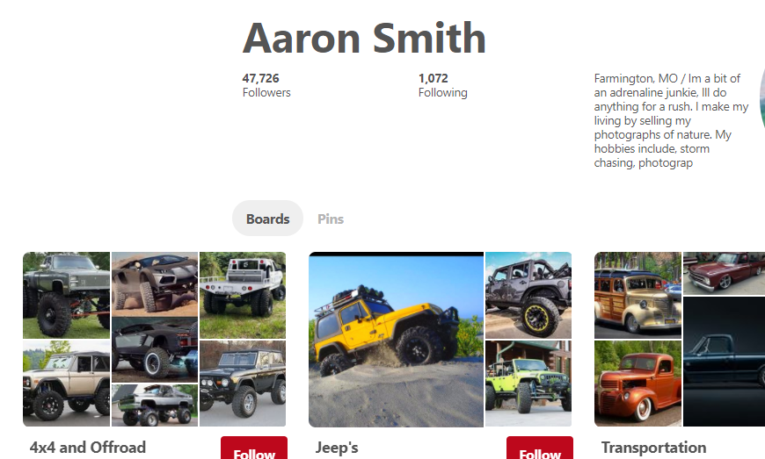

Slide 5
Solution Statement:
Training Models:
a) Predictive model using resnet50 with imagenet weights. To predict a test image for comparison with the trained model.
b) Training a model using boards as categories, dividing the dataset into test train and validation sets. Using transfer learning comparing the accuracy with pretrained models (Inception, Xception and VGG 19)
c) Using the classes from trained set, assigning each class with corpus,
eg: “Running Shoe” :[“These shoes fit me well”, ”Nike manufactures some of the best running shoes”, ”I like red color shoes”]
Training this corpus using NLTK, tensorflow

Slide 6
Experiment on Description based IR
Choosing one/two classes, describing the corpus for the each class
for eg:
“dogs”:[‘Doberman’, ‘retriever’, ‘has a tail’, ‘barks’, ‘man’s best friend’, ‘animal’ ………..]
“horse”:[‘has a tail’, ‘runs fast’, ‘four legged animal’, ‘pulls cart’………….]
“Dogs and Horses”:[“has a tail”, ”four legged animal”, “mammal”…….]
Testing:
“Has a tail” (Dogs, Horse)
“Has a tail and barks” (Dog)

Slide 7
Expected results
For any given image, retrieving user name, board and sample images based on the best match from both the models(a,b)
For any given sentence, classifying the sentence among trained classes and retrieving user name, board and sample images corresponding to the class.
Comparing accuracy of the trained models.
Validating the results based on the image being tested and retrieved.

Slide 8
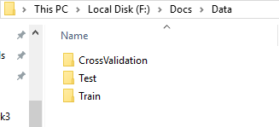
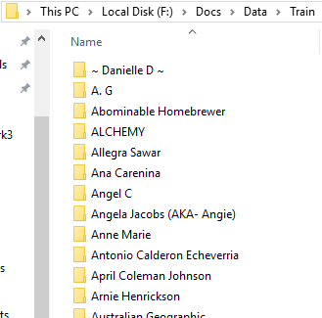
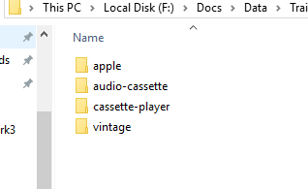
Dataset:
Original Dataset:
200 users, up to 4 boards per user, 48794 Images, 791 boards(classes),7910 Validation, 4746 Test images,36138 Training Images

Slide 9
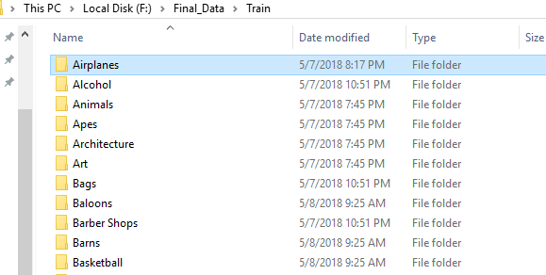
Dataset
Modified Dataset:
135 classes, 250 images per class.
Cameras,"cameras,polaroid,cameras-etc,portrait,camera-bag"
Camping,"camping-pillows,sleeping-bag-accessories,sleeping-bags-bedding,sleeping-bags"
Candles,"candles-holders,candle,candlelight"

Slide 10
Limitations:
Images does not generalize well.
User boards have many images which does not relate to board name.
Image quality varies.
Limited images for each class
Images are biased on classes.
---Some classes has all related images some does not.
----Some newly created classes has more images

Slide 11
Text Classification Data
Manually created dataset of 55 classes with 60 sentences assigned for each class
Created a small corpus for 8 classes with general descriptions.

Slide 12
Methods
Image classification:
CNN built from scratch:
---3 - conv layers , maxpool, dense and dropouts rms prop optimizer
Inception V3, Xception and VGG16:
---Transfer learning training on created final layer.
---Finetuning on last block of the models.
Text Classification:
---Used tflearn’s DNN to train the corpus, Tried with CNN and LSTM but yielded low accuracy as the corpus was small

Slide 13
Image Classification Accuracy
Network | Training Loss | Training ACC | Validation Loss | Validation ACC
CNN | 3.8952 | 18% | 3.95 | 17%
Xception(transfer learning) | 1.2781 | 67.76% | 1.5232 | 63%
Xception(fine tuning) | 0.3562 | 92% | 2.056 | 65%
Inception(transfer leaning) | 1.26 | 68% | 1.8 | 56%
Inception(fine tuning) | 0.8 | 79% | 1.5 | 65%
VGG16(transfer learning) | 2.6049 | 38% | 2.9 | 34%
VGG16(fine learning) | 1.6 | 60% | 2.14 | 51%

Slide 14
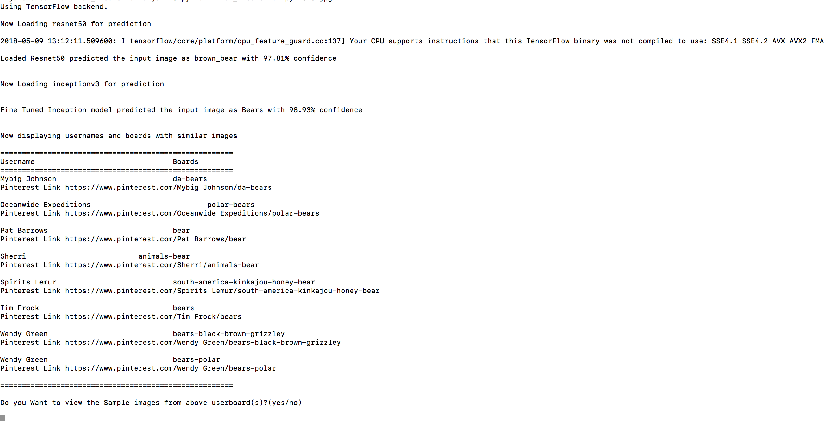
Results:

Slide 15
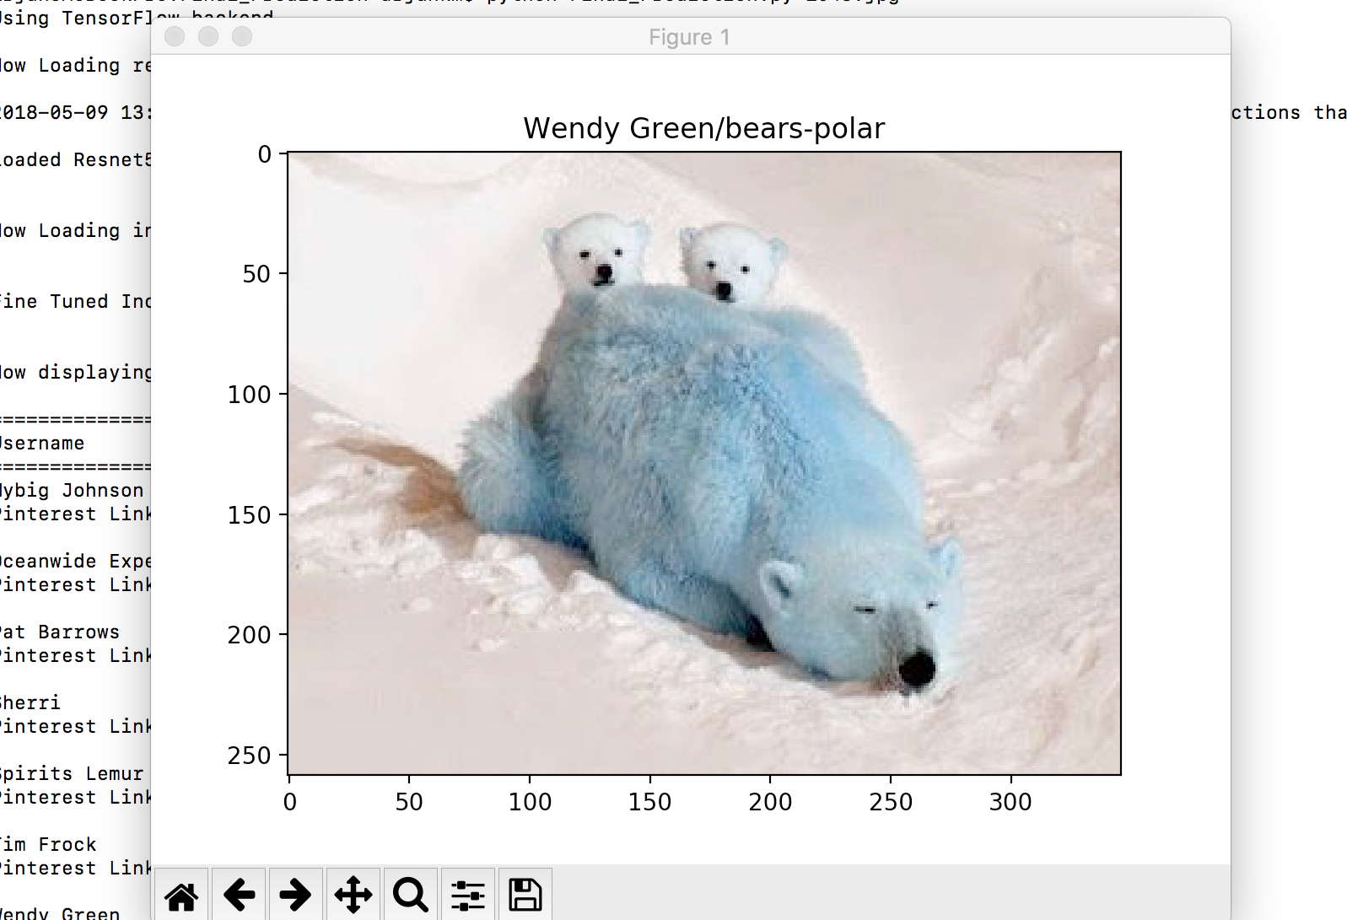
Results

Slide 16
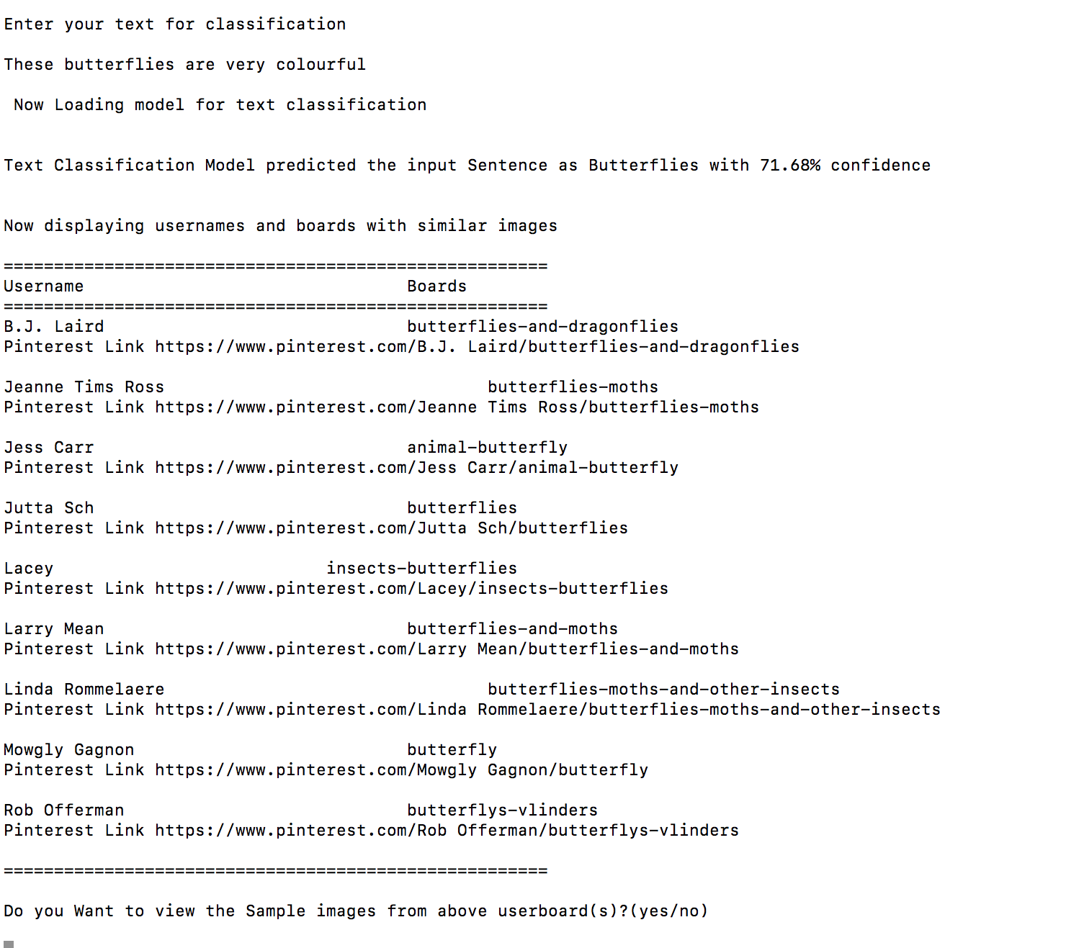
Results
For the image being classified sample images from each of the board will be displayed

Slide 17
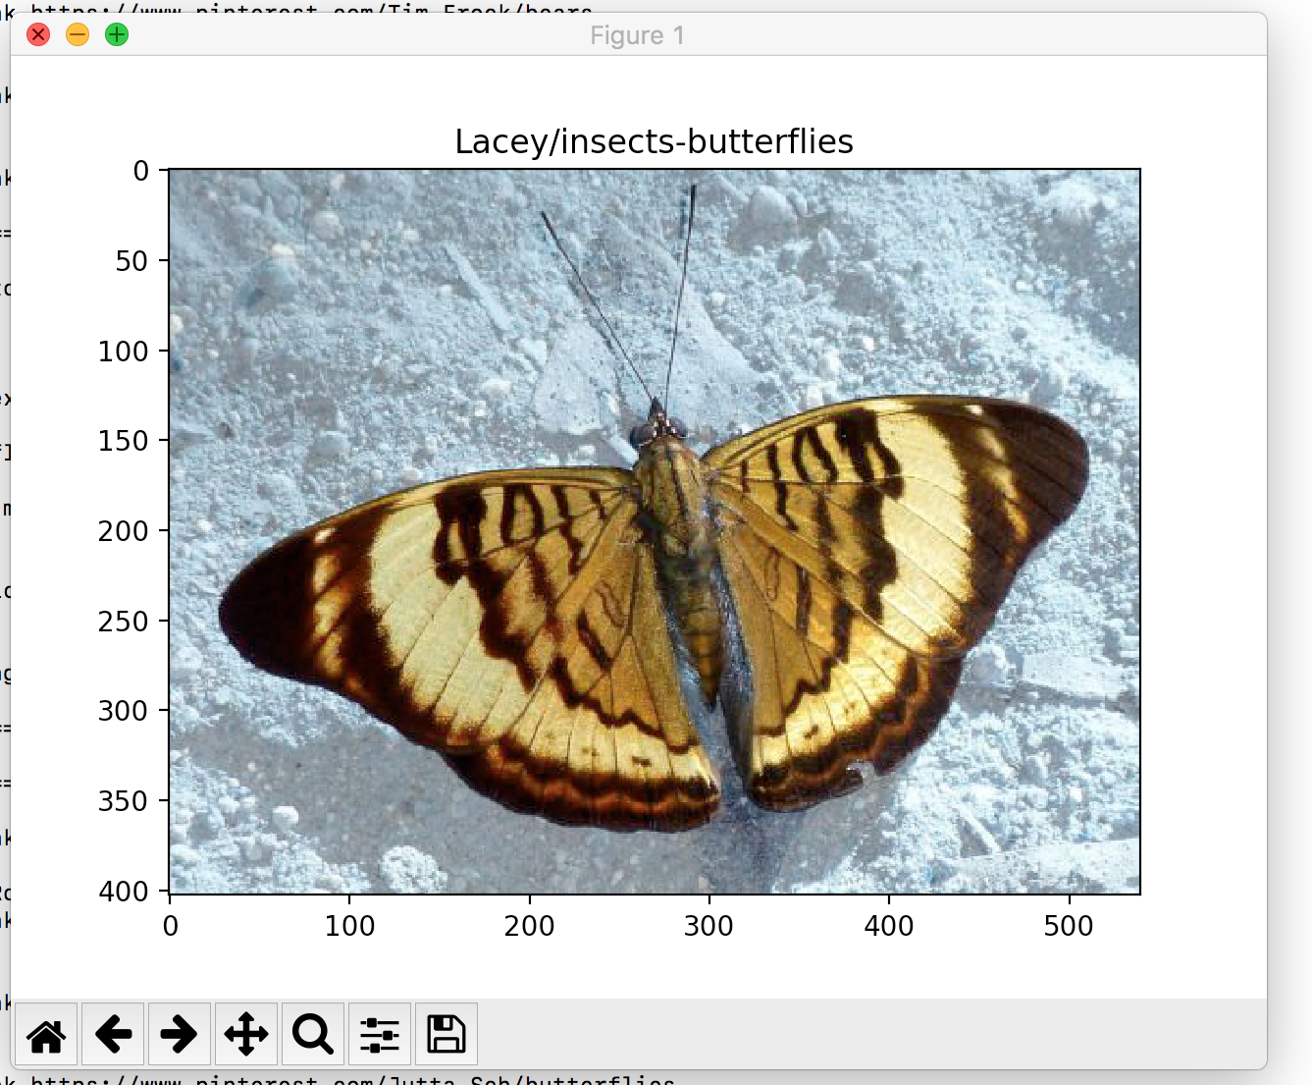
Results

Slide 18
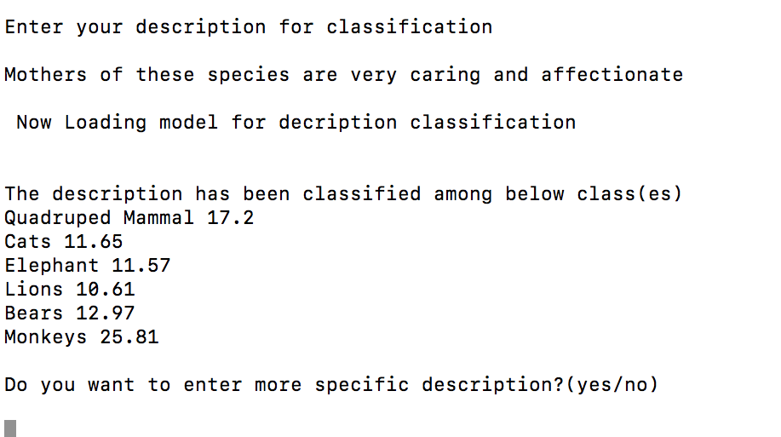
Results
If the sentence is classified among different classes with plus or minus 0.2 confidence the model ask for specific description

Slide 19
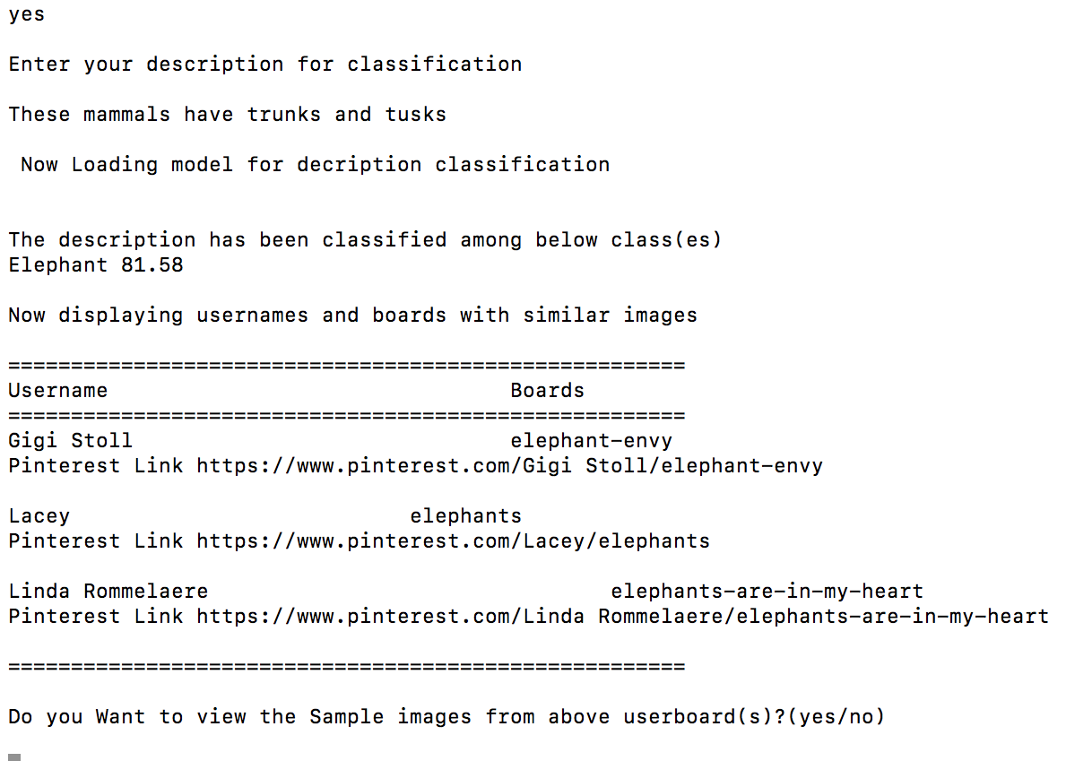
Results

Slide 20
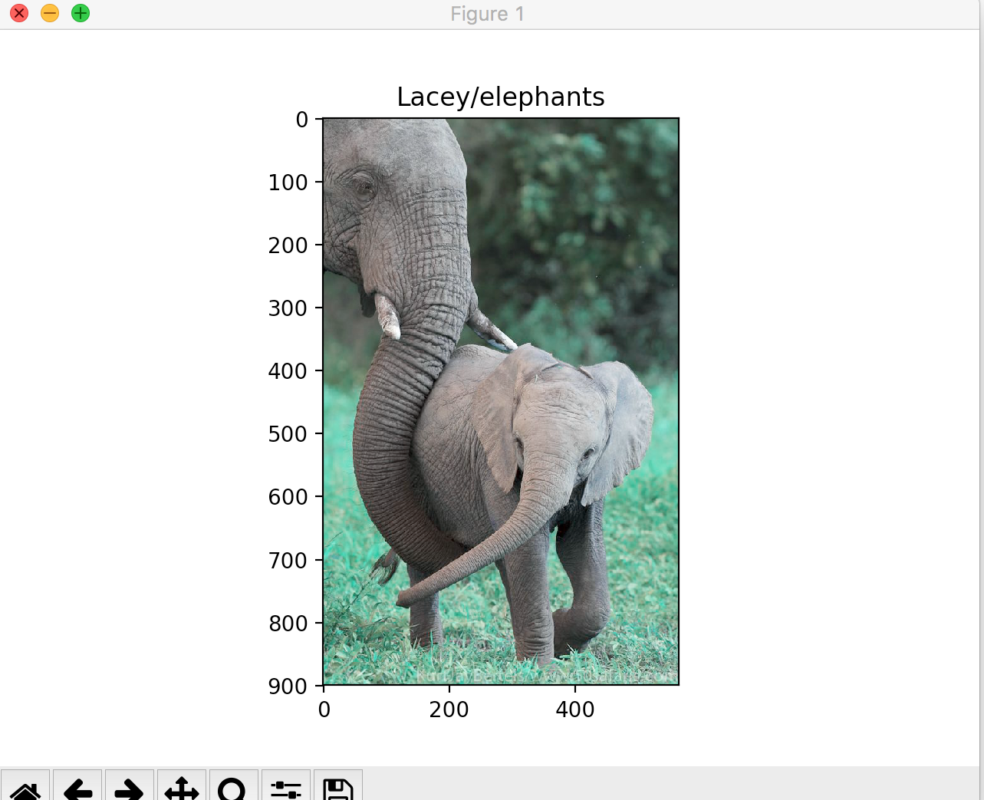
Results

Slide 21
THANK YOU

