Slide 1
Credit Wise Loan Approval System -BY (SACHIN SOURAV & ROUNAQUE AFROZ)
PROBLEM STATEMENT
A mid-sized financial company, SecureTrust Bank, offers personal and home loans to customers across both urban and rural regions of India. Every day, hundreds of customers apply for loans through online platforms as well as branch applications.
Until now, SecureTrust Bank has relied on a manual verification process, where loan officers evaluate applications by checking income proofs, employment details, credit history, and other supporting documents.
This process is:
Time-consuming
Prone to human bias
Inconsistent in decision-making
As a result, the bank faces two major challenges:
Good customers sometimes get rejected, leading to loss of potential business.
High-risk customers sometimes get approved, resulting in financial losses.

Slide 2
SOLUTION
To address these issues, the bank aims to introduce an intelligent loan approval system powered by Machine Learning. This system will:
Automatically analyze applicant details .
Predict whether a loan should be Approved or Rejected.
Assist in decision-making before final human verification.
The system must:
Learn hidden patterns from past customer records.
Provide accurate and fast predictions .
Ensure unbiased and consistent loan approval decisions.

Slide 3
DATASET DESCRIPTION
Column Name | Description
Applicant_ID | Unique applicant ID
Applicant_Income | Monthly income of the applicant
Coapplicant_Income | Monthly income of the co-applicant
Employment_Status | Employment type (Salaried / Self-Employed / Business)
Age | Applicant's age
Marital_Status | Marital status (Married / Single)
Dependents | Number of dependents
Credit_Score | Credit bureau score
Existing_Loans | Number of currently active loans
DTI_Ratio | Debt-to-Income ratio
Savings | Savings balance of the applicant
Collateral_Value | Value of collateral provided
Loan_Amount | Loan amount requested
Loan_Term | Loan duration (in months)
Loan_Purpose | Purpose of loan (Home / Education / Personal / Business)
Property_Area | Location type (Urban / Semi-Urban / Rural)
Education_Level | Education level (Graduate / Postgraduate / Undergraduate)
Gender | Gender of the applicant (Male / Female)
Employer_Category | Employer type (Govt / Private / Self)
Loan_Approved (Target) | Loan approval status (1 = Approved, 0 = Rejected)

Slide 4
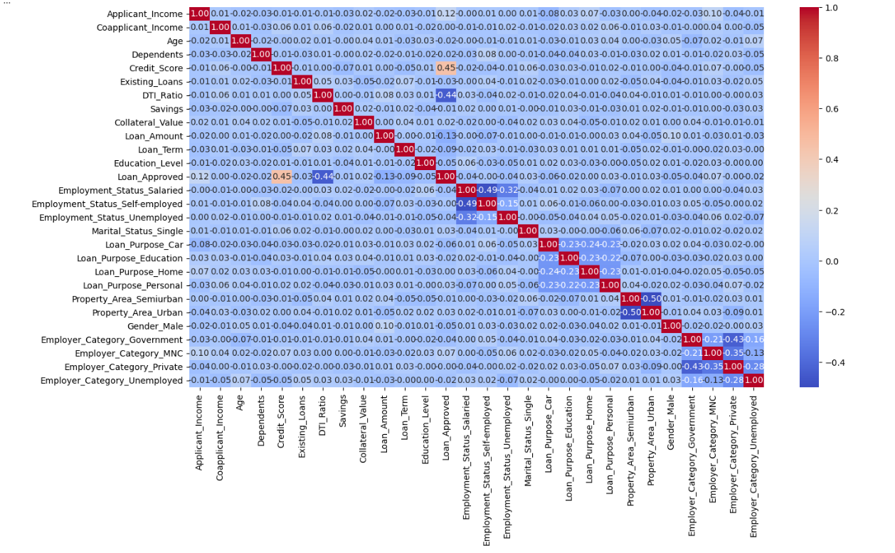
STEPS
STEP 1 : DATA LOADING
STEP 2 : DATA CLEANING & EXPLORATION
STEP 3 : HANDLE MISSING VALUES
STEP 4 : EDA
STEP 5 : HANDLING OUTLIERS
STEP 6 : VISUALIZATION
STEP 7 : ENCODING
STEP 8 : CORRELATION HEATMAP
STEP 9 : TRAIN-TEST-SPLIT & FEATURE SCALING
STEP 10 : TRAINING & MODEL EVALUATION
- LOGISTIC REGRESSION
- KNN
- NAIVE BAYES
STEP 11: FEATURE ENGINEERING

Slide 5
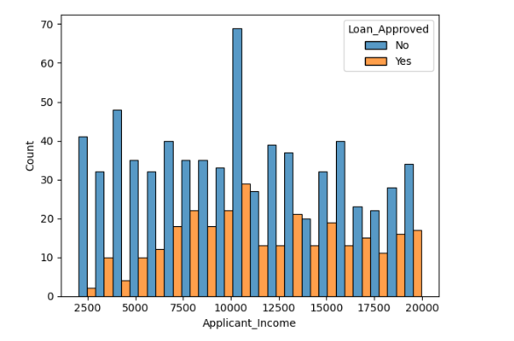
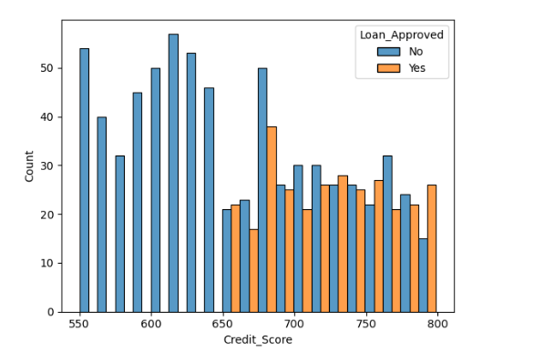
Conclusion & FUTURE goals
On the basis of precision, we chose Naïve Bayes over Logistic Regression and KNN.
In the future, we plan to use Decision Tree and Random Forest algorithms to further improve precision. We also aim to deploy this project and expand the dataset to train the model on a larger and more diverse set of data.
Ultimately, our main objective is to gain knowledge and derive key insights, which will help us in developing and deploying a more advanced real-world major project.

