Slide 1
ANALYSIS OF MUMBAI NEIGHBORHOODS
Coursera capstone project

Slide 2
SCOPE OF THE PROJECT
The project aims at exploring different neighborhoods in the metropolitan city of Mumbai.
Further exploratory analysis is done with respect to each neighborhood, thus clustering them based on the similar venues they share.
The results are further mapped with each cluster of neighborhood highlighted in a unique color for better understanding.
This can be highly beneficial for people to quickly figure out the various neighborhoods and accordingly plan a visit or get settled in a particular neighborhood based on his/her preferences.

Slide 3
DATA RESOURCES & EXTRACTION
Data regarding the neighborhoods in Mumbai along with their coordinates was obtained from Wikipedia. (https://en.wikipedia.org/wiki/List_of_neighbourhoods_in_Mumbai)
The neighborhoods data was extracted by web-scraping using the python library BeautifulSoup.
Data of the venues (within 500m) of each neighborhood was leveraged from ‘Foursquare.com’ using the foursquare API.

Slide 4
DATA WRANGLING
At first, data of the area, location and respective coordinates were fit into the pandas data frame, using the pandas read_html method.
Further the data frame was transformed such that it consisted of neighborhood(area), coordinates of the neighbourhood, nearby venues and their respective coordinates along with the category of the venues.
At last, the data frame was modified to include the top ten venues against each neighbourhood, along with the cluster number.

Slide 5
MODELLING
K-means clustering, which is a type of unsupervised machine learning was employed in clustering the neighborhoods based on the similarity of venues they housed.
The python scikit-learn library was used for modelling purpose.
In total, five clusters were formed.

Slide 6
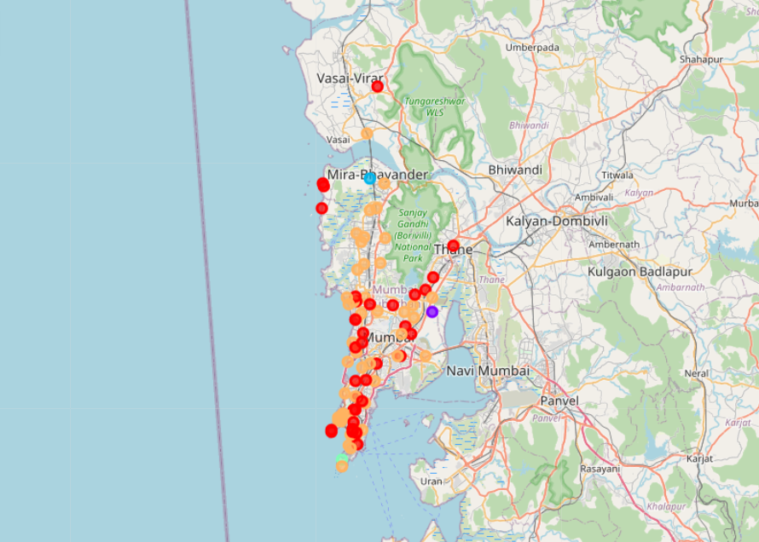
VISUALIZATION
Visualization is done using the folium library.
Further, each cluster of neighborhoods was highlighted in distinctive color, which in turn eased understanding.

Slide 7
RESULTS AND INFERENCE
All the neighborhoods of Mumbai were clustered into five clusters, with each cluster containing varying numbers of neighborhoods.
Cluster 1 contained 37 neighborhoods with Indian restaurant being the most common venue in its neighborhoods.
Cluster 2,3 and 4 contained only one neighborhood each with ATM, shopping store and garden being the most common venues, respectively.
Cluster 5 contained the most with 46 neighborhoods. In this case, there is no one dominant most common venue, considering all the neighborhoods within the cluster.

Slide 8
ACKNOWLEDGEMENT
I would like to acknowledge the efforts of the Coursera team in order to put forth a comprehensive study material and hand-on lab for learning the concepts, which indeed equipped me with the necessary skills to do this project.

Slide 9
References
Wikipedia
Foursqare.com
Stack overflow

